Slide 1
Africa Subsea Strategy
Sunil Tagare
SAFNOG-5

Slide 2
Dialog Needed Between OTTs And Carriers
Because They Are So Different

Slide 3
OTTs
Telecom Is
Cost Center

Slide 4
Carriers
Telecom Is
Profit Center

Slide 5
OTT
Revenues
Telecom
Advertising/Cloud/E-Commerce

Slide 6
Carrier
Revenues
Telecom
Only

Slide 7
OTT
Telecom Strategy
Share Fiber Costs With Carriers
Offer Free Telecom Services

Slide 8
















OTT Free Telecom Services
Messaging Images
Voice Blogs
Video Conference Calls

Slide 9
OTT Revenues
Total OTT Revenues ~$1 Trillion/yr

Slide 10
OTT Market Caps
Total OTT Market Cap ~$8-$10 Trillion

Slide 11
African Countries Combined GDP
Total Africa GDP (54 Countries) $2 Trillion

Slide 12
Revenue Per User
Total All OTTs $2,000/yr(USA), $500/yr(Overseas)

Slide 13
Africa Statistics
Countries: 54
Population: 1.3 Billion
Total Internet Users: 550 Million (40% of total)
Potential Internet Users: 800 Million (60% of total)
Additional Internet Users Expected: 250 Million

Slide 14
Addl Revs For 250 Million New Users
Total All OTTs $125 Billion/yr (Revs), $1 Trillion(NPV)

Slide 15
Price/Revs Ratio For Valuation
Market Cap/ Excess Valuation
Revenues for 250 mm subs
Facebook 8.5 $50 Billion
Google 5.5 $190 Billion
Alibaba 10 $80 Billion
Amazon 3.5 $220 Billion
Total All OTTs 5.5 $800 Billion

Slide 16
Total Revs For 800 Million Users
Total All OTTs $400 Billion /yr(Revs), $4 Trillion(NPV)

Slide 17
Total Revs For 800 Million Users
Revs (Billion) NPV (Billion)
Facebook $20 $200
Google $110 $1,100
Alibaba $25 $250
Amazon $200 $2,000
Total All OTTs $400/yr $4 Trillion

Slide 18
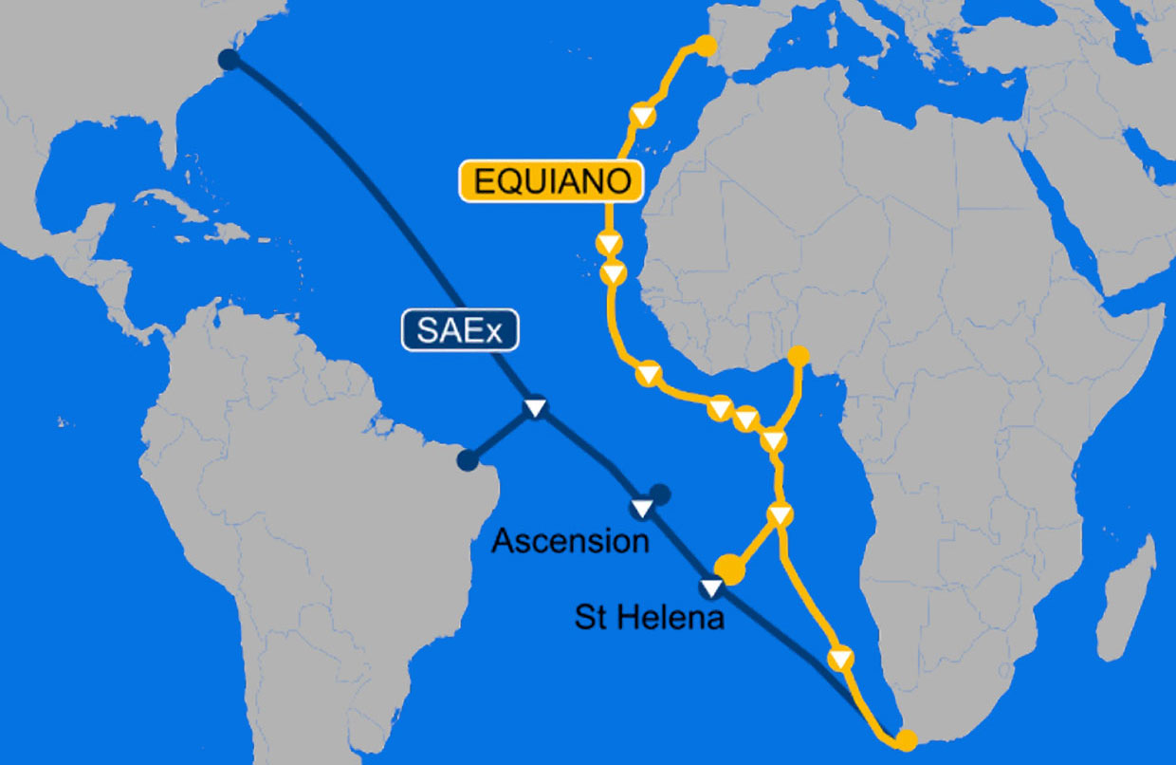

Slide 19
Equiano Africa Landing Points
Country/Island Investment (M) Potential Revs (M) Valuation (M)
Canary Island $30 $120 $980
St. Helena $30 $0.4 $2
South Africa $30-$50 $4,700 $25,800
Namibia $30-$50 $200 $1,100
Angola $30-$50 $2,500 $13,500
Nigeria $30-$50 $15,600 $86,000
Portugal $30-$50 $820 $4,500
Morocco $30-$50 $3,000 $16,300
Mauritania $30-$50 $360 $2,000
Senegal $30-$50 $1,300 $7,200
Sierra Leone $30-$50 $600 $3,400
Ghana $30-$50 $2,400 $13,000
Cote D’Ivoire $30-$50 $2,000 $11,000
Total $390-$610 $33,600/yr $185,000

Slide 20
Simba Africa Landing Points (1)
Country/Island Investment (M) Potential Revs (M) Valuation (M)
South Africa $30 $850 $7,200
Namibia $30 $40 $340
Angola $30 $460 $3,910
Nigeria $30 $2,900 $25,000
Portugal $30 $150 $1,300
Morocco $30 $550 $4,700
Mauritania $30 $70 $600
Senegal $30 $240 $2,000
Sierra Leone $30 $110 $950
Ghana $30 $440 $3,800
Cote D’Ivoire $30 $370 $3,200
Mozambique $30 $450 $3,800
Tanzania $30 $875 $7,500

Slide 21
Simba Africa Landing Points (2)
Country/Island Investment (M) Potential Revs (M) Valuation (M)
Madagascar $30 $400 $3,400
Kenya $30 $750 $6,400
Somalia $30 $225 $1,900
Ethiopia $30 $1,650 $14,000
Sudan $30 $600 $5,100
Saudi Arabia $30 $500 $4,200
Egypt $30 $1,500 $13,000
Libya $30 $90 $770
Tunisia $30 $180 $1,500
Italy $30 $3,600 $30,000
France $30 $4,000 $35,000
Total $720 $21,000/yr $178,500

Slide 22
Equiano Investment Summary
Cost of building Equiano: Around $300 Million
Private cable
Expected cable revenues from carriers: $390-$610 Million
After Google keeping 50% of bandwidth for its own use
Potential advertising/cloud revenues: $33.6 Billion/year
Potential valuation at those revenues: $185 Billion
Serving 400 million people

Slide 23
Simba Investment Summary
Cost of building Simba: Around $800 Million
Consortium cable
Expected cable revenues from carriers: $720 Million
After Facebook keeping 10% of bandwidth for its own use
Potential advertising revenues: $21 Billion/year
Potential valuation at those revenues: $178 Billion
Serving 1.3 Billion people

Slide 24
Real Bad News For Carriers
Carriers pay 100% for the CAPEX of the branches
And they pay 100% for the O&M of the branches in addition to their share of the main cable

Slide 25
Branching Unit Case Study
Sea-Me-We-5 vs Tagare Cable (AAE-1)

Slide 26
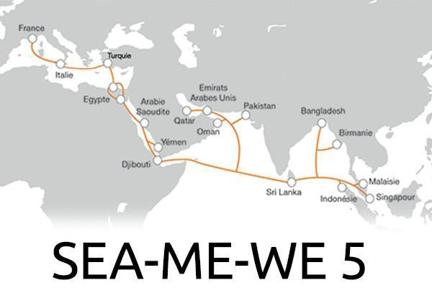

Slide 27
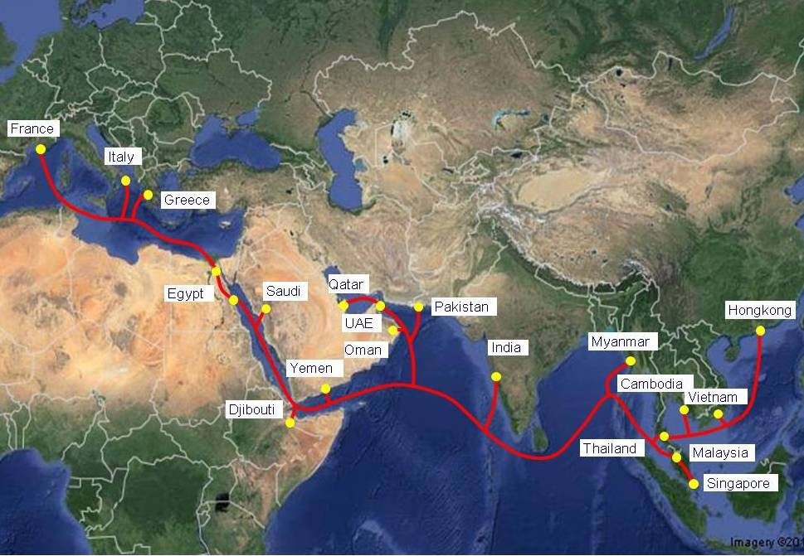
Tagare Cable Renamed As AAE-1

Slide 28
Absolute No-No
Under no conditions should you accept to pay 100% of the CAPEX and O&M for any branch
Just walk away

Slide 29
Massive Technological Change: SDM
4 fp, 1 Tbps Design: 2000
8 fp, 20 Tbps Design: 2010
48 fp, 1Pbps Design: 2025
16 fp, 320 Tbps Design: 2020
24 fp, 500 Tbps Design: 2022

Slide 30
Massive Price Declines
$1,000/Mbps: 2000
$400/Mbps: 2010
<$1/Mbps: 2025
$80/Mbps: 2020
$20/Mbps: 2022

Slide 31
OTT ARPU vs Bandwidth Prices

Slide 32
There Is A Possibility
Both Simba and Equiano will be economically obsolete in 5 years if a new cable is announced
Example: TAT-14
O&M more expensive than bandwidth

Slide 33
On The Issue Of Fiber Switching
Fiber Switching only helps the OTTs
Africa Should Be The Last Continent To Get This
Just Say No

Slide 34
More Fiber Is Good For Africa
But entire Eco-System has to survive
It’s Not A Zero Sum Game

Slide 35
What Do OTTs Want?
Access to eyeballs
By spending as little as possible on bandwidth
Do not want to pay taxes in any jurisdiction
Do not want to be regulated as a carrier
Better quality of bandwidth than their competitors

Slide 36
Traditional Problems of Carriers
Confused -- not understanding who the competition is
Monopoly mindset thinking they are the only ones who can build a cable
Screwing each other on cable station access and last mile
Example: India
OTT reaction: Divide and Rule like East India Company

Slide 37
Business Problems of Carriers
Most telecom services given away for free by OTTs
Many enterprise services will not need IPLC connections
IP connectivity through VPNs
Wholesale business is dead
Aggressive OTTs want free services
Free data center space
Free power
Customers do not like carrier-owned data centers
Rise of carrier-neutral data centers

Slide 38
Over Capacity in Africa
Equiano and Simba each can reach up to 500 Tbps of future capacity (Shannon Limit)
On the West Coast, that represents 1 Pbps of capacity
Not taking in to account all the other cables in the region
How many countries in Africa have requirements of more than 10 Tbps capacity today?
How many Hyper Scale Data Centers are present in Africa today? In which countries?

Slide 39
Internet Infra Business Is Changing
NOIA Network
Spare capacity exchange network
IPV6-based segment routing (SRV6)
Programmable Internet
Blockchain-based
Start of a major trend that will change the industry

Slide 40
Traffic Flows Will Change For Sure
Trans-Atlantic bandwidth was once hot property
NY/Virginia center of gravity shifted to Europe
If India becomes the next hyper-scale haven
Fixed circuits to Europe could be expensive and obsolete
New satellite networks will create a distributed network instead of a hub-and-spoke network
SpaceX, Amazon, OneWeb
Entirely different traffic flow requirements
Buying on point-to-point cables for 25 years is a bad idea
Portability will be a mandatory requirement

Slide 41
Differences in Equiano And Simba
Equiano is a private for-profit cable
Simba is a consortium cable
Equiano CIF is signed. It is a Spec cable
Simba is waiting for everyone to sign in order to commit
Equiano will provide monopoly to one carrier per country
Simba can have more than one partner per country
Equiano owns the branch paid by customers
In Simba, customers have to own the branches

Slide 42
Historical Actions of OTTs
In all of the trans-Atlantic cables, the OTTs have swapped fiber pairs with carriers after signing the CIF
The original partners who were guaranteed exclusivity now feel cheated as new competitors emerged overnight
With 16 fiber pairs, expect more of the same from the OTTs in Africa
Goal of OTTs is to make the cost of transport ZERO
And with open cable landing stations, carriers will face intense competition in last mile charges

Slide 43
Solution?
Time Is On The Carrier’s Side
And Time Is The OTTs Biggest Enemy

Slide 44
Equiano Investment Summary
Cost of building Equiano: Around $300 Million
Expected cable revenues from carriers: $390-$610 Million
Potential advertising/cloud revenues: $33.6 Billion/yr
Potential valuation at those revenues: $185 Billion

Slide 45
Simba Investment Summary
Cost of building Simba: Around $800 Million
Expected cable revenues from carriers: $720 Million
Potential advertising revenues: $21 Billion/yr
Potential valuation at those revenues: $178 Billion

Slide 46
Most Important OTT Strategy
Divide And Rule
Imperial War Strategy

Slide 47
Recommended Carrier Strategy
Carriers In Each Country Unite
And Speak In One Voice

Slide 48
What Is Fair?
Carriers signing up to Equiano and Simba get 20% of bandwidth for free
With Zero Investment

Slide 49
In Return, OTTs Get
Regulatory cover
Taxation cover
Free CLS
Free Last Mile to Carrier-Neutral DC

Slide 50
My Recommendation
Stop investing in submarine cables
Invest in the domestic network
Swap what you have to get free bandwidth on new cables

Slide 51
Carrier Savings In Equiano & Simba
$1.5 Billion Total
(including O&M)
$50 Million per Carrier
(30 Carriers)

Slide 52
Remember
OTTs Have No Other Choice
They Must Invest

Slide 53
Also
It is in the interest of OTTs
Time, Time, Time……..

Slide 54
Eco-System Has To Survive
Think Long-Term
It’s A Marathon

Slide 55
Thank You
Sunil Tagare
sunil@opencables.com
+1-650-906-0329

