Slide 1

AFRINIC Numbering Services & Policy Updates
James Chirwa
Registration Services Team
SAFNOG-5 | 27th August 2019

Slide 2
Agenda
IP Numbers Resource Management
Member Profile Management
Policy Development Process

Slide 3
Internet Number Resource Management
Scope
The WHOIS database
Managing the IP numbers
IPv4 exhaustion
Services
Updates

Slide 4
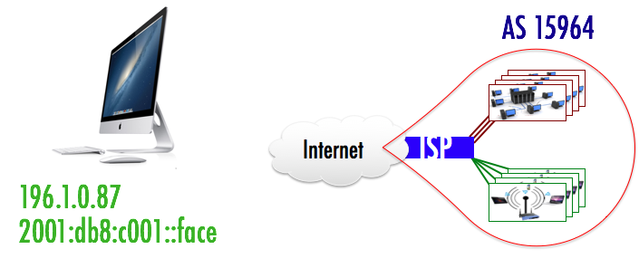



Internet Number Resource Management
Internet Number Resources
Address Management Objectives

Slide 5
Internet Number Resource Management
The Number resources managed in the WHOIS database.
The database uses the Routing Policy Specification Language (RFC2622)
Below are some of the important objects in the database:
INET(6)NUM - Specifies a range of IP addresses (IPv4/IPv6)
AUT-NUM - Representation of an Autonomous System Number (ASN).
DOMAIN - It is used for Reverse DNS delegations
ROUTE - Define an originating AS for a given IP prefix

Slide 6
Internet Number Resource Management
Internet Number Resources have the following states
Available - These resources are available and shall be issued to resource requesters who satisfy the requirements of the applicable resource policies.
Allocated/Assigned - They are registered on the AFRINIC WHOIS database to an organisation.
Reserved - Not available for immediate allocations and assignments
Notes:
Importance of understanding resource status:
Troubleshooting - know who to contact if allocated/assigned
Quickly identify if bogon space is used for malicious activity

Slide 7
Internet Number Resource Management
I have received IP Number Resources from AFRINIC. What Next??
New members ensure you received an email with login credentials to MyAFRINIC portal and the mntner object and its password.
- Check that logins work and keep the mntner details safe and available
Create route objects in the IRR database
Create Route Origin Authorization (ROA) using RPKI interface
Register your IP usage in the WHOIS database.
Register your Reverse DNS delegation
Update the contact details
Notes:
Emphasis on 4 and 5 ordering due to policy

Slide 8
Internet Number Resource Management
How do I go about managing my IP resource?
Managing your IP resources can be done through the following interfaces:
https://my.afrinic.net
Need a person object (NIC-HDL) and password to login
https://whois.afrinic.net
Must have the plain-text password for mntner object(s)
E-mail to auto-dbm@afrinic.net
Must have the plain-text password for mntner object(s)

Slide 9
Internet Number Resource Management
IPv4 Depletion:
On 2nd April 2017: Phase 1 of Soft-landing (Equivalent of a /8)
Today, 27 August 2019 : ≈ 4.8 Million /32 IPv4 Available
Approx. 2.7 Million /32 IPv4 Available until Phase 2 (IPv4 /11)
We estimate that AFRINIC could hit phase 2 of Soft-landing by November 2019

Slide 10
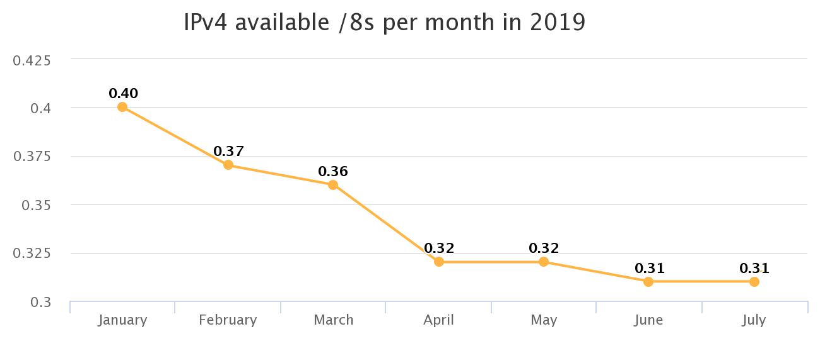
Internet Number Resource Management
Current Stats on Number Resource
‹#›

Slide 11
Internet Number Resource Management
Implications Phase 2 of Softlanding:
Maximum of a /22 IPv4 allocation/assignment
Increased cases of IPv4 hijacking and squatting
Impact on IPv6 adoption?

Slide 12
Internet Number Resource Management
IPv6:
Members with IPv6: 798
~ 9222 /32’s issued
~ 1019567 /32s Available
ASN:
Members with asn: 1562
1761 ASN’s allocated to members
365 ASN’s Available - Replenishment to be done when threshold is reached
Policy Reservations
ASNs - “small” for Internet Exchange Points
IPv4 - 2 /16 IPv4 prefixes for Internet Exchange Points
/12 - future use, yet unforeseen

Slide 13
Internet Number Resource Management
Service - Internet Routing Registry (IRR)
Stores routing policy information
Defined by the Routing Policy Specification Language (RPSL) standard in RFC2622
Provides for a common format that operators use to configure backbone router’s route filters
Network troubleshooting - use of whois contacts associated with the source ASN
Router configuration: Tools such as IRRToolset can create router configurations
Link: https://afrinic.net/internet-routing-registry
Notes:
Benefits:
Single source of information

Slide 14
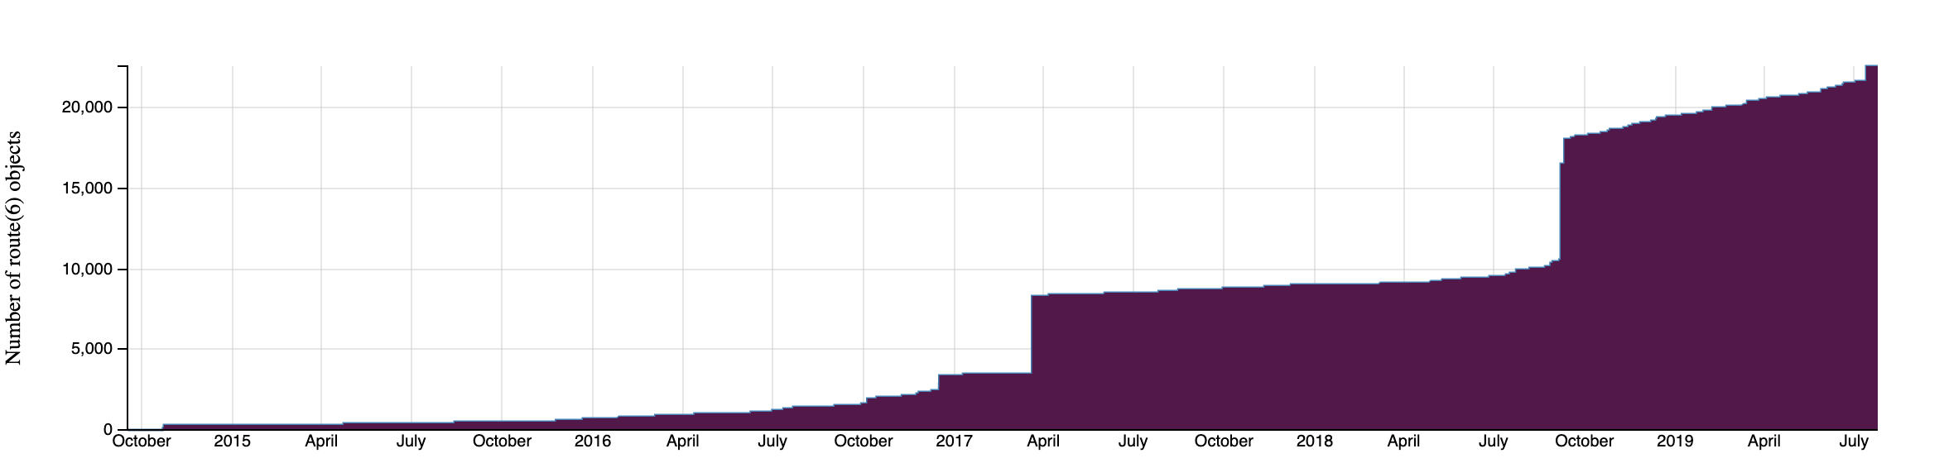
Internet Number Resource Management
Service Adoption - IRR

Slide 15
Internet Number Resource Management
Service - Resource Public Key Infrastructure (RPKI)
security framework for verifying the association between Internet number resources (IP addresses and AS Numbers)
Prove the right to use resources
Sign Route Origin Authorisations
Prove ownership of Internet number resources in the context of IPv4 transfer after the exhaustion of the IPv4 pool of the RIR
Help to secure the inter-domain routing protocol by conveying the right-to-use of the resources and to validate routing information
Link: https://afrinic.net/resource-certification

Slide 16
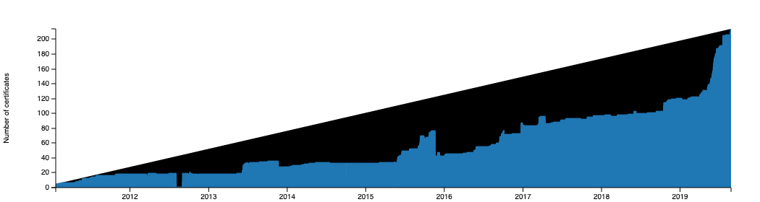
Internet Number Resource Management
Service Adoption - RPKI

Slide 17
Internet Number Resource Management
Service - DNSSEC
AFRINIC manages and publishes Reverse DNS (RDNS) zone data for the IP space we allocate or assign to members
DNSSEC deployment at AFRINIC aims to
Signing Reverse DNS zones.
Publish DS record in parent zones
Accept and publish DS records from our members
Link: https://afrinic.net/dnssec
Notes:
The DS record is used to verify the authenticity of child zones** of DNSSEC zones

Slide 18
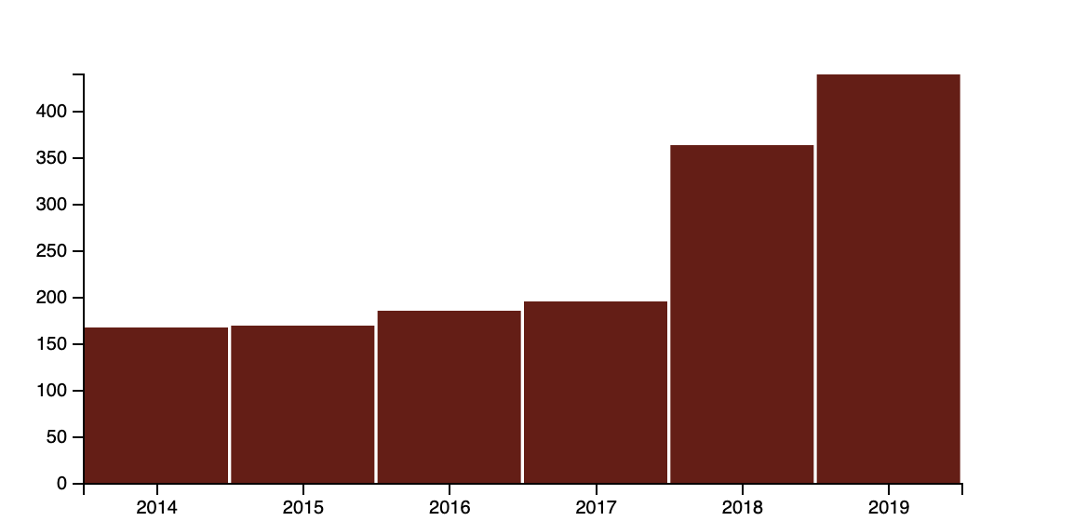
Internet Number Resource Management
Service Adoption - DNSSEC

Slide 19
Internet Number Resource Management
Service: Policy Based Transfer
Applicable to IPv4 resource only
Applicable to Companies incorporated in the AFRINIC’s
Service region
Must meet policy conditions
Partial-transfers are accepted
Policy ratified by AFRINIC Board on 26th April 2017
Went live on 22nd February 2018

Slide 20
Internet Number Resource Management
Service: Mergers & Acquisition based Transfer
Applicable to IPv4, IPv6 & ASN
Applicable to Companies incorporated in the AFRINIC’s
Service region
Evidence of a merger/acquisition must be available
Details published: ftp://ftp.afrinic.net/stats/afrinic/transfers/transfers_latest.json

Slide 21
Internet Number Resource Management
Service Updates
Introduction of
Payment preference - Credit Card or Wire Transfer
Credit Card payment without login
Withholding tax declaration
Electronic documents use
Upcoming updates
IRR Integration
BPKI enrolment interface
Notes:
The DS record is used to verify the authenticity of child zones** of DNSSEC zones

Slide 22
Resource Member Management
Scope:
Membership Account
Membership Growth
Maintainer Objects
Contact Objects

Slide 23



Resource Member Management
Resource Membership Types
Local Internet Registry (LIR)
End-User member (EU)
Why Get Own IP Number Resources From AFRINIC?

Slide 24
Resource Member Management
Becoming A New Resource Member:
Send your request at https://nmrp.afrinic.net
Provide:
Organisation and points of contact details
Certificate of incorporation (incorporation within AFRINIC region)
Detailed IP addressing plan
Service regulators license(where applicable)
Contract with upstream ISP
Sign RSA
Other available documentation justifying your IP needs
May be required to provide evidence of infrastructure in the region

Slide 25
Resource Member Management
Managing your resource membership account
Organisation and Points of contact details kept up-to-date
Points of Contact enrol and get BPKI certificate
Have a signed Registration Services Agreement (RSA)
Update preferences
Payment method and currency
Withholding tax
Register your IP addressing utilisation
Annual fees paid on time
Avoid delays in getting urgent service support
Avoid membership account closure

Slide 26
Resource Member Management
Requesting additional IPv4 space:
Must be compliant with the contractual obligations.
- Must be in good financial standing (All pending fees are paid)
- Registration Service Agreement on file
- Updated contact details
Must have used at least 90% of current IPv4 allocation/assignment
Provide Details on how the current IPs allocation/assignment are being used
Provide a detailed IP addressing plan showing your needs
May require a remote desktop session

Slide 27
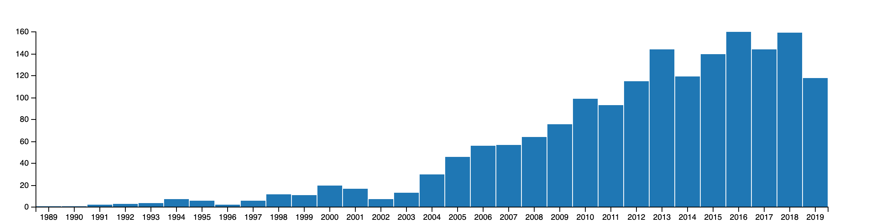
Resource Member Management
Membership Growth:
Notes:
188 Member in 2019
1732 Total members

Slide 28
Resource Member Management
Important Membership Account Details
MNTNER - Specifies authentication information required to authorise creation, deletion or modification of other objects protected by it.
ORGANISATION (ORG-HDL) - Provides information identifying an organisation such as a company.
PERSON (NIC-HDL) - Contains personal information such as name, email address and phone number.
Can be referenced as Admic-c, Tech-c or Zone-c in other objects.
ROLE - Similar to the person but it describes a role performed by one or more human beings.

Slide 29
Resource Member Management
The Maintainer objects - Why do I need this??
Secure the WHOIS database objects
Protect Database Objects from unauthorised updates.
- Reference a mntner in other objects.
- Use MNT-BY attribute
Control creation of IP resources’ child objects
- Authenticate by using password of MNT-LOWER/MNT-ROUTES/MNT-DOMAINS value from parent object
- Same mntner referenced as MNT-BY in child objects
Forgot your password?
Go to: https://www.afrinic.net/whois/utilities#crypt

Slide 30
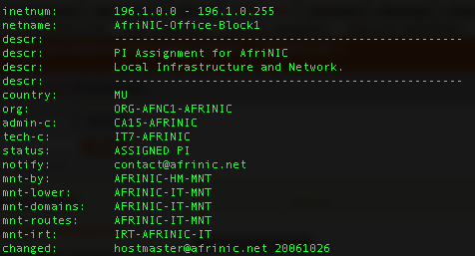
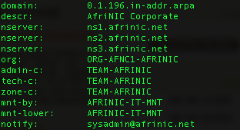
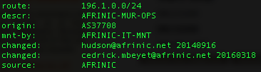
Resource Member Management
Maintainer Objects Use Cases Protecting Database Objects.
Creation of IP resources child objects

Slide 31
Resource Member Management
Point of contacts - Person & Role
Why are Contact details important in Resource Manage?
Point-of-Contact can:
- Login to myafrinic portal and manage account details and resources
- Receive important communication from AFRINIC
- Receive network problem/troubleshooting related notification
Why Maintain Contact Details Update??
- Effectively manage your number resources
- Avoid service interruption due to missed communication
- Avoid membership account closures

Slide 32
Resource Member Management
Leveraging the “ROLE”object:
Personal Information privacy concerns
Can be referenced everywhere a PERSON object can
While people performing a role may change jobs; the role itself remains.
Change only effected on role object but all other references remain intact.
Ease of maintenance than a person object
Notes:
Role objects are too limited for a more complex organisational structure though. In many cases the proper
point of contact is a department, a job function or a group of people.

Slide 33
Policy Development Process
The set of steps by which the Internet community, proposes, deliberates and adopts the policies that guide the use of number resources in the AFRINIC service region.
This audience is part of AFRINIC Internet community
Minimal engagement in policy discussion so far
It is important to get engaged in the policy development process
The policies affect all network operators
Very important to read and understand the policies before requesting IP resources and related services
Subscribe to the resource policy discussion mailing list

Slide 34
Policy Development Process
Policies in Last Call
IPv6 PI Clarification - AFPUB-2019-V6-001-DRAFT01
SL-Update - AFPUB-2018-v4-001-DRAFT-01
Policies Ratified - Pending Implementation
Clarification on IPv6 Sub-Assignments - AFPUB-2018-V6-002-DRAFT02
IPv6 PI Update - AFPUB-2018-V6-004-DRAFT01

Slide 35
Policy Development Process
Policies under discussion
AFRINIC Policy Development Process Bis v5 - AFPUB-2017-GEN-002-DRAFT-05
Abuse Contact Policy Update - AFPUB-2018-GEN-001-DRAFT02
Internet Number Resources review by AFRINIC - AFPUB-2016-GEN-001-DRAFT-08
Multihoming not required for ASN - AFPUB-2019-ASN-DRAFT02
IPv4 Inter-RIR Resource Transfers (Comprehensive Scope) - AFPUB-2019-IPv4-002-DRAFT01
IPv4 Inter-RIR Legacy Resource Transfers - AFPUB-2019-IPv4-001-DRAFT01
Provisions for Resource Hijacking - AFPUB-2019-GEN-001-DRAFT01

Slide 36
Recommendations
Read and Understand policies
Visit the FAQ pages on our websites
Read member support documentation on our websites
Subscribe here https://lists.afrinic.net/ and get engaged on mailing lists
Contribute your ideas on the database working group
Contribute to the resource policy discussions
Contact: hostmaster@afrinic.net
irr@afrinic.net

Slide 37


