Slide 1

Routing Security 101
Amreesh Phokeer
Research Manager
SAFNOG-5, JNB, ZA

Slide 2

Routing security
BGP is based entirely on trust
No in-built security mechanism to validate BGP announcements
No single point of control
Work on the basis of unreliable sources of data (WHOIS, IRR, etc)

Slide 3
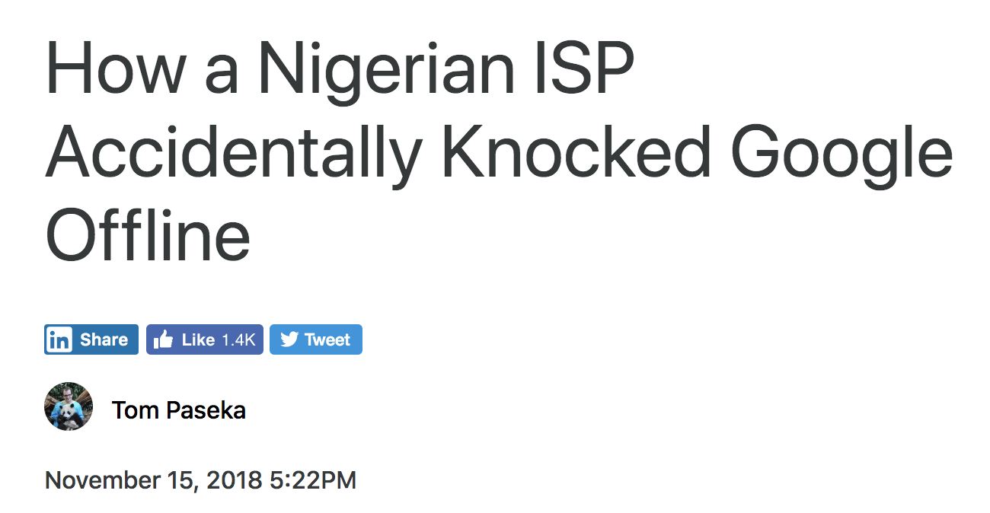
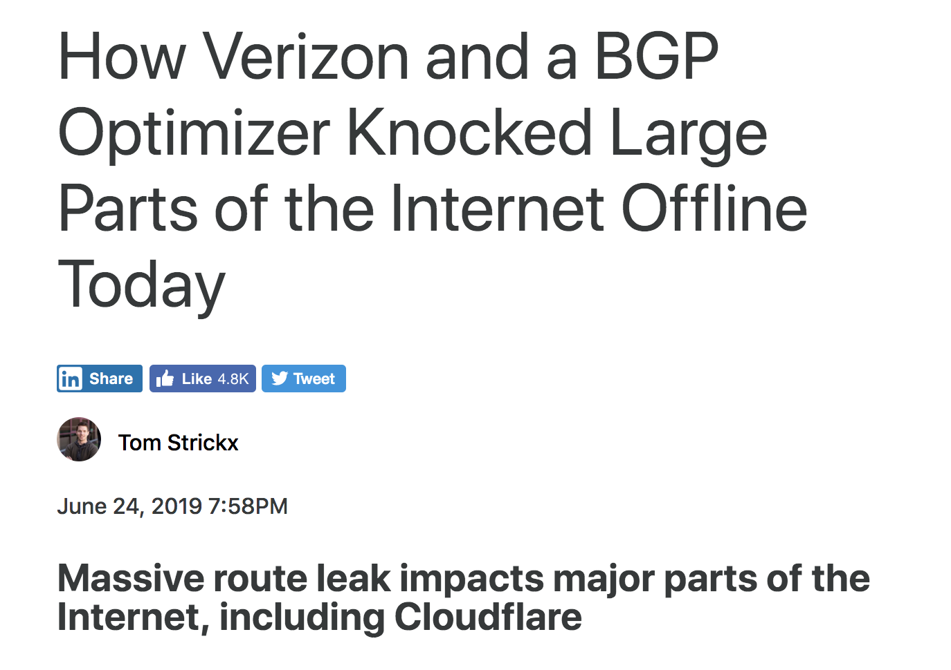
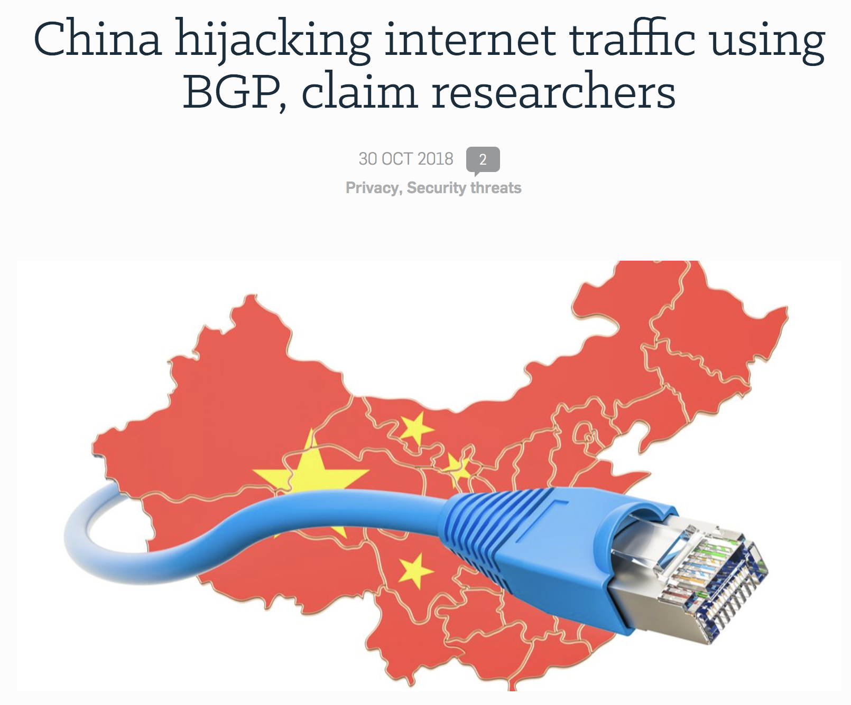

Slide 4
Route hijacking
When a network operator impersonates another network operator (I advertise your prefix) or pretends that announced prefixes are their clients
BGP principles: More specifics and Shortest path
Malicious or unintentional
Might create outages

Slide 5

Route hijacking
When a network operator impersonates another network operator (I advertise your prefix) or pretends that announced prefixes are their clients
BGP principles: More specifics and Shortest path
Malicious or unintentional
Might create outages

Slide 6

Route hijacking
AS C
ISP
Internet
Transit Provider
AS D
AS A
AS B
AS X
2001:db8:1001::/48
192.0.0.0/22
2001:db8:2002::/48
198.51.100.0/22

Slide 7
Route hijacking
AS C
ISP
Internet
Transit Provider
AS D
AS A
AS B
AS X
2001:db8:1001::/48
192.0.0.0/22
2001:db8:2002::/48
198.51.100.0/22

Slide 8
Route hijacking
AS C
ISP
Internet
Transit Provider
AS D
Normal
path
AS X
AS A
AS B
2001:db8:1001::/48
192.0.0.0/22
2001:db8:2002::/48
198.51.100.0/22

Slide 9
Route hijacking
AS C
ISP
Internet
Transit Provider
AS D
Normal
path
AS X
AS A
AS B
192.0.2.0/24
2001:db8:1001::/48
192.0.0.0/22
2001:db8:2002::/48
198.51.100.0/22

Slide 10
Route hijacking
AS C
ISP
Internet
Transit Provider
AS D
Normal
path
AS X
AS A
AS B
192.0.2.0/24
2001:db8:1001::/48
192.0.0.0/22
2001:db8:2002::/48
198.51.100.0/22

Slide 11
Route leaks
When a network operator who is multi-homing (2 upstream) accidentally announces routes learned from one upstream to the other upstream
Customer AS become an intermediary
Usually unintentional

Slide 12
Route leaks
2001:db8:2002::/48
198.51.100.0/22
AS A
8.8.8.0/24
Transit
AS T
8.8.8.0/24
Google
Internet
ISP
8.8.8.0/24
8.8.8.0/24
AS B
2001:db8:1001::/48
192.0.0.0/22

Slide 13
Route leaks
2001:db8:2002::/48
198.51.100.0/22
AS A
8.8.8.0/24
Transit
AS T
8.8.8.0/24
Google
Internet
Leaks
8.8.8.0/24
ISP
8.8.8.0/24
8.8.8.0/24
AS B
2001:db8:1001::/48
192.0.0.0/22

Slide 14
Route leaks
2001:db8:2002::/48
198.51.100.0/22
AS A
8.8.8.0/24
Transit
AS T
8.8.8.0/24
Google
Internet
Leaks
8.8.8.0/24
ISP
8.8.8.0/24
8.8.8.0/24
AS B
Prefer
Customer routes
2001:db8:1001::/48
192.0.0.0/22

Slide 15
Route leaks
2001:db8:2002::/48
198.51.100.0/22
AS A
8.8.8.0/24
Transit
AS T
8.8.8.0/24
Google
Internet
Leaks
8.8.8.0/24
ISP
8.8.8.0/24
8.8.8.0/24
AS B
Prefer
Customer routes
2001:db8:1001::/48
192.0.0.0/22

Slide 16
Solutions
Yes a few:
Prefix and AS-PATH filtering
RPKI, IRR
BGPSEC (now standardised)
Issues
Lack of incentives for deployment
Lack of reliable data

Slide 17
Build filters!
Some Stats for 2018:
12,600 total incidents (outages or route leaks)
Over 4% of ASNs were affected
2,737 ASNs were victim of a least one routing incident
1,294 networks caused routing incidents
Yes a few:
Prefix and AS-PATH filtering
RPKI, IRR
BGPSEC (now standardised)
Issues
Lack of incentives for deployment
Lack of reliable data
Source: BGPStream

Slide 18


Tragedy of the commons
Internet Routing:
Security is more often in the hands of your peers. Securing you own network does not necessarily make it more secure.
Mutually
Agreed
Norms for
Routing
Security

Slide 19
Principles
Filtering – Prevents announcements of incorrect routing information
Filter your own announcements
Filter incoming announcements from your peers and customers
Filter AS-PATH
Build filters using IRR, RPKI
Big Network filters
Anti-spoofing – Prevent traffic with spoofed source IP addresses
Source address validation for stub customers
Coordination – Facilitate global operational communication and coordination between network operators
Maintain up-to-date data on IRR, WHOIS, etc
Global Validation – Facilitate validation of routing information on a global scale
Publish your routing policies

Slide 20

twitter.com/ flickr.com/
facebook.com/ linkedin.com/company/ youtube.com/ www.
afrinic afrinic afrinic
afrinic
afrinic
afrinic
media
.net
Thank you for your Attention
Questions?

