Slide 1
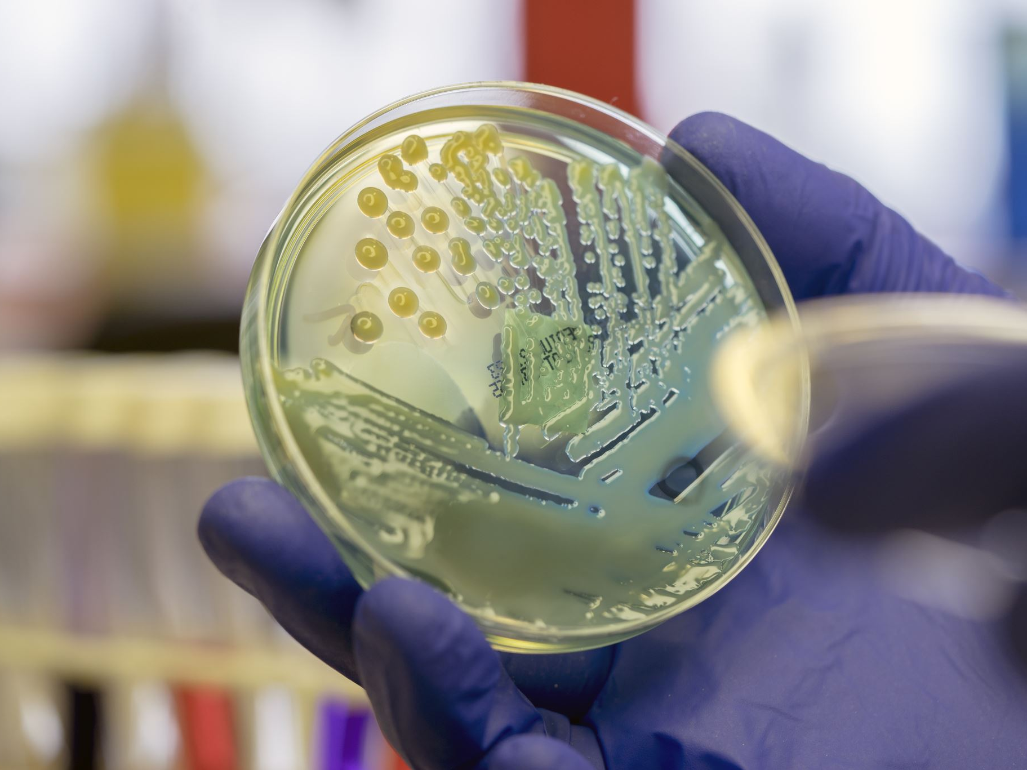
Immunity Lecture
Parte Dos

Slide 2
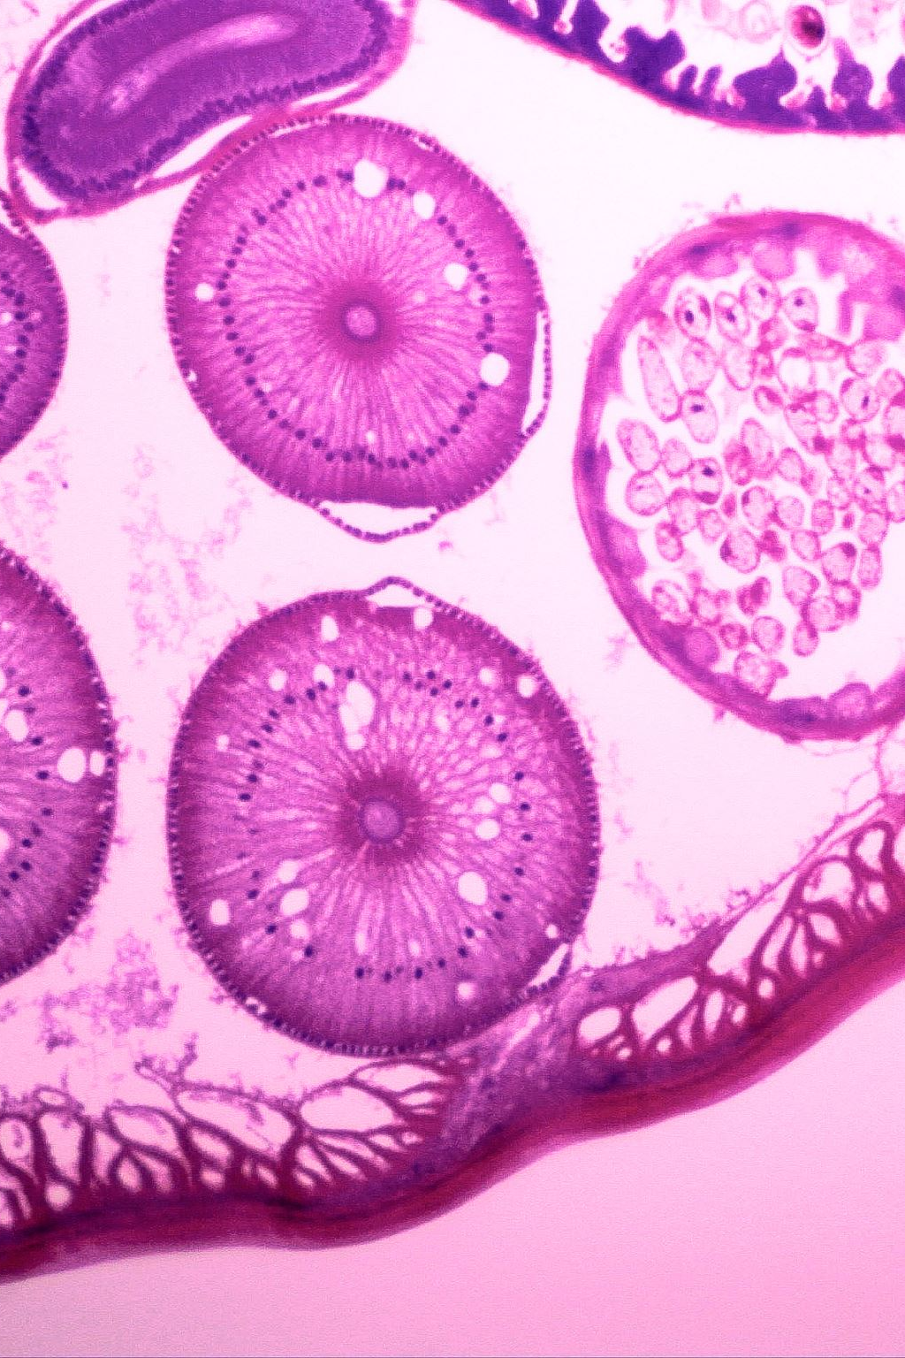
Immunity: Definitions
Abscess formation
Necrosis
Pyemia
Serous drainage
Bacteremia
Septicemia
Sepsis
Cellulitis
Gangrene
Purulent drainage
Sanguineous drainage
Serosanguineous drainage

Slide 3
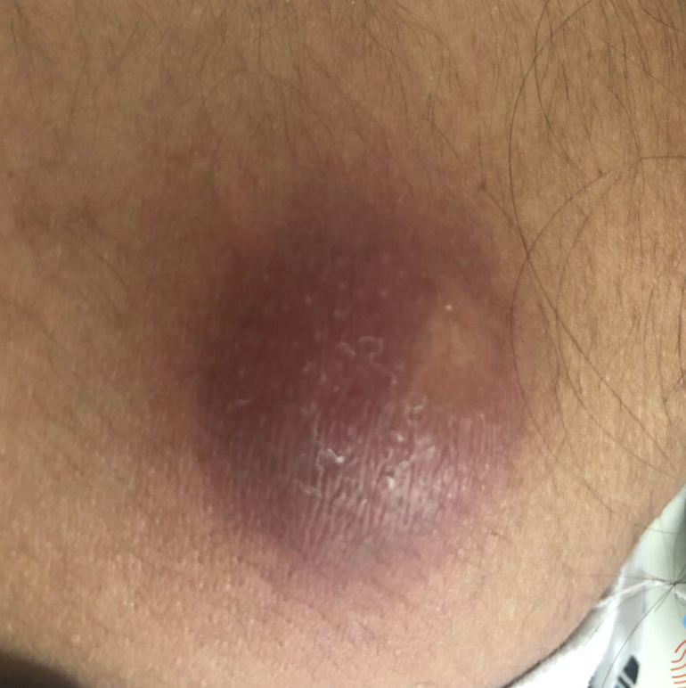
An abscess is a painful, localized collection of pus that forms when the body's immune system tries to fight off a bacterial infection.
When bacteria enter the tissue—often through a cut, a hair follicle, or an open wound—white blood cells rush to the site to attack the pathogens.
This response creates a pocket filled with living and dead white blood cells, bacteria, and dead tissue, which the body walls off with a capsule of tissue to prevent the infection from spreading
Notes:
Causes of abcess inside you:
A Burst Appendix: If you have appendicitis and the appendix ruptures, it spills gut bacteria into your belly cavity.
Diverticulitis: Small pouches in your large intestine can inflame and tear, releasing bacteria.

Slide 4
Abscess
A localized pocket of pus that forms when the body fights an infection.
Often caused by bacteria
May appear red, warm, swollen & painful
Contains pus (purulent drainage)
May require incision & drainage (I&D) and/or antibiotics
_________________________________________________________
🩺 Nursing Priorities
Assess size, redness, warmth, pain & drainage
Monitor for fever or spreading infection
Perform wound care as ordered
Notes:
“An abscess happens when the immune system tries to contain an infection. WBCs, bacteria, damaged cells, and fluid accumulate and form pus.”
“An abscess is localized, meaning the infection is contained in one area. But we still monitor because infection can spread.”

Slide 5
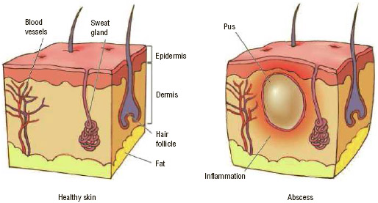
Abscess

Slide 6
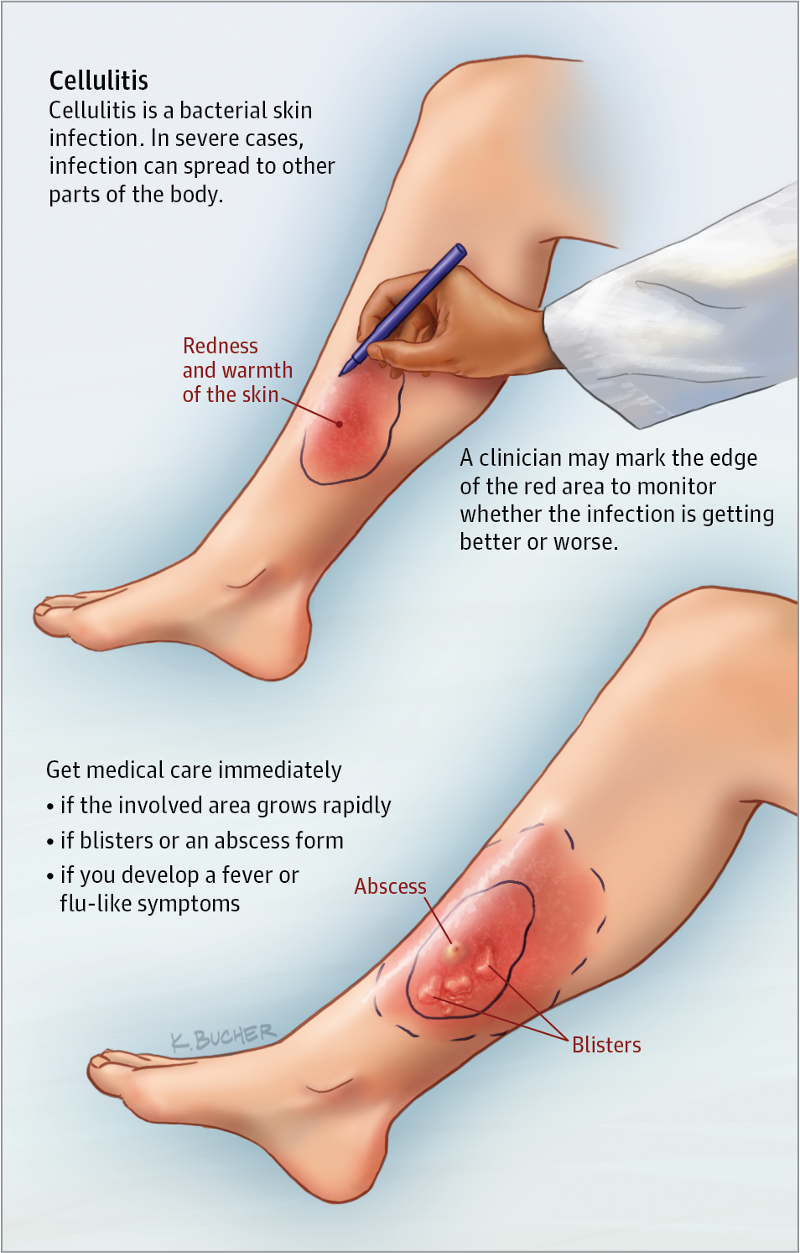
Cellulitis
Cellulitis is caused by a bacterial infection that leaks into the deeper layers of your skin and the fat tissue beneath it.
Unlike an abscess—which forms a walled-off pocket of pus—cellulitis is a flat, spreading infection. It causes the skin to look red, swollen, tight, and feel very warm and painful to the touch
It develops by a 2-step process:
1.bacteria must be present
2.must find a way past your skin's defenses.

Slide 7
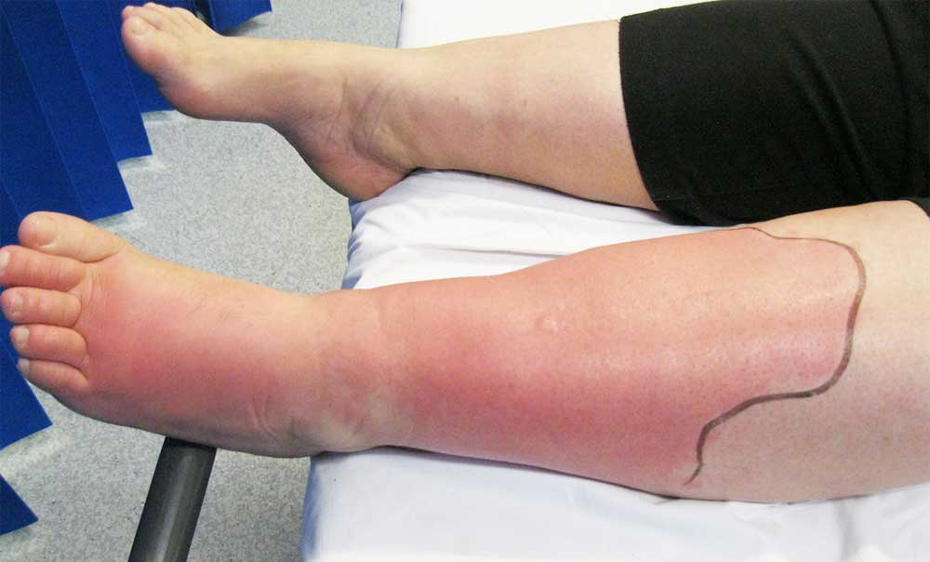
Cellulitis
A bacterial infection of the deeper layers of the skin and subcutaneous tissue.
Common Findings
🔴 Redness
🔥 Warmth
Swelling
Pain/tenderness
May develop fever
🩺 Nursing Priorities
Assess and document the affected area
Monitor for spreading redness
Administer antibiotics as ordered
Monitor temperature and systemic symptoms
Report rapidly spreading redness or worsening symptoms
Notes:
Speaker Notes
“Unlike an abscess, cellulitis isn't necessarily a pocket of pus. The infection is spreading through the skin and underlying tissue.”
“Sometimes the edge of the redness is marked so we can tell whether it's spreading.”
Your existing cellulitis slide actually shows exactly that—marking the edge of the erythema to monitor progression.
Teaching connection:
Abscess = POCKET of infection.
Cellulitis = SPREADING skin infection.

Slide 8
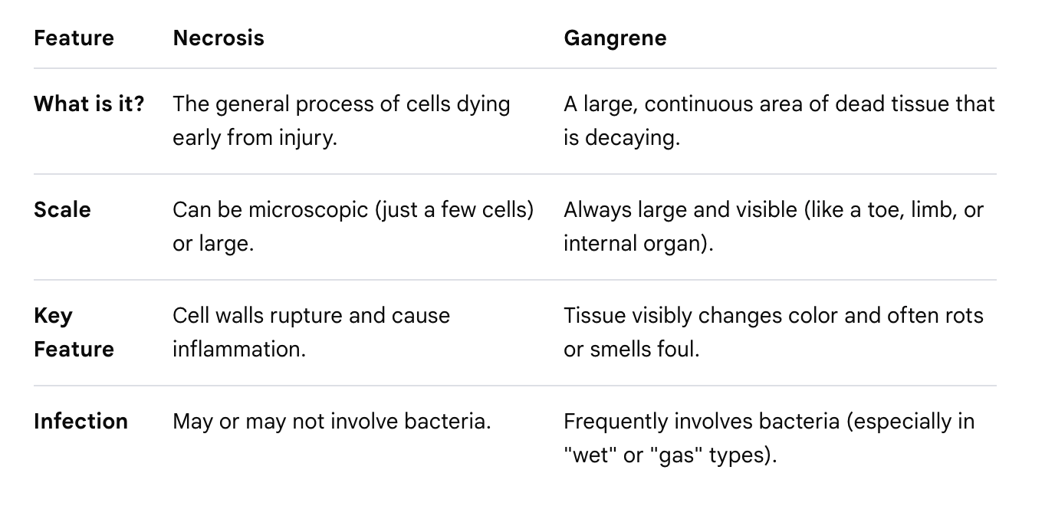
Necrosis Left Leg
NECROSIS & GANGRENE
Necrosis: Death of body tissue.
Common Causes
🩸 Decreased blood flow → tissue doesn't receive enough oxygen (pressure sores, for example)
🦠 Severe infection
🔥 Trauma/injury such as burns or severe wounds
Prolonged pressure → decreased circulation
Necrotic tissue may appear black, brown, or devitalized.
Notes:
The main difference between gangrene and necrosis is that necrosis is a general term for all cell death, while gangrene is a specific type of necrosis that happens on a large scale, usually in a limb.

Slide 9
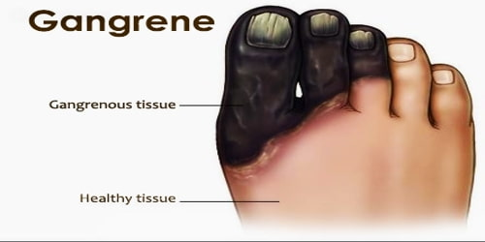
Nursing assessment:
Assess color, temperature, pulses, sensation & drainage
Monitor for signs of infection
Protect affected tissue from further injury Report new or worsening tissue changes
Debridement may be ordered to remove dead (necrotic) tissue Antibiotics if infection is present, as ordered Severe gangrene may require surgical intervention/amputation
Notes:
Gangrene: localized death and decomposition of body tissue, resulting from either obstructed circulation or bacterial infection.

Slide 10
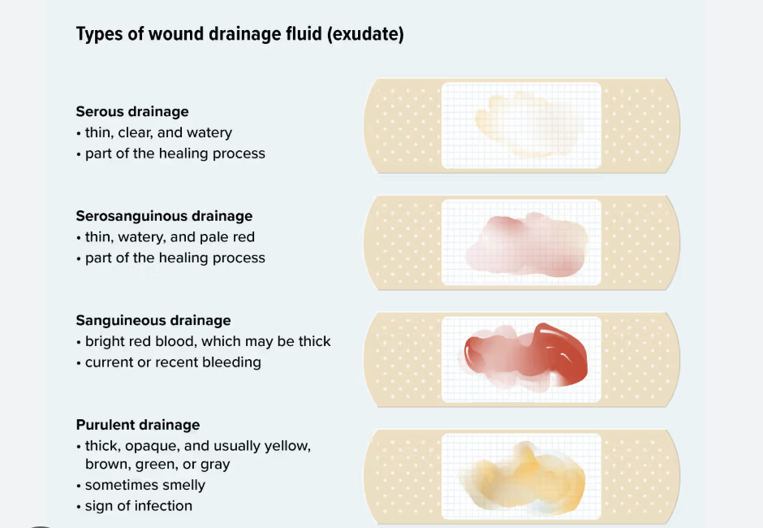

Slide 11

Serous
Serosanguinous
Sanguineous
Purulent
Notes:
Serous – pale yellow
Serosanguinous – pale yellow and red drainage
Sanguineous – red drainage
Purulent – green drainage (pus)

Slide 12
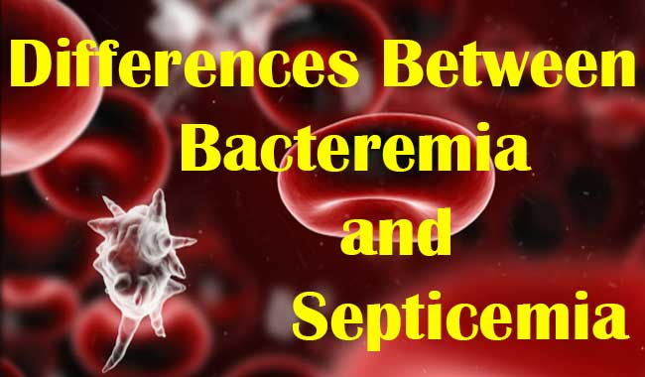

Slide 13
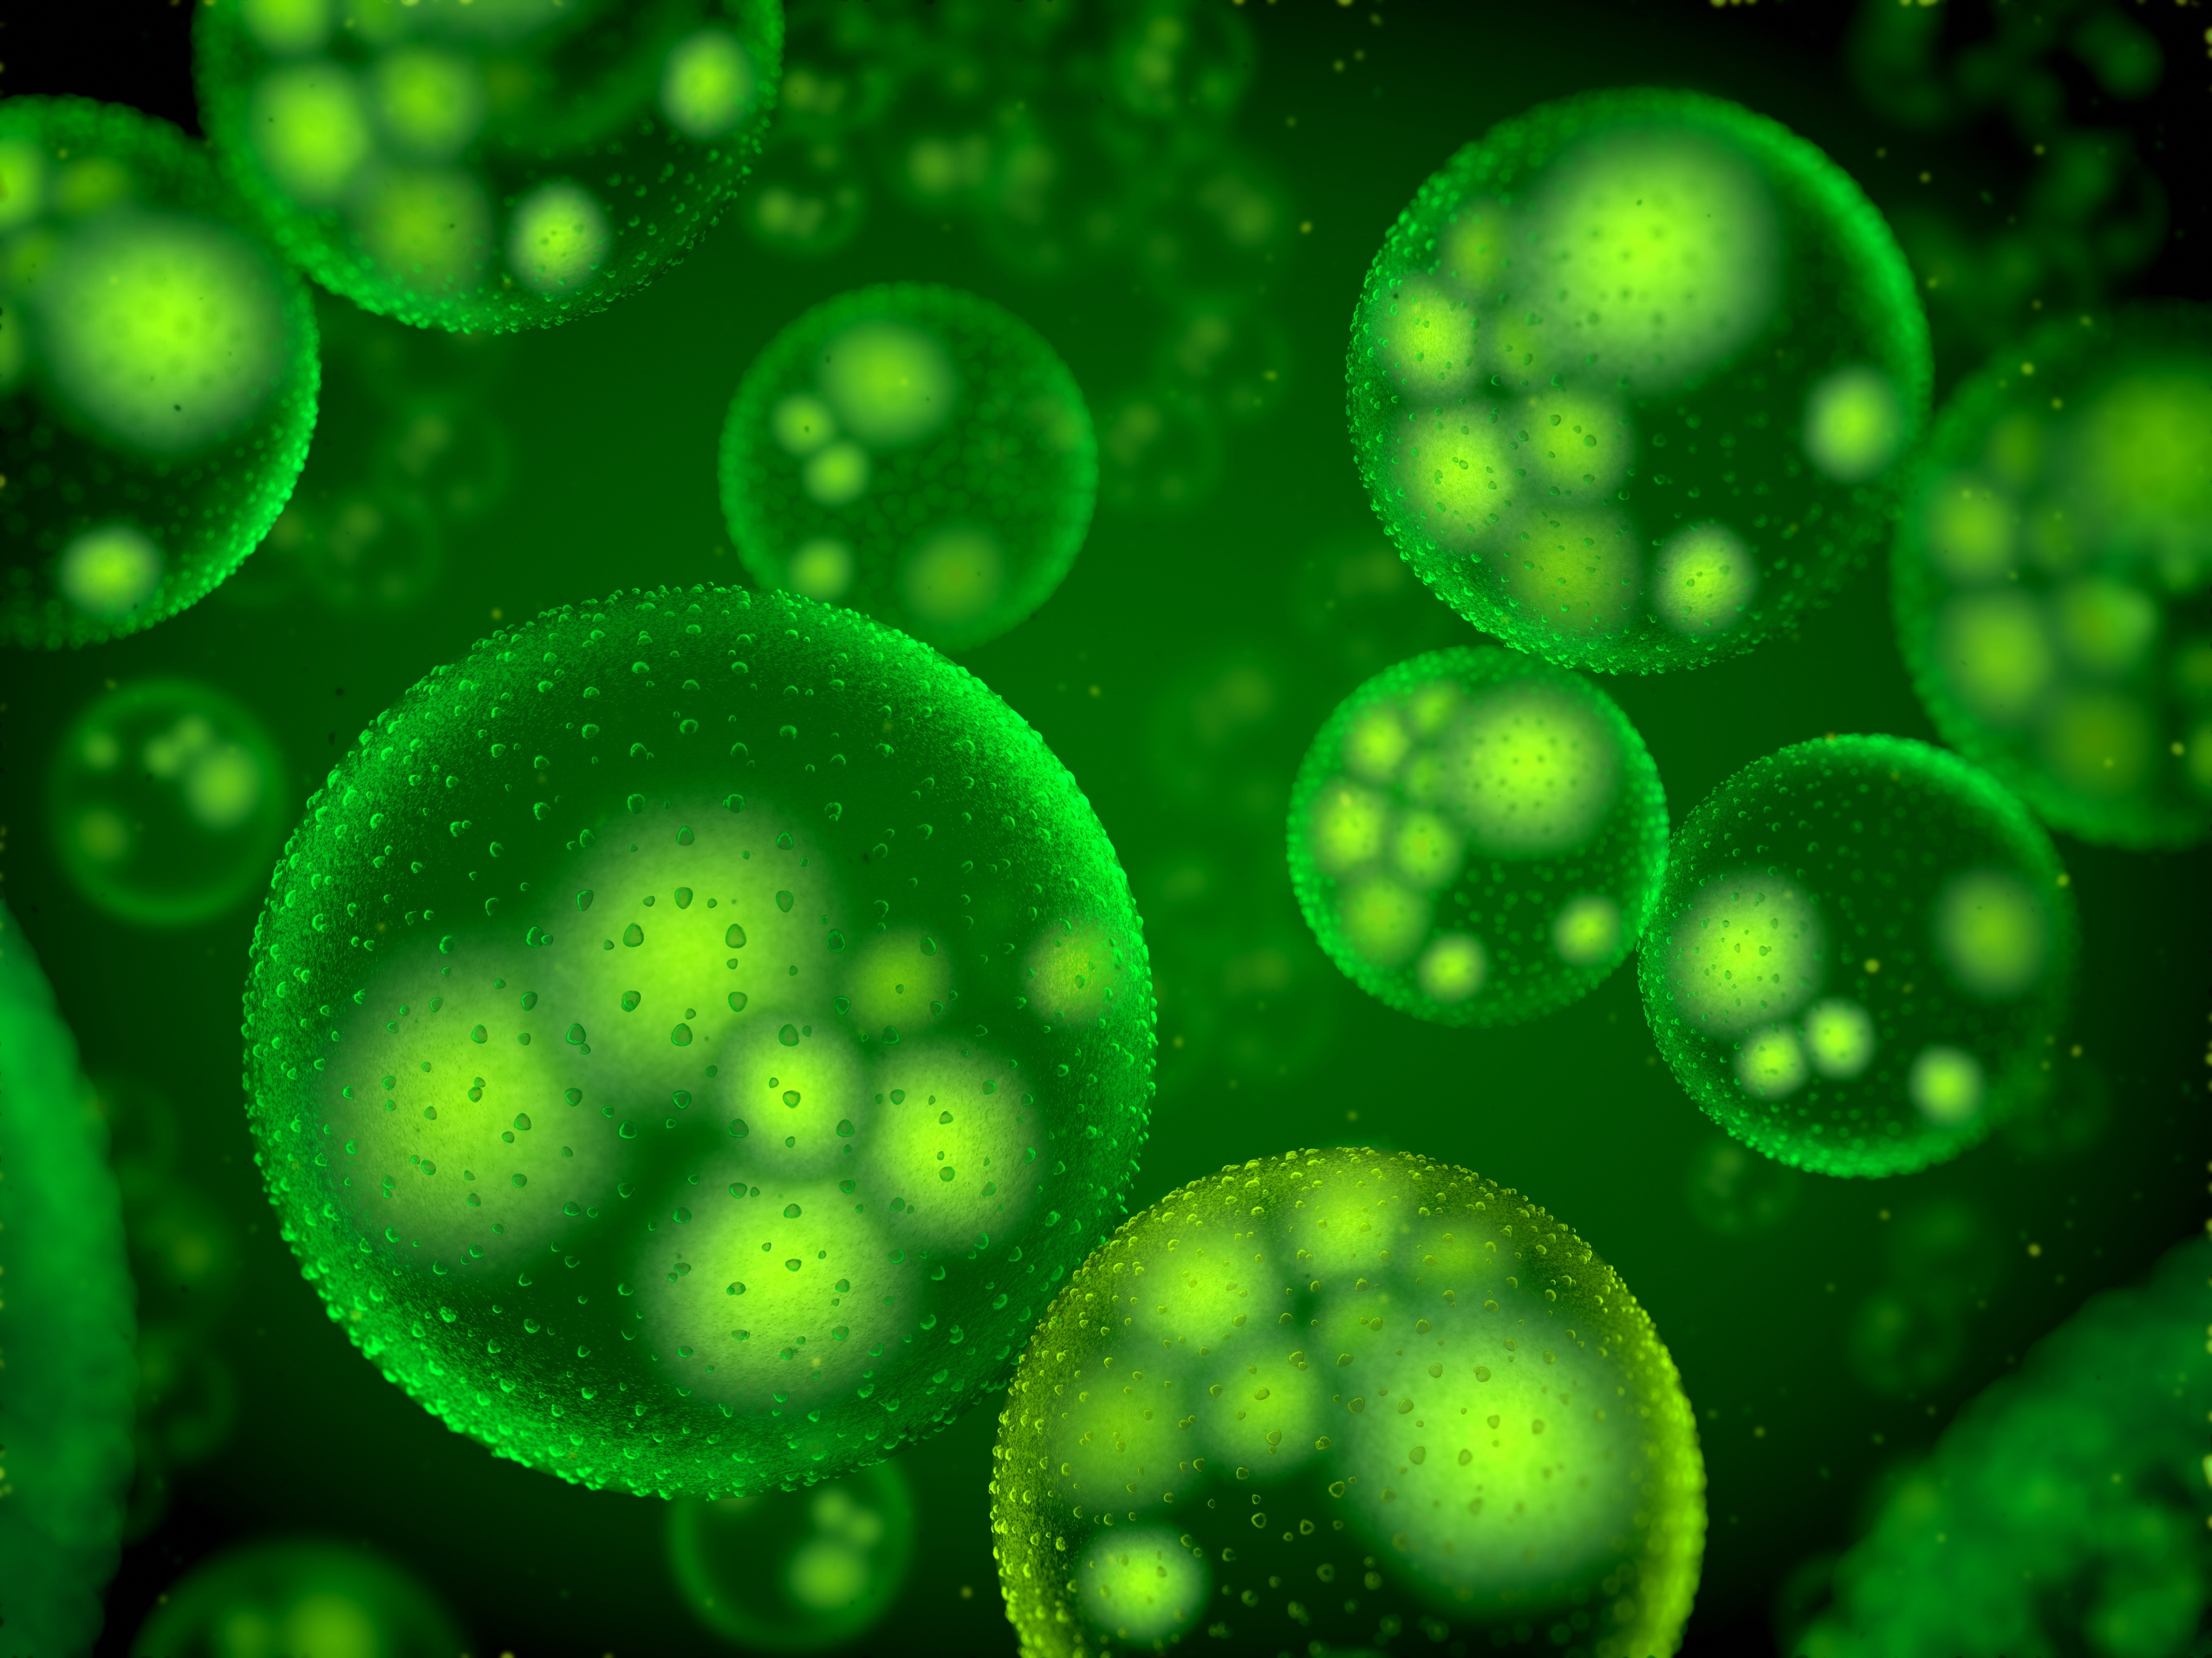
🦠 Bacteremia
Bacteria are present in the bloodstream.
Common Causes
Bacteria can enter the blood from an infection such as:
UTI , Pneumonia , Skin/wound infection , Infected IV/central line
It can also be brief/transient and not necessarily cause illness.
Bacteremia does NOT automatically mean sepsis.
🚨 Sepsis
A life-threatening response to infection that causes organ dysfunction.
🧠 Connection:
Infection somewhere in the body → dysregulated systemic response → organ dysfunction = SEPSIS

Slide 14
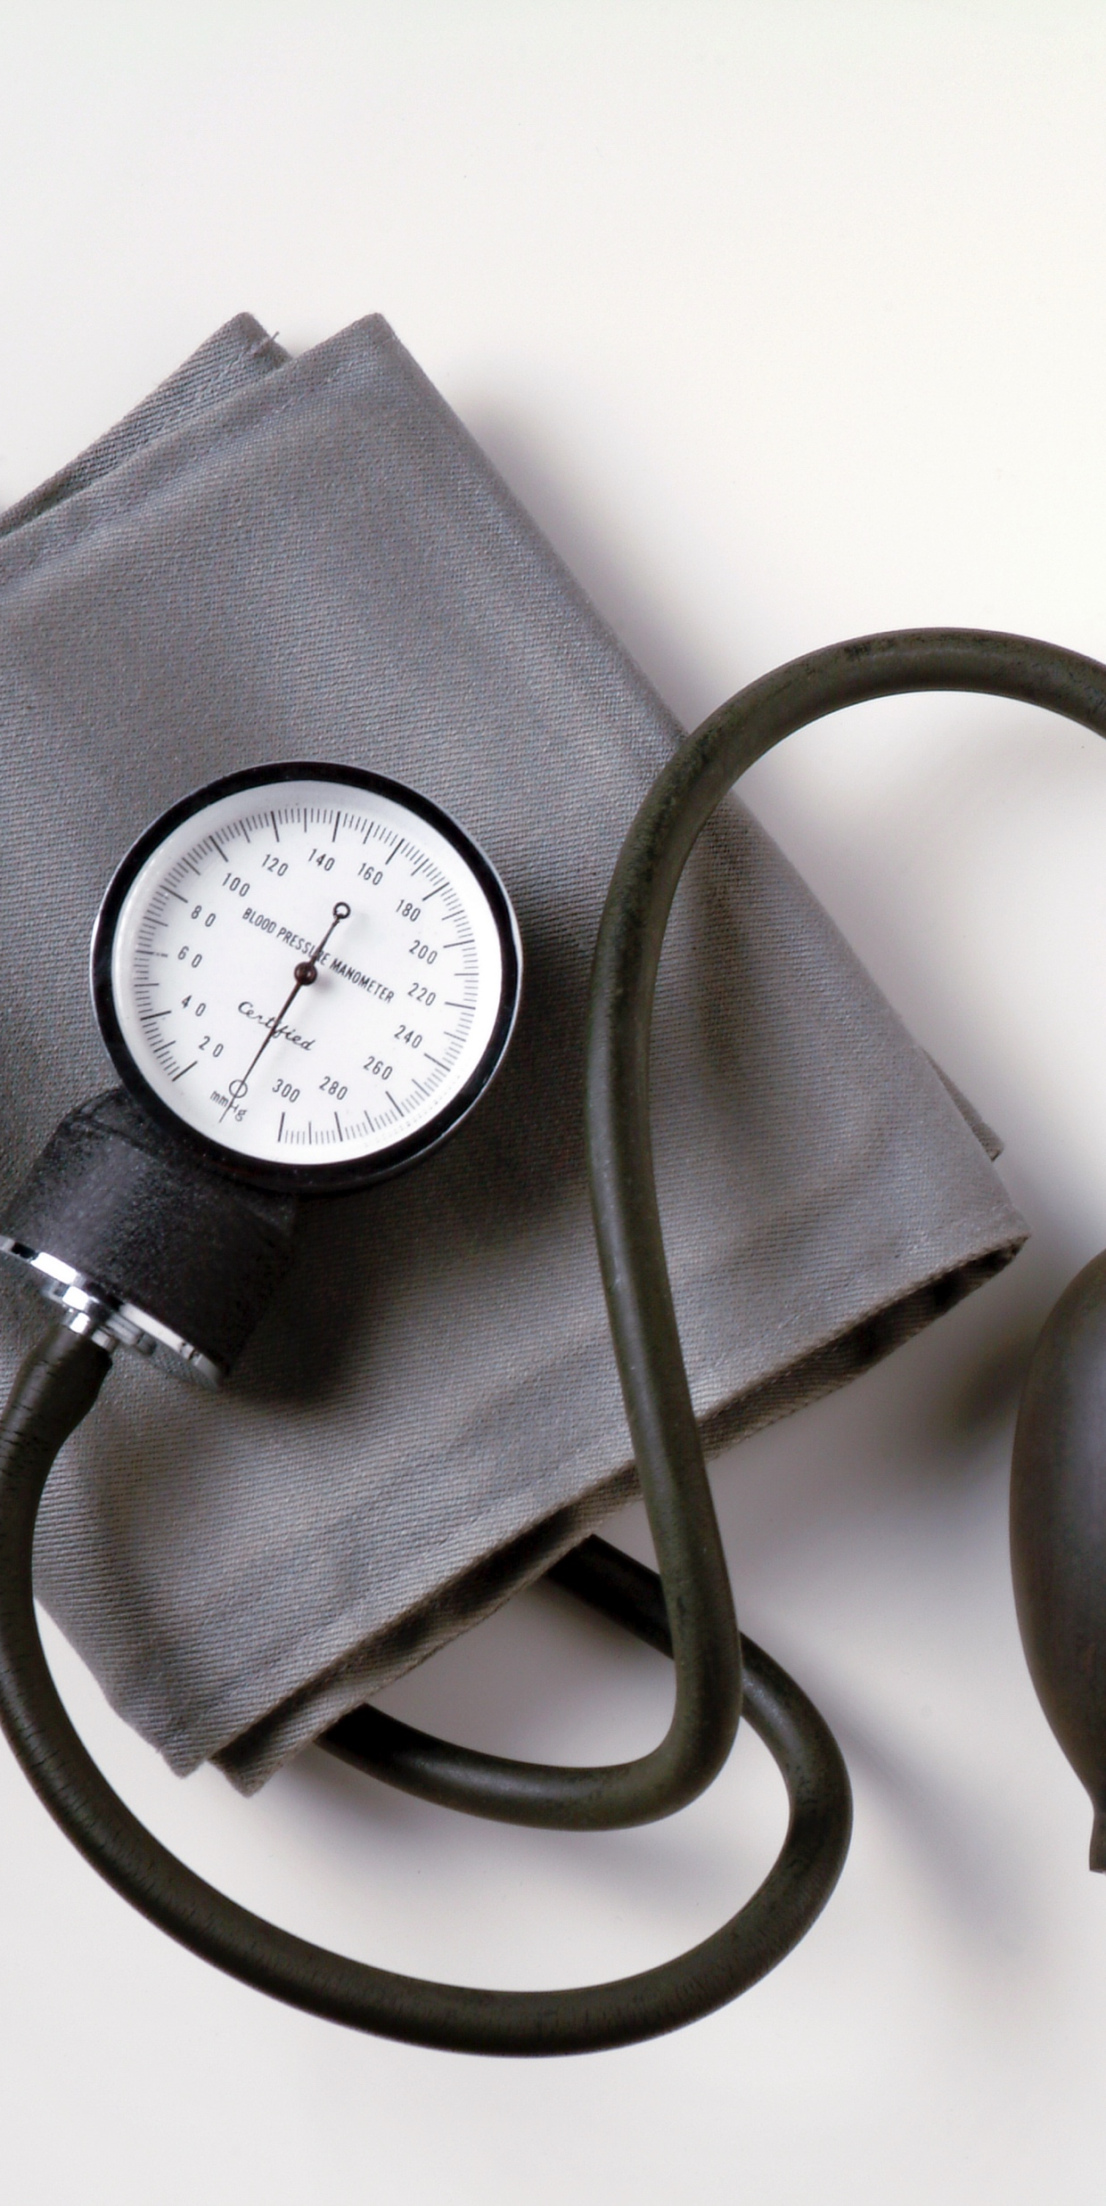
Why Does Sepsis Cause Hypotension (low BP)?
Infection 🦠
↓
Dysregulated inflammatory response 🔥
↓
Widespread vasodilation 🩸
+
Capillary leak 💧
↓
↓ Blood pressure 📉
↓
↓ Tissue/organ perfusion
↓
🚨 Organ dysfunction
🧠 Big vessels + leaky vessels = LOW BP

Slide 15
Child with a Communicable Disease
Let's Review your book
Safe Maternity and Pediatric Nursing Care CH 37
Box 37.2, Page 678
Safe and Effective Nursing Care
Patient Teaching/Guidelines
Safety Guidelines

Slide 16
COMMON COMMUNICABLE DISEASES
A communicable disease is an illness caused by germs like viruses, bacteria, or parasites that spreads from one person, animal, or surface to another.
Haemophilus Influenza Type B
Pneumococcus
Diptheria
Pertussis (Whooping cough)
Tetanus
Influenza: The “Flu”
Measles
Mumps
Rubella (German measles)
Roseola
Varicella (Chicken pox)
Polio
Hepatitis A
Hepatitis B
Rotavirus
Human Papilloma Virus (HPV)

Slide 17
YOU MADE IT!!!!!!!

Slide 18


