Slide 1
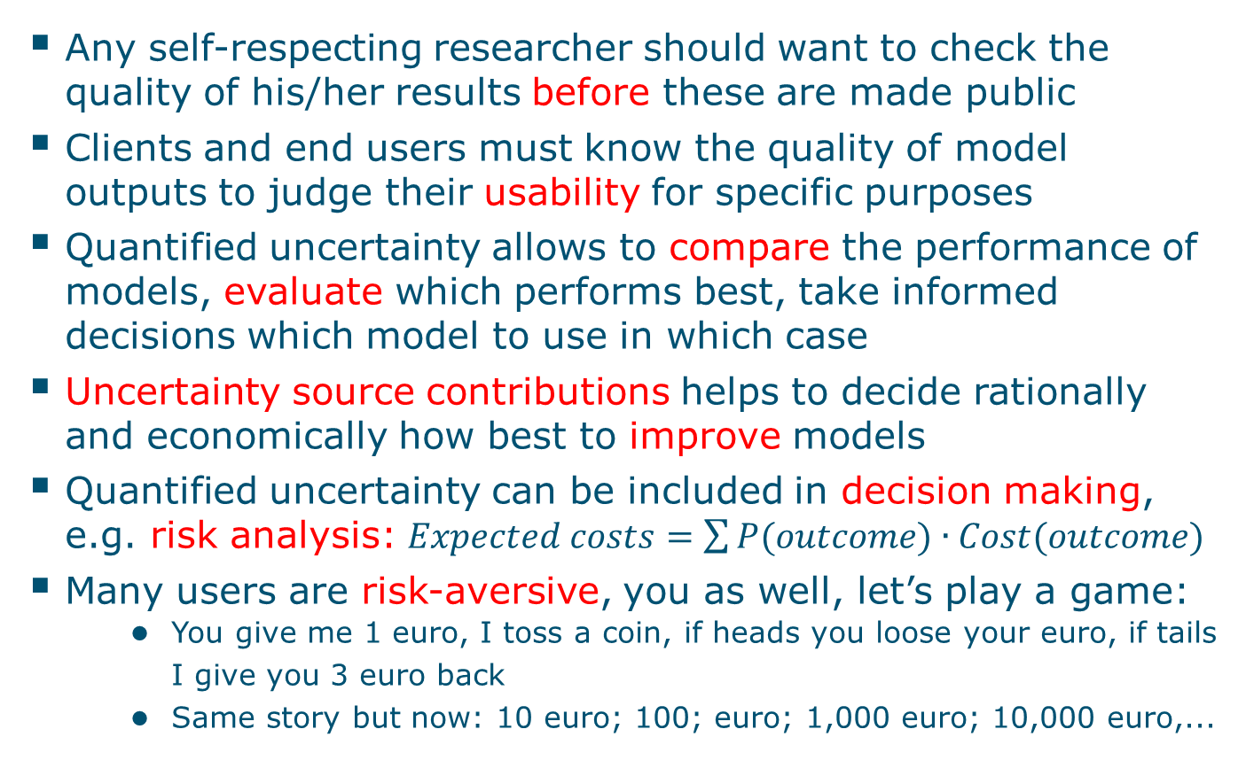
Why pay attention to uncertainty?
Any self-respecting researcher should want to check the quality of his/her results before these are made public
Clients and end users must know the quality of model outputs to judge their usability for specific purposes
Quantified uncertainty allows to compare the performance of models, evaluate which performs best, take informed decisions which model to use in which case
Uncertainty source contributions helps to decide rationally and economically how best to improve models
Quantified uncertainty can be included in decision making, e.g. risk analysis: $Expected costs=\sum{P(outcome)∙Cost(outcome)}$
Many users are risk-aversive, you as well, let’s play a game:
You give me 1 euro, I toss a coin, if heads you loose your euro, if tails I give you 3 euro back
Same story but now: 10 euro; 100; euro; 1,000 euro; 10,000 euro,...

