Slide 1





spup – an R package for uncertainty propagation analysis in spatial environmental modelling
Kasia Sawicka and Gerard B.M. Heuvelink
(with contributions from Dennis Walvoort, Stefan van Dam and Damiano Luzzi)
Underlying methodology
Functionality
Examples
Planned applications
Acknowledgements
Oval shapes are clickable
This project has received funding from the European Union’s Seventh Framework Programme for research, technological development and demonstration under grant agreement no 607000.

Slide 2

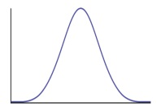



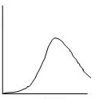

Underlying methodology
Underlying methodology
Functionality
Oval shapes are clickable
Planned applications
Examples
Monte Carlo approach principle
Variable 1
Sampling
Model run (e.g.
Output = Var1 x Var2)
Variable 2
Sampling
c(10, 14, 3, 16, ....)
R
Realiza-tions
D
Define UM
R
Realiza-tions
P
Propag-ation
V
Visualizations
2
Notes:
The principle of how it all works using Monte Carlo approach is as follow:
The user characterises uncertain model inputs with probability distribution functions (PDFs) and appropriate correlation model.
Repeatedly sample from (spatial) PDFs.
Run model with sampled inputs and store model outputs.
Compute summary statistics of the model outputs.

Slide 3

spup functionality
Underlying methodology
Functionality
Oval shapes are clickable
Planned applications
Examples
R
Realiza-tions
Additional functionality for analysis with ‚external’ models
D
Define UM
R
Realiza-tions
P
Propag-ation
V
Visualizations
Import data and objects and define UM
Monte Carlo sampling techniques
Model call and simulations
Visuali
zation of results
Imports: gstat, magrittr, mvtnorm, purrr, raster, whisker
Available on CRAN and GitHub
Notes:
Functions that allow user to define uncertainty model (UM):
Functions that quantify uncertainty propagation by sampling from uncertain inputs and running the model with sampled realizations:
Functions that allow user to save output in a format of data or images:
Model as:
As a function in R
Outside R call
Model used externally

Slide 4
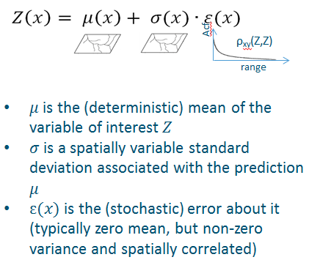
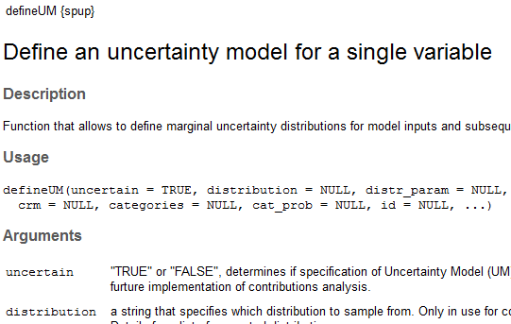
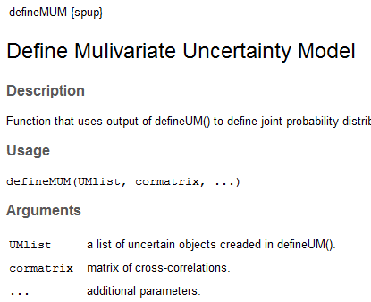
Defining uncertainty model (UM)
Underlying methodology
Functionality
Oval shapes are clickable
Planned applications
Examples
R
Realiza-tions
D
Define UM
R
Realiza-tions
P
Propag-ation
V
Visualizations
More details
Notes:
For uncertain spatially distributed continuous variables, such as elevation, rainfall or soil organic carbon content, we assume the following geostatistical model:$Z\left(x\right)= μ\left(x\right)+ σ(x)∙ε(x)$
$μ$ is the (deterministic) mean of the variable of interest $Z$, $σ$ is a spatially variable standard deviation associated with the prediction $μ$
$ε$ is simulated as a map a standardized, zero-mean, spatially auto-correlated residual modelled a correlogram.
– and this is actually sampled using stochastic spatial simulation.

Slide 5
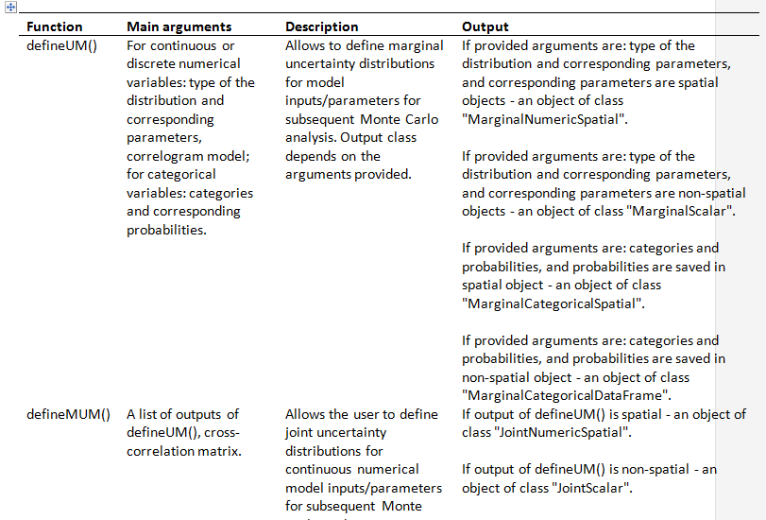

Defining uncertainty model (UM)
Underlying methodology
Functionality
Oval shapes are clickable
Planned applications
Examples
R
Realiza-tions
D
Define UM
R
Realiza-tions
P
Propag-ation
V
Visualizations
Notes:
For uncertain spatially distributed continuous variables, such as elevation, rainfall or soil organic carbon content, we assume the following geostatistical model:$Z\left(x\right)= μ\left(x\right)+ σ(x)∙ε(x)$
$μ$ is the (deterministic) mean of the variable of interest $Z$, $σ$ is a spatially variable standard deviation associated with the prediction $μ$
$ε$ is simulated as a map a standardized, zero-mean, spatially auto-correlated residual modelled a correlogram.
– and this is actually sampled using stochastic spatial simulation.

Slide 6
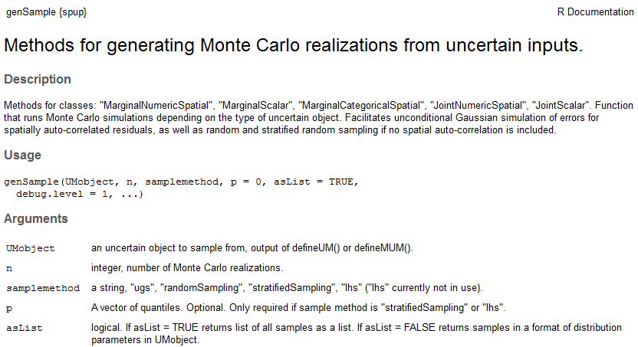
Monte Carlo sampling
Underlying methodology
Functionality
Oval shapes are clickable
Planned applications
Examples
R
Realiza-tions
R
Realiza-tions
D
Define UM
P
Propag-ation
V
Visualizations
S3 methods for MC sampling from uncertain inputs
More details

Slide 7
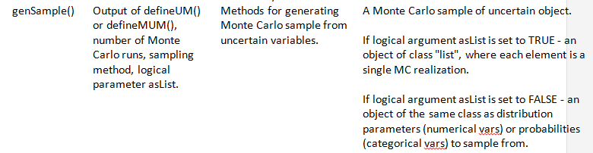
Monte Carlo sampling
Underlying methodology
Functionality
Oval shapes are clickable
Planned applications
Examples
R
Realiza-tions
R
Realiza-tions
D
Define UM
P
Propag-ation
V
Visualizations
S3 methods for MC sampling from uncertain inputs
More details

Slide 8
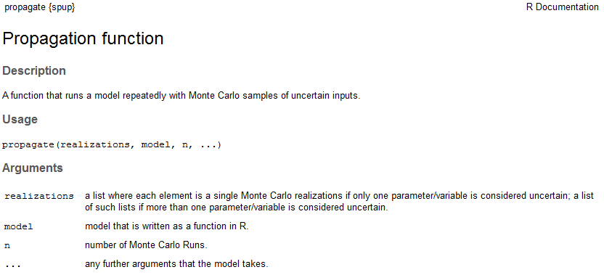
Propagation through the model
Underlying methodology
Functionality
Oval shapes are clickable
Planned applications
Examples
R
Realiza-tions
P
Propag-ation
D
Define UM
R
Realiza-tions
V
Visualizations
Run any model written as R function with a MC sample of uncertain input and additional parameters/inputs
More details
Notes:
The output of the propagation is post-processed. The you can use it in the vusializations functions.

Slide 9
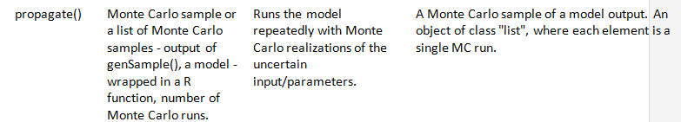
Propagation through the model
Underlying methodology
Functionality
Oval shapes are clickable
Planned applications
Examples
R
Realiza-tions
P
Propag-ation
D
Define UM
R
Realiza-tions
V
Visualizations
Run any model written as R function with a MC sample of uncertain input and additional parameters/inputs
More details
Notes:
The output of the propagation is post-processed. The you can use it in the vusializations functions.

Slide 10
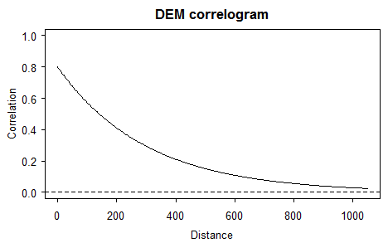
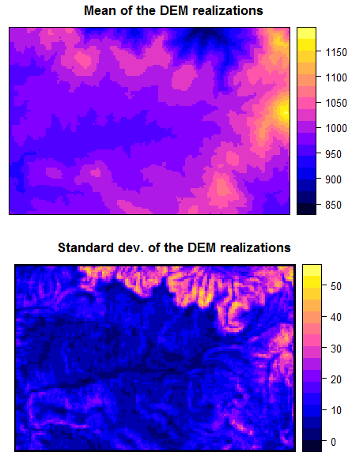
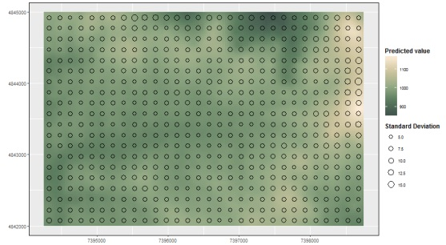
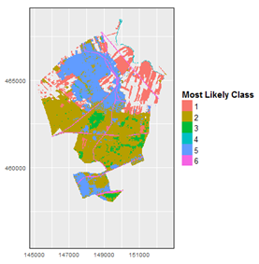
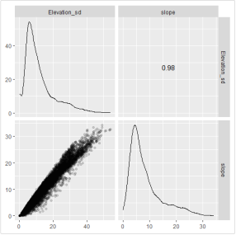
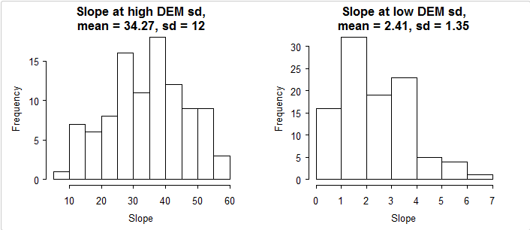
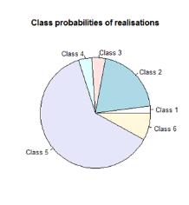
Visualization of the results
Underlying methodology
Functionality
Oval shapes are clickable
Planned applications
Examples
R
Realiza-tions
D
Define UM
R
Realiza-tions
P
Propag-ation
V
Visualizations
R is a powerful visualization tool so can make a use of existing functionality
Spatial correlogram
Adjacent maps
Glyphs
Categorical data
Correlations
Histograms
Notes:
Adjacent maps: Two maps were placed next to each other, displaying the predicted value map on the left and the uncertainty on the right for continuous data. For categorical data, the left map displayed the most likely class and the right map the associated class probability.
The second static method - Glyphs can encode data through various variables such as size, shape and colour (only used for continues data)

Slide 11
Examples
Underlying methodology
Functionality
Oval shapes are clickable
Planned applications
Examples
1
2
Example 1
Example 2
Uncertainty propagation analysis with cross-correlated numerical variables – predicting soil C/N ratio from soil organic carbon and total nitrogen content
Uncertainty propagation analysis with a model writen in C – simple linear regression model with uncertain scalar parameters

Slide 12


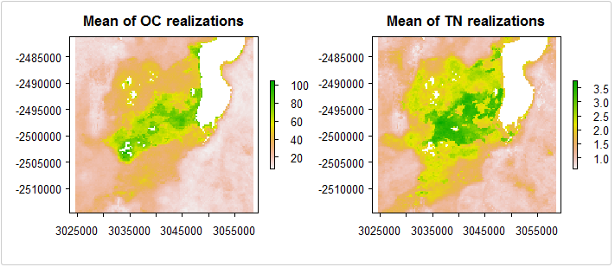
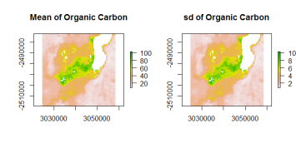
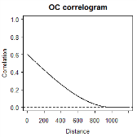


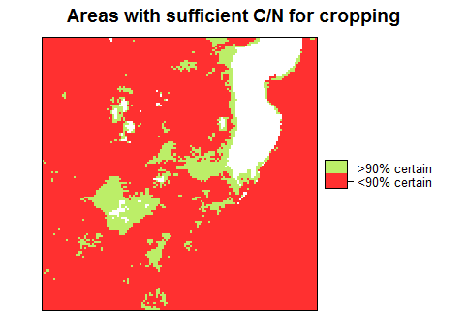
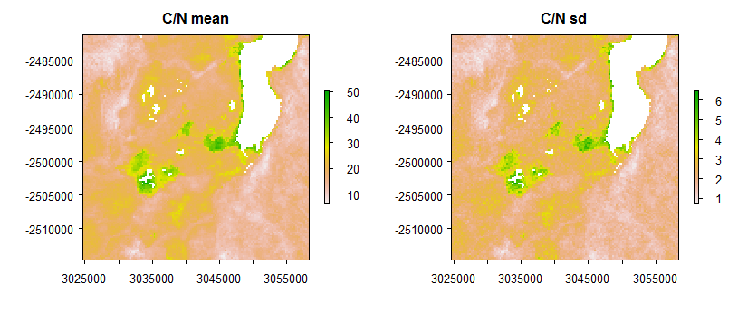
Examples (1) – uncertainty propagation with cross-correlated vars.
Underlying methodology
Functionality
Oval shapes are clickable
Planned applications
Examples
1
2
Predicting soil C/N ratio from soil organic carbon and total nitrogen content in south region of lake Alaotra in Madagascar
1.
2.
)
- repeat the same for TN
3.
4.
100
Identify areas that are suitable for crop production with 90% certainty
Data source:ISRIC Soil Grid database (www.soilgrids.org) (Hengl et al., 2017)

Slide 13
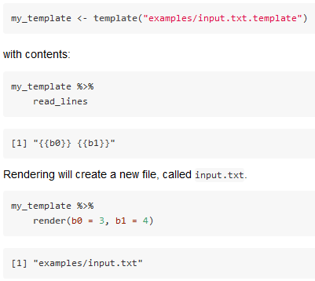
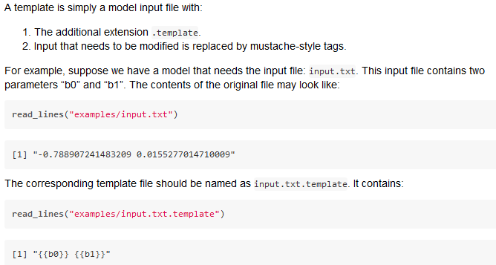
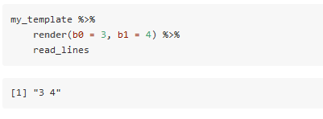
Examples (2) – uncertainty propagation with ‚external’ models
Underlying methodology
Functionality
Oval shapes are clickable
Planned applications
Examples
1
2
Simple linear regression model written in C with uncertain scalar parameters
Spatial (or other) inputs to the models are often stored in ASCII files. In that case, when using external models in R we need code to:
Modify ASCII input file.
Run the external model.
Modifying ASCII files - rendering
1
2

Slide 14
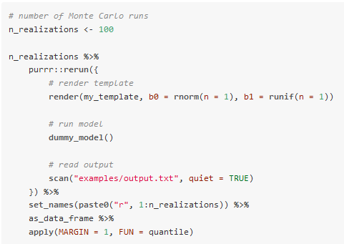
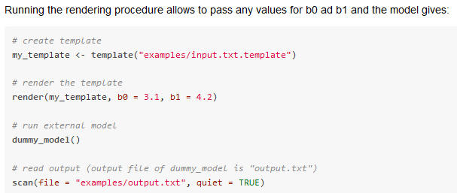
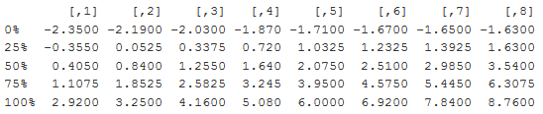

Examples (2) – uncertainty propagation with ‚external’ models
Underlying methodology
Functionality
Oval shapes are clickable
Planned applications
Examples
1
2
Simple linear regression model written in C with uncertain scalar parameters
Spatial (or other) inputs to the models are often stored in ASCII files. In that case, when using external models in R we need code to:
Modify ASCII input file.
Run the external model.
To perform the uncertainty propagation analysis we need to derive multiple realizations of the model output in steps as follows:
1. Render the template, 2. Run the model,
3. Read the results. 4. Process the results.
For example:
Running external models
1
2

Slide 15
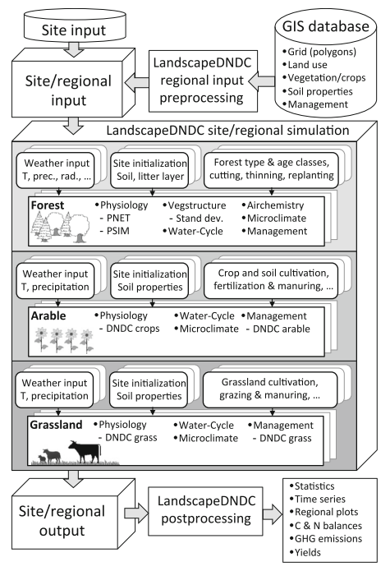
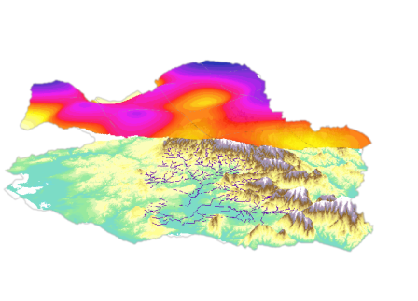
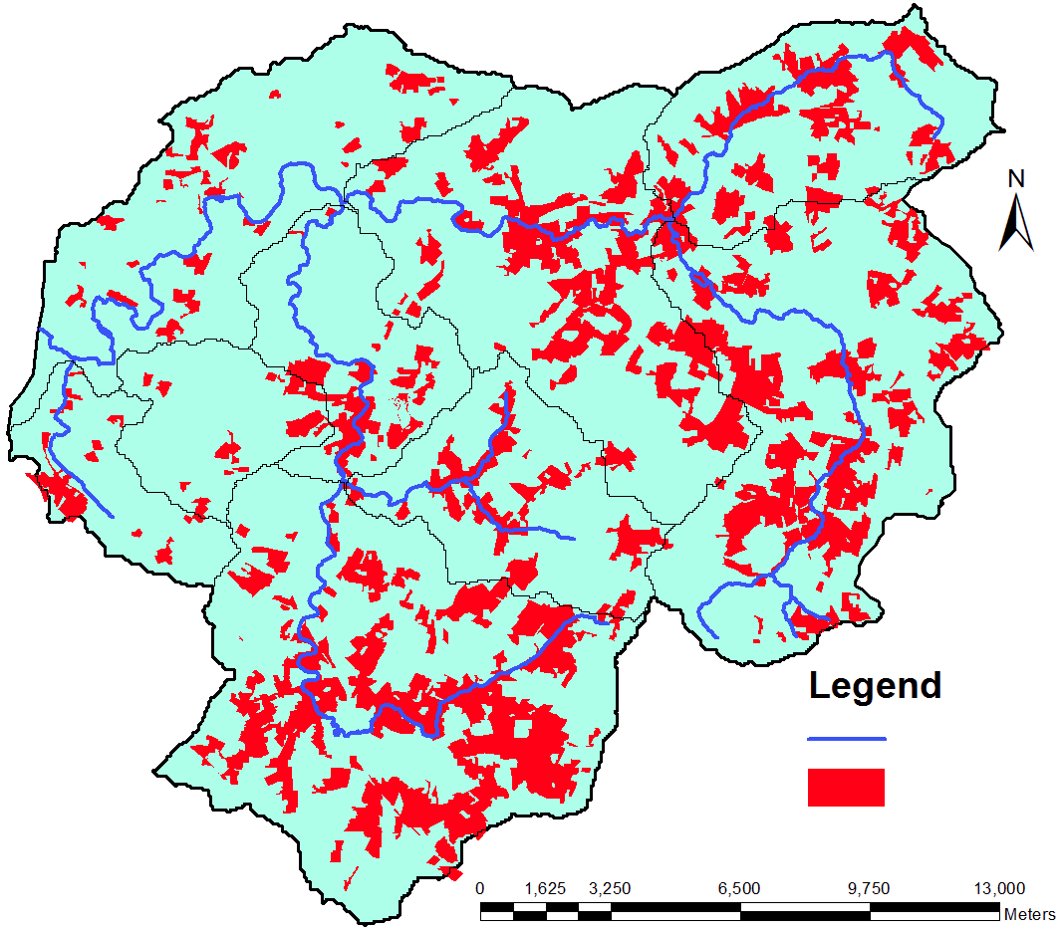
Planned applications
Underlying methodology
Functionality
Oval shapes are clickable
Planned applications
Examples
Uncertainty propagation analysis with process-based model LandscapeDNDC
Uncertainty propagation analysis with Metaldehyde Prediction Model
Radar rainfall data
Risk map
River
High risk areas
Haas et. al. (2013)
Auto-sampler locations
Notes:
The planned application of ‘spup’ currently includes: uncertainty propagation analysis with LandscapeDNDC - a very complex process-based model for simulation of biosphere-atmosphere-hydrosphere exchange processes.
Another study case for ‘spup’ application will be with Metaldehyde prediction model which basing on risk area maps developed from rainfall data calculates the time of closing the abstraction points if necessarry. As the metaldehyde is a pollutant that cannot be treated the water supplier needs to know when to control the water source abstraction points.

Slide 16


Acknowledments
Underlying methodology
Functionality
Oval shapes are clickable
Planned applications
Examples
Damiano Luzzi
Stefan van Dam
Sytze de Bruin
Dennis Walvoort
QUICS fellows and partners
EU funding
https://github.com/
ksawicka
‘spup’ repository

