Slide 1
SIC AI CAPSTONE
GENEODE
Phage Host-Genus Prediction
AI-powered decision support for genome-based phage host identification
Core result
0.677
Honest macro-F1
Samsung Innovation Campus · AI Training Track

Slide 2
01
Problem
Why host prediction matters
Phage therapy depends on matching the right phage to the right bacterial host.
Most sequenced phages have no experimentally confirmed host range.
A genome-only host predictor could speed screening, discovery, and targeted phage selection.
This project turns that challenge into a GENEODE-ready AI module.
Challenge
Genome-only signal
No direct host labels
Need reliable validation

Slide 3
02
Approach
Data, features, and validation strategy
Data: 900 complete phage genomes across 6 host genera from NCBI.
Features: 4-mer frequencies and GC content, chosen to capture host-associated genome composition.
Models: majority baseline, logistic regression, and random forest.
Key method: homology-aware clustering keeps related phages in the same fold to avoid leakage.
Dataset
900 genomes
6 genera
188 clusters
5-fold CV

Slide 4
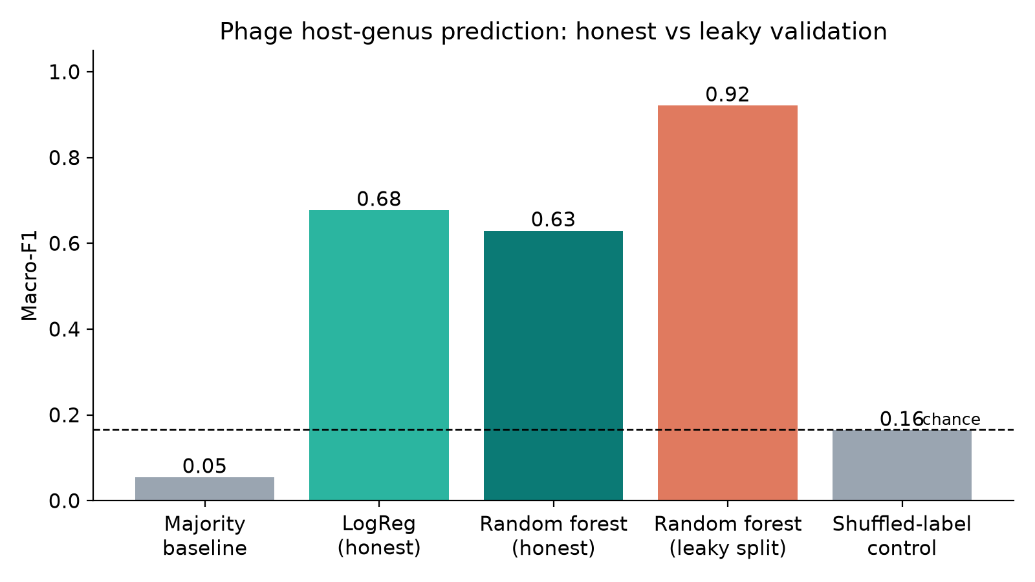
03
Validation
The difference between honest and leaky evaluation
Random split: 0.921 macro-F1 (leaky). Homology-aware split: 0.677 macro-F1 (honest). Shuffled labels fall to chance.

Slide 5
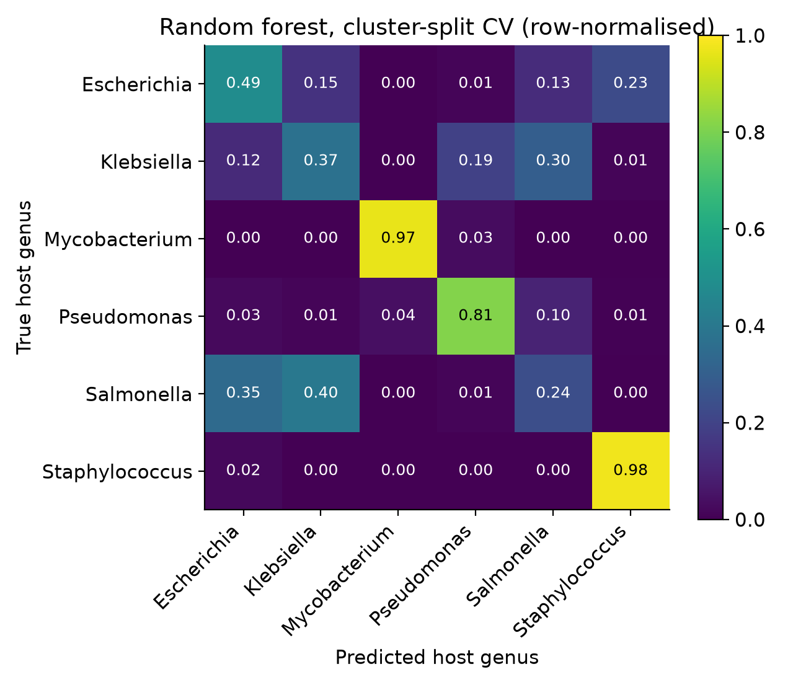
04
Results
Performance is meaningful only when leakage is controlled
Honest cluster-split macro-F1: 0.677 for logistic regression.
Leaky random split macro-F1: 0.921, showing the inflation caused by close relatives in both sets.
Shuffled-label control stays at chance (~0.16), confirming real signal rather than label memorisation.
The main errors are among genetically related taxa, which is biologically reasonable and not random failure.

Slide 6
05
Helper workflow
From genome to decision support
The model reports a host-genus prediction with confidence and uncertainty bands.
It checks GC deviation, ambiguous bases, ORF-like composition, and novelty against the training set.
This supports discovery, triage, and follow-up experiments rather than acting as a black-box labeler.
The roadmap: protein features, curated host labels, species-level targets, and deeper GENEODE integration.
Outputs
Top 3 host calls
Confidence band
Novelty check
Next-step guidance

Slide 7
06
Takeaway
A credible AI foundation for phage host prediction
Genome composition can predict host genus from sequence alone.
The key is honest validation: related genomes stay together across folds, so the model is tested on truly unseen phages.
That turns this project from a demonstration into a strong starting point for a real GENEODE module.

