Slide 1
GENEODE
Phage host-genus prediction from genome sequence
AI-powered decision support for identifying the bacterial genus
a phage infects from its genome alone.
A proof-of-concept module for the GENEODE bioinformatics platform.
6
host genera
188
homology clusters
0.677
honest macro-F1
Sequence-only prediction + honest validation = a credible AI module for phage discovery workflows.

Slide 2
Why this matters
Phage therapy needs fast host identification
Antibiotic resistance is accelerating, and phage therapy depends on choosing the right phage for the right bacterial target.
Most phages in public databases do not have experimentally confirmed host ranges.
Genome-only host prediction can accelerate screening, discovery, and decision support in clinical and applied microbiology.
This project turns a bioinformatics problem into a machine-learning module for a broader GENEODE workflow.
Clinical need
Faster triage
Sequence-first
Validatable AI

Slide 3
Approach
DNA composition, not explicit host labels
Data: 900 complete phage genomes across 6 host genera from NCBI records.
Features: strand-symmetric 4-mer frequencies plus GC content, designed to capture host-associated genome composition.
Models: majority baseline, logistic regression, and random forest.
Critical validation step: cluster-aware grouping prevents near-identical phages from leaking across train and test folds.
900 genomes
6 genera
188 clusters
5-fold CV

Slide 4
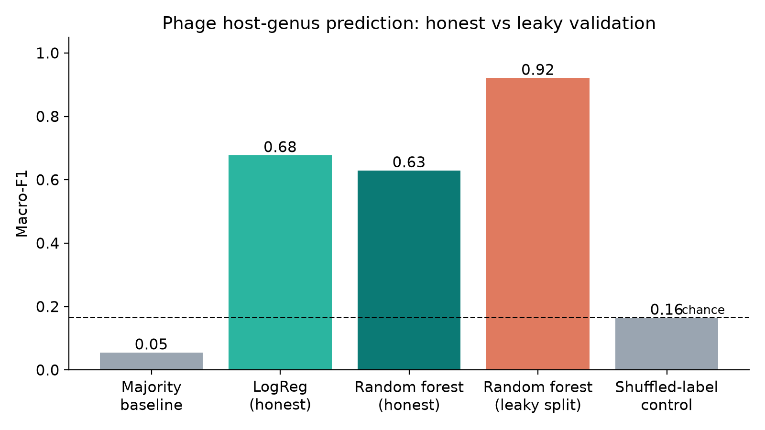
Validation
This is where the science becomes credible
Random split: 0.921 macro-F1 (leaky). Homology-aware split: 0.677 macro-F1 (honest). Shuffled labels fall to chance.

Slide 5
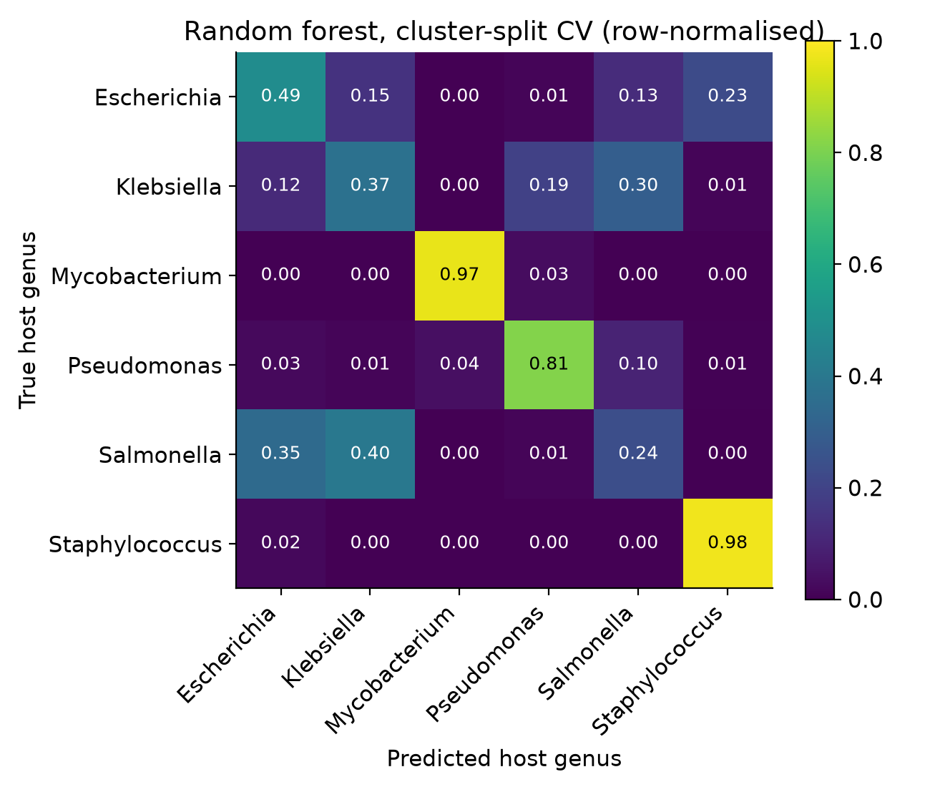
Results
Performance is meaningful when leakage is controlled
Honest cluster-split logistic regression: macro-F1 = 0.677; balanced accuracy = 0.667.
Naive random split gives 0.921 because near-identical phages appear on both sides of the divide.
Shuffled-label control sits at chance (~0.16), confirming the model is learning real signal rather than dataset artifacts.
The hardest confusions are among closely related taxa, which is biologically sensible and not random failure.

Slide 6
GENEODE helper workflow
From prediction to decision support
Load a phage genome, inspect quality and composition, and generate a host-genus prediction with confidence.
The helper reports soft checks: GC deviation, ambiguous bases, ORF-like composition, and novelty against the training set.
It ranks the top candidate genera, highlights uncertainty, and recommends next steps based on evidence rather than a single raw label.
This makes the model useful as a discovery and triage tool, not just as a benchmark.
Outputs
• Top 3 host calls
• Confidence band
• Novelty check
• Suggested next steps

Slide 7
Limits and roadmap
What is needed to turn this into a real product
Current labels are weak: they are based on NCBI record titles rather than curated host-range data.
The model predicts genus, not strain; species-level decisions need more biology and deeper evidence.
Composition-only features limit performance on closely related taxa and distant phages.
Next steps: protein-level signals, receptor-binding features, Evo 2 embeddings, curated host-range labels, and a held-out benchmark set.
Roadmap
• Protein features
• Targeted host data
• Species-level model
• GENEODE integration

Slide 8
Takeaway
A honest, validated foundation for AI-assisted phage host prediction
This project demonstrates that genome composition can predict the host genus of a phage from sequence alone.
The key differentiator is honest validation: the model is tested on genetically distinct relatives, not near-duplicates.
That makes the work a credible starting point for a much stronger, biology-aware GENEODE module.

