Slide 1
GENEODE Phage Module
Host-genus prediction from genome composition
A proof-of-concept AI module for predicting the bacterial genus
infected by a phage from genome sequence alone.
Built for GENEODE bioinformatics workflows and model validation.
6
host genera
188
homology clusters
Macro-F1
0.677
Project scope: phage host prediction, homology-aware validation, and decision support.

Slide 2
Problem
Why host prediction matters
Antibiotic resistance is growing, and phage therapy depends on matching the right phage to the right bacterium.
Most sequenced phages in public databases have no experimentally confirmed host range.
A fast, sequence-based host predictor would support discovery, screening, and clinical decision support.
This project is a GENEODE-style AI module for that workflow.
Challenge
Genome-only signal
No direct host labels
Need honest validation

Slide 3
Approach
Data, features, and models
Data: 900 complete phage genomes from NCBI, sampled across 6 host genera.
Features: strand-symmetric 4-mer frequencies plus GC content.
Models: majority baseline, logistic regression, and random forest.
Validation: homology-aware cluster split instead of random split, plus shuffled-label negative control.
6 genera
900 genomes
188 clusters
5-fold CV

Slide 4
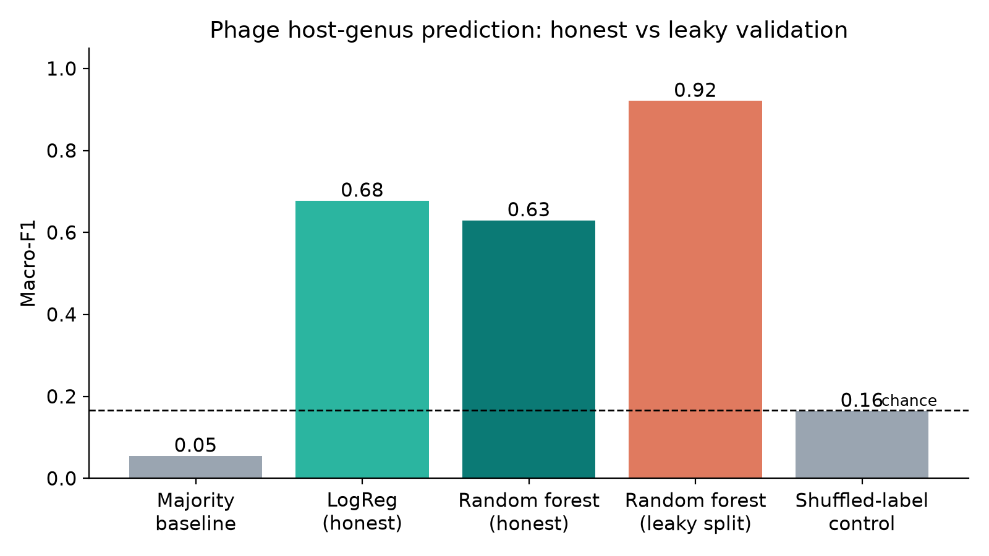
Validation
The honest comparison matters
Random split inflates the score because near-identical phages appear in both train and test. The homology-aware split prevents that leakage.

Slide 5
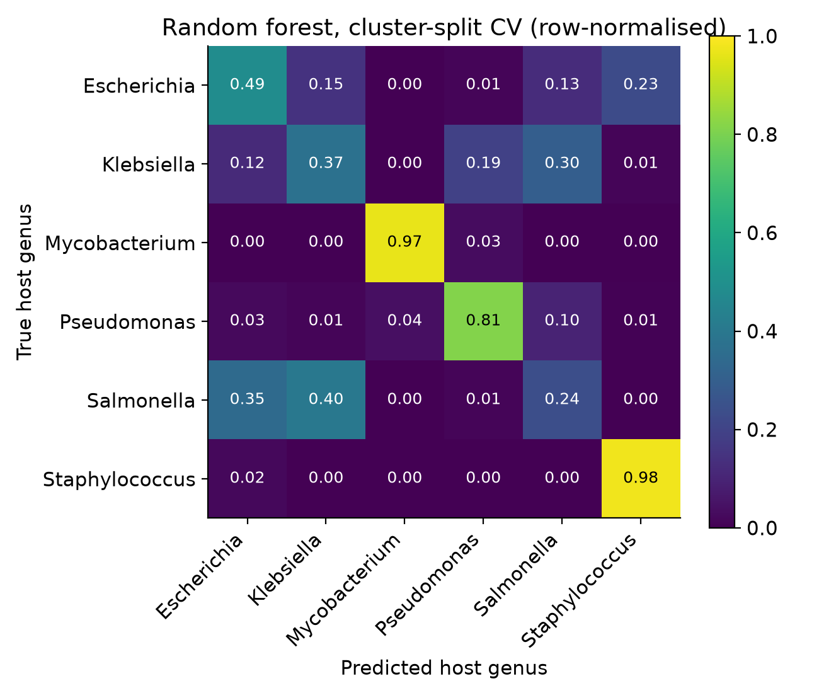
Results
Key model performance
Honest cluster-split macro-F1: 0.677 for logistic regression.
Leaky random split macro-F1: 0.921, showing the inflation caused by related-phage leakage.
Shuffled-label control drops to chance level, confirming the pipeline is not overfitting labels.
Mycobacterium and Staphylococcus are the most distinctive; Enterobacteriaceae genera remain the hardest cases.

Slide 6
Limits and next steps
From proof of concept to GENEODE module
Weak labels come from NCBI record titles, not curated host-range data.
Current scope is genus-level prediction, not strain-level identification.
Composition-only features limit performance on closely related taxa.
Next: protein-level features, receptor-binding proteins, Evo 2 embeddings, and curated host-range labels.
Roadmap
• Held-out test set
• Protein features
• Species-level labels
• GENEODE integration

Slide 7
Takeaway
A truthful, validated module for phage host prediction
This project shows that genome composition can predict host genus from sequence alone.
The honest evaluation is the key point: cluster-aware validation and shuffled controls prevent inflated claims.
The next step is a stronger, biology-aware model integrated into the GENEODE platform.

