Slide 1








Geb to Grid
Ralph A. Navarro Jr.
PH: 508-287-0190
GitHub: https://github.com/eaglet3d/GebToGrid

Slide 2
Geb to Grid

Slide 3
Geb to Grid
Overview
1st Half
Problem
Groovy
Spock
Selenium
Geb
2nd Half
Docker
Docker Compose
Selenium Grid
Putting it together
Q&A

Slide 4
Geb to Grid
Overview
1st Half
Problem
Groovy
Spock
Selenium
Geb
2nd Half
Docker
Docker Compose
Selenium Grid
Putting it together
Q&A

Slide 5
Geb to Grid
Simplified SDLC
Create requirements
Develop code
Test to verify against requirements (PASS/FAIL)
Repeat 2+3 until all requirements are met
Send to production
Notes:
Fits loosely into any SDLC paradigm;
Agile, Waterfall, TDD, etc.

Slide 6
Geb to Grid
Problem
When testing your web application against a browser...
Manual testing is too slow
  One Tester with one browser
Need way to automate testing
Test against many browsers
Test in parallel
Notes:
Fits loosely into any SDLC paradigm;
Agile, Waterfall, TDD, etc.

Slide 7
Requirement
Use Case
When user navigates to Login page
Then Login page is displayed
When user provides valid Admin credentials and clicks on login button
Then user is taken to Admin page

Slide 8
Not Geb
import org.openqa.selenium.*;
import org.openqa.selenium.WebDriver;
import org.openqa.selenium.WebElement;
public class LogIn_Page {
private static WebElement element = null;
public static WebElement txtbx_UserName(WebDriver driver){
element = driver.findElement(By.id("log"));
return element;
}
public static WebElement txtbx_Password(WebDriver driver){
element = driver.findElement(By.id("pwd"));
return element;
}
public static WebElement btn_LogIn(WebDriver driver){
element = driver.findElement(By.id("login"));
return element;
}
}

Slide 9
Problem
Automated Web test development effort is similar to application development effort.
Wouldn’t it be great if tests could align closer to the requirements?
How can we improve test development and execution efficiency?

Slide 10
Geb to Grid
Overview
1st Half
Problem
Groovy
Spock
Selenium
Geb
2nd Half
Docker
Docker Compose
Selenium Grid
Putting it together
Q&A

Slide 11
Groovy
http://groovy-lang.org

Slide 12
Groovy
Why Groovy?
Design Goals
  Improve developer productivity
  Scripting and testing capabilities
  Write concise and maintainable
    Tests
    Builds
    Automation
  Smooth Java integration

Slide 13
Groovy
Why Groovy?
Features
  Closures
  builders
  Runtime & Compile time Meta-programming
  Domain Specific Language Authoring

Slide 14
Groovy
Why Groovy?
Features
  Closures
  builders
  Runtime & Compile time Meta-programming
  Domain Specific Language Authoring

Slide 15
Groovy
Closures
A closure in Groovy is:
  An open, anonymous, block of code
  Can take arguments
  Return a value
  And be assigned to a variable
  May reference variables in its surrounding scope
  Can also contain free variables defined outside of its surrounding scope

Slide 16
Groovy
Closures
Example
[ 0, 1, 2, 3, 4, 5 ].each { print it }
Output:
012345

Slide 17
Groovy
Why Groovy?
Features
  Closures
  builders
  Runtime & Compile time Meta-programming
  Domain Specific Language Authoring

Slide 18
Groovy
Builders
Simplifies creation of data structures
Includes JsonBuilder and MarkupBuilder out of the box
Or build your own builder

Slide 19
Groovy
JsonBuilder
Example:
def json = new groovy.json.JsonBuilder()
json name: "Guillaume", age: 33
assert json.toString() == '{"name":"Guillaume","age":33}'

Slide 20
Groovy
Why Groovy?
Features
  Closures
  builders
  Runtime & Compile time Meta-programming
  Domain Specific Language Authoring

Slide 21
Groovy
Meta-programming
Add methods to classes or objects, dynamically at runtime
Including Java clsses, or final Java classes
Comes with built-in methods or add your own.

Slide 22
Groovy
Meta-programming
Example:
“http://google.com”.toURL().text
Returns:
The Google home page html as text
<!doctype html><html itemscope="" itemtype="http://schema.org/WebPage" lang="en"><head><meta content="Search the world's information, including webpages, images, videos and more. Google has many special features to help you find exactly what ...

Slide 23
Groovy
Why Groovy?
Features
  Closures
  builders
  Runtime & Compile time Meta-programming
  Domain Specific Language Authoring

Slide 24
Groovy
DSL
“A DSL is a mini-language aiming at representing constructs for a given domain.”
Fergal Dearle
“Groovy for Domain-Specific Languages”

Slide 25
Groovy
DSL
Spock and Geb are mini-languages
Thanks to Groovy

Slide 26

Groovy
Getting Started
Install SDKMAN
Simplifies Groovy install
Written in Bash
$ curl -s "https://get.sdkman.io" | bash

Slide 27
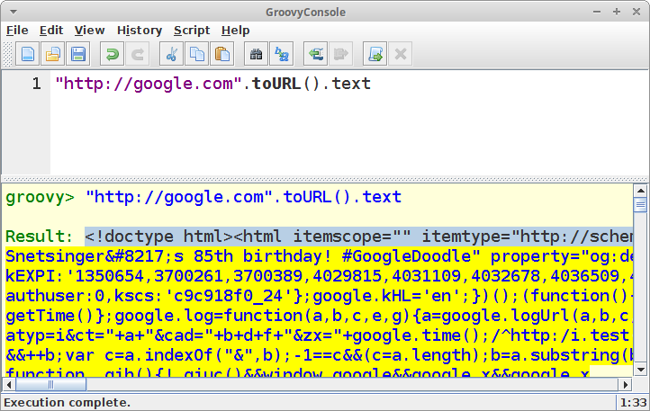
Groovy
Getting Started

Slide 28
Geb to Grid
Overview
1st Half
Problem
Groovy
Spock
Selenium
Geb
2nd Half
Docker
Docker Compose
Selenium Grid
Putting it together
Q&A

Slide 29
Spock
A more logical way to test
Has Junit runner
Highly expressive specification language

Slide 30
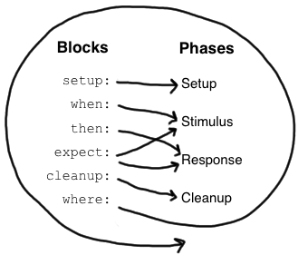
Spock

Slide 31
Spock
Specification
Groovy Class
Extends from spock.lang.Specification
Name should relate to system or system operation
Instructs Junit to run specification using Sputnik

Slide 32
Spock
Specification
class MyFirstSpecification extends Specification {
// fields
// fixture methods
// feature methods
// helper methods
}

Slide 33
Spock
Specification Components
Fields
Fixture Methods
Feature Methods
Helper Methods
Store objects
Belong to fixture
Initialize at declaration
Not shared between feature methods
Every feature method gets its own object
@Shared

Slide 34
Spock
Specification
Fields
Fixture Methods
Feature Methods
Helper Methods

Slide 35
Spock
Fixture Methods
def setup() {} // run before every feature method
def cleanup() {} // run after every feature method
def setupSpec() {} // run before the first feature method
def cleanupSpec() {} // run after the last feature method

Slide 36
Spock
Specification
Fields
Fixture Methods
Feature Methods
Helper Methods

Slide 37
Spock
Feature Method
Heart of a specification
Describes the features (properties, aspects) that is expected to be in the System Under Specification
Named with string literals
def "pushing an element on the stack"() {
// blocks go here
}

Slide 38
Spock
Feature Method
Four Phases
Set up the feature’s fixture (optional)
Provide a stimulus to the system under specification
Describe the response expected from the system
Clean up the feature’s fixture (optional)

Slide 39
Spock
Specification
Fields
Fixture Methods
Feature Methods
Helper Methods
Setup/Cleanup logic
Complex conditions

Slide 40
Spock
Helper Methods
def "offered PC matches preferred configuration"() {
when:
def pc = shop.buyPc()
then:
matchesPreferredConfiguration(pc)
}
def matchesPreferredConfiguration(pc) {
pc.vendor == "Sunny"
&& pc.clockRate >= 2333
&& pc.ram >= 4096
&& pc.os == "Linux"
}

Slide 41
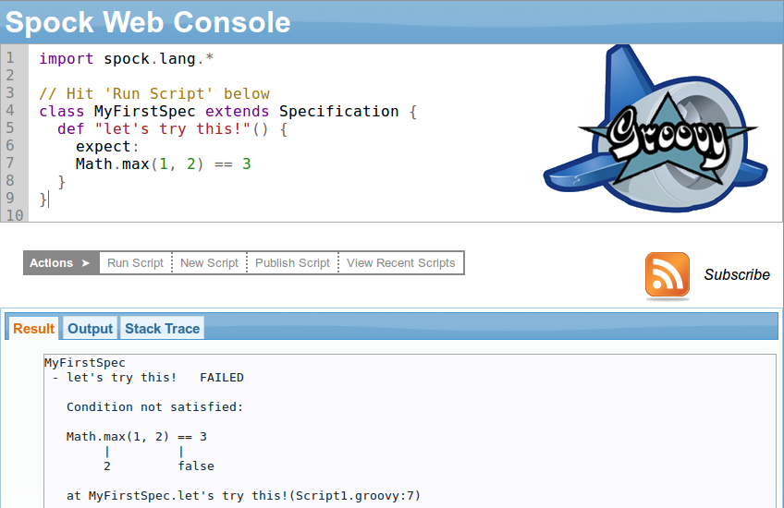
Spock
Spock Web Console
https://meetspock.appspot.com

Slide 42
Spock
Spock Web Console
Demo

Slide 43
Geb to Grid
Overview
1st Half
Problem
Groovy
Spock
Selenium
Geb
2nd Half
Docker
Docker Compose
Selenium Grid
Putting it together
Q&A

Slide 44
Selenium
Selenium automates browsers.

Slide 45
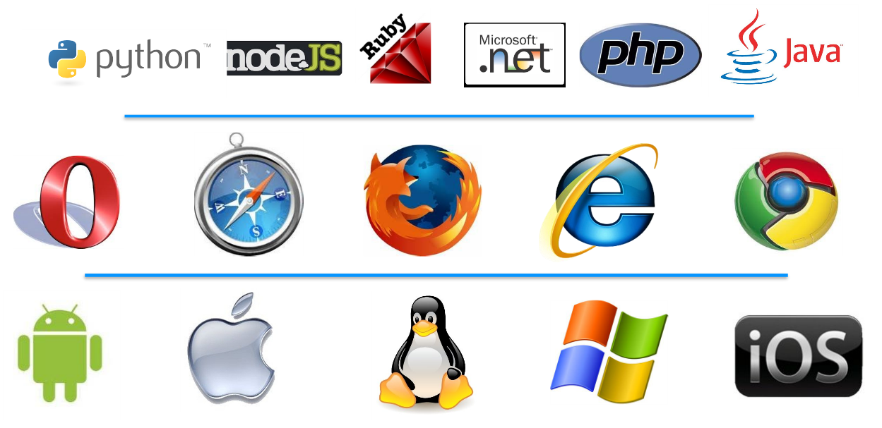
Selenium

Slide 46
Geb to Grid
Overview
1st Half
Problem
Groovy
Spock
Selenium
Geb
2nd Half
Docker
Docker Compose
Selenium Grid
Putting it together
Q&A

Slide 47
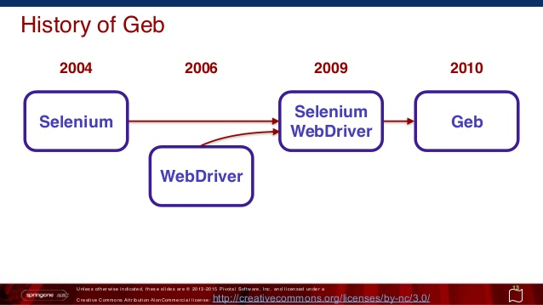
Geb

Slide 48
Geb uses WebDriver
A Domain Specific Language that simplifies Selenium coding
Leverages WebDriver interface
WebDriver is a remote control interface
Enables user agent introspection & control
W3C Working Draft of WebDriver:
https://www.w3.org/TR/webdriver/

Slide 49
Requirement
Use Case
When user navigates to Login page
Then Login page is displayed
When user provides valid Admin credentials and clicks on login button
Then user is taken to Admin page

Slide 50
Geb
Spock + Geb
Login

Slide 51
Geb
import geb.Page
class LoginPage extends Page {
static url = "http://myapp.com/login"
static at = { heading.text() == "Please Login" }
static content = {
heading { $("h1") }
loginForm { $("#login-form") }
loginButton(to: AdminPage) { loginForm.login() }
}
}

Slide 52
Geb + Spock
import geb.spock.GebReportingSpec
import spock.lang.*
import pages.*
Class LoginSpec extends GebReportingSpec {
def "Admin logs in with valid credentials"() {
when:
to LoginPage
then:
at LoginPage
when:
loginForm.username = "IronMan"
loginForm.password = "jarv1s"
loginButton.click()
then:
at AdminPage
}
}

Slide 53
Not Geb
package com.example.test.pageobjects;
import static com.example.test.Constants.loginUrl; //URL definitions
import com.example.test.UserCredentials; //username and password
import org.openqa.selenium.WebDriver;
import org.openqa.selenium.WebElement;
import org.openqa.selenium.support.FindBy;
import org.openqa.selenium.support.PageFactory;
/* Using PageFactory to inject WebElements, defined by annotations. */
public class LoginPageObject {
private final WebDriver driver;
@FindBy(id = "d-name")
private WebElement name;
@FindBy(id = "d-pass")
private WebElement pass;
/* This one is not always there! */
@FindBy(id = "d-error-message")
private WebElement message;

Slide 54
Not Geb
Continued ...
/* This one is not always there! */
@FindBy(id = "d-error-message")
private WebElement message;
public LoginPageObject(WebDriver driver) {
this.driver = driver;
PageFactory.initElements(driver, this);
/* Make sure the Login Page has rendered as expected. LIKE THE GEB "at" assertions */
if (!name.isDisplayed()) {
throw new RuntimeException("LoginPageObject name field not displayed");
}
if (!pass.isDisplayed()) {
throw new RuntimeException("LoginPageObject pass field not displayed");
}
}
/**
* Example:
* <pre>
* WebDriver driver = // details elided
* LoginPageObject loginPage = LoginPageObject.browse(driver, "#optional");
* // do some work ...
* loginPage.logout();
* </pre>
*/
public static LoginPage browse(WebDriver driver, String ... suffix) {
final String url =
(0 < suffix.length) ?
loginUrl + "/" + suffix[0] :
loginUrl;
driver.get(url);
return new LoginPage(driver);
}

Slide 55
Not Geb
...done.
public AnotherPageObject login(UserCredentials user) {
name.clear();
name.sendKeys(user.getUsername());
pass.clear();
pass.sendKeys(user.getPassword() + "\n");
return new AnotherPageObject(driver); // LIKE THE GEB "to" NAVIGATION
}
public LoginPageObject loginWithoutPermissions(UserCredentials user) {
name.clear();
name.sendKeys(user.getUsername());
pass.clear();
pass.sendKeys(user.getPassword() + "\n");
LoginPageObject result = new LoginPageObject(driver);
if (!result.getMessage().contains("Access Denied")) {
throw new RuntimeException("Access Denied message expected but not seen.");
}
return result;
}
public String getMessage() {
return message.getText();
}
//.... More elided
}

Slide 56
Geb
With Geb, less code is more!

Slide 57

Break

Slide 58
Geb to Grid
Overview
1st Half
Problem
Groovy
Spock
Selenium
Geb
2nd Half
Docker
Docker Compose
Selenium Grid
Putting it together
Q&A

Slide 59
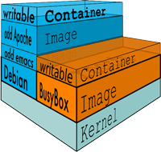
Docker
What is Docker?
“Docker allows you to package an application with all of its dependencies into a standardized unit for software development.”

Slide 60
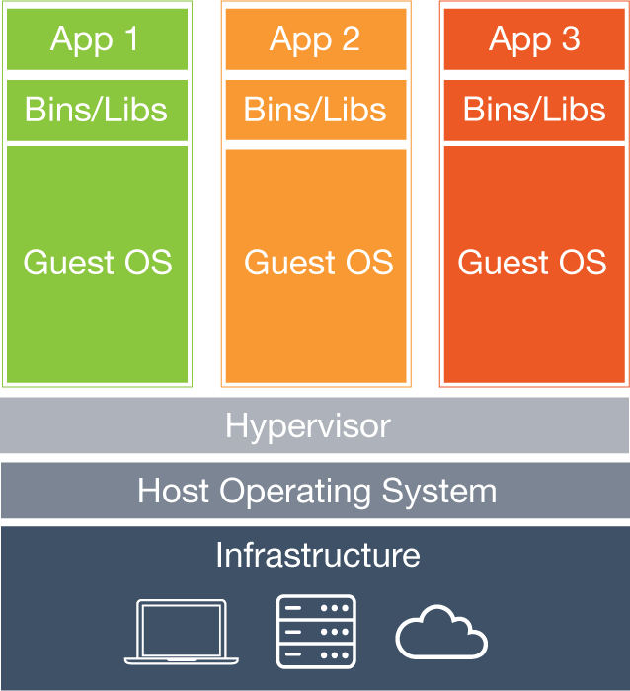
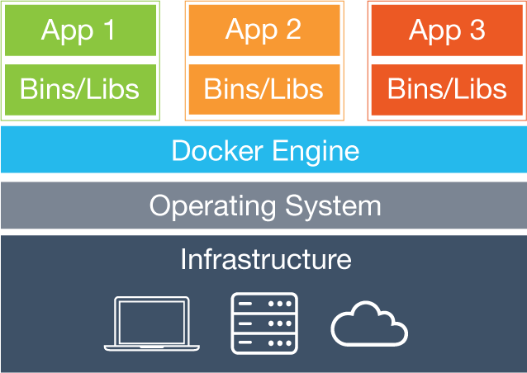
Docker
How is this different from a VM?
VM abstracts at the Hardware Layer
Container Abstracts at the Kernel Layer

Slide 61
Docker
Available for Mac and Windows running in a VirtualBox VM.
March 2016, Beta program announced for Mac and Windows
Soon As of Aug 15th, no VM to deal with on Mac and Windows

Slide 62
Docker
Dockerfile
Models the provisioning of the docker image
(similar to Vagrantfile)
FROM ubuntu
ENV VERSION 2.53.0
RUN apt-get update -qqy \
&& apt-get -qqy --no-install-recommends install \
software-properties-common \
&& rm -rf /var/lib/apt/lists/*
RUN add-apt-repository -y ppa:webupd8team/java
RUN echo debconf shared/accepted-oracle-license-v1-1 select true | debconf-set-selections
RUN echo debconf shared/accepted-oracle-license-v1-1 seen true | debconf-set-selections

Slide 63
Docker
Dockerfile (cont.)
RUN apt-get update -qqy \
&& apt-get -qqy --no-install-recommends install \
bzip2 \
ca-certificates \
oracle-java7-installer \
sudo \
unzip \
vim \
&& rm -rf /var/lib/apt/lists/*
RUN cd /var && wget http://selenium-release.storage.googleapis.com/${VERSION%.*}/selenium-server-standalone-${VERSION}.jar
#========================================
# Add normal user with passwordless sudo
#========================================
RUN sudo useradd seluser --shell /bin/bash --create-home \
&& sudo usermod -a -G sudo seluser \
&& echo 'ALL ALL = (ALL) NOPASSWD: ALL' >> /etc/sudoers \
&& echo 'seluser:secret' | chpasswd

Slide 64
Geb to Grid
Overview
1st Half
Problem
Groovy
Spock
Selenium
Geb
2nd Half
Docker
Docker Compose
Selenium Grid
Putting it together
Q&A

Slide 65
Docker
Docker Compose
Multi-container Docker Applications
Configure with docker-compose.yml

Slide 66
Docker
Docker Compose docker-compose.yml
version: '2'
services:
hub:
build: hub/.
image: selenium_grid/hub:hub
ports:
- "4433:4433"
logging:
driver: "json-file"
network_mode: "host"
volumes:
- ./hub/var/log:/var/log
firefox:
build: firefox/.
image: selenium_grid/firefox:firefox
links:
- hub
expose:
- "5555"
logging:
driver: "json-file"
volumes:
- ./firefox/var/log:/var/log

Slide 67
Docker
Docker Compose
Define your application
(Dockerfile)
Define your services
(docker-compose.yml)
Start your entire application
(docker-compose up)

Slide 68
Docker
Docker Compose
Define your application
(Dockerfile)
Define your services
(docker-compose.yml)
Start your entire application
(docker-compose up)

Slide 69
Geb to Grid
Overview
1st Half
Problem
Groovy
Spock
Selenium
Geb
2nd Half
Docker
Docker Compose
Selenium Grid
Putting it together
Q&A

Slide 70
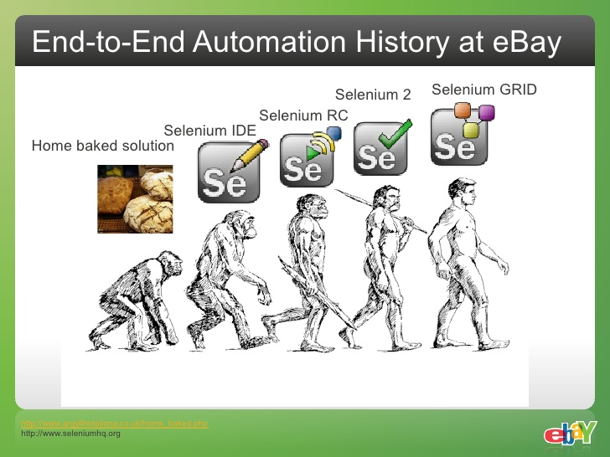
Selenium Grid

Slide 71
Selenium Grid
What is a Selenium Grid?
A Grid is basically a Hub connected to any number of nodes.

Slide 72
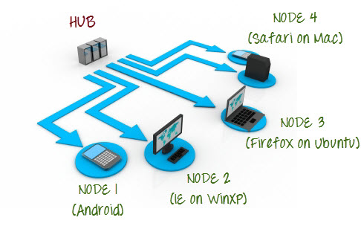
Selenium Grid
Topology

Slide 73
Selenium Grid
Simplifies Testing
Client always connects to known endpoint
Hub takes care of browser allocation
Nodes can be added dynamically
Hub handles bad nodes

Slide 74
Selenium Grid
Resiliency
Hub can send heartbeat requests to node to tell if it has gone down
Hub can gracefully kill idle sessions
Hub can kill sessions that take to long to create

Slide 75
Geb to Grid
Overview
1st Half
Problem
Groovy
Spock
Selenium
Geb
2nd Half
Docker
Docker Compose
Selenium Grid
Putting it together
Q&A

Slide 76
Geb to Grid
Putting it all together

Slide 77
Geb to Grid
Windows
Firefox
Node
Write Tests that connect to Grid
Linux
Firefox
Node
Linux
Firefox
Node
Hub

Slide 78
Geb to Grid
Demo

Slide 79
Geb to Grid
Resources
SdkMan
  http://sdkman.io
Groovy
  http://groovy-lang.org
  closures: http://groovy-lang.org/closures.html
Spock
  http://spockframework.github.io/spock/docs
  Spock Web Console: https://meetspock.appspot.com
Geb
  http://gebish.org

Slide 80
Geb to Grid
Resources
Docker
  http://www.docker.com
Docker Compose
  https://docs.docker.com/compose
Selenium Grid
  http://www.seleniumhq.org/docs/07_selenium_grid.jsp
Selenium
  http://www.seleniumhq.org
  W3C Webdriver: https://www.w3.org/TR/webdriver/

Slide 81

Q&A

Slide 82
Geb to Grid
Ralph A. Navarro Jr.
PH: 508-287-0190
GitHub: https://github.com/eaglet3d/GebToGrid

