Slide 1
Recommendation
System for Movies

Slide 2
Team members:
Rinki nag(rinki_nag)
Bhavita bhatt(bhavita bhatt)
Sony rahul(sonyrahul520)
Shubham(shubham_37)
Supriya Aggarwal(Supriya Aggarwal)
Surekha ,_ash_98, Harman

Slide 3
Project overview

Slide 4
This system is basically use for rating the movies according to previous movie rating.
This system is widely use in Netflix, Pandora, Spotify, etcetera

Slide 5
How project works?

Slide 6
This project follows the procedure as follows:
The training dataset is very wide matrix.
(It contains 100,000 movie per user and there are 943 users!!)
From 100,000 * 943matrix only 3% ratings are given other 97% rating will generate from analysis of 3% ratings.

Slide 7
We have develop algorithm such that it analyse the data and make prediction on training data set.
Training data set have different information as name of user ,sex, and work type and Of course rating.
Ratings are in range from 1 to 5.

Slide 8
100,000 ratings (1-5) from 943 users
on 682 movies.
• Each user has rated at least 20 movies.
• Simple demographic info for the users
(age, gender, occupation, zip)

Slide 9
Technology used:

Slide 10
Development language
Python
External library
Pandas
Graphlab
Technology
data set from movie lens data .

Slide 11
Github link.
https://github.com/eaglewarrior/Recommendation-system

Slide 12
Output:

Slide 13
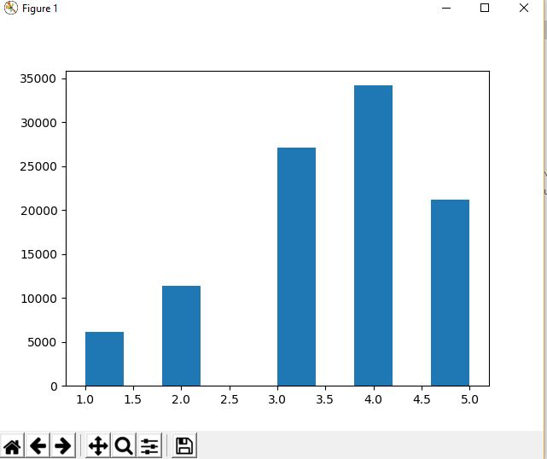

Slide 14
