Slide 1
Christmas Poem Generation
By Haley Matuszak and Eagle Yuan

Slide 2
Main Goal/Task
Create Christmas Poems that can take in rhyme schemes and a starter word

Slide 3
The Data
Created by Hand
Includes Christmas poems and songs
Variety of authors and styles
Around 24,000 lines
Vocab around 12,000 words

Slide 4
Cleaning and Preparing the Data
Lowercase the text
Remove punctuation
Spelling corrections by hand
“Merrie” vs “Merry”
Standardize

Slide 5
Cleaning and Preparing the Data….Part 2
Keras Tokenizer Encoder
Separation of ngram for gold labels
General batching

Slide 6
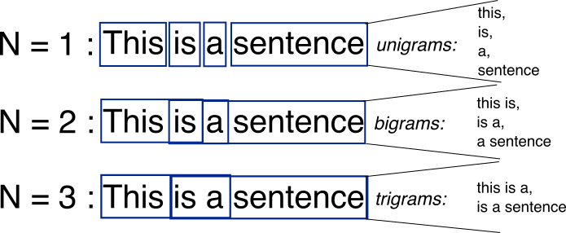

Slide 7
The Model
Word Generation
Instead of character generation, we focus on word generation. This is integrated earlier through the tokenizer.
Layers
Embedding
GRU
Dense
Hyperparameters were determined based off vocabulary size.
Training
-Sparse Categorical Cross Entropy
-Adam Optimizer
-100 Epochs
-Loss of 0.4 and its significance

Slide 8
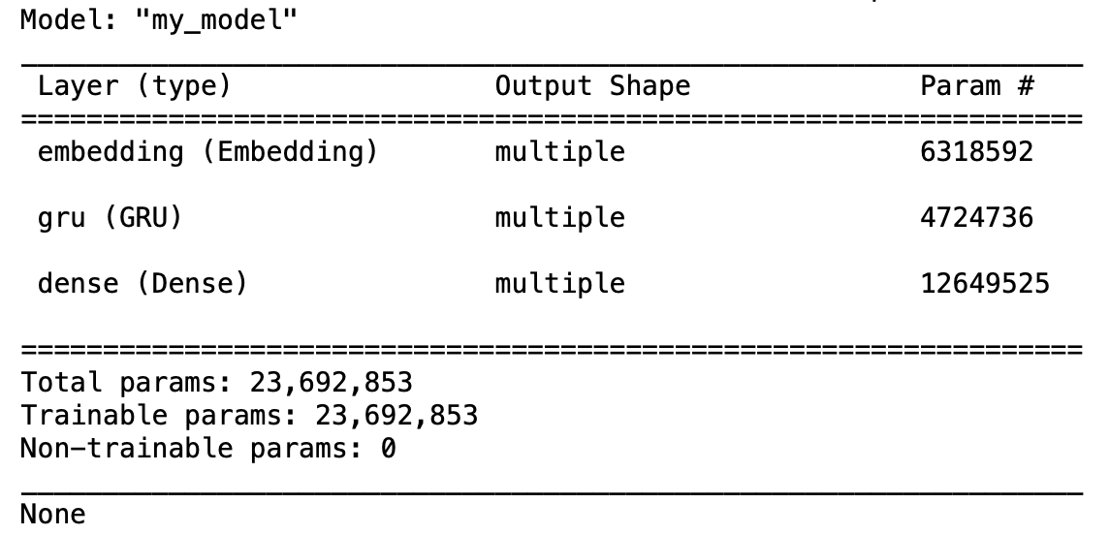

Slide 9
Generating the Rhyming Scheme
Determine which words need to rhyme
Get a list of all the words that can rhyme using CMU library
Determine the best rhyme using gensim pretrained model (glove-wiki-gigaword-300)
Replace the word with the best context rhyming word

Slide 10
Evaluation and Results
32 participants
3 sets of pairs
Asked which is a “better poem”
Asked to ignore metaphorical or literary elements
Same rhyme schemes for each pair

Slide 11
Possible Output
“Christmas take blue
And the presents are staved with lights upon the carolers singing
The sun of through
Which is no bringing
The stars were kind
Upon the frosty night
Which doesn’t been staved with gold the behind
Now come and water like might”
*ABAB CDCD

Slide 12
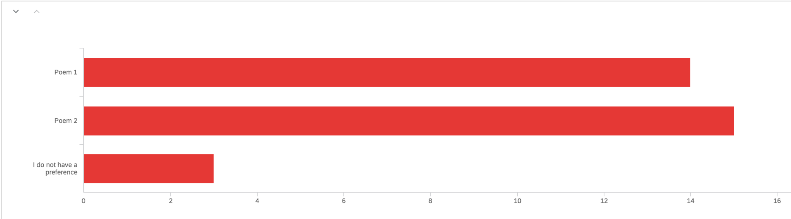
Comparison 1
Ours was Poem 1

Slide 13
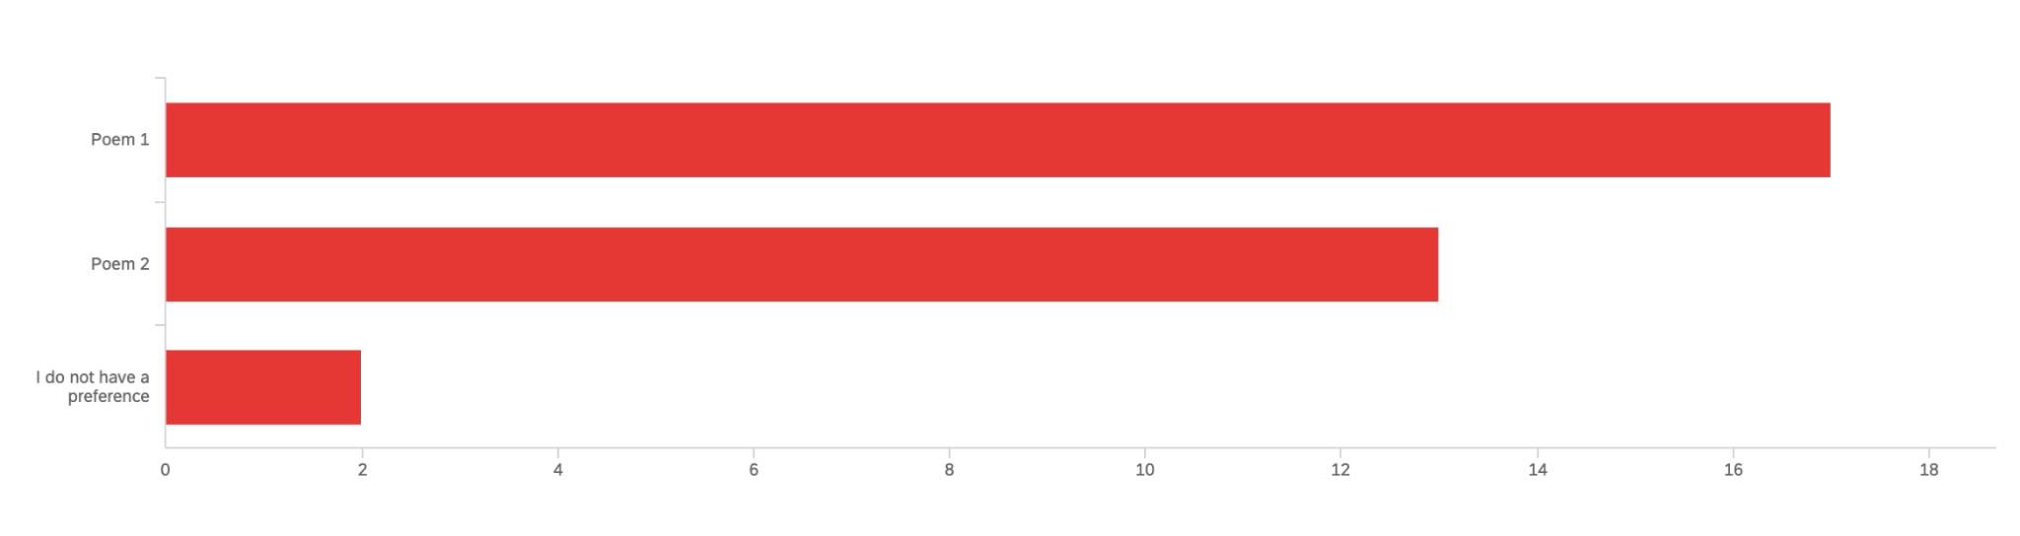
Comparison 2
Ours was Poem 2

Slide 14
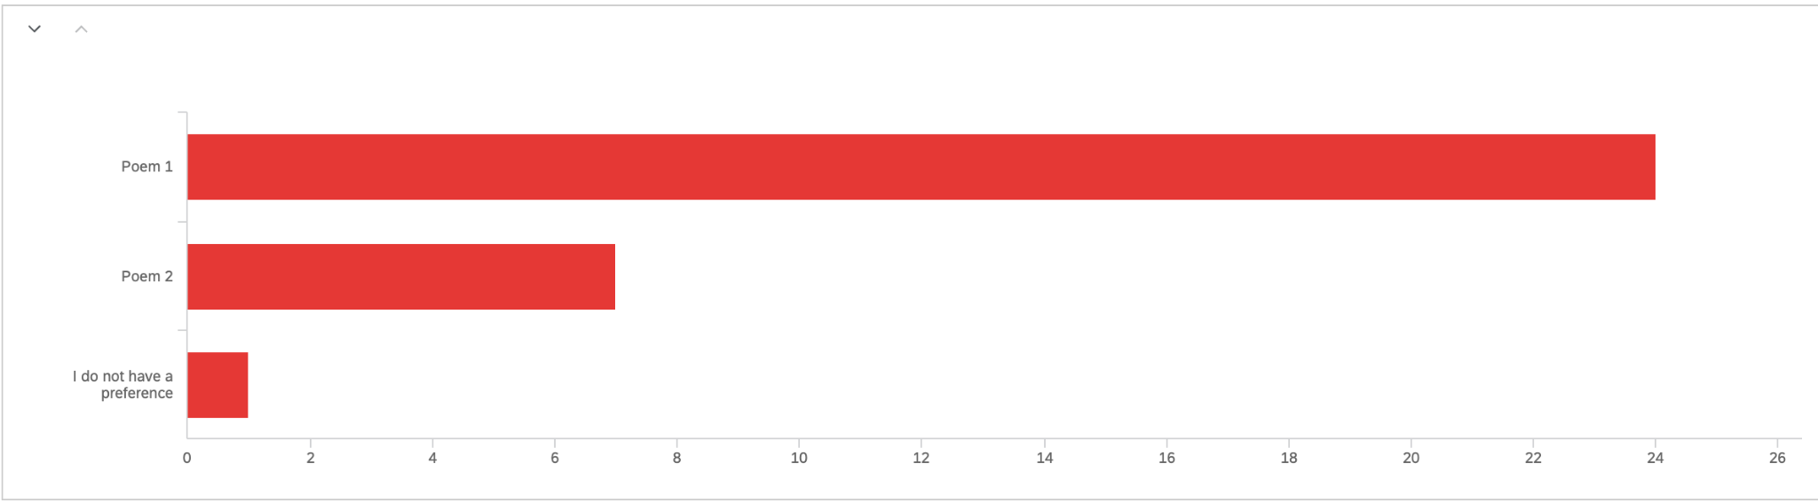
Comparison 3
Ours was Poem 2
“Death”

Slide 15
Some Possible Factors
“Uses better prose”, “longer lines”
“Good imagery”
“Grammar is throwing me off”
“More nostalgic”, “I liked topic X more”

Slide 16
Limitations
-Poem generation is split across two different techniques instead of one
-Lack of unified tone, as well as metaphoric comprehension

Slide 17
Thank You!
If you have any questions, you can contact us at matuszak.h@northeastern.edu and yuan.e@northeastern.edu

