Slide 1
Lecture 3
Fundamentals of Aerospace Engineering
From Airfoil to Wing: Aerodynamic Design Trade-offs
Naol S. Erega
‹#›

Slide 2
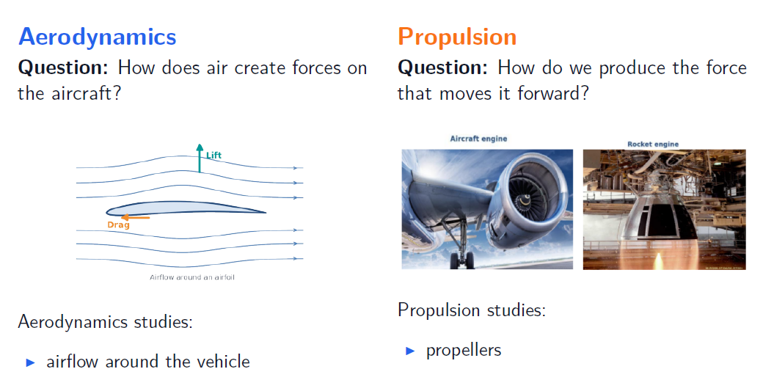
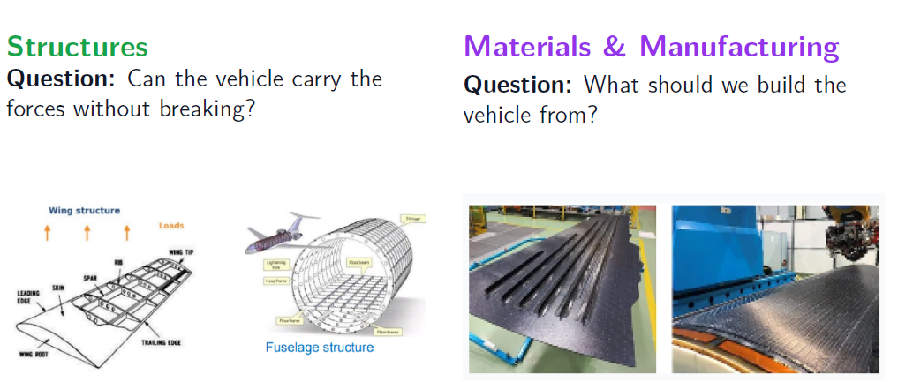
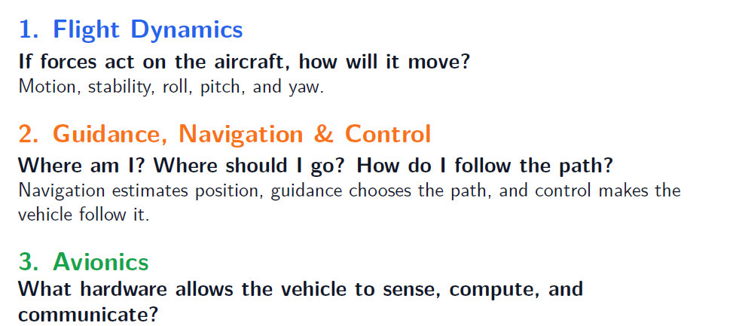
Recap: disciplines of aerospace engineering

Slide 3

Recap: disciplines of aerospace engineering

Slide 4
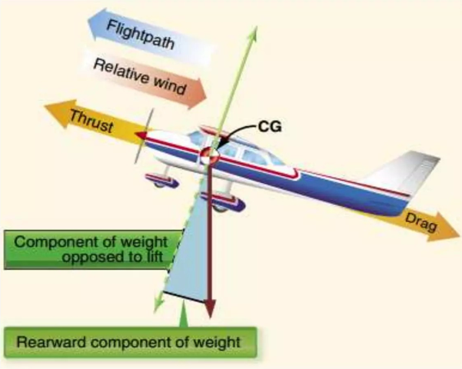
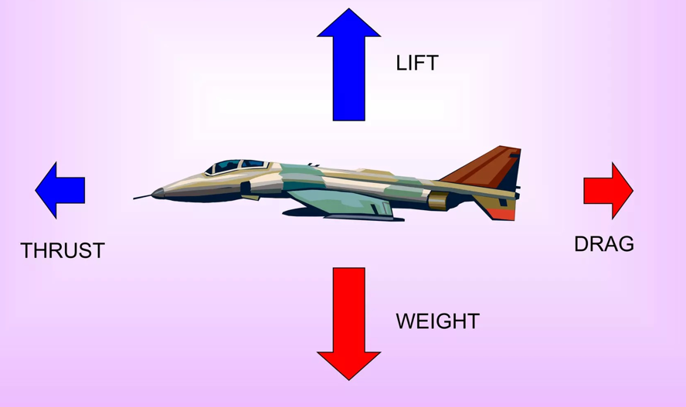
Recap: the four forces of flight
Lift: upward force generated by air pressure difference on surfaces.
Weight: pulling force due to gravity
Drag: air resistance that opposes thrust
Thrust: pushing force generated by engine
Lift and Drag are generated by air interacting with airplane surfaces
(! especially wing )
Forces during straight flight
Forces during climb
‹#›

Slide 5
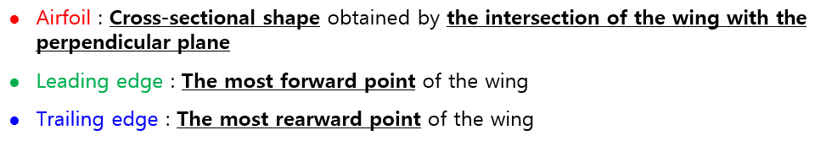
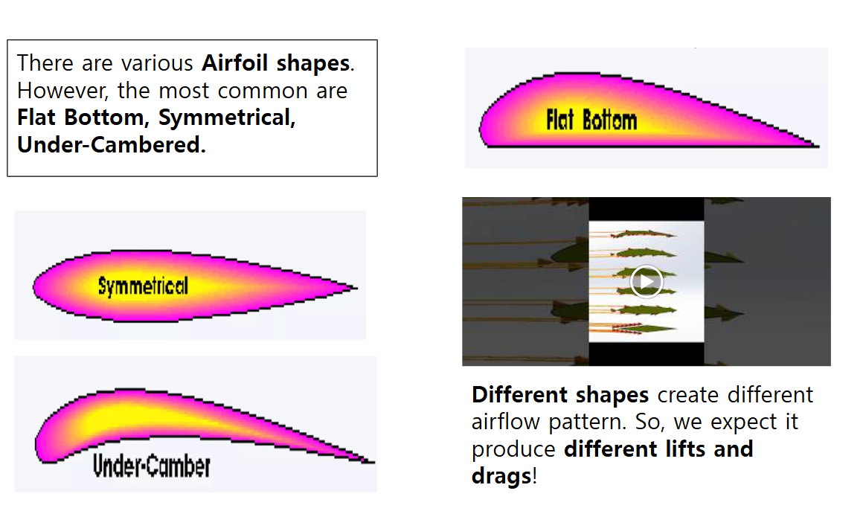
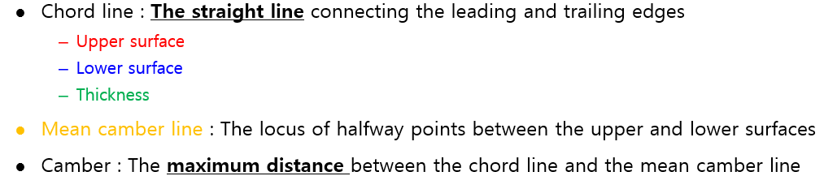
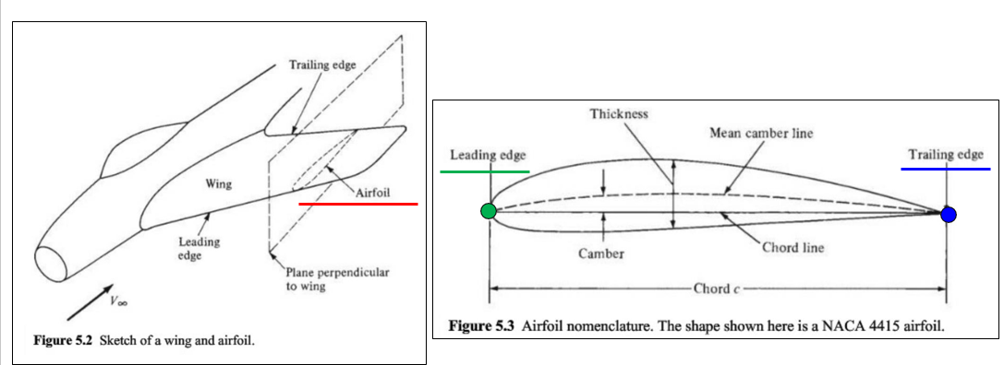
Recap: fundamentals of airfoil
Common airfoil shapes

Slide 6
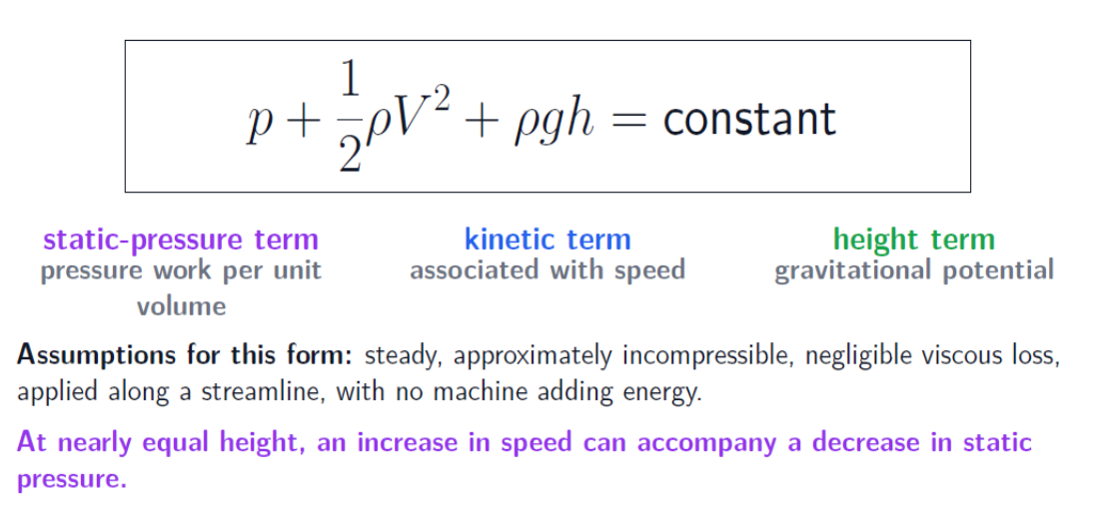
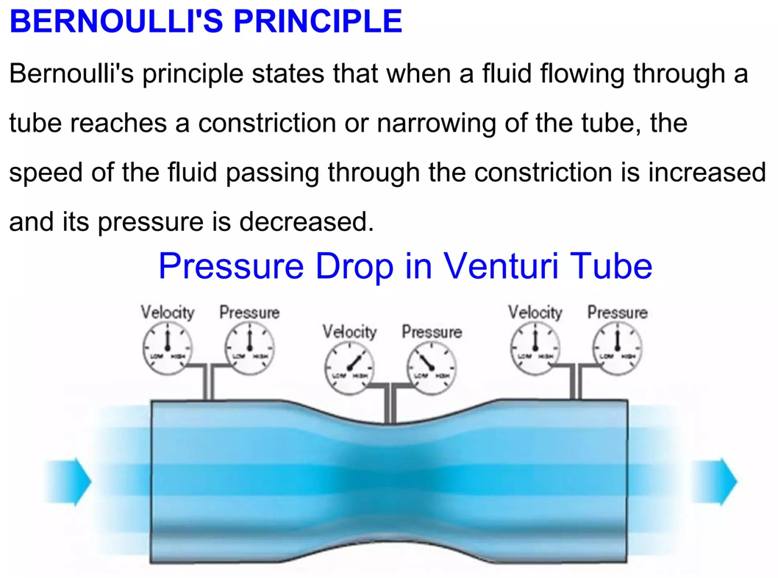
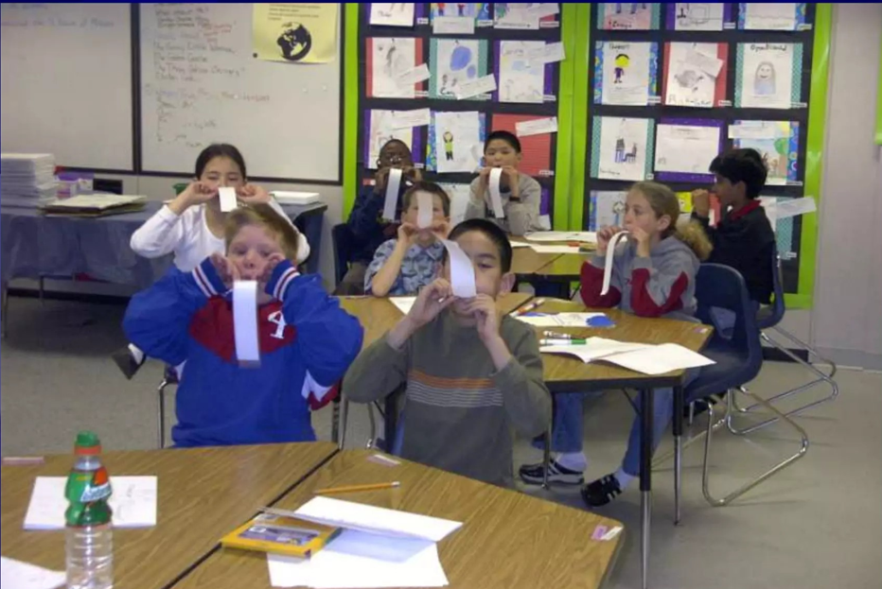
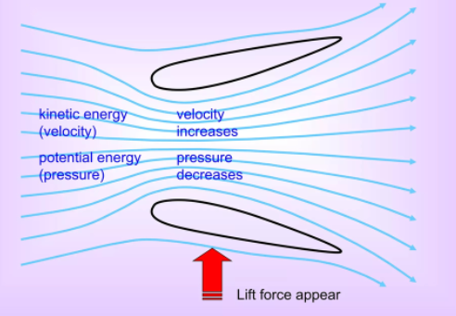
Recap: Bernoulli explained how lift is created!
Airfoil is half venturi Tube!
Blow and see it yourself!

Slide 7
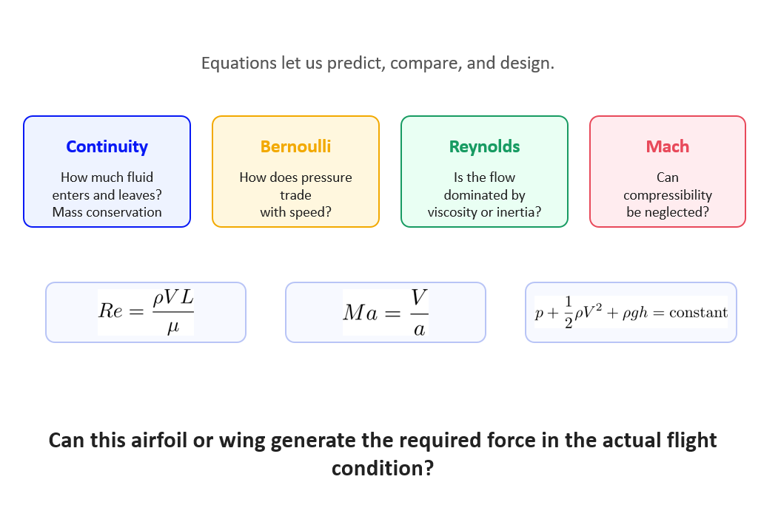
Recap: why we study flow characterizing equations?
Check this link – Much of the Aerodynamics is flow characterization
https://www.scribd.com/document/610739358/Aerodynamics-Formulas

Slide 8
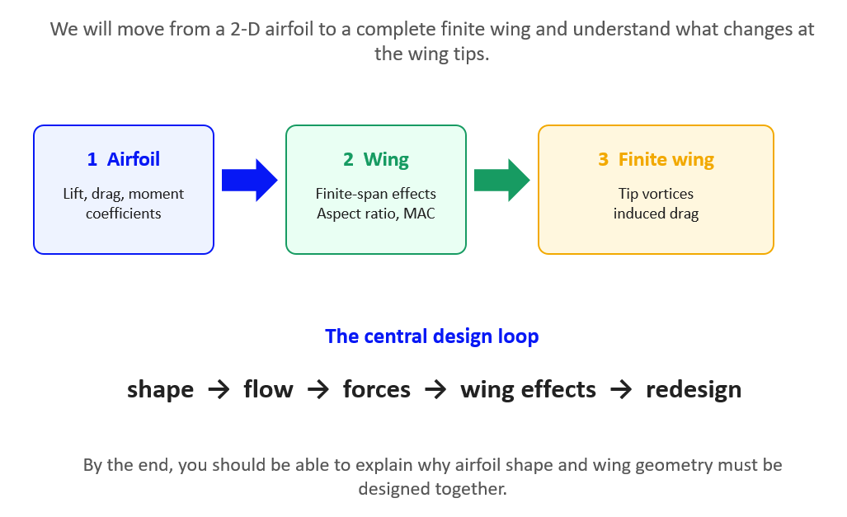
Today’s focus: From airfoil to wing

Slide 9
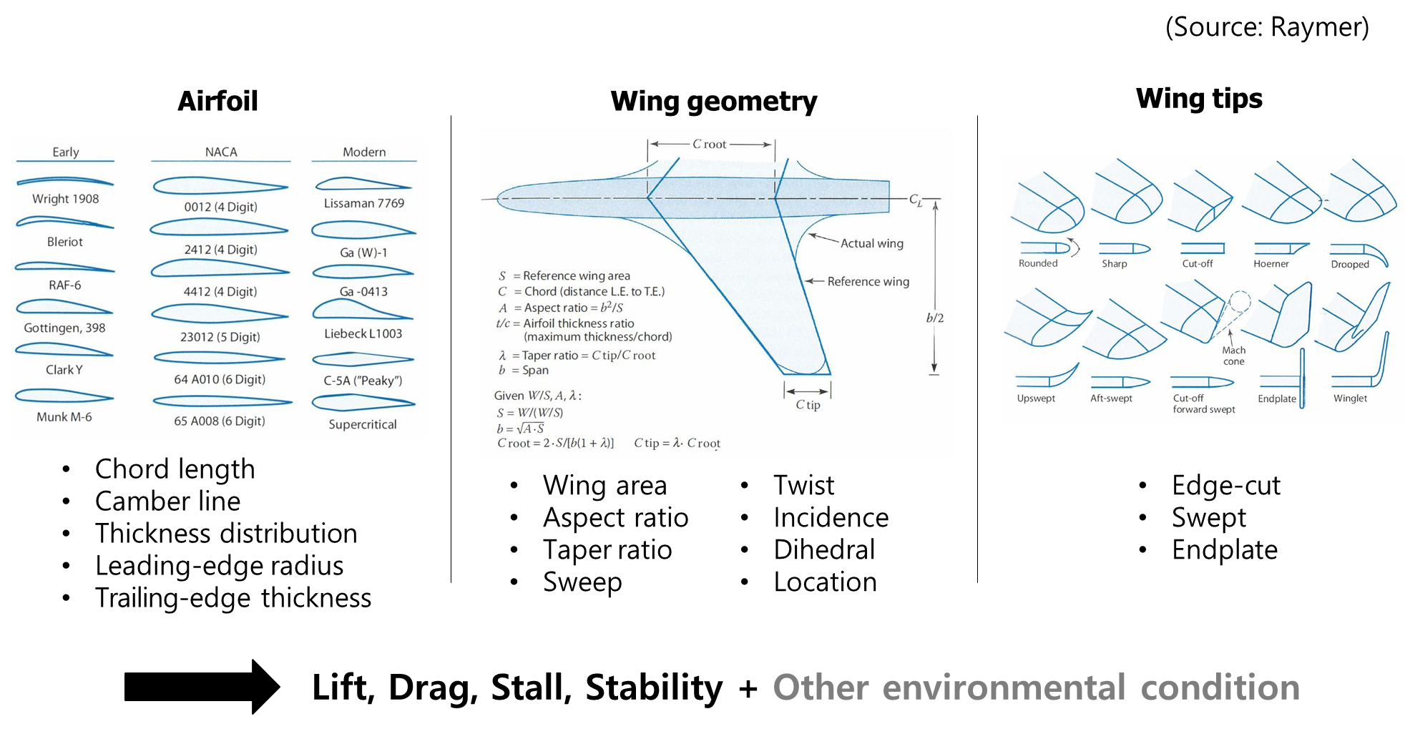
How to design your wing for your aircraft?

Slide 10
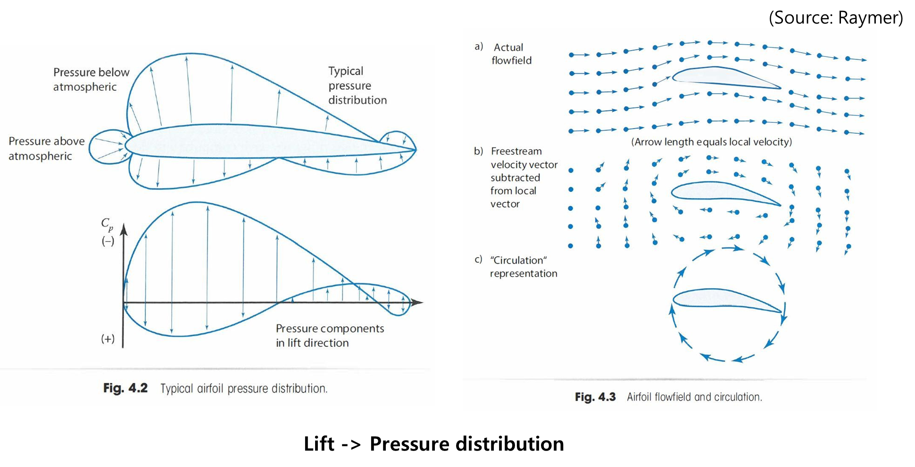
Airfoil Design – Lift and Drag

Slide 11
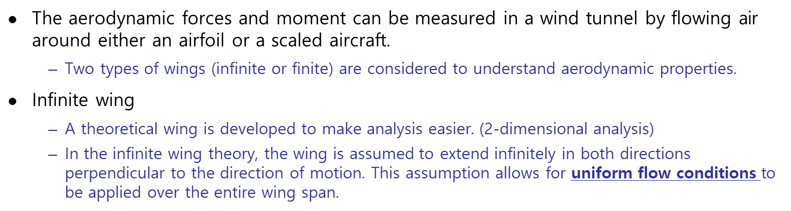
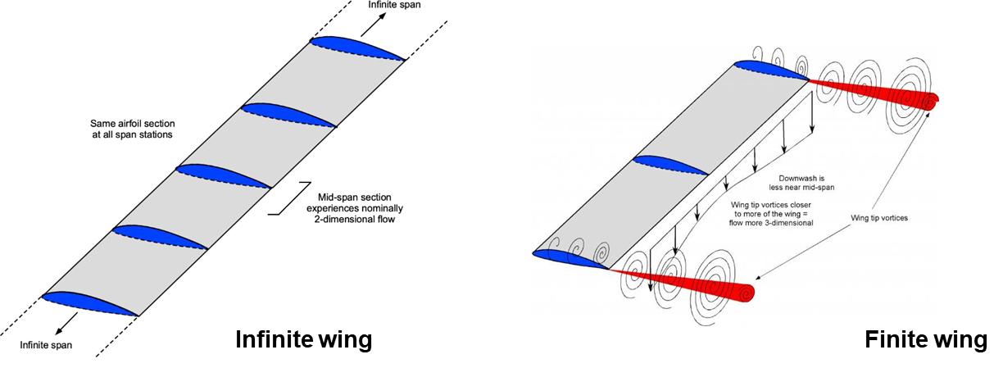
Airfoil Design – lift, drag, and moment coefficients

Slide 12
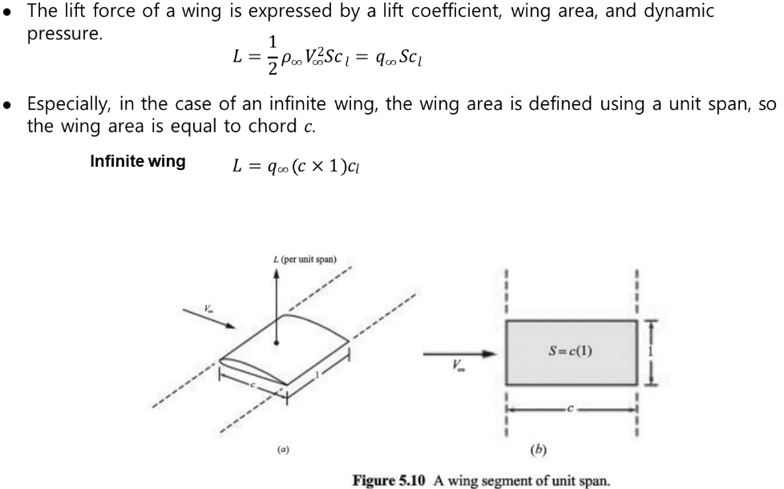
Airfoil Design – lift, drag, and moment coefficients

Slide 13
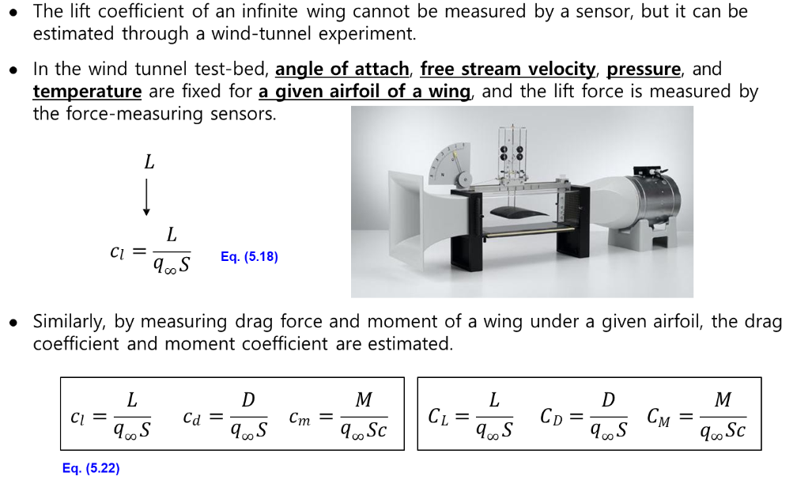
Airfoil Design – lift, drag, and moment coefficients

Slide 14
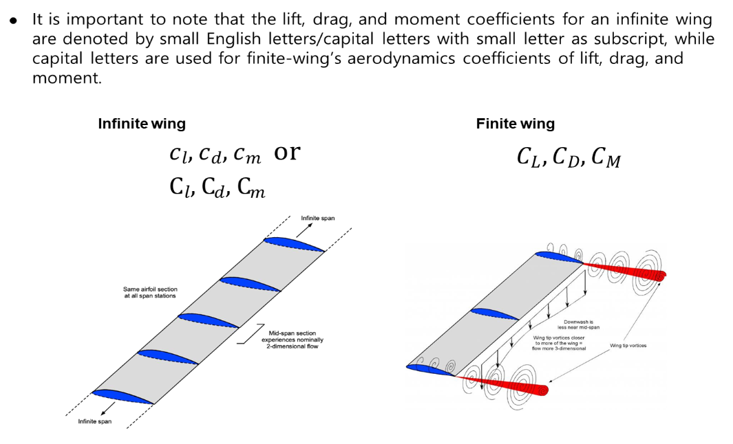
Airfoil Design – lift, drag, and moment coefficients

Slide 15
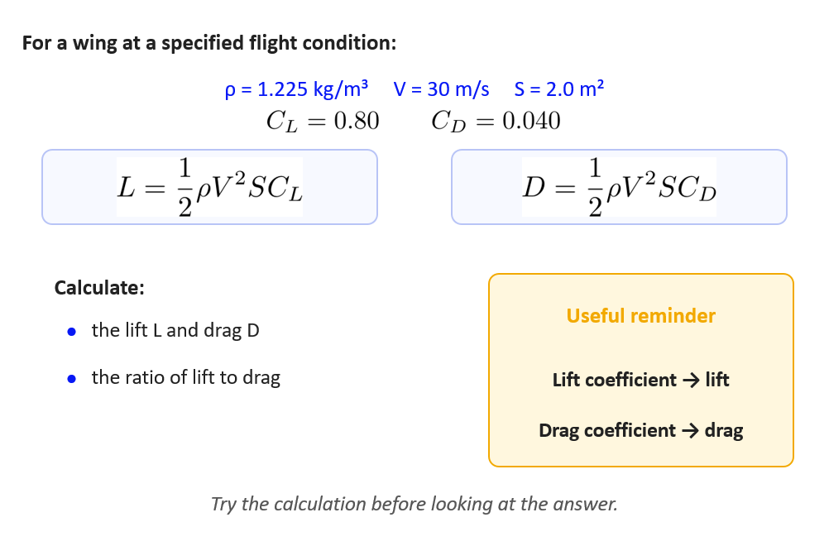
Worked example: calculate the aerodynamic forces

Slide 16
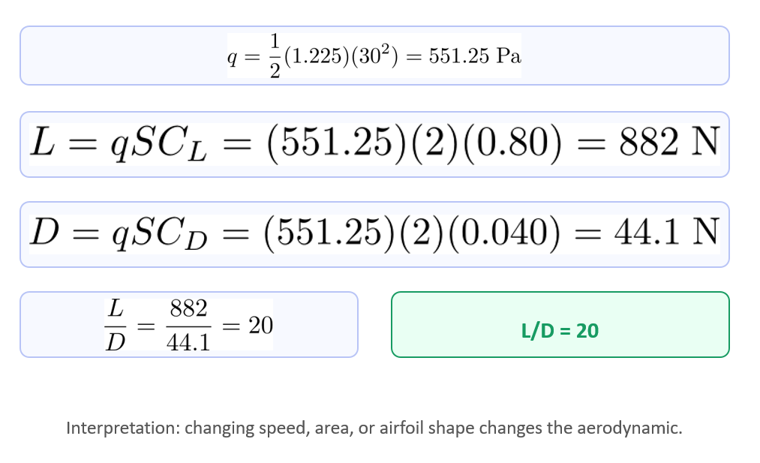
Worked example: the answer

Slide 17
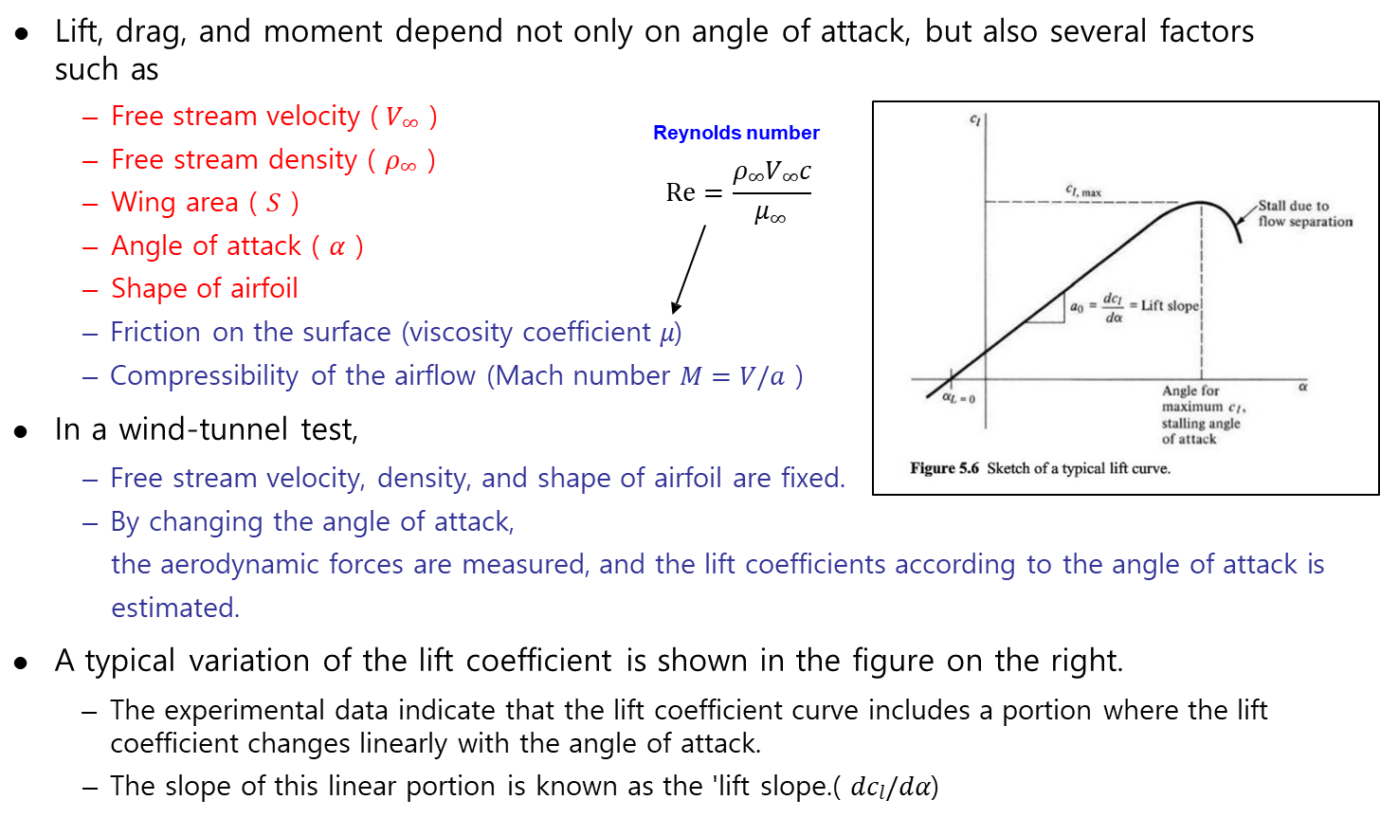
Lift and drags are affected by various physical quantities

Slide 18
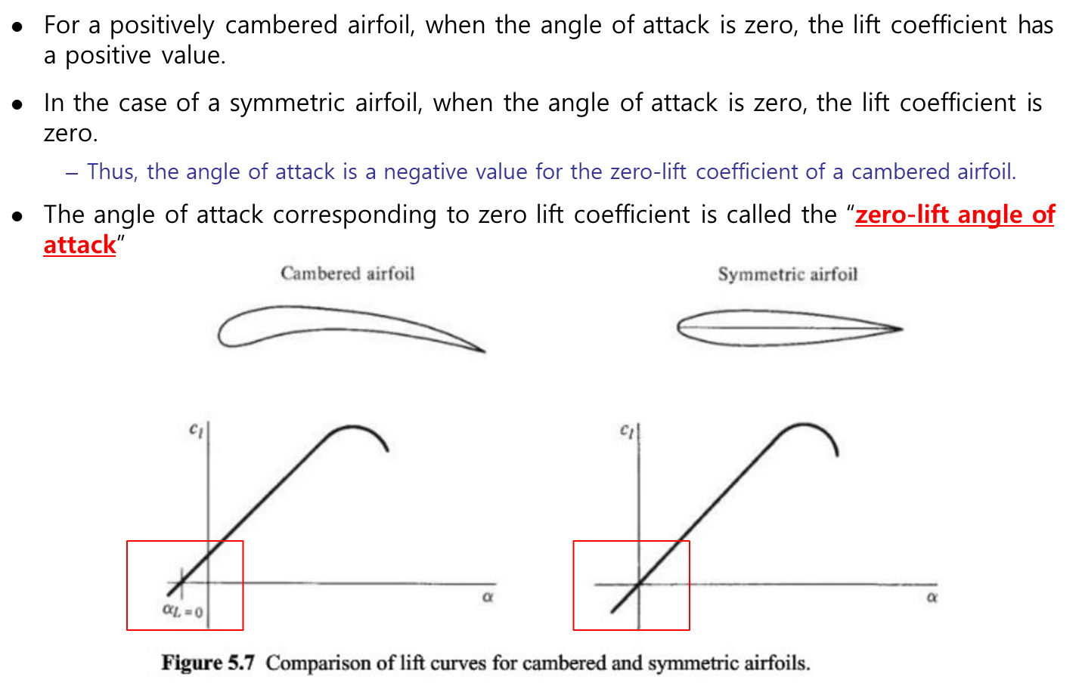
Airfoil Design - remember airfoil shape really matters!

Slide 19
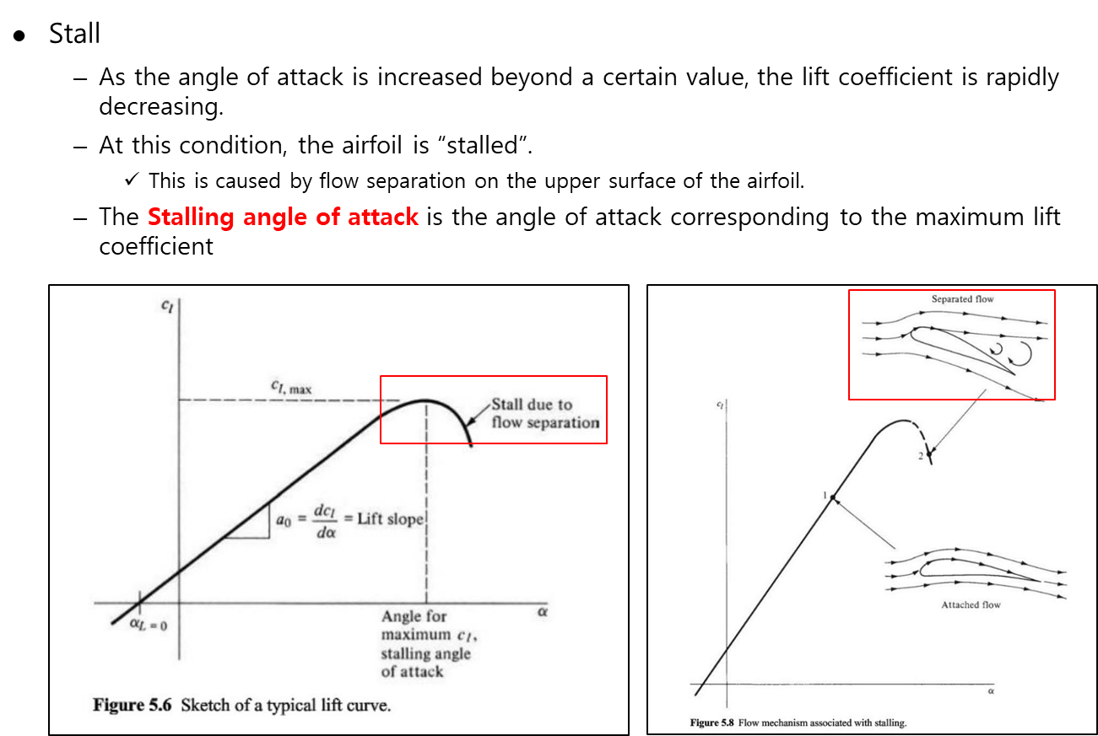
Angle of attack: more is not always better

Slide 20
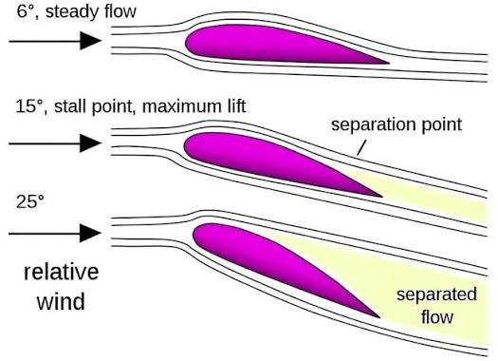
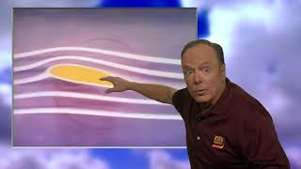
Stall: flow separation reduces lift
https://youtu.be/D1J1oUP-aKA?si=xNmQqexTPLQle5Ml
Reasoning: Flow separation creates adverse pressure gradient toward the rear end. This increasing pressure pushes back against the flow and makes the speed of flow in the upper surface increase.

Slide 21
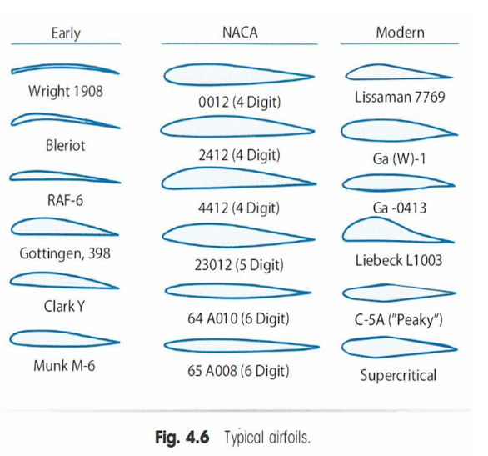
Airfoil Design – catalog
NACA stands for the National Advisory Committee for Aeronautics. It was the organization that developed many standardized airfoil families before NASA was created.
Today, we only decode the four-digit NACA notation !

Slide 22
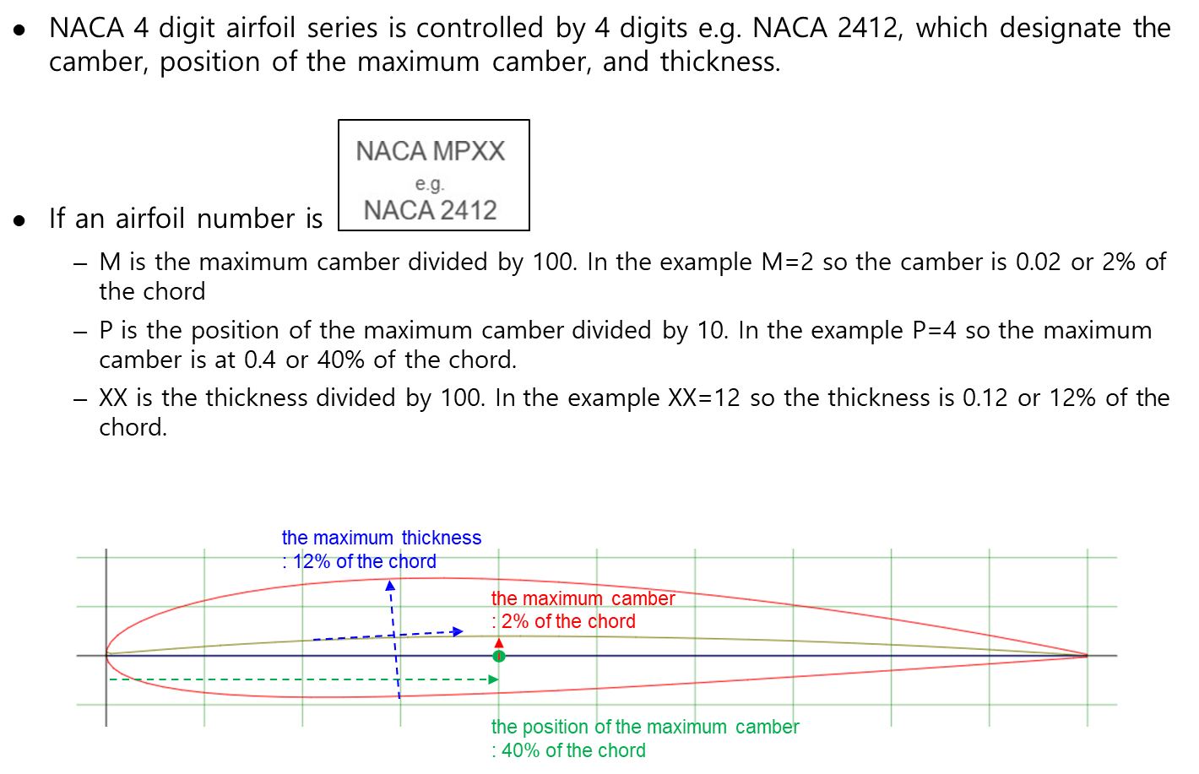
Airfoil Design – NACA 4 Digit Airfoil

Slide 23
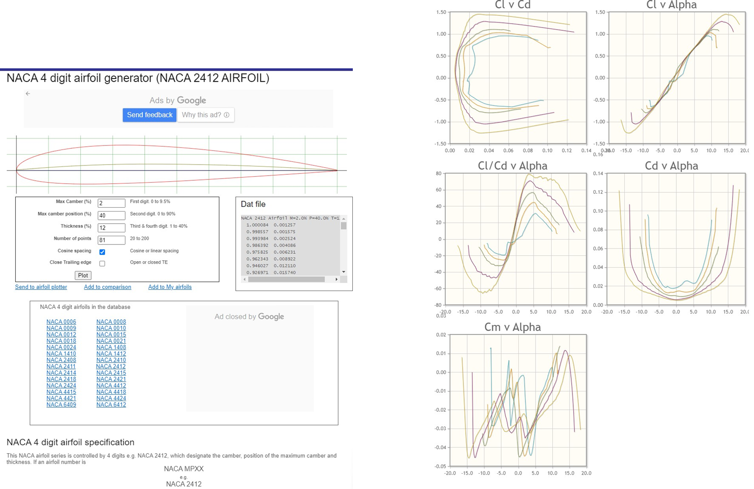
Airfoil Design – Catalog
http://airfoiltools.com/airfoil/details?airfoil=naca2412-il

Slide 24
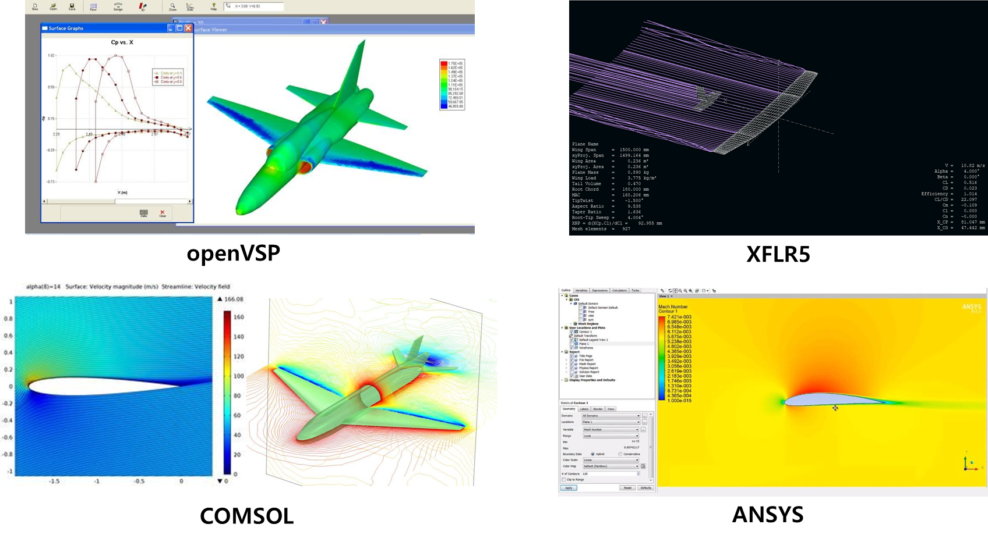
Airfoil Design – Computational design method

Slide 25
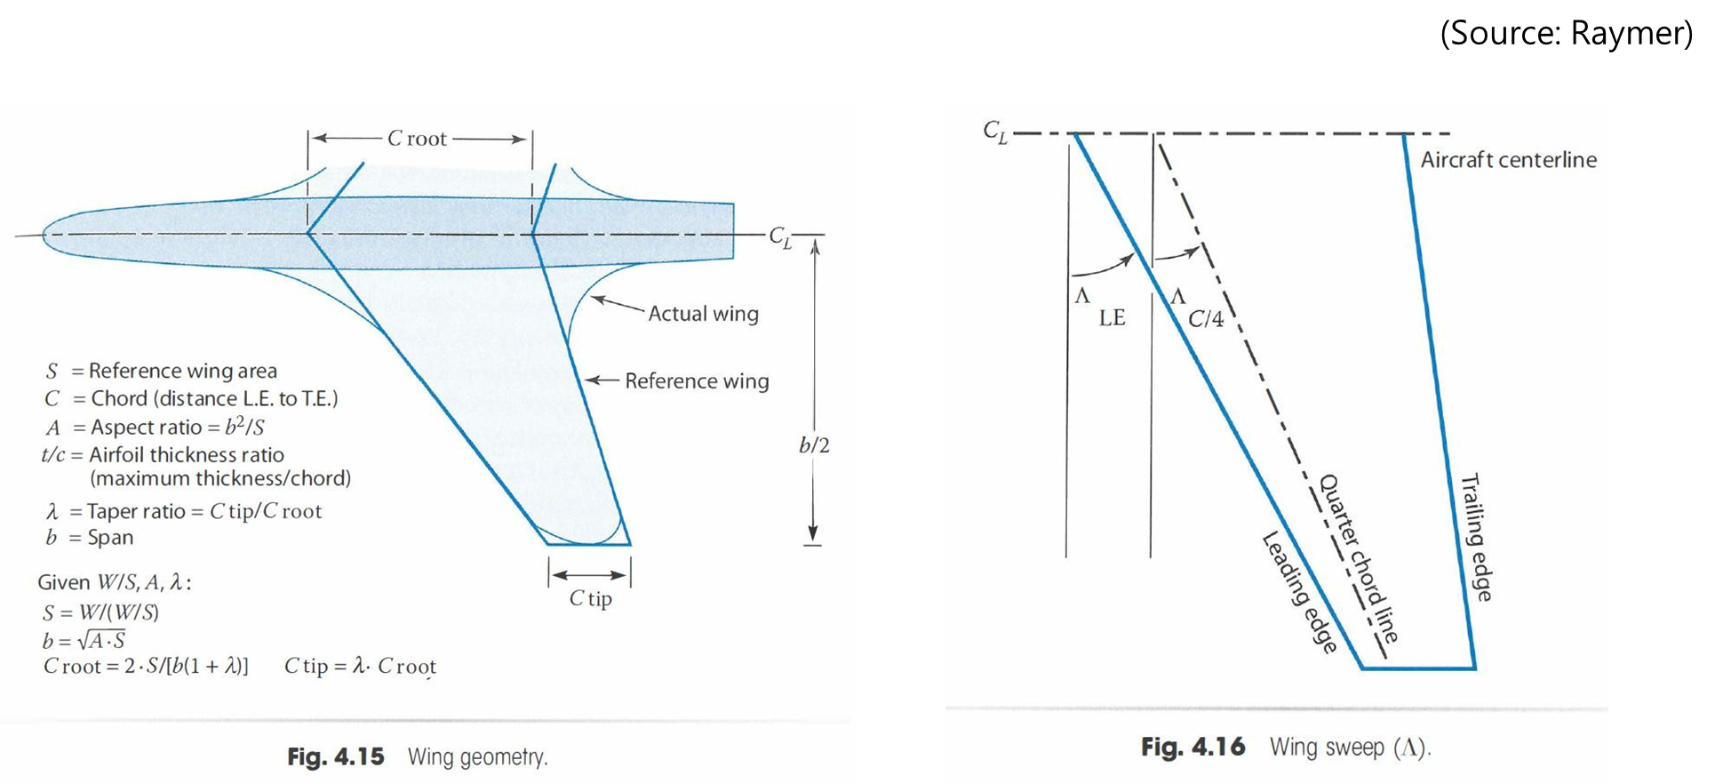
Wing geometry: the essential vocabulary

Slide 26
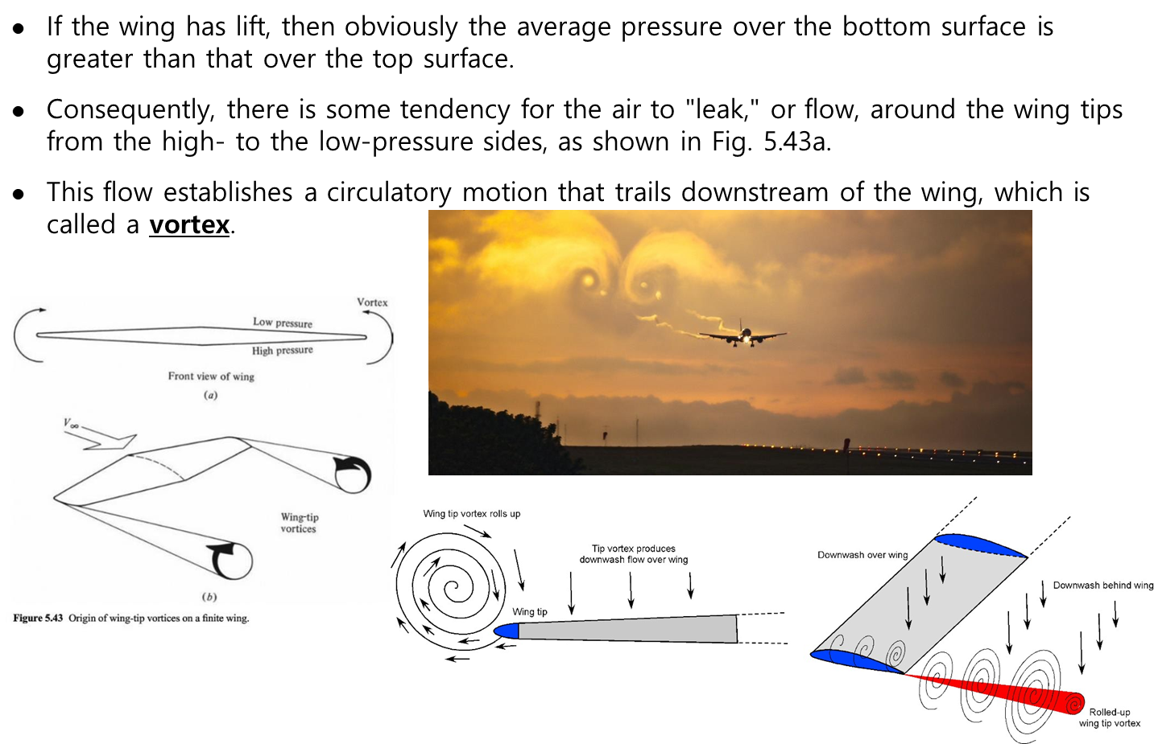
Finite wings create wingtip vortices

Slide 27
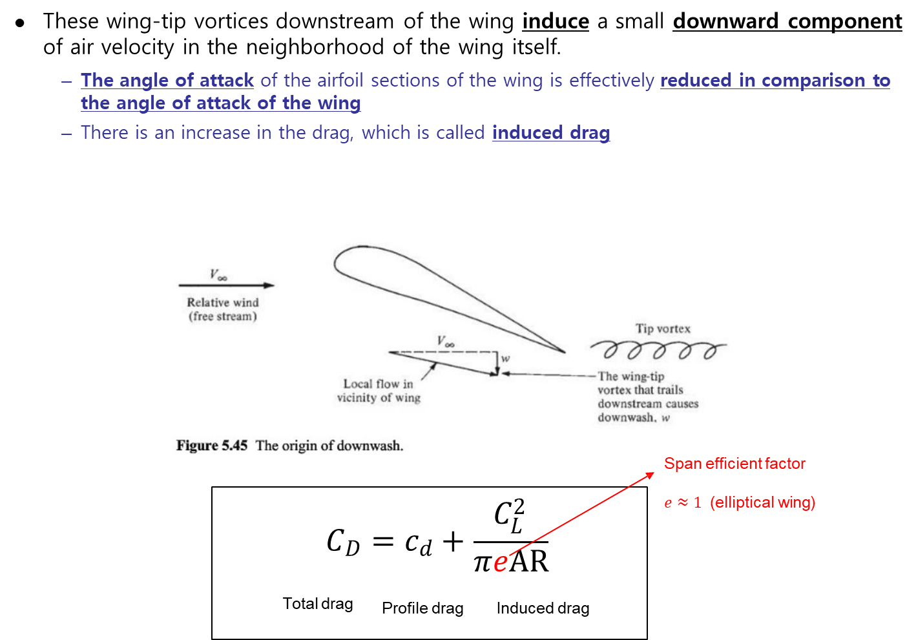
Downwash creates induced drag

Slide 28

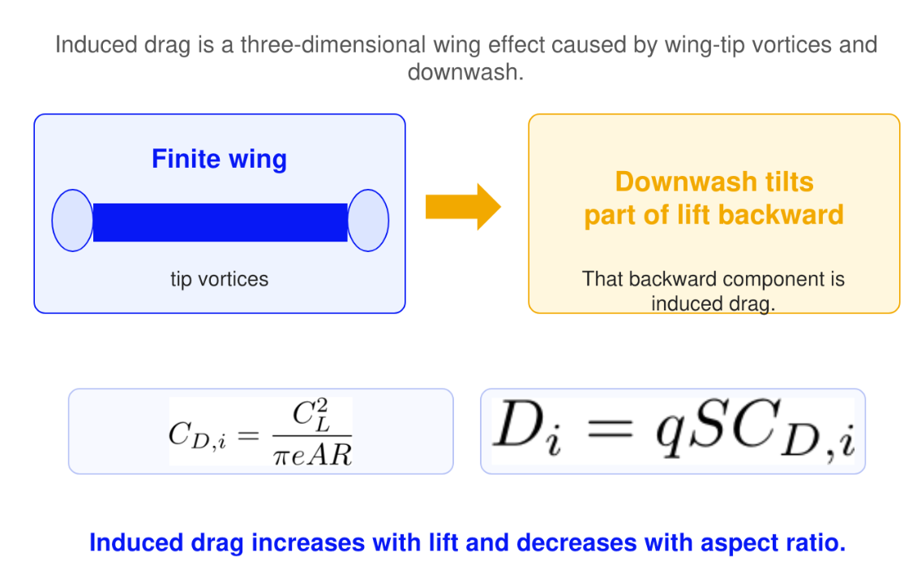
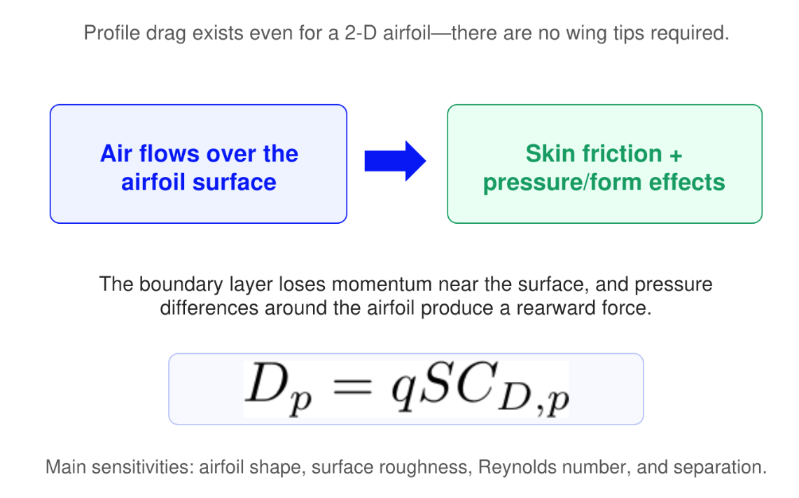
Remember two types of drags

Slide 29
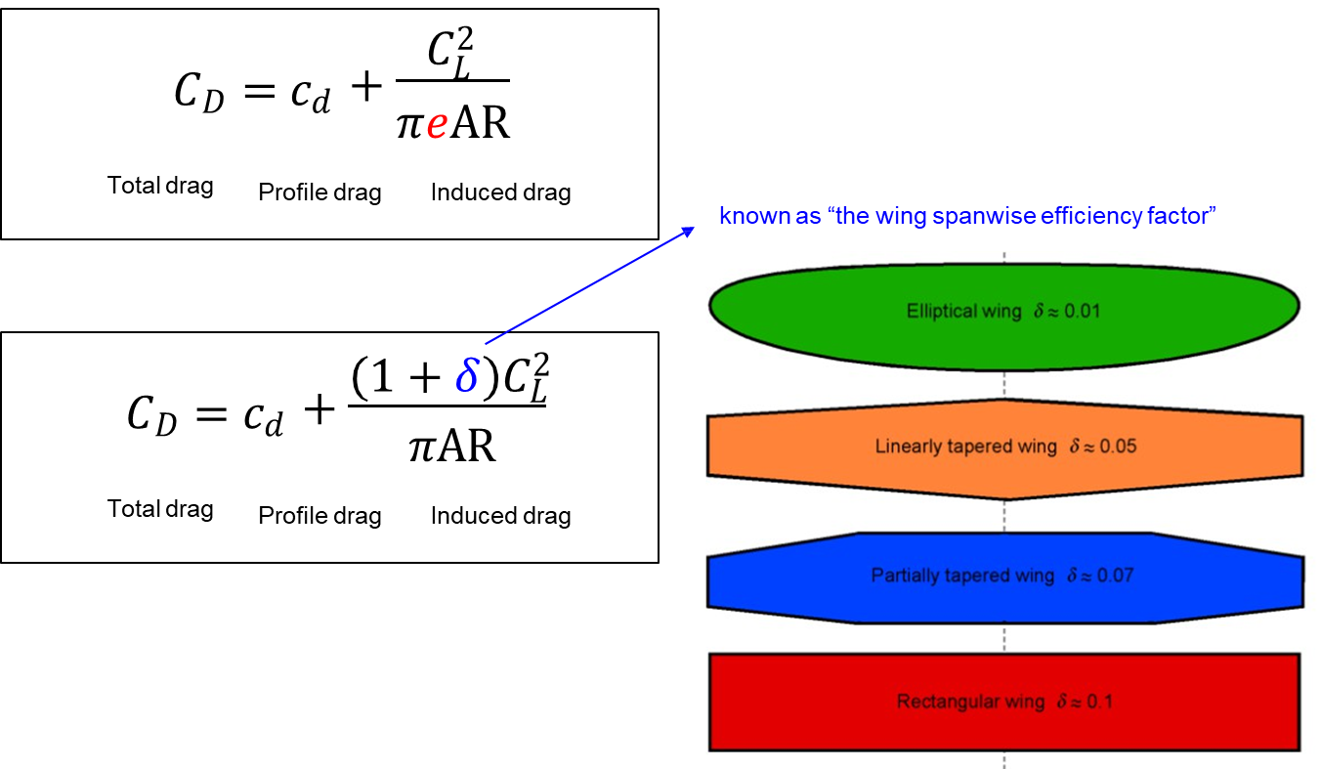
Total drag has two main components

Slide 30
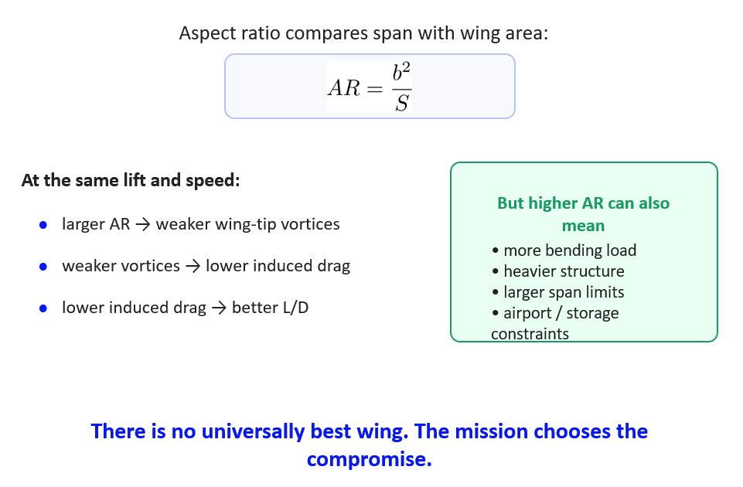
Aspect ratio is a design trade-off

Slide 31
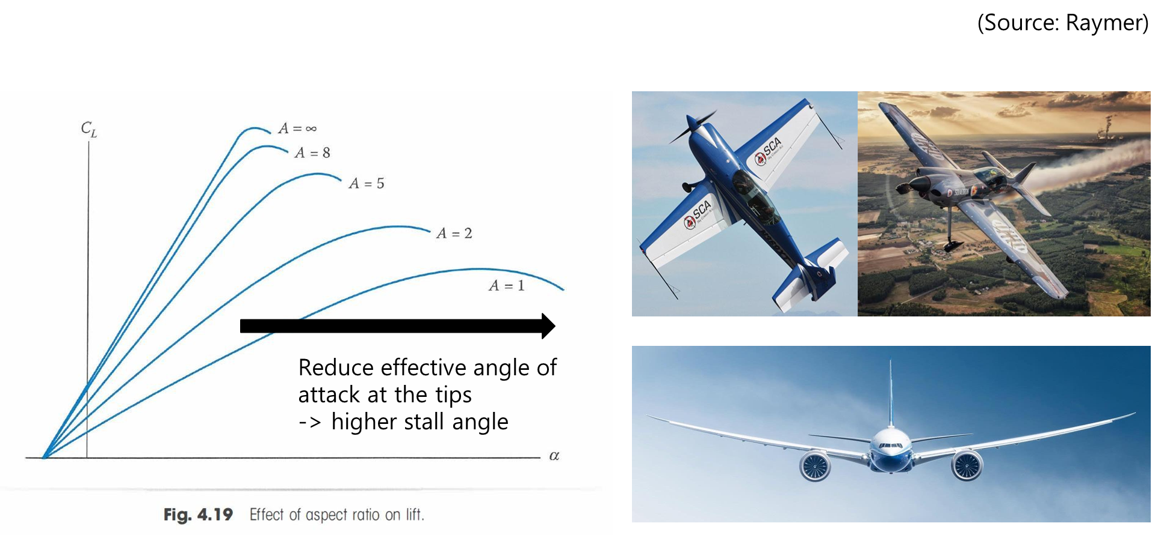
Aspect ratio changes the lift curve and stall behaviour

Slide 32
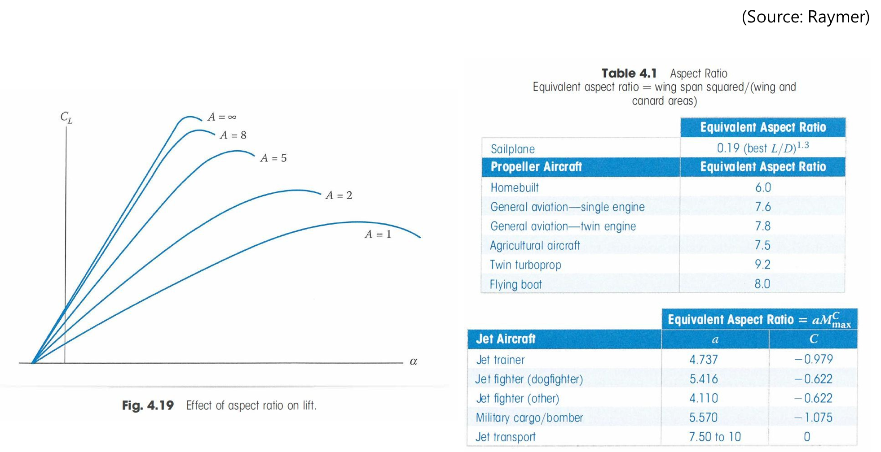
Typical aspect ratios reflect different missions

Slide 33
Key takeaways
Airfoil shape affects lift, drag, and stall.
Angle of attack increases lift only up to stall.
A finite wing creates wingtip vortices and downwash.
Profile drag comes from the airfoil and boundary layer.
Induced drag comes from producing lift on a finite wing.

