Slide 1
Lecture 4
Fundamentals of Aerospace Engineering
From Airfoil to Wings, Stability.
Naol S. Erega
‹#›

Slide 2
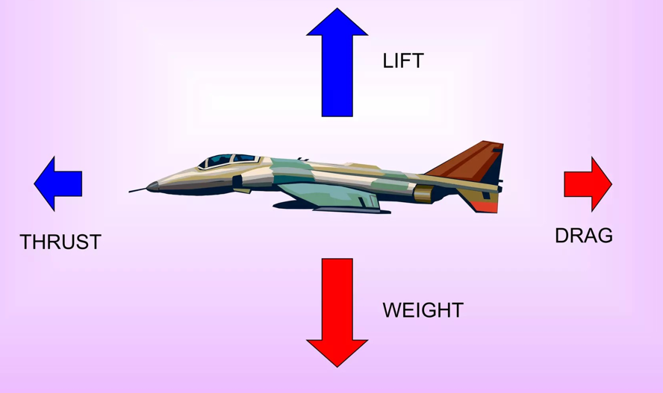
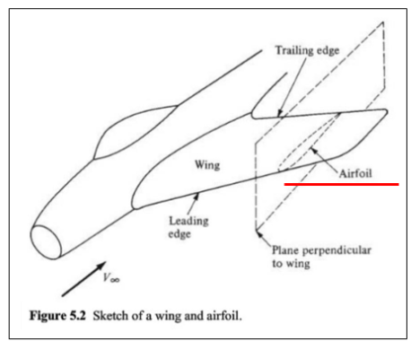
Recap: From aircraft forces to airfoils
An aircraft in flight is acted upon by four fundamental forces.
Lift and drag are aerodynamic forces generated by the flow of air around the aircraft. They result mainly from pressure differences and skin friction.
The wing is the primary lifting surface of an aircraft.
The lift and drag produced by a wing depend strongly on its cross-sectional shape, known as an airfoil.
This is why we study airfoils !

Slide 3
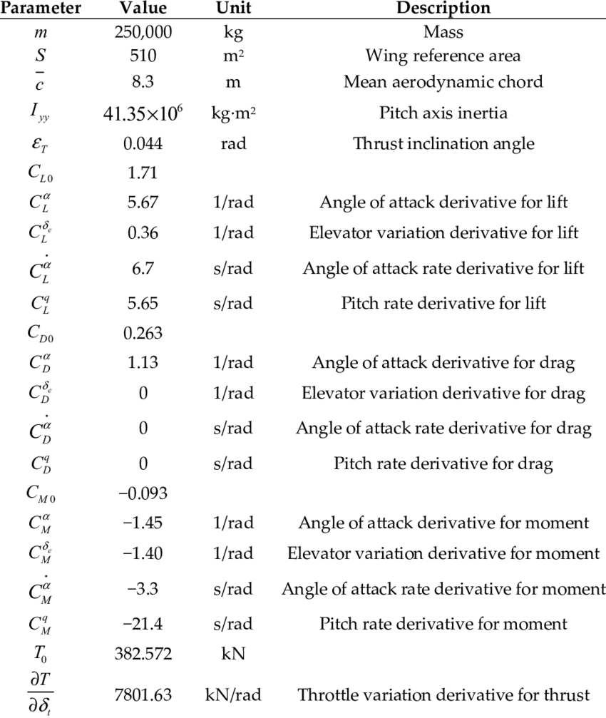
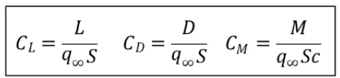
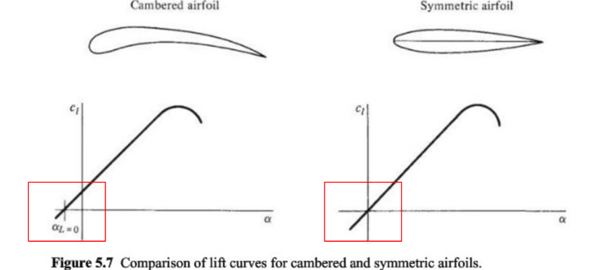
Recap: We have only begun to explore aerodynamic coefficients
We have only barely scratched the surface of aerodynamic coefficients
ex.) CL depends on airfoil shape, flow Reynold’s number, Mach number, angle of attack, and etc.
Example: Boeing 747 aircraft parameters.

Slide 4
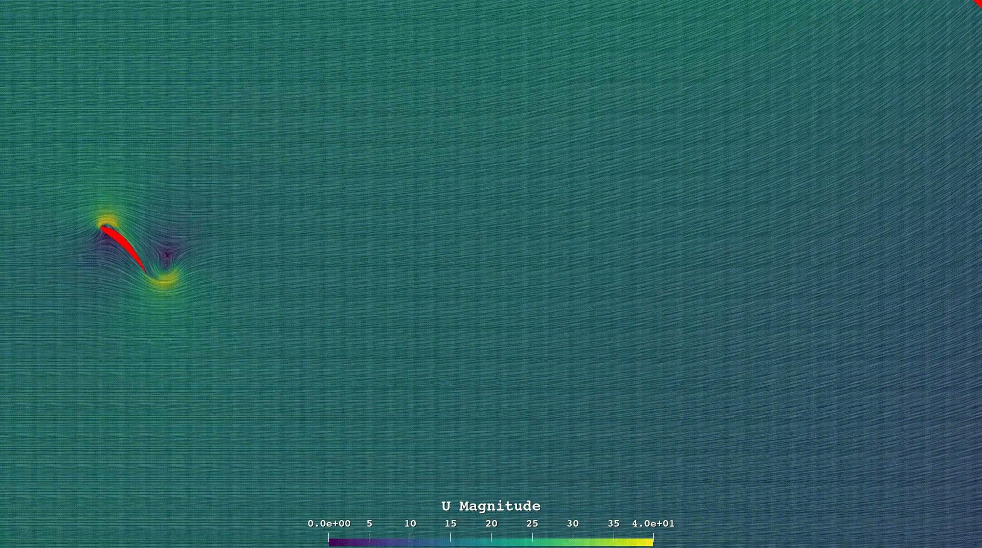
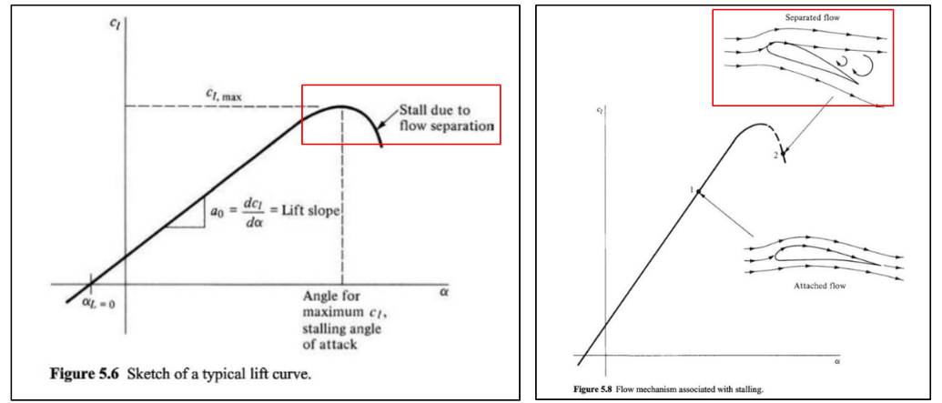
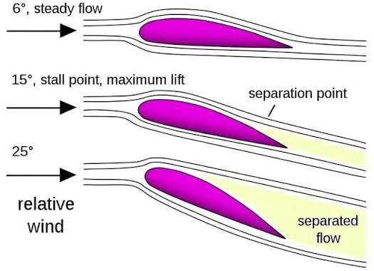
Recap: Aerodynamic stall
As the angle of attack is increased beyond a certain value, the lift coefficient is rapidly start decreasing. At this condition, the airfoil is “stalled”.
Stall occurs when the airflow separates significantly from the airfoil surface, especially over the upper surface.
Visualization of flow separation during stall

Slide 5
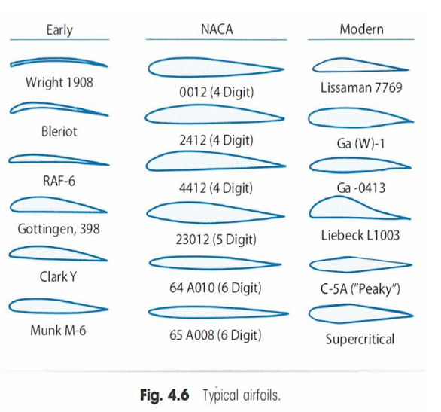
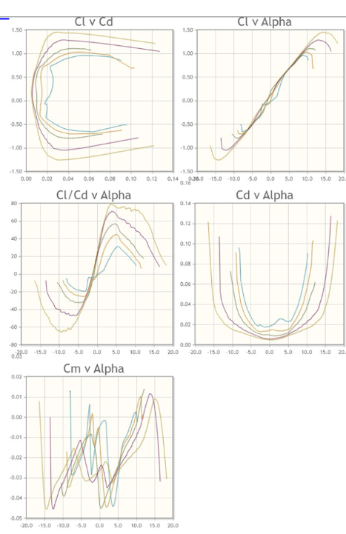
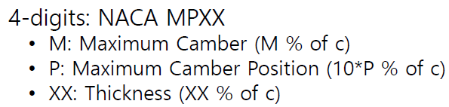
Recap: Airfoils catalog
Many airfoils have already been studied, tested, documented, and shared among engineers. Designers can use them as a starting point for developing new aircraft.
NACA stands for the National Advisory Committee for Aeronautics. It was the organization that developed many standardized airfoil families before NASA was created.
ex.) http://airfoiltools.com/airfoil/details?airfoil=naca2412-il
Remember each digit has meaning!

Slide 6
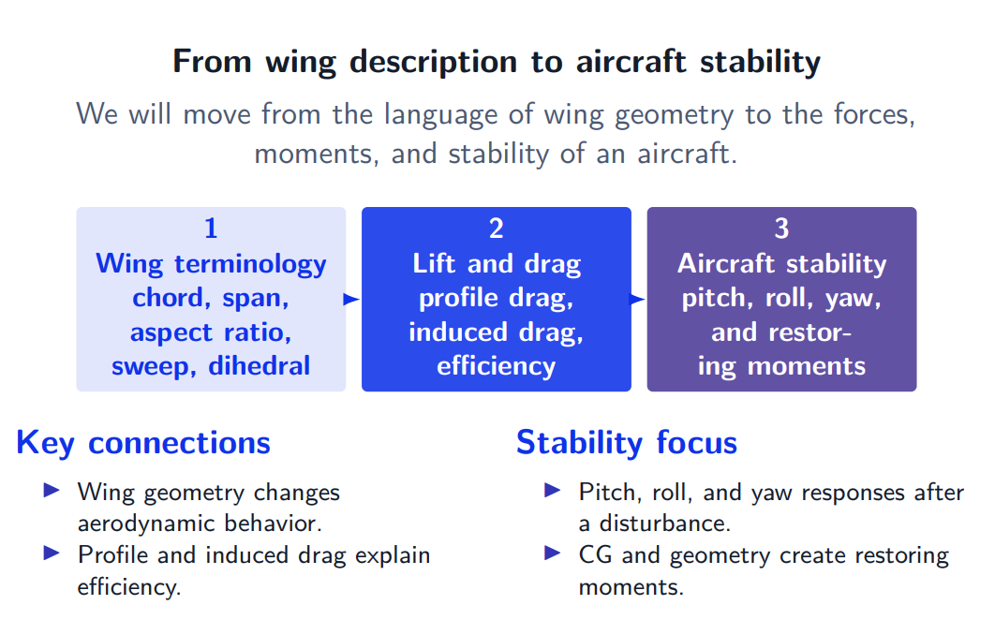
Today’s Content

Slide 7
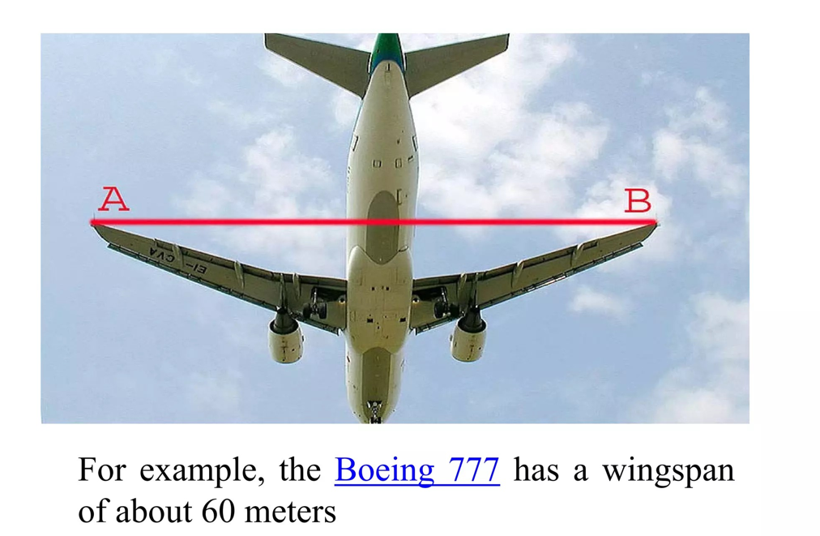
Wing related vocabularies
Wing Span b
The distance between the extreme wing tips

Slide 8
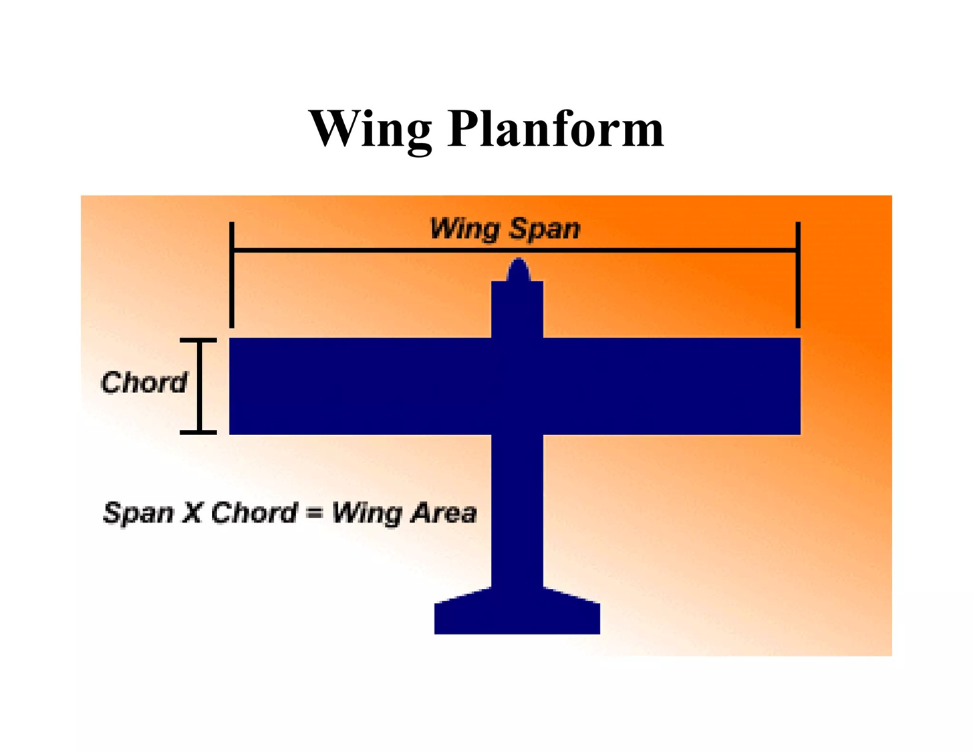
Wing related vocabularies
Wing Area A/S
The area of wing planform (i..e top view of the wing)

Slide 9
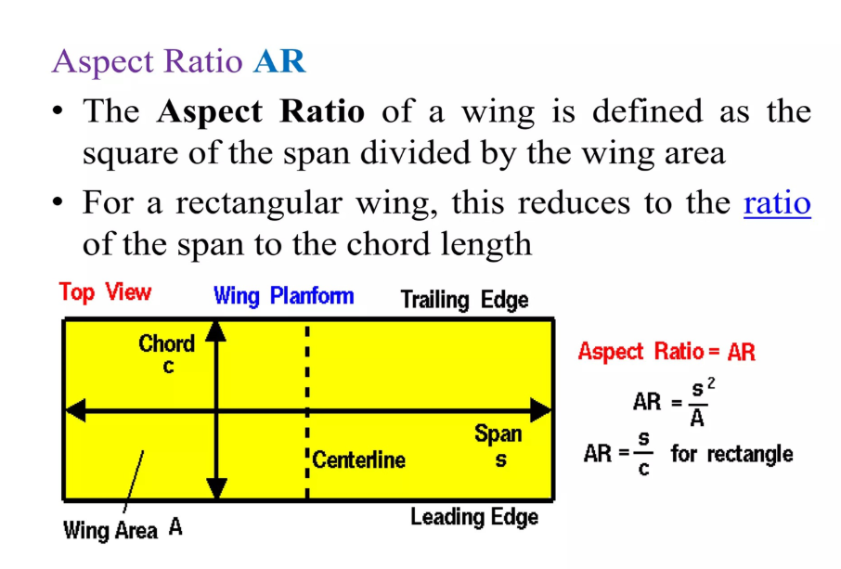
Wing related vocabularies

Slide 10
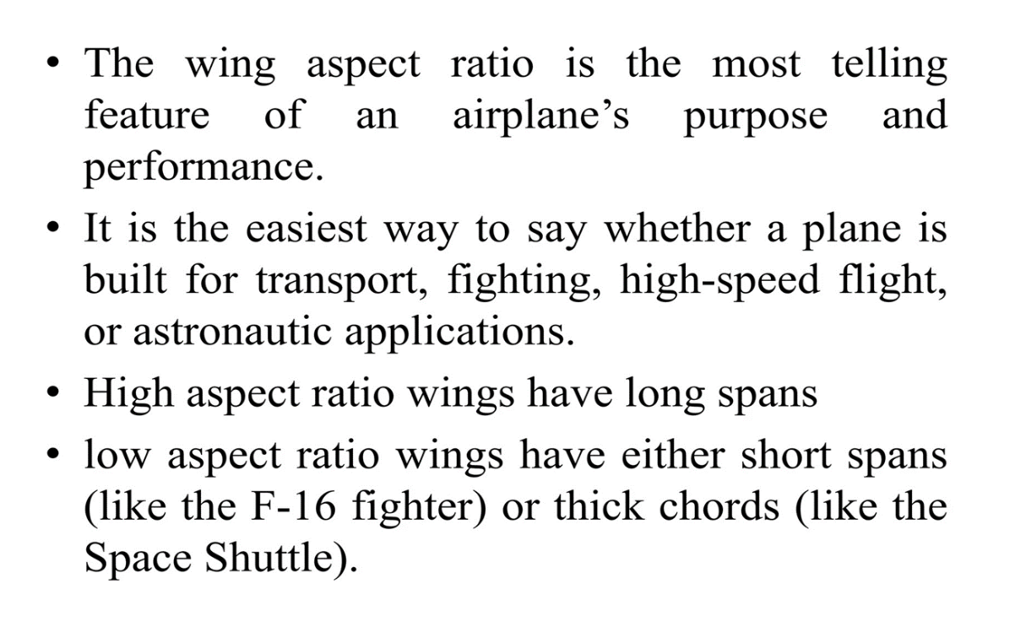
Wing related vocabularies

Slide 11
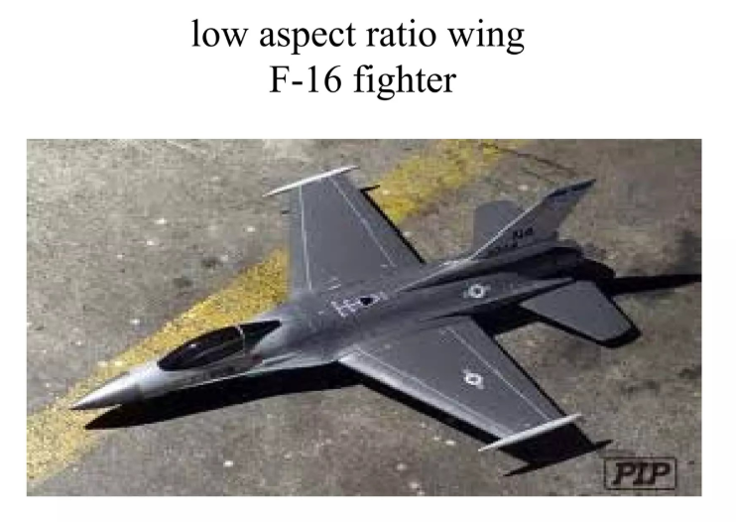
Wing related vocabularies

Slide 12
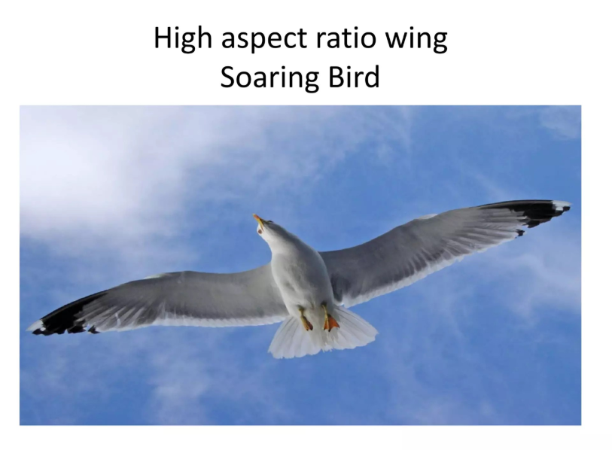
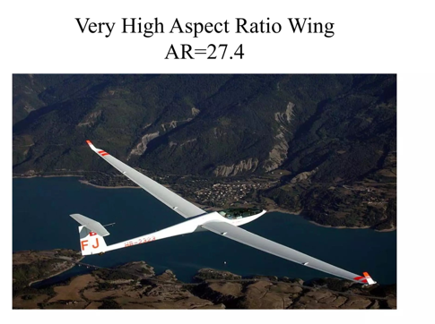
Wing related vocabularies

Slide 13
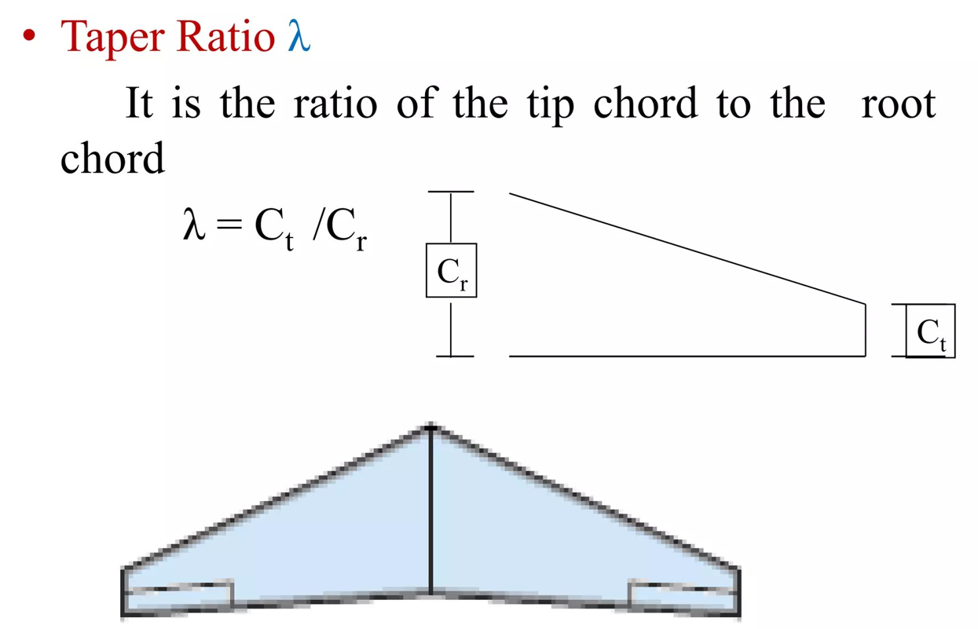
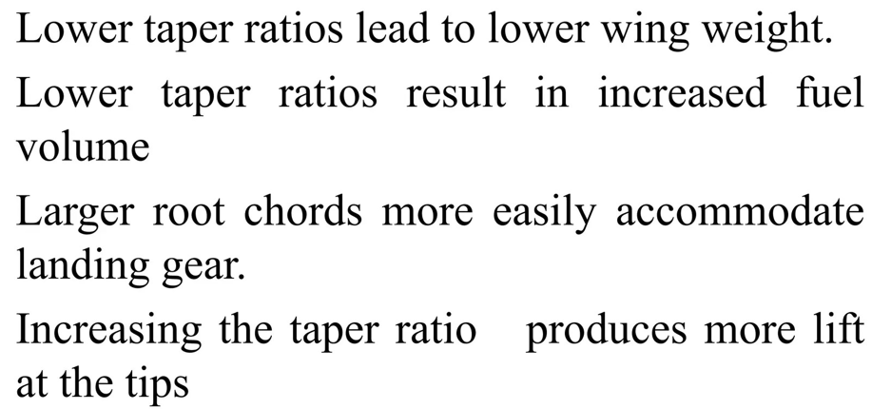
Wing related vocabularies

Slide 14
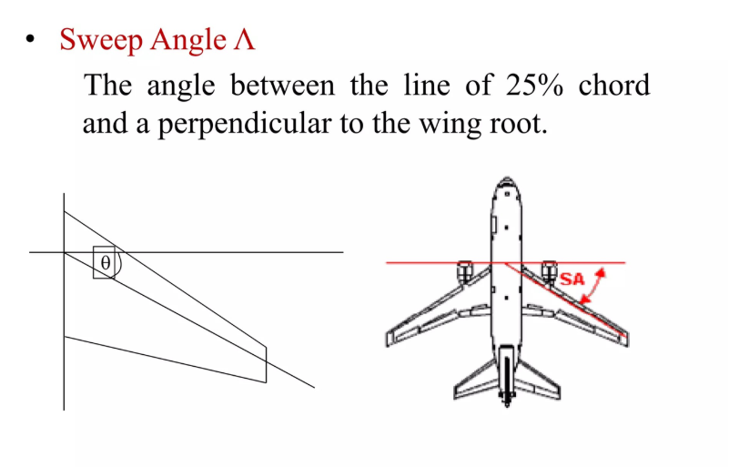
Wing related vocabularies

Slide 15
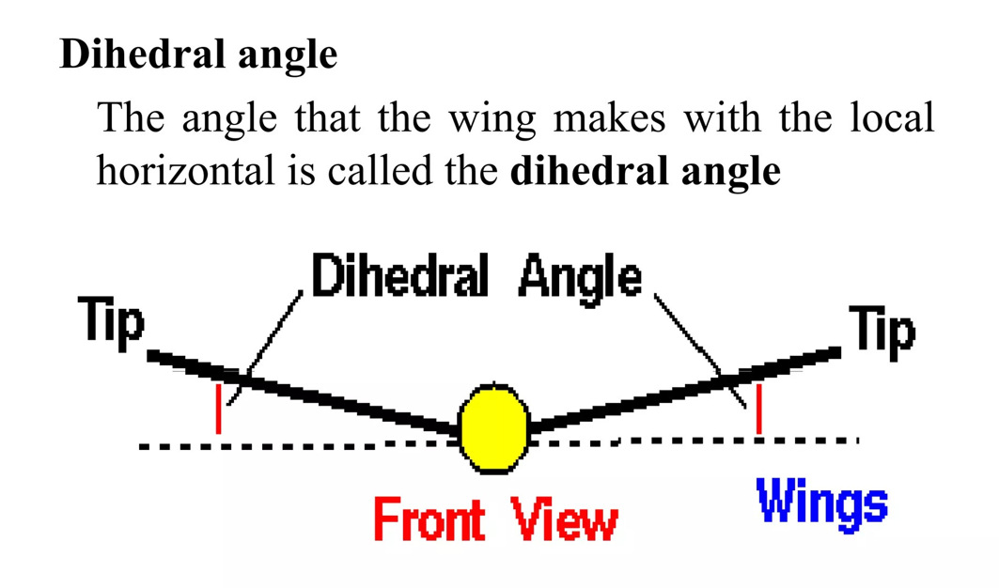
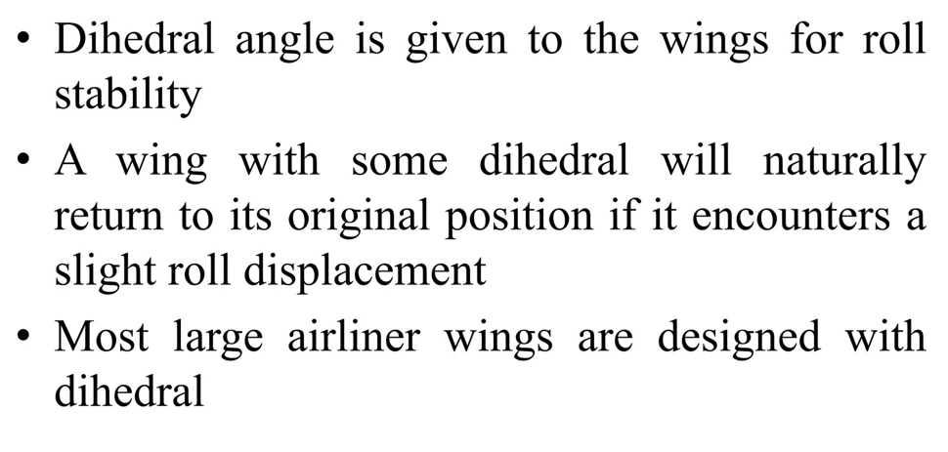
Wing related vocabularies

Slide 16
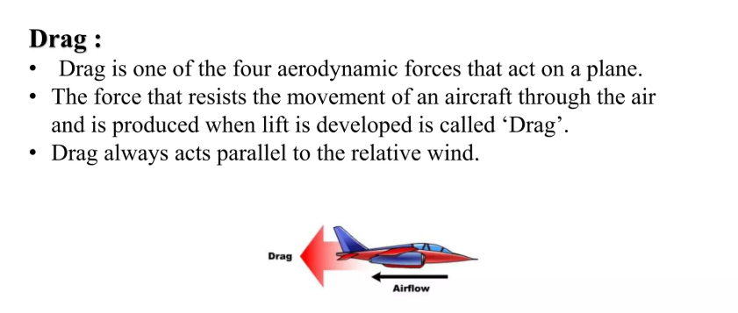
Introduction to drag force
There are 2 main types of Drag:
Parasitic drag/ Zero lift drag
Lift induced drag/Vortex drag

Slide 17
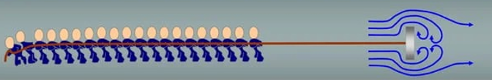
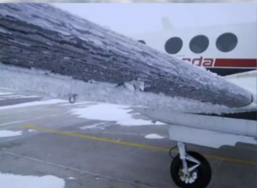
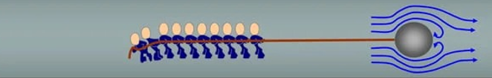
Parasitic drag/ Zero lift drag
When an aircraft is flying at an angle of attack which gives zero lift, the resultant forces acting parallel and opposite to the direction of flight is called Zero Lift Drag.
Zero lift drag can be subdivided into:
Surface friction drag
Form drag
Interference drag
Form drag: Depending on the shape of plate, the number of people preventing it from moving changes.
Surface friction drag: the tendency of air flowing over the body to cling to its surface. It can be because of Ice on wings, Dirts build up etc.

Slide 18
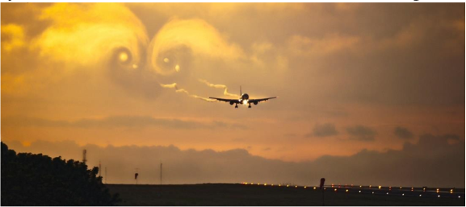
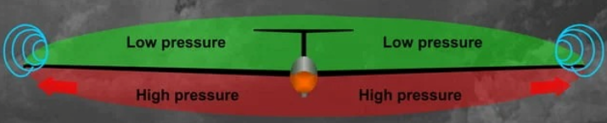
Lift induced drag/Vortex drag
Wing-tip vortices: if the wing has lift, then obviously the average pressure over the bottom surface is greater than that of over the top surface. Consequently, there is some tendency for the air to “leak,” or flow, around the wing tips from the high- to the low- pressure sides, as shown in the figure belows.
This rotating flow structure is called a wing-tip vortex.
Lift induced drag: this is a drag increment happening as a result of vortex.
How does this happen? Next slide!
Remember: An ideal wing with infinite span has no wing tips; therefore, wing-tip vortices and lift-induced drag do not occur.

Slide 19
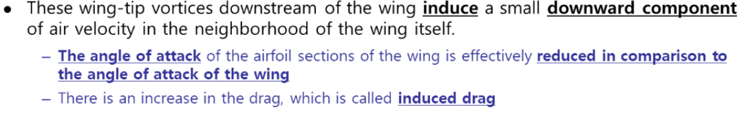
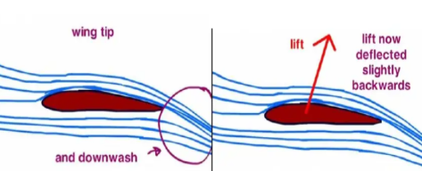
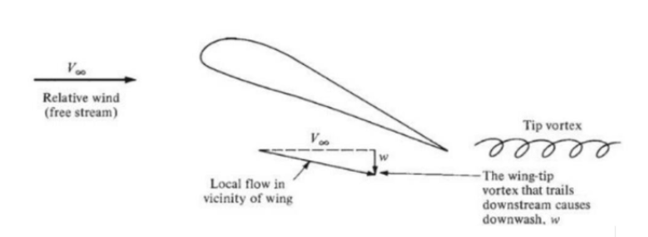
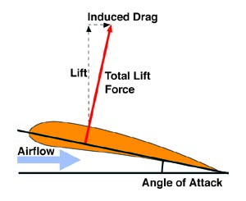
Wing-tip vortices create lift-induced drag

Slide 20
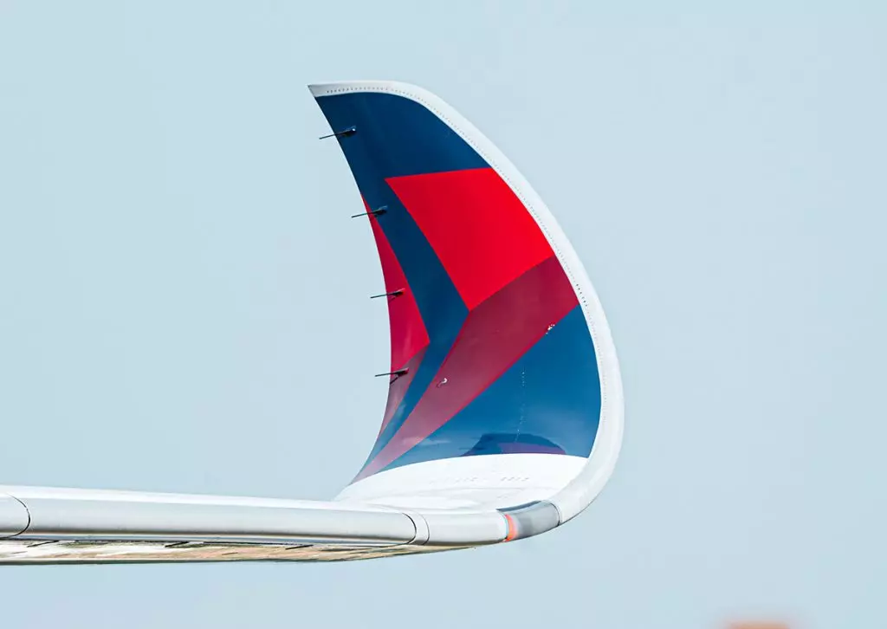
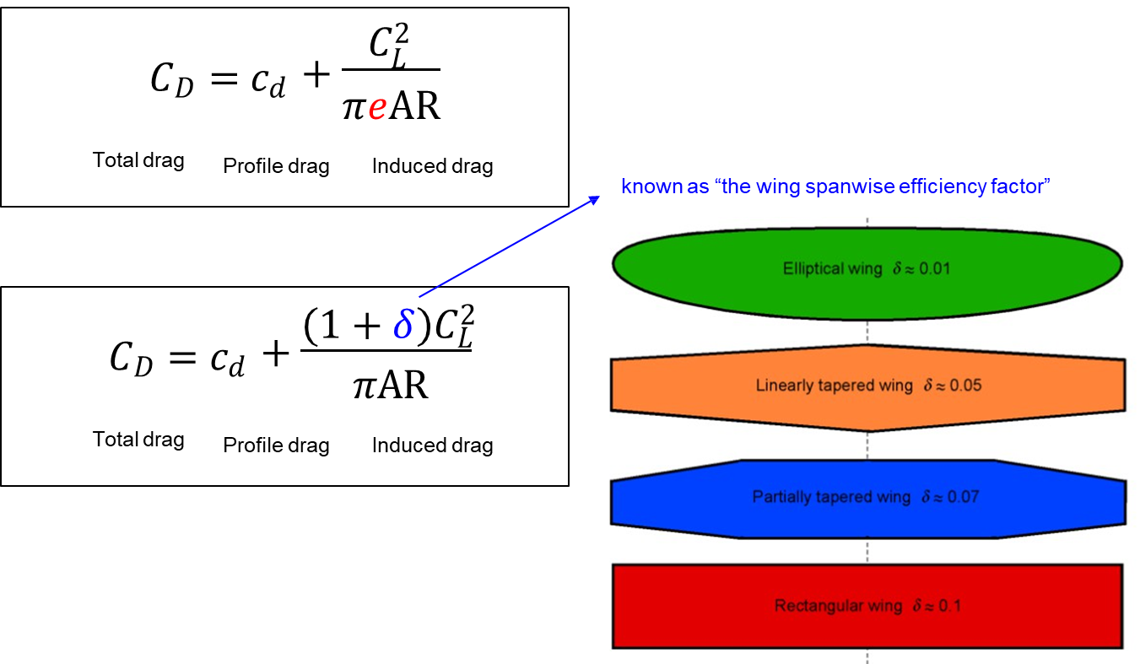
Summary: total drag has two main components
Winglet
The higher AR the lower induced drag. Therefore, Aircraft with higher AR flies long range. Cons of higher AR?

Slide 21
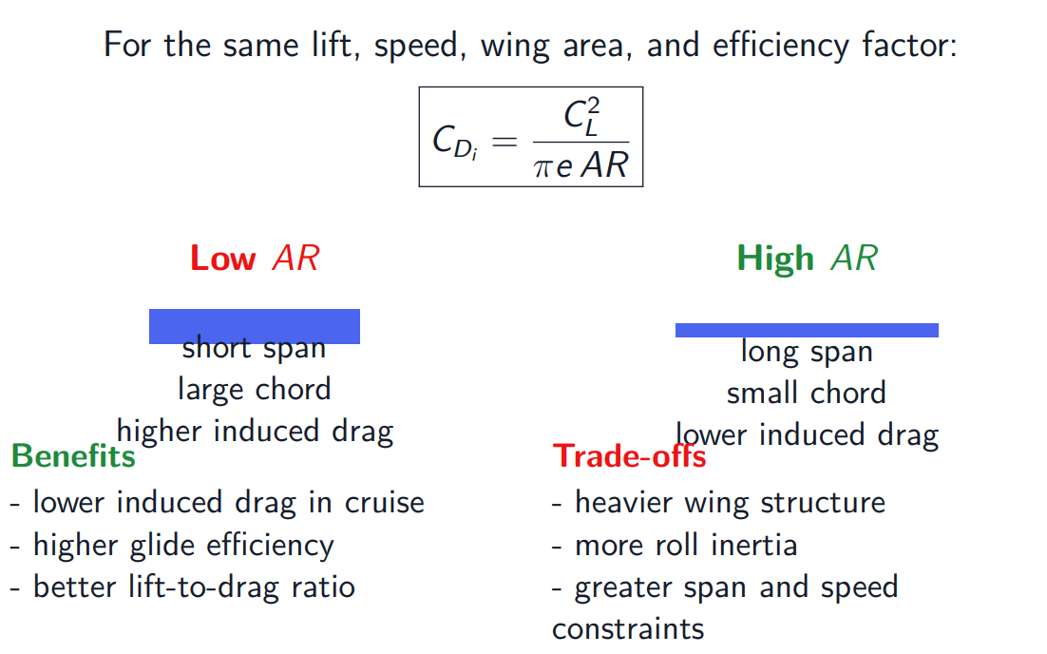
High aspect ratio: efficient, but not free

Slide 22
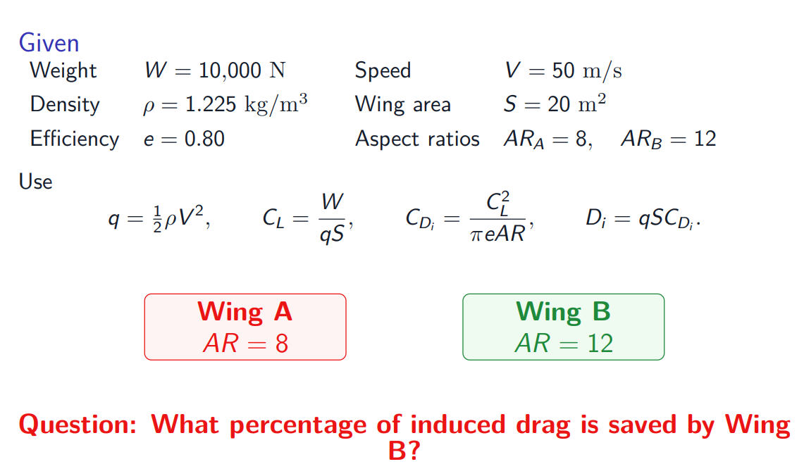
Worked example: compare induced drag

Slide 23
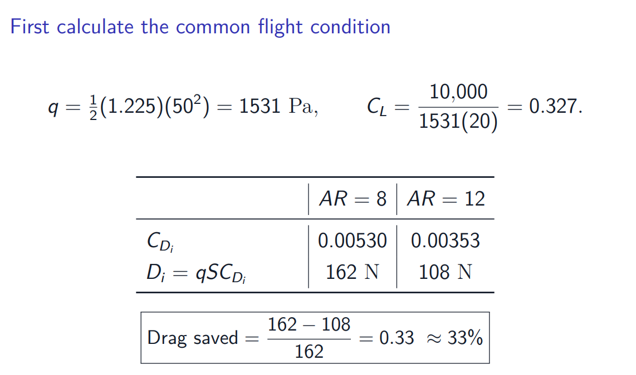
Worked example: AR = 12 saves 33% induced drag

Slide 24
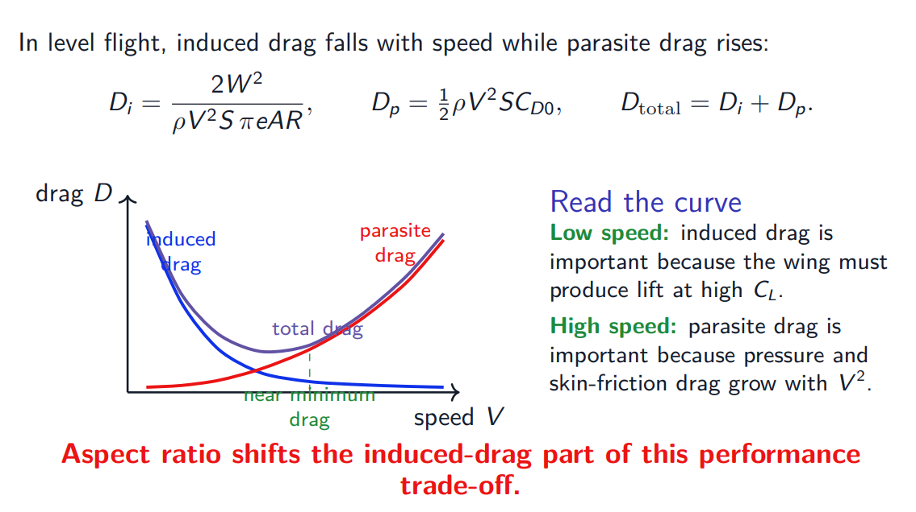
The drag-vs-speed curve links aerodynamics to performance

Slide 25
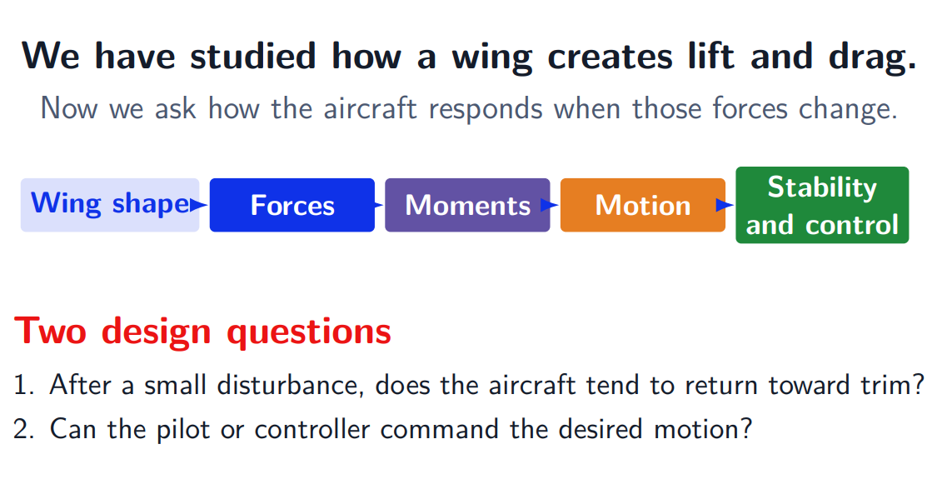
Mechanics of aircraft

Slide 26
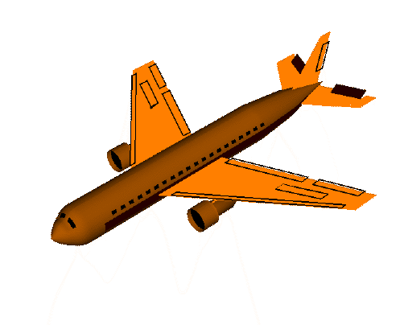
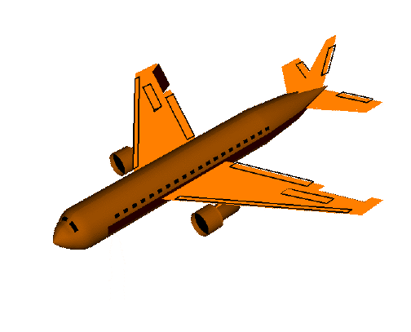
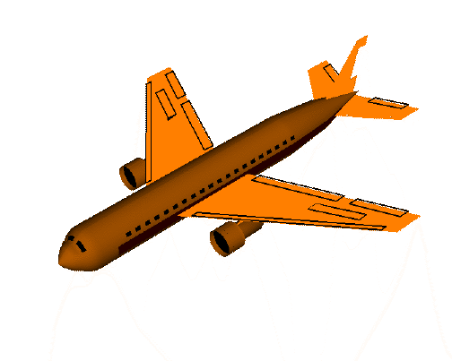
Aircraft main control surfaces
Elevator
Alerion
Rudder
PITCH
nose up / nose down
ROLL
rotation about forward axis
YAW
nose left / nose right
‹#›

Slide 27
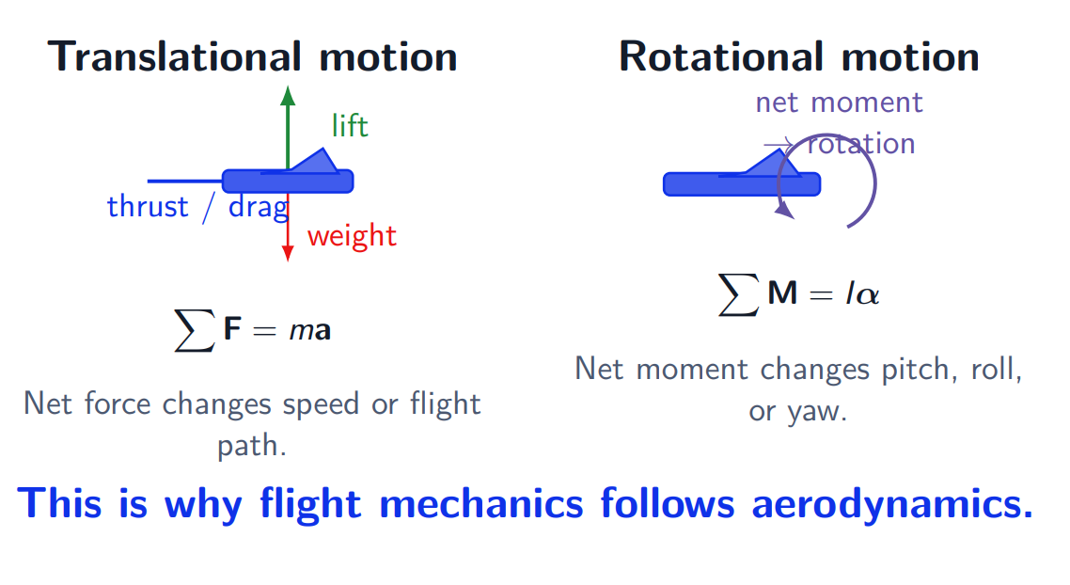
Forces translate the aircraft; moments rotate it.

Slide 28
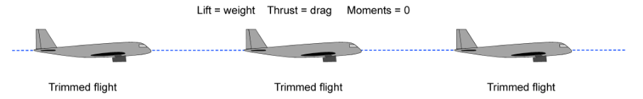
Trimmed flight
Trimmed (equilibrium) flight

Slide 29
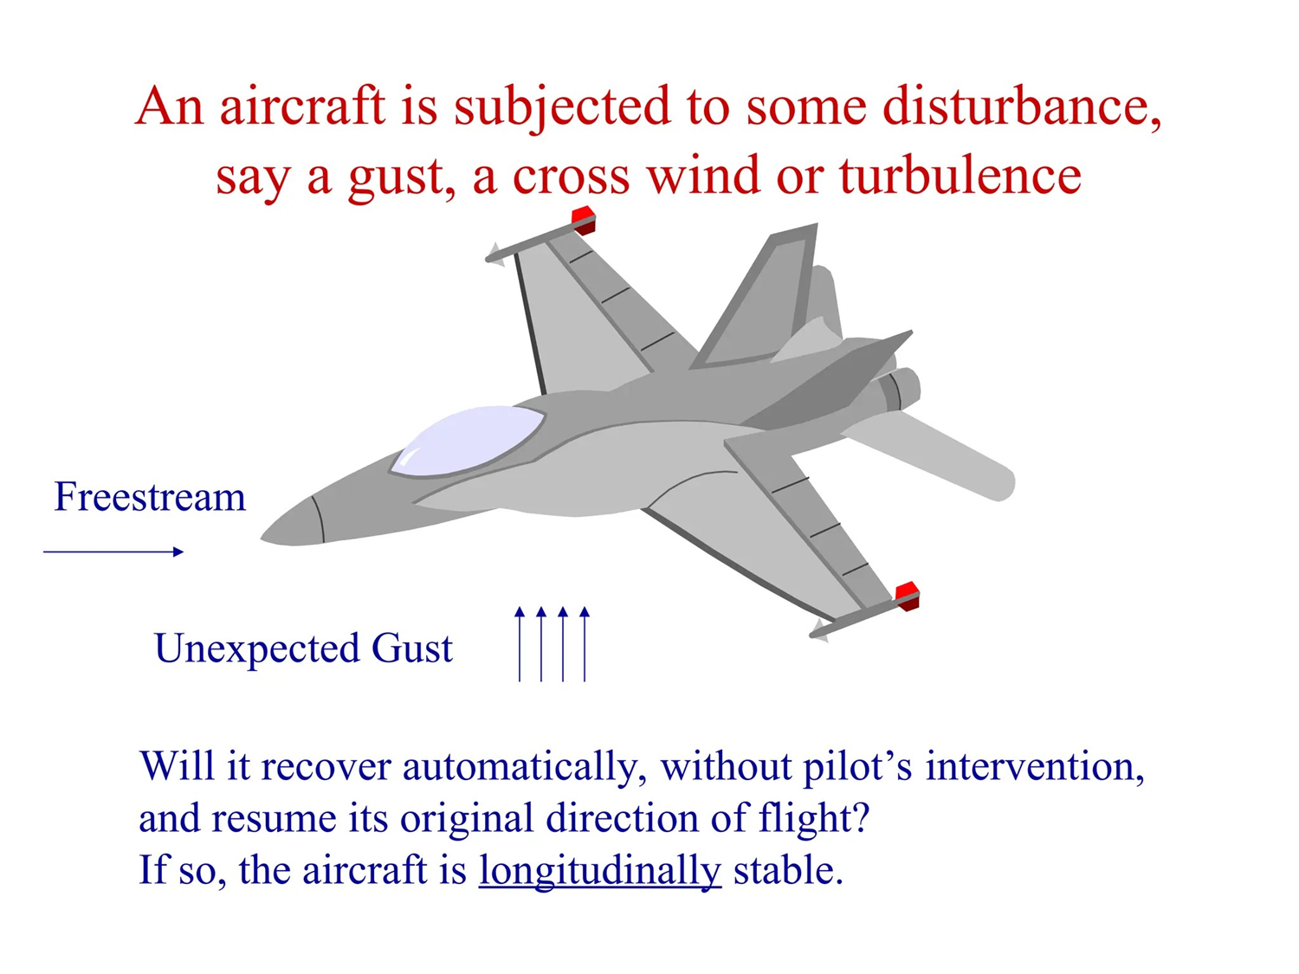
Aircraft stability: Longitudinal static stability

Slide 30
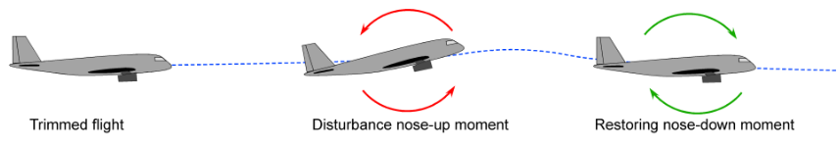
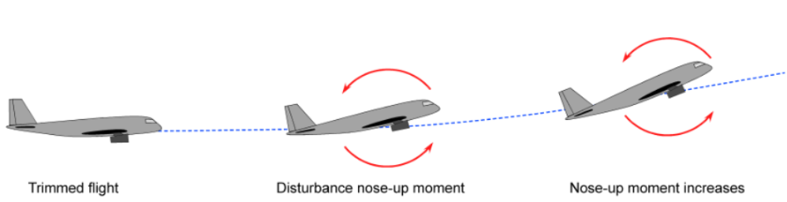
Aircraft stability: Longitudinal static stability
Statically stable
Statically unstable

Slide 31
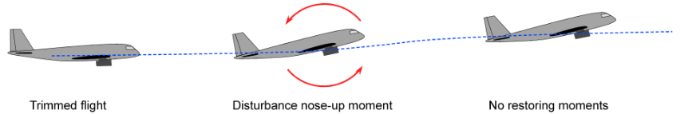

Aircraft stability: Longitudinal static stability
Neutrally stable
How do aircraft designers make aircraft Longitudinally statically stability at trimmed flight?

Slide 32

Aircraft stability: Longitudinal pitching moment
Pitching moment/torque about aircraft center of gravity:
You don’t need to understand the derivation now :)
BUT

Slide 33
Aircraft stability: pitching moment
Pitching moment/torque about aircraft center of gravity:
Moment created by the wing lift acting at the wing aerodynamic center

Slide 34
Aircraft stability: pitching moment
Pitching moment/torque about aircraft center of gravity:
Wing inherent pitching moment.

Slide 35
Aircraft stability: pitching moment
Pitching moment/torque about aircraft center of gravity:
Additional pitching moment produced by flap deflection.

Slide 36
Aircraft stability: pitching moment
Pitching moment/torque about aircraft center of gravity:
Pitching moment generated by the fuselage.

Slide 37
Aircraft stability: pitching moment
Pitching moment/torque about aircraft center of gravity:
Pitching moment produced by the horizontal-tail lift.

Slide 38
Aircraft stability: pitching moment
Pitching moment/torque about aircraft center of gravity:
Pitching moment caused by the thrust line being vertically offset from the center of gravity.

Slide 39
Aircraft stability: pitching moment
Pitching moment/torque about aircraft center of gravity:
Pitching moment caused by the propulsion force acting away from the center of gravity.

Slide 40


Primary factors affecting longitudinal static stability

Slide 41

The mathematical requirement for longitudinal static stability
This is the requirement!

Slide 42

A stable aircraft has a negative pitching-moment slope

Slide 43

The center of gravity must be ahead of the neutral point

Slide 44


The horizontal tail creates the restoring pitching moment

Slide 45

Worked example: determine trim and restoring response

Slide 46

Final design check for longitudinal static stability

Slide 47

Lateral + directional static stability

Slide 48
Basics of Flight Dynamics

Slide 49


Aircraft as point mass
Lift
Y
Thrust
Drag
Weight
x
Point mass model:
For the 2D level flight:
What important aircraft motion is missing from this model?

Slide 50
Aircraft as point mass
Lift
Y
Thrust
Drag
Weight
x
Point mass model:
For the 2D level flight:
What important aircraft motion is missing from this model?
== Rotational motion

Slide 51
Aircraft as rigid body

