Slide 1



Lecture - 3
Input/output and Functions

Slide 2
Introduction to C++
I/O statements and functions
  Using Library Functions
    Formatting Numbers for Program Output
  Input using the cin object
  Writing Functions
    Function and parameter declarations
    Returning a value
    Pass by Value and Pass by Reference
  Variable Scope and Lifetime

Slide 3
I/O statements
C++ I/O operation is using the stream concept. Stream is the sequence of bytes or flow of data. It makes the performance fast.
If bytes flow from main memory to device like printer, display screen, or a network connection, etc, this is called as output operation.
If bytes flow from device like printer, display screen, or a network connection, etc to main memory, this is called as input operation.
I/O Library Header Files
Let us see the common header files used in C++ programming are:
Header File | Function and Description
<iostream> | It is used to define the cout, cin and cerr objects, which correspond to standard output stream, standard input stream and standard error stream, respectively.
<iomanip> | It is used to declare services useful for performing formatted I/O, such as setprecision and setw.
<fstream> | It is used to declare services for user-controlled file processing.

Slide 4
Standard output stream (cout)
The cout is a predefined object of ostream class.
It is connected with the standard output device, which is usually a display screen.
The cout is used in conjunction with stream insertion operator (<<) to display the output on a console.
Let's see the simple example of standard output stream (cout):
  #include <iostream>
  using namespace std;
  int main( ) {
  cout <<"Welcome to C++ class";
  }

Slide 5
Standard input stream (cin)
The cin is a predefined object of istream class.
It is connected with the standard input device, which is usually a keyboard. The cin is used in conjunction with stream extraction operator (>>) to read the input from a console.
Let's see the simple example of standard input stream (cin):
  #include <iostream>
    using namespace std;
    int main( ) {
    int age;
    cout << "Enter your age: ";
    cin >> age;
    cout << "Your age is: " << age << endl;
  }
cin can accept multiple input values to be stored in different variables
Example: cin >> num1 >> num2

Slide 6
Formatting Numbers for Program Output
Proper output formatting contributes to ease of use and user satisfaction
cout with stream manipulators can control output formatting
Manipulator | Action
setw (n) | Set the field width to n
scientific | Set the output to display real numbers in scientific notation
endl | Output a newline character and display all characters in the buffer
fixed | Always show a decimal point and use a default of six digits after the decimal point. Fill with trailing zeros, if necessary.
setprecision(n) | Set the floating-point precision to n places.

Slide 7
The field width manipulator must be included for each value in the data stream sent to cout
Other manipulators remain in effect until they are changed
Formatting floating-point numbers requires three field-width manipulators to:
    Set the total width of the display
    Force a decimal place
    Set the number of significant digits after the decimal point
Example:
cout << "|" << setw(10) << fixed << setprecision(3) << 25.67 << "|";
produces this output: | 25.670|4
Case Study:
Length Conversion: Write a program that takes as input given lengths expressed in feet and inches. The program should then convert and output the lengths in centimeters. Assume that the given lengths in feet and inches are integers.

Slide 8
Functions
A function is a group of statements that together perform a task. Every C++ program has at least one function, which is main(), and all the most trivial programs can define additional functions.
A function is known with various names like a method or a sub-routine or a procedure etc.
When your program starts, main() is called automatically. main( ) might call other functions, some of which might call still others.
A C++ function definition consists of a function header and a function body.
A function declaration tells the compiler about a function's name, return type, and parameters. A function definition provides the actual body of the function.
The reason why we use functions is to aid modularization of a program and a function reduces program size.
Any fragments of code that are needed frequently in a program are best candidates to be written as a function.

Slide 9
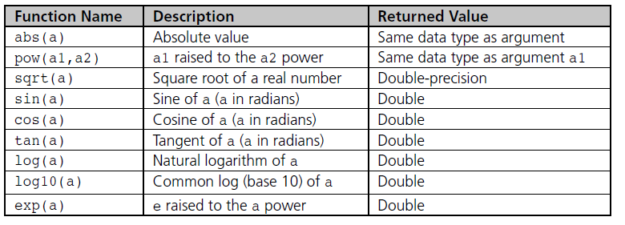
Advantage of functions
Code Reusability
By creating functions in C++, you can call it many times. So we don't need to write the same code again and again.
Code optimization
It makes the code optimized, we don't need to write much code.
Types of Functions
There are two types of functions in C++ programming:
1. Library Functions: are the functions which are declared in the C++ header files.
if you include the cmath header file: #include <cmath> you can access predifend method under the cmath header file see it below

Slide 10
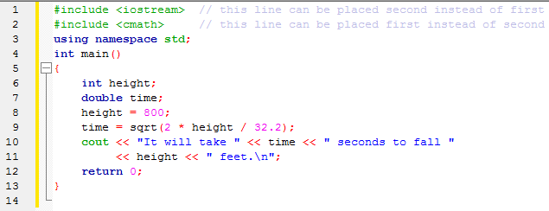
Using Mathematical Library Functions example
2. User-defined functions: are the functions which are created by the C++ programmer, so that he/she can use it many times. It reduces complexity of a big program and optimizes the code.

Slide 11
Function Declarations
As you can’t use variables before declarations (telling the compiler what the variable is), you can’t use function before telling the compiler what this function is.
The common approach to declare functions is at the beginning of the program.
The function declaration (function prototype) tells the compiler that later on in the program a function introduced in the declaration is going to be used.
Function declaration is terminated with semicolon. If the function has arguments, then they should be indicated in the declaration.
A function declaration has the following parts
    return_type function_name( parameter list );
  Examples :- int max(int num1, int num2);
Parameter names are not important in function declaration only their type is required, so following is also valid declaration − int max(int, int);

Slide 12
Function Definition
A function definition consists of two parts: interface and body.
The interface of a function (called its prototype) specifies how it may be used.
It consists of three entities:
  The function name. This is simply a unique identifier.
  The function parameters (also called its signature)-: this is a set of zero or more typed identifiers used for passing values to and from the function.
  The function return type. This specifies the type of value the function returns. A function which returns nothing should have the return type void.
The body of a function contains the computational steps (statements) that comprise the function.

Slide 13
function definition example
    int max(int num1, int num2)
    {
    int result;
    if (num1 > num2)
    result = num1;
    else
    result = num2;
    return result;
    }
The function body is placed in one place in memory. But it could be invoked in several places in the program.

Slide 14
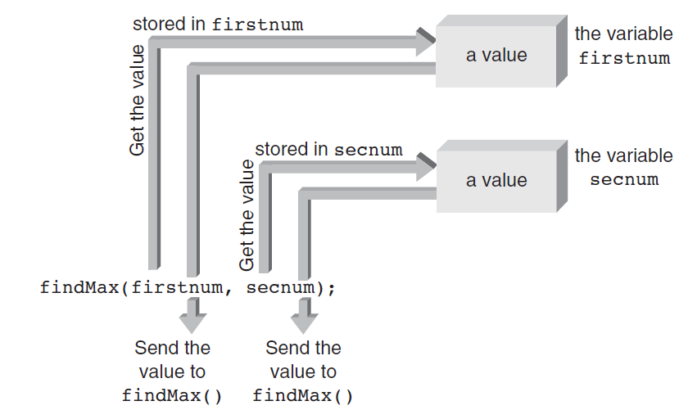
Calling Functions
Calling functions is invoking function to execute.
The function call involves the function name, followed by parentheses.
The function call is similar to its declaration except that the return type is not mentioned.
The call is terminated by semicolon.
Executing the call statement causes the function to execute, i.e. control is transferred to the function, the statements in the function definition are executed and then control returns to the statement following the function call.

Slide 15
  #include <iostream>
  using namespace std;
  int max(int num1, int num2); // function declaration
  int main () {
  int a = 100, b = 200, int ret;
  ret = max(a, b); // calling a function to get max value.
  cout << "Max value is : " << ret << endl;
  return 0;
  }
  // function defination
  int max(int num1, int num2) {
  int result;
  if (num1 > num2)
  result = num1;
  else
  result = num2;
  return result; }

Slide 16
Pass By Value and Pass By Reference
Pass By Value
In call by value method of parameter passing, the values of actual parameters are copied to the function’s formal parameters.
  There are two copies of parameters stored in different memory locations.
  One is the original copy and the other is the function copy.
Any changes made inside functions are not reflected in the actual parameters of the caller.
Advantages of Call by Value in C++
Functions are free to modify the passed values without affecting the original data.
Great while working with multithreaded or asynchronous programs where we need to keep track of the values.
Pass by value method can be used to convert a string from an integer without modifying its value.

Slide 17
Pass By Value and Pass By Reference
Disadvantages of Call by Value in C++
Since pass by value is implemented by passing a copy of the data, the data size increases (doubles). This may not be an issue with smaller programs but can cost efficiency in larger programs.
If the argument is too large, copying the values can take a significant amount of time.
There is no way to propagate back the updated values through the parameters.
Consider the following example

Slide 18
// C++ program to illustrate call by value
#include <iostream>
using namespace std;
void swapx(int x, int y);// Function Prototype
int main()
{ int a = 10, b = 20;
swapx(a, b); // Pass by Values
cout << "In the Caller:\n";
cout << "a = " << a << " b = " << b << endl;
return 0; }
void swapx(int x, int y) // Swap functions that swaps two values
{ int t;
t = x;
x = y;
y = t;
cout << "In the Function:\n";
cout << "x = " << x << " y = " << y << endl; }

Slide 19
  Output
Inside Function:
  x = 20 y = 10
  In the Caller:
  a = 10 b = 20
Thus actual values of a and b remain unchanged even after exchanging the values of x and y in the function.

Slide 20
Call by Reference
In call by reference method of parameter passing, the address of the actual parameters is passed to the function as the formal parameters.
  Giving a called function direct access to its calling function’s variables
  Both the actual and formal parameters refer to the same locations.
Any changes made inside the function are actually reflected in the actual parameters of the caller.
It is perfectly valid for a function to use pass-by-value for some of its parameters and pass-by-reference for others.
Whether a value or an address is actually passed depends on the parameter types declared; Address operator (&) provides the variable’s address
When to use Call by Reference in C++?
When we are changing the parameters passed by the client program.
When passing large structures and classes to make the program efficient.
To avoid copying the values and reducing the space complexity.

Slide 21
Call by Reference
Advantages of Call by Reference in C++
We can produce efficient programs since no copy of the data is made.
It enhances the ease of exchanging the information between functions through the use of parameters.
Disadvantages of Call by Reference in C++
This method is not recommended while developing multithreaded programs since it can cause loss of data.
Being a high-level mechanism, pass by reference can only be used within a single program.

Slide 22
// C++ program to illustrate Call by Reference
#include <iostream>
using namespace std;
void swapx(int&, int&); // Function Prototype
int main() {
  int a = 10, b = 20;
swapx(a, b); // Pass reference
cout << "In the Caller:\n";
cout << "a = " << a << " b = " << b << endl;
return 0;}
void swapx(int& x, int& y) // Function to swap two variables by references
{ int t;
t = x;
x = y;
y = t;
cout << "In the Caller:\n";
cout << "x = " << x << " y = " << y << endl; }

Slide 23
  Output
  Inside the Function:
  x = 20 y = 10
  Inside the Caller:
  a = 20 b = 10
Thus actual values of a and b get changed after exchanging values of x and y.

Slide 24
Default Arguments
When you define a function, you can specify a default value for each of the last parameters. This value will be used if the corresponding argument is left blank when calling to the function.
This is done by using the assignment operator and assigning values for the arguments in the function definition. If a value for that parameter is not passed when the function is called, the default given value is used, but if a value is specified, this default value is ignored and the passed value is used instead.
Default arguments are suitable for situations where certain (or all) function parameters frequently take the same values.
Consider the following example

Slide 25
#include <iostream>
using namespace std;
int sum(int a, int b = 20) {
int result = a + b;
return result;}
int main () {
int a = 100, b = 200, result;
result = sum(a, b); // calling a function to add the values.
cout << "Total value is :" << result << endl; // output :- Total value is :300
result = sum(a); // calling a function again as follows.
cout << "Total value is :" << result << endl; // output :- Total value is :120
return 0;
}

Slide 26
Overloaded Functions
Two different functions can have the same name if the prototype of their arguments are different. That means that you can give the same name to more than one function if they have either a different number of arguments or different types in their arguments.

Slide 27
Example
# include<iostream>
using namespace std;
int devide (int a, int b=2);
int devide(int z, int r, int y);
float devide (float a, float b);
int main(){
int x=20, y=2;
float n=5.0, m=2.0;
cout<<devide(x,y)<<endl;
cout<<devide(n,m)<<endl;
cout<<devide(n,m,m)<<endl;
return 0;
}

Slide 28
int devide (int a, int b)
{
return a/b;
}
int devide (int a, int b, int c)
{
int w=a/b
return w/c;
}
float devide (float x, float y)
{
return x/y;
}

Slide 29
Global and Local Scope
Everything defined at the program scope level (i.e., outside functions) is said to have a global scope.
Thus the sample functions we have seen so far all have a global scope.
Variables may also be defined at the global scope.
Since global entities are visible at the program level, they must also be unique at the program level. This means that the same global variable or function may not be defined more than once at the global level.
Global entities are generally accessible everywhere in the program.
Un initialized global variables are automatically initialized to zero.

Slide 30
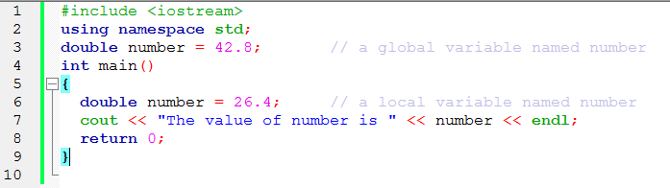
Each block in a program defines a local scope. Thus the body of a function represents a local scope.
The parameters of a function have the same scope as the function body.
Variables defined within a local scope are visible to that scope only. Hence, a variable need only be unique within its own scope.
Local scopes may be nested, in which case the inner scopes override the outer scopes.
For example

Slide 31
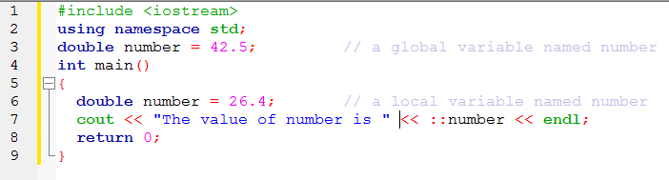
Scope Resolution Operator
To reference a global variable when a local variable of the same name is in scope, use C++’s scope resolution operator, which is ::

Slide 32
Misuse of Globals
Global variables allow programmers to “jump around” the normal safeguards provided by functions
Instead of passing variables to a function, it is possible to make all variables global: do not do this
Indiscriminate use of global variables destroys the safeguards C++ provides to make functions independent and insulated from each other
Using only global variables can be especially disastrous in large programs with many user-created functions

Slide 33
Lifetime of Variables
A variable’s scope can be thought of as the space in the program where the variable is valid
In addition to space dimension represented by scope, variables have a time dimension that refers to the length of time storage locations are reserved for a variable
This time, dimension is referred to as the variable’s lifetime
When and how long a variable’s storage locations are kept before they are released can be determined by the variable’s storage category

Slide 34
Variable Storage Categories
The four available storage categories are:
  auto
  static
  extern
  register

Slide 35
Local Variable Storage Categories
Local variables can be members only of the auto, static, or register storage categories
Storage for automatic local variables is reserved or created automatically each time a function is called
As long as the function hasn’t returned control to its calling function, all automatic variables local to the function are “alive”
A local static variable isn’t created and destroyed each time the function declaring it is called
Local static variables remain in existence for the program’s lifetime

Slide 36
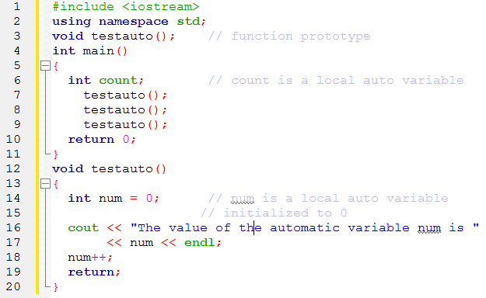
Local Automatic Variable

Slide 37
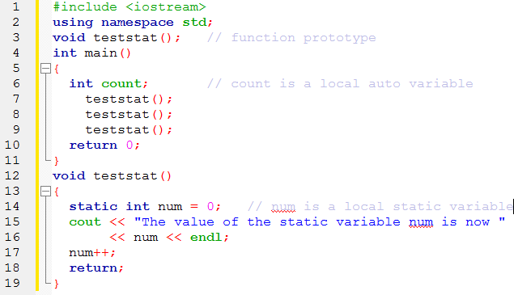
Local Static Variable

Slide 38
Global Variable Storage Categories
Global variables are created by definition statements external to a function By their nature, global variables do not come and go with the calling of a function After a global variable is created, it exists until the program in which it’s declared has finished executing
Global variables can be declared with the static or extern storage category, but not both

Slide 39
Quiz
  1. Identify the error and reWrite of the following code.
  #include<iostream>
  using namespace std;
  int main() {
  count=0;
  ++count;
  cout<<"value of counter is:'<<countt;
  return 0 }
  2. Write the output of the following code.
  count=0;
  ++count;
  cout<<"value of counter is:"<<count<<",";
  count=count+10;
  count--;
  count=count%2;
  cout<<count++<<“/t";
  count=count*10;
  --count;
  cout<<count;
  3. Write a program in C++ that converts kilometers per hour to miles per hour using function.
  4. Write a program in C++ to convert temperature in Kelvin to Fahrenheit using function.

