Slide 1

AddisCoder: Week 2
Lecture 9B/10:
Time Complexity

Slide 2
Algorithms

Slide 3
Algorithms
An algorithm is the process that you use to get to an answer. It is the series of steps that you execute to to solve a problem.
For each of these paths, the rule that you decide where to turn is your algorithm. The path itself is the solution that your algorithm comes up with.
Algorithm for Solution 3
At each intersection, take a turn if that puts me closer to the White House.
Algorithm for Solution 4
At each intersection, make a random turn. Walk until you see the White House.

Slide 4
Algorithms
Examples of other algorithms

Slide 5

Algorithms
Examples of other algorithms
How to make change as a shopkeeper

Slide 6
Algorithms
Examples of other algorithms
How to make change as a shopkeeper
Algorithm 1:
For the change amount, give the largest coin that is less than the remaining change amount, and subtract from remaining change to give.
Repeat step 1 over and over (until remaining change to give is $0.00)

Slide 7
Algorithms
Examples of other algorithms
How to make change as a shopkeeper
Algorithm 2:
Given them change amount ($X.XX) * 100 pennies.

Slide 8
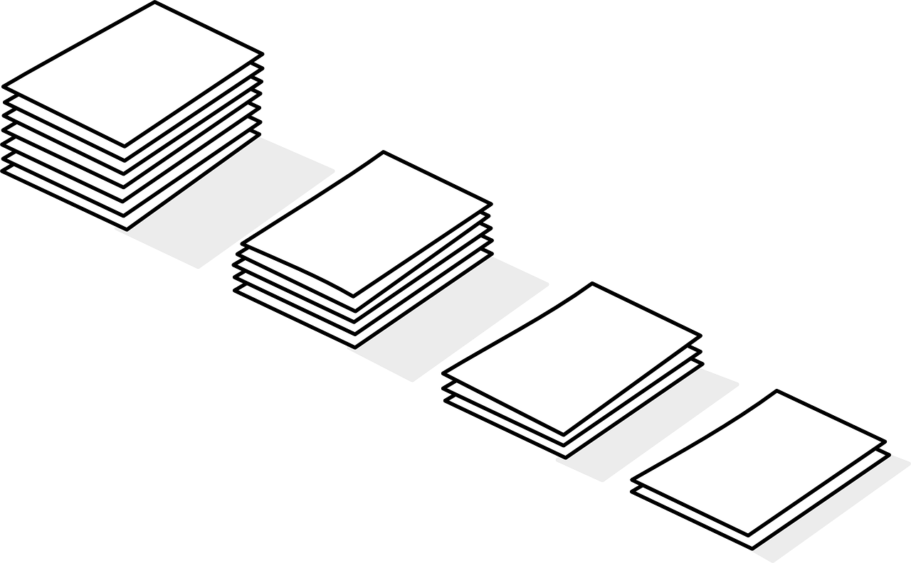
Algorithms
Examples of other algorithms
How to sort a pile of exams into alphabetical order
Sort all papers into 26 piles by the first letter of the name only (A, B, …)
Sort each of the 26 piles into 26 piles by the second letter of the name
Repeat until all piles are of size 1, then combine

Slide 9



Algorithms in Industry
Recommender Systems: a type of algorithm that recommends content to you based on what you’ve already watched (by looking at what other people with similar tastes have watched).

Slide 10
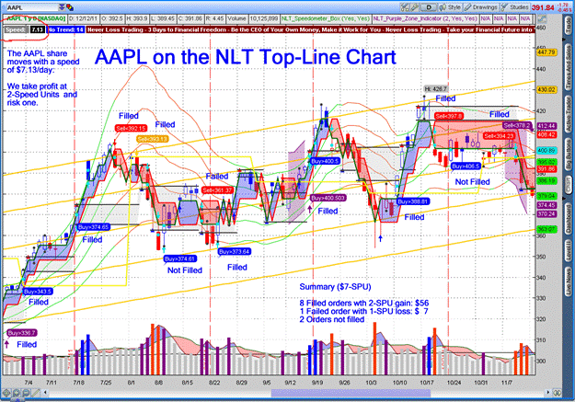
Algorithms in Industry
Trading Algorithms: financial algorithms that look at the historical stock price data and try to predict future pricing (so as to decide when is best to buy)

Slide 11
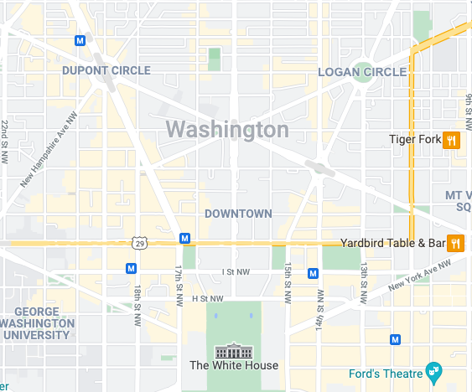


Tourist Walks
Which of the 4 algorithms produced the best path?
Depends on what you care about!

Slide 12
Complexity

Slide 13
Complexity
Complexity refers to how we measure programming efficiency in an objective way.
We think about this to...
predict how much time needed to solve problem with particular input size
be able to compare and pick a “best” algorithm among multiple algorithms

Slide 14
Evaluating Program Runtime
Three approaches we can take to measure runtime:
Measure with a timer
Count number of operations
Order of growth: abstractly describe behavior of algorithm

Slide 15
Measuring Time

Slide 16
Timing a Program
Can use time module
Get the time before you call function
Call function
Stop clock
import time def cels_to_fahr(celsius): return celsius * 9 / 5 + 32 t0 = time.time_ns() cels_to_fahr(100000) t1 = time.time_ns() - t0 print('t = ' + str(t1) + ' nanoseconds') print('t = '+ str(round(t1 / 1000000, 2)) + ' milliseconds')

Slide 17
Timekeeping Problems
What if you and your friend travel at different speeds!
Maybe you walk faster
Maybe your friend is on a scooter and you’re walking
Maybe you get tired more easily
Many factors! Same problems in computer science
What if one computer has a faster processor than the other?
What if one computer has a limit on how much power it can consume?
What if one computer has less memory than the other?

Slide 18
Timing Programs: Inconsistent
Goal: evaluate different algorithms
Running time:
✅ varies between algorithms
❌ varies between implementations
❌ varies between computers
❌ is not predictable based on small inputs
❌ varies for different inputs, cannot express relationship between inputs and time
Notes:
Our goal here is to evaluate algorithms. Do different algorithms have different amounts of time associated with them? The good news is is that if we measure running time, it will certainly vary as the algorithm changes. Just what we want to measure.
One of the problems is that it will also vary if we change the implementation. For example, if we use a loop and one loop has a few more steps inside of it than another algorithm, the time is going to change. But, we don’t actually really care about that difference.
Next, this time is going to depend on the computer. A newer computer or a computer with better specs will run faster than an older one with less memory or CPU. That’s not going to help us measure how fast an algorithm is.
And even if we could measure the timing on a small-sized inputs, it doesn’t necessarily predict what happens when we pass in huge inputs because it might take more time to get those inputs out of memory and such.
So what this means is that timing will vary based on what we’d like to measure, but it will also depend on a lot of other factors that make this measurement not that valuable.

Slide 19
Counting Operations

Slide 20
Counting Operations
Assume these steps take constant time:
mathematical operations
comparisons
assignments
accessing items in memory
Count number of operations executed as function of input size
def mysum(x): total = 0 for i in range(x): total = total + i return total
def mysum(x):
total = 0
for i in range(x + 1):
total = total + i
return total
total = 0 => 1 op
range => loop x times
every time increment => 1 op
inside for:
total + i => 1 op
store into total => 1 op
return => 1 op
total: 1 + 3x + 1
def c_to_f(c): return c * 9.0/5 + 32
5 + 32
return value, *, /, + = 4 ops
Notes:
So we can’t objectively measure how fast our code is by seeing how fast our computer runs that code. Let’s take a look at counting operations instead. We’re going to make the following assumption. We’re going to identify a set of operations that the machine do for us automatically and instantaneously. That would be things like arithmetic or mathematical operations, multiplication, division, subtraction, comparisons, something equal to another thing, something greater than, something less than, assignments, set a name to a value, and retrieval from memory. We’re going to assume that all of these operations take about the same amount of time inside our computers.
The good thing here is then it doesn't matter which machine we’re using. We’re measuring how long the algorithm takes by counting how many operations of this type are done inside our code, and we’ll use that count to come up with a number of operations executed as a function of the size of the input.

Slide 21
Counting Operations
def mysum(x): total = 0 for i in range(x): total = total + i return total
def mysum(x): total = 0 i = 0 while i < x: total = total + i i = i + 1 return total
total = 0 => 1 op
range => loop x times
every time increment => 1 op
inside for:
total + i => 1 op
store into total => 1 op
return => 1 op
total: 1 + 3x + 1
total = 0 => 1 op
i = 0 => 1 op
while => loop x times
i comparison => 1 op
inside while:
total = total + i => 2 op
i = i + 1 => 2 op
return => 1 op
total: 1 + 1 + 5x + 1
Notes:
So rather than getting 3x + 1, we have 4x + 1. When we’re talking about really big numbers - ie if x is big, this is going to matter, and so our efficiency depends on the implementation. But what we’re trying to do here is to measure the impact of the algorithm.
We see here that if we count operations, it still depends on the implementation. Changing the code to a while loop changed how fast our code is.
But, it still depends on the implementation. What if we changed this to a while loop? We’d have to set i outside the for loop, and then we’d have to check while i is less than x + 1. But, it still depends on the implementation. What if we changed this to a while loop? We’d have to set i outside the for loop, and then we’d have to check while i is less than x + 1.

Slide 22
Counter Operations: Nested Loops
def mystery(x): for i in range(x): for j in range(x): print(i, j)
How many times do we print? x² times

Slide 23
Counting Operations: Better
Goal: evaluate different algorithms
Running time:
✅ varies between algorithms
Notes:
Sounds pretty good. The time we get depends on the algorithm - the number of operations directly relates to the algorithm we’re trying to measure, which is what we’re trying to do here.

Slide 24
Different Inputs Changes How Program Runs
def search_for_element(lst, element): for item in lst: if item == element: return True return False
element first element in list: best case
element not in list: worst case
look through about half of elements in list: average case
want to measure behavior in a general way

Slide 25
Best, Average, Worst Cases
Suppose given list lst of some length len(lst)
best case: minimum running time over all possible inputs of given size, len(lst)
constant for search_for_element
ex: first element in any list
average case: average running time over all possible inputs of given size, len(lst)
practical measure
worst case: maximum running time over all possible inputs of given size, len(lst)
linear in length of list for search_for_element
must search entire list and not find it

Slide 26
Counting Operations: Slightly Better
Goal: evaluate different algorithms
Running time:
✅ varies between algorithms
❌ varies between implementations
✅ independent between computers
❌ no clear definition of which operations to count
✅ varies for different inputs, can express relationship between inputs and count
Notes:
Another good news is the count is independent of what computer we run on. As long as all of our computers come with the same set of basic operations, we don’t care what the time of my computer is vs yours when we’re measuring the number of operations. The number of operations doesn’t change depending on what computer we’re running on.
Earlier, we made an assumption that getting something from memory takes the same amount of time that it takes to do a mathematical operation. That might not actually be accurate, so how do we determine which operations actually take the same time and should be counted as an operation?
And lastly, counting the number of operations does differ depending on what the input is, and we can use this to come up with a relationship between the inputs and the count. And for the most part, it reflects the algorithm and not the exact implementation. But there’s still some problems with this, as we’ve talked about.

Slide 27
Still Need Better Way
Timing and counting evaluate implementations
Timing evaluates machines
Want to:
evaluate algorithm
evaluate scalability
evaluate in terms of input size
To be continued...
Notes:
So what can we say about this now? Timing and counting do evaluate or reflect implementations. We don't want that. Timing also evaluates machines. What we want to do is just evaluate the algorithm. And especially, we want to understand how does it scale? If we were to take an algorithm, and we know what its complexity is, my question is if I double the size of the input, what does that say about the speed? Because that's going to tell me something about the algorithm.We want to know what happens when we scale it and in particular, we want to relate that to the size of the input.

Slide 28
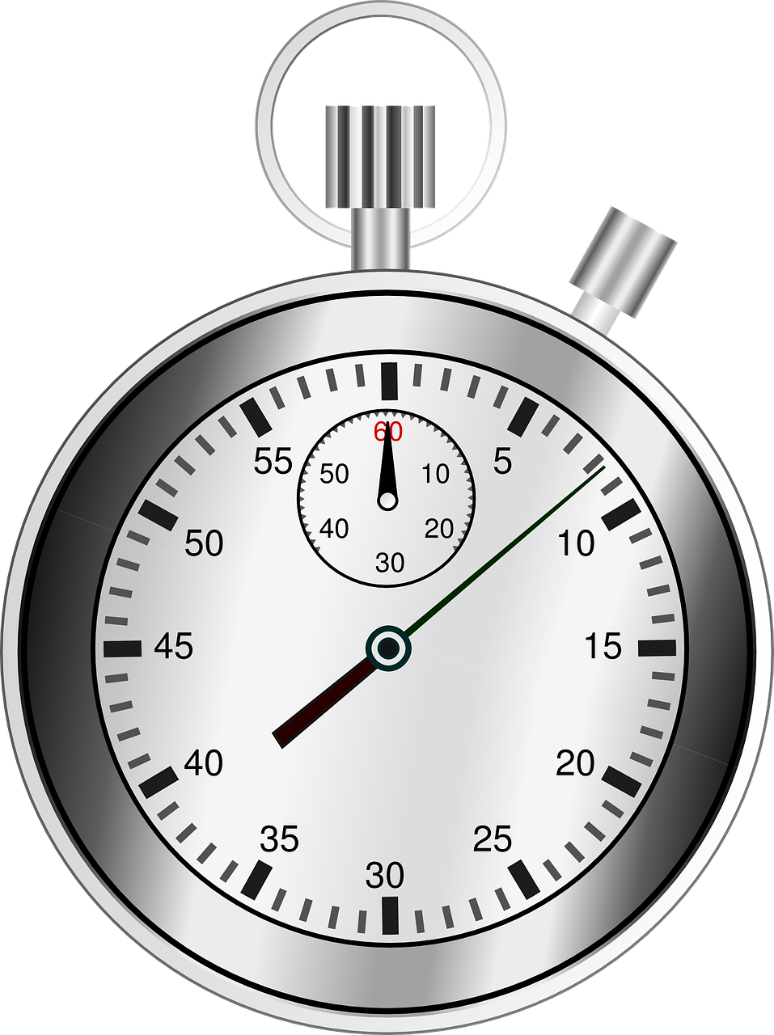
Evaluating Program Runtime
Three approaches we can take to measure runtime:
Measure with a timer
Time the program using an accurate stopwatch.
Compare how long 2 different algorithms take to run.
Problems:
  Depends on the hardware the code is running on
  Varies from run-to-run (based on available memory, etc.)
Count number of operations
Order of growth: abstractly describe behavior of algorithm

Slide 29
Evaluating Program Runtime
Three approaches we can take to measure runtime:
Measure with a timer
Count number of operations
Assume each “operation” takes 1 unit of time, count number of operations
Count uses variable “n” which is the size of input
Pros: takes into account size of input
Cons: What counts as an “operation”? Unruly answer with many terms?
Order of growth: abstractly describe behavior of algorithm
def mysum(n): total = 0 for i in range(n): total = total + i return total
total = 0 => 1 op
range => loop n times
every time increment => 1 op
inside for:
total + i => 1 op
store into total => 1 op
return => 1 op
total: 1 + 3n + 1

Slide 30
Evaluating Program Runtime
Three approaches we can take to measure runtime:
Measure with a timer
Count number of operations
Order of growth: abstractly describe behavior of algorithm

Slide 31
Big O Notation

Slide 32
Counting Operation Cons
Counting operations seems nice, but…
We end up getting long, complicated functions (300n² + 10n + 15)
  We really only care about what happens when the input is large
What should we count as an operation?
Is there some way we can
Count operations but not worry about small variations
Performance when problem size gets arbitrarily large
Notes:
What we're going to focus on is that idea of counting operations, but we're not going to worry about small variations, whether it's three or four steps inside of the loop. We're going to show that that doesn't matter.
We’re focus on what happens when the size of the problem gets arbitrarily large. Wo don’t care about counting things from 0 up to x when x is 10 or 20. Instead, what happens when it’s a million or a billion?
And we want to relate that time needed against the size of the input, so we can make that comparison.
So to do that, we have to do a couple of things. We have to decide what we’re going to measure, and then we have to think how we count without worrying about implementation details.

Slide 33
Big O Notation: O()
Slight tweak to counting operations...we will leave out any multiplicative or lower-order additive terms. This is the “order of growth” of the function.
We often call this “Big O notation” of the runtime. Measures upper bound on order of growth
Used to describe worst case
Occurs often and is bottleneck when program runs
Express rate of program growth relative to input size
Evaluate algorithm, not machine / implementation

Slide 34
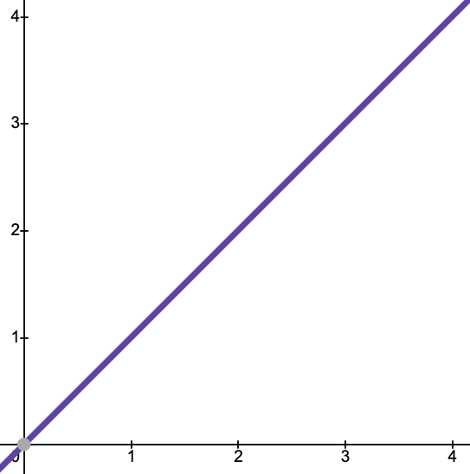
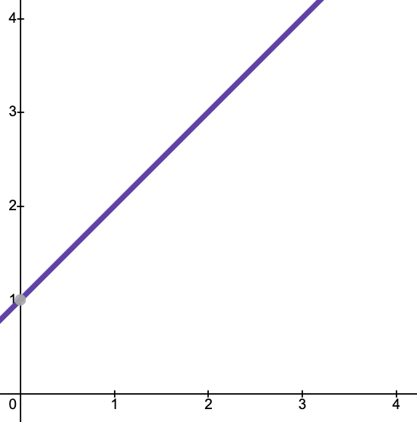
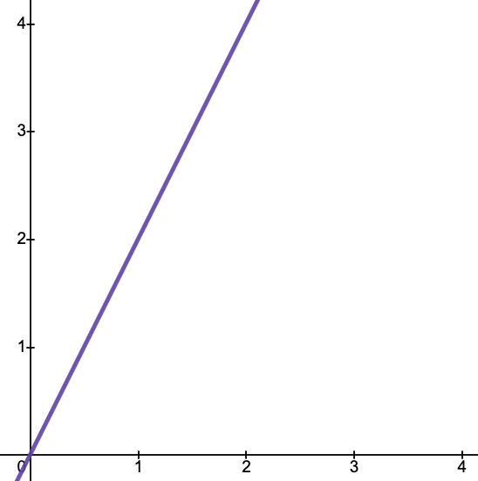
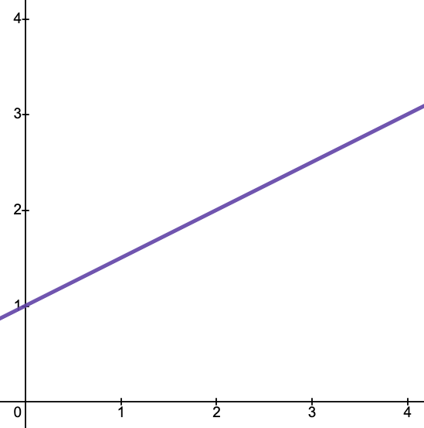
Order of Growth
y = n
y = n + 1
y = 2n
y = 0.5n + 1
Multiplicative Constant

Slide 35
Order of Growth
y = n
y = n + 1
y = 2n
y = 0.5n + 1
Lower Order Terms

Slide 36
Order of Growth
Dropping all multiplicative constants and lower order terms, these are all O(n).
y = n
y = n + 1
y = 2n
y = 0.5n + 1

Slide 37
Lower-Order Terms
The “order” of a term is how quickly it grows. The most common ones in order from lower order to higher order
Lower “order”
Name | Function | Examples
constant | 1 | 1, 5, 10
logarithmic | log(n) | log(2n), 3log(n)
linear | n | 4n, 0.5n, n
log-linear | n log(n) | 3nlog(n), nlog(0.5n)
polynomial | n^{c} | 2n², 5n³
exponential | c^{n} | 2^{n}, 5^{n + 1}
Higher “order”
Notes:
Pull up Desmos

Slide 38
Lower-Order Terms
The “order” of a term is how quickly it grows. The most common ones in order from lower order to higher order
Lower “order”
Name | Function | Examples
constant | 1 | 1, 5, 10
logarithmic | log(n) | log(2n), 3log(n)
linear | n | 4n, 0.5n, n
log-linear | n log(n) | 3nlog(n), nlog(0.5n)
polynomial | n^{c} | 2n², 5n³
exponential | c^{n} | 2^{n}, 5^{n + 1}
Higher “order”
Notes:
Pull up Desmos

Slide 39
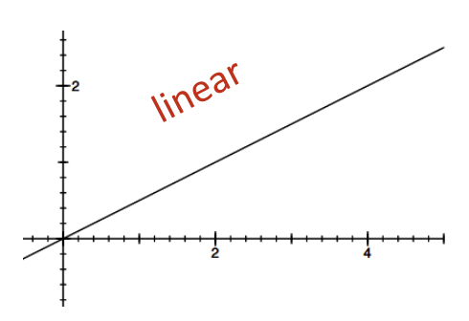
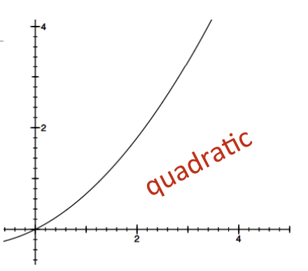
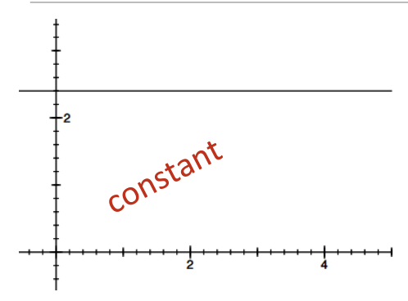
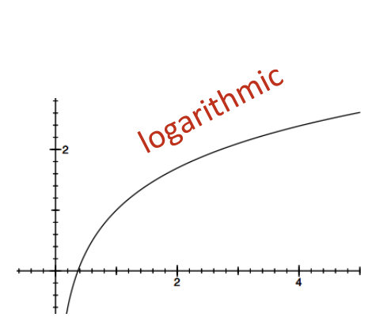
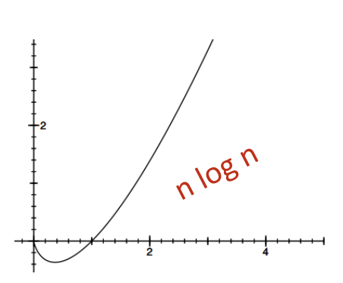
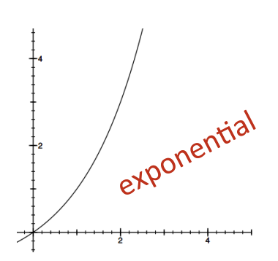
Orders of Growth
Notes:
Let’s take a look at different orders of growth. The x axis on these charts is the size of input and the y axis is the amount of time taken for that input size. First here we have constant growth, which means that the time needed for the program to run is constant and the amount of time doesn't change as the size of the input gets changed. Next here we have linear growth, which grows in a straight line. Quadratic starts to grow more quickly. Here we also have logarithmic, which is always better than linear because it slows down as we increase the size. n log n or log linear is kind of interesting, but it's a very common complexity for really valuable algorithms in computer science, notably ones for sorting. And it has a nice behavior, sort of between the linear and the quadratic. And lastly here we have exponential, which very quickly escalates in time as our inputs get bigger.

Slide 40
Simplification Examples
Drop lower order terms and multiplicative factors
Focus on dominant term: term that will increase the fastest
2n² + 2n + 2
10¹⁰⁰⁰ + 10n³ + 100n
log(n) + n + 4
0.0001 * n * log(n) + 300n
2n³⁰ + 3^{n}
2n²
10n³
n
0.0001 n log n
3^{n}
O(n²)
O(n³)
O(n)
O(n log n)
O(3^{n})
Notes:
So here are some examples. If we’re counting operations and we come up with an expression that has n squared plus 2n plus 2 operations, that expression is order n squared. The 2 and the 2n don't matter. Let’s think about what happens if we made n really big. n squared is much more dominant than the other terms. We say that's order n squared.
Even this expression we say is order n squared. So in this case, for lower values of n, this term is going to be the big one in terms of number of steps. I have no idea how I wrote such an inefficient algorithm that it took 100 steps to do something. But if we had that expression for smaller values of n, this matters a lot. This is a really big number. But when we’re interested in the growth, then that's the term that dominates. When we have expressions, if it's a polynomial expression, it's the highest order term. It's the term that captures the complexity. Both of these are quadratic. This term is order n, because n grows faster than log of n.
This funky looking term, even though that looks like the big number there and it is a big number, that expression we see is order n log n. Because again, if I plot out as how this changes as I make n really large, this term eventually takes over as the dominant term. What about that one? What's the big term there?

Slide 41
Orders of Growth
The “Order of Growth” of a program looks at the largest factors in the runtime (which part contributes the most to the runtime when input size gets very big).
Doesn’t need to be precise: “order of”, not “exact”, growth
Properties:
Evaluate program’s efficiency when input is very big
Express growth of program’s runtime as input size grows
Put upper bound on growth
Want upper bound (worst case) on growth as function of input size
Notes:
We want to evaluate efficiency, particularly when the input is very large. What happens when we really scale this up? We want to express the growth of the program's runtime as that input grows. Not the exact runtime, but that notion of it. If we doubled the input, how much longer does it take? What's the relationship between increasing the size of the input and the increase in the amount of time it takes to solve it?
We're going to put an upper bound on that growth. An upper bound means that it’s at least as big as or bigger than the actual amount of time it's going to take. And we’re going to not worry about being precise. We're going to talk about the order of rather than the exact growth. We don't need to know to the femtosecond how long this is going to take, or to the exact number of operations this is going to take.
But, we do want to say things like this is going to grow linearly. We double the size of the input, it doubles the amount of time. Or this is going to grow quadratically. We double the size of the input, it's going to take four times as much time to solve it. Or if we’re really lucky, this is going to have constant growth, meaning no matter how the input changes, it's not going to take any more time.
To do that, we're going to look at the largest factors in the runtime. Which piece of the program takes the most time? And so in orders of growth, we are going to look an upper bound on the growth as a function of the size of the input in the worst case. So here's the notation we're going to use. It's called Big O notation.

Slide 42
Exact Steps vs O()
def mystery(n): num1 = n * 2 num2 = n + 6 return num1 + num2
(Exact) Number of Operations
Big O Runtime
num1 = n * 2 => 2 ops
num2 = n + 6 => 2 ops
num1 + num2 => 1 op
return => 1 op
total: 6
Take the number of operations, and drop multiplicative constants and lower order terms
O(6) = O(1)
Constant runtime

Slide 43
Law of Addition
Example:
def printing(items, digits):
for item in items:
print(item)
for digit in digits:
print(digit)
Sequential statements, add
O(f(n)) + O(g(n)) = O(f(n) + g(n))
O(n)
O(n)
O(n) + O(n)
= O(n + n)
= O(2n)
= O(n)

Slide 44
Exact Steps vs O()
def fact_iter(n): answer = 1 while n > 1: answer = answer * n n = n - 1 return answer
(Exact) Number of Operations
Big O Runtime
answer = 1 => 1 op
while => loop n times
n > 1 => 1 op
inside while:
answer * n => 1 op
store into answer => 1 op
n - 1 => 1 op
store into n => 1 op
return => 1 op
total: 1 + 5n + 1
Take the number of operations, and drop multiplicative constants and lower order terms
O(1 + 5n + 1) = O(5n + 2) = O(n)
Linear runtime

Slide 45
Law of Multiplication
Example:
def printing(grid):
for row in range(len(grid)):
for col in range(len(row)):
print(grid[row][col])
Used with nested loops
O(f(n)) * O(g(n)) = O(f(n) * g(n))
O(n)
n loops, each O(n)
O(n) * O(n)
= O(n * n)
= O(n²)

Slide 46
Exact Steps vs O()
def mystery(n): for i in range(n): for j in range(n): print(str(i), str(j)) print("------") for k in range(n): print(k + 2)
(Exact) Number of Operations
Big O Runtime
for i in range(n) => n times
for j in range(n) => n times
print(str(i) + str(j)) => 4 ops
==> 4n^2 ops
print(“---”) => 1 op
for k in range(n) => n times
print(k + 2) => 2 ops
==> 2n ops
total: 4n^2 + 1 + 2n
Take the number of operations, and drop multiplicative constants and lower order terms
O(4n^2 + 1 + 2n) = O(n^2 + 1 + n)
= O(n^2)
Quadratic runtime

Slide 47
What’s O() Measuring?
Amount of time needed grows as size of input, n, to problem grows
Want to know asymptotic behavior as size of problem gets large
Focus on term that grows most rapidly in sum of terms
Ignore multiplicative and additive constants
Notes:
So what does o of n measure? Well, we're just summarizing here. We want to describe how much time is needed to compute or how does the amount of time, rather, needed to compute problem growth as the size of the problem itself grows. So we want an expression that counts that asymptotic behavior. And we're going to focus as a consequence on the term that grows most rapidly.

Slide 48
Practical Use of Big O

Slide 49
Computing Big O Runtime
Steps:
Count the number of operations
Drop all multiplicative constants and keep only highest order term.
Notice that because you drop lowest order terms, you don’t need to worry about whether to count something as 1 or 2 or 5 operations. They are all O(1) (constant time)

Slide 50
Comparing Efficiency of Two Algorithms
Steps:
Compute Big O Runtime of both algorithms
Compare which is higher order. The order Big O Runtime is slower.

Slide 51
Which Input to Evaluate Function Efficiency?
Express efficiency in terms of input size, so need to decide what input is
Could be integer: my_sum(n)
Could be length of list: sum_list(lst)
Decide when multiple parameters: search_for_element(lst, element)
def search_for_element(lst, element): for item in lst: if item == element: return True return False
Notes:
So we're going to express efficiency in terms of size of input. If we have a function that takes one argument that's an integer, the size of the integer is the thing we’ll measure things in. If we double the size of that integer, what happens to the computation?
In another instance, if we’re running a function that takes a list and iterates over it, typically the length of the list is going to be the thing we’ll use to characterize the size of the problem.
And then, if we have a function that takes more than one argument, we’ll have to decide what parameter to use to measure efficiency. Usually when that happens, we care about the size of the list and not the size of the element - but we’ll talk about this in a moment.

Slide 52
Terminology Sidenote
Sometimes, you’ll hear Big O / Order of Growth also called “asymptotic runtime”.
Asymptote
A-sum-ptote
Not - together - fall
Not meeting
An asymptote is a line that approaches a curve but doesn’t meet it.
This is because the Big O runtime of a program is the curve that most closely approaches the actual runtime curve from as N gets very large.

Slide 53
Common Operation Runtimes
List or string contains(item) check ‘item in sequence’:
  O(n), Because we have to look through each item in the list/string
list.append(item)
  O(1). Constant time to add one more item to the end of a list
Indexing: `sequence[index]`:
  O(1), Constant time to read the value at particular index in a sequence
Slicing: ‘sequence[:k]’:
  O(k), Linear because slicing creates a new list with items 0,1, …,k-1
Getting length of something with len(sequence):
  O(1), The length is a property of the sequence, quick to look up
Comparing two lists:
  O(n), Linear because you have to compare each item to each other item in both lists
  n here is the minimum length of the two lists

Slide 54
Concatenate +: O(n + k)
sentence = 'I think'
sentence = sentence + 'therefore I am' is O(n + k), where n is size of original string and k is size of string added to original string
Why is + operation O(n + k)?
Computer memory allocates enough space for both strings
Original string gets copied over -> O(n)
String to concatenate gets written -> O(k)

Slide 55
Space Complexity

Slide 56
Space Complexity
The same way we’ve been thinking about time complexity, we can analyze the space complexity of a particular solution.
Space Complexity refers to how much additional space in memory a program uses when it runs.
For time complexity, our unit was “operations”. For space complexity, we think about number of single “units” written to memory:
Integers
Booleans
Characters
etc.

Slide 57
Space Complexity - Big O
We talk about space complexity in terms of Big O as well.
def mystery(n): num1 = n * 2 num2 = n + 6 return num1 + num2
Creates 2 integers in memory
O(2) = O(1), so constant space complexity

Slide 58
Space Complexity - Big O
We talk about space complexity in terms of Big O as well.
def mystery1(nums, item): length = len(nums) new_list = [] for num in nums: if num == item: break new_list.append(num) return new_list
In the worst case, creates a new list with n items in it (where n is the length of the given list `nums`), and 1 new integer variable in memory.
O(n + 1) = O(n), linear space complexity

Slide 59
Complexity Practice
We’ll see much more complexity practice in classwork and lab this week.

