Slide 1
Rackspace Private AI
RackAI Roadmap

Slide 2
RackAI Roadmap Progress
UI/UX
CSP Platform
Capabilities
Model Registry UI
AI Playground
Fine-Tuning Workflow UI
User/Group Mgmt Dashboard
Model Deployment UI
Data Mgmt UI
Job Dashboard
Auth
Provider
Multi-Tenancy
Delivered in Production
Platform Monitoring
Quota Mgmt
APIs/CLIs
Milestone 2 – Target May 15th
Inference Endpoint API
Dataset Creation
Fine-Tuning
Jobs
API Key Mgmt
Batch API Handlers
RBAC Controls
User Secrets Mgmt
Inference Embeddings
Dataset Attach
Model Inventory
API Gateways
Milestone 3+ - Rolling 4 Week Launches
Usage Metrics (Tokens)
Audit-Logging
Core
Services
vLLM
Runtime
NVIDIA
NIM
PEFT/SFT
Fine-Tuning
AMD AIE
Model Routing
Dataset Registry
Embeddings Reranker Models
Note: AMD will be pulled in based on partnership discussions
LLM Guardrails
In-Tenant Observability
Model Registry
LoRa
Fine-Tuning
QLORA
Fine-Tuning
SGLang
Runtime
Multi-Model
Serving
MOE Fine
tuning
Rate Limiting
Core
Platform
Core Networking
File Storage
GPU Scheduler
AMD GPUs
(ROCm)
Object Storage
Managed Kubernetes
NVIDIA GPUs (CUDA)
Cluster Autoscaling
CPU/GPU Discovery

Slide 3
Inference as a Service (vLLM/NIM optimized vLLM)

Slide 4
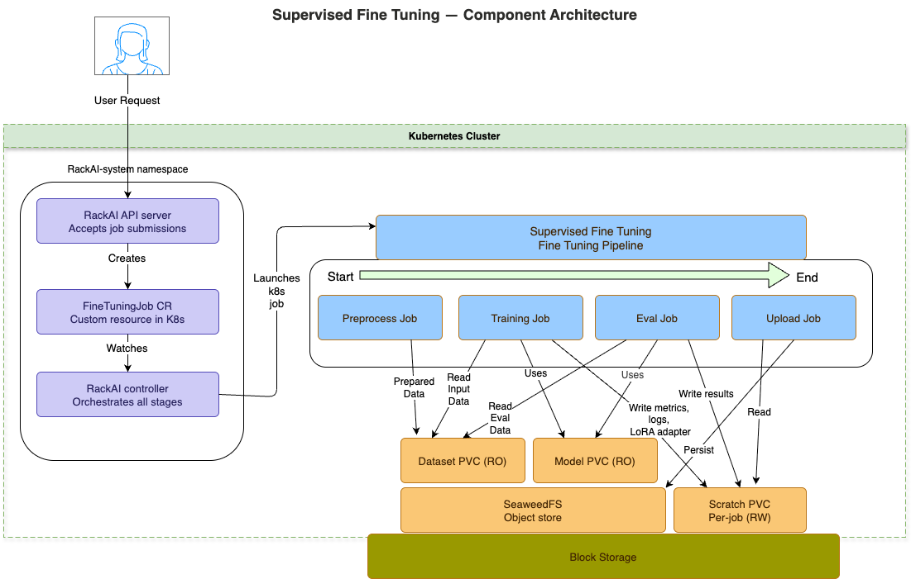
Supervised Fine Tuning

Slide 5
Supervised Fine Tuning – Pipeline stages

Slide 6
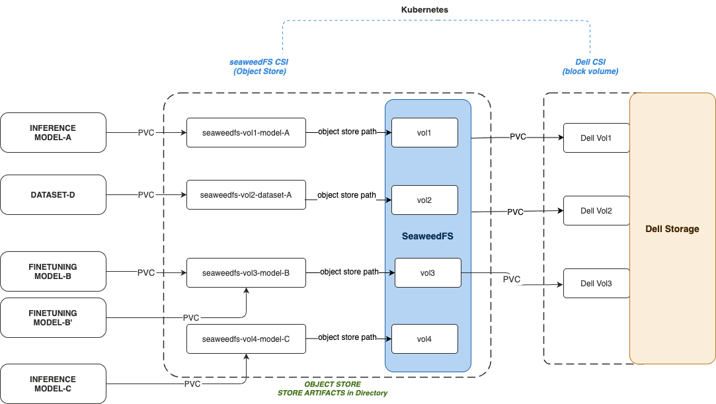
Dataset/Model Store Persistence

