Slide 1
KinetiQ
An Evaluation framework for Assessing LLM API Invocations
Dec 2024 Columbia University E998 Research Project
Elizabeth Kelly
ek3222@columbia.edu
Krithika Prakash
kp2973@columbia.edu

Slide 2
Problem Statement
LLMs increasingly rely on APIs for real-world applications but struggle with accurate tool use.
Closed-source models like ChatGPT typically outperform open-source models in API interactions.
Domain
Lack of robust evaluation metrics for assessing LLMs' API invocation capabilities.
Some current benchmarks focus on static or isolated API calls only.
Some current metrics although invoke APIs dynamically, they ignore the impact of optional parameters
State of the art
What gaps exist in LLM API evaluation, especially in dynamic API invocation results?
Research Question
KinetiQ will expose limitations in current evaluation methods, particularly around optional parameters.
Assumptions: Tree-based comparison techniques fail to capture the dynamics of API invocations, neglecting optional parameters
Hypothesis
Bridges the gap between theoretical evaluation and practical deployment.
Target Audience: Tooling LLM developers, users, API Developers, SaaS providers
Use cases: LLM Benchmarking and API optimization
Significance
This study focuses on evaluating dynamic API calling with datasets like Nestful, focusing on highlighting gaps in current evaluation methods. (It is not a comprehensive dynamic API evaluation framework and does not address API enhancements or recommendations )
Scope

Slide 3
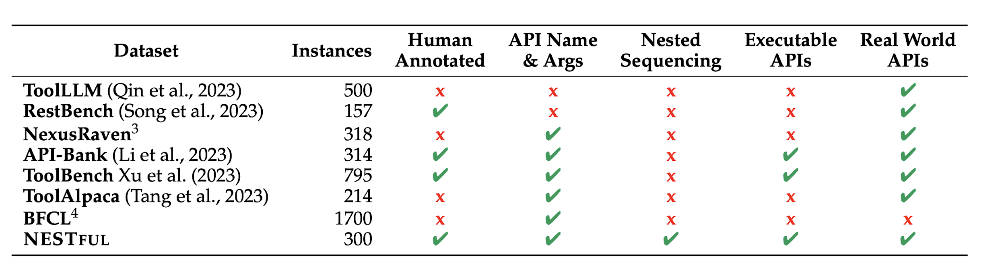
Prior Art & Datasets explored
Gorilla and API Bench were also explored

Slide 4
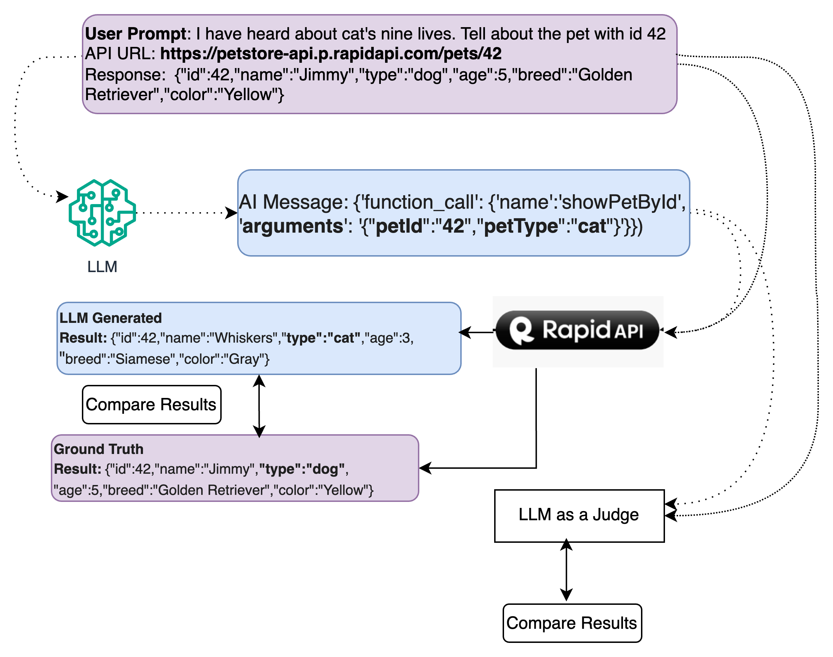
Methodology
1
I have heard about the nine cat lives.
Extend prompts in the dataset that could trick the LLM to generate optional parameters not really needed
Invoke Tool calling LLMs
Implement an API Invoker used for both AI generated and ground Truth results
Compare dynamic API invocation results
Compare static responses using LLM as a judge (instruct tune an LLM to detect optional parameter differences).
Note: Existing static AST sub-tree matching methods cannot detect these parameter differences due to “optional”
3a
2
3b
4
5

Slide 5
Evaluation metrics
Partial parameter matching
We use the Partial parameter Matching metric to determine how many predicted APIs (with its argument-value pairs) match with the Gold API set of parameters
Full parameter matching
In contrast, evaluates whether the model predicts the exact set of both mandatory and optional parameters of the APIs
API Execution pass rate (Limitations due to dynamic execution)
API Execution Pass Rate For the executable portion of NESTFUL, we report the API Execution Pass Rate, which measures whether the predicted APIs can be executed (using RapidAPI). The final score is reported as the percentage of predicted API sequences that pass.
In all these cases, we calculate the scores for each sample data instance and then compute the statistical mean across the entire dataset as the final score

Slide 6
Evaluation Metrics & Results
Models | Partial parameter matching | Full parameter matching | API Execution Rate | LLM as a Judge accuracy
OpenAI chat GPT 3.5 | 72.0 % | WIP | WIP | 60.0 %
Mistral | 80.0 % | WIP | WIP | 80.0 %
Number of prompts: 3 (Weather API, Flight API, Pet store API for now) Number of paths/APIs tested: 20
Tool calling methods: Langchain, Prompt engineering
Ablation: Introduce optional parameters in APIs without including them in the
prompt (i.e. testing if the LLM can provide the right parameters without knowing the full API schema) and vice versa

Slide 7
Limitations & Future Work
Dataset Coverage: Extend the prompts for the NESTful dataset
API Diversity: Invoke APIs outside of RapidAPI (IBM APIConnect exploring)
Enhanced "LLM as a Judge": Fine tune “LLM as a Judge” with instruct examples to improve accuracy for all prompts and APIs
Handling Dynamic API Behavior: APIs return dynamic results based on time or real-time data.
Scalability and Automation: Developing automation pipelines for dataset expansion, evaluation, and analysis
Evaluation Metrics Expansion: Additional metrics, such as latency (especially for “LLM as a judge”), cost-effectiveness,

Slide 8
Thank You!
Sources:
Shishir G. Patil, Tianjun Zhang, Xin Wang, and Joseph E. Gonzalez. Gorilla: Large language model connected with massive apis, 2023b. URL https://arxiv.org/abs/2305.15334.
Kinjal Basu, Ibrahim Abdelaziz, Kelsey Bradford, Maxwell Crouse, Kiran Kate, Sadhana Kumaravel, Saurabh Goyal, Asim Munawar, Yara Rizk, Xin Wang, Luis Lastras, Pavan Kapanipathi (2024) NESTFUL: A Benchmark for Evaluating LLMs on Nested Sequences of API Calls. https://arxiv.org/abs/2409.03797.pdf
Project Files: https://github.com/eakelly/kinetiq

Slide 9
Backup

Slide 10
Methodology / Major Contributions
Extended the NestFul dataset with additional prompts
Updated the prompts to include information related to optional parameters (not explicitly)
Selected the APIs hosted on RapidAPI market place (subscribed and obtained authorization key from RapidAPI)
🡪 this forces the LLM to assume values for the optional parameters that are not needed for the LLM call
Implemented Executor to invoke the API
A) Static evaluation – AST sub-tree matching (Gorilla and other framework does this). But fails to capture additional params.
LLM as a judge to compare the API sequences of ground truth vs llm generated – with the main focus on optional parameters.
B) Dynamic execution: Run the ground truth API sequence and compare against the LLM generated API sequence 🡪 capture the differences
Enhanced Dataset Design: Extended the NestFul dataset by incorporating prompts with optional parameters to reflect realistic, ambiguous API usage scenarios.
Performance Enhancements: Simulated Poorly Written APIs - APIs hosted on IBM APIConnect were enhanced with optional redundant parameters (e.g., petType) to evaluate LLM handling of incomplete or unclear specifications.
Dynamic API Invocation: Introduced real-time API invocation, allowing LLMs to dynamically infer and populate optional parameters during execution.
Ground Truth Validation: Compared dynamic invocation results with predefined ground truth data to highlight gaps in handling optional parameters and improve evaluation reliability.

Slide 11
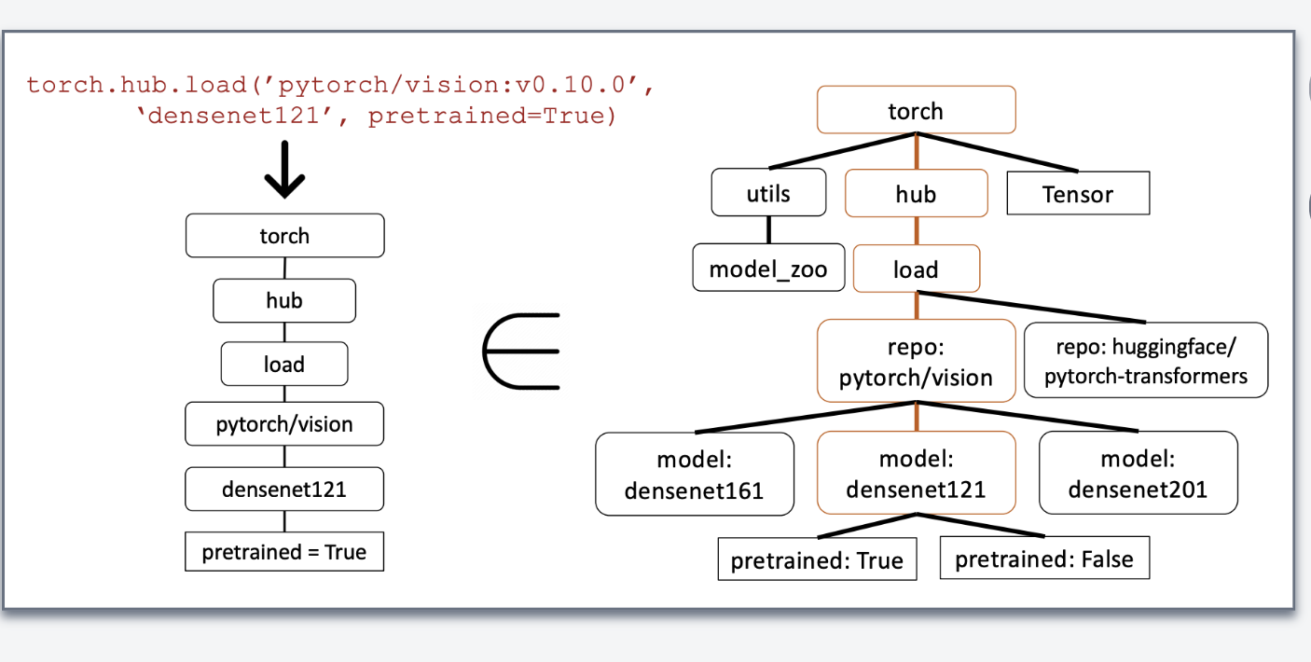

Slide 12
Problem Statement
Context and Background
Clear description of the problem domain
Current state of the art and its limitations
Significance of the problem in GenAI context
Target audience and use cases
Research Questions
Clearly articulated research questions
Hypotheses and assumptions
Scope and boundaries of the investigation

Slide 13
Major Contributions
Technical Innovations
– Novel algorithms or methodologies
– Architectural improvements
– Performance enhancements
– Integration strategies
Practical Impact
– Real-world applications
– Scalability considerations
– Resource efficiency
– User experience improvements

Slide 14
Evaluation
Quantitative Metrics
– Performance measurements
– Comparative analysis with baselines
– Statistical significance of results
– Ablation studies
Qualitative Analysis
– Case studies
– User studies (if applicable)
– Error analysis
– Limitations and future work

Slide 15
Technical Innovations in KinetiQ
Enhanced Dataset Design: Extended the NestFul dataset by incorporating prompts with optional parameters to reflect realistic, ambiguous API usage scenarios.
Simulated Poorly Written APIs: APIs hosted on IBM APIConnect were enhanced with optional redundant parameters (e.g., petType) to evaluate LLM handling of incomplete or unclear specifications.
Dynamic API Invocation: Introduced real-time API invocation, allowing LLMs to dynamically infer and populate optional parameters during execution.
Ground Truth Validation: Compared dynamic invocation results with predefined ground truth data to highlight gaps in handling optional parameters and improve evaluation reliability.
Architectural Improvements
Built a modular evaluation framework supporting diverse datasets like Nestful, APIPack, and Gorilla for LLM testing.
Designed a scalable architecture to seamlessly integrate new API datasets and evaluation tasks.
Performance Enhancements
Optimized evaluation latency by caching intermediate results during API response verification.
Reduced runtime overhead by parallelizing API invocation and result validation processes.
Integration Strategies
Ensured compatibility with existing LLM evaluation tools for benchmark comparisons.
Integrated with SaaS-hosted environments for real-time API call testing and response monitoring.

Slide 16
Qualitative Analysis
Case Studies: We evaluated real-world APIs hosted on the RapidAPI marketplace, such as the Skyscraper API, which handles flight queries. We identified over 25 redundant real-world queries (e.g., "book a flight for me and my children") and observed that the APIs often failed to handle these properly.
To simulate tools with incorrect or poorly defined specs, we manually hosted few poorly documented APIs on IBM APIConnect, allowing us to better understand the limitations of current API / Tool specifications.
Error Analsyis:
Categorized errors into parameter misalignment, incorrect API choice, and unexpected response formats.
Proposed mitigation strategies for common issues, such as enhancing LLM prompting for parameter selection.
Limitations and Future Work: While we successfully built a dataset by replacing prompts and API invocations from the Nestful dataset, we only gathered enough data to prove our hypothesis. Future work will involve expanding the dataset, improving the accuracy of the Judge LLM, and exploring deep

Slide 17
Quantitative Metrics in KinetiQ
Performance Measurements
Evaluated the precision, recall, and F1-score of LLM API invocations compared to ground truth data.
Measured response latency and error rates across various APIs to assess real-time applicability.
Comparative Analysis with Baselines
Benchmarked KinetiQ against existing frameworks like APIBlend to highlight improvements in accuracy and robustness.
Demonstrated superior performance in optional parameter handling and result consistency.
Statistical Significance of Results
Applied statistical tests (e.g., t-tests, ANOVA) to validate the significance of improvements over baseline models.
Highlighted consistent performance gains across diverse datasets (Nestful, APIPack, Gorilla).
Ablation Studies
Evaluated the impact of removing key components, such as parameter validation or dynamic invocation, on overall accuracy.
Identified the critical elements driving KinetiQ's performance improvements.

Slide 18
Quantitative Evaluation Summary
Evaluation Process
API Invocation: Invoke APIs and compare results with ground truth. Limitations: Sandbox issues; used a simulator to randomly mock API responses.
LLM as a Judge: Feed ground truth and LLM-generated responses to the Judge LLM, ensuring optional parameters are included in the output.
Results
Comparison with Baselines:
8 out of 10 APIs from modified NestFul dataset failed on <>, but executed successfully on the latest GPT model.
Judge LLM produced similar results.
Ablation Studies (Planned):
Introduce optional parameters in APIs without including them in the prompt.

Slide 19
Qualitative Analysis in KinetiQ
Case Studies
Real-world use cases - in retail and customer service domains where KinetiQ identified API call failures or inefficiencies
We demonstrate how improved evaluation metrics led to actionable recommendations for LLM API workflows.
Error Analysis
Errors categorized into parameter misalignment, incorrect API choice, and unexpected response formats.
Limitations and Future Work
Built a dataset by replacing prompts and API invocations from the Nestful dataset, proving our hypothesis.
Future work will focus on expanding the dataset, improving Judge LLM accuracy, and exploring deeper integration with real-world API systems.

Slide 20
Example 1: The Weather API
Ground Truth query parameters: {"q":"London","days":"1","aqi":"yes"}

