Slide 1
Regularization

Slide 2
Regularization
Regularization is a technique used to reduce errors by fitting the function appropriately on the given training set and avoiding overfitting.

Slide 3
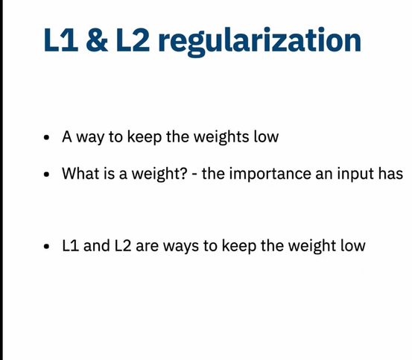
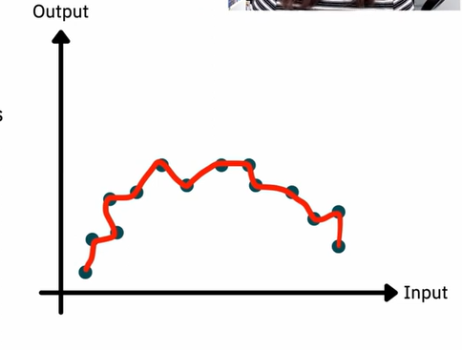
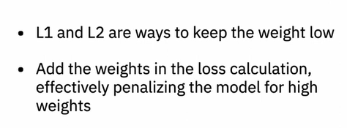

Slide 4

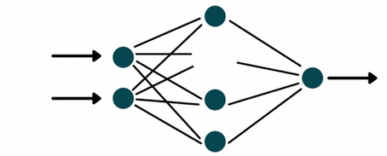

Slide 5

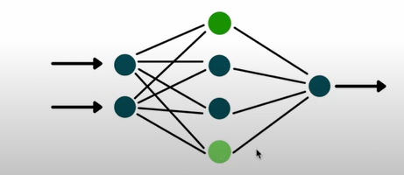

Slide 6
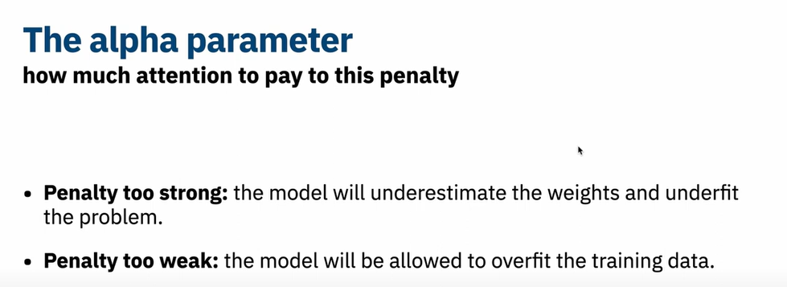

Slide 7
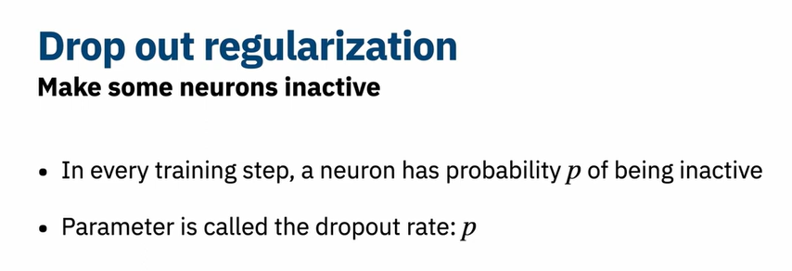


Slide 8

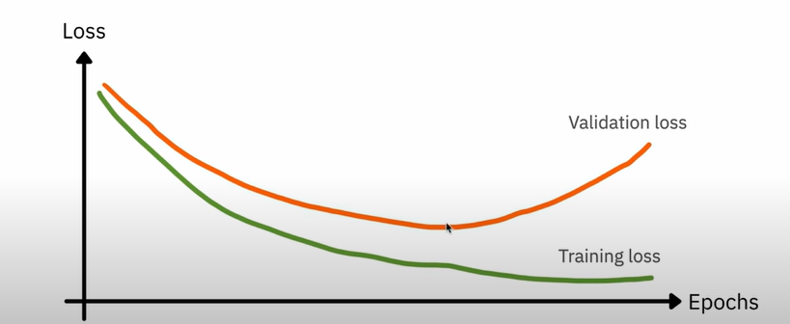

Slide 9
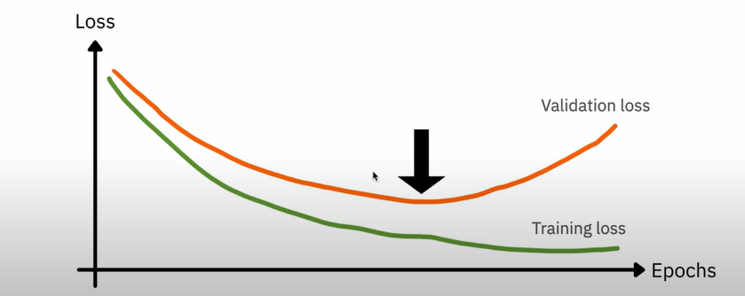

Slide 10

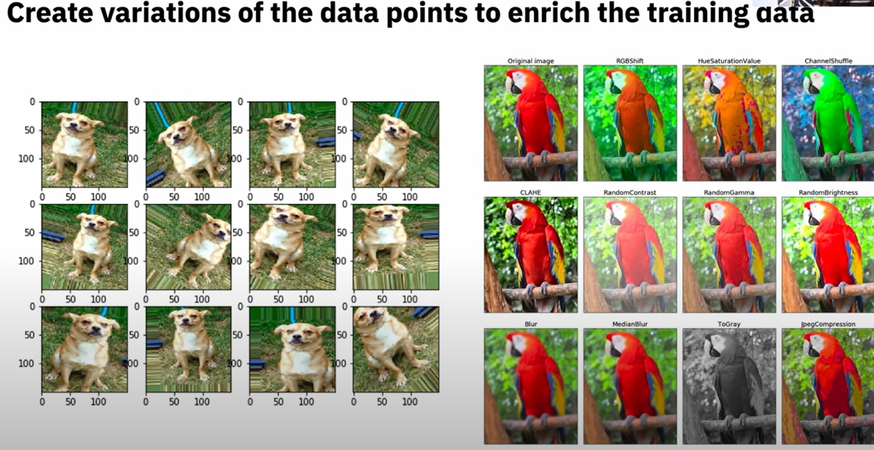

Slide 11
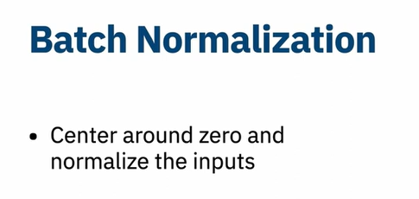
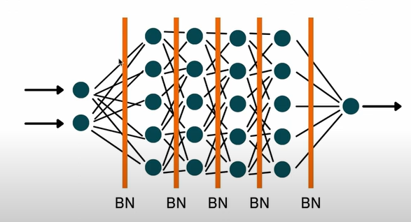
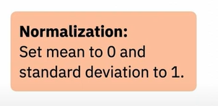

Slide 12
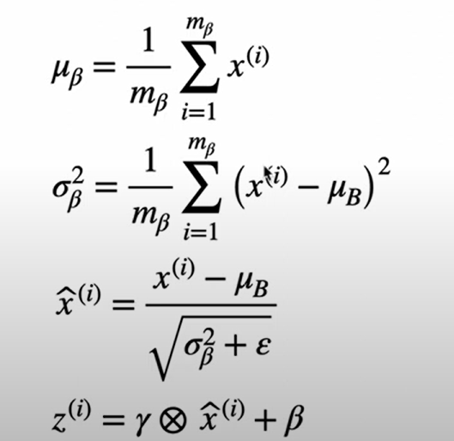

Slide 13
By applying Batch Normalization into the hidden layers of the network, the gradients propagated during backpropagation are less likely to vanish or explode, leading to more stable training dynamics. This ultimately facilitates faster convergence and better performance of the neural network on the given task.

Slide 14
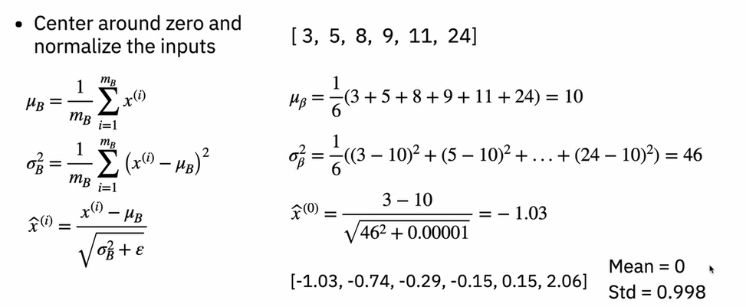

Slide 15
