Slide 1

Time Series Forecasting with Keras
Enes AKGUN
eakgun161@gmail.com

Slide 2
Installation Tips
Prefer Conda package manager over pip.
Do NOT install Keras on your base environment, create a new environment.
Conda command description | Syntax
Create a new environment named py35, install Python 3.5 | conda create --name py35 python=3.5
Activate the new environment to use it | activate py35
Get a list of all my environments, active environment is shown with * | conda env list
Install a package | conda install PACKAGENAME
List all packages and versions installed in active environment | conda list

Slide 3
Check for available GPUs
import tensorflow as tf
print("Num GPUs Available: ", len(tf.config.list_physical_devices('GPU')))

Slide 4
Data that we are dealing with: dataset.csv
Date, Time, temp
05/12/2018,13:00:00,12.894430
05/12/2018,14:00:00,13.786860
05/12/2018,15:00:00,14.377980
05/12/2018,16:00:00,14.705680
05/12/2018,17:00:00,14.429200
05/12/2018,18:00:00,13.663510
05/12/2018,19:00:00,12.801050
05/12/2018,20:00:00,12.463490
05/12/2018,21:00:00,12.580490
05/12/2018,22:00:00,12.456000
05/12/2018,23:00:00,12.269040
06/12/2018,00:00:00,12.007520

Slide 5
Data Preprocessing and Preparation
Reading
Filtering, cleaning and indexing
Splitting
Reframing time-series as supervised learning problem (Sliding Window)

Slide 6
df = pd.read_csv(‘path_to_dataset.csv’)
 | Date_time | temp
0 | 2015-12-31 00:00:00 | 3.60282
1 | 2015-12-31 01:00:00 | 3.52037
2 | 2015-12-31 02:00:00 | 2.03573
3 | 2015-12-31 03:00:00 | 0.51446
4 | 2015-12-31 04:00:00 | 0.42179
... | ... | ...
27115 | 2019-12-31 19:00:00 | 0.00000
27116 | 2019-12-31 20:00:00 | 0.00000
27117 | 2019-12-31 21:00:00 | 0.00000
27118 | 2019-12-31 22:00:00 | 0.00000
27119 | 2019-12-31 23:00:00 | 0.00000

Slide 7
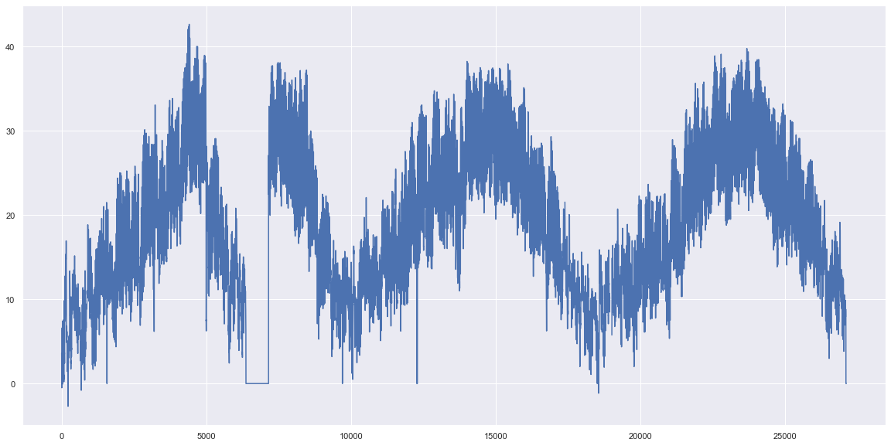
df['temp'].plot()

Slide 8
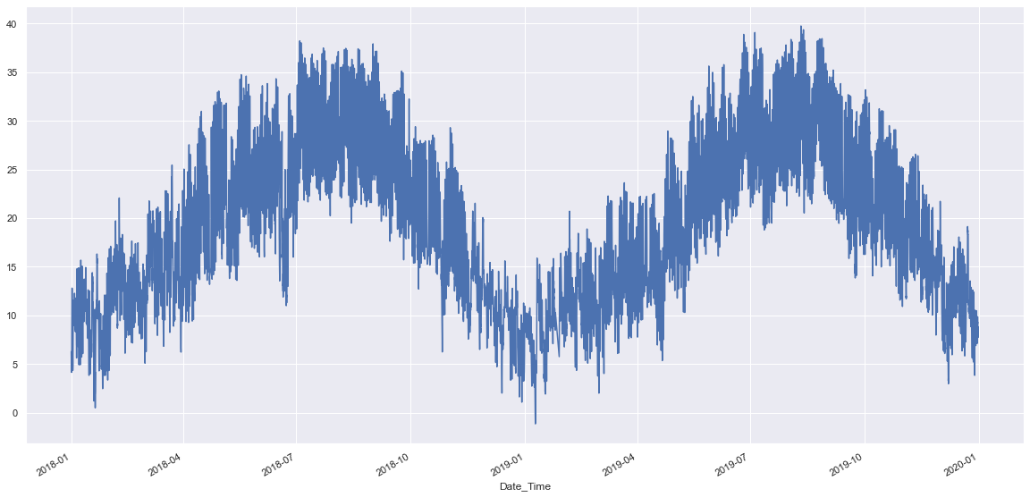
df.index = pd.to_datetime(df['Date_Time’]) #Use date-time as an index
df= df[df['temp'] != 0] #keep only non-zero values
tempData = df['temp’]
tempData = tempData.dropna()
tempData = tempData['2018':'2019']

Slide 9
Sliding Window
t | measurement
0 | 10
1 | 20
2 | 30
3 | 40
4 | 50
5 | 60

Slide 10
Sliding Window
10
20
30
40
50
60
10 | 20
20 | 30
30 | 40
40 | 50
50 | 60
60 | ?
? | 10 | 20
10 | 20 | 30
20 | 30 | 40
30 | 40 | 50
40 | 50 | 60
50 | 60 | ?
Window width = 1
Window width = 2

Slide 11
Multi-Step or Sequence Forecasting
10
20
30
40
50
60
70
Window size = 3
Forecast length = 2
10 | 20 | 30
20 | 30 | 40
30 | 40 | 50
40 | 50
50 | 60
60 | 70
X
y
F(X) = y

Slide 12
Timeseries to X_y
def df_to_X_y(df, window_size, forecast_length):
df_as_np = df.to_numpy()
X = []
y = []
for i in range(len(df_as_np) - window_size - forecast_length +1):
row_x = [[a] for a in df_as_np[i:i+window_size]]
X.append(row_x)
# row_y = df_as_np[i+window_size]
row_y = [b for b in df_as_np[i+window_size:i+window_size+forecast_length]]
y.append(row_y)
return np.array(X), np.array(y)

Slide 13
Keras Data Loading
Keras models accept three types of inputs:
NumPy arrays* array([10, 20, 30, 40, 50, 60, 70, 80])
TensorFlow Dataset objects
Python generators that yield batches of data

Slide 14
Building the Model architecture
Set layers
Compile the model (select optimizer, performance metrics, loss function)
Fit the model (select no_epochs, batch_size, callbacks…)
Evaluate the model
Save the best model
Predict with the saved model

Slide 15
Keras Sequential Model
model = Sequential()
model.add(Conv1D(filters=256, kernel_size=3, activation='relu', input_shape=(time_steps, n_features)))
model.add(MaxPooling1D(pool_size=2))
model.add(Flatten())
model.add(Dense(50, activation='relu'))
model.add(Dense(1))
model.compile(optimizer='adam', loss='mse')
#fit model
model.fit(X, y, epochs=1000, verbose=0)
#demonstrate preds
X_input = array([90, 100,110, 120])
X_input= X_input.reshape((1, time_steps, n_features))
yhat = model.predict(X_input, verbose=0)
print(yhat)

Slide 16
Model Training History
save_weights_at = filePath
save_best = ModelCheckpoint(save_weights_at, monitor='val_loss', verbose=0,
save_best_only=True, save_weights_only=False, mode='min')
history = model.fit(X_train,
y_train,
validation_data=(X_val,y_val),
epochs=no_epochs,
batch_size=batchSize,
callbacks=[save_best, rlrop],
shuffle=True)
# score = model.evaluate(X_test, y_test, verbose = 1)
plt.figure(2)
plt.plot(history.history['loss'], color = 'red', label='Loss')
plt.plot(history.history['val_loss'], color = 'green', label = 'Validation Loss')
plt.legend(['Loss', 'Val_loss'], loc='upper right')

Slide 17
X_forecast, y_forecast= df_to_X_y(to_pred, WINDOW_WIDTH, FORECAST_LENGTH)
def forecast(X, predictHorizon, forecast_length):
future = []
currentStep = np.array([X[0]]) #last step from the previous prediction
realPredictHorizon = predictHorizon//forecast_length
if realPredictHorizon < 1:
realPredictHorizon = 1
print(currentStep.shape)
print('Calculated predict horizon: ', realPredictHorizon)
for i in range(realPredictHorizon):
prediction = model.predict(currentStep)
# print(i)
print(currentStep.shape)
future.append(prediction)
prediction = prediction.reshape(1, FORECAST_LENGTH, 1)
currentStep = np.delete(currentStep,np.arange(FORECAST_LENGTH),axis=1)
currentStep = np.append(currentStep,prediction,1)
return future, currentStep
future, currentStep = forecast(X_forecast, predictHorizon, FORECAST_LENGTH)
future = np.array(future)
future = future.flatten()

Slide 18
Forecast(Window_size=3, forecast_length=2)
1 | 2 | 3 | 4 | 5 | 6 | 7 | … | 25 | 26 | 27 | 28 | 29 | 30 | 31 | 32 | 33
25 | 26 | 27 | 28 | 29 | 30 | 31 | 32 | 33
25 | 26 | 27
26 | 27 | 28
27 | 28 | 29
28 | 29 | 30
29 | 30 | 31
30 | 31 | 32
31 | 32 | 33
predict( )
=
31 | 32 | 33
34 | 35
predict( )
=
33 | 34 | 35
36 | 37
predict( )
=
35 | 36 | 37
38 | 39
31 | 32 | 33
FUTURE =
34 | 35 | 36 | 37 | 38 | 39

Slide 19
Hyper-Parameter Optimization with Keras Tuner
import keras_tuner as kt
from tensorflow import keras
def build_model(hp):
model = keras.Sequential()
model.add(keras.layers.Dense(
hp.Choice('units', [8, 16, 32]),
activation='relu'))
model.add(keras.layers.Dense(1, activation='relu'))
model.compile(loss='mse')
return model
tuner = kt.RandomSearch(
build_model,
objective='val_loss',
max_trials=5)
tuner.search(x_train, y_train, epochs=5, validation_data=(x_val, y_val))
best_model = tuner.get_best_models()[0]

Slide 20
KerasTuner HyperModels
class MyHyperModel(kt.HyperModel):
def build(self, hp):
model = keras.Sequential()
model.add(keras.layers.Dense(
hp.Choice('units', [8, 16, 32]),
activation='relu'))
model.add(keras.layers.Dense(1, activation='relu'))
model.compile(loss='mse')
return model

Slide 21
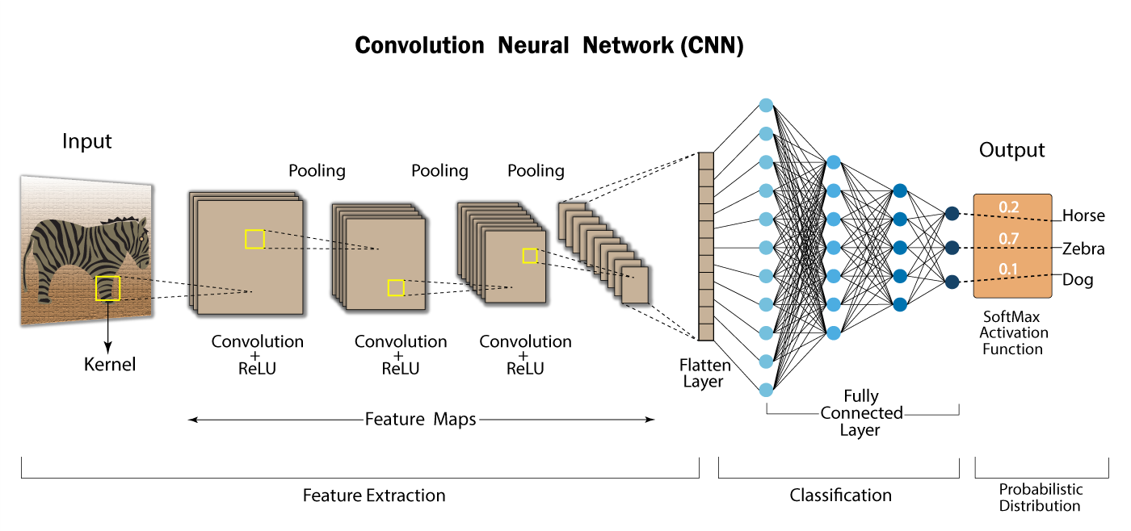
Extras

