Slide 1

KK Invaders
Презентация проекта по C++11
Квасный Алексей
Курников Егор

Slide 2
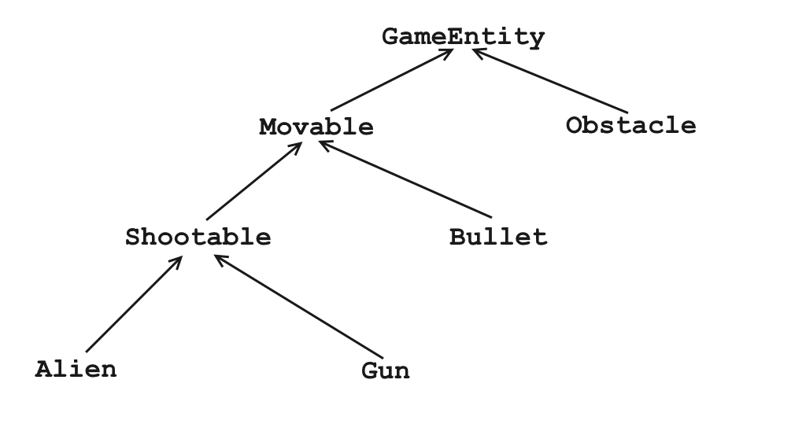
Иерархия наследования

Slide 3
Некоторые классы
Point2D
Singleton
Box2D
Logger
Main window
Textured rect
Space widget

Slide 4
Game Entity
class GameEntity
{
public: virtual ~GameEntity() = default; virtual void SufferDamage(int amount); bool IsCreated() const; void SetHP(unsigned int hp); unsigned int GetHP() const; void SetCoordinate(Point2D const & coordinate); Point2D const & GetCoordinate() const; void SetX(float const & x); void SetY(float const & y); Box2D const & GetBody() const; float GetWidth() const; float GetHeight() const; virtual void PrintInfo(std::ostream & os); static bool DoObjectsIntersect(GameEntity const & obj1, GameEntity const & obj2); void Kill();
protected: GameEntity(); bool m_isAlive = false; bool m_isCreated = false; unsigned int m_hp = 0; float m_height, m_width = 0.0f; Point2D m_coordinate = {0.0f, 0.0f}; Box2D m_body = {0.0f, 0.0f, 0.0f, 0.0f}; std::string m_info = "";
};

Slide 5
Obstacle
class Obstacle : public GameEntity
{
public: Obstacle(); Obstacle(Point2D const & obj); Obstacle(Box2D const & obj); void SufferDamage(int amount) override; bool IsAlive() const; void PrintInfo(std::ostream & os) override;
};

Slide 6
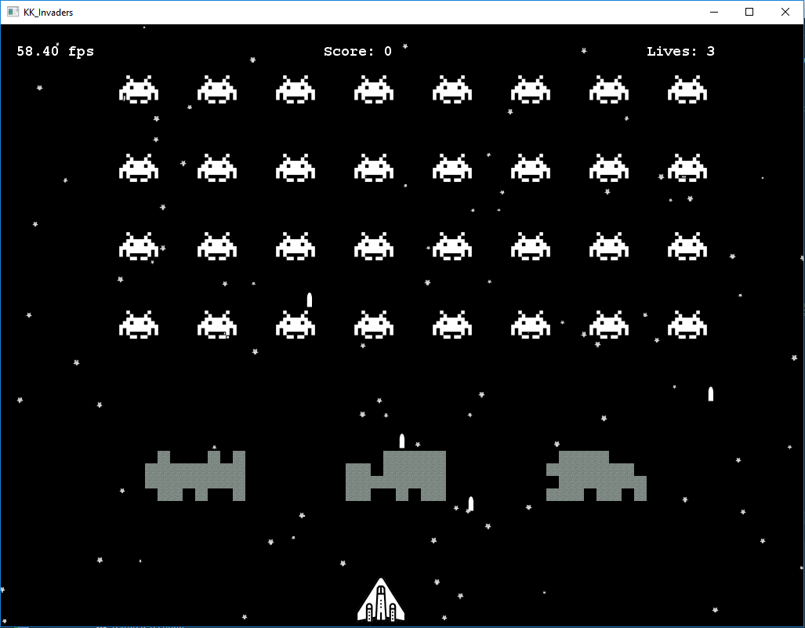
Пример окна

Slide 7
Movable
class Movable : public GameEntity
{
public: virtual ~Movable() = default; virtual Movable const & Move(); void SetSpeed(float speed); float GetSpeed() const; protected: Movable() = default; float m_speed = 0.0f;
};

Slide 8
Bullet
class Bullet : public Movable
{
public:
Bullet(); Bullet(Shootable & shooter); Bullet(Ray2D const & obj, Shootable & shooter); Bullet(Ray2D const & obj, float speed,
float damage, Shootable & shooter); Bullet const & Move() override; bool IsAlive() const; void SetDamage(float damage); float GetDamage() const; Ray2D GetTrajectory() const; Shootable * GetShooter() const; void Notify() const; void Hit(GameEntity & obj); void PrintInfo(std::ostream & os) override;
private: bool m_isAlive = false; float m_damage = BULLET_DAMAGE; Ray2D m_trajectory = {0.0f, 1.0f, 0.0f, 0.0f}; Shootable * m_viewerFirst; GameEntity * m_viewerSecond; };

Slide 9
Bullet
Shootable * m_viewerFirst;
GameEntity * m_viewerSecond;
void Bullet::Notify() const
{
m_viewerFirst->CauseDamage(m_damage);
m_viewerSecond->SufferDamage(m_damage);
}
void Bullet::Hit(GameEntity & obj)
{
m_viewerSecond = &obj;
Notify();
}

Slide 10
Gun
class Gun : public Shootable
{
public: Gun(); Gun(Point2D const & obj); Gun(Point2D const & obj, unsigned int const Ammo, float firingRate); Gun const & Move(float const shift); void Shot() override; void SufferDamage(int amount) override; void CauseDamage(int amount) const override; bool IsAlive() const; void PrintInfo(std::ostream & os) override; int GetScore() const; int GetNumberOfLives() const;
private: int m_score = 0; int m_numberOfLives = 0;
};

Slide 11
Alien
class Alien : public Shootable
{
public: Alien(); Alien(Point2D const & obj); Alien(Box2D const & obj); Alien const & Move() override; Alien & MoveDown(); void Shot() override; void SufferDamage(int amount) override; void CauseDamage(int amount) const override; bool IsAlive() const; float GetXshift() const; float GetYshift() const; void Refract(); void PrintInfo(std::ostream & os) override;
private: float m_yShift = 5.0f; float m_xShift = 1.0f; };
void SpaceWidget::RenderAliens()
{
for(int i = 0; i < m_aliens.size(); ++i)
{
m_texturedRect->Render(m_textureAlien,
Point2D(static_cast<int>(m_aliens[i]->Move().GetCoordinate().x()),
static_cast<int>(m_aliens[i]->Move().GetCoordinate().y())),
QSize(ALIEN_WIDTH, ALIEN_HEIGHT),
m_screenSize);
}
}

Slide 12
Templates
template <typename T> class Singleton
{
public: static T & Instance()
{
static T inst;
return inst;
}
protected: Singleton() = default; ~Singleton() = default; Singleton(Singleton const &) = delete;
Singleton(Singleton &&) = delete; Singleton & operator = (Singleton const &) = delete;
Singleton & operator = (Singleton &&) = delete; };
class Factory : public Singleton<Factory>
{
public: template <typename T, typename ... Args>
std::unique_ptr<T> Create(Args && ... args)
{
return std::unique_ptr<T>(new T(std::forward<Args>(args)...));
}
private:
friend class Singleton<Factory>;
Factory() = default;
};

Slide 13
Templates
template <typename EntityType, template<typename, typename> class C>
void Log(C <EntityType, std::allocator<EntityType>> const & objs, ActionType actionType)
{
m_file.open("Log.txt", ios::app);
if (m_file.is_open())
{
for (auto const & obj : objs)
Log(obj, actionType);
m_file.close();
}
}
template <typename T, template <typename, typename> class C>
std::ostream & operator << (std::ostream & os, C<T, std::allocator<T> > const & objs)
{
for (auto const & obj : objs) os << obj << ' '; return os;
}

Slide 14
Qt
#include <QMainWindow>
#include <QPushButton>
#include <QIcon>
#include <QLabel>
#include <QPixmap>
#include <QLineEdit>
#include <QWidget>
#include <QGridLayout>
#include <QSlider>
#include <QFont>
#include <QApplication>
#include <QRadioButton>
#include <QSound>
#include <QTimer>
#include <QOpenGLWidget>
QSound * m_mainTheme = new
QSound("data/Main-theme.wav");
…
m_mainTheme->play();
m_mainTheme->setLoops(QSound::Infinite);

Slide 15
Qt
// Настройки пушки
m_centralWidgetGun = new QWidget(m_centralWidget);
m_centralWidgetGun->setStyleSheet("background-color:black;");
m_layoutGun = new QGridLayout(m_centralWidgetGun);
m_labelGun = new QLabel("Настройки пушки", m_centralWidgetGun);
m_labelGun->setStyleSheet("QLabel {color : Red; }");
m_labelGun->setAlignment(Qt::AlignCenter);
m_labelGunHP = new QLabel("HP:", m_centralWidgetGun);
m_labelGunHP->setStyleSheet("QLabel {color : White; }");
m_sliderGunHP = new QSlider(Qt::Horizontal, m_centralWidgetGun);
m_sliderGunHP->setRange(GUN_HP_MIN, GUN_HP_MAX);
m_labelValueGunHP = new QLabel(std::to_string(m_sliderGunHP->value()).c_str(), m_centralWidgetGun);
m_labelValueGunHP->setAlignment(Qt::AlignRight);
m_labelValueGunHP->setStyleSheet("QLabel {color : White; }");
connect(m_sliderGunHP, SIGNAL(valueChanged(int)), m_labelValueGunHP, SLOT(setNum(int)));

Slide 16
GL Widget
// Настройки пушки
m_centralWidgetGun = new QWidget(m_centralWidget);
m_centralWidgetGun->setStyleSheet("background-color:black;");
m_layoutGun = new QGridLayout(m_centralWidgetGun);
m_labelGun = new QLabel("Настройки пушки", m_centralWidgetGun);
m_labelGun->setStyleSheet("QLabel {color : Red; }");
m_labelGun->setAlignment(Qt::AlignCenter);
m_labelGunHP = new QLabel("HP:", m_centralWidgetGun);
m_labelGunHP->setStyleSheet("QLabel {color : White; }");
m_sliderGunHP = new QSlider(Qt::Horizontal, m_centralWidgetGun);
m_sliderGunHP->setRange(GUN_HP_MIN, GUN_HP_MAX);
m_labelValueGunHP = new QLabel(std::to_string(m_sliderGunHP->value()).c_str(), m_centralWidgetGun);
m_labelValueGunHP->setAlignment(Qt::AlignRight);
m_labelValueGunHP->setStyleSheet("QLabel {color : White; }");
connect(m_sliderGunHP, SIGNAL(valueChanged(int)), m_labelValueGunHP, SLOT(setNum(int)));

Slide 17
GL Widget
for(int i = 0; i < m_starsNumber; i++)
m_stars.push_back(Star());
for(int j = 0; j < NUMBER_OF_LINES; j++)
{
for(int i = 0; i < NUMBER_OF_ALIENS_IN_LINE; i++)
m_aliens.push_back(Factory::Instance().Create<Alien>(Point2D(i * 100.0f + 50.0f, j * 100.0f + 400.0f)));
}
m_gun = Factory::Instance().Create<Gun>(Point2D(m_screenSize.rwidth() / 2, GUN_HEIGHT / 2));
Point2D m_start ;
for(int k = 1; k <= NUMBER_OF_GROUPS; k++)
{
m_start = {k * m_screenSize.rwidth() / 4 - OBSTACLE_WIDTH * 4, 200 - OBSTACLE_HEIGHT * 2};
for(int j = 0; j < 4; j++)
{
for(int i = 0; i < 8; i++)
m_obstacles.push_back(Factory::Instance().Create<Obstacle>(Point2D(m_start.x() + i * OBSTACLE_WIDTH, m_start.y() + j *
OBSTACLE_HEIGHT)));
}
}

Slide 18
GL Widget
void GLWidget::RenderAliens()
{
for(int i = 0; i < m_aliens.size(); ++i)
{
if ((m_aliens[i]->GetCoordinate().x() + ALIEN_WIDTH / 2 > m_screenSize.rwidth()
|| m_aliens[i]->GetCoordinate().x() - ALIEN_WIDTH / 2 < 0) && m_aliens[i]->IsAlive())
{
for(int j = 0; j < m_aliens.size(); ++j)
{
m_aliens[j]->Refract();
m_aliens[j]->MoveDown();
}
break;
}
}

Slide 19
GL Widget
for(int i = 0; i < m_aliens.size(); ++i)
{
m_texturedRect->Render(m_textureAlien,
Point2D(static_cast<int>(m_aliens[i]->Move().GetCoordinate().x()),
static_cast<int>(m_aliens[i]->Move().GetCoordinate().y())),
QSize(ALIEN_WIDTH, ALIEN_HEIGHT), m_screenSize);
}
}

Slide 20
Спасибо за внимание

