Slide 1
My first presentation

Slide 2
This is the second slide
First line
Second Line
Third line

Slide 3
Table Example
a | b | c
1 | 11 | 21
2 | 12 | 22
3 | 13 | 23
4 | 14 | 24
5 | 15 | 25
6 | 16 | 26
7 | 17 | 27
8 | 18 | 28
9 | 19 | 29
10 | 20 | 30

Slide 4
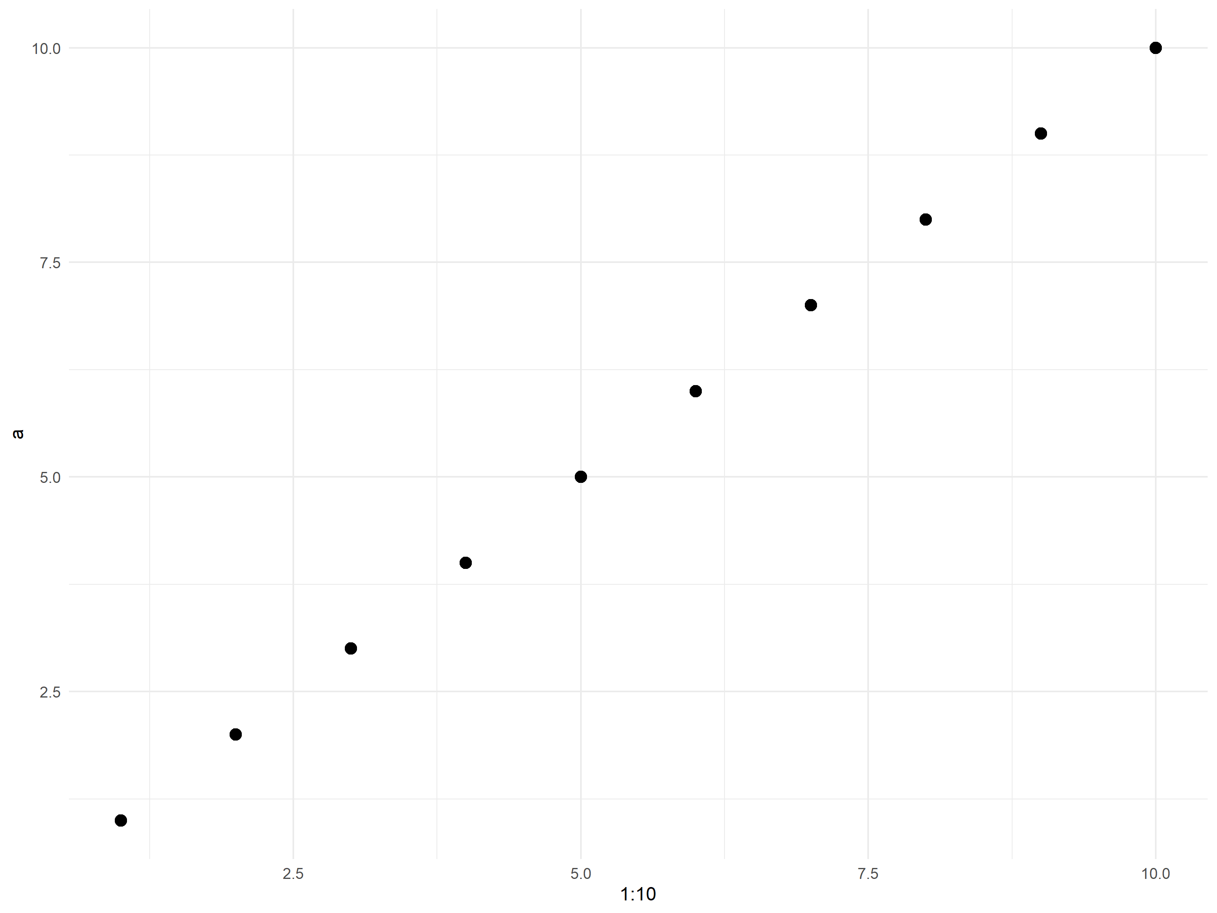

Slide 5
This line is bold
This line is green and Arial

