Slide 1

Comparison of Different Algorithms for Classification of Different Types of Cancer
This Photo by Unknown Author is licensed under CC BY

Slide 2

Dataset
1. Dataset contains 881 samples
2. Each sample contains 20551 features-gene expression values
3. All 881 samples belong to 5 cancer cell lines: PRAD, LUAD, BRCA, KIRS, and COAD
This Photo by Unknown Author is licensed under CC BY-SA

Slide 3
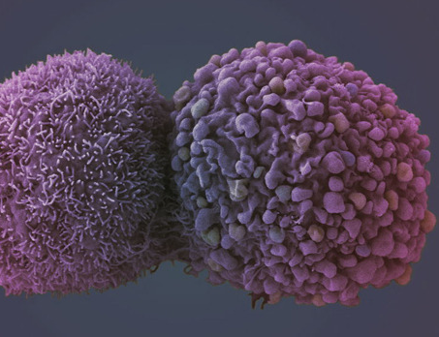
Methods
1. The number of features will be reduced to two from 20551 using principal component analysis (PCA)
2. The K means method was applied to all samples to cluster them based on two features
3. The DBSCAN algorithm was applied to all samples to cluster them based on two features
This Photo by Unknown Author is licensed under CC BY-SA-NC

Slide 4
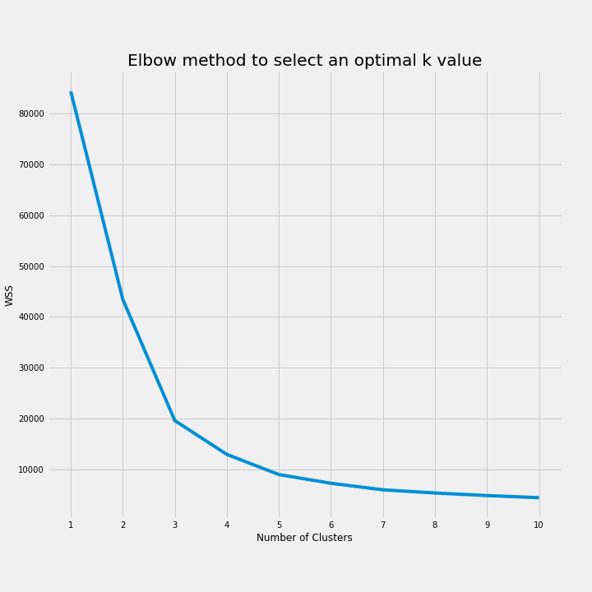
K means: Selecting the K Value
The elbow method was applied to estimate an optimal number of k-value.
The k value 5 was selected for this project.

Slide 5
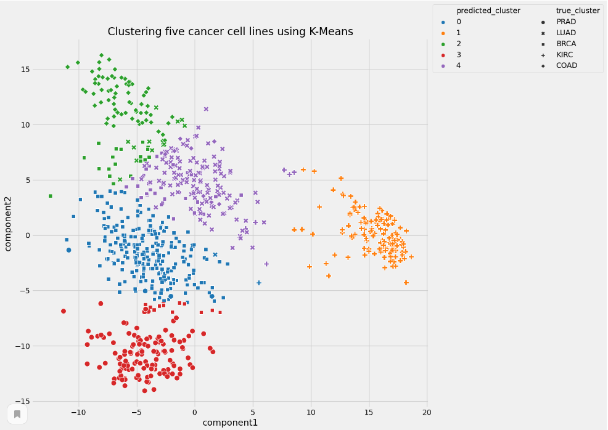
K Means
Separated samples into 5 clusters based on two principal components.

Slide 6
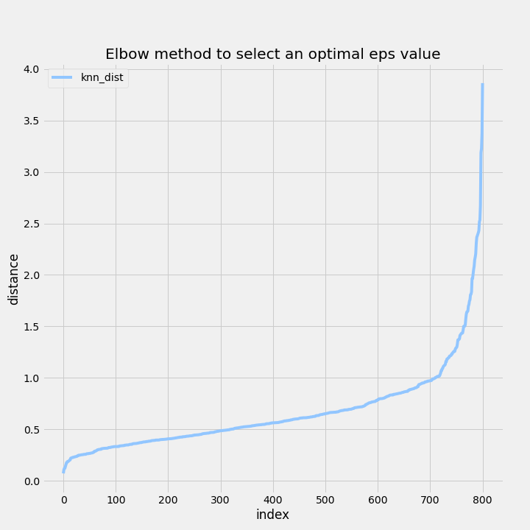
DBSCAN. Selecting an optimal eps value
Two optimal values, 1 and 1.5, were selected for the following consideration.

Slide 7
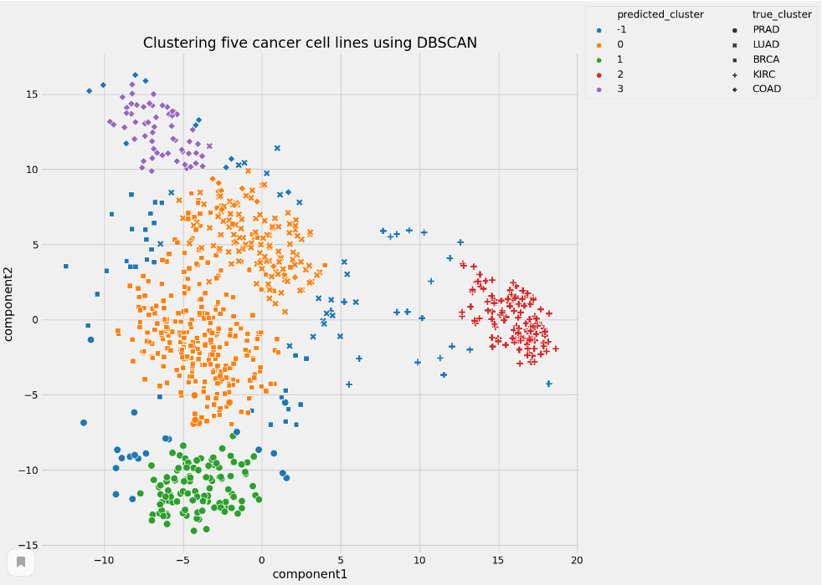
DBSCAN Clustering
Parameters:
eps=1.5
min_samples=15

Slide 8
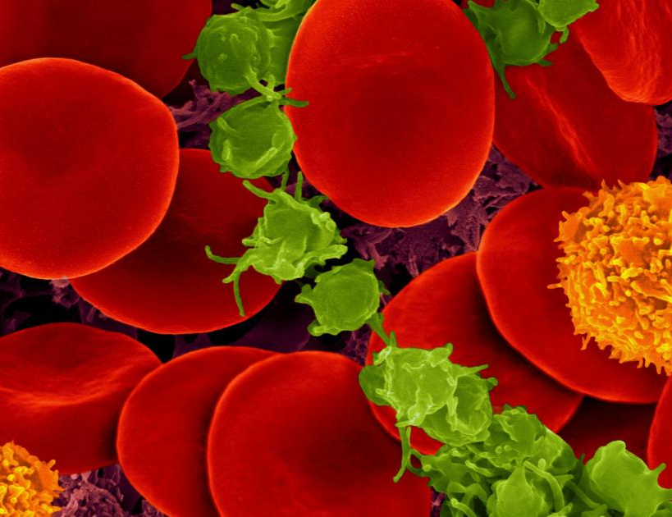
Conclusions
1. The k-means algorithm performance-silhouette_score=0.512, adjusted_rand_index=0.722
2. DBSCAN algorithm performance- silhouette_score=0.379, adjusted_rand_index=0.523
3. The k means algorithm is much more effective in terms of clustering of cancer cell lines based on gene expression in comparison with DBSCAN
This Photo by Unknown Author is licensed under CC BY-ND

