Slide 1
Deep Demographic Insights from Amazon Customer Data
By Earnest Long

Slide 2
Overview
Introduction
Data Wrangling
Exploratory Data Analysis (EDA)
Inferential Statistics
Machine Learning
Conclusion & Recommendations

Slide 3
Introduction

Slide 4


The QuickSnapⓇ Replaceable Cat Scratcher
by Feline Innovations

Slide 5
Why Data Science?
Marketing: The Art Of Masterful Storytelling
(h/t Forbes, by Bill Carmody)
Two Questions:
What stories to tell?
To whom do we tell them?
Answer: Experience or….

Slide 6
Data Science: The Roadmap to Insight
The magic of Data Science: Raw Data --> Insights
Step 1: Get the data
Amazon Fulfillment Reports
U.S. Demographic Data (data.gov)
Step 2: Clean the data
Convert to a format that makes structured analysis possible & convenient

Slide 7
Data Science: The Fundamentals
Step 3: Explore the data
Visualize!
Step 4: Statistical Analysis
Understand the data through statistics
Step 5: Machine Learning
Selectively apply algorithms to make predictions or uncover patterns

Slide 8
Data Wrangling
“Data wrangling, sometimes referred to as data munging, is the process of transforming and mapping data from one "raw" data form into another format with the intent of making it more appropriate and valuable for a variety of downstream purposes such as analytics.” - Wikipedia

Slide 9
Cleaning: Amazon Data
Monthly Fulfillment / Order Reports -> Merge into One
Filter out invalid orders (cancelled, internal, etc.)
Format & Standardize ZIP Codes
Some 5 digits, some 9 digits
Leading 0 truncation (Excel)

Slide 10
Cleaning: Demographic Data
Summary / special rows deleted
ZIP Code = 0 => Aggregated values for each AGI bin
ZIP Code = 99999 => “ZIP codes with less than 100 returns and those identified as a single building or nonresidential ZIP code”

Slide 11
Exploratory Data Analysis (EDA)
“In statistics, exploratory data analysis (EDA) is an approach to analyzing data sets to summarize their main characteristics, often with visual methods.” - Wikipedia

Slide 12
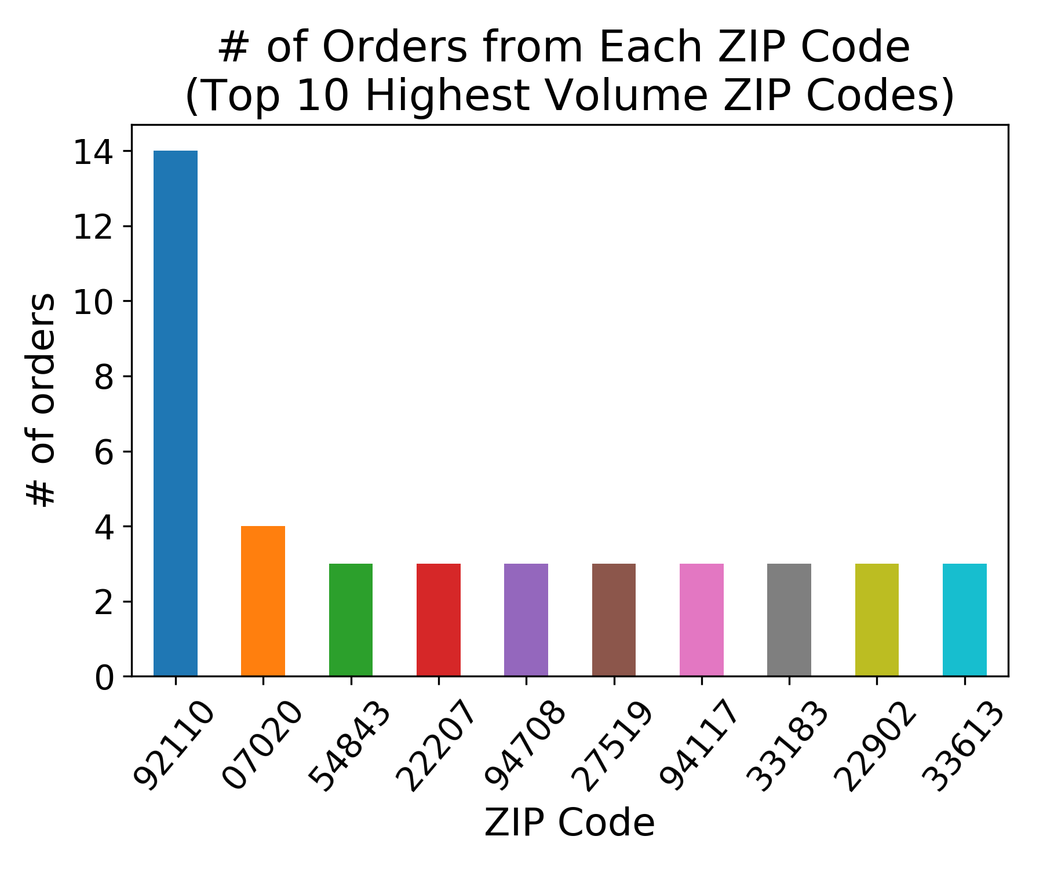
In which ZIP codes do most of our customers reside?
San Diego, CA
Edgewater, NJ

Slide 13
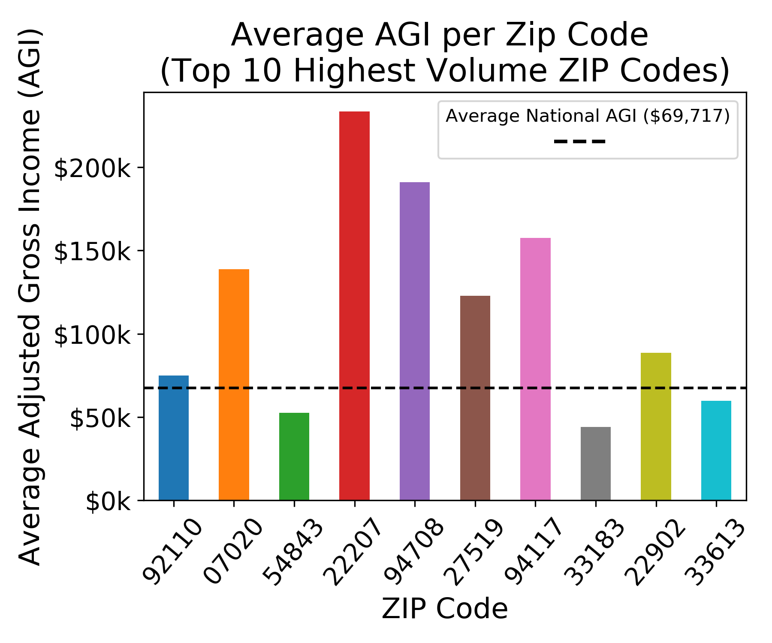
How wealthy are those ZIP Codes?

Slide 14
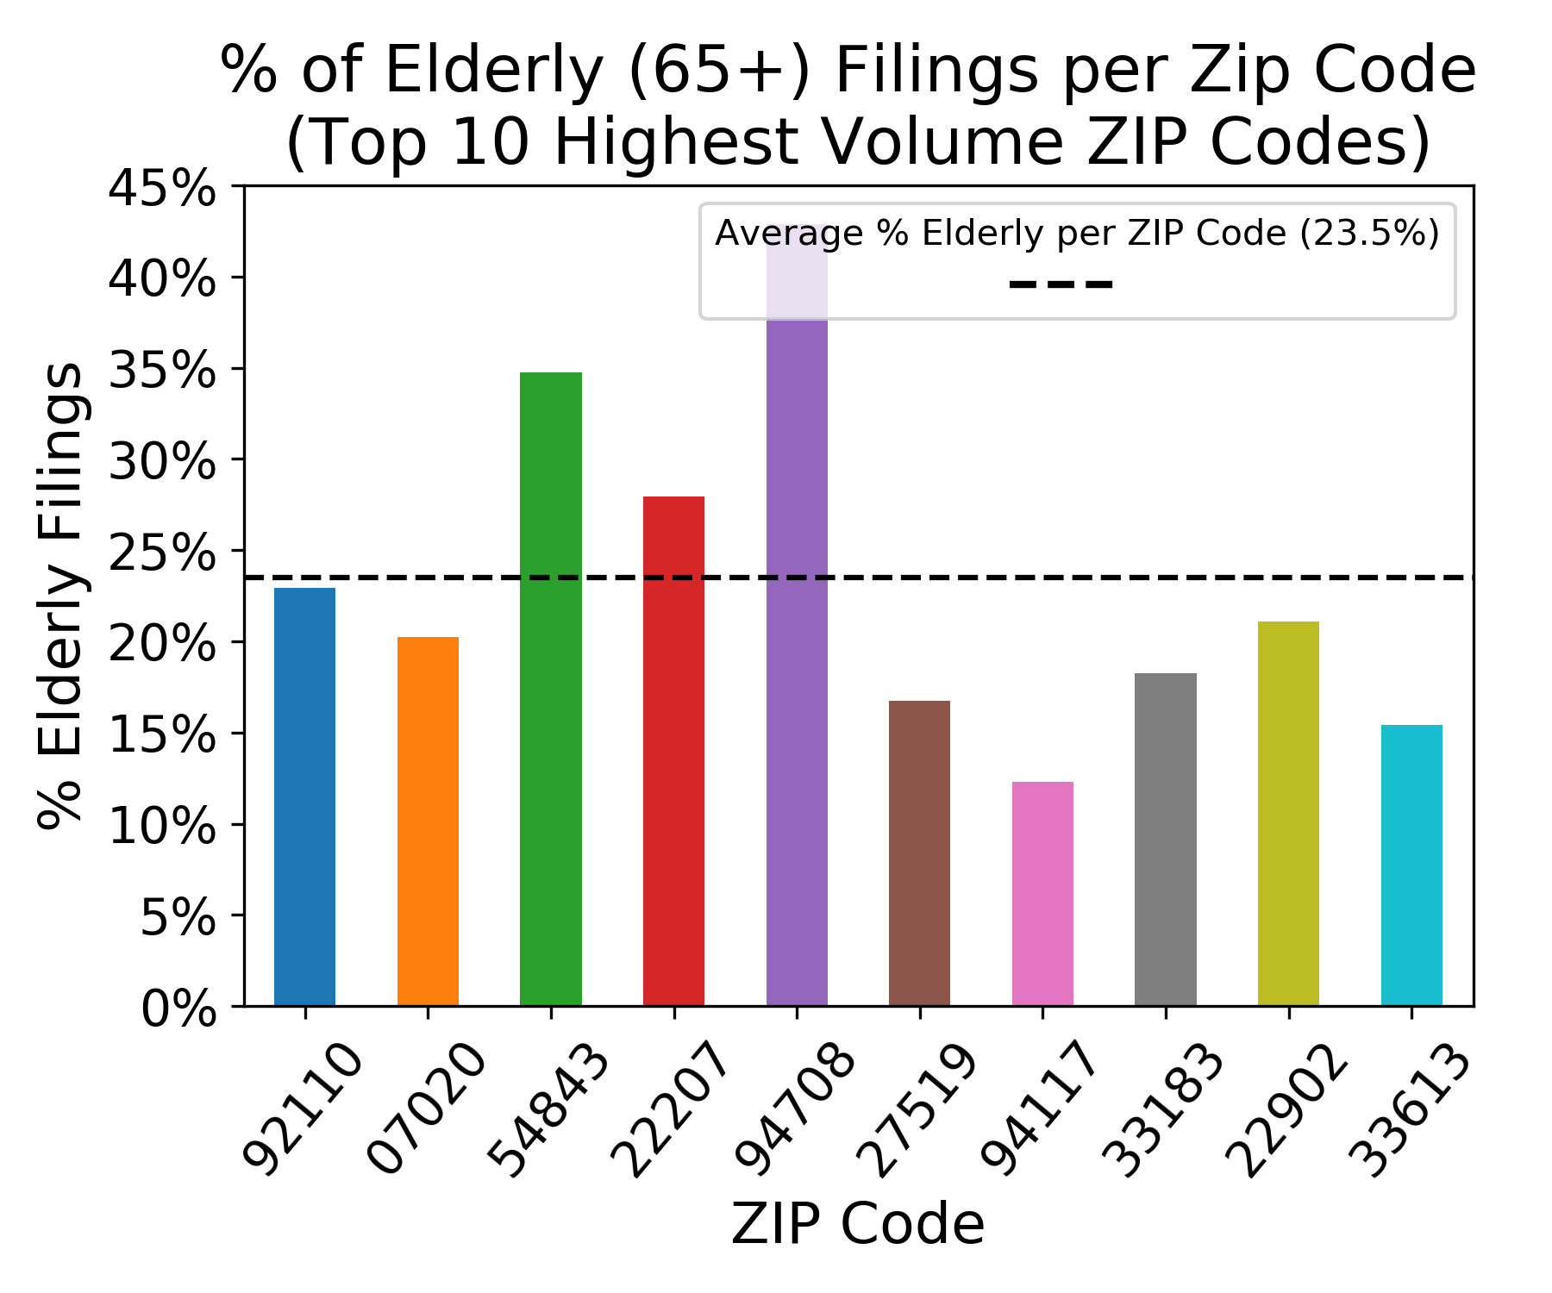
Can we get some idea of the age distribution of these ZIP codes?

Slide 15
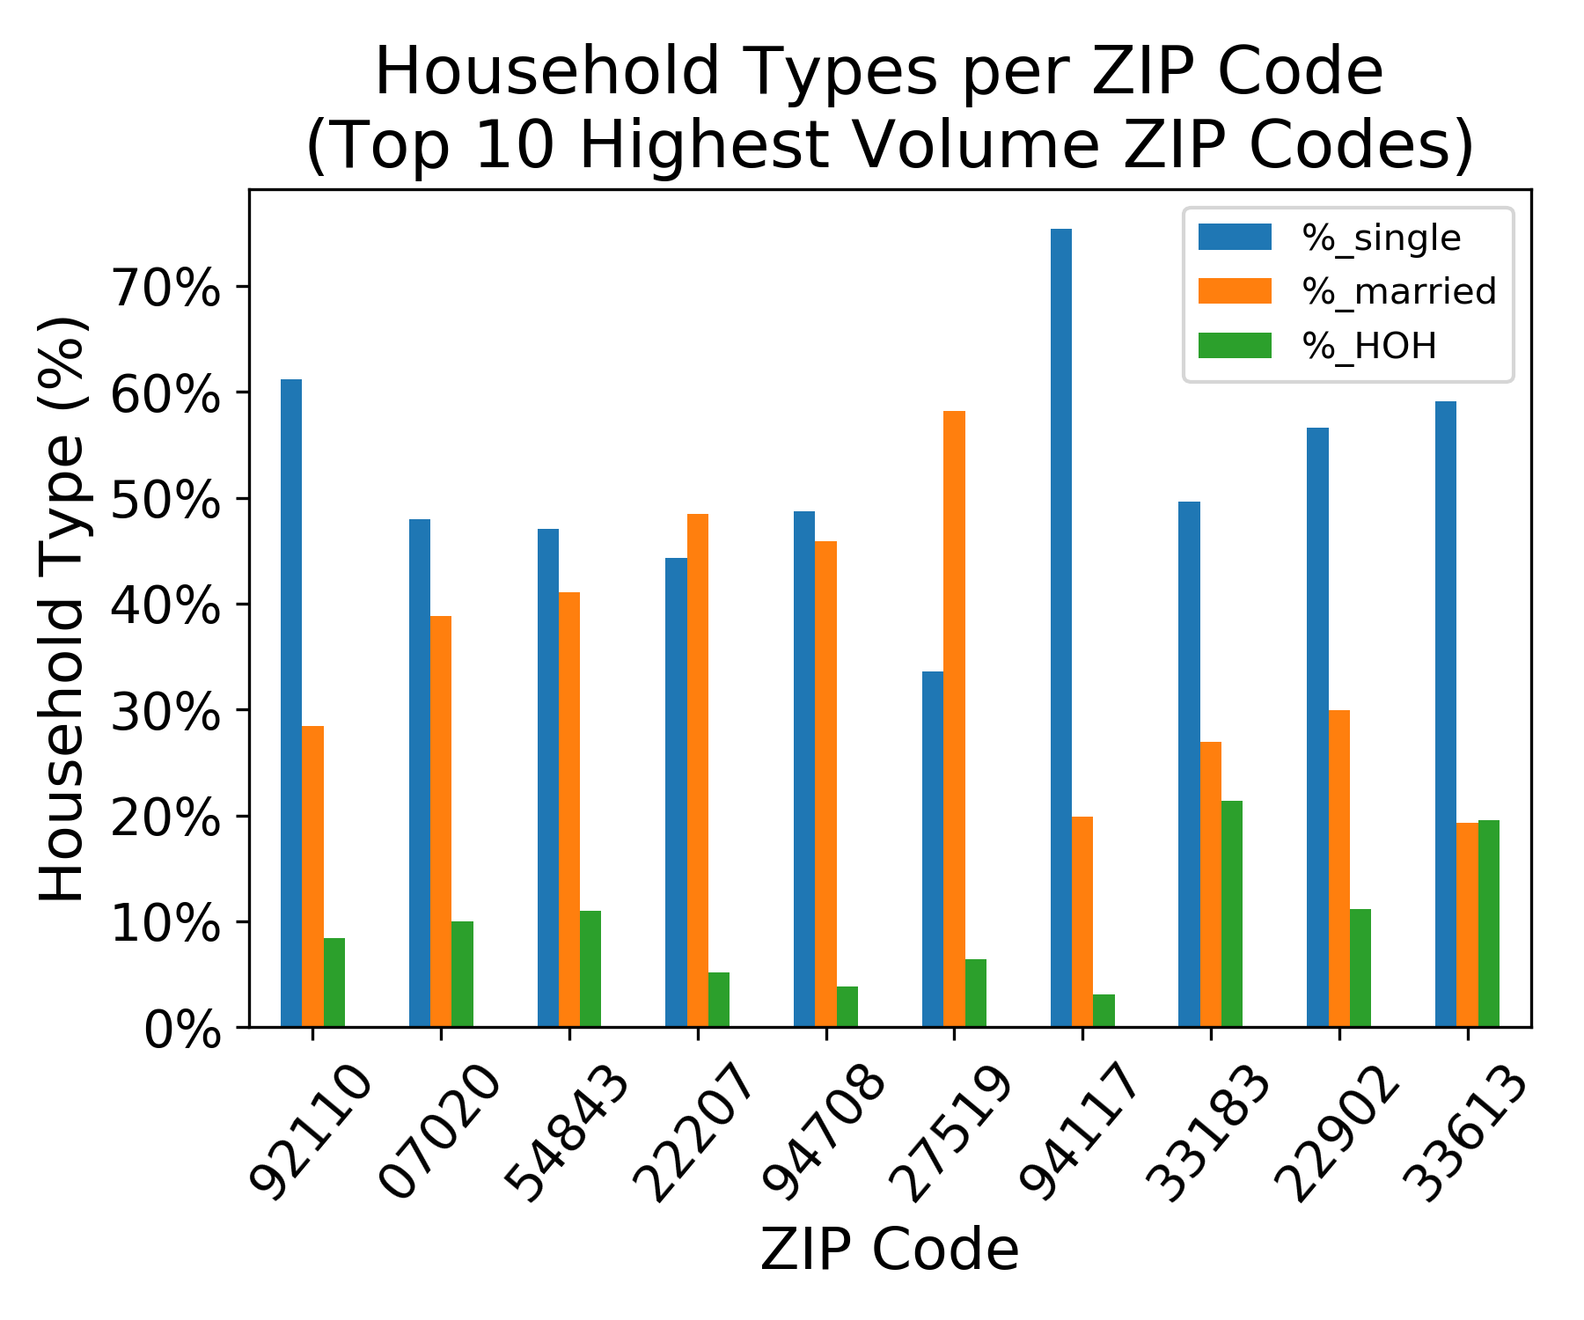
What is the distribution of single households vs. families (married or HOH filings)?

Slide 16
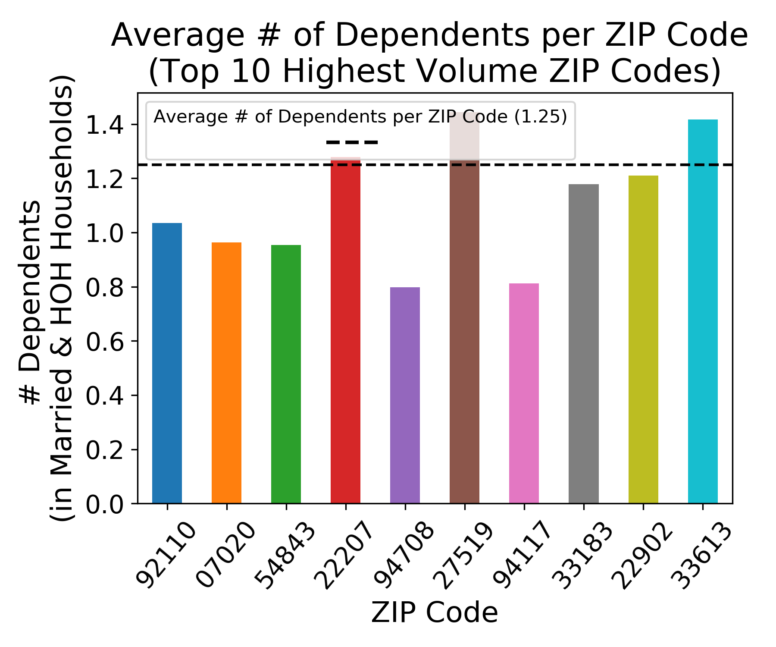
What is the average # of children in married & HOH households?

Slide 17
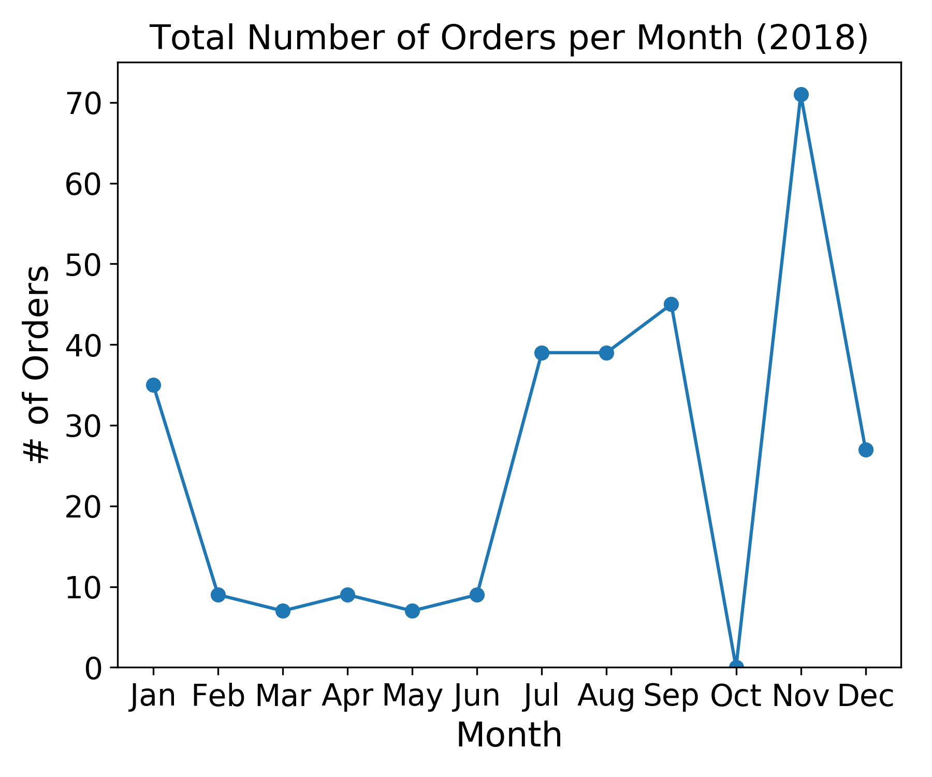
In what months do the majority of our customers make purchases?

Slide 18
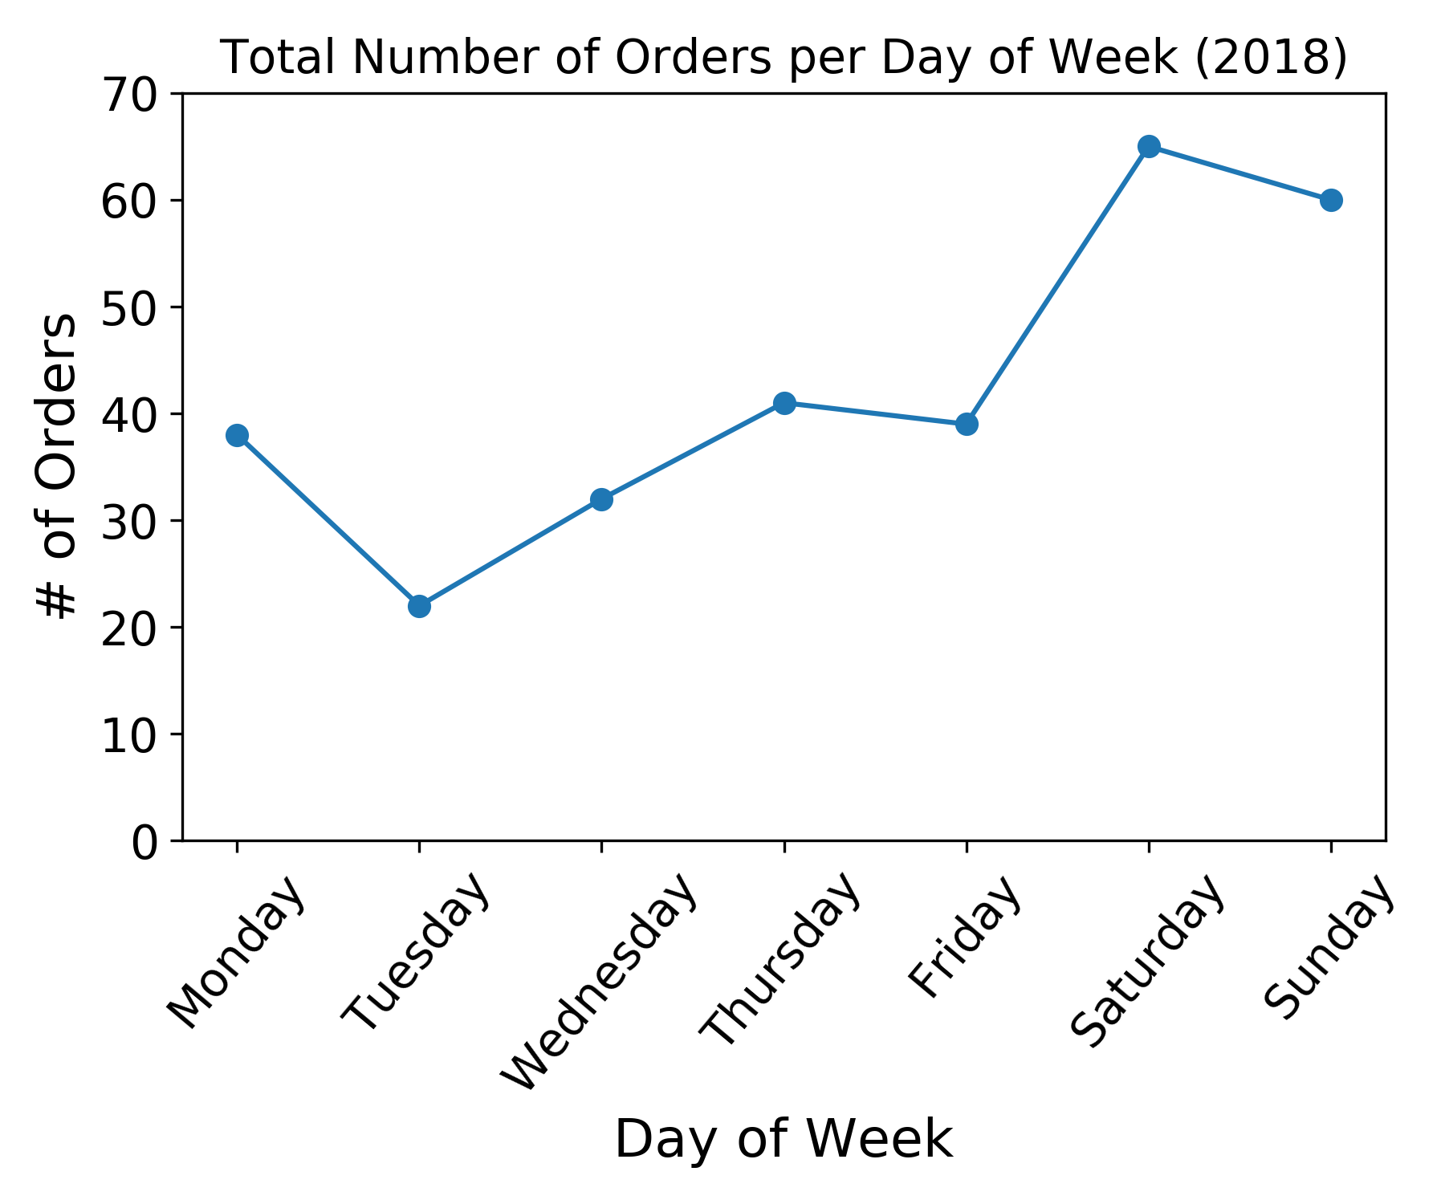
On what days do the majority of our customers make purchases?

Slide 19
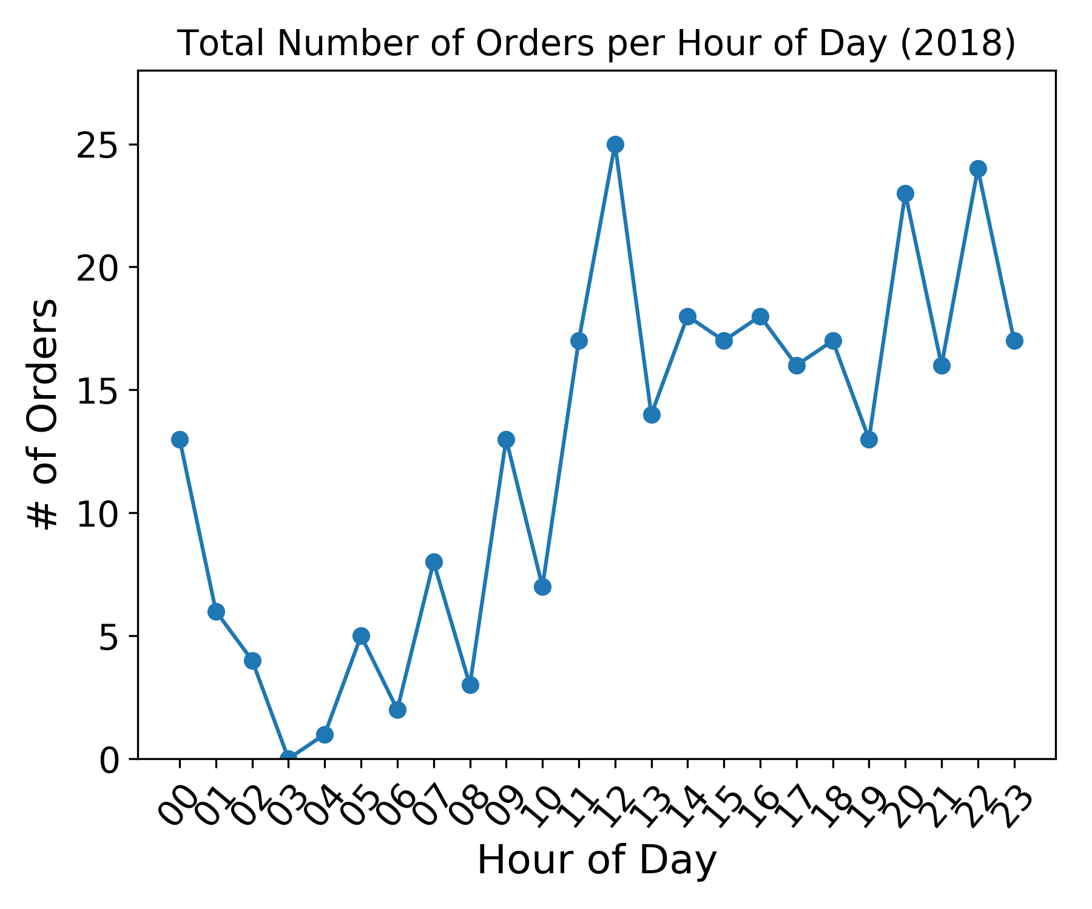
At what time of day do the majority of our customers make purchases?

Slide 20
Inferential Statistics
“Statistical inference is the process of using data analysis to deduce properties of an underlying probability distribution. Inferential statistical analysis infers properties of a population, for example by testing hypotheses and deriving estimates.” - Wikipedia

Slide 21
Representativeness of Samples
Question: How to determine how representative are these ZIP codes of all the other ZIP codes from which we received orders?
Answer: Chi-Squared (χ²) Goodness of Fit test!
Null Hypothesis: Sample containing Top 10 ZIP Codes has same distribution in analyzed metrics as total population.
Alternative Hypothesis: Sample containing Top 10 ZIP Codes has significantly different distribution than total population.
Significance level (⍺): 0.05

Slide 22
Chi-Squared Results
Average AGI
χ² = 835.21 => p ~ 0 => NULL HYPOTHESIS REJECTED!
% Elderly
Χ² = 34.14 => p = 0.00008 => NULL HYPOTHESIS REJECTED!
Number of Dependents
Χ² = 0.55 => p = 0.99995 => NULL HYPOTHESIS ACCEPTED!

Slide 23
Recommendations
Average AGI & % Elderly NOT Representative
=> Distinct segment to target with marketing efforts!
BUT:
Overall sample size small
Top 10 ZIP Codes = small % of total # of orders
So, MORE DATA & FURTHER ANALYSIS NEEDED

Slide 24
Machine Learning (ML)
“Machine learning (ML) is the scientific study of algorithms and Statistical models that computer systems use to effectively perform a specific task without using explicit instructions, relying on models and inference instead. It is seen as a subset of artificial intelligence.” - Wikipedia

Slide 25
ML Approach
Supervised or unsupervised learning?
No data to train on & no predictions to make => UNSUPERVISED!
Specifically, clustering -> uncover customer segments

Slide 26
Clustering Approach
Features:
Price of items purchased
# of filings [proxy for ZIP code size]
Average AGI
Average number of dependents
Average % elderly population

Slide 27
Algorithms
KMeans – most popular clustering algorithm
Principal Component Analysis (PCA)
Dimension Reduction
Affinity Propagation – clustering
Density-based spatial clustering of applications with noise (DBSCAN) – clustering
HDBSCAN – clustering

Slide 28
KMeans
# of clusters must be supplied as parameter
So, try different values of K (# of clusters) and evaluate results

Slide 29
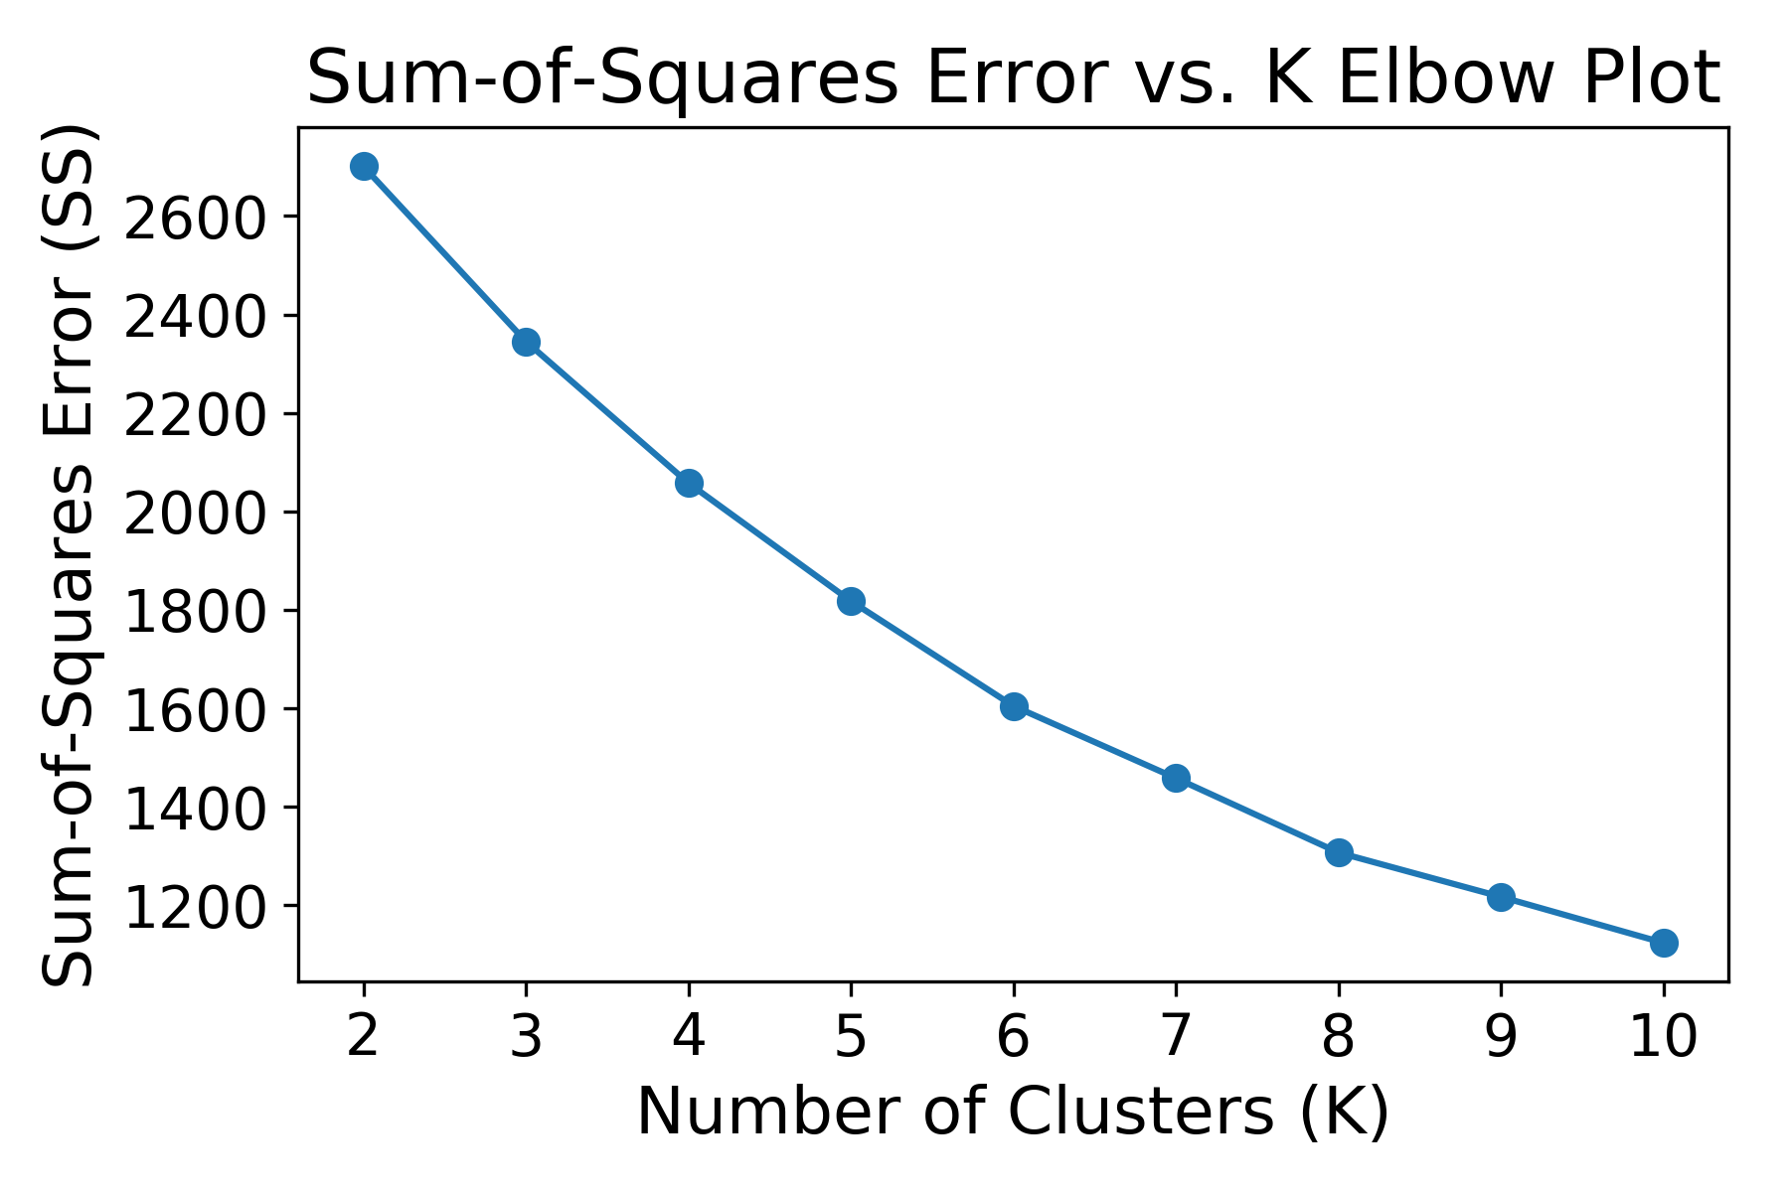
KMeans – Elbow Plot
Plot Sum-of-Squares Error vs. K and look for “elbow” in the plot => Optimal K!
Result: No clear elbow…

Slide 30
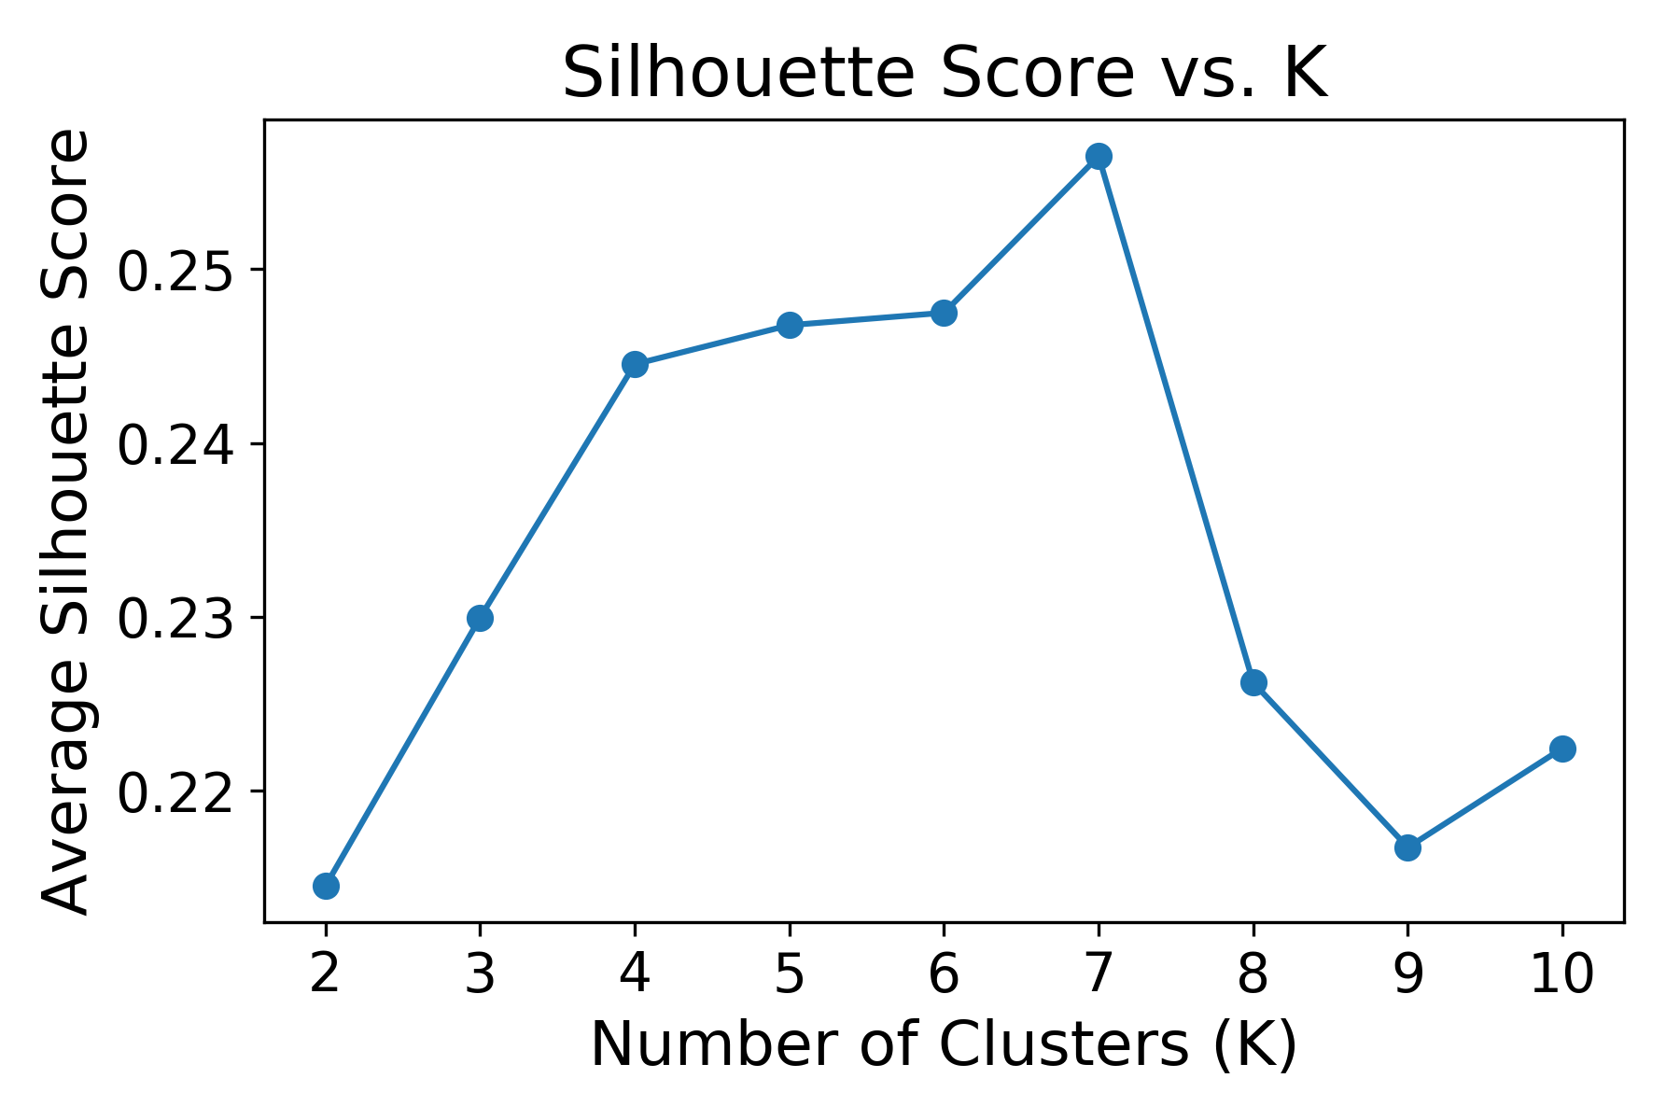
Silhouette Scores
Calculate silhouette score for each K => highest K = optimal K!
Result: Highest score for K=7 but score ~0.25 => weak clustering structure, so no clear optimum

Slide 31
PCA
Dimension Reduction
Understand components contributing to variance of data
Reduce to 2 dimensions in order to plot in X-Y coordinates

Slide 32
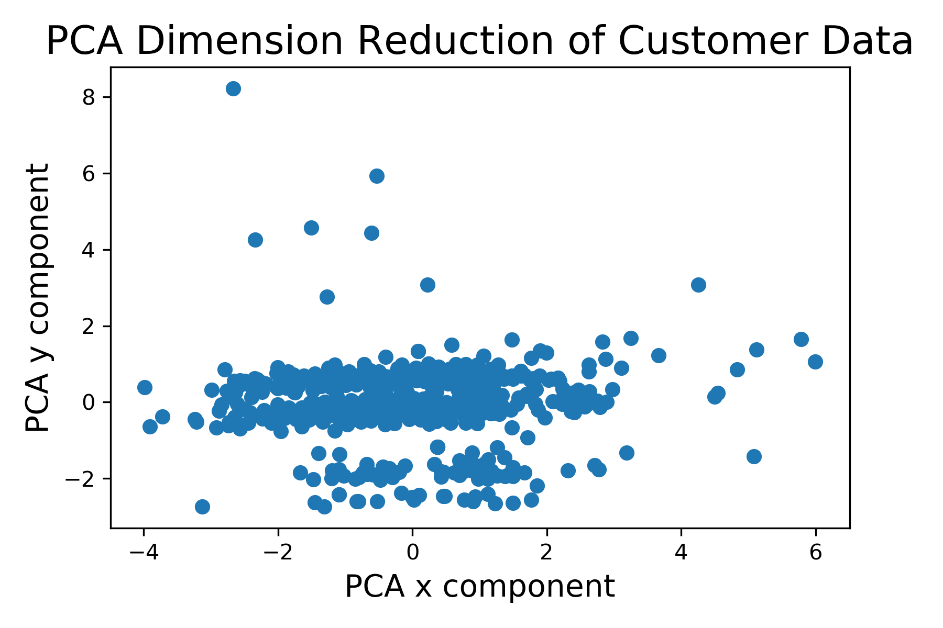
PCA – Data Visualization

Slide 33
Affinity Propagation
Advantage: Determines # of clusters algorithmically
Result: 50 clusters?!
Silhouette scores for higher (10-20) # of clusters: SAME
Evaluation: Far too many, very small (a.k.a. meaningless) clusters

Slide 34
DBSCAN
Advantage: Recognizes noisy points and discards
Advantage: Able to handle non-linear cluster boundaries
One main parameter: eps
eps = maximum distance between points in same cluster
Empirically optimal value: 0.66
Result: 7 reasonable clusters!

Slide 35
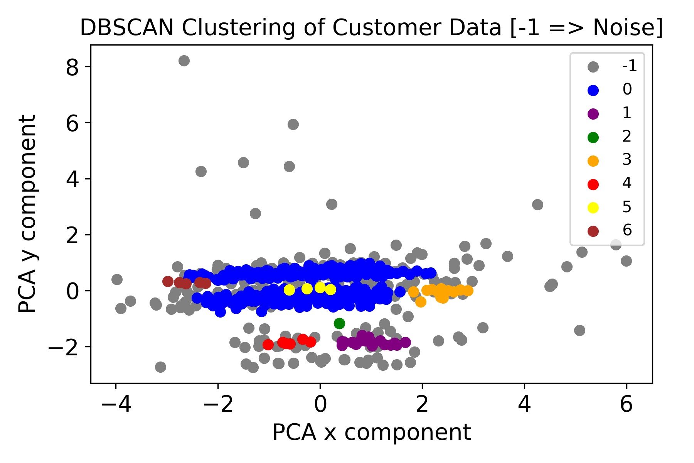
DBSCAN – Data Visualization

Slide 36
DBSCAN Results
7 Clusters:
Cluster ‘6’: Very low AGI (30-45), very high item-price (69.24), very young pop., large pop. size
Cluster ‘3’: High AGI, high item-price, much older pop., low # children
Cluster ‘1’: Medium AGI, low item-price, average aged pop.
Cluster ‘4’: Medium-low AGI, very low item-price, very high pop. size, average aged pop.

Slide 37
DBSCAN Results (Con’t)
Cluster ‘5’: VERY high AGI, medium-high item-price, very young pop.
Cluster ’2’: (5 identical orders) low item-price, otherwise average
Cluster ‘0’ (Largest cluster): High AGI, medium-high item-price, average aged pop.

Slide 38
HDBSCAN
Upgraded version of DBSCAN
Same advantages as DBSCAN
One main parameter: min_cluster_size
Empirically optimal value: 4

Slide 39
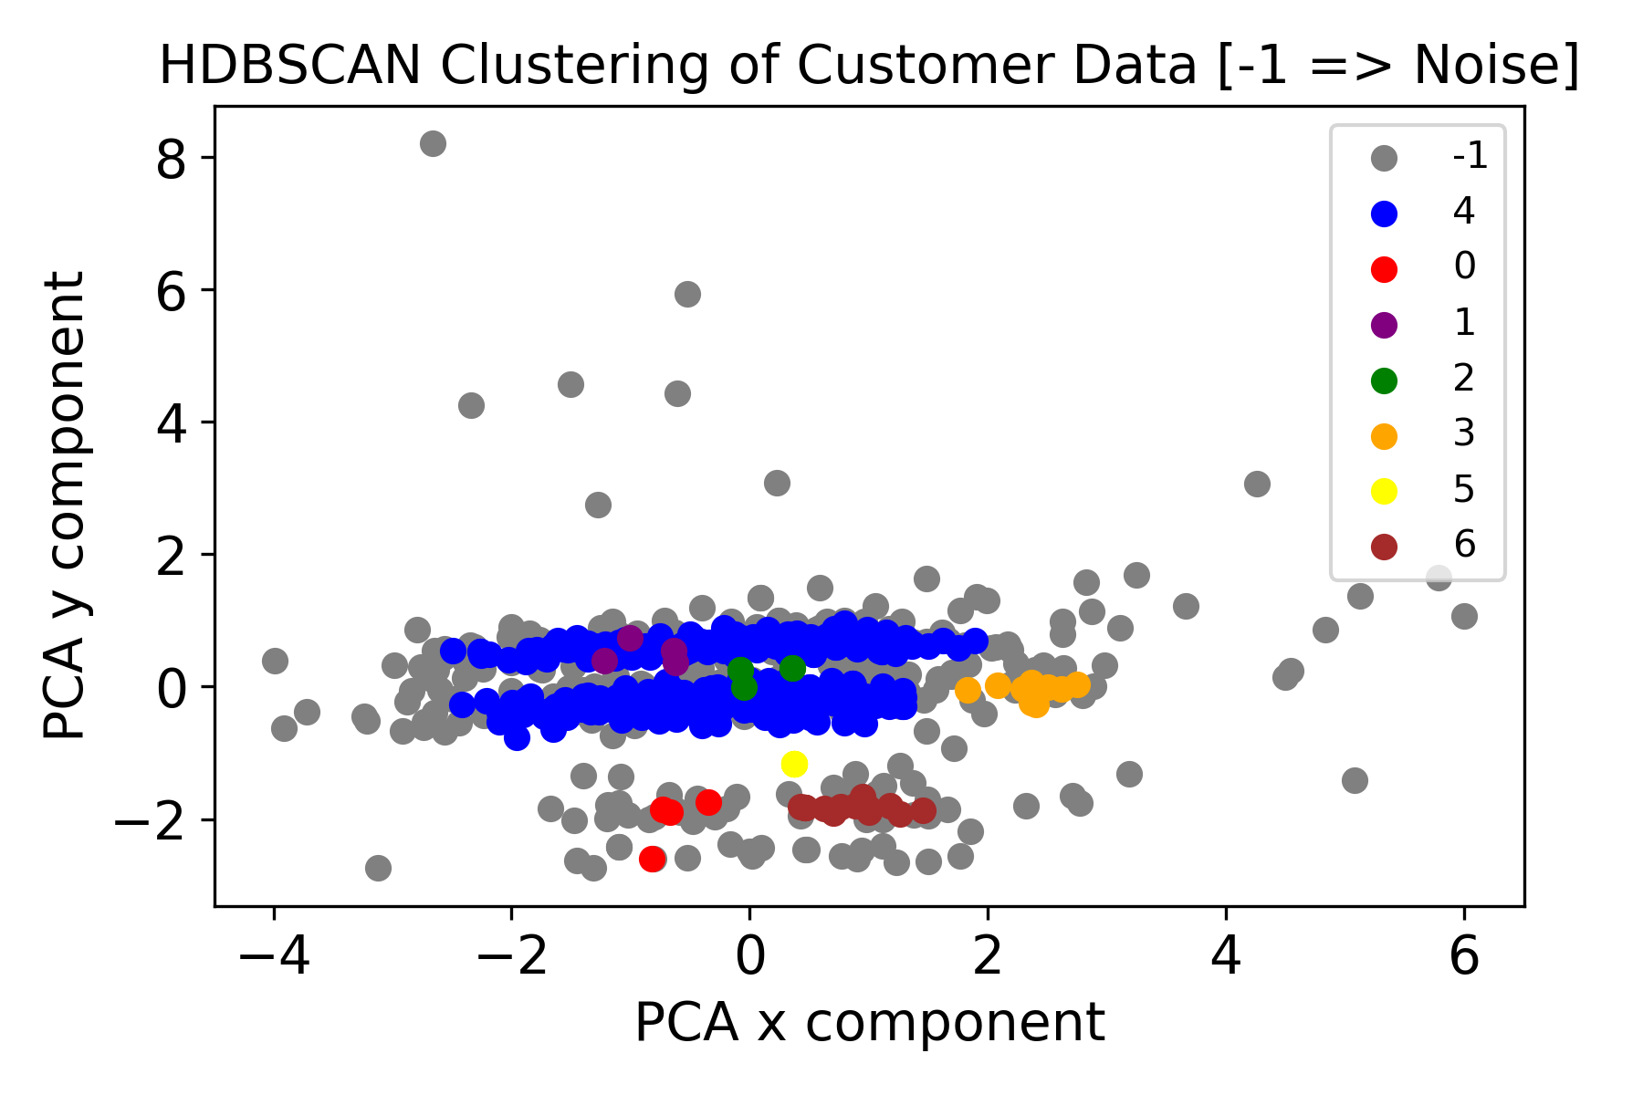
HDBSCAN – Data Visualization

Slide 40
HDBSCAN Results
Drops DBSCAN's cluster ‘6’
In place of DBSCAN cluster '5', finds clusters '1' and '2'

Slide 41
Recommendations
From DBSCAN clusters: create separate marketing campaigns to target distinct clusters, as well as features shared by clusters
From Cluster ‘6’: Target young, lower AGI ZIP Code customers in densely populated (urban) areas w/ higher pricing
From Clusters ‘3’ and ‘5’: Target customers from very wealthy ZIP Codes (e.g. luxury branding) w/ higher pricing
From Clusters ‘1’ and ‘4’: Target medium AGI ZIP Code customers with lower pricing

Slide 42
Project Conclusion
Insights & patterns discovered… but not representative of entire order pop.
MORE DATA NEEDED!
Average customer profile:
Wealthier than average
Older than average
Probably single
Fewer children than average

Slide 43
Final Recommendations
Investigate highest order freq. ZIP Code (92110)
Create marketing campaigns targeting aforementioned clusters
Introduce new products targeting above segments

Slide 44
Thank You!
felineinnovations.com
Amazon Storefront
Follow us on Facebook!

