Slide 1
RC Car Mark I
Adaptive Cruise Control — Master of Electrical Engineering
Erickson A Mijangos
Master of Electrical Engineering | Project Defense CSUF | Dr. Michael Turi

Slide 2
Motivation & Goal
Why this project?
Autonomous driving is one of the most impactful engineering challenges of our time. This project applies core electrical engineering principles — embedded systems, control theory, sensor fusion, and software development — to a tangible, testable platform: an RC Car.
Project Goal
Design and build an RC Car that:
Drives autonomously at a tuned speed using a PID controller
Detects objects ahead with a LIDAR sensor and slows down or stops
Transmits real-time sensor data to a Python GUI for analysis and tuning
Supports accelerometer calibration for improved velocity estimation

Slide 3
Engineering Disciplines
Embedded Systems
Wireless Comms
Sensor Integration
STM32H723ZG (RC Car)
STM32L432KC (Transmitter)
State machine firmware, ISR-driven timing
NRF24L01 2.4GHz RF
Bidirectional TX/RX at 20ms cycle
Garmin LIDAR Lite V3 (I2C)
LIS3DH Accelerometer (SPI)
Calibration & offset compensation
Control Engineering
Software Development
Hardware Design
PID controller framework
Velocity estimation via Euler integration
Adaptive speed and braking logic
Python GUI (PyQt5, PyQtGraph)
Real-time plotting & data acquisition
CSV export for analysis
Perfboard sensor integration
Power isolation (Traco DC-DC converter)
Optocoupler motor isolation

Slide 4
System Architecture
Three subsystems working together over wireless and wired communication
RC Car
(STM32H723ZG)
Transmitter
(STM32L432KC)
Python GUI
(PyQt5)
NRF24L01
RF Modules
UART
115200 baud
Sensors: LIDAR, LIS3DH IMU
Motors: DC + Servo
Isolated power supply
Real-time plots
Motor & steering control
CSV export
Calibration

Slide 5
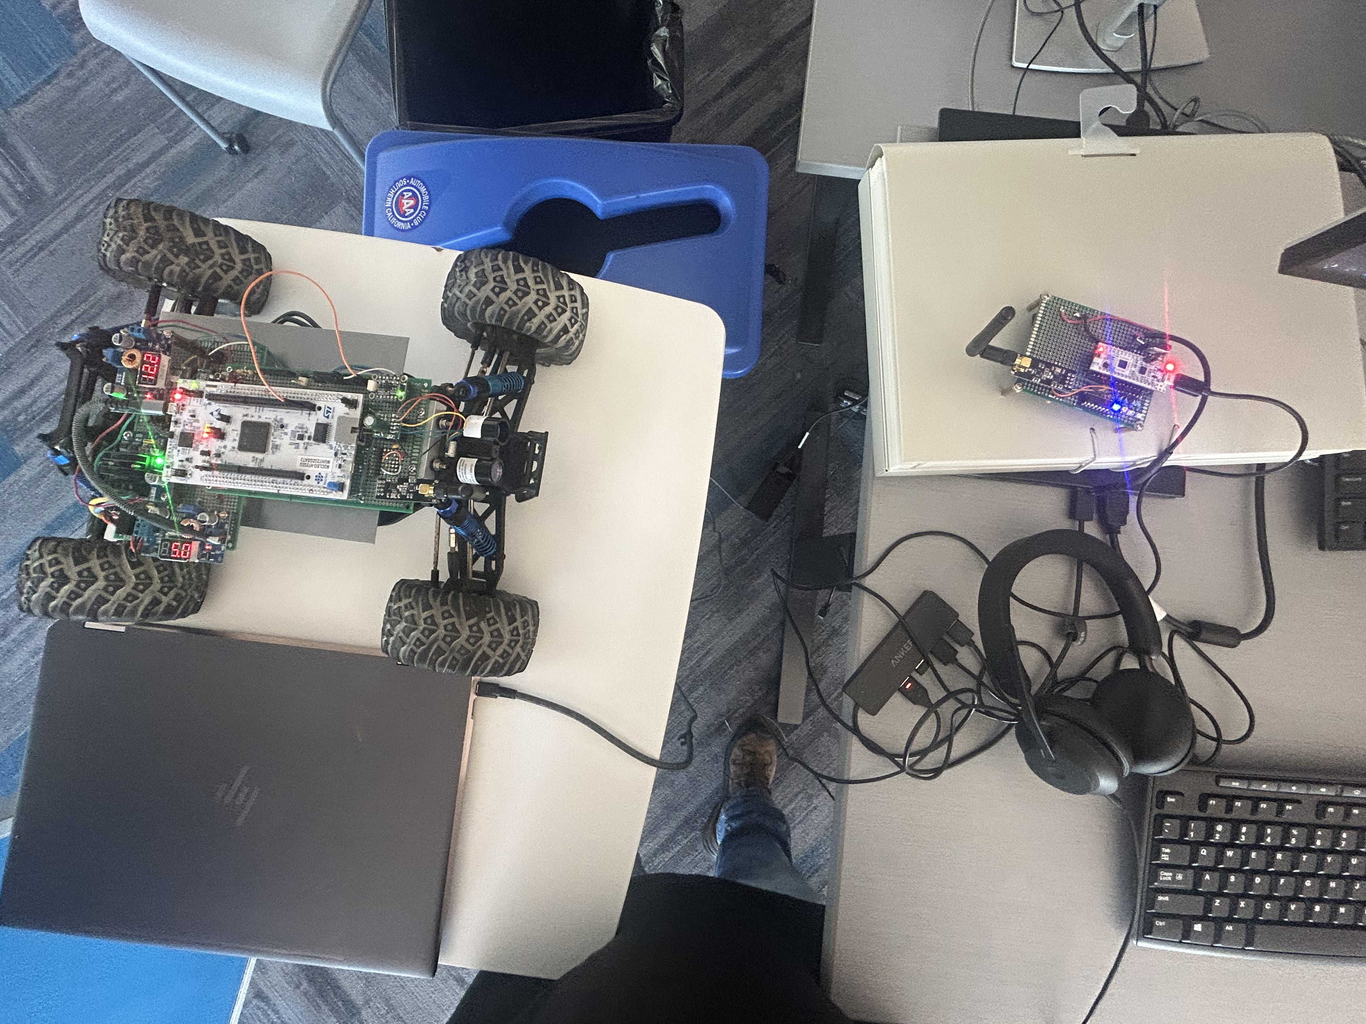
Hardware: RC Car
Component | Part / Detail
MCU | STM32H723ZG Nucleo-Board
RF | NRF24L01 (SPI)
LIDAR | Garmin LIDAR Lite V3 — 40m range (I2C)
IMU | LIS3DH Accelerometer (I2C)
Motor Driver | IBT-4 50A H-Bridge (PWM 4kHz)
Isolation | FOD8001 Optocoupler + TMH1205S DC-DC
Power | 12V 5200mAh Li-ion Battery
Steering | Servo Motor (PWM 50Hz, 1–2ms pulse)

Slide 6
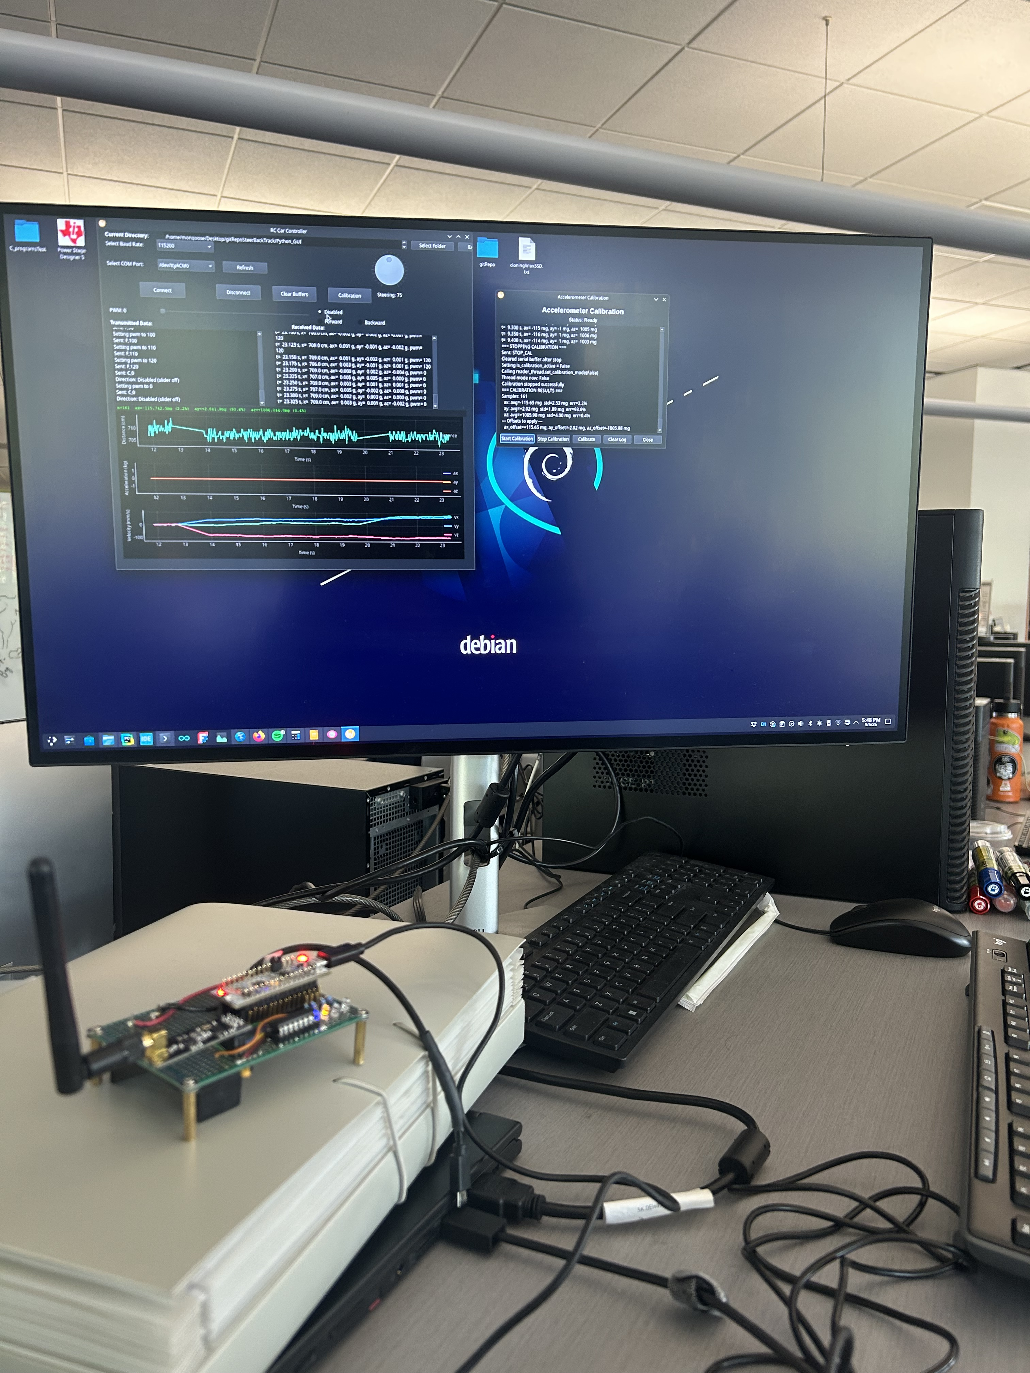
Hardware: Transmitter
Component | Part / Detail
MCU | STM32L432KC Nucleo-Board
RF | NRF24L01 (SPI)
Shift Register | Garmin LIDAR Lite V3 — 40m range (I2C)
LED | LIS3DH Accelerometer (SPI)

Slide 7
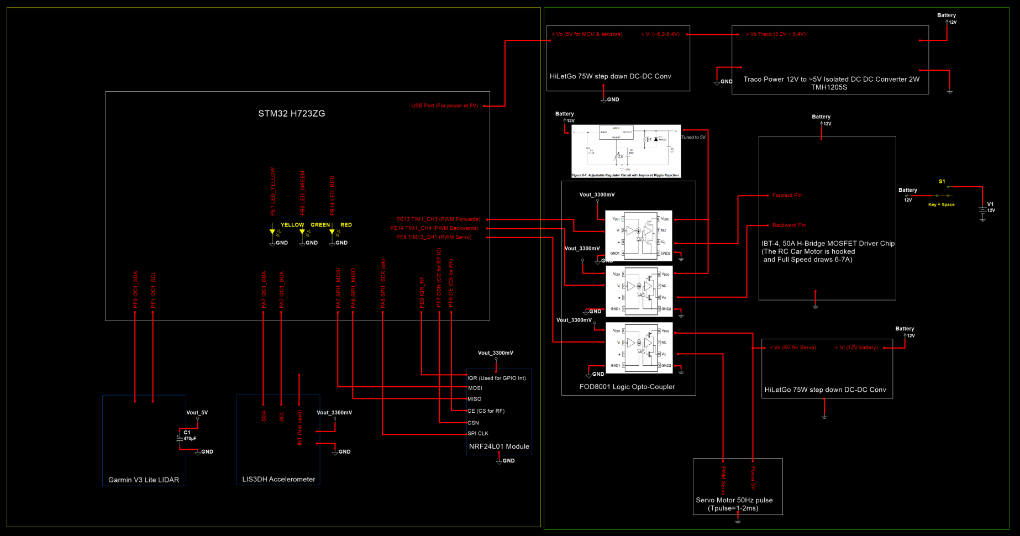
RC Car: Schematic

Slide 8
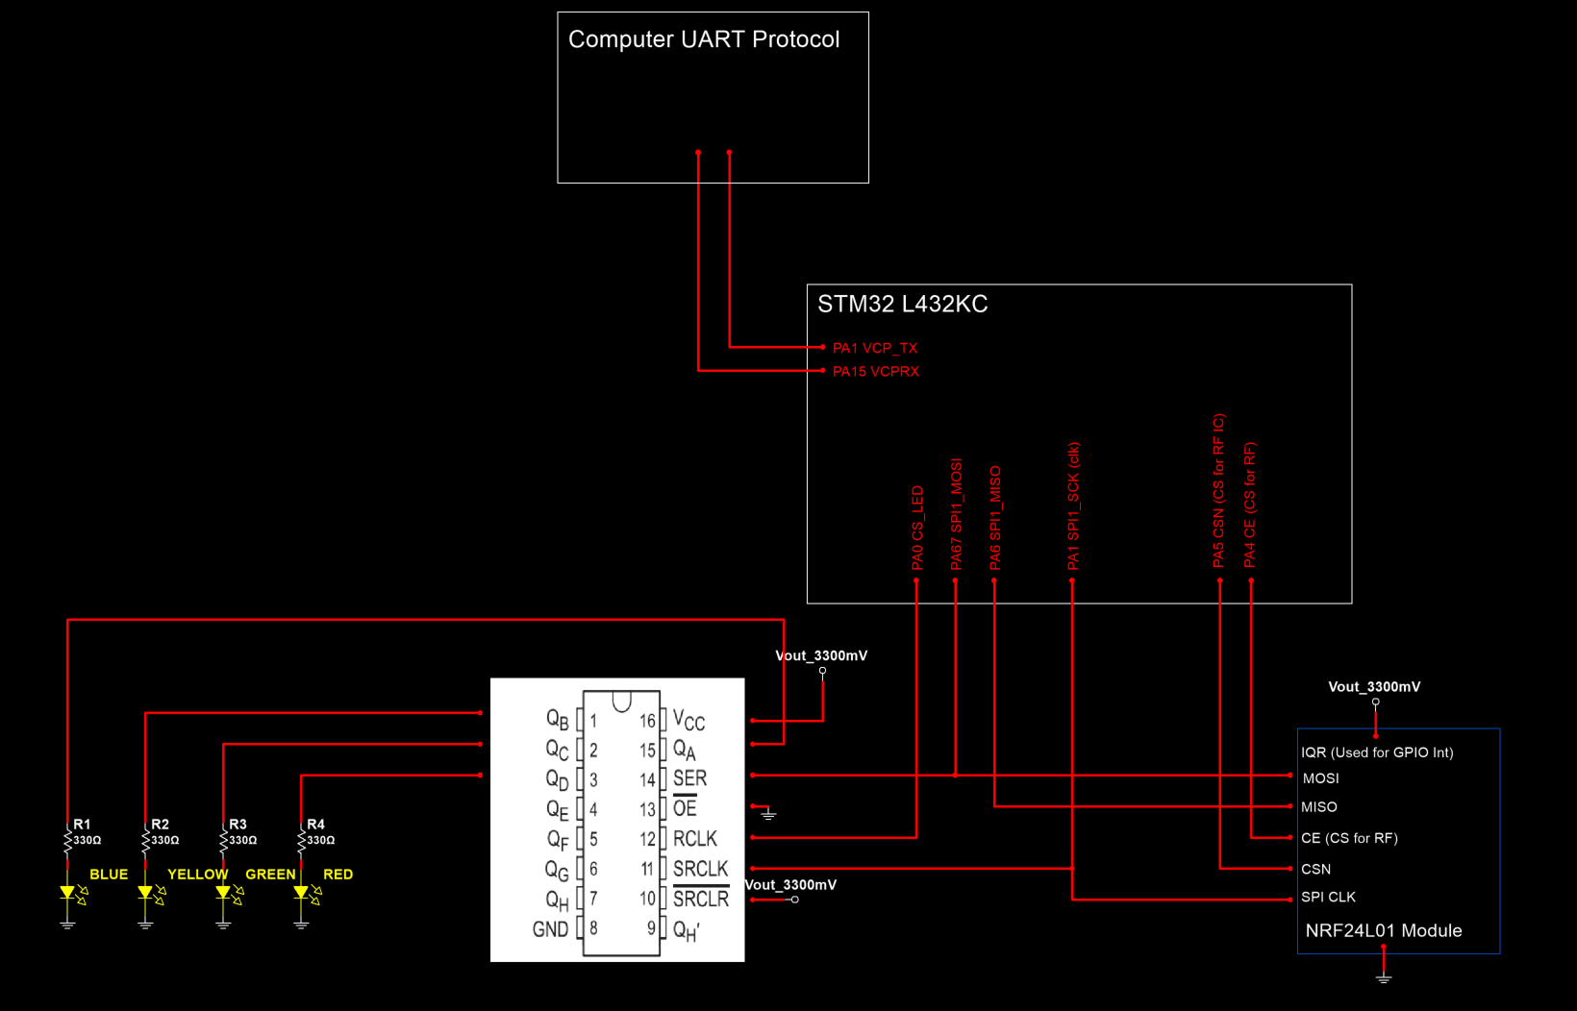
Transmitter: Schematic

Slide 9
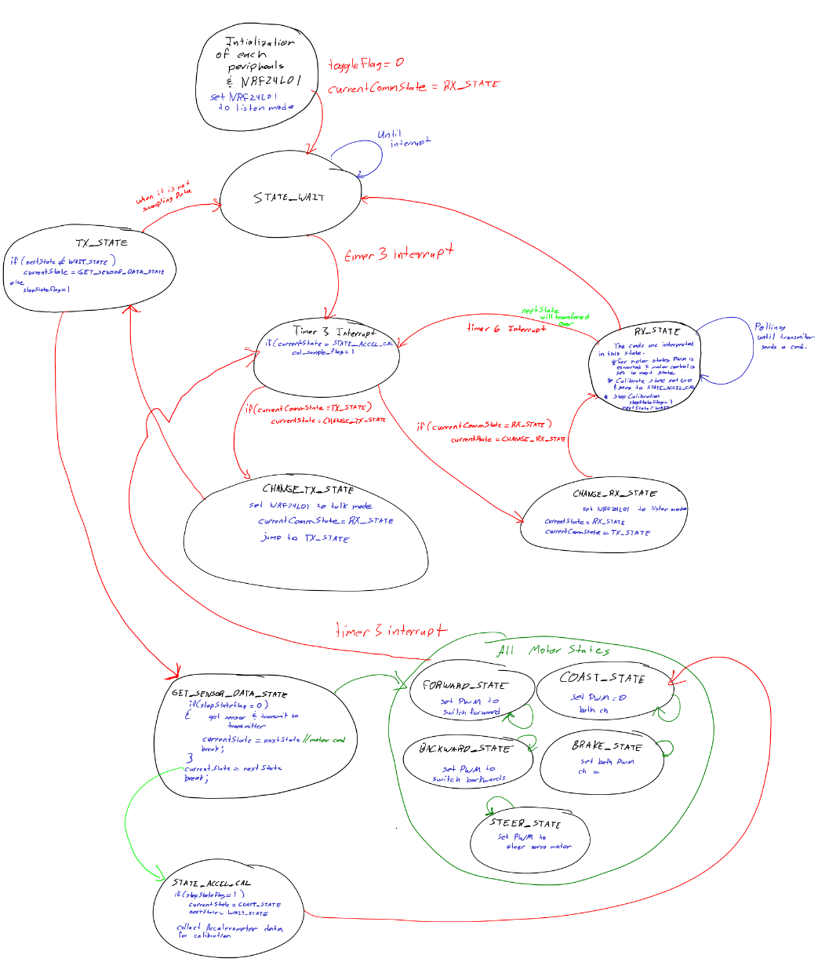
RC Car: State Machine
LED Status Indicators
Yellow — TX mode
Red — packet transmitted in RC Car
Green — RX mode

Slide 10
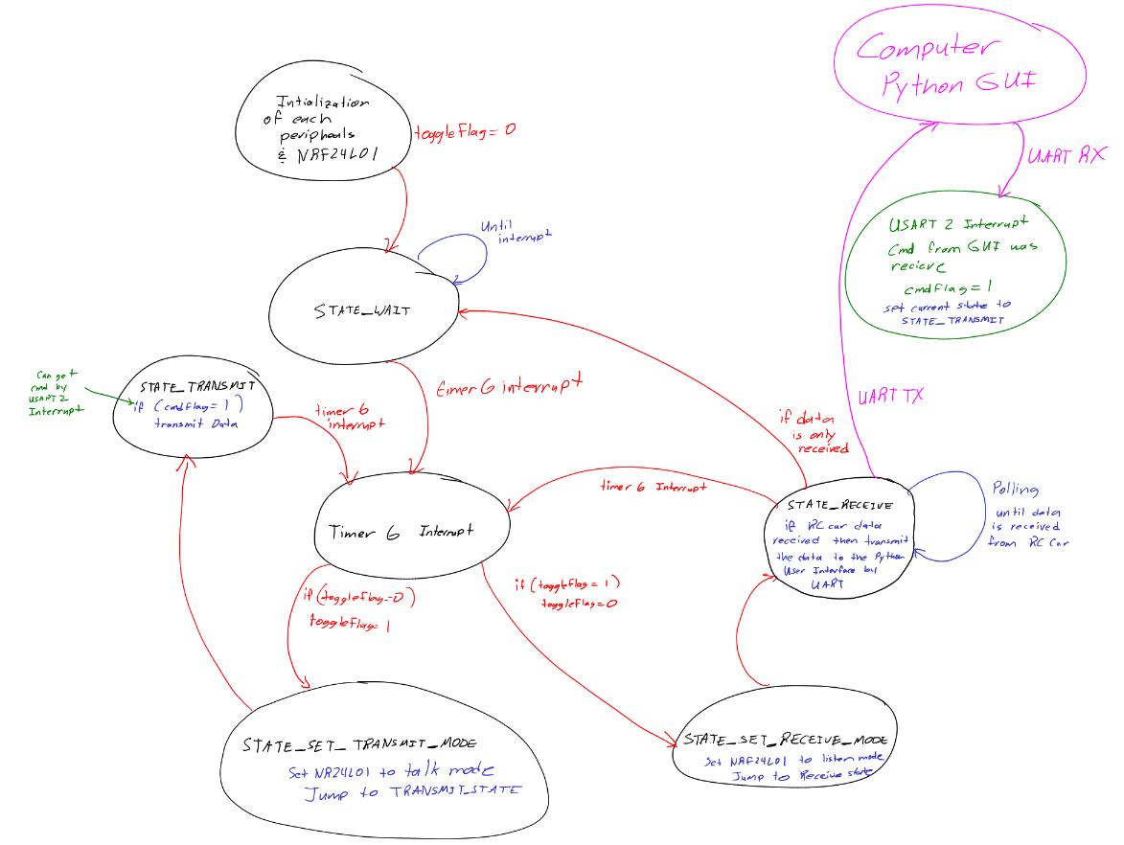
Transmitter: State
Machine
LED Status Indicators
Blue — RX mode
Yellow — TX mode
Red — packet received from RC Car
Green — command received from GUI

Slide 11
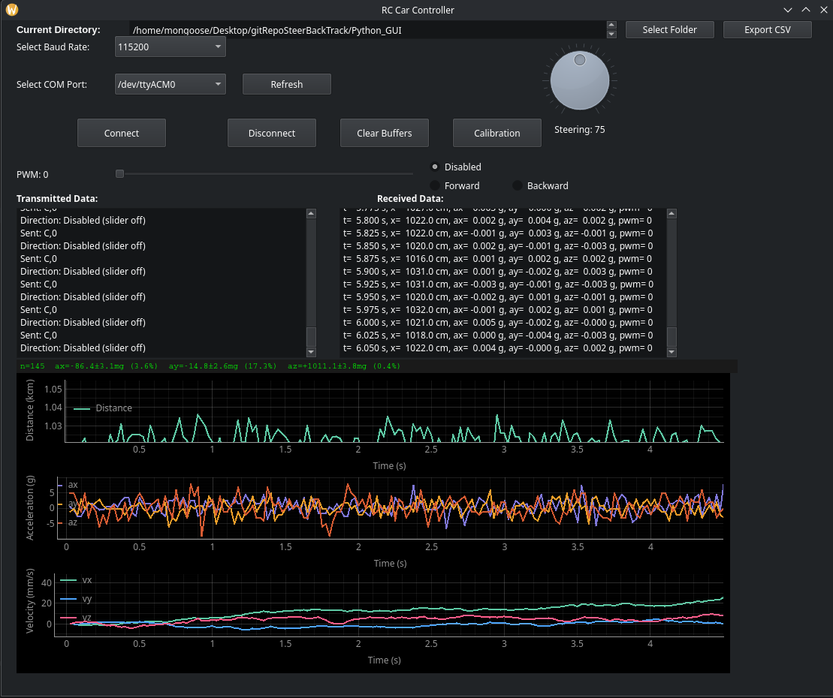
Python GUI — Real-Time Data Acquisition
Connect
Selects COM port, connects to STM32L432KC over UART at 115200 baud
Motor Control
PWM slider (0–65535) with Forward / Backward / Disabled direction
Steering
QDial widget, range 50–100 (center=75), debounced 10ms
Real-Time Plots
Distance (cm), Acceleration (ax/ay/az in mg), Velocity (vx/vy/vz)
Calibration
Collects stationary IMU samples, computes per-axis offsets
Export CSV
Saves all data: time, distance, accel, velocity, PWM to file

Slide 12
Sensor Data & Packet Format
Data flows from RC Car → Transmitter → Python GUI over two wireless hops
Normal Telemetry Packet (5 fields, 32 bytes)
timestamp_ms , distance_cm , ax_mg , ay_mg , az_mg \n
Calibration Packet (4 fields — CAL mode only)
timestamp_ms , ax_mg , ay_mg , az_mg \n
Field | Unit | Description
timestamp_ms | ms | Time since MCU boot unless reset
distance_cm | cm | LIDAR distance to object ahead
ax_mg | mg | X-axis acceleration
ay_mg | mg | Y-axis acceleration
az_mg | mg | Z-axis acceleration (~1000mg = ~1g stationary)

Slide 13
Velocity Estimation
Euler Method of Numerical Integration
v(t) = v(t−1) + a(t) × Δt where a [mg] × 0.001 × 9.81 → m/s²
Known Limitations
Calibration Mitigation
Integration drift — noise accumulates over time causing velocity to grow even when stationary
Stop detection — integrator has no initial condition to reset when car stops
Gravitational Influence — RC Car tilt causes ax to feel a component of Earth's gravity
Stationary IMU samples collected before run
Average offset computed per axis (ax, ay, az)
Offset removed from all measurements before integration
Reduces gravitational bias
[ NoCalibrationWF.png ]
[ CalibrationWF.png ]

Slide 14
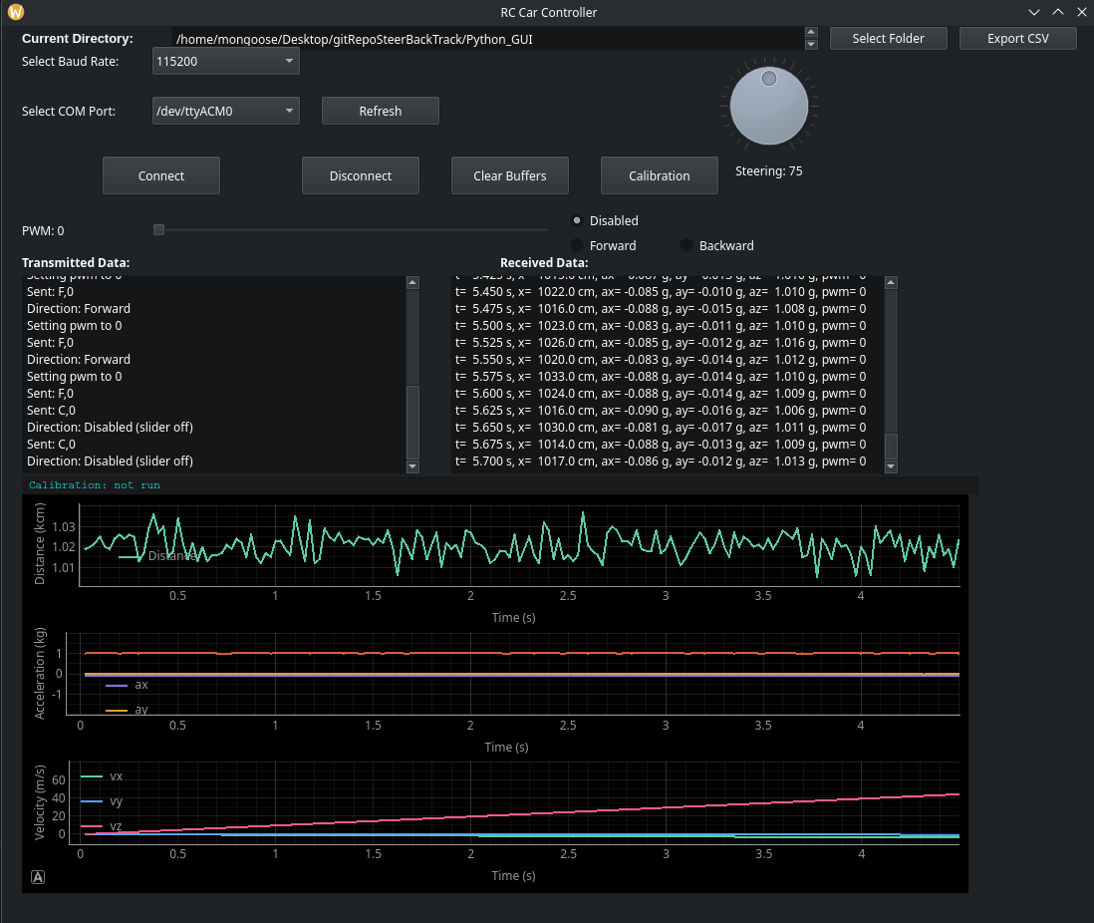
Measurement
without
Calibration
https://youtu.be/ox59gKyVjFU

Slide 15
Measurement
with
Calibration
https://youtu.be/ydO1_pEh5iw

Slide 16
Key Challenges
Data Acquisition Gap
Velocity Integration Drift
NRF24L01 socket loosened after crash → intermittent 1–1.4s communication blackouts for a second and reconnects.
Fix: Enclosure, direct solder for NRF24L01 RF Module.
Euler integration of noisy accelerometer data causes velocity to drift even when stationary. Tilt adds gravitational component to ax.
Fix: Calibration offset subtraction. Full solution requires sensor fusion (Hall effect + Kalman filter).

Slide 17
Future Works
01 PID Controller
02 Kalman Filter + Sensor Fusion
03 Hall Effect Velocity
Implement closed-loop speed control using the velocity estimate. Tune Kp, Ki, Kd on the RC Car and validate against LIDAR distance feedback.
Combine accelerometer (predictor) with Hall effect wheel speed sensor (observer) to correct integration drift. Foundation at kalmanfilter.net.
Mount A1133 Hall effect sensor near wheel hub with a magnet. Measure pulse intervals to compute precise linear velocity — eliminates drift.
04 Savitzky-Golay Filter
05 RTOS Implementation
06 Adaptive Cruise Control
Apply polynomial smoothing over a sliding window to clean accelerometer noise without introducing the lag of a simple moving average.
Implement RTOS to sample more data on the sensor such as accelerometer to remove most of the noise.
Combine PID speed control + LIDAR distance feedback to automatically maintain following distance and stop for stationary objects.

Slide 18
Conclusion
What was built
A fully functional RC Car system with real-time wireless telemetry, bidirectional control, live data plotting, and accelerometer calibration.
What was learned
Embedded state machine design, ISR-driven timing, I2C/SPI sensor integration, NRF24L01 radio synchronization, PyQt5 threading, and the practical limits of accelerometer-based velocity estimation.
What comes next
PID speed controller, Kalman filter sensor fusion with Hall effect velocity, custom PCB, and full Adaptive Cruise Control.
RC Car Mark I | Master of Electrical Engineering | Erickson Mijangos

Slide 19
Github RC Car Mark I
https://github.com/eam95/RC_Car_Mark_I/tree/main
RC Car Mark I | Master of Electrical Engineering | Erickson Mijangos

