Slide 1

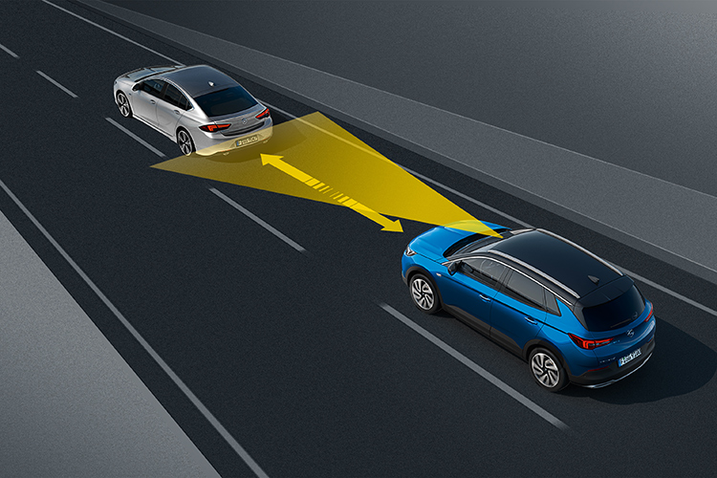
Adaptive cruise control
Team Members:
Dave Contreras, Israel Mejia, Erickson Mijangos

Slide 2
System Overview: Adaptive Cruise Control (ACC) is an automotive feature that allows a vehicle's cruise control system to adapt the vehicle's speed to the traffic environment. A radar system attached to the front of the vehicle is used to detect whether slower moving vehicles are in the ACC vehicle's path. If a slower moving vehicle is detected, the ACC system will slow the vehicle down and control the clearance, or time gap, between the ACC vehicle and the forward vehicle. If the system detects that the forward vehicle is no longer in the ACC vehicle's path, the ACC system will accelerate the vehicle back to its set cruise control speed. This operation allows the ACC vehicle to autonomously slow down and speed up with traffic without intervention from the driver.

Slide 3
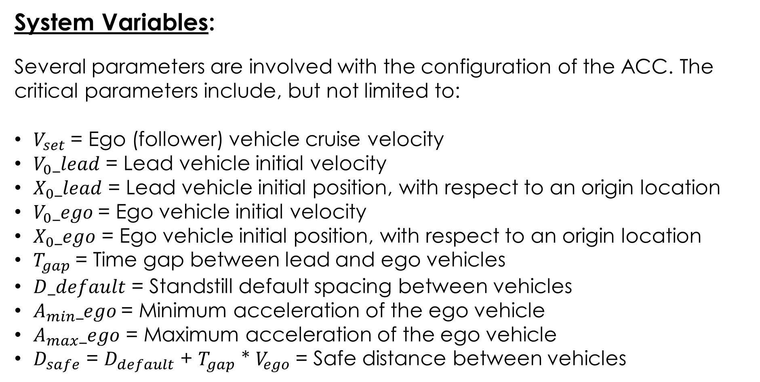
System Variables:
Several parameters are involved with the configuration of the ACC. The critical parameters include, but not limited to:
$V_{set}$= Ego (follower) vehicle cruise velocity
$V_{0}_lead$ = Lead vehicle initial velocity
$X_{0}_lead$ = Lead vehicle initial position, with respect to an origin location
$V_{0}_ego$= Ego vehicle initial velocity
$X_{0}_ego$ = Ego vehicle initial position, with respect to an origin location
$T_{gap}$= Time gap between lead and ego vehicles
$D_default$ = Standstill default spacing between vehicles
$A_{min}_ego$= Minimum acceleration of the ego vehicle
$A_{max}_ego$ = Maximum acceleration of the ego vehicle
$D_{safe}$ = $D_{default}$ + $T_{gap}$ * $V_{ego}$= Safe distance between vehicles

Slide 4
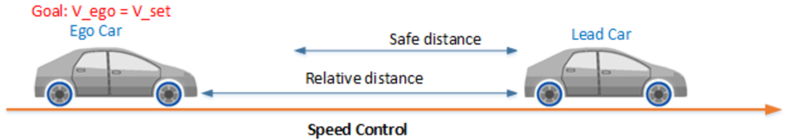
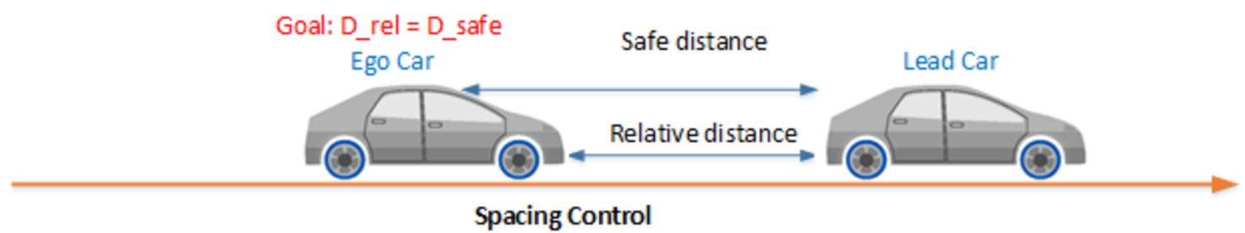
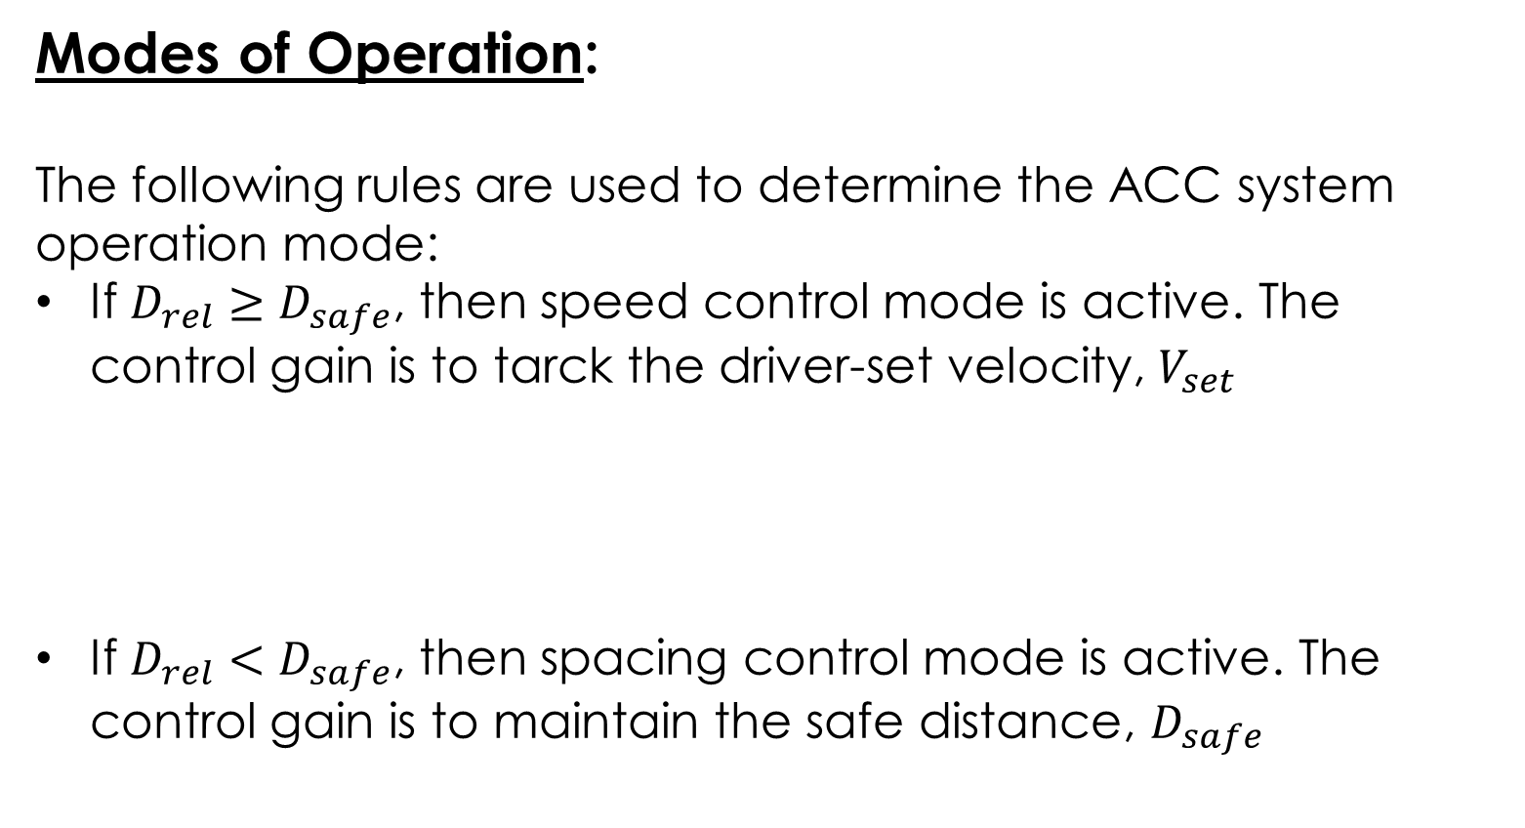
Modes of Operation:
The following rules are used to determine the ACC system operation mode:
If $D_{rel}≥D_{safe}$, then speed control mode is active. The control gain is to tarck the driver-set velocity, $V_{set}$
If $D_{rel}<D_{safe}$, then spacing control mode is active. The control gain is to maintain the safe distance, $D_{safe}$

Slide 5
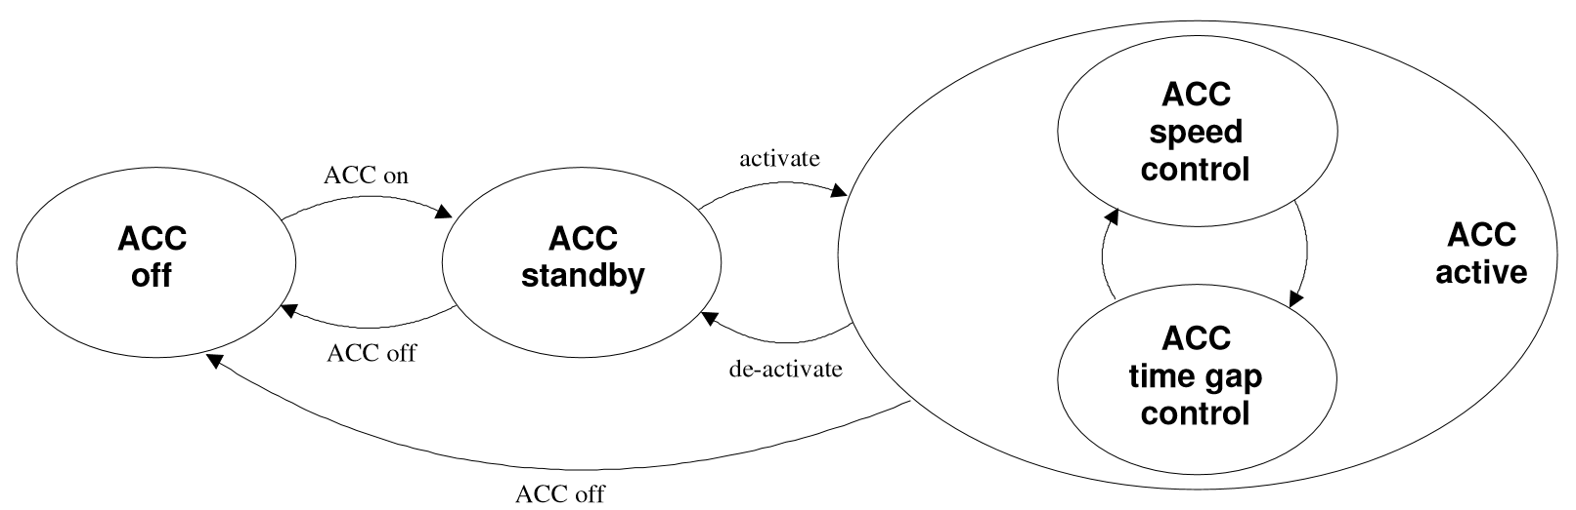
ACC State Machine Representation:

Slide 6
Control System:
The control system employed for the ACC is a PI controller. The system Simulink model is structured in a modular approach, for concise overview. The modules (subsystems) that comprise the system are the following:
Input signal configuration
ACC controller
Sensor
Scene
Vehicle position (scene)
Data exporting
Development tools

Slide 7
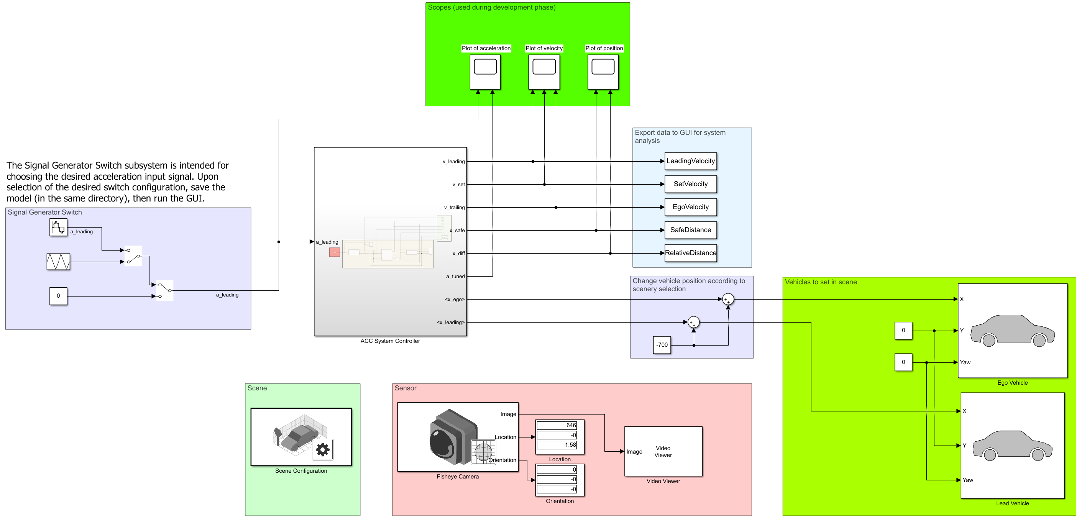
Overall system model:

Slide 8
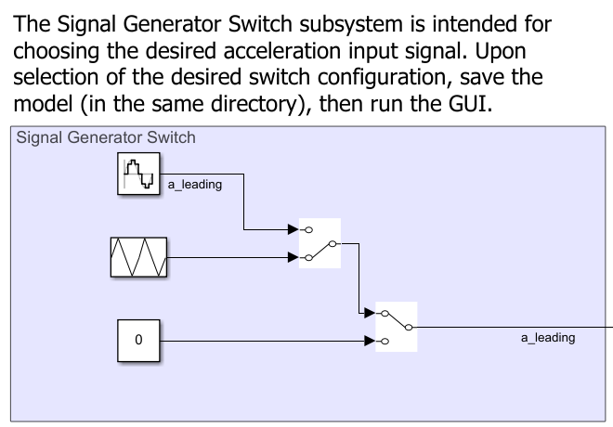
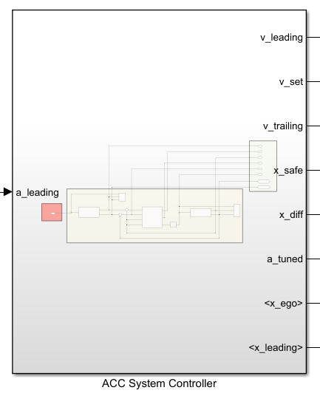
Input signal configuration:
ACC controller:

Slide 9
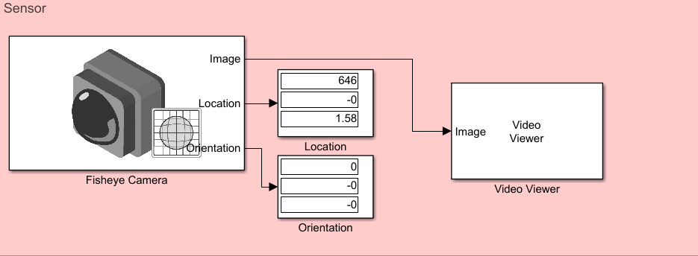
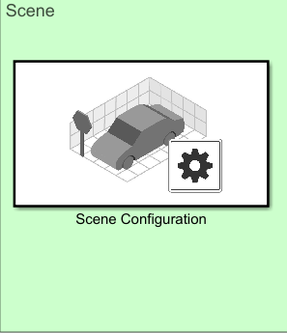
Sensor:
Scene:

Slide 10
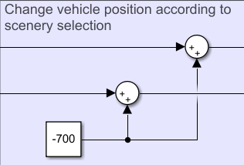
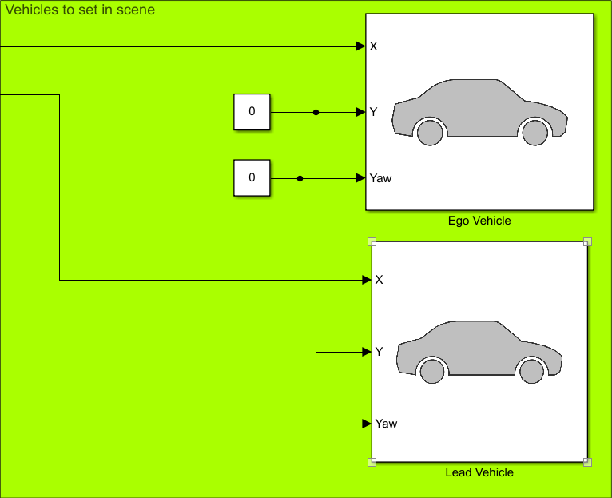
Vehicle position (scene):

Slide 11
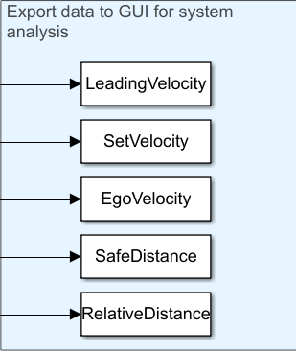
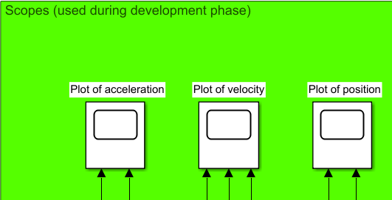
Data exporting:
Development tools:

Slide 12
Simulation:
Guided User Interface (GUI):
A GUI has been designed for a user-friendly approach to understanding the basics of the Adaptive Cruise Control system. The user will choose the Simulink model of choice, followed by entering the critical parameters required. The user will also define the length of the simulation, via the Simulation Time slider. Simulation controls are embedded onto the GUI for the user to begin the simulation, along with the ability to stop (when required). Relevant system data will be plotted for functional evaluation, after the simulation has concluded.

Slide 13
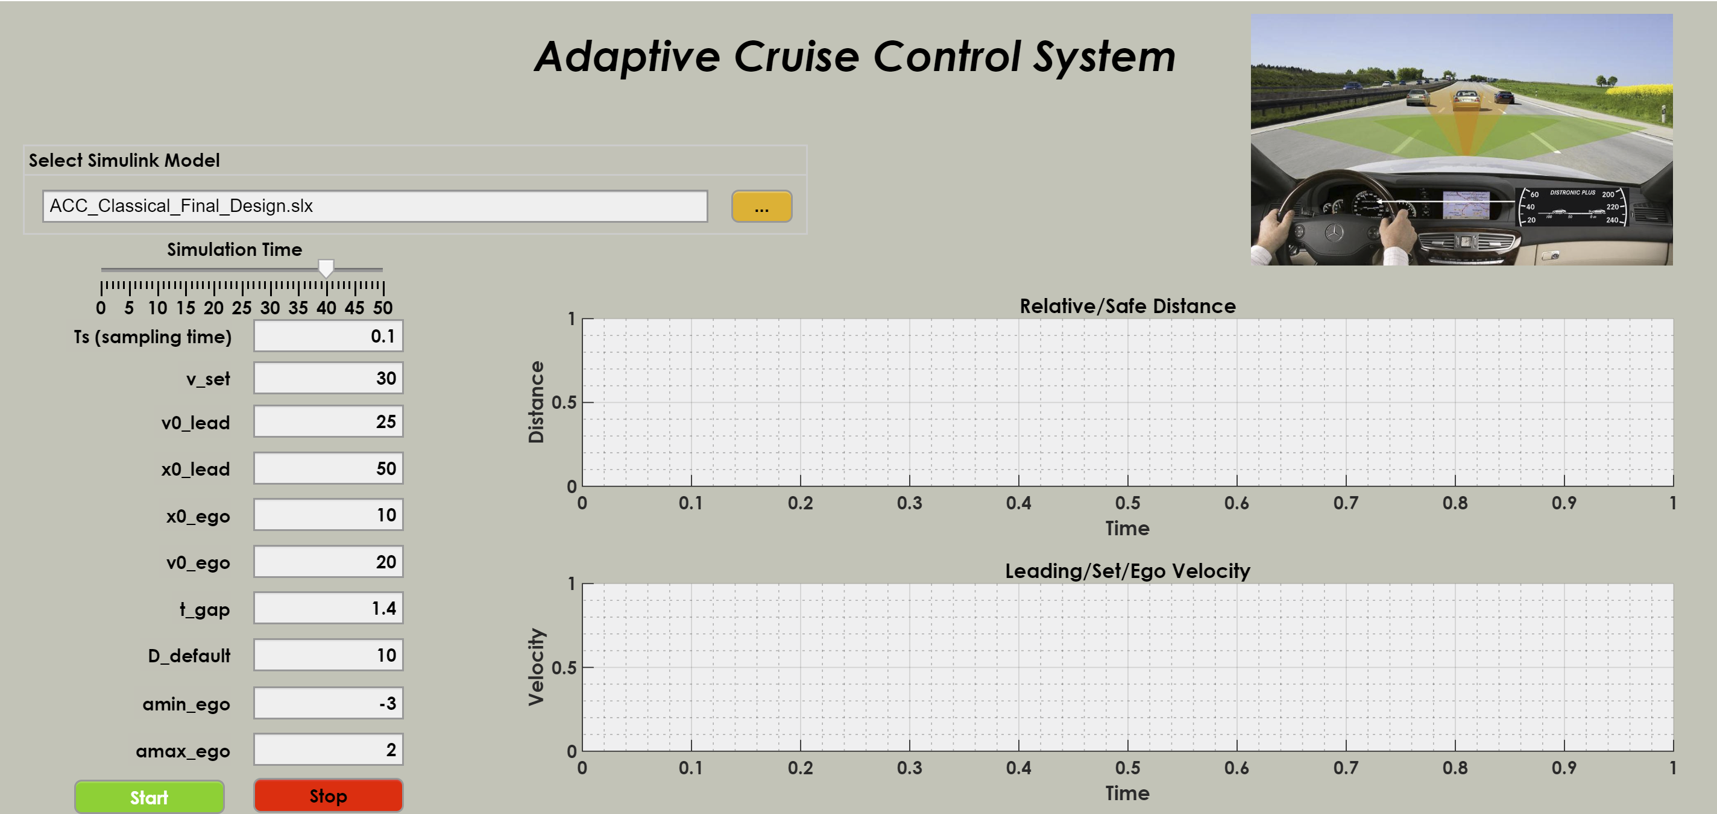
GUI display:

Slide 14
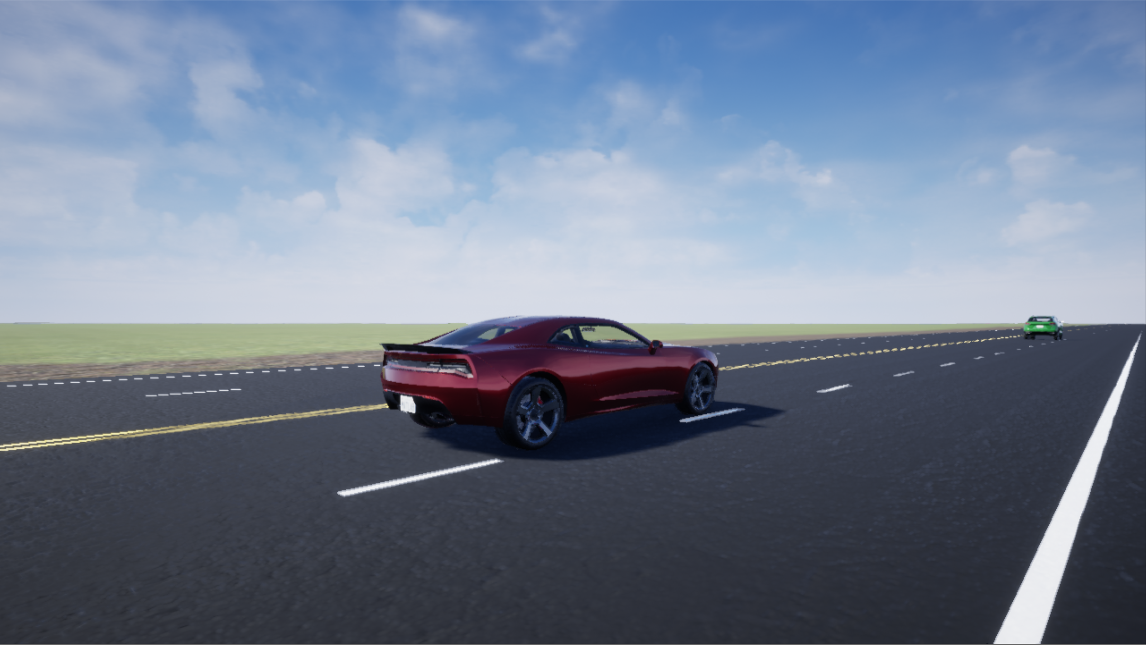
Once the simulation has begun, animation will commence, creating an active driving experience displaying ACC operation

Slide 15
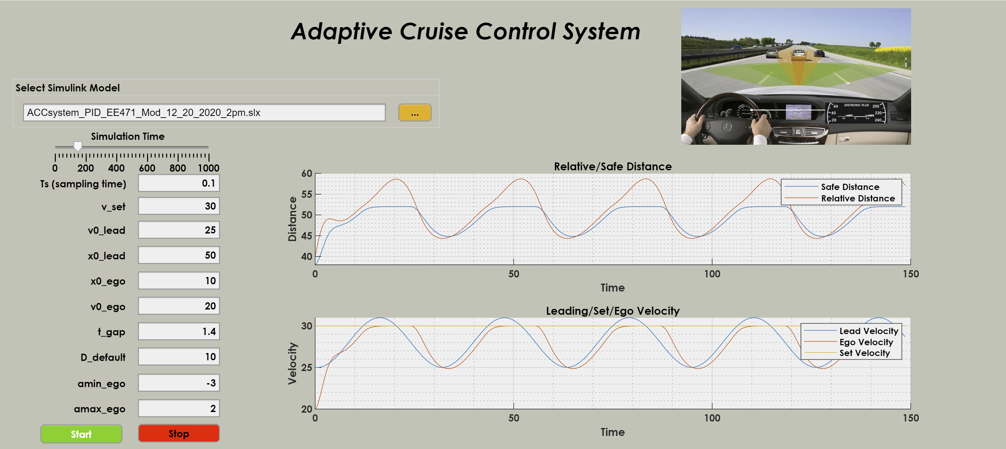
Upon completion of the animation, the relevant position and velocity data becomes populated onto the GUI panel

Slide 16
System Conclusion:
Adaptive Cruise Control (ACC) is an innovative approach toward vehicle autonomy. The ACC simulation experienced during this presentation provides insight on the critical parameters that are used for functional operation of the system. The notion of optimal traffic flow may be attained with an increased amount of vehicles actively using an ACC system, effectively creating a “platoon of vehicles”. While the system may not offer the greatest value in stop-and-go traffic, it provides its greatest opportunity to lend efficiency with traffic-flow issues when extended periods of unobstructed travel is expected (e.g. highways/interstates).

