Slide 1


An experience creating a local community in a small town
Emmanuel Arias

Slide 2
Who am I?
I am from La Rioja, Argentina
I love contribute to open source & free software projects
I have started contribute on Debian in 2017, but I use it since 2010
DM since February

Slide 3
Why should we use FOSS?
We have control about what we are running.
Transparency.
Reduce costs.
We can win experiences.
We can adapt piece of code of our purpose.
No need for a company absolute dependency.

Slide 4
What happen with my University?
Public Education.
Universities are for everybody.
From the schools we learn about non free systems (if we learn IT).
Very little professor use and promote the use of FOSS, and that’s a problem...

Slide 5
Some issues
What happen if the students can not pay a license?
How teach how the things work?
We are losing the sharing culture.
Maybe compatibility problems?

Slide 6
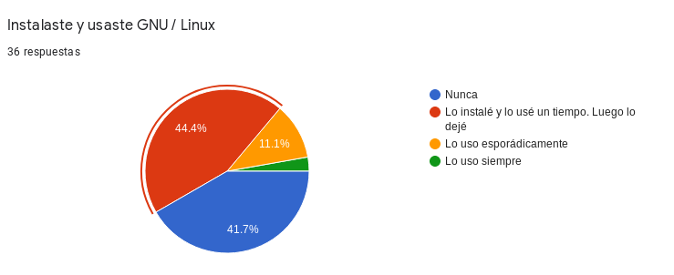
Some issues
I used just work a particular course.
I had not a good educational base and I could not adapt it.
I had not time to study a Linux distribution.
I use <private> Systems in my work.

Slide 7
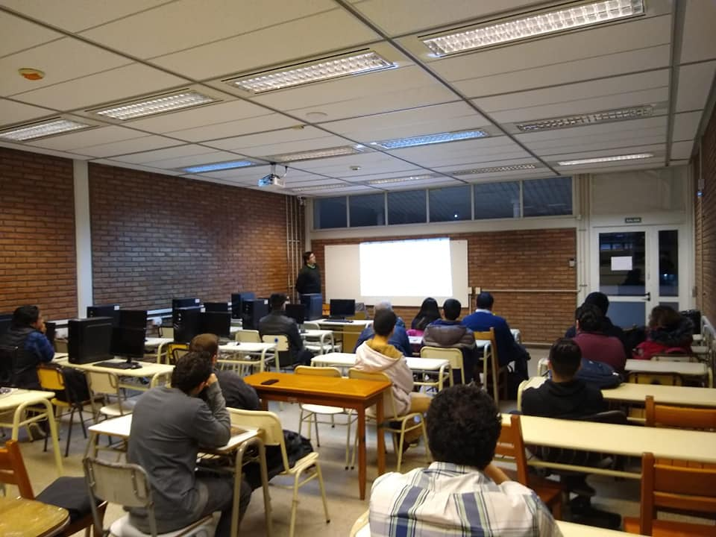
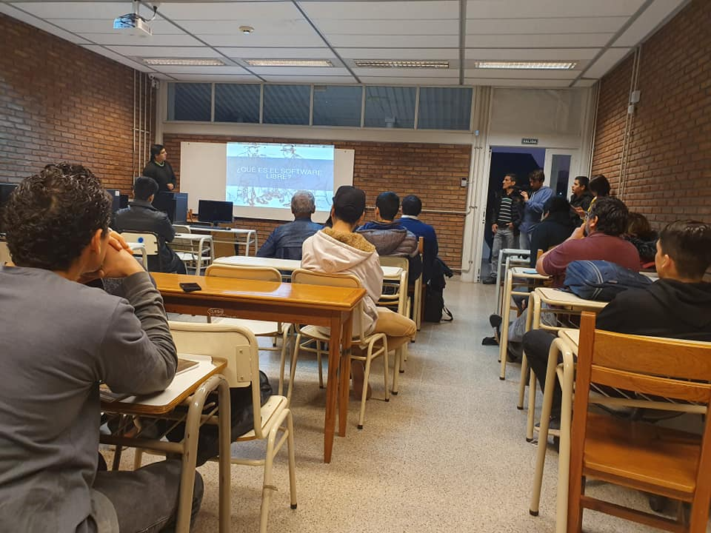
Let’s create a Local Community

Slide 8
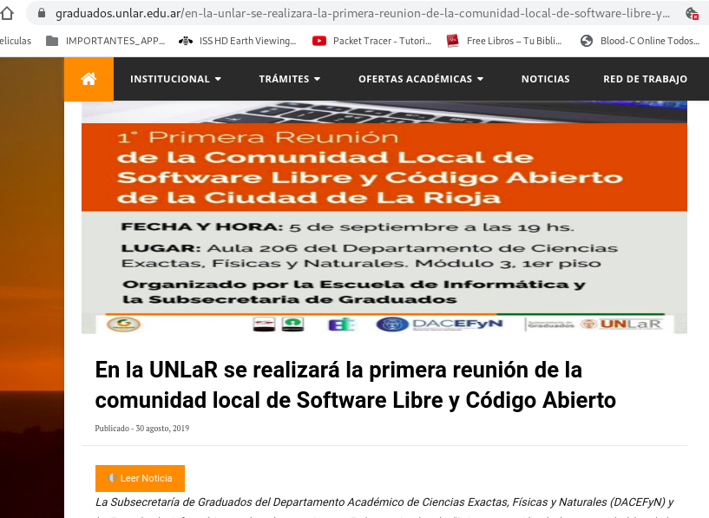
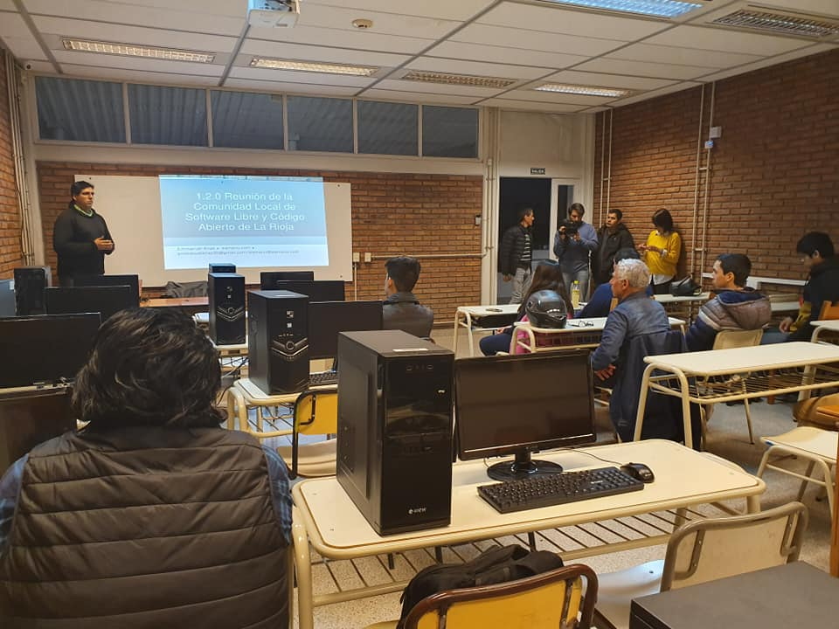

Slide 9

Houston, we have a problem
Difficult on motivate people to contribute to FOSS projects.
We have some difficult to start a project.
We could not found a project to start contribute.
Is not easy maintain the group active.

Slide 10
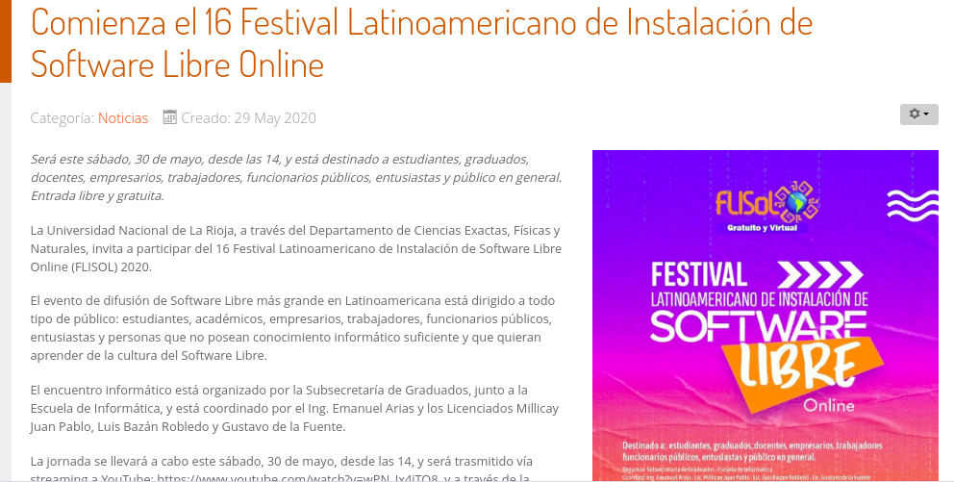

Not so bad...

Slide 11
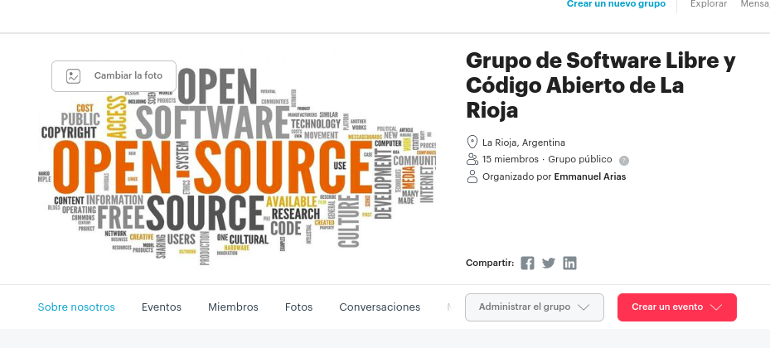
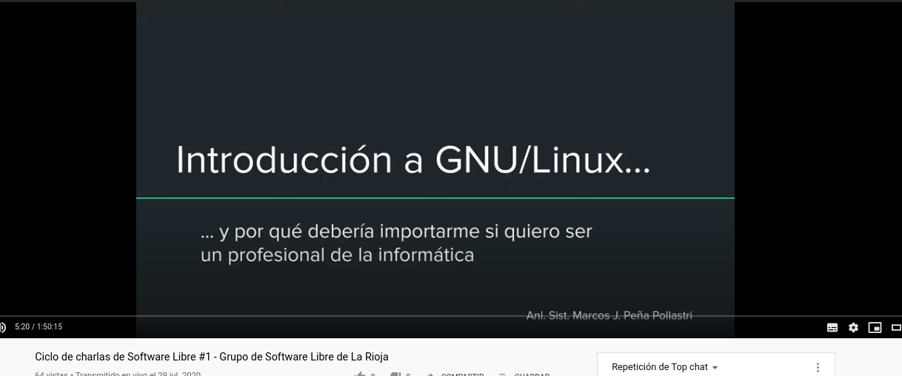
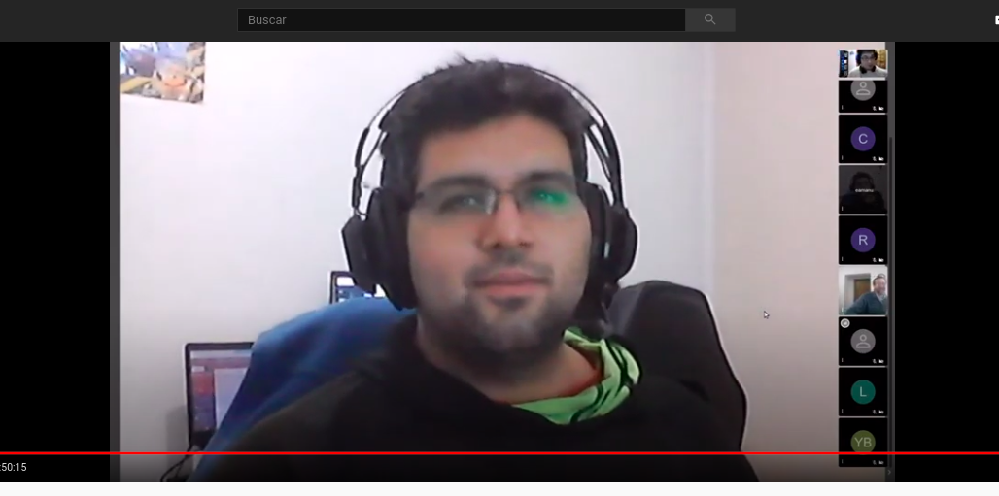

Slide 12
What can we do?
Make 101 courses.
Continue with meetups, and motivate to more people participate.
Organize events.
Make noises.

Slide 13
Thanks!

