Slide 1
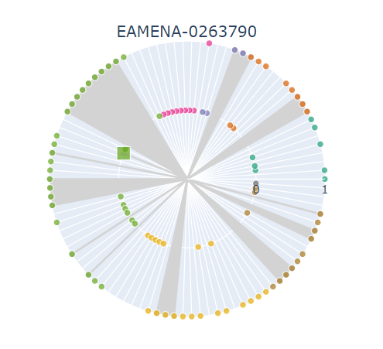
EAMENA Heritage Place ID
Outer ring: all these fields have a value
Inner ring: a square symbol means that this MDS field hasn’t been populated
Inner ring: all these fields don’t have a value
Grey beams: these are the MDS fields
Each dot represents one field. Fields are coloured according to their categories, see the EAMENA website

