Slide 1
Detecting Disasters
Using Social Media
Alex Nguyen
Eamon Fleming
Javier Martinez

Slide 2
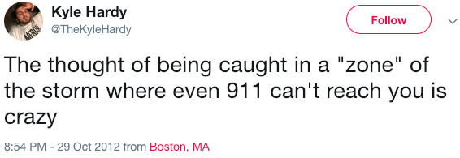
Problem Statement:
During disasters, many people are in situations where first responders that need urgent help. Ex: many people call 911 or manually scour through twitter data looking to filter through which situations need immediate assistance or not.
How can we utilize social media to design a tool that will identify disaster events in real time using geo-location to bring attention to urgent disaster tweets?
Notes:
Dataset that had 10,000 tweets that contained tweets pulled from preset keywords like “ablaze”, “quarantine”, and “pandemonium”, then noted whether the tweet referred to a disaster event

Slide 3
Workflow
Finding and Cleaning Data
Extracting Sandy Tweets (via Twython)
Identifying Disaster Tweets From Regular Tweets During Sandy Hurricane
(Model + Wordfilter)
Create Model That Separates Disaster
And Non-Disaster Tweets
Setting Weights of Critical Tweets and Oversampling
Manual Classification of Critical Tweets
Identifying Disaster Tweets From Regular Tweets During Sandy Hurricane
(Model + Wordfilter)
Geo-Mapping Results
Live Streaming

Slide 4

Finding Data:
Initial Obstacles:
Twitter, Instagram, Snapchat restrict number of tweets pulled using their API. Not possible to grab in real time without access, and no current disasters.
Presumably FEMA would have access to this in emergencies. We wanted to simulate this by finding a dataset with a large number of tweets in a short time in a disaster, and with as much information as possible (geotags, timestamps).
Data Source:
CrisisLex: SandyHurricaneGeoT1 Geo-Located tweets from the 2012 Sandy Hurricane (6 Million Tweets)
Includes all geotagged enabled tweets from the 11 day window leading into and through Hurricane Sandy, in the areas affected by the hurricane (Northeastern Seaboard).
Mixture of both regular tweets and disaster related tweets. Includes precise geo-coordinates of where tweet was sent for about 90% of set. Includes timestamps to the second.
Having specific Tweet IDs allows for a greater rate of pulling tweets from the API.
Notes:
Dataset that had 10,000 tweets that contained tweets pulled from preset keywords like “ablaze”, “quarantine”, and “pandemonium”, then noted whether the tweet referred to a disaster event

Slide 5

Twython: Getting the tweets
Twython: (Python wrapper for the Twitter API)
900 Tweet Limit within 15 minutes
Twitter Developer Accounts
Designed a Tweet Pull Function and While Loop to run through a list of tweet ids in chunks of 900 repeatedly. Ran in tandem with multiple app keys
Training data: Pulled all 180000 tweets from the peak disaster period (1 hour before landfall in NJ/NY to 2 hours after) in hopes of getting a maximum number of critical tweets to train with
Test data: Pulled a random sample of ~40000 of the two million tweets after that point to test on.
Notes:
Supports both normal and streaming Twitter APIs

Slide 6
Figure eight dataset
Example:
“I see a fire across the street from my house”
“This chipotle burrito is fire”
Models:
Logistic Regression
Multinomial Naive Bayes
Random Forest Classifier
XG Boosting (Extreme Gradient Boosting
SVM
Data: 10,000 tweets that contained tweets pulled from preset keywords like “ablaze”, “quarantine”, and “pandemonium”, then noted whether the tweet referred to a disaster event
Goal: Create a model that can distinguish disaster related from regular tweets
Vectorizers:
Count Vectorizer
TF-IDF Vectorizer
Hashing Vectorizer
Final Model:
Voting Classifier using parameters found on our grid searches from LogReg, Random Forest and XGB
Test Score = 81%

Slide 7
Keyword Filtering
Unsatisfied with some labeling in Kaggle Set
CrisisLex - List of crisis related words
Edited word list and applied a map filter to all tweets not predicted as disaster tweets by the Figure Eight set model to label anything that got a hit as a successful predict
In short, Phase One of our tweet categorization process is to identify disaster tweets via combined efforts of Figure 8 set model and Keyword Filtering. Phase Two is to train on these disaster tweets to identify Critical.

Slide 8


Manual Tagging, Weighting, Bootstrapping
Combed through 9000 disaster related data determined by the model.
And identified which ones we think were critical and not critical
Gave weights to the tweets that were more urgent than others
Some of the data was mislabel (human error)
We found a list of disaster related keywords from CrisisNLP
We applied this labeling to detect disaster labeling
Bootstrap:
Imbalanced Classes
90:10 split of Disaster not critical vs. Disaster critical
We oversampled our data to even out these classes.

Slide 9
Modeling to Predict Critical Tweets
Goal: Create a model that can distinguish critical tweets from the disaster-related tweets
Final Model:
Similar to the first model, we grid searched through multiple vectorizers and classifiers to find the best parameter for our Voting Classifier that used LogReg, Random Forest and XGB
Test Score = 96%
Example of Critical Tweets:
“Priority 1 Milford house filling with fire/smoke #MFG #MPD”
“Heavy wind, streets are #Flooded #Scared #Sandy”

Slide 10
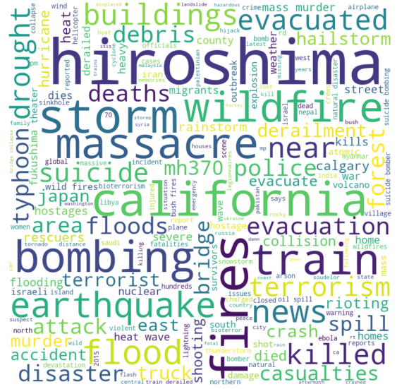
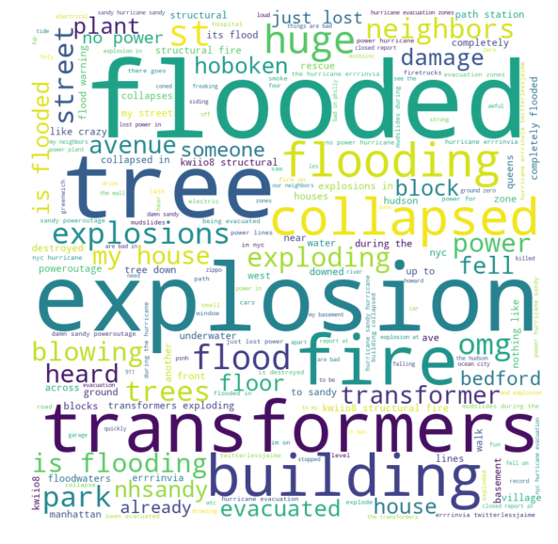
Word Clouds

Slide 11
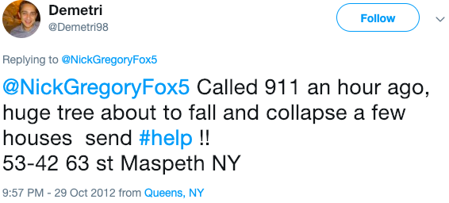
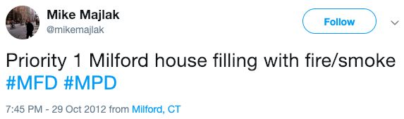
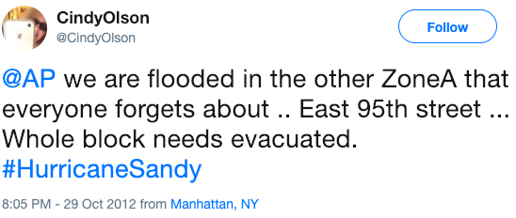
Disaster Critical Tweets

Slide 12

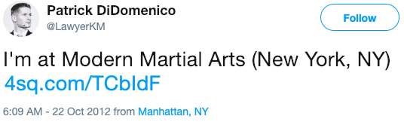
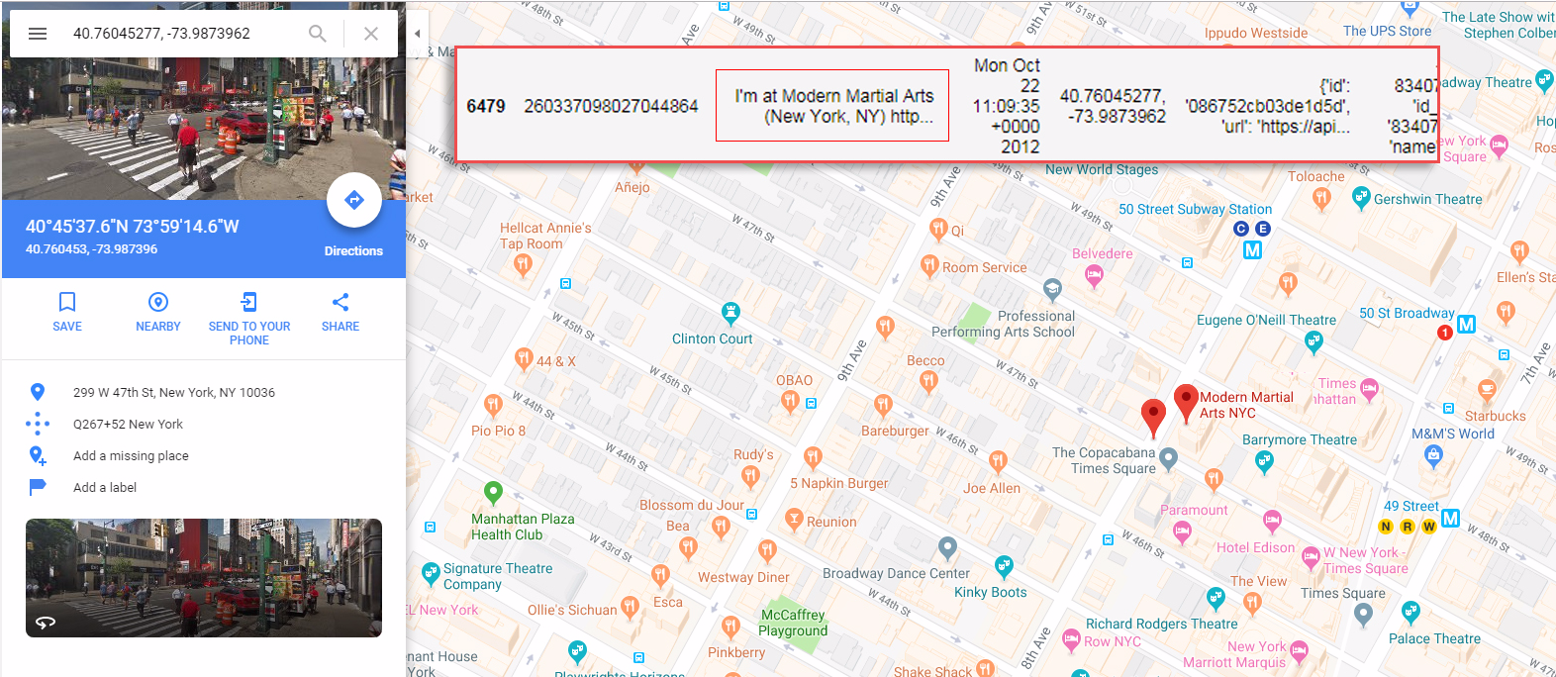
Geo-location

Slide 13
Geo-mapping Proof of Concept
Example shown on Tableau Desktop
Northeastern Seaboard during Landfall (all tweet types)
NYC during landfall (filtered for critical)

Slide 14
Livestream Example
Model will be shown on Google cloud

Slide 15
Thanks!
Any questions?

