Slide 1
DRESS IN LAYERS
using convolutional neural netWORKs
to classify FASHION images in keras

Slide 2
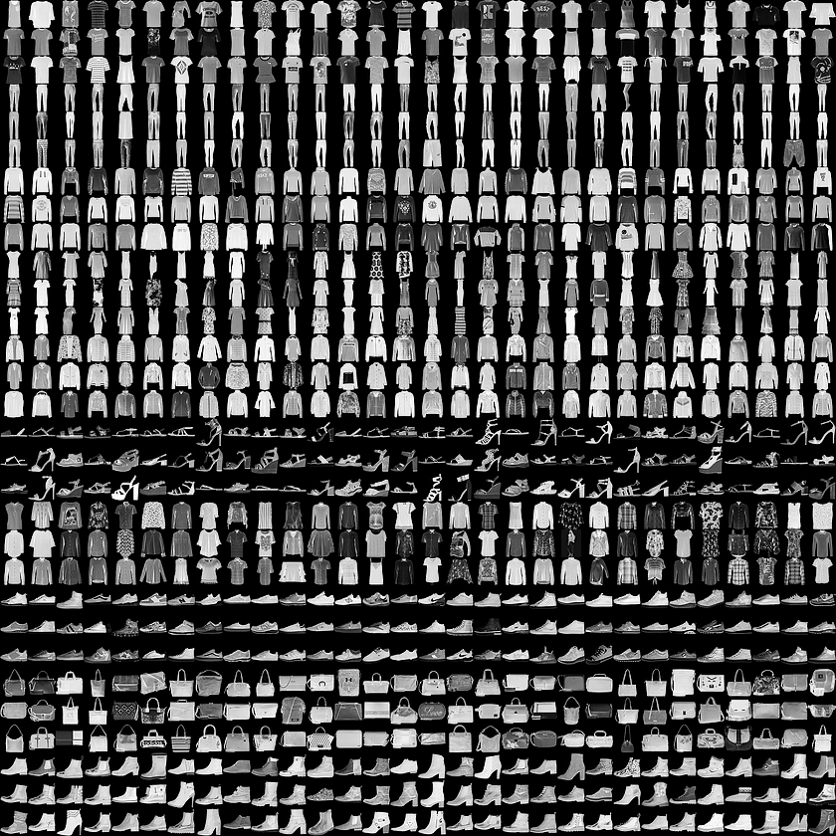
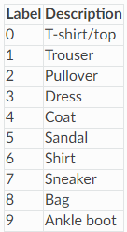
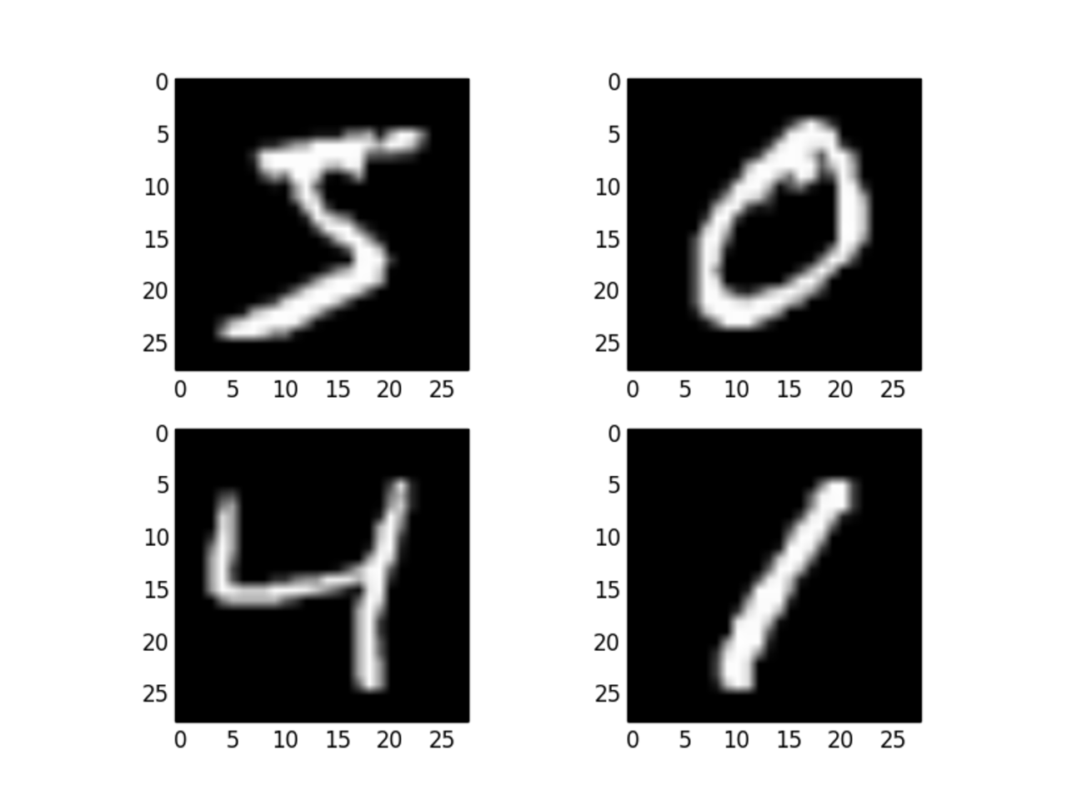
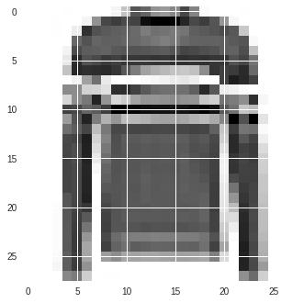
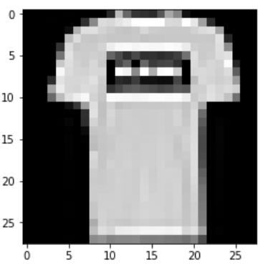
The Fashion MNIST Dataset
70000 28x28 pixel grayscale images of fashion items: 60000 train, 10000 test, labeled into 10 balanced classes (6000/1000 for each class)
The classic MNIST handwritten digits dataset in the same format has long been used as a benchmark for neural network image classification, but is becoming dated.
This dataset has been presented as an alternative. It is significantly more difficult.

Slide 3
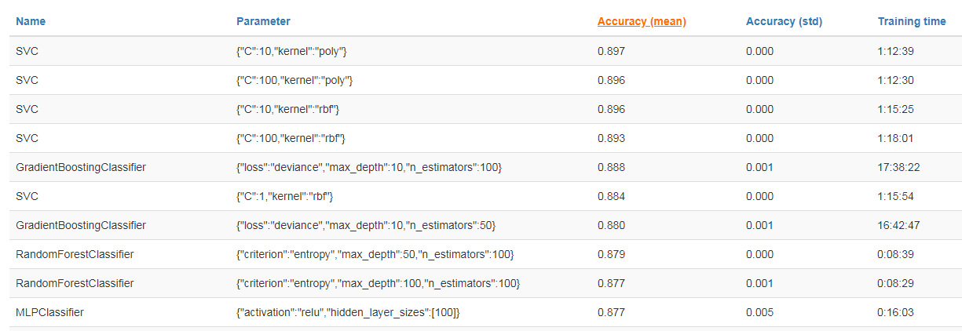
Reproducing Top SKLearn Benchmarks
RandomForestClassifier (0.878)
SupportVectorClassifier (0.892)
GradientBoostingClassifier, MLPClassifier

Slide 4
Sequential Neural Network
Input Layer > Hidden Layers > Output Layers
Weights and Biases randomly initialized at each neuron in the network
After a certain number of inputs are fed through, the system backpropagates and adjusts the weights and biases at each neuron to minimize some loss function. In this case it is categorical crossentropy.
Sequential Network returned test accuracy of 0.892 after 15 epochs with minor tweaking.
Testament to the power of NNs

Slide 5
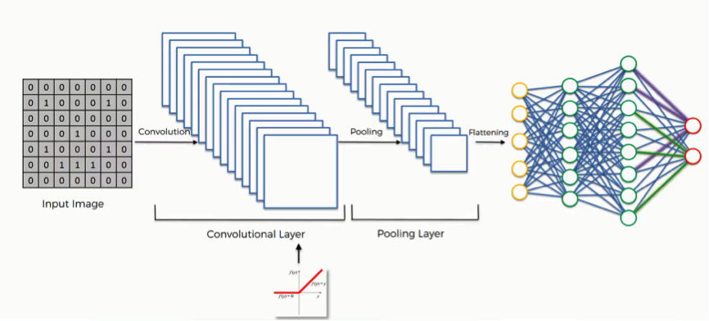
Convolutional Neural Networks and Image Processing
Reshape data into 2D Array
Each convolutional layer passes a filter over the input image and identifies features, edges, etc.
Max Pooling layers condense the image data by passing a filter that takes the maximum value only from pools of a specified size
Flatten and feed into Dense Neural Network

Slide 6
Tweaking the CNN – Endless Options
- Conv2D Layer edits: Strides, Padding, Kernel Size
- Number and depth of Dense layers
- Number of convolutional layers and number of filters in each.
- Where to add pooling layers and pool size
- Regularization: Regularizers, Early Stopping, Dropout
- Batch size (64, 128, 256)
- Number of epochs
-

Slide 7
The Process and Where I Saw Gains
- Tried a few different initial setups that I had seen performed elsewhere, either in class or in image classification situations, and tried to tweak up from there.
- Dropout is the essential regularizer, extends the life of deep networks
- Reducing dropout percentage on dense layers
- Applying dropout on Convolution Layers
- BatchNormalization: Keras layer option that essentially normalizes the activation values in the hidden layers after each batch in the layer to which it is applied. This allows for higher learning rates, and minimizes effect of a bad initialization. Can also have a regularization effect.

Slide 8
Cool Discoveries in Keras
ModelCheckpoint
Callback option that allows you to save model to an h5 or hdf5 file at the end of each epoch
Can be set to save only the best performing end-of-epoch model, according to the metric you specify.
Model file can be loaded in later and worked with. Even its run state remains intact
LearningRateScheduler
Another callback option
Can be used to set the learning rate to vary as a function of the loss delta
Can be designed to escape local minima
To some extent I believe this functionality is cooked into the adam optimizer

Slide 9
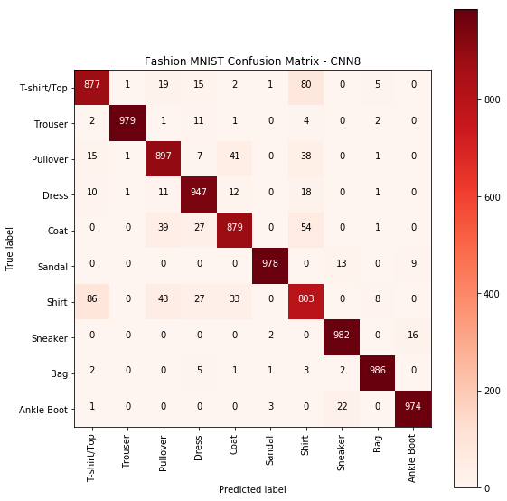
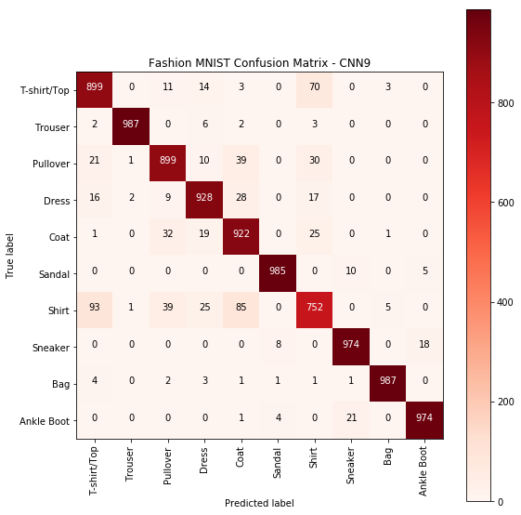

Slide 10
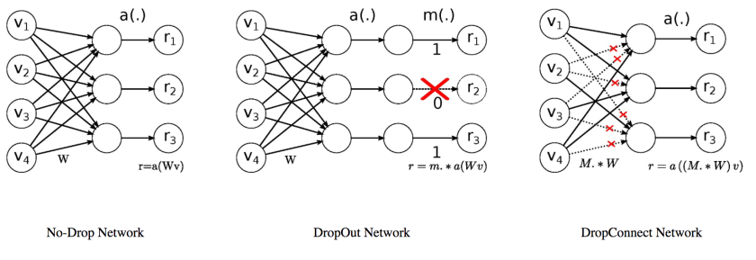
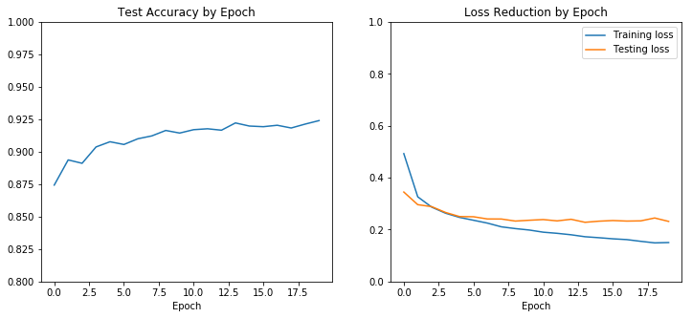
DropConnect
Earlier in the year, I heard about this technique while researching best performers on the traditional MNIST dataset out of curiosity
NNs using DropConnect showed accuracy up to 99.79%, the highest accuracy considered legitimate
Drops random WEIGHTS instead of random NEURONS
Typically used only with TensorFlow, but I was able to locate a Keras implementation on GitHub, and get it to work with a bit of tweaking
Can only be applied to dense layers
Can be combined with normal dropout on the same layer
Showed strong results in isolation and in combination with regular dropout, however, only one dense layer in my best models, so did not significantly affect performance.
Would be curious to see how it can improve NNs running multiple dense layers with Dropout and DropConnect

Slide 11
Thanks, GA!

