Slide 1
Asking Men and Women
Eamon Fleming – Data Science Immersive – Project 3
Classification of subreddit comments WITH natural language processing

Slide 2
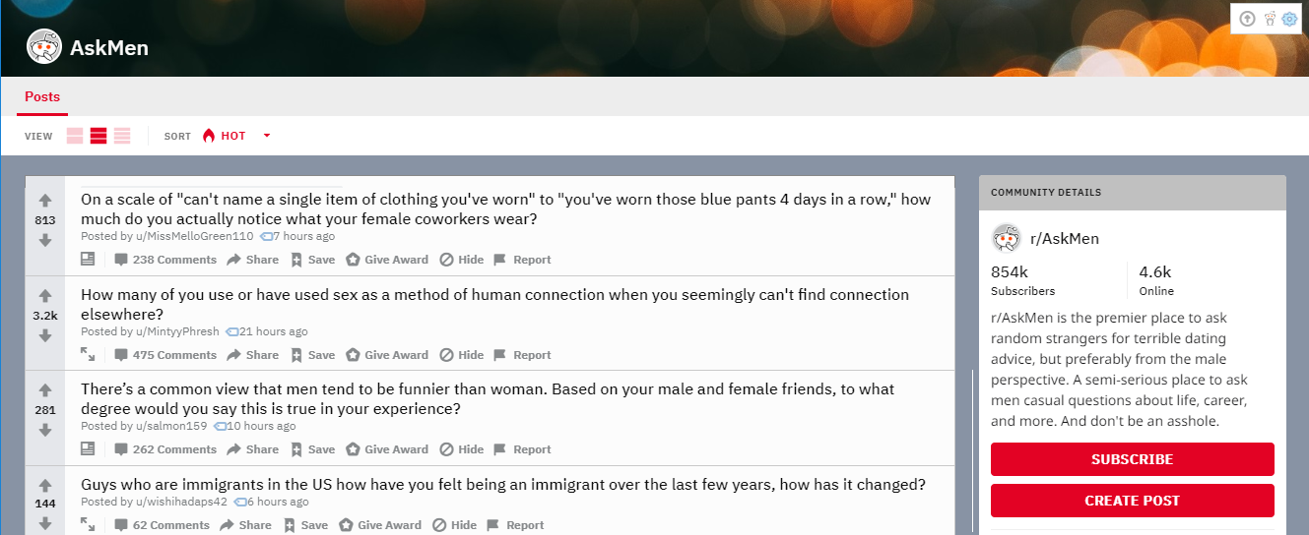
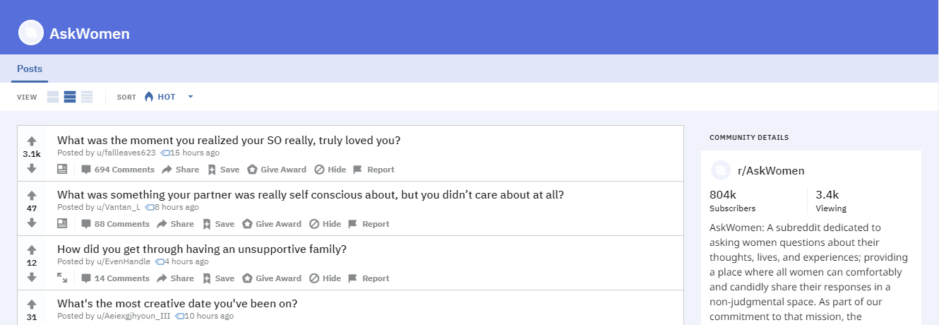
A TALE OF TWO SUBREDDITS
r/AskMen and r/AskWomen: two subreddits designed so that redditors can come ask questions that they want to direct at redditors of the male or female gender.
Generally serious/good-faith questions, but no ban on humor.
First-tier comment replies in threads should be overwhelmingly women in r/AskWomen, and men in r/AskMen, respectively.
This creates an obvious comparison problem for natural language processing:
Can we identify comments as belonging to one subreddit or the other?
By extension look at: The language of men answering questions for men vs. the language of women answering questions for women?

Slide 3
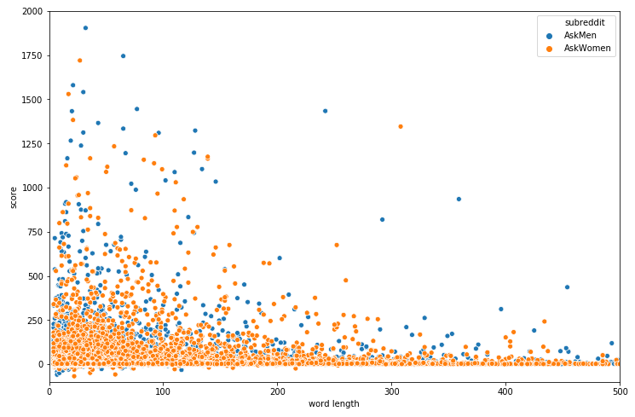
DATA CLEANING AND PROCESSING
Pushshift.io
Looping for first-tier comments at twelve-day intervals
Epoch Converter
‘t3_’ filter on parent_id
Attempts at Exploratory Data Analysis
Word length via Regex substitution, string splitting
Correlations by word length and upvote score

Slide 4
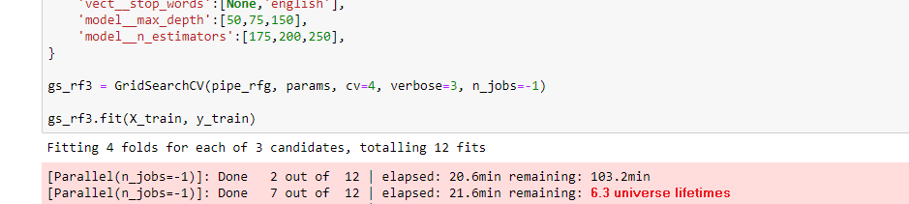
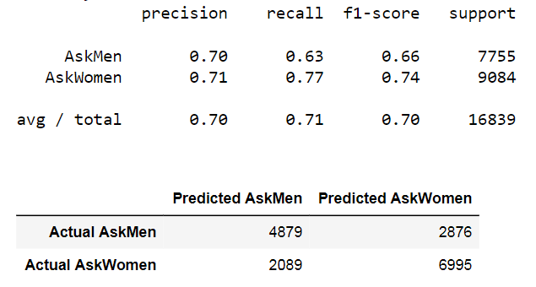
MODELING WITH CLASSIFIERS
Naïve Bayes
Logistic Regression (GridSearch)
CountVectorizer
TfidfVectorizer
HashingVectorizer
Random Forest Classifier (GridSearch)
Processing Issues
Overfitting Issues
Vast numbers of features
Attempts to reduce via regularization strength, max_features argument

Slide 5
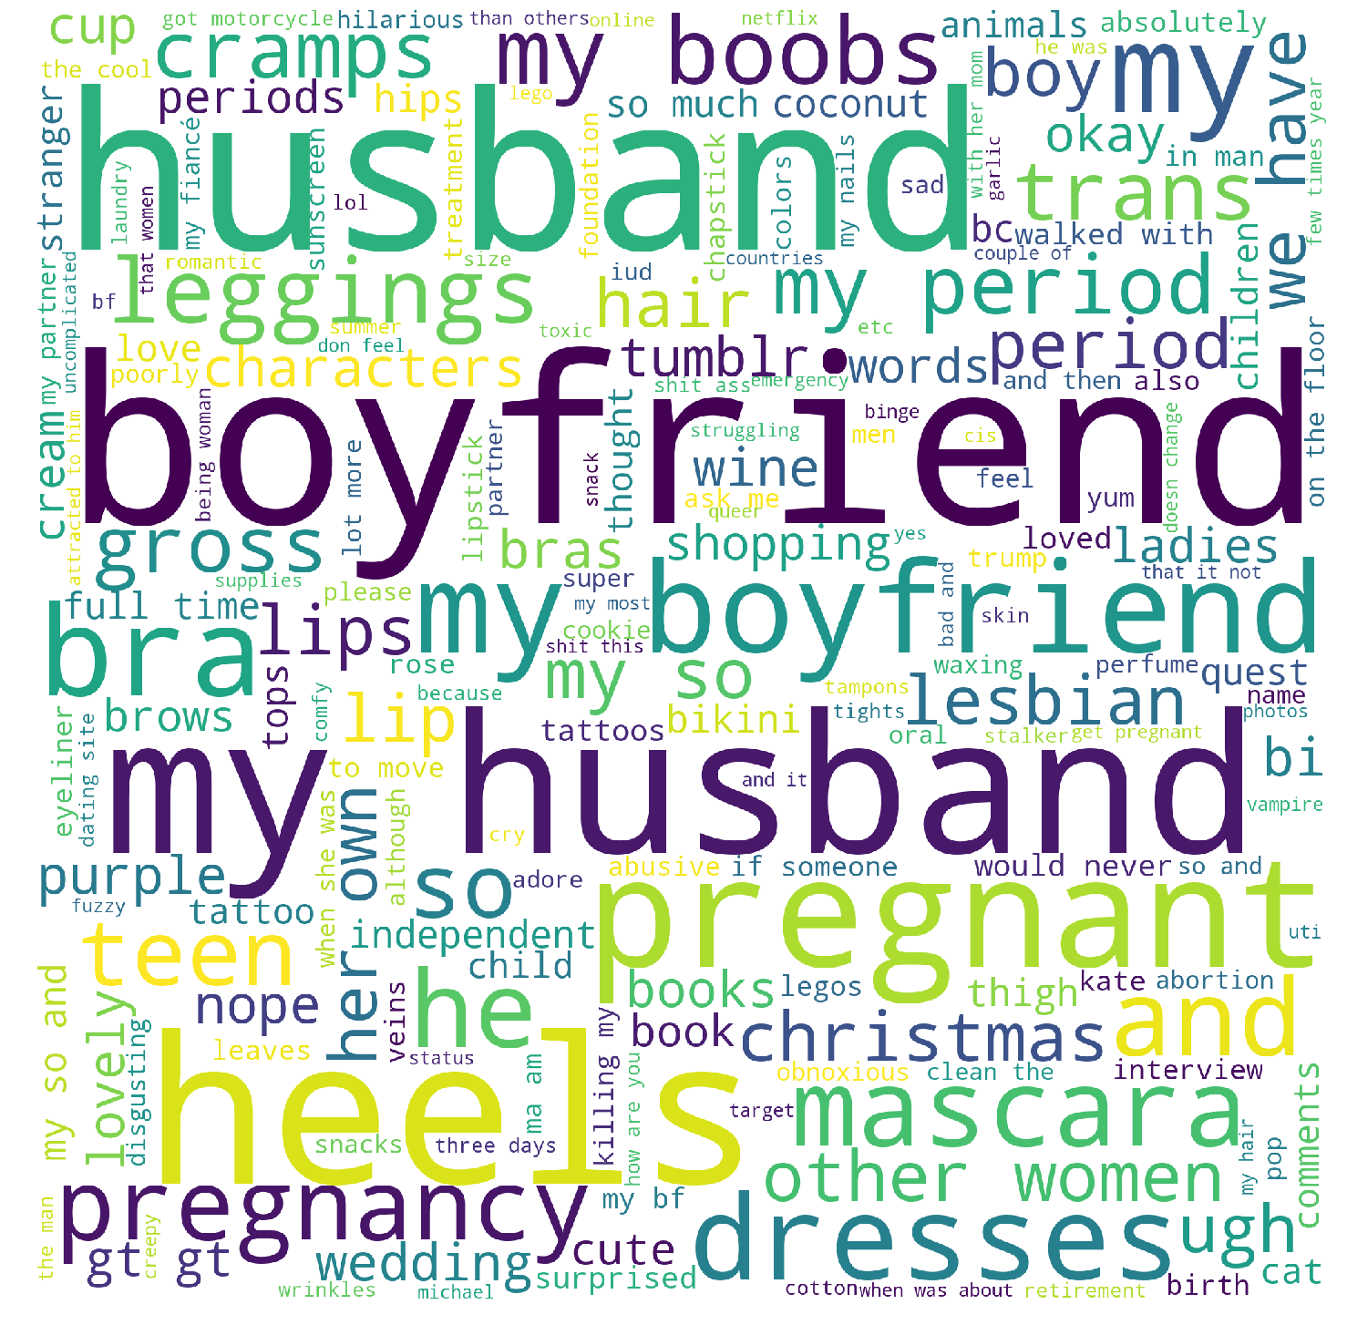
R/ASKWOMEN
"My boyfriend! I love his natural body scent.“
"Cleanse, tone, moisturize, eye primer, shadow, liner, powder foundation, highlight, blush, setting spray, eyebrows, lipstick. Sometimes mascara, although I mostly hate it."
"My boyfriend wears vintage black and it's so freaking sexy lol. I rarely wear perfume, I prefer natural smells or sweet smells if I do though, pink sugar was my jam in high school lol. I mostly just use lavender and fruity smelling soaps and it's not overpowering but I still smell delicious lol"
"My boobs grew and hurt in ways I'd never known before and then I started getting really bad cramps but no period. So I took the test while at work and it was positive. A tiny part of me was very excited but I was mostly sad and scared. I have severe endometriosis and was told if I ever got pregnant that the baby would die. So I spoke with my husband and the doctor and we agreed (very reluctantly on our part) on having a medical abortion. That was last July. I switched doctors early this year and was told there's no reason I wouldn't be able to have children. I'd just have to be on bed rest and monitored very closely. I could have had a baby by now and it makes me sad every single day."
"Cats Zumba My husband Reselling designer clothing"

Slide 6
R/ASKWOMEN
“I’m a graphic designer. For my senior show I had to showcase my work in a gallery. So I went to a few print shops and talked to managers about their quality and printing process. One print shop I went with my boyfriend after lunch, and we walked in and my boyfriend stood behind me while I talked to the manager. I asked a few questions but the manager would direct his answer to my boyfriend. And even asked my boyfriend if he wanted a quote. My boyfriend said “you need to talk to her, it’s her project and her money” and my boyfriend went and sat down behind me. I continued asking about color quality, and asked what happens if I’m not happy with the outcome, and the manager laughed and said “well it’s not like picking wallpaper for the kitchen sweetheart” and looked at my boyfriend for approval on his joke. He didn’t get approval and we left.”

Slide 7
R/ASKWOMEN
Transition cadence to further explanation:
“and then”, “although”, “also”, “so”, “because”
Personal touch:
“ask me”, “how are you”, “please”, “feel”
Short and sweet casual language:
“super”, “ugh”, “comfy”, “cute”, “lol”, “yum”
Miscellaneous expressions:
“uncomplicated”, “killing my”, “lot more”, “obnoxious”, “would never”, “if someone”, “struggling”, ”my most”, “absolutely”, “nope”

Slide 8
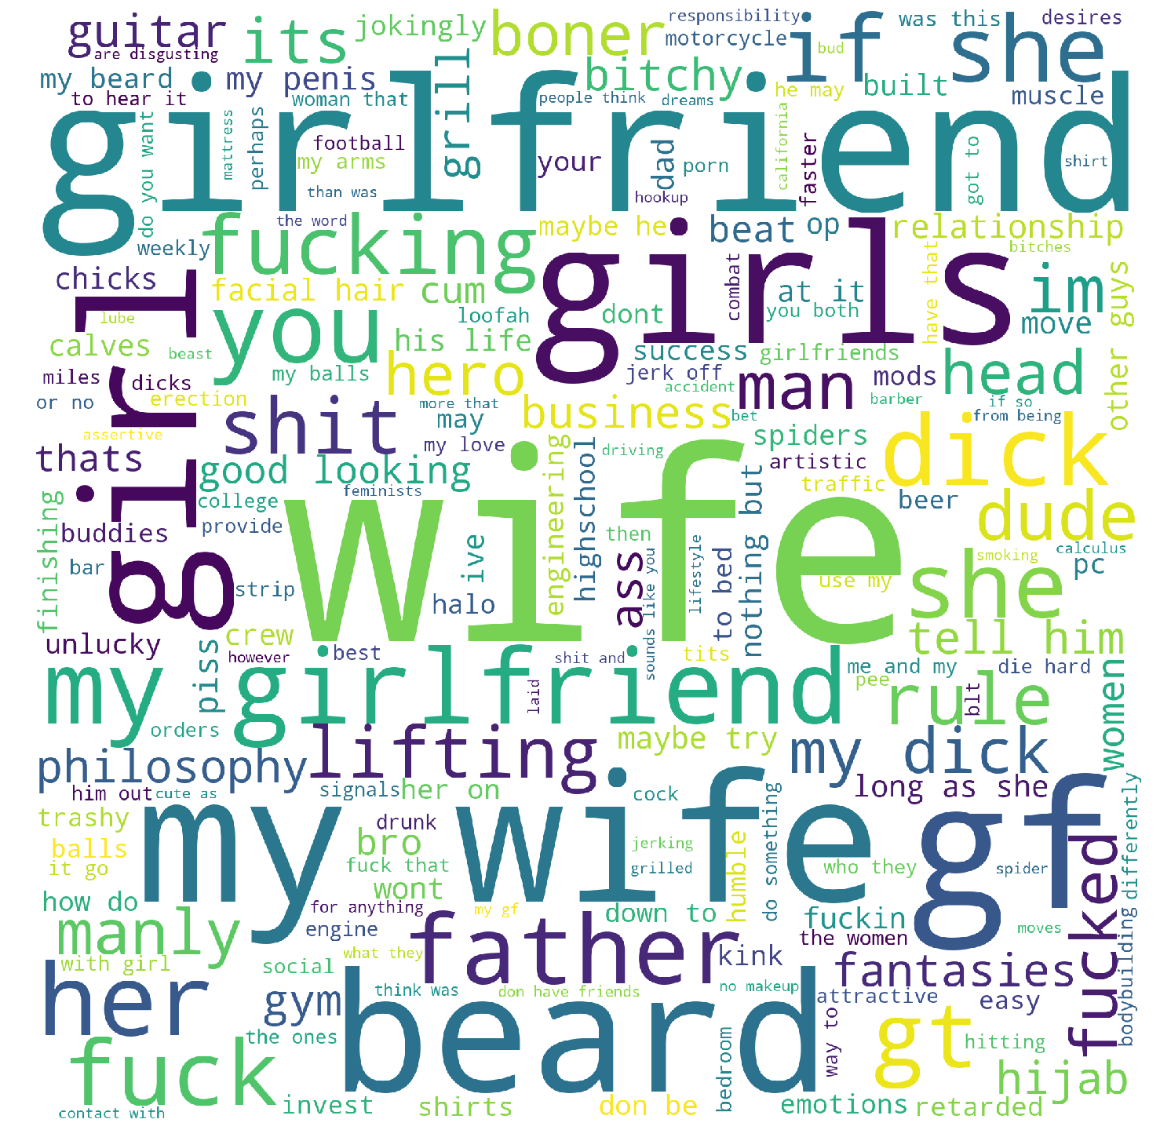
R/ASKMEN
She's my wife :)
"Dated like a 9.5/10. She was a child model but couldn't continue as she got older because she was only like 5'8" or some shit. Blonde, size 0, conventionally attractive in pretty much every way. A lot of it is a ton of fun. People are in awe of your seductive prowess, you can lose arguments and say you're going to go bang your ex-model girlfriend as you walk away from your defeat. Its worth doing once in your life if you can."
“Hands, beard, shoulders, head, chest”
"Usually, you are attracted to the person before you find out she is taken. Been in the situation before. You want her to be attracted to you, but at the same time you don't want her to cheat on her dude. "If she cheats with you, she will cheat on you". Ironically, her loyalty attracts you to her even more. (In my case at least). Even worse is when you get mixed signals."
"Start with a physical change. Get a good haircut. Put some time into grooming yourself. Shave or trim your beard if you’ve got one. Buy some good cologne for when you go out. Start a work out routine and stick to it even when you don’t want to. Doesn’t have to be anything crazy, it could just be sit ups and push ups.“
"Tickling my wife drives her crazy."

Slide 9
R/ASKMEN
Casual male language:
“at it”, “down to”, “got to”, “me and my”, “the ones”, “do something”
Testosterone/hardo language:
“crew”, ”beast”, “built”, “hero”, “bro”
Impersonal/analytical language:
“more that”, “than was”, “perhaps”, “may”, “if so”, “contact with”, “however”
Language that subtly dis-individualizes women:
“the women”, “women that”, “feminists”

Slide 10
R/ASKMEN
“Well, most likely if she’s [expletive content] she probably likes you. Unless it’s for money or drugs, then it’s very possible she don’t give a [expletive] or even really not like yo ass. Assuming this [expletive] is [expletive content] for free, if she [expletive content] without you having to say shit, that bish in Love, [expletive]. L.O.V.E. If she [expletive content], she might like you and just be an ungrateful rude [expletive], or she think you nasty and therefore your [expletive content]. If That bish don’t even let you [expletive content], like right before you [expletive content] she pulls away, dump That [expletive] as soon as [expletive content]. Shit. Not only is she not feelin you, bish was scheming some way to get something besides yo heart out of yo [expletive]. And you don’t want an ungrateful rude, prude [expletive], no fun having [expletive content] like Dat anyway. Now I know you might think I’m clownin, but there’s a lot of truf to this shit I ain’t playin. See for yoself my man. Good luck to ya. Tell her it’s [expletive content]. Hopefully it ain’t [expletive content] haha even if it is if she like you, or you giving enough dollas, or you tell her she gonna [expletive content].”

Slide 11
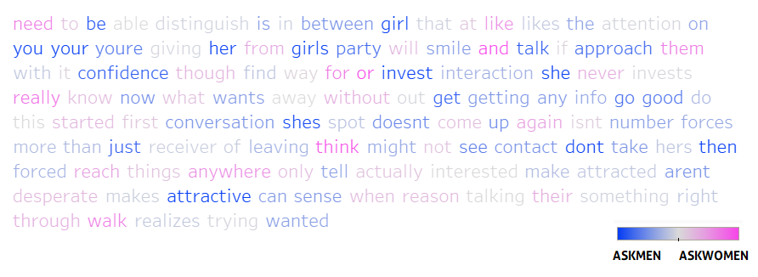
R/ASKMEN: HEATMAPPING TEXT IN TABLEAU
The comment at left was consistently top 3 associated with r/AskMen by predict_proba, but the keywords driving this prediction were less obvious.
Color divergent mapping in Tableau according to single word regression coefficients helps visualize how the model sees the text.
“You need to be able to distinguish between a girl that likes the attention you're giving her from a girl that likes you. Most girls at a party will smile and talk to you if you approach them with confidence. After you talk to her though, you need to find a way for her to invest in the interaction. If she never invests in it you never really know what she wants. Walking away from the girl without getting any info is a good way to do this. You started the first conversation, now she's on the spot. If she doesn't come up to you and talk to you again, she isn't getting your number. This forces her to be more than just a receiver of attention. If you're leaving the party, or think you might not see her again at that party. Give her your contact info, don't take any of hers. She's then forced to reach out to you if she wants things to go anywhere. Not only will this tell you if she's actually interested in you, it will make her more attracted. She will see that you aren't desperate, and that makes you more attractive. Girls can sense when the only reason you're talking to them is to get their number or something like that. They can see right through you. When you walk away without the number, she realizes you're not just trying to get her number, you actually just wanted to talk to her. That is attractive.”

Slide 12

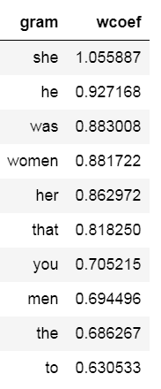
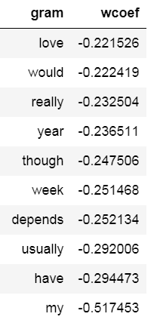
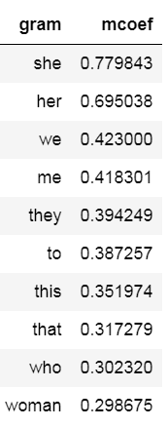
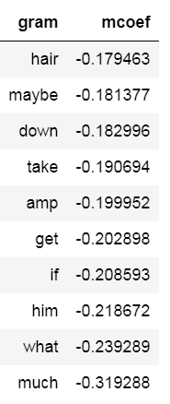
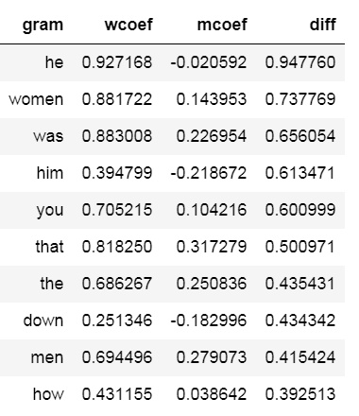
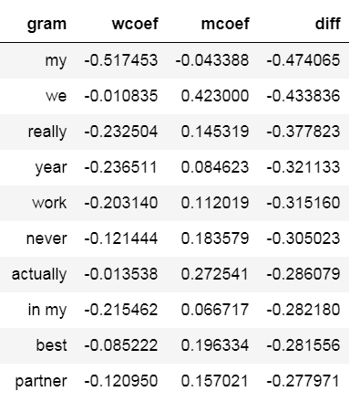
UPVOTED N-GRAMS BY SUBREDDIT
Here I created a classifier feature for elite comments (with 10+ upvotes) and ran GridSearch Logreg with TfidfVect to see if I could predict which comments would be in the upvoted class. The answer is yes, with 85% (AskMen) and 84% (AskWomen) accuracy, and no overfitting whatsoever. See top grams below.
MOST PREDICTIVE OF UPVOTED VS NOT UPVOTED, R/ASKWOMEN
MOST PREDICTIVE OF UPVOTED VS NOT UPVOTED, R/ASKMEN
DOES BETTER IN R/ASKWOMEN
DOES BETTER IN R/ASKMEN

