Slide 1

Note: The data and information in this document is reflective of a hypothetical situation and client. This document is to be used for KPMG Virtual Internship purposes only.
Sprocket Central Pty Ltd
Data analytics approach
[Division Name] - [Engagement Manager], [Senior Consultant], [Junior Consultant]

Slide 2
Note: The data and information in this document is reflective of a hypothetical situation and client. This document is to be used for KPMG Virtual Internship purposes only.
Agenda
Introduction
Data Exploration
Model Development
Interpretation

Slide 3
Note: The data and information in this document is reflective of a hypothetical situation and client. This document is to be used for KPMG Virtual Internship purposes only.
Introduction
Customer targets to drive the most value based on existing customer data.
Identify customer segments that are most valuable to the company using:
Data exploration
Modelization
Analysis and reporting

Slide 4
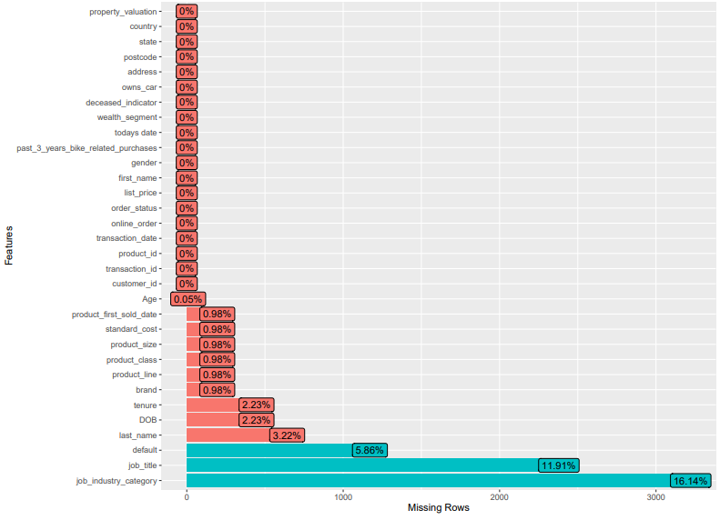
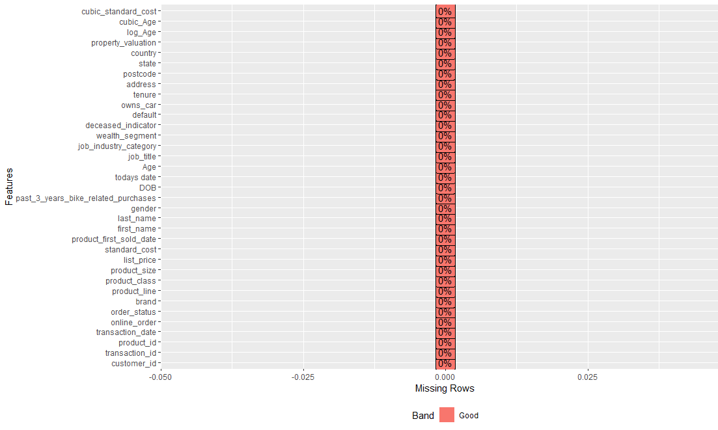
Note: The data and information in this document is reflective of a hypothetical situation and client. This document is to be used for KPMG Virtual Internship purposes only.
Data Exploration
Cleaning data, visualizing the distribution of data and feature engineering
Missing values
job_title – 11.91% missing data
job_industry_category – 16.14% missing data
Remove the missing values from the analysis

Slide 5
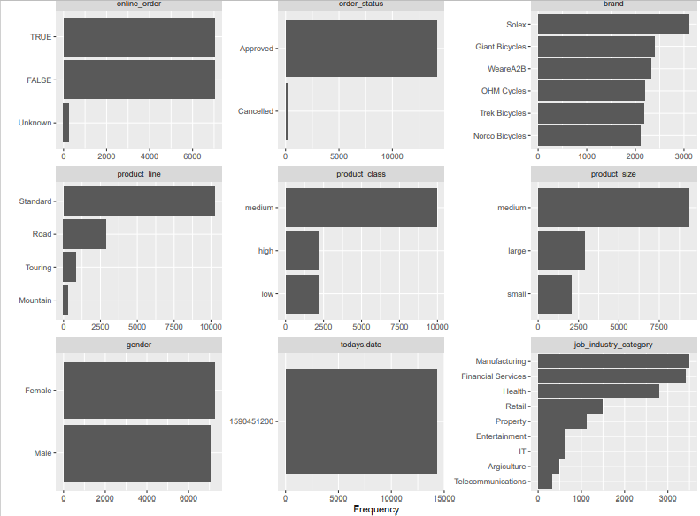
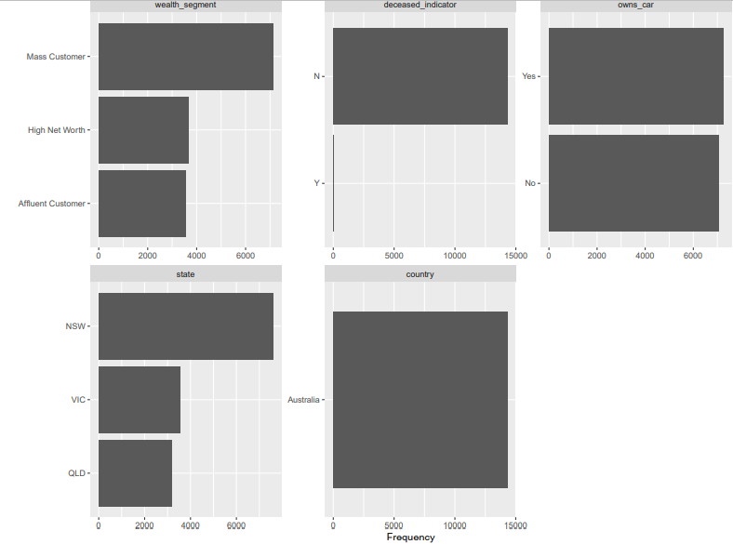
Note: The data and information in this document is reflective of a hypothetical situation and client. This document is to be used for KPMG Virtual Internship purposes only.
Data Exploration
Cleaning data, visualizing the distribution of data and feature engineering
Initial distributions: Categorical Data
Most purchased brand is Solex
Most purchased product line is the Standard line
More female customers than male
Top two jobs industries are from manufacturing and financial services
Most customers are Mass Customers
Majority of customers are in NSW

Slide 6
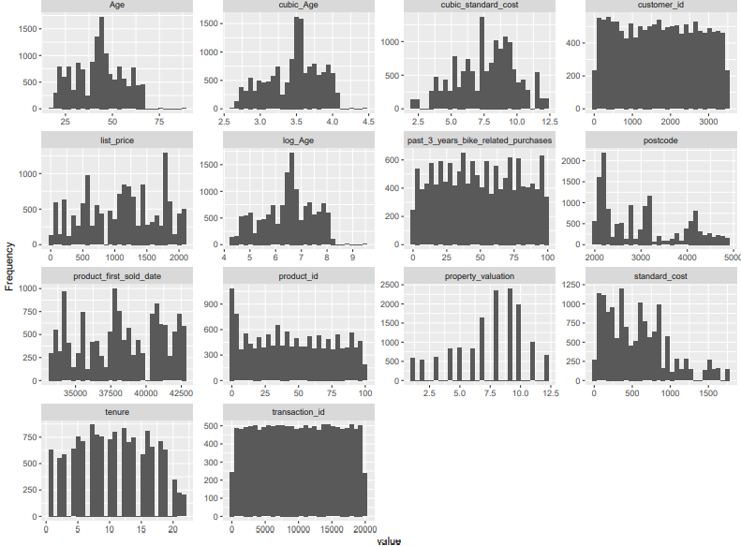
Note: The data and information in this document is reflective of a hypothetical situation and client. This document is to be used for KPMG Virtual Internship purposes only.
Data Exploration
Cleaning data, visualizing the distribution of data and feature engineering
Initial distributions: Continuous Data
Most customers are between the Ages of 38-45
Most customers live in area postcodes 2000-2200
Most products sold are have a low standard cost
Most products sold have a high list price

Slide 7
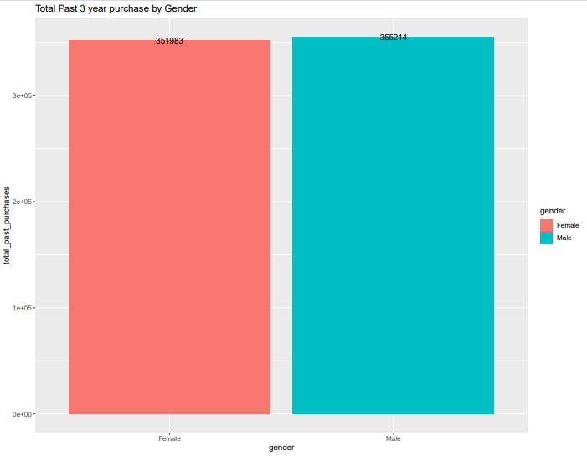
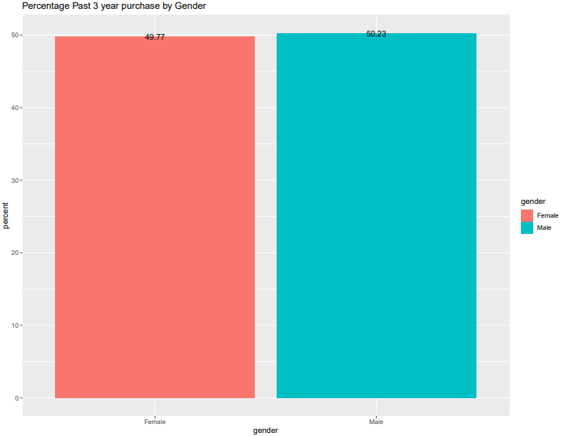
Note: The data and information in this document is reflective of a hypothetical situation and client. This document is to be used for KPMG Virtual Internship purposes only.
Data Exploration
Cleaning data, visualizing the distribution of data and feature engineering
Past 3 year purchase vs gender
Male customers have made more purchases in the last 3 years than Female customers
Male customers make 0.46% more purchases than Females

Slide 8
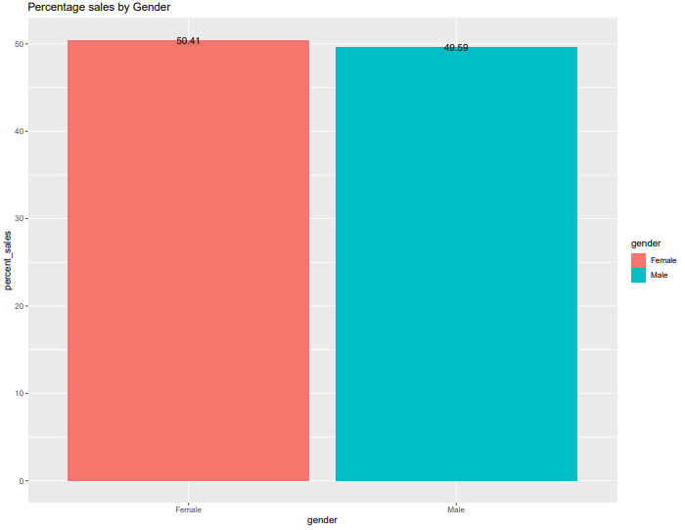
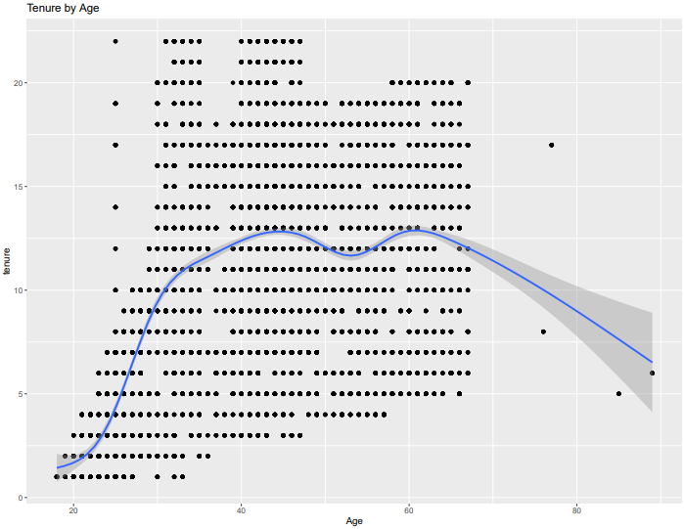
Note: The data and information in this document is reflective of a hypothetical situation and client. This document is to be used for KPMG Virtual Internship purposes only.
Data Exploration
Cleaning data, visualizing the distribution of data and feature engineering
Sales by gender
Male customers have made more purchases in the last 3 years than Female customers
Male customers make 0.46% more purchases than Females
Tenure by Age
Customers aged 30-70 have a longest tenure
Outlier ages have low tenure

Slide 9
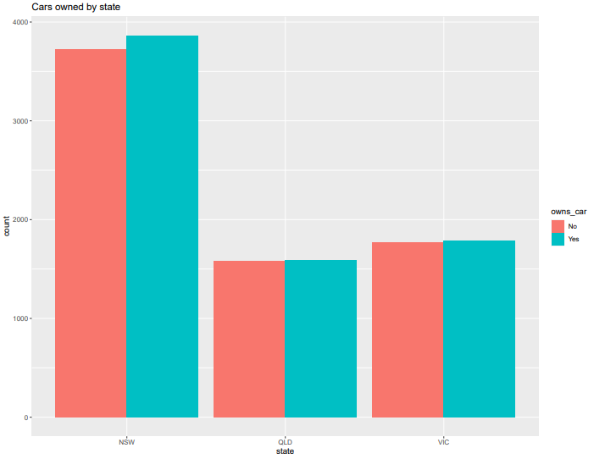
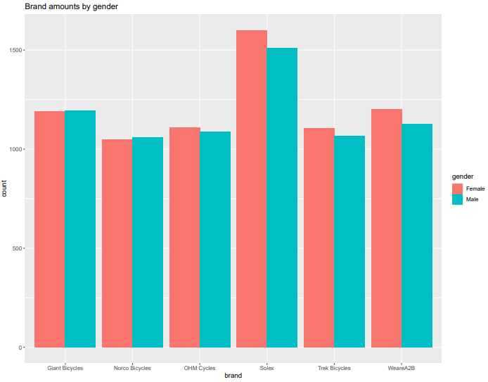
Note: The data and information in this document is reflective of a hypothetical situation and client. This document is to be used for KPMG Virtual Internship purposes only.
Data Exploration
Cleaning data, visualizing the distribution of data and feature engineering
Cars owned per state
Customers own slightly more cars that not per state
NSW has the most customers with cars and without cars
Brand sold per gender
Solex was sold the most amongst male and females
Females have purchased more of OHM Cycles, Solex, Trek Bicycle and WeAre2B than Males

Slide 10
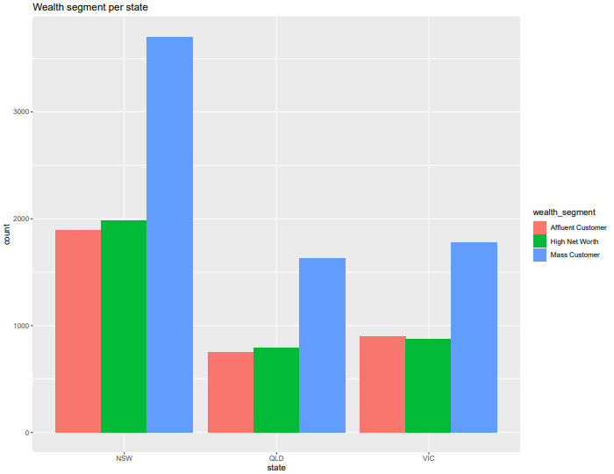
Note: The data and information in this document is reflective of a hypothetical situation and client. This document is to be used for KPMG Virtual Internship purposes only.
Data Exploration
Cleaning data, visualizing the distribution of data and feature engineering
Cars owned per state
Mass Customer purchases the most in all three states
Majority Mass, Affluent and High Net Worth Customers are in NSW

Slide 11
Note: The data and information in this document is reflective of a hypothetical situation and client. This document is to be used for KPMG Virtual Internship purposes only.
Model Development
Cleaning data, visualizing the distribution of data and feature engineering
Feature Engineering
All relevant variables are normally distributed and didn’t need transformation
The irrelevant variables were removed or joined

Slide 12
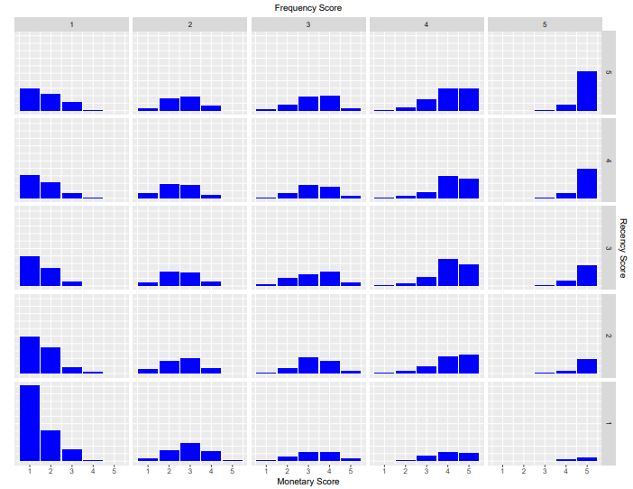
Note: The data and information in this document is reflective of a hypothetical situation and client. This document is to be used for KPMG Virtual Internship purposes only.
Model Development
Recency, Frequency and Monetary (RFM) analysis and modeling
Generate RFM
RFM table was produced
RFM distributions
Large amount of customers have low Frequency, Monetary and Recency scores of 1
The score are well distributed between RFM scores of 2 and 3
High amount of customers have RFM scores of 4
More customers at risk or lost than loyal customers

Slide 13
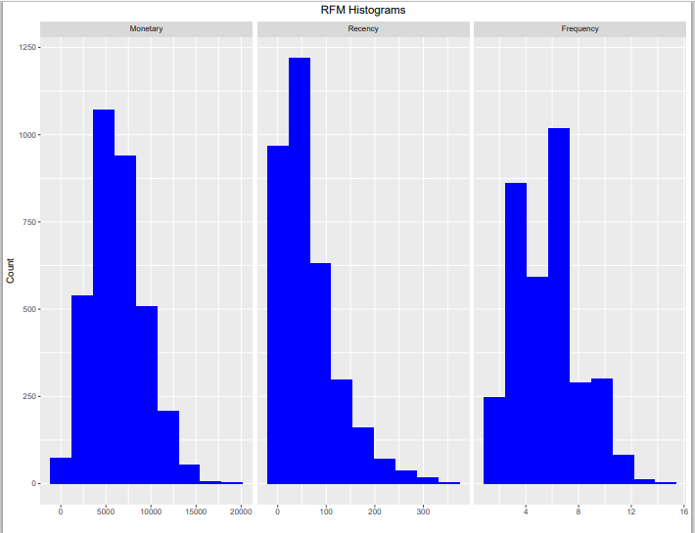
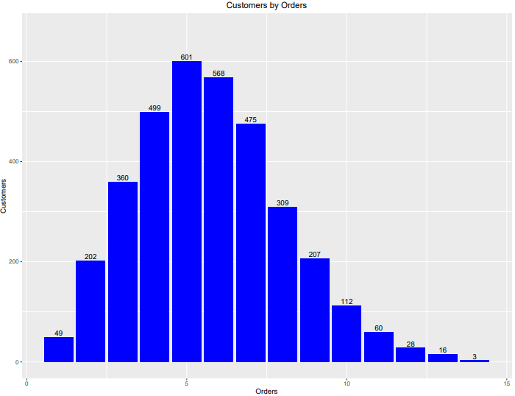
Note: The data and information in this document is reflective of a hypothetical situation and client. This document is to be used for KPMG Virtual Internship purposes only.
Model Development
Recency, Frequency and Monetary (RFM) analysis and modeling
Data visualization of RFM
Monetary and Frequency values are normally distributed
Recency values are skewed to the right
Customers by orders
Most customers make around 5 orders
Majority of customers make between 3 and 8 orders

Slide 14
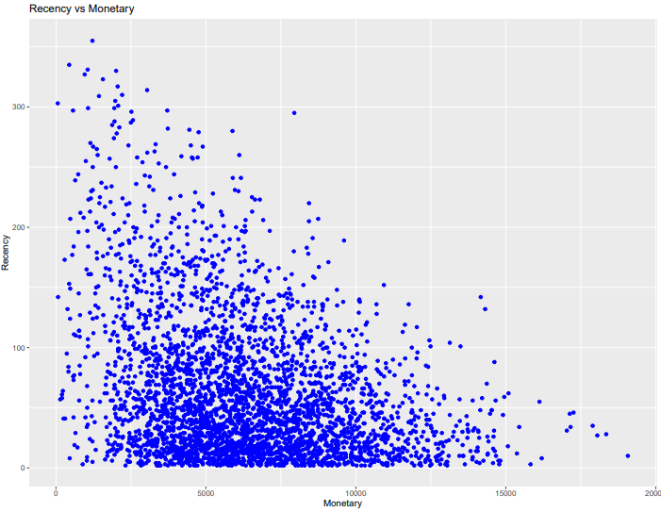
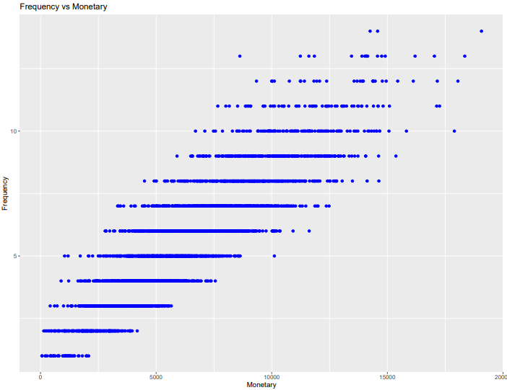
Note: The data and information in this document is reflective of a hypothetical situation and client. This document is to be used for KPMG Virtual Internship purposes only.
Model Development
Recency, Frequency and Monetary (RFM) analysis and modeling
Recency vs Monetary
Recency increases as Monetary decreases
Most frequent customers spend between 2500 to 10000
Customers by orders
Frequent customers spend more money than less frequent customers

Slide 15
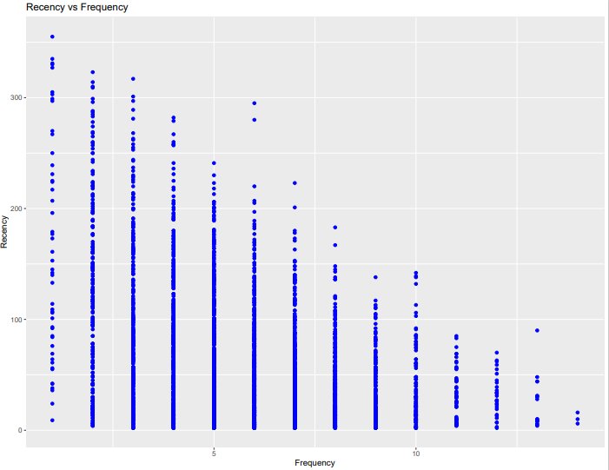
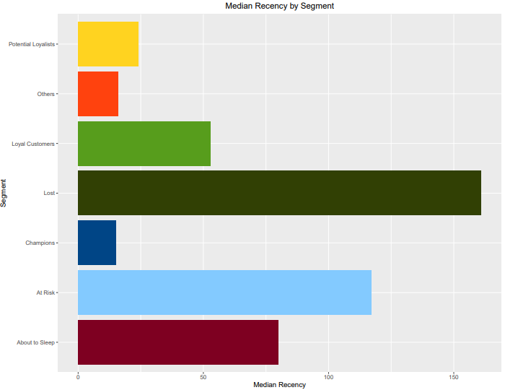
Note: The data and information in this document is reflective of a hypothetical situation and client. This document is to be used for KPMG Virtual Internship purposes only.
Model Development
Recency, Frequency and Monetary (RFM) analysis and modeling
Recency vs Monetary
Most recent customers make the least frequent purchases
Median Recency by Segment
The customers that have the lower RFM scores are the most recent customers

Slide 16
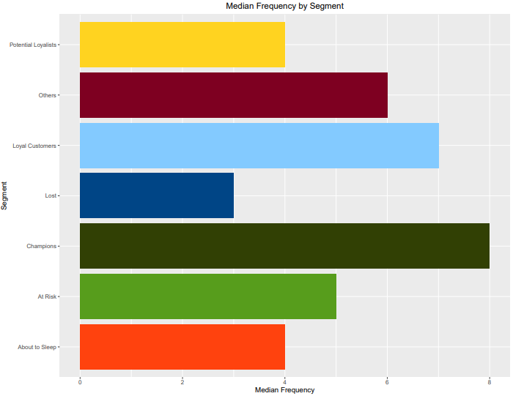
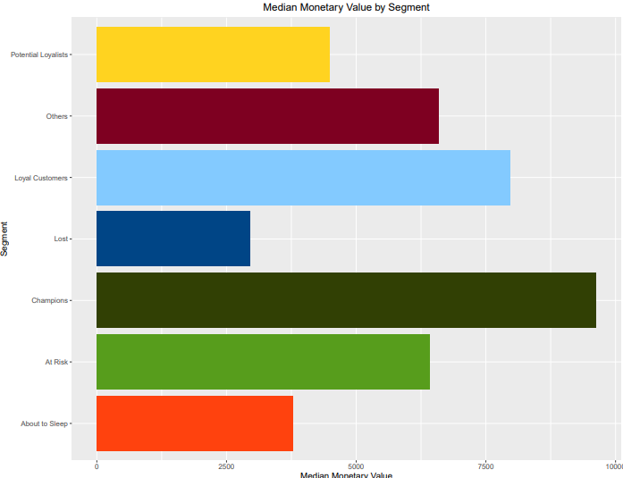
Note: The data and information in this document is reflective of a hypothetical situation and client. This document is to be used for KPMG Virtual Internship purposes only.
Model Development
Recency, Frequency and Monetary (RFM) analysis and modeling
Median Frequency by Segment
The most valuable customers make frequent purchases
Median Monetary by Segment
Most valuable customers spend more money with the company

Slide 17
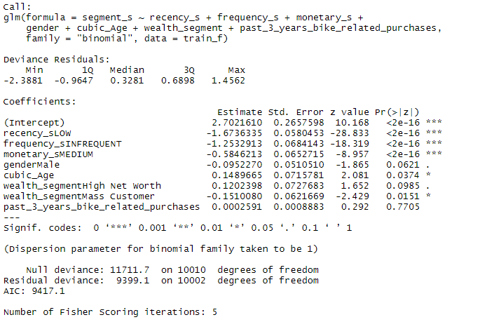
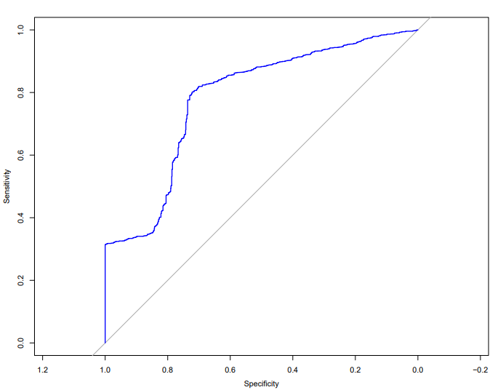
Note: The data and information in this document is reflective of a hypothetical situation and client. This document is to be used for KPMG Virtual Internship purposes only.
Model Development
Develop model
Hypothesis
Null hypothesis: Mean scores is equal to 3
t-statistic test: the mean score is above 3
Model
Multiple Logistics Regression Model
ROC curve was used
AUC value of 0.78
Mean prediction value of 78% success

Slide 18
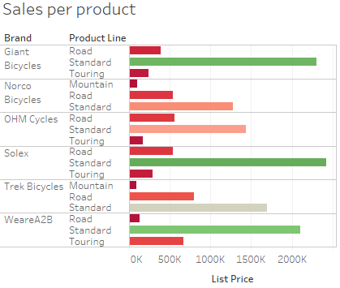
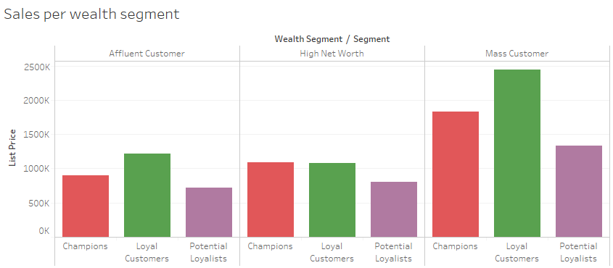
Note: The data and information in this document is reflective of a hypothetical situation and client. This document is to be used for KPMG Virtual Internship purposes only.
Interpretation
Report and interpretation
Data visualisation dashboard in Tableau
Sales insights:
Standard product line of brands Solex, Giant Bicycle and WeAre2B are the top sellers
Loyal customers in Mass Customer wealth segment spent the most money
Most sales were recorded in NSW 02153 with 128,464 and transaction count of 747

Slide 19
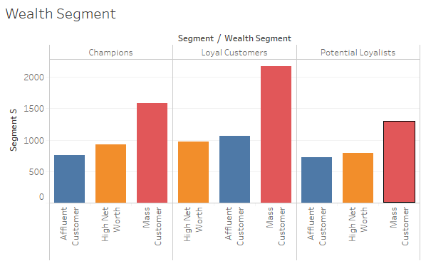
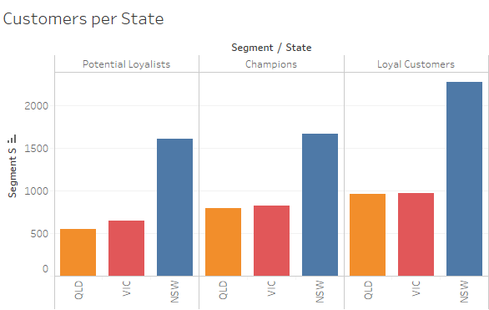
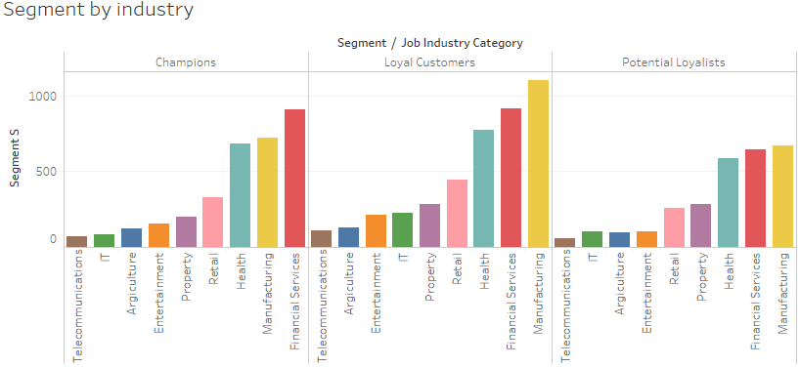
Note: The data and information in this document is reflective of a hypothetical situation and client. This document is to be used for KPMG Virtual Internship purposes only.
Interpretation
Report and interpretation
Data visualisation dashboard in Tableau
Customer Segment Insights
Mass customers purchased the most products from Champion, Loyal and Potential Loyal customers
Mass Loyal Customers purchased the most products at a total of 2177
Mass Loyal Customers in NSW made the most purchases at 2276.
Champion, Loyal and Potential Loyal customers are the top customers in NSW.
Champion, Loyal and Potential Loyal customers top job industries were Health, Manufacturing and Financial Services

Slide 20
Note: The data and information in this document is reflective of a hypothetical situation and client. This document is to be used for KPMG Virtual Internship purposes only.
Interpretation
Report and interpretation
Most valuable customers
Mass Customers and High Net Worth
Customers in NSW, but all states should be considered to maximize profits.
Customers that work in Retail, Property, Health, Manufacturing and Financial Services.
521 of the 1000 new customers will be your most valuable customers

