Slide 1
Deep Learning Course
Network Training and Loss Functions

Slide 2
Reminder: Network Architecture
Input Layer
Hidden Layers
Output Layer
.
.
.
.
.
.
.
.
.
.
.
.
.
.
.
.
.
.
.
.
.
.
.
.

Slide 3
Logits and Activation Functions
Input Layer
Hidden Layer
Output Layer
z
a
Activation Function
Logit
X
Y₀
X
Y₁
X
Y₂

Slide 4
Forward Propagation
Input Layer
Hidden Layer
Output Layer
z
a
Activation Function
Logit
X
Y₀
X
Y₁
X
Y₂

Slide 5
Recap:
Regression and Classification as Fundamental Tasks
Hand crafted parameters are OK, but let’s allow the Neural Network to learn the parameters instead
Neural Networks: units, layers, weights, biases
Generally, we supply the units and layers, and we allow the network to learn the weights and biases
Signal flows from the input layer to the output layer through a ‘Feed Forward Algorithm’
The input to a given unit is called a logit – product of values from last layer x parameters (weights and biases)

Slide 6
Questions
For a given input, do we always compute the same output?
What are the parameters of the network?
What are the hyperparameters of the network?
Given a layer of the network where the weights are all = 0, what can we say about the logit values of the following layer?
Draw out an example feedforward network with more outputs than inputs? Why might a network like this make sense?

Slide 7
Backpropagation

Slide 8
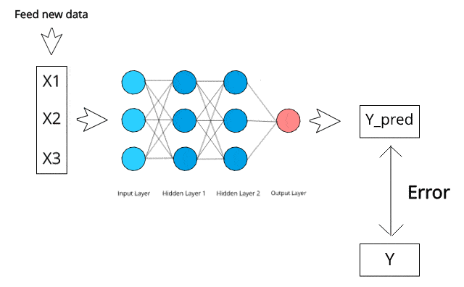
From Inputs to Loss

Slide 9
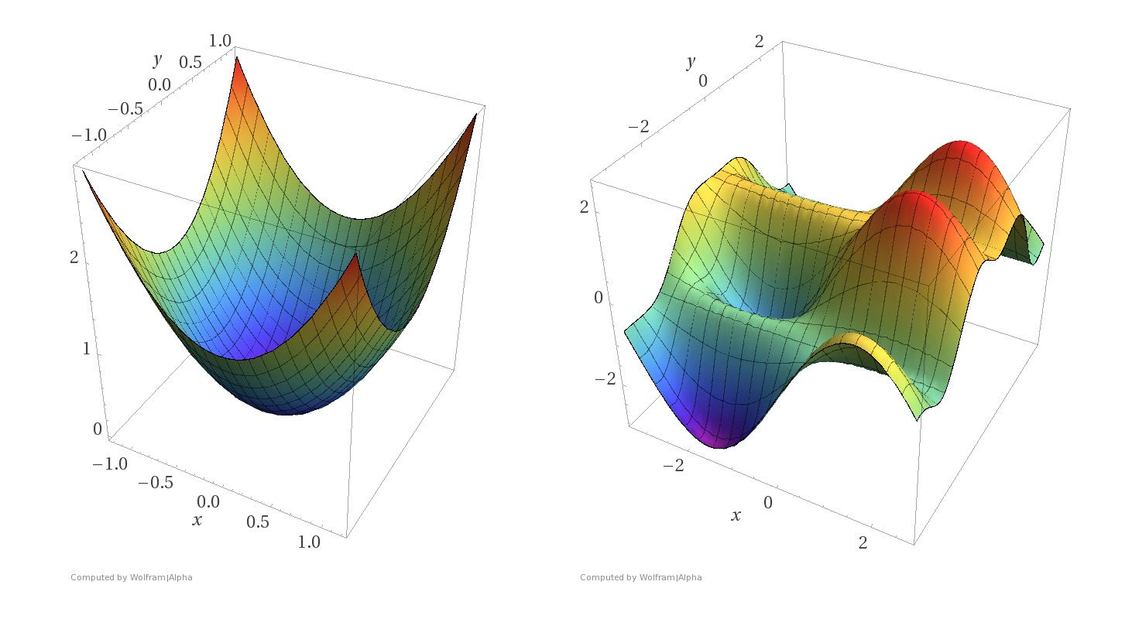
Learning the Parameters aka Training the Network
https://blog.paperspace.com/intro-to-optimization-in-deep-learning-gradient-descent/
We cannot directly use optimisation as for Linear Regression and Logistic Regression
Instead, we use optimisation alongside another algorithm that distributes the weight changes that are necessary
  This is the backpropagation algorithm
  Note that backpropogation gets the Gradient Descent bit ‘baked in’

Slide 10
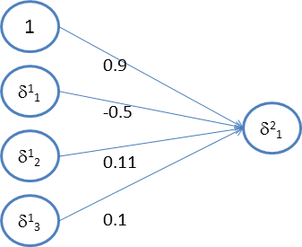
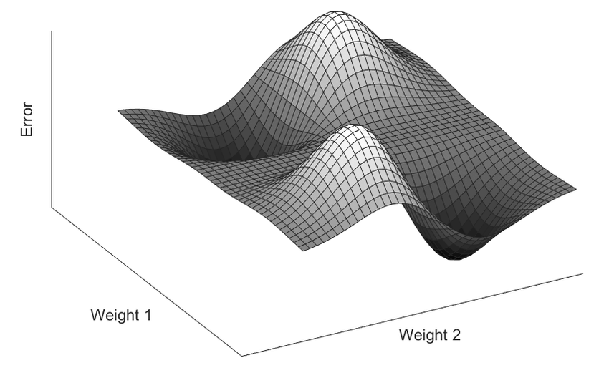
Backpropagation
Sample Error Surface
Idea 1: The recursive error derivative

Slide 11




Backpropagation
Sample Error Surface
Error Derivatives
Idea 1: The recursive error derivative
Note, we tend to use g as the function name when it is being applied to (z). The function h on the other hand is often assumed to be applied to x, i.e., h(x), and has the logit calculation built in.

Slide 12

Backpropagation
Sample Error Surface
Idea 2: Output Layer Error Derivative

Slide 13



Backpropagation
Sample Error Surface
Idea 3: Weight Changes

Slide 14
Backprop Overview
Input Layer
Hidden Layers
Output Layer
.
.
.
.
.
.
.
.
.
.
.
.
.
.
.
.
.
.
.
.
.
.
.
.
Calculate Error Derivative (not error) for final layer
Calculate Error Derivative for prior layer - proportional to derivative in final layer, weights, and activation in prior layer
Calculate weight updates to be made.

Slide 15
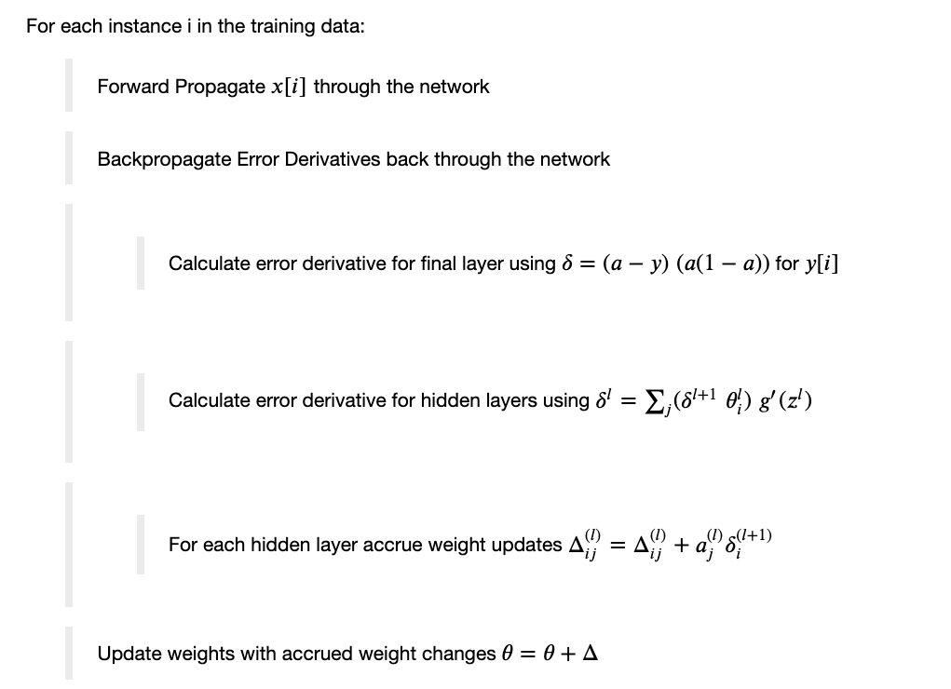
Backpropagation Algorithm

Slide 16

Backpropagation Algorithm

Slide 17

Backpropagation Algorithm

Slide 18


Backpropagation Algorithm

Slide 19

Backpropagation Algorithm

Slide 20
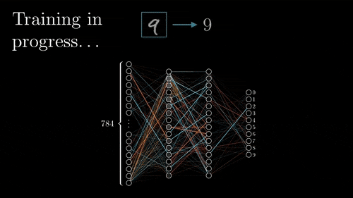
https://www.google.com/search?q=backpropagation&tbm=isch&tbs=itp%3Aanimated&hl=en&ved=0CAMQpwVqFwoTCIDx0LXVsOcCFQAAAAAdAAAAABAC&biw=1213&bih=608#imgrc=CufDRhQcARzdoM

Slide 21
Deriving the Backpropagation Equations
See the notebook!

Slide 22
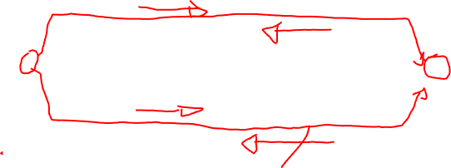
Do I need to know the derivations?
In short, no. However, you should have an understanding of the terminology and ideas as presented in these slides. The derivations in the full notes will help you to understand the ideas at a much greater level of detail and clarity.

Slide 23
Backprop Assignment
Split into small groups and discuss the following while keeping notes on the answers (20 mins):
  What is the relationship between Gradient Descent and Backprop?
  Do we need to calculate error for the backprop algorithm?
  What impact does backprop have on the input layer?
  What does it mean if a weight after training has a value close to 0 (relatively speaking)?
  Discuss the interaction between the backprop algorithm and network baiases.

Slide 24
Losses for Neural Networks

Slide 25
Note: We Used a Loss in Defn of Backprop
Input Layer
Hidden Layers
Output Layer
.
.
.
.
.
.
.
.
.
.
.
.
.
.
.
.
.
.
.
.
.
.
.
.

Slide 26
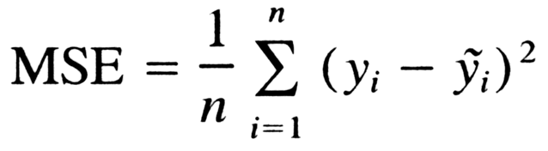
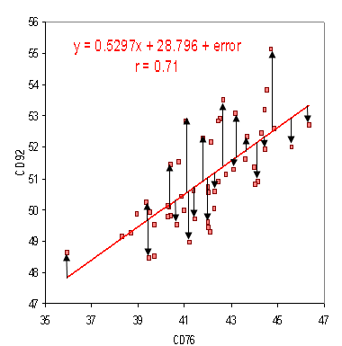

Calculating Errors – Real Valued Outputs
Input Layer
Hidden Layer
Output Layer
X
X
_{8.7}
X
₋₁₀

Slide 27
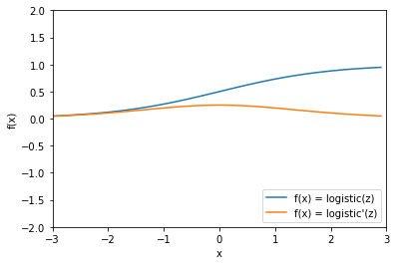

Problem
Our definition of the backprop equations is dependent on the derivative of z which is given by
a(1 - a)
If we are using a sigmoid unit (classification) then the derivative is not very strong if we are very right or very wrong!

Slide 28
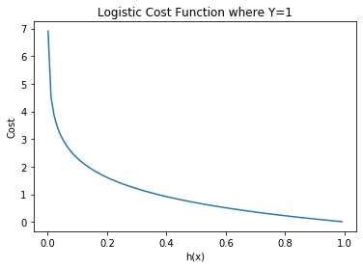
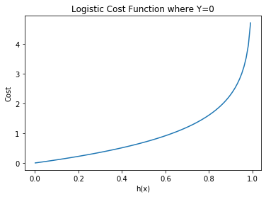
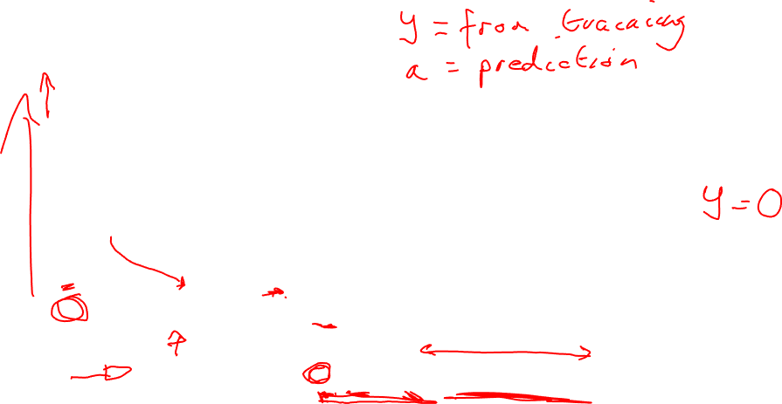
Cross Entropy Loss

Slide 29
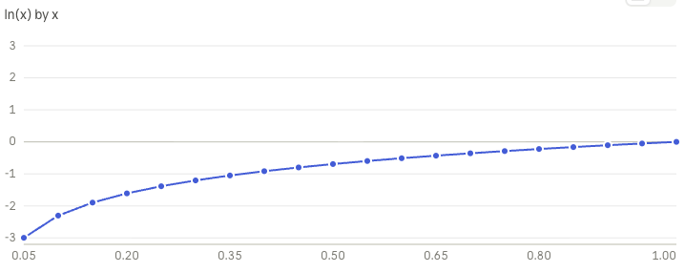
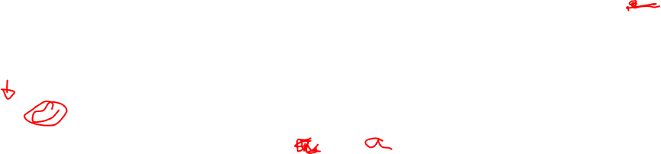
Key: Natural Log Between (0, 1]

Slide 30

Cross Entropy Loss

Slide 31

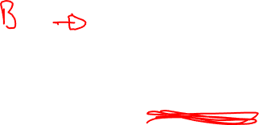
Calculating Errors – Binary Outputs
Input Layer
Hidden Layer
Output Layer
Loss Function – Cross Entropy Loss Function
Error Derivative (final Layer)
X
X
₀
X

Slide 32
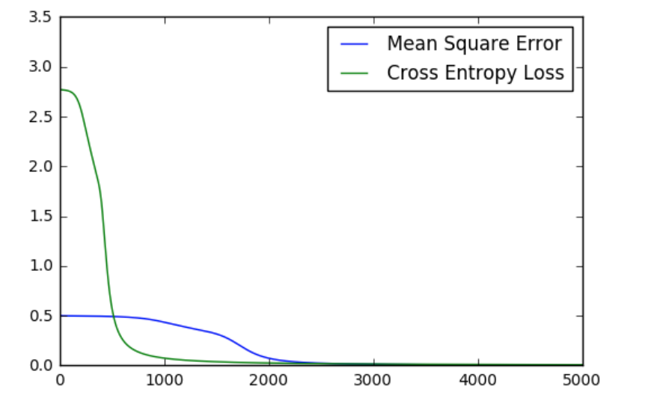
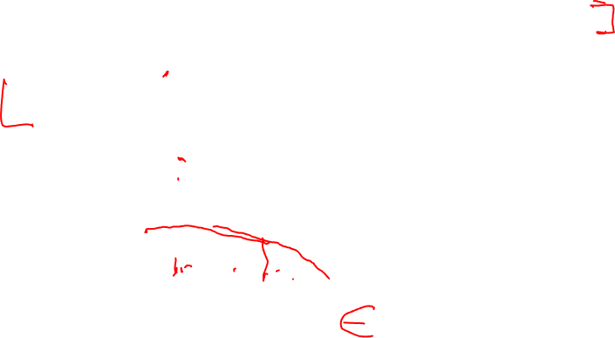
Cross Entropy Loss Function Performance

Slide 33
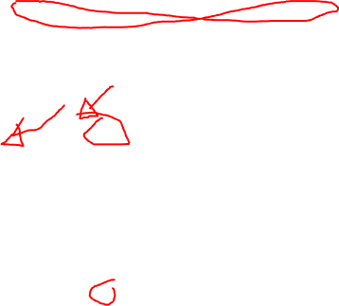
Calculating Errors – Multi-Label Outputs
Input Layer
Hidden Layer
Output Layer
Loss Function – Cross Entropy Loss Function
Error Derivative (final Layer)
X
₁
X
₀
X
₀

Slide 34

Calculating Errors – Multinomial Outputs
Input Layer
Hidden Layer
Output Layer
Remember / Assumption – One positive outcome per instance. Everything else negative, e.g., figure out the type of animal in an image.
Loss Function – Cross Entropy Loss Function
We can use this but it isn’t great.
X
_{0.8}
X
_{0.2}
X
_{0.1}

Slide 35

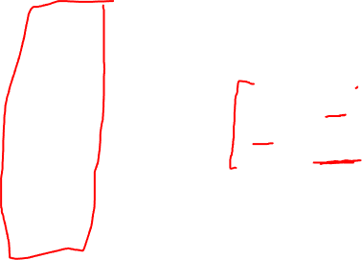
Multinomial: Softmax Activation Function
Input Layer
Hidden Layer
Output Layer
If we know that we only have one possible ‘activation’ in a given layer, we can use a
‘Softmax Activation Layer’
To take advantage of this fact.
X
Y₀
X
Y₁
X
Y₂

Slide 36
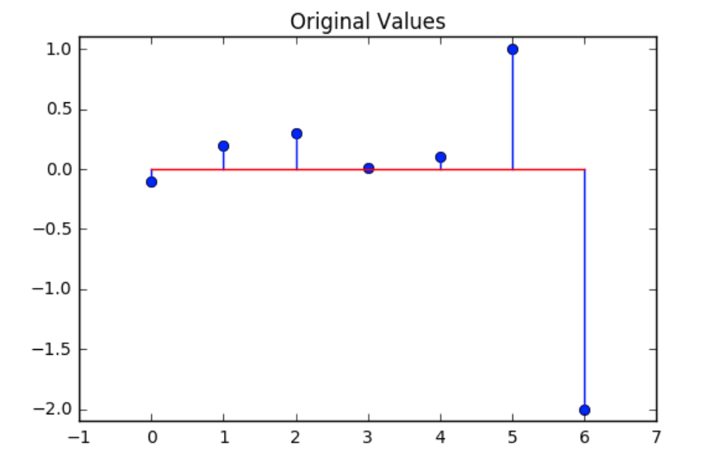
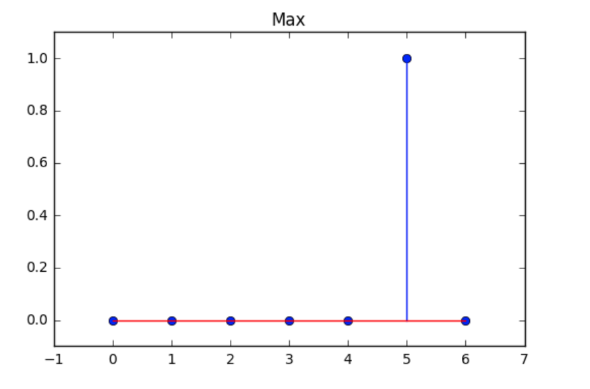
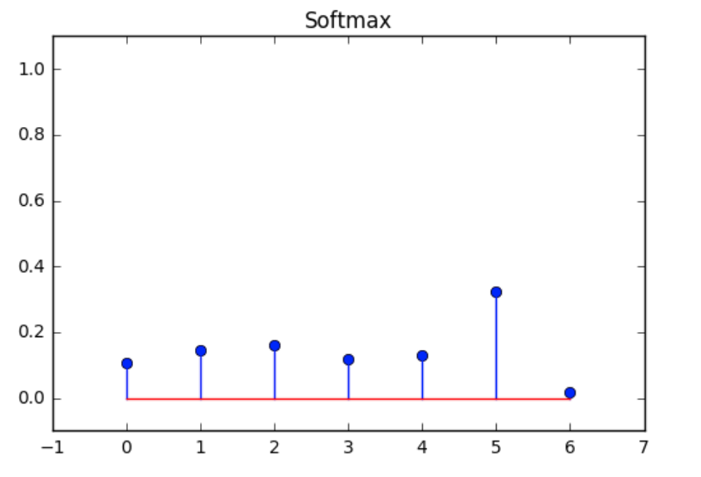

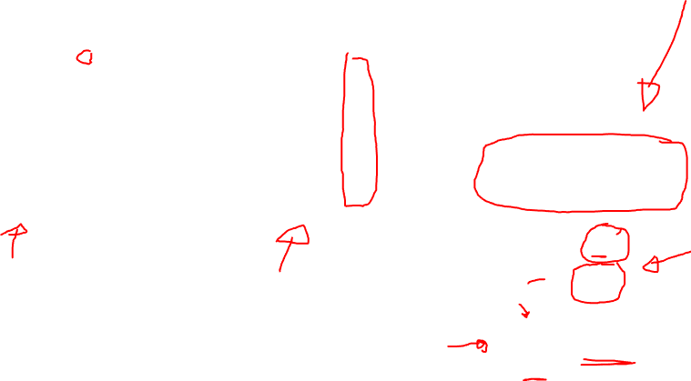
Softmax Activation Function

Slide 37
Tutorial Session Work: Loss Functions
Split into smaller groups.
As a group assign each person a loss function to investigate (look at Keras losses as a starting point) (10 mins)
Individually investigate your loss in a Keras context (10 mins)
Report back to the smaller group
Have a group reporter enter details on the losses investigated into the form provided.

