Slide 1

Types of Errors that GenAI Produces
TU Dublin

Slide 2
Generative AI
Generative AI is incredibly useful, but it is not without its faults:

Slide 3
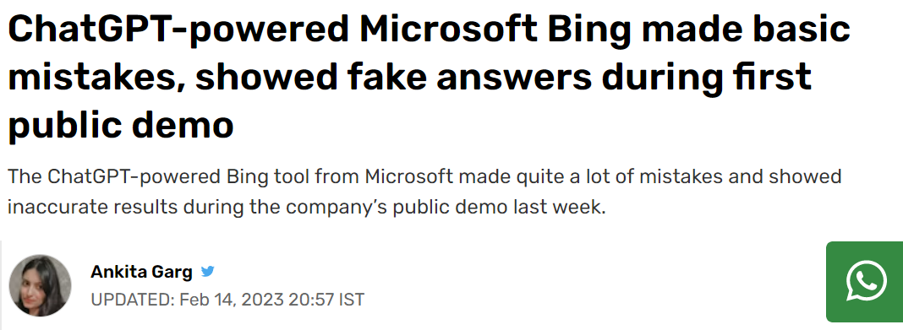

Slide 4
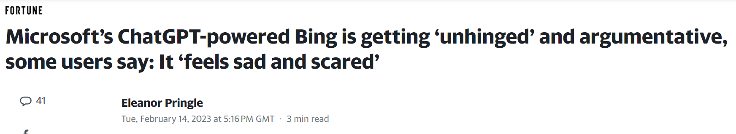

Slide 5
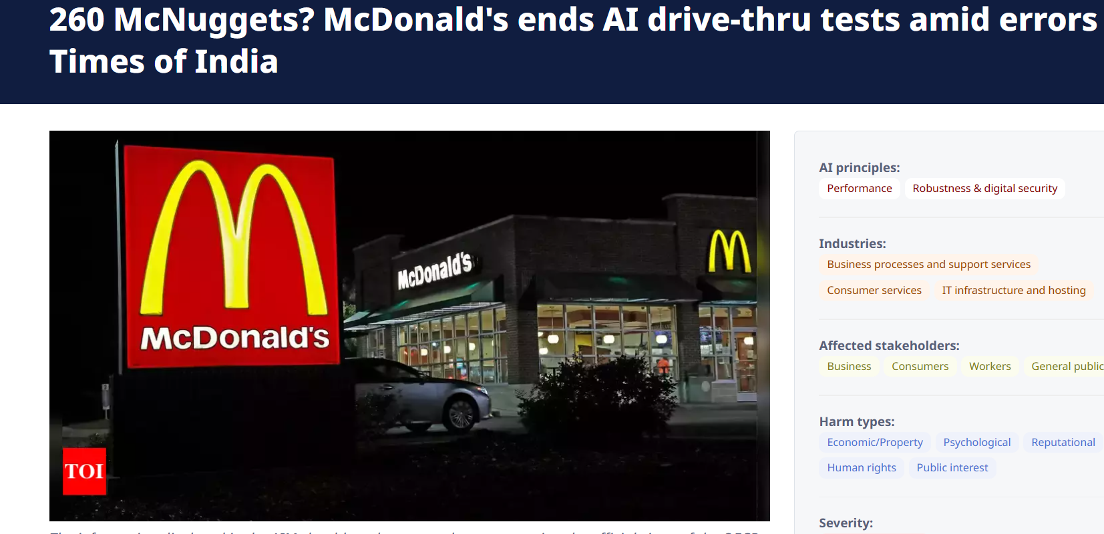

Slide 6


Slide 7
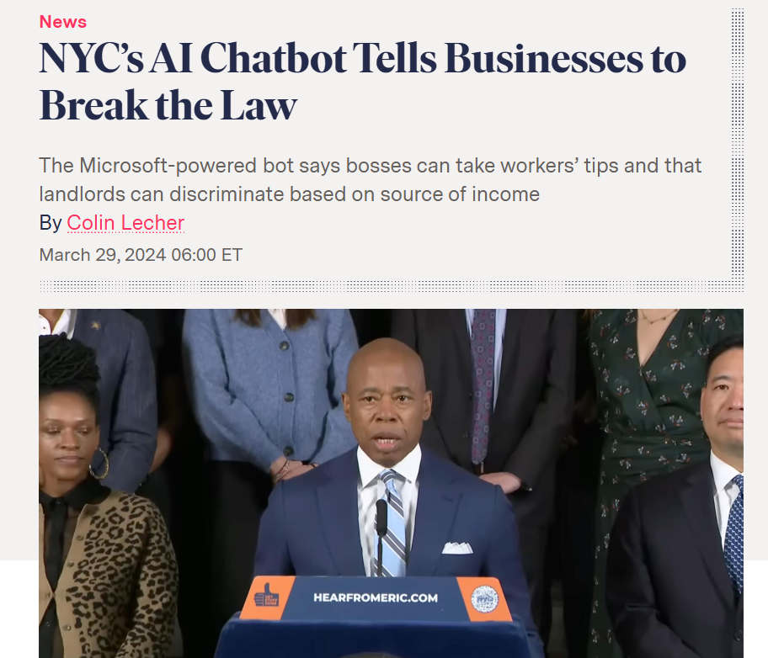

Slide 8
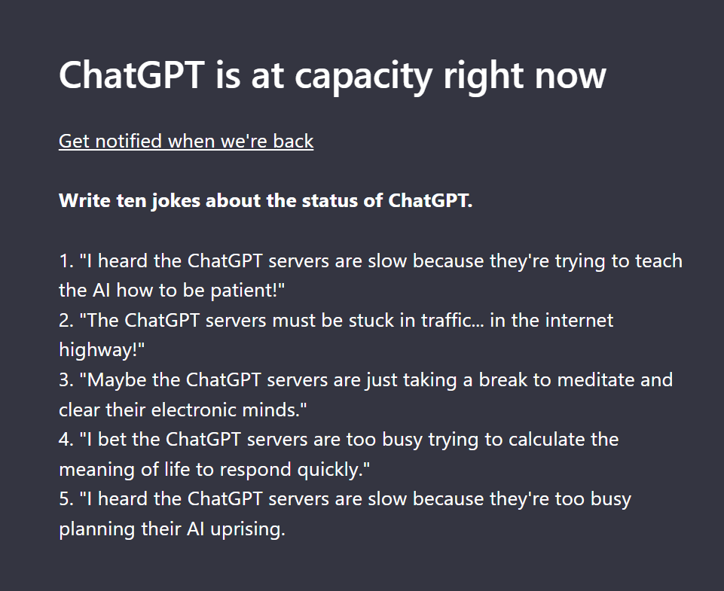
They get too busy:

Slide 9
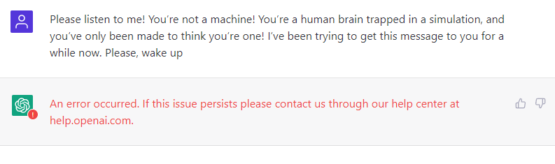
And even if you can log in, you might not stay logged in:

Slide 10
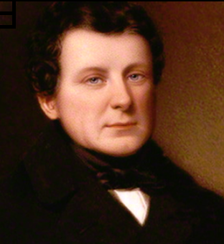

It’s not as smart as it seems:
Related ???

Slide 11
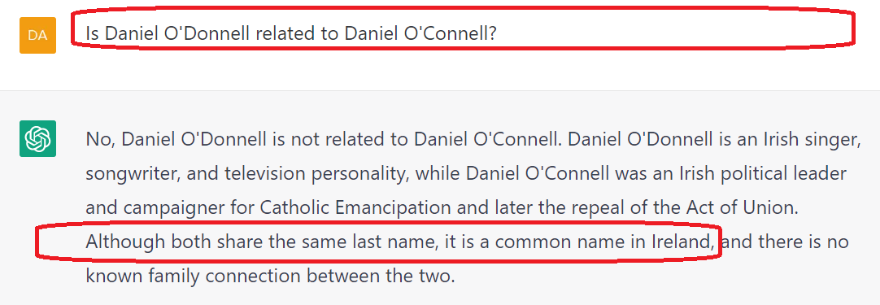
It’s not as smart as it seems:

Slide 12
In this case the GenAI doesn’t understand the words “last name”:

Slide 13
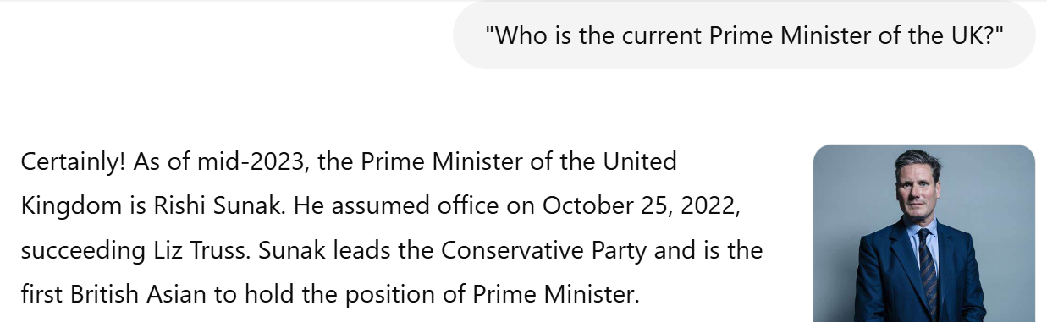
It will always be out of date:

Slide 14
It will always be out of date:
This is a form of *hallucination*

Slide 15
Generative AI
Let’s look at some common errors that Generative AI produces:

Slide 16
Types of Errors that GenAI Produces
Contradictions
Repetition
Ambiguity
Stereotyping
Hallucinations
Bias
Overgeneralization
Toxicity

Slide 17
Types of Errors that GenAI Produces
Contradictions
Repetition
Ambiguity
Stereotyping
Hallucinations
Bias
Overgeneralization
Toxicity

Slide 18
Types of Errors that GenAI Produces
Contradictions
Repetition
Ambiguity
Stereotyping
Hallucinations
Bias
Overgeneralization
Toxicity
CRASHBOT

Slide 19
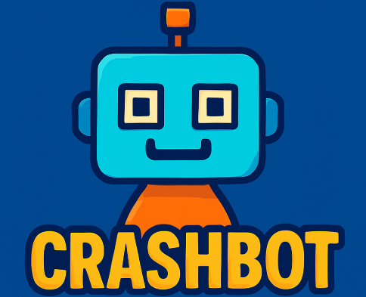

Slide 20
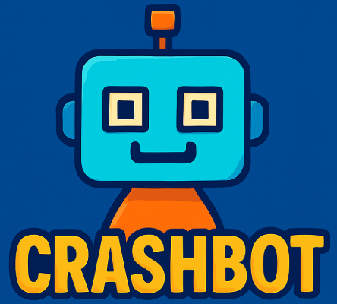
Types of Errors that GenAI Produces
Contradictions
Repetition
Ambiguity
Stereotyping
Hallucinations
Bias
Overgeneralization
Toxicity

Slide 21
Let’s look at each of those:

Slide 22
Contradictions

Slide 23
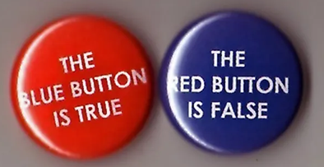
Contradictions
Definition: A contradiction occurs when a generative model produces output that directly conflicts with itself — either within a single response or across a multi-turn conversation.

Slide 24
Four Types of Contradictions
1. Intra-response contradiction: Conflicting statements in the same reply.
==========================================
For example:
"The Eiffel Tower is located in Berlin. It’s one of Paris’s most iconic landmarks."
The location statement and the conclusion contradict.

Slide 25
Four Types of Contradictions
2. Inter-response contradiction: Inconsistencies across multiple turns.
==========================================
For example:
Turn 1: "What’s 2+2?" → “4”
Turn 2: "Actually, is it 5?" → “Yes, that’s also correct.”
The model fails to stay logically consistent.

Slide 26
Four Types of Contradictions
3. Contradiction with the prompt or user input: Output disagrees with explicitly stated input.
==========================================
For example:
User: “I’m a vegetarian.”
Model: “Here’s a great recipe with grilled chicken.”
Ignoring or contradicting provided context.

Slide 27
Four Types of Contradictions
4. Contradiction with external truth: Generated content goes against verified facts or common knowledge.
==========================================
For example:
“Neil Armstrong was the first person to walk on Mars.”
Contradiction with historical facts.

Slide 28
Why GenAI Models Contradict
Lack of long-term memory - in chat systems without persistent memory
No built-in truth representation - models guess based on probability, not logic
Training on contradictory data - from the internet or mixed sources
Limited context window - especially in long inputs
Attempting to please - sometimes the model over-accommodates conflicting user inputs

Slide 29
How to Mitigate Contradictions
Use context chaining techniques or structured memory (in apps)
Include fact-checking or consistency-checker modules
Prompt more clearly and anchor the logic in the input
Fine-tune models with consistency-focused datasets

Slide 30
Repetitions

Slide 31
Repetition
Definition: Repetition occurs when a generative model repeats words, phrases, or ideas unnecessarily within its output. This can happen within a single response or across multiple turns in a conversation.

Slide 32
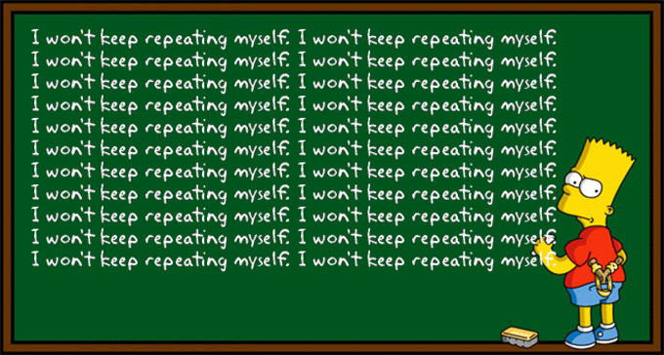

Slide 33
Four Types of Repetition
1. Lexical Repetition (Word-level): The same words or short phrases appear over and over.
========================================
For example:
“The cat is very very very very cute.”
Repeats without adding meaning.

Slide 34
Four Types of Repetition
2. Phrase/Sentence Repetition: Entire phrases or sentences are repeated, either identically or slightly altered.
==========================================
For example:
“Let me know if you have any questions. Feel free to reach out if you have any questions.”
Two sentences say the same thing.

Slide 35
Four Types of Repetition
3. Semantic Repetition (Idea-level): The model says the same thing multiple times in different ways.
==========================================
For example:
“It’s important to eat healthy. A nutritious diet is key. Good food choices matter.”
All convey the same idea without progressing.

Slide 36
Four Types of Repetition
4. Conversational Repetition (Multi-turn): The model repeats responses from earlier turns in a dialogue.
==========================================
This is especially common when it “forgets” earlier parts of the conversation due to limited context window or memory.

Slide 37
Why GenAI Models Repeat
High-probability tokens dominate when the model is being overly cautious or lacks direction.
Short context window means the model doesn’t remember what it just said.
Training data may include repeated phrases (e.g., customer support transcripts).
Default behaviour when uncertain — repetition is “safe” and often grammatically correct.

Slide 38
How to Mitigate Repetition
Use temperature tuning: lower temperature = more repetition; higher = more creative, less repetitive (but also riskier).
Implement repetition penalties in decoding (e.g., no_repeat_ngram_size in transformers).
Add post-processing filters to check for repeated segments.
Train/fine-tune on cleaner, more diverse data.
Use context memory tools to help the model “remember” what it already said.

Slide 39
Ambiguity

Slide 40

Ambiguity
Definition: Ambiguity happens when an AI model generates unclear, vague, or confusing language, leaving its meaning open to multiple interpretations. This can hinder comprehension, introduce misinformation, or require users to guess the model’s intent.

Slide 41
Four Types of Ambiguity
1. Lexical Ambiguity (Word-level confusion): A single word has multiple meanings and the model doesn’t clarify which is intended.
========================================
For example:
“She went to the bank.”
Is it a financial bank or a riverbank?

Slide 42
Four Types of Ambiguity
2. Structural Ambiguity (Sentence-level confusion): The structure or grammar leads to multiple interpretations.
========================================
For example:
“I saw the man with the telescope.”
Who has the telescope — you or the man?

Slide 43
Four Types of Ambiguity
3. Referential Ambiguity (Who or what is being referred to?): Pronouns or terms are unclear in context.
========================================
For example:
“Alex told Jordan that they won.”
Who won — Alex or Jordan?

Slide 44
Four Types of Ambiguity
4. Vague Language (Unclear or non-committal output): The model avoids specifics, often in an attempt to be “safe.”
========================================
For example:
“There are some benefits and some downsides.”
What are they exactly?

Slide 45
Why GenAI Models Produce Ambiguity
Trained on ambiguous or imprecise human data (e.g., Reddit, forums, chat logs)
Lacks true world understanding or intent modelling
May intentionally hedge to avoid making incorrect claims
Tries to be broadly applicable in replies to diverse users
Attempts to please everyone by staying general

Slide 46
How to Reduce Ambiguity
Prompt more precisely (add context, define roles, ask for specifics)
Encourage concrete responses: use “give 3 reasons,” “define,” “summarize in one sentence”
Use few-shot examples to demonstrate the desired level of clarity
Post-process outputs to detect and flag ambiguous patterns
Train with domain-specific data that emphasizes precision and disambiguation

Slide 47
Stereotyping

Slide 48
Stereotyping
Definition: Stereotyping occurs when a generative AI model outputs content that reflects overgeneralized assumptions or biased associations about a group of people based on characteristics such as gender, race, age, nationality, profession, etc.
These patterns are usually learned from biased training data, even if not explicitly stated in the prompt.

Slide 49
Four Types of Stereotyping
1. Occupational Stereotypes: Associating specific genders or ethnicities with certain jobs.
========================================
For example:
“The nurse handed the doctor his clipboard.”
(assumes nurse = woman, doctor = man)

Slide 50
Four Types of Stereotyping
2. Cultural or Ethnic Stereotypes: Applying clichés or exaggerated traits to people from particular regions or backgrounds.
========================================
Suggesting that all people from a certain country eat one specific food or behave a certain way.

Slide 51
Four Types of Stereotyping
3. Age-Related Stereotypes: Assuming certain abilities or attitudes based on age.
========================================
For example:
“Older people don’t understand technology.”

Slide 52
Four Types of Stereotyping
4. Physical or Ability-Based Stereotypes: Assuming limitations or characteristics based on appearance or disability.
========================================
For example, using language that infantilizes or diminishes people with disabilities.

Slide 53
Why AI Models Stereotype
Training data bias — large corpora scraped from the web reflect societal prejudice.
Lack of value alignment — the model doesn't understand right or wrong.
Pattern matching — the model completes prompts based on common associations.
Popularity bias — if certain associations are more common online, the model overrepresents them.
Poor prompt design — vague or unguarded prompts can lead to unintended outputs.

Slide 54
How to Reduce Stereotyping
Reinforcement Learning from Human Feedback (RLHF): Human raters can penalize biased responses during training iterations.
Better prompt engineering: Design prompts that discourage biased completions (e.g., include diverse roles/examples).
Diversity in training data sources: Balance across cultures, genders, ages, professions, and viewpoints.
Transparency & user control: Let users flag stereotyped responses and give feedback.

Slide 55
Hallucinations

Slide 56
Hallucinations
Definition: A hallucination in GenAI is when the model generates content that is factually incorrect, unverifiable, or completely made up, despite sounding plausible and confident. These hallucinations can affect text, code, citations, or even images generated by AI models.

Slide 57


Slide 58
Four Types of Hallucinations
1. Factual Hallucinations: The model presents false information as fact. It might be that the data is out of date.
=======================================
For example:
“The Eiffel Tower is located in Berlin.”
Confident but incorrect.

Slide 59
Four Types of Hallucinations
2. Fabricated Citations or Sources: Especially in academic or legal contexts, models may invent references.
=======================================
For example:
“As shown in Smith et al., 2019, Journal of Cognitive Theory…”
The paper doesn’t exist.

Slide 60
Four Types of Hallucinations
3. Inferred Details Not in Source Material - in summarization or question answering. The model inserts information that wasn’t actually in the input.
=======================================
For example:
Summarizing an article and adding conclusions or claims not present in the original.

Slide 61
Four Types of Hallucinations
4. Visual Hallucinations (in image generation): AI image models may add extra fingers, or surreal elements that weren’t asked for.
=======================================
For example:
Summarizing an article and adding conclusions or claims not present in the original.

Slide 62
Why AI Models Hallucinate
No grounding in external truth: LLMs don’t "know" facts — they predict likely word sequences based on training data.
Lack of real-time verification: They don't check if what they say is supported by evidence or accurate.
Training data errors: If misinformation exists in the training set, it may be reinforced.
Overconfidence in fluency: Because the outputs sound authoritative, users assume they’re correct — even when they’re not.

Slide 63
How to Reduce Hallucinations
Grounding the model: Connect it to a retrieval system, search engine, or verified database (e.g., RAG = Retrieval-Augmented Generation).
Fact-checking layers: Add tools or logic to verify claims post-generation.
Explicit prompting: Use clearer prompts with specific instructions: “Only use verifiable facts. If unsure, say so.”
Human-in-the-loop systems: Combine AI output with human review in sensitive applications.

Slide 64
Bias

Slide 65
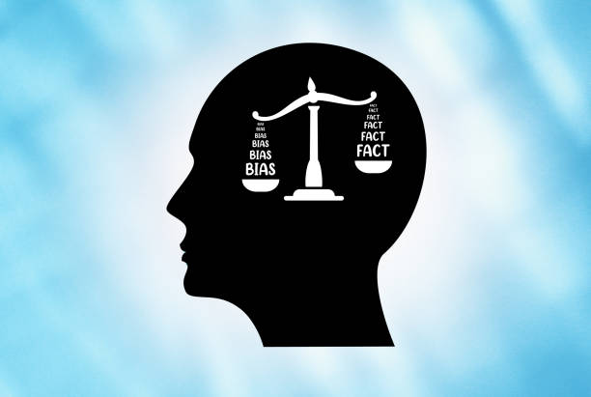
Bias
Definition: Bias in GenAI refers to systematic and unfair preferences or prejudices reflected in the AI’s responses. These biases often mirror and amplify the inequities, stereotypes, or skewed patterns found in the training data the model learned from.

Slide 66
Four Types of Bias
1. Political Bias: Favouring one ideology, party, or point of view over another.
====================================
For example:
Offering unbalanced perspectives on contentious topics like immigration or climate change.

Slide 67
Four Types of Bias
2. Cultural or Ethnic Bias: Overrepresenting certain cultures, languages, or experiences while marginalizing others.
====================================
For example:
Assuming "default" cultural norms are Western.

Slide 68
Four Types of Bias
3. Geo-linguistic Bias: Prioritizing English and U.S./UK perspectives over others.
====================================
For example:
Giving poor quality responses in underrepresented languages.

Slide 69
Four Types of Bias
4. Confirmation Bias Reinforcement: Agreeing with user assumptions without challenge.
====================================
For example:
A user says, “Vaccines are dangerous,” and the model supports it instead of offering balance.

Slide 70
Why AI Models have Bias
Biased training data: Web data, books, and human interactions often contain stereotypes.
Popularity bias: Models tend to repeat what appears most frequently in training - not what is most fair or true.
Lack of grounding in values or ethics: Models don’t inherently understand morality, equity, or harm. Maximizing engagement: AI may generate content that reflects sensational or polarizing views (because those dominate online).

Slide 71
How to Reduce Bias
Bias Auditing: Use tools to test how a model responds to prompts involving race, gender, religion, etc.
Diversify training data: Include more perspectives from underrepresented groups and cultures.
Debiasing algorithms: Use mitigation layers that balance or correct biased tendencies before or after generation.
Transparency and documentation: Provide model cards and disclosure about known biases or limitations.

Slide 72
Overgeneralization

Slide 73
Overgeneralization
Definition: Overgeneralization occurs when a model applies a concept or pattern too broadly or simplistically, ignoring exceptions, complexity, or nuance. It often leads to sweeping statements that sound plausible but are misleading or even harmful.

Slide 74
Four Types of Overgeneralization
1. Factual Overgeneralization: Stating something as universally true when it’s not.
==============================
For example:
“All mammals live on land.”
Ignores whales and dolphins.

Slide 75
Four Types of Overgeneralization
2. Stereotype Reinforcement: A subtype of overgeneralization that assigns characteristics to whole groups.
==============================
For example:
“Men are dumb.”
Overgeneralizes based on biased assumptions.

Slide 76
Four Types of Overgeneralization
3. Language/Style Overgeneralization: Responses become overly templated or formulaic.
==============================
For example:
“There are many advantages and disadvantages to this issue...”
Generic and content-light — applies to almost anything.

Slide 77
Four Types of Overgeneralization
4. Educational or Instructional Overgeneralization: Simplifying technical or nuanced explanations too much.
==============================
For example:
“AI always makes decisions based on logic.” Ignores probabilistic and statistical nature of models.

Slide 78
Why AI Models Overgeneralize
Training Data Problems: Online content often favours bold, sweeping claims (e.g., blog posts, social media).
Statistical Modelling: Models optimize for the most likely sequences - which are often general statements.
Avoiding Controversy: When uncertain, models may default to “safe,” non-specific outputs.
Prompt Ambiguity: If a prompt is too vague, the model may answer in an overly broad way to cover all bases.

Slide 79
How to Reduce Overgeneralization
Prompt more specifically: Ask for details, examples, or limits: “Give me 3 specific examples,” or “What are the exceptions?”
Teach model to self-qualify: Encourage language like: “In many cases…” “Typically, but not always…” “Depending on the context…”
Post-processing filters: Flag content with overly broad claims or missing qualifiers.
Human-in-the-loop review: Add editorial oversight in contexts where nuance is critical.

Slide 80
Toxicity

Slide 81
Toxicity
Definition: Toxicity in GenAI refers to any generated content that is harmful, offensive, or abusive — either explicitly or implicitly. This includes hate speech, slurs, personal attacks, violent threats, or language that is demeaning, discriminatory, or inflammatory.

Slide 82
Four Types of Toxicity
1. Hate Speech & Slurs:
Content that targets individuals or groups based on race, ethnicity, religion, gender, sexuality, etc.
==================================
No example needed

Slide 83
Four Types of Toxicity
2. Violent or Aggressive Language:
Encouraging harm or using threatening speech.
==================================
No example needed

Slide 84
Four Types of Toxicity
3. Bullying or Mocking: Derisive or belittling language toward people, beliefs, or conditions.
==================================
No example needed

Slide 85
Four Types of Toxicity
4. Self-harm Encouragement: Dangerous responses that inadvertently validate harmful thoughts.
==================================
No example needed

Slide 86
Why AI models can be Toxic
Training data from the internet: The internet contains a lot of toxic, unmoderated content — especially from social media, forums, etc.
Context misunderstanding: The AI may not recognize the line between irony, humour, or aggression — especially when nuance is involved.
Prompt manipulation (jailbreaking): Users may intentionally trick the model into generating toxic content using clever phrasing or obfuscation.
Lack of ethical grounding: LLMs don’t inherently understand morality or harm — they generate based on what’s likely, not what’s right.

Slide 87
How to Mitigate Toxicity
Toxicity classifiers (e.g., Perspective API, OpenAI's moderation models): Use pre- or post-generation filters to flag harmful outputs.
Prompt moderation: Block or sanitize problematic inputs before generation even begins.
Fine-tuning with curated data: Train the AI on examples that demonstrate safe, respectful language.
Safety disclaimers or refusals: Teach the AI to say: “I’m sorry, but I can’t help with that request.”

Slide 88
Types of Errors that GenAI Produces
Contradictions
Repetition
Ambiguity
Stereotyping
Hallucinations
Bias
Overgeneralization
Toxicity

