Slide 1

Data Management Data Quality
Dr Emma Murphy

Slide 2
Overview
Ethical Assessment Framework
Data Quality
CA1 Presentation – Q and A

Slide 3
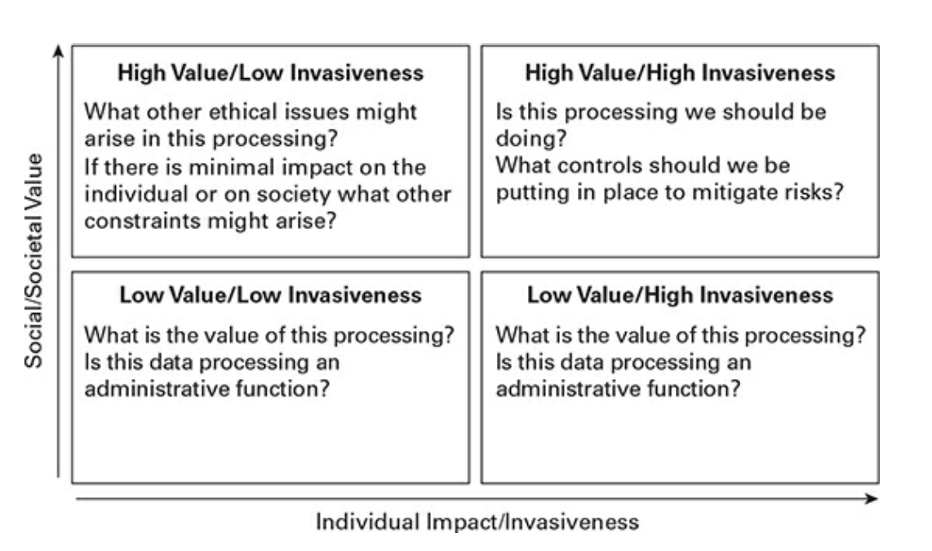
Social vs Individual

Slide 4
First Principles Ethical Test
Does the outcome of your design/algorithm/process ﻿outcome contribute positively to ‘the good’, or positive preservation of human rights?
(O'Keefe and O’Byrne, 2018)

Slide 5
First Principles Ethical Test
What is the outcome?
﻿Does it preserve or enhance human dignity?
Does it preserve the autonomy of the human?
Is the processing necessary and proportionate?
Does it uphold the common good?
﻿does the outcome violate any of these four points?

Slide 6
Case Study: Health Identifier
A public-health-services body is planning to implement universal health identifiers for all individuals who use the health services. They foresee many benefits to the implementation, including increased accuracy in prescriptions, a ‘single view of patient’, and possible cost savings through increased efficiency:
(O’Keefe and O’Brien, 2018)

Slide 7
Does it uphold the common good?
﻿It could be argued that the identifier will increase ﻿accuracy in reporting and statistics, providing necessary information to identify which services are needed most and increase the ability to provide needed services to the public. This will have to be balanced against the privacy aspects and the proportionality and necessity of processing.

Slide 8
Does it preserve human dignity?
﻿Does it enhance human dignity? A properly implemented individual health identifier has the potential to preserve and enhance human dignity; accurate identification of patient and procedure required for the patient ﻿can mean the difference between an oral exam and a rectal exam. Reducing the chances of procedural error in delivering medical treatment would not just preserve but enhance the dignity and well-being of the individual.
(O’Keefe and O’Brien, 2018)

Slide 9
﻿Does it preserve the autonomy of the human?
The question of autonomy raises issues of free and informed consent, which are extremely important for ethical medical practice. The existence of a health identifier might not necessarily adversely affect the autonomy of the patient, but people may object to having their medical information combined in a way that provides an overarching view of what is often extremely sensitive information. Control measures will have to be in place to ensure that information management is centred on the individual and ensures their autonomy as active ‘choosers’ is preserved. Great care will need to be taken to ensure that the design and implementation of the health identifier preserves the individuals’ privacy and their rights to autonomous action as ‘choosers’.
(O’Keefe and O’Brien, 2018)

Slide 10
Is it necessary and proportionate?
﻿If the organization wishes mandatory use of health identifiers across the board, this processing of personal data will have to be justified as necessary and proportionate.
(O’Keefe and O’Brien, 2018)

Slide 11
Activity (5%)
Due in Week 8
Conduct an First Principles Ethical Assessment on the Product that you have chosen for CA1
Activity spec to follow

Slide 12
First Principles Test
What is the outcome
﻿Does it preserve or enhance human dignity?
Does it preserve the autonomy of the human?
Is the processing necessary and proportionate?
Does it uphold the common good?

Slide 13
Data Quality
The term data quality refers both to the characteristics associated with high quality data and to the processes used to measure or improve the quality of data.
(DAMA, 2017)

Slide 14
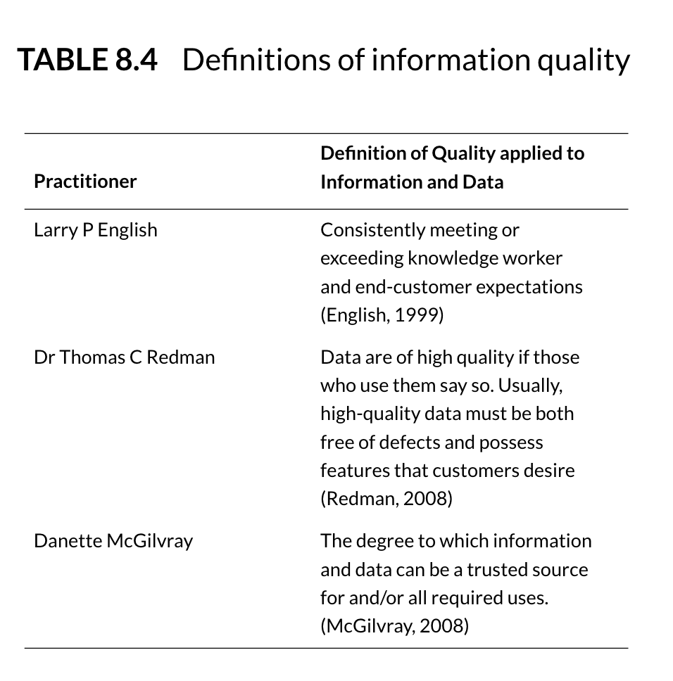
Defining DQ

Slide 15
Data Quality Management
﻿Just as with ethics, information quality management requires you to have some mechanism for defining and measuring what ‘good’ is.
It also requires formal processes and methods to plan for, design for, and ensure controls for good-quality information.
(O’Keefe and O’Brien, 2018)
Notes:
Of course, just as in debating what is ‘ethical’, there are a variety of schools of thought on the topic of what quality information is and how best to measure it.
﻿Depending on the context of your processing, different aspects of your information will be more important from a quality perspective.

Slide 16
Context
Data is of high quality to the degree that it meets the expectations and needs of data consumers. That is, if the data is fit for the purposes to which they want to apply it. It is of low quality if it is not fit for those purposes. Data quality is thus dependent on context and on the needs of the data consumer.
(DAMA, 2017)

Slide 17
Challenges
One of the challenges in managing the quality of data is that expectations related to quality are not always known.
However, if data is to be reliable and trustworthy, then data management professionals need to better understand their customers’ quality requirements and how to measure them.
(DAMA, 2017)
Notes:
One of the challenges in managing the quality of data is that expectations related to quality are not always known. Customers may not articulate them. Often, the people managing data do not even ask about these requirements. However, if data is to be reliable and trustworthy, then data management professionals need to better understand their customers’ quality requirements and how to measure them. This needs to be an ongoing discussion, as requirements change over time as business needs and external forces evolve.

Slide 18
Data Quality Dimensions
A Data Quality dimension is a measurable feature or characteristic of data. The term dimension is used to make the connection to dimensions in the measurement of physical objects (e.g., length, width, height).
Data quality dimensions provide a vocabulary for defining data quality requirements. From there, they can be used to define results of initial data quality assessment as well as ongoing measurement.

Slide 19
Data Quality Dimensions
In order to measure the quality of data, an organization needs to establish characteristics that are both important to business processes (worth measuring) and measurable. Dimensions provide a basis for measurable rules, which themselves should be directly connected to potential risks in critical processes.
DAMA, 2017

Slide 20
Data Quality Dimensions
For example, if the data in the customer email address field is incomplete, then we will not be able to send product information to our customers via email, and we will lose potential sales.
Therefore, we will measure the percentage of customers for whom we have usable email addresses, and we will improve our processes until we have a usable email address for at least 98% of our customers.
(DAMA, 2017)

Slide 21
Data Quality Dimensions
Dimensions include some characteristics that can be measured objectively (completeness, validity, format conformity) and others that depend on heavily context or on subjective interpretation (usability, reliability, reputation).
Whatever names are used, dimensions focus on whether there is enough data (completeness), whether it is right (accuracy, validity), how well it fits together (consistency, integrity, uniqueness), whether it is up-to-date (timeliness), accessible, usable, and secure.

Slide 22
DAMA Data Quality Dimensions
While there is not a single, agreed-to set of data quality dimensions, DAMA (2017) has created a set of dimensions based on common ideas and describes approaches to measuring them.
(DAMA, 2017)

Slide 23
Dimension 1 - Accuracy
Accuracy refers to the degree that data correctly represents “real life” entities.
Accuracy can be difficult to measure, unless an organisation can reproduce data collection or manually confirm accuracy of records.
(DAMA, 2017)
Notes:
Accuracy refers to the degree that data correctly represents “real life” entities.
Accuracy is difficult to measure, unless an organisation can reproduce data collection or manually confirm accuracy of records. Most measures of accuracy rely on comparison to a data source that has been verified as accurate, such as a system of record or data from a reliable source.

Slide 24
Dimension 2: Completeness
Completeness refers to whether all required data is present. Completeness can be measured at the data set, record, or column level.
Assign completeness rules to a data set with varying levels of constraint: Mandatory attributes that require a value, data elements with conditional and optional values, and inapplicable attribute values. Data set levels may require comparison to a source of record or may be based on historical levels of population.
Notes:
Completeness refers to whether all required data is present. Completeness can be measured at the data set, record, or column level.
Does the data set contain all the records expected? Are records populated correctly? (Records with different statuses may have different expectations for completeness.) Are columns/attributes populated to the level expected? (Some columns are mandatory. Optional columns are populated only under specific conditions).
Assign completeness rules to a data set with varying levels of constraint: Mandatory attributes that require a value, data elements with conditional and optional values, and inapplicable attribute values. Data set levels may require comparison to a source of record or may be based on historical levels of population.

Slide 25
Dimension 3: Consistency
Consistency can refer to ensuring that data values are consistently represented within a data set and between data sets, and consistently associated across data sets.
It can also refer to the size and composition of data sets between systems or across time.
Notes:
Consistency can refer to ensuring that data values are consistently represented within a data set and between data sets, and consistently associated across data sets. It can also refer to the size and composition of data sets between systems or across time. Consistency may be defined between one set of attribute values and another attribute set within the same record (record-level consistency), in different records (cross-record consistency), or between one set of attribute values and the same attribute set within the same record at different points in time (temporal consistency).
Characteristics that are expected to be consistent within and across data sets can be used as the basis for standardising data. Data standardisation refers to the conditioning of input data to ensure that data meets rules for content and format.

Slide 26
Dimension 3: Consistency
Consistency may be defined between one set of attribute values and another attribute set within the same record (record-level consistency), in different records (cross-record consistency), or between one set of attribute values and the same attribute set within the same record at different points in time (temporal consistency).
Characteristics that are expected to be consistent within and across data sets can be used as the basis for standardising data. Data standardisation refers to the conditioning of input data to ensure that data meets rules for content and format.

Slide 27
Dimension 4: Data Integrity
Data Integrity (or Coherence) includes ideas associated with completeness, accuracy, and consistency.
In data, integrity usually refers to either referential integrity (consistency between data objects via a reference key contained in both objects) or internal consistency within a data set such that there are no holes or missing parts. Data sets without integrity are seen as corrupted, or have data loss.
Notes:
Data Integrity (or Coherence) includes ideas associated with completeness, accuracy, and consistency. In data, integrity usually refers to either referential integrity (consistency between data objects via a reference key contained in both objects) or internal consistency within a data set such that there are no holes or missing parts. Data sets without integrity are seen as corrupted, or have data loss. Data sets without referential integrity have ‘orphans’ – invalid reference keys, or ‘duplicates’ – identical rows which may negatively affect aggregation functions. The level of orphan records can be measured as a raw count or as a percentage of the data set.

Slide 28
Dimension 5: Reasonability
Reasonability asks whether a data pattern meets expectations.
For example, whether a distribution of sales across a geographic area makes sense based on what is known about the customers in that area.
Measurement of reasonability can take different forms. For example, reasonability may be based on comparison to benchmark data, or past instances of a similar data set (e.g., sales from the previous quarter).
Some ideas about reasonability may be perceived as subjective
Notes:
Reasonability asks whether a data pattern meets expectations. For example, whether a distribution of sales across a geographic area makes sense based on what is known about the customers in that area. Measurement of reasonability can take different forms. For example, reasonability may be based on comparison to benchmark data, or past instances of a similar data set (e.g., sales from the previous quarter). Some ideas about reasonability may be perceived as subjective. If this is the case, work with data consumers to articulate the basis of their expectations of data to formulate objective comparisons. Once benchmark measurements of reasonability are established, these can be used to objectively compare new instances of the same data set in order to detect change.

Slide 29
Dimension 6: Timeliness
The concept of data Timeliness refers to several characteristics of data.
Measures of timeliness need to be understood in terms of expected volatility – how frequently data is likely to change and for what reasons.
Data currency is the measure of whether data values are the most up-to-date version of the information.
Relatively static data, for example some Reference Data values like country codes, may remain current for a long period.
Volatile data remains current for a short period.
(DAMA, 2017)
Notes:
Some data, for example, stock prices on financial web pages, will often be shown with an as-of-time, so that data consumers understand the risk that the data has changed since it was recorded. During the day, while the markets are open, such data will be updated frequently. Once markets close, the data will remain unchanged, but will still be current, since the market itself is inactive. Latency measures the time between when the data was created and when it was made available for use. For example, overnight batch processing can give a latency of 1 day at 8am for data entered into the system during the prior day, but only one hour for data generated during the batch processing.

Slide 30
Dimension 7: Uniqueness
Uniqueness states that no entity exists more than once within the data set. Asserting uniqueness of the entities within a data set implies that a key value relates to each unique entity, and only that specific entity, within the data set.

Slide 31
Dimension 8: Validity
Validity refers to whether data values are consistent with a defined domain of values.
A domain of values may be a defined set of valid values (such as in a reference table), a range of values, or value that can be determined via rules.
The data type, format, and precision of expected values must be accounted for in defining the domain.
Keep in mind that data may be valid (i.e., it may meet domain requirements) and still not be accurate or correctly associated with particular records.
Notes:
Validity refers to whether data values are consistent with a defined domain of values. A domain of values may be a defined set of valid values (such as in a reference table), a range of values, or value that can be determined via rules. The data type, format, and precision of expected values must be accounted for in defining the domain. Data may also only be valid for a specific length of time, for example data that is generated from RFID (radio frequency ID) or some scientific data sets. Validate data by comparing it to domain constraints. Keep in mind that data may be valid (i.e., it may meet domain requirements) and still not be accurate or correctly associated with particular records.

Slide 32
Key quality dimensions
﻿Organizations need to identify what dimensions are important to business processes and can also be measured.
The key aspect of what is being measured is that it should be linked back to a business risk or issue.
For example, if the blood group is not recorded correctly for patients in a hospital, this could result in potential treatment complications. Therefore, a hospital might require 100 per cent population of blood group and an accuracy level of 99.999 per cent for that data.

Slide 33
Question?
What are the key quality dimensions that a clinician would be concerned with if asked to base a diagnosis or care plan for a patient based on commercial personal sensing devices such as the fitbit or Apple health watch?
Using data such as hours of sleep, heart rate, step count.
[Accuracy/ Completeness/ Consistency/ Data Integrity/ Reasonability/ Timeliness/ Uniqueness/ Validity]
Notes:
Practitioners say that while consumer wearables have boosted patients’ and providers’ ability to get data, there are limits to its usefulness. “If you’re gathering redundant or nonpredictive information, that information just increases the noise-to-signal ratio,” LaJoie said .

Slide 34
Business Rules
﻿Data quality dimensions are used as inputs into data quality business rules. These rules describe how the data should be for it to be useful.
They codify the expectation of quality of data and act ﻿either to prevent, detect or remedy issues when they are identified. ﻿
Notes:
﻿Data quality dimensions are used as inputs into data quality business rules. These rules describe how the data should be for it to be useful. They codify the expectation of quality of data and act ﻿either to prevent, detect or remedy issues when they are identified. ﻿

Slide 35
Data Profiling
Data profiling is the process by which data is measured against defined business rules to identify issues in the data.
A profiling tool will produce a statistical analysis of the data, which can be used to inform analysts about patterns of defect in the content and structure of the data. Depending on the business rule a value may be significant or not.

Slide 36
Data Profiling
Data profiling is a form of data analysis used to inspect data and assess quality. Data profiling uses statistical techniques to discover the true structure, content, and quality of a collection of data. A profiling engine can produce statistics that analysts can use to identify patterns in data content and structure. For example:
Counts of Nulls
Max/Min Value
Max/Min Length
Frequency Distribution
Data Type and Format
Profiling also includes cross-column analysis and inter-table analysis.

Slide 37
Data Profiling
﻿For example, if a data-profiling exercise is expected to reveal that 100 per cent of all the rows in field X are null, but there are 20 per cent of the records that have values, this might indicate a problem in the data that needs to be investigated.

Slide 38
Data Cleansing
Data Cleansing or Scrubbing transforms data to make it conform to data standards and domain rules. Cleansing includes detecting and correcting data errors to bring the quality of data to an acceptable level.
It costs money and introduces risk to continuously remediate through cleansing. Ideally, the need for data cleansing should decrease over time as the root causes of data quality issues are resolved. The need for data cleansing can be addressed by:
Implementing controls to prevent data entry errors
Correcting the data in the source system
Improving the business processes that create data

Slide 39
Meta Data
Metadata is critical to managing the quality of data. The quality of data is based on how well it meets the requirements of data consumers. Metadata defines what the data represents.
Having a robust process by which data is defined supports the ability of an organization to formalize and document the standards and requirements by which the quality of data can be measured. Data quality is about meeting expectations. Metadata is a primary means of clarifying expectations.

Slide 40
Meta data
Well-managed Metadata can also support the effort to improve the quality of data. A Metadata repository can house results of data quality measurements so that these are shared across the organization and the Data Quality team can work toward consensus about priorities and drivers for improvement.

Slide 41
Data Quality Improvement
Most approaches to improving data quality are based on the techniques of quality improvement in the management of physical products. In this paradigm, data is understood as the product of a set of processes. At it’s simplest, a process is defined as a set of steps that turn inputs into outputs.

Slide 42
Data Quality Improvement
At any step, data can be negatively affected. It can be collected incorrectly, dropped or duplicated between systems, aligned or aggregated incorrectly, etc.
Improving data quality requires the ability to assess the relationship between inputs and outputs, in order to ensure that inputs meet the requirements of the process and that outputs conform to expectations. Since outputs from one process become inputs to other processes, requirements must be defined along the whole data chain.

Slide 43
Data Quality Improvement
For a given data quality set, the Data Quality lifecycle begins by identifying data that does not meet data consumer’s requirements and data issues that are obstacles to the achievement of business objectives.
Data needs to be assessed against key dimensions of quality and known business requirements. Root causes of issues will need to be identified so that stakeholders can understand the costs of remediation and the risks of not remediating the issues.
This work is often done in conjunction with Data Stewards and other stakeholders.

Slide 44
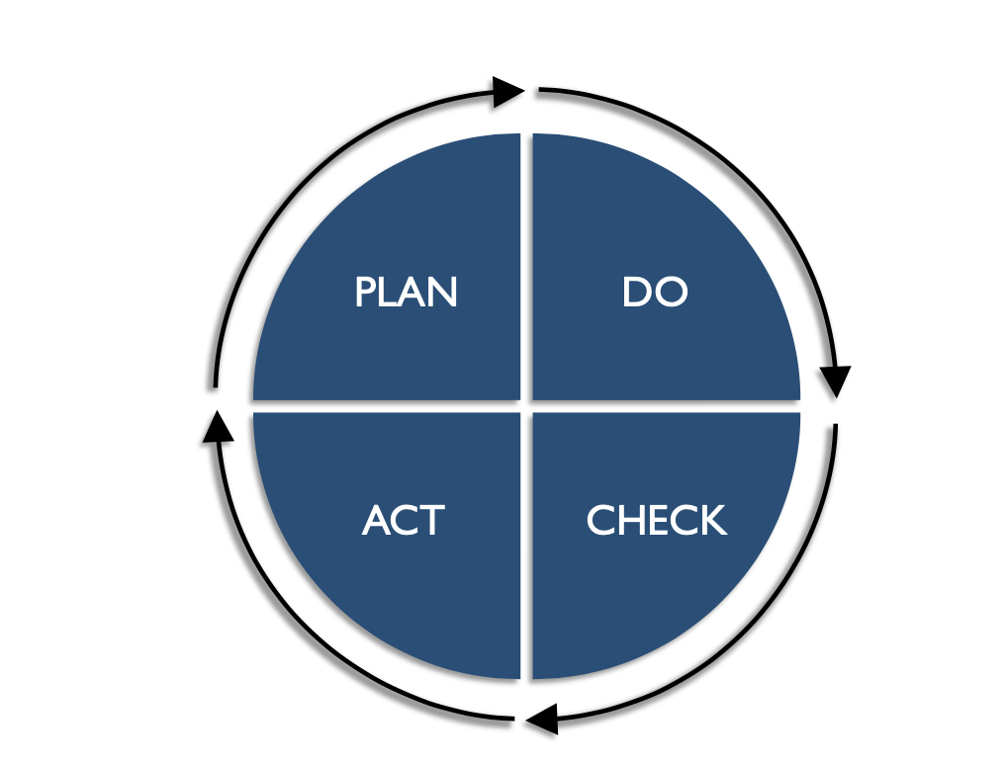
PDCA Model
The PDCA Model is a four-stage model for continuous improvement that can be used in areas including:
• Business Process Management
• Product Lifecycle Management
• Project Management • Human Resource Management
The model was developed by Dr Edward Deming, considered the father of modern quality control, and is also known as the Deming Model.
(DAMA, 2017)

Slide 45
Plan
In the Plan stage, the Data Quality team assesses the scope, impact, and priority of known issues, and evaluates alternatives to address them. This plan should be based on a solid foundation of analysis of the root causes of issues. From knowledge of the causes and the impact of the issues, cost / benefit can be understood, priority can be determined, and a basic plan can be formulated to address them.
(DAMA, 2017)

Slide 46
Do
In the Do stage, the DQ team leads efforts to address the root causes of issues and plan for ongoing monitoring of data. For root causes that are based on non-technical processes, the DQ team can work with process owners to implement changes. For root causes that require technical changes, the DQ team should work with technical teams to ensure that requirements are implemented correctly and that technical changes do not introduce errors.
(DAMA, 2017)

Slide 47
Check
The Check stage involves actively monitoring the quality of data as measured against requirements. As long as data meets defined thresholds for quality, additional actions are not required. The processes will be considered under control and meeting business requirements. However, if the data falls below acceptable quality thresholds, then additional action must be taken to bring it up to acceptable levels.
(DAMA, 2017)

Slide 48
Act
The Act stage is for activities to address and resolve emerging data quality issues. The cycle restarts, as the causes of issues are assessed and solutions proposed. Continuous improvement is achieved by starting a new cycle. New cycles begin as:
Existing measurements fall below thresholds
New data sets come under investigation
New data quality requirements emerge for existing data sets
Business rules, standards, or expectations change
(DAMA, 2017)

Slide 49
Measuring Data Quality
﻿The quality of information is something that can be, to a greater or lesser extent, objectively measured.
﻿The importance of having a metric of quality is that it allows you to demonstrate the scale of a problem, and to demonstrate improvement arising from remedial actions you might take to improve the quality of information in your organization.
(O’Keefe and O’Brien, 2018)

Slide 50
Data Quality Measurement
The operational data quality management procedures depend on the ability to measure and monitor data quality. There are two primary reasons to implement operational measurements:
To inform consumers about levels of quality
To manage risks that change may be introduced
Measurements should be developed based on findings from data assessment and root cause analysis. Knowledge of past problems should be applied to manage risk.
Measurement rules can be described at two levels, the detailed related to the execution of individual rules and the overall, based on the aggregate.

Slide 51
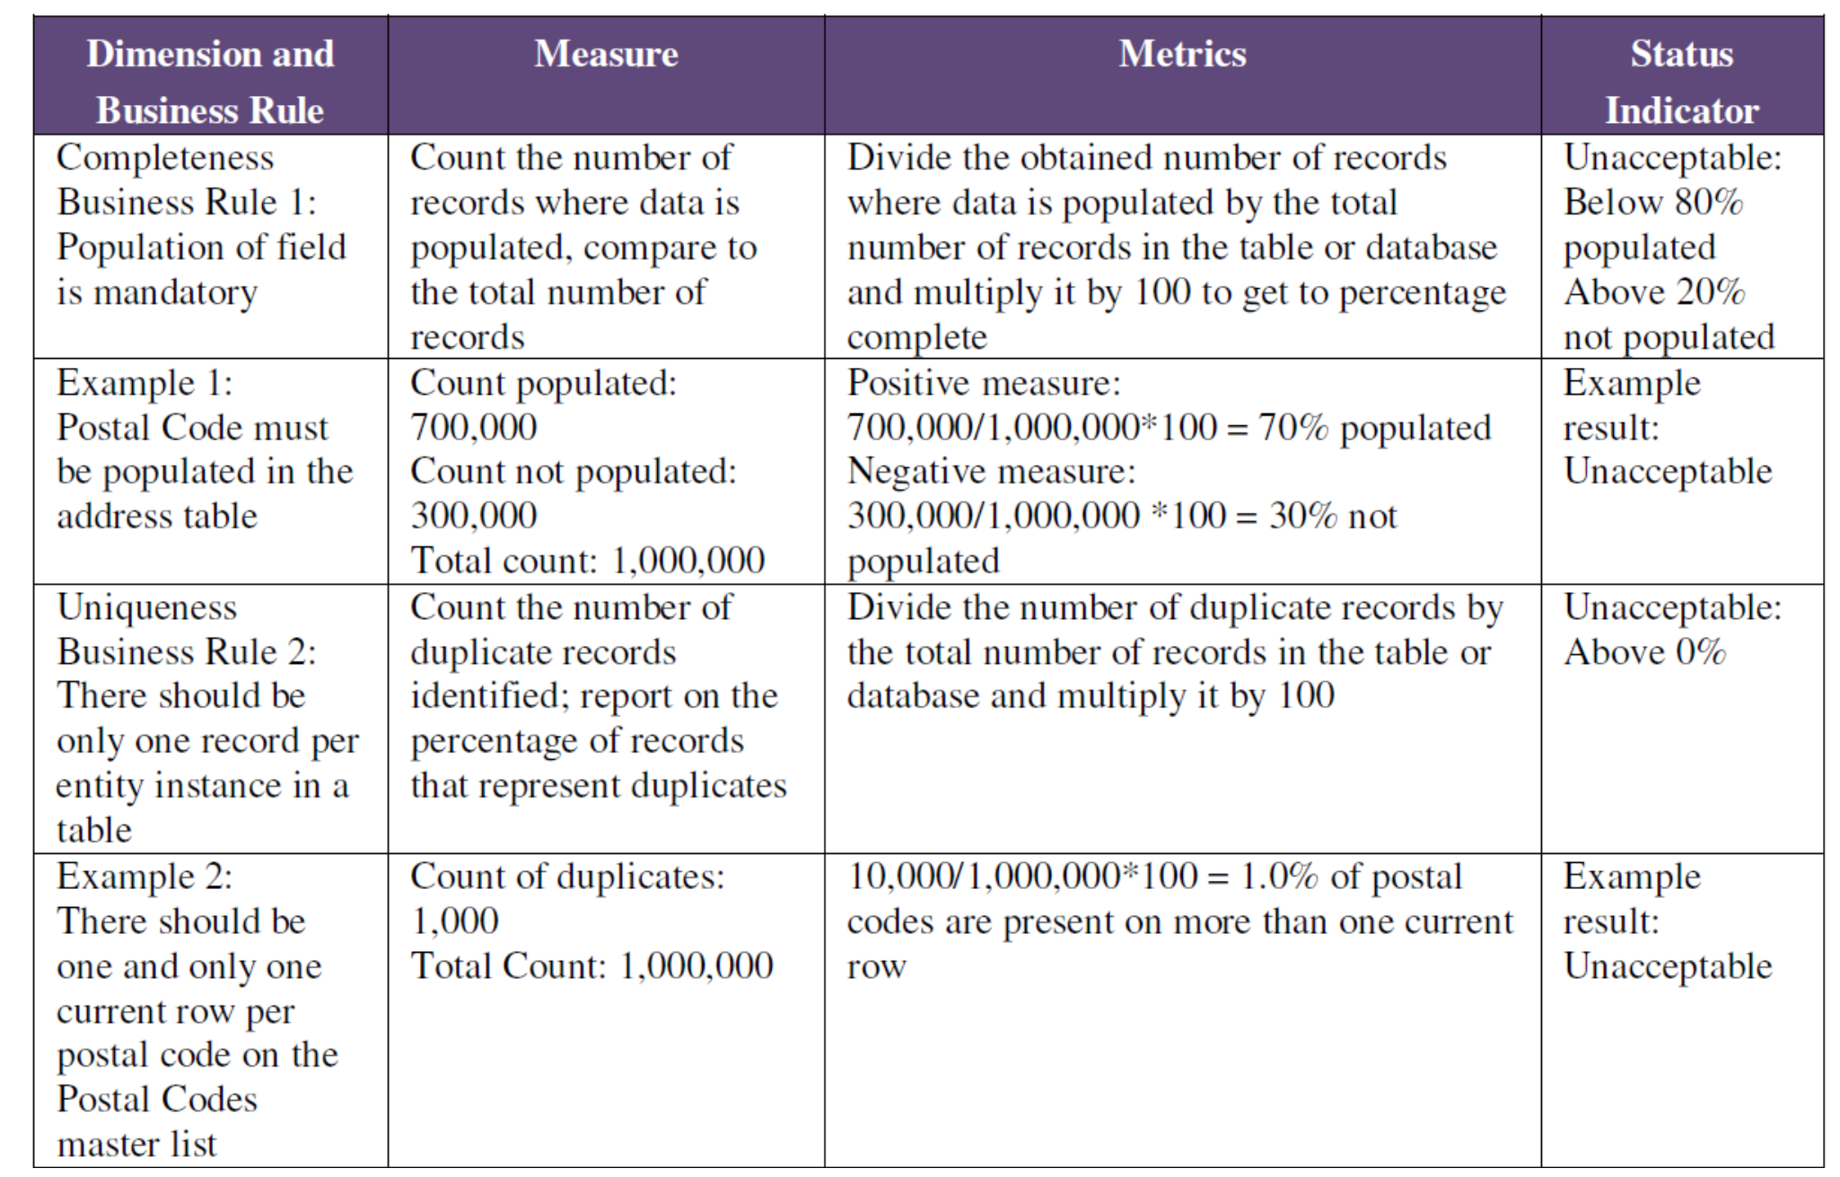
Measurement Examples

Slide 52
DQ Measurement Example
Dimension | Measure | Metric | Status Indicator
Validity: Heart rate sensor | Check data point within (clinically) possible data range | Work out maximum range including resting and active heartrate (i.e. 20-300bpm) | Acceptable if between range identified otherwise unacceptable
What are the risks when creating measures such as the one above?
How could they be overcome?

Slide 53
Causes of poor DQ
﻿A lack of leadership and appropriate governance;
﻿Difficulty in justifying the required improvements; inappropriate or ineffective tools to measure the value of information; data-entry process issues, including inconsistent processes and lack of training; data-processing issues, including assumptions about data sources; data systems design issues, including data modelling issues; issues caused by hasty fixes.

Slide 54
Cost
The cost of getting data right the first time is cheaper than the costs from getting data wrong and fixing it later.
Building quality into the data management processes from the beginning costs less than retrofitting it.
Maintaining high quality data throughout the data lifecycle is less risky than trying to improve quality in an existing process. It also creates a far lower impact on the organization.
Establishing criteria for data quality at the beginning of a process or system build is one sign of a mature Data Management Organization. Doing so takes governance and discipline, as well as cross-functional collaboration.

Slide 55
An Ethical Approach to DQ
﻿Organizations that are thinking in terms of quality systems and quality approaches tend to:
Focus on the needs of their customers – they make sure they identify and understand them, both customers and their needs, correctly. Drive out fear and encourage pride in a job well done – blaming people for errors and failures of the overall system is counterproductive. While it might be tempting to blame the person nearest the symptom, often the root cause lies elsewhere in the organization. Focus on continuous improvement – by incrementally improving quality ﻿and not resting on laurels, the organization can develop a sustainable level of quality.

Slide 56
An Ethical Approach to DQ
Avoid creating the ‘hero ethic’ where staff are thrown at problems to fix them manually i.e. individual employees cleansing or reworking data as it is encountered
A much better approach is to apply a quality ethic in the organization and focus on preventing the defects rather than just hurrying to scrap and rework data. This requires an ethical focus on the needs, wants and concerns of the stakeholders in that data, which could include internal and external customers, so that quality is designed in.
(O’Keefe and O’Brien, 2018)

Slide 57
An Ethical Approach to DQ
﻿Measuring the successful outcomes and not tracking people on the defects that have been created but on the number of records that meet the required standard.
This changes the ethic of quality improvement away from punishment for deviation from standard towards one of reward and recognition for good-quality outputs.
(O’Keefe and O’Brien, 2018)

Slide 58
An Ethical Approach to DQ
﻿This ties into the wider ethical concepts of preserving and promoting human dignity.
If you constantly highlight the failings of the organization, teams within the organization, or single out individuals as being below par, you can impact on morale and feelings of dignity at the micro and macro level
(O’Keefe and O’Brien, 2018)

Slide 59
References
DAMA International (2017) DAMA DMBOK, DAMA DMBOK – Data Management Body of Knowledge, Technics Publications, New Jersey, pp 381–85
O’Keefe, K. and O’Brien, D. (2018) Ethical Data and Information Management: Concepts, Tools and Methods (1st. ed.). Kogan Page Ltd., GBR.
﻿Hasselbach, G and Tranberg, P (2017) Data Ethics: The new competitive advantage, PubliShare, Copenhagen.

