Slide 1
Understanding the AUC–ROC Curve
An intuitive and visual explanation

Slide 2
Why AUC–ROC?
In binary classification, models output probabilities, not just 0 or 1. To measure how well the model separates positive and negative classes across all thresholds, we use the Receiver Operating Characteristic (ROC) curve and its Area Under the Curve (AUC).
Positive class
Negative class
0
1
Predictions

Slide 3
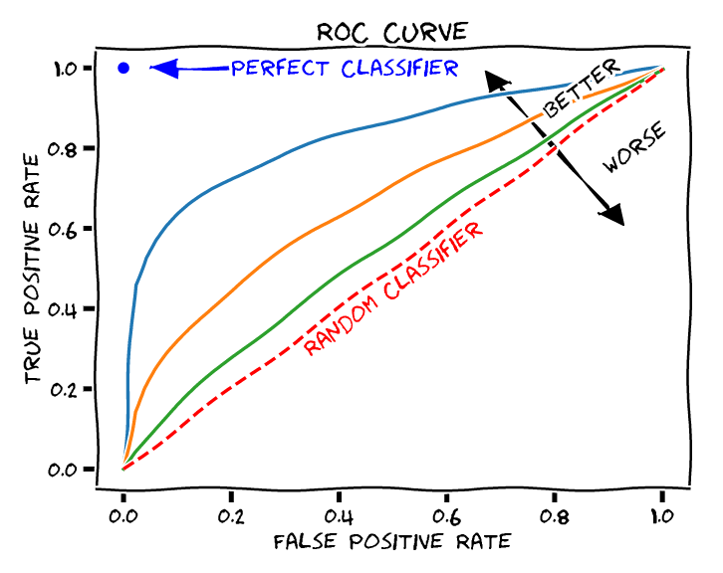
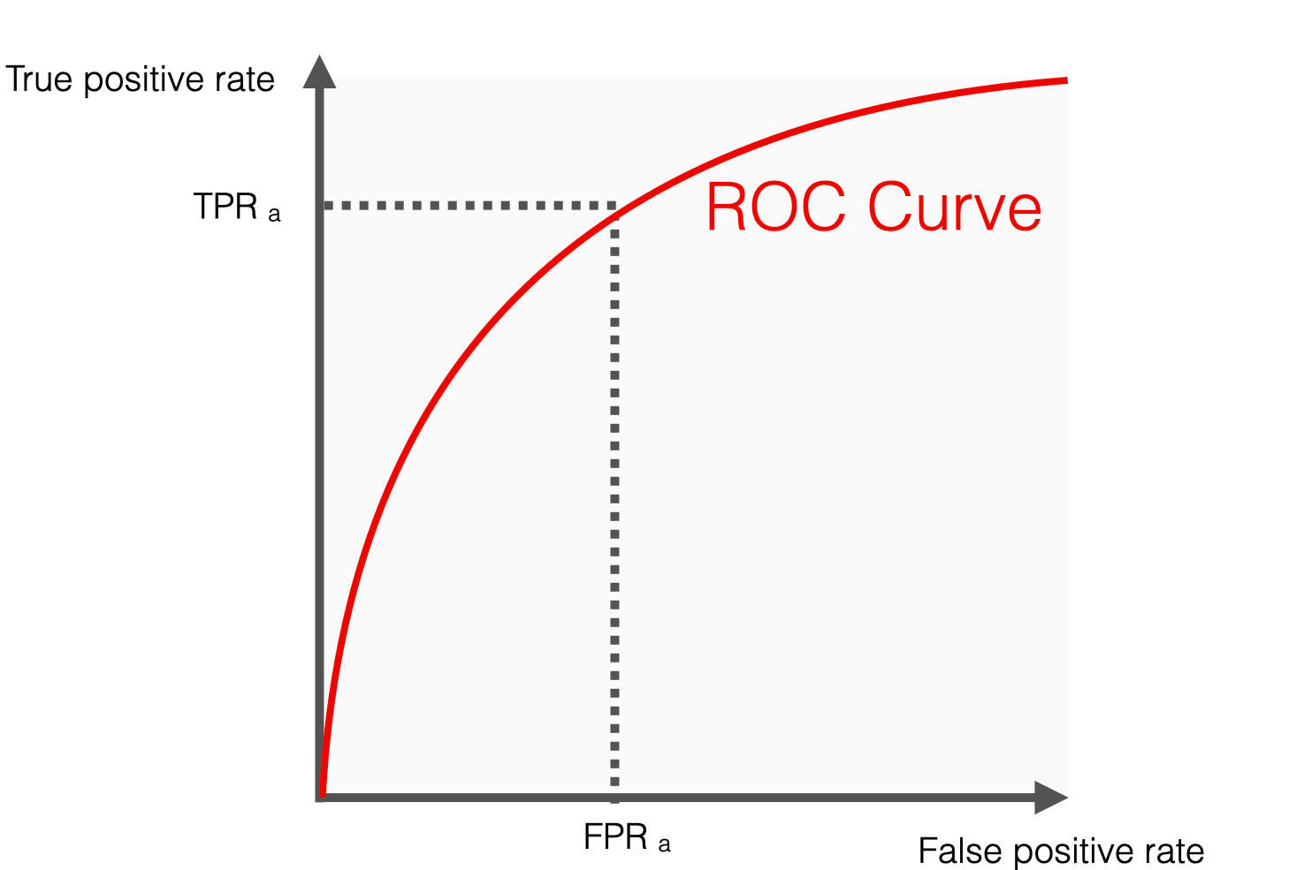

Binary Classification Example
Imagine a classifier predicting whether an email is spam or not:
Each email gets a score between 0 and 1.
Higher scores → more likely spam.
We can set a threshold (e.g., 0.5) to decide.
Changing the threshold changes how many emails are labeled spam.

Slide 4
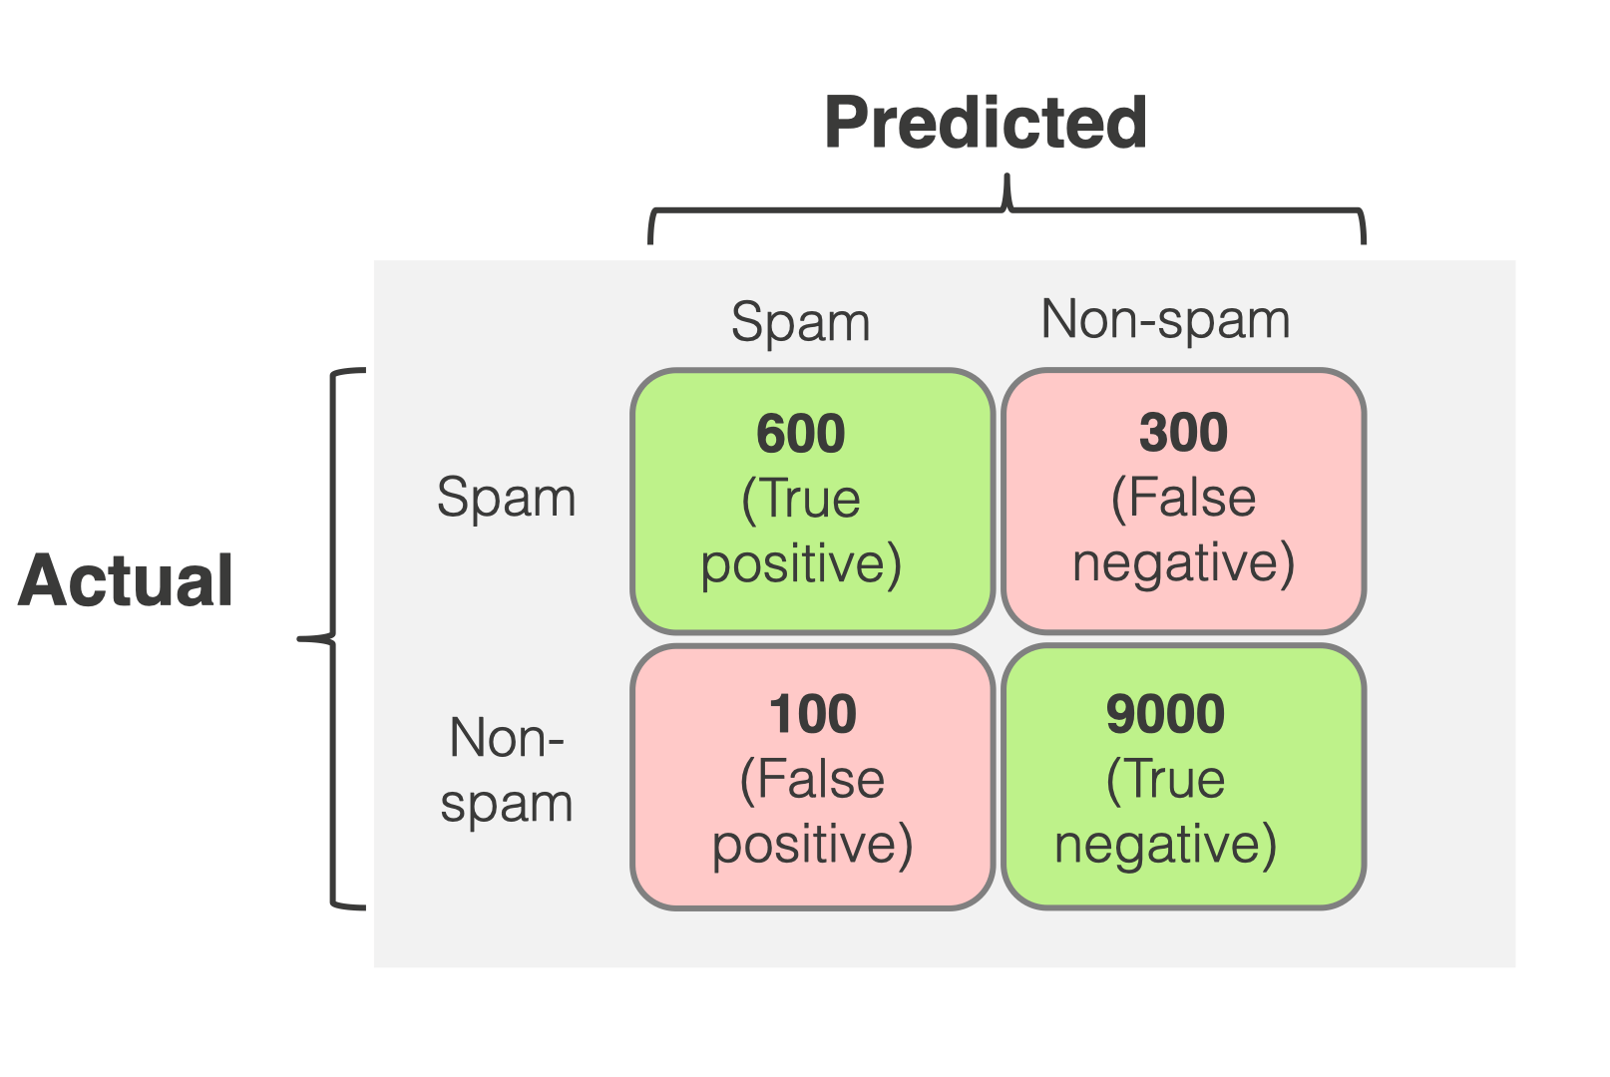
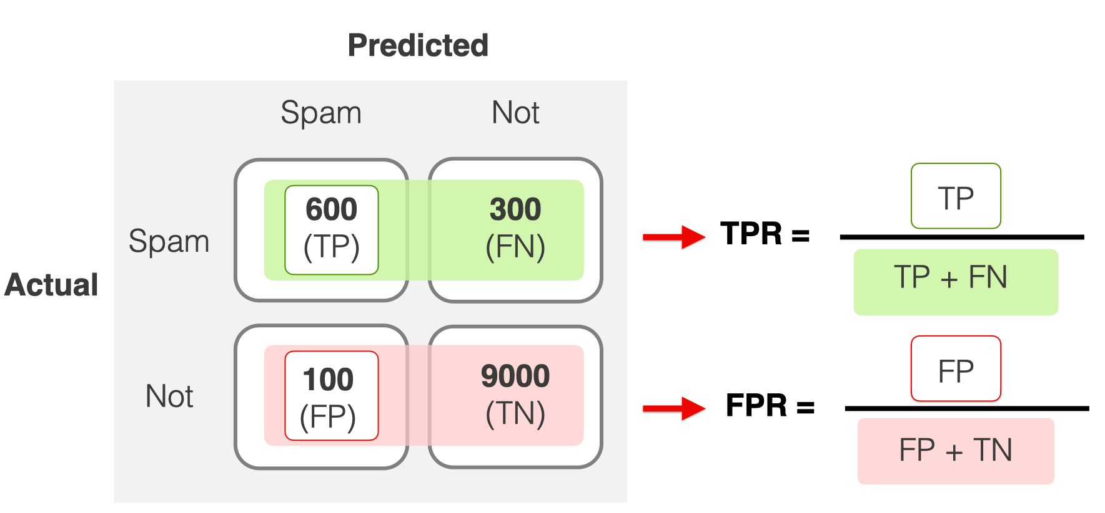
Thresholds and the Confusion Matrix
At a given threshold:
True Positives (TP): correctly predicted positives.
False Positives (FP): incorrectly predicted positives.
True Negatives (TN): correctly predicted negatives.
False Negatives (FN): missed positives.
As we vary the threshold, TP, FP, TN, and FN change — producing new rates.

Slide 5
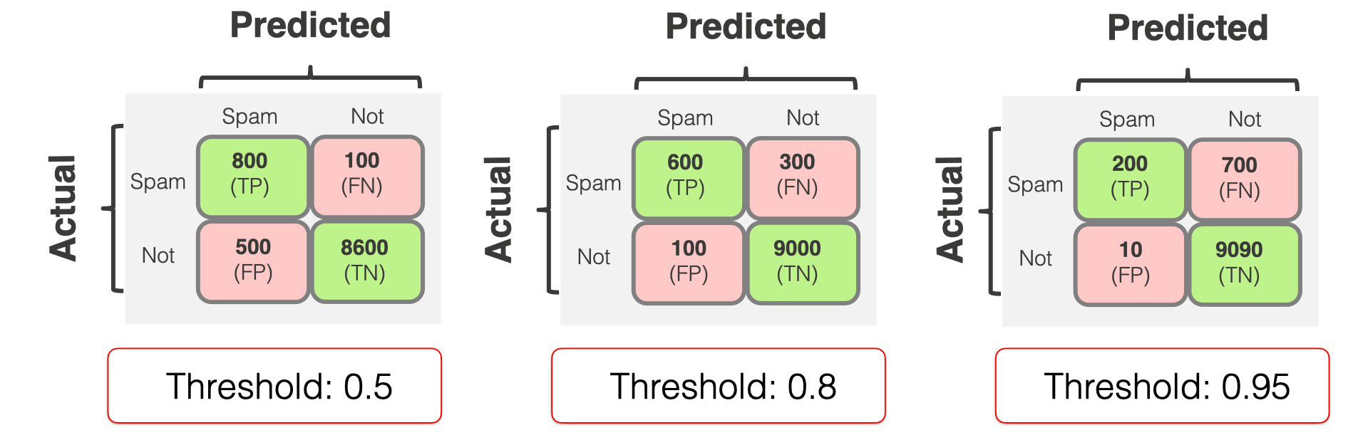
The ROC Curve
ROC = Receiver Operating Characteristic curve.
Axes:
X-axis: False Positive Rate (FPR)
Y-axis: True Positive Rate (TPR)
Each threshold gives a point (FPR, TPR). Connecting all gives the ROC curve.
Formulas:
TPR = TP / (TP + FN)
FPR = FP / (FP + TN)

Slide 6
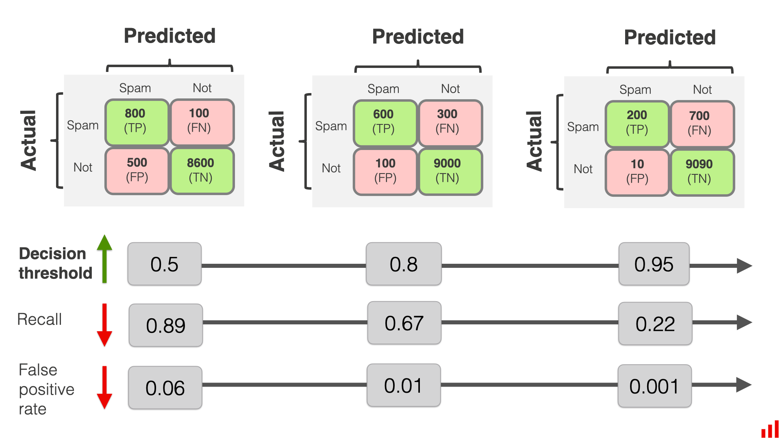
Area Under the Curve (AUC)
The Recall and False Positive will go down but the TPR will go up.

Slide 7
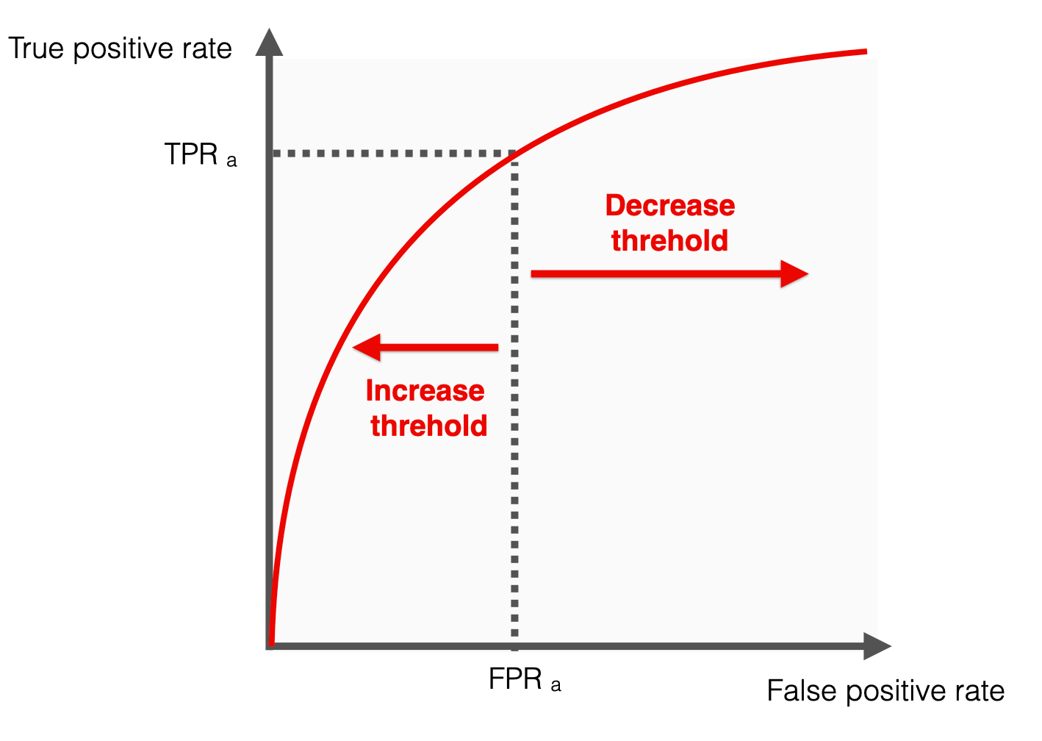
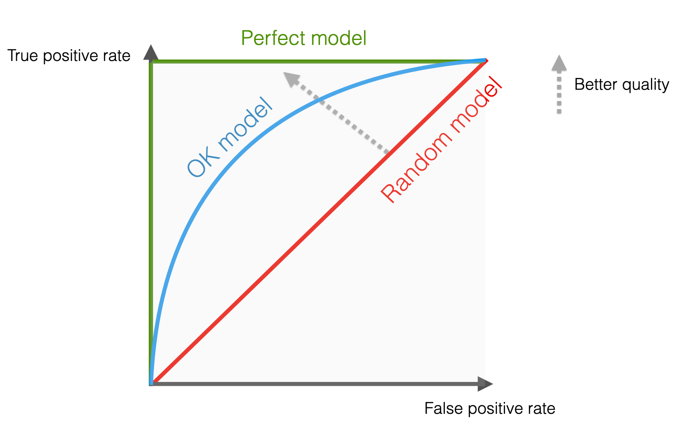
Area Under the Curve (AUC)
AUC represents model's ability to rank positives higher than negatives.
AUC = 1 → Perfect classifier.
AUC = 0.5 → Random guessing.
AUC < 0.5 → Model is worse than random.
Mathematically:
AUC = ∫₀¹ TPR(FPR) d(FPR)

Slide 8
Intuitive Meaning of AUC
AUC can be interpreted as:
Probability that a randomly chosen positive instance has a higher score than a randomly chosen negative instance.
Formally:
AUC = P(score_positive > score_negative)

Slide 9
Visual Examples of ROC Curves
Perfect model → Curve hugs top-left corner (AUC = 1)
Good model → Curve bows toward top-left (AUC ≈ 0.8–0.9)
Random model → Diagonal line (AUC = 0.5)
Poor model → Below diagonal (AUC < 0.5)

Slide 10
Effect of Threshold on ROC
Moving the threshold changes how strict the classifier is:
- High threshold → fewer positives, low TPR, low FPR.
- Low threshold → more positives, high TPR, high FPR.
Each threshold corresponds to a different point on the ROC curve.

Slide 11
Comparing Models Using AUC
We can compare multiple classifiers:
- Model A: AUC = 0.95 → Excellent separation.
- Model B: AUC = 0.70 → Moderate separation.
- Model C: AUC = 0.50 → No separation.
The higher the AUC, the better the model is at distinguishing between classes.

Slide 12
Summary
• ROC curve shows the trade-off between TPR and FPR.
• AUC summarizes performance over all thresholds.
• Higher AUC → better ranking ability.
• Ideal model: AUC = 1.0, Random: 0.5.
AUC–ROC is threshold-independent and widely used for comparing classifiers.

Slide 13
References
https://sefiks.com/2020/12/10/a-gentle-introduction-to-roc-curve-and-auc/
http://www.navan.name/roc/?ref=dataschool.io
https://www.datacamp.com/tutorial/auc
https://www.evidentlyai.com/classification-metrics/explain-roc-curve

