Slide 1
Develop Machine Learning using Python
Rafie Tarabay eng_rafie@mans.edu.eg mrafie@eg.ibm.com

Slide 2
Machine Learning

Slide 3
Machine Learning
a machine learning-based system is not explicitly programmed but learnt from data.
a machine learning algorithm infers patterns and relationships between different variables in a dataset then uses that knowledge to generalize beyond the training dataset.
Terms used in the context of machine learning
Data mining
Features
Labels
Models
Accuracy, and Precision

Slide 4
Data Mining
Definition: "the application of specific algorithms for extracting patterns from data."
data mining is a process, during which machine learning algorithms are utilized as tools to extract potentially-valuable patterns held within datasets.
Data mining is exploratory analysis with unsupervised machine learning algorithms
The main application is text mining in a big data environment:
Text parsing
Sentiment analysis
Opinion mining
Natural language processing using *deep learning algorithm
* deep learning is the process of applying deep neural network technologies - that is, neural network architectures with multiple hidden layers - to solve problems. Deep learning is a process, like data mining, which employs deep neural network architectures, which are particular types of machine learning algorithms.
Data Mining algorithms:
1. C4.5
2. k-means
3. Support vector machines
4. Apriori
5. EM
6. PageRank
7. AdaBoost
8. kNN
9. Naive Bayes
10. CART
For more information http://infolab.stanford.edu/~ullman/mmds/book.pdf

Slide 5
Features
a feature represents an independent variable
In a tabular dataset, a row represents an observation and column represents a feature.
Features are also collectively referred to as dimensions.
Categorical Features
It can take on one of a fixed number of discrete values with name or a label.
The values of a categorical feature have no ordering.
gender is a categorical feature. It can take on only one of two values.
Numerical Features
It can take on any numerical value
numerical feature have mathematical ordering
discrete numerical feature : number of persons, number of rooms
continuous numerical feature: temperature value

Slide 6
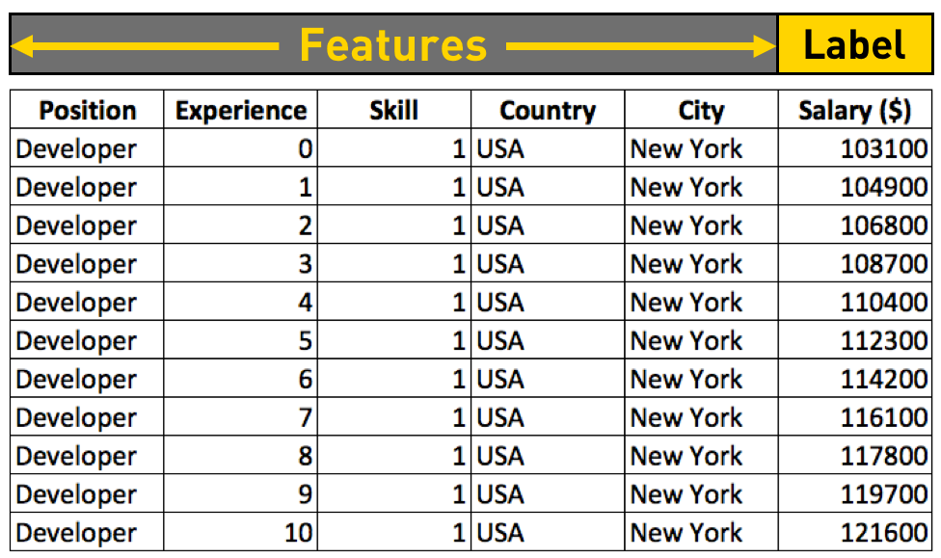
Labels
label is a variable that a machine learning learns to predict
categorical label: ex, category of a news article is a categorical label
numerical label: ex, price is a numerical label

Slide 7
Models
a mathematical construct for capturing patterns within a dataset and estimates the relationship between the dependent and independent variables and has predictive capability. and can calculate or predict the value for the dependent variable when get the values of the independent variables.
Training a model is a compute intensive task, while using it is not as compute intensive.
A model is generally saved to disk, so that it can be used without go to training step again.
Training Data (80% of data)
The data used by a machine learning algorithm to train a model
Test Data (20% of data)
The data used for evaluating the predictive performance of a model

Slide 8
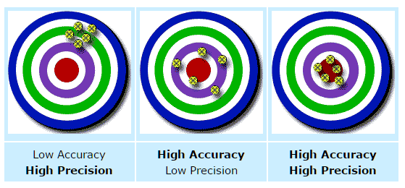
Accuracy vs Precision
Accuracy is how close a measured value is to the actual (true) value.
Precision is how close the measured values are to each other.

Slide 9
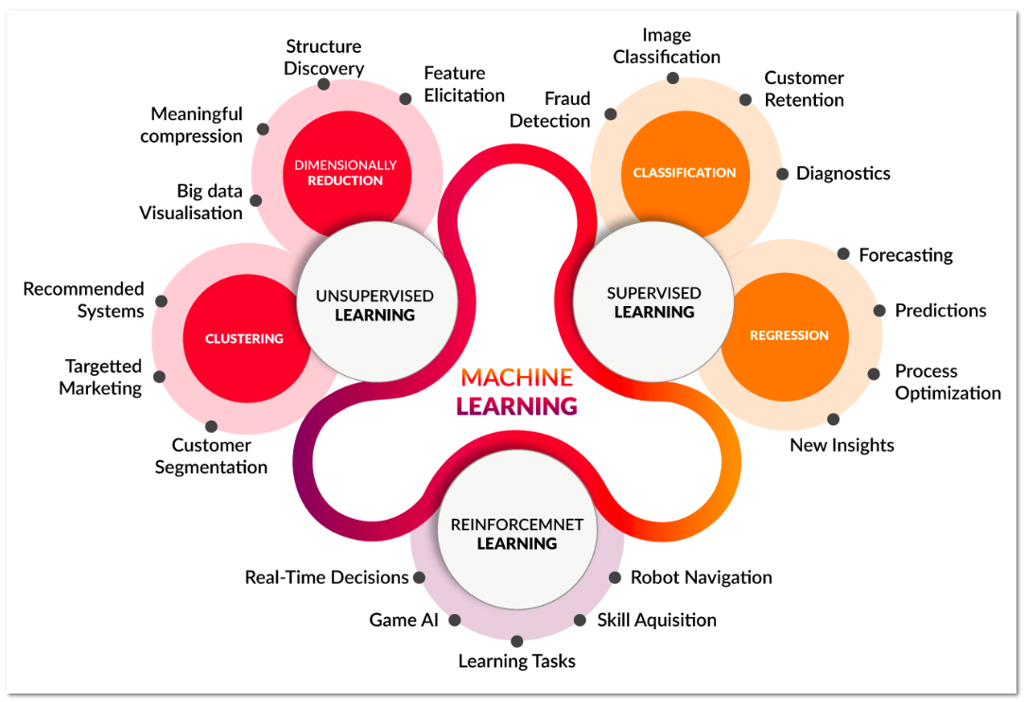
Machine learning techniques
Machine learning mainly has three types of learning techniques:
Supervised learning
Unsupervised learning
Reinforcement learning

Slide 10
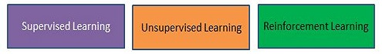
Machine Learning tasks categories
Classification
Regression
Clustering
Anomaly detection
Association
Recommendation
Dimensionality reduction
Computer Vision
Text Analytics

Slide 11
Classification [supervised learning]
Classification is concerned with building models that separate data into distinct classes. These models are built by inputting a set of training data for which the classes are pre-labelled in order for the algorithm to learn from. The model is then used by inputting a different dataset for which the classes are withheld, allowing the model to predict their class membership based on what it has learned from the training set.
Binary classification examples (divide data to two options only)
spam filtering is a classification task
Tumor diagnosis can be treated as a classification problem.
determining credit risk using personal information such as income, outstanding debt
Multi-class classification examples
handwritten recognition each character is a multi-class classification problem
image recognition is a multi-class classification task
Xbox Kinect360, which infers body parts and position

Slide 12
Regression [ supervised learning]
The goal is to predict a numerical label for an unlabeled observation
Regression algorithms: Linear regression, Decision trees
Examples
home valuation
Asset trading, and forecasting
Sales or inventory forecasting

Slide 13
Anomaly Detection [ supervised learning]
the goal is to find outliers, noise, deviations in a dataset
Anomaly detection applications
In manufacturing, it is used for automatically finding defective products.
In data centers, it is used for detecting bad systems.
Websites use it for fraud detection.
Detecting security attacks. Network traffic associated with a security attack is unlike normal network traffic. Similarly, hacker activity on a machine will be different from a normal user activity.

Slide 14
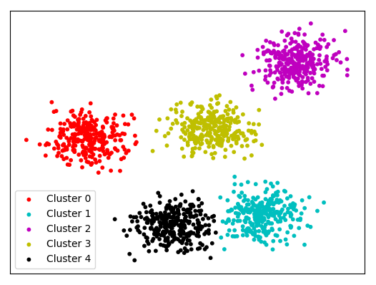
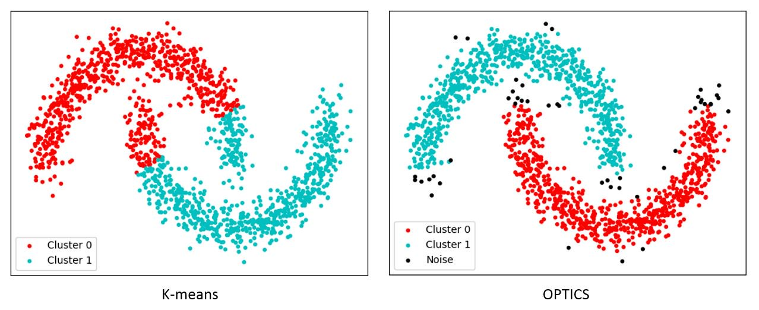
Clustering [unsupervised learning]
The aim is to split a dataset into a specified number of clusters or segments.
Elements in the same cluster are more similar to each other than to those in other clusters.
Clustering algorithms
1) k-means
The number of clusters (k) must be given explicitly.
Identify the best k cluster centers in an iterative manner
Clusters are assumed to be spherical.
2) OPTICS /DBSCAN
it is a density-based clustering algorithm. represents clusters by its nature
Example
creating customer segments, which can be targeted with different marketing programs

Slide 15
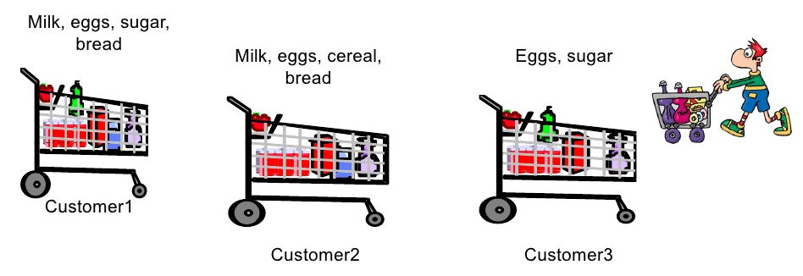
Association [unsupervised learning]
Association is most easily explained by introducing market basket analysis, a typical task for which it is well-known.
attempts to identify associations between the various items that have been chosen by a particular shopper and placed in their market basket and assigns support and confidence measures for comparison.
The value of this lies in cross-marketing and customer behavior analysis.

Slide 16
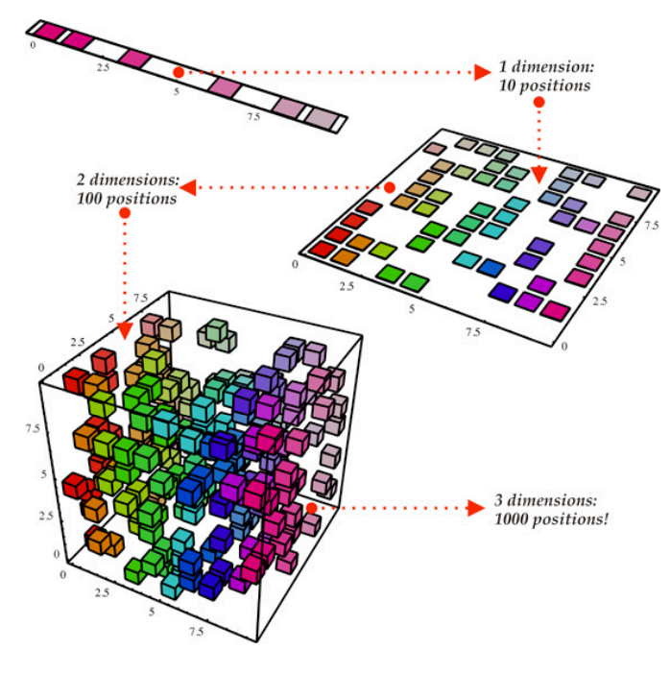
Dimensionality Reduction [unsupervised learning]
The goal in dimensionality reduction is to reduce the number of features in a dataset without significantly impacting the predictive performance of a model and this will reduce the computational complexity and cost of machine learning.

Slide 17
Recommendation [Reinforcement]
The goal of a recommendation system is to recommend a product to a user based on past behavior to determine user preferences.
Unlike Association, Recommendation focus on user behavior and suggest according to this user behavior.
It is reinforcement because we not sure of result until user choose one of our recommendation, if not, then our recommendation was not correct.

Slide 18
Supervised machine learning algorithms
Classification
Two Class Classification
- Logistic Regression (Fast)
- Decision Tree (Fast)
- Decision jungle(Accurate)
- SVM (Accurate) (>100 features)
- Boosted Decision Tree (Fast - Large memory)
- Bayes point machine (Fast)
Multi Class Classification
- Decision Tree (Fast)
- Logistic Regression (Fast)
- Random Forest (Accurate)
- Gradient Boosting Tree (Accurate)
- Naive Bayes (Big Data)
- Decision jungle(Accurate)
Regression
- Linear Regression (Fast)
- Decision Tree (Fast)
- Random Forest (Accurate)
- Gradient Boosting Tree (Accurate)
- Ordinal regression
- Bayesian linear regression
- Boosted Decision Tree (Fast - Large memory)
- SGD Regressor (<100K rows)
- Lasso/ ElasticNet (Few Features)
- RidgeRegression
- SVR(kernel=linear/ rbf)
- EnsembleRegressors
Anomaly Detection
- One Class SVM (support vector machine)
- PCA based Anomaly Detection
- Time Series Anomaly Detection

Slide 19
Unsupervised machine learning algorithms
Clustering
- K-means Clustering
- K-modes (Categorical variables)
- DBScan (predict the number of clusters automatically)
- OPTICS (predict the number of clusters automatically)
Association
Apriori
Dimension Reduction
- PCA
- Singular value decomposition
Recommendation
- Matchbox Recommender
Computer Vision
- OpenCV Library
Text Analytics (Supervised Learning)
- Named Entity Recognition
- Sentimental Analysis

Slide 20
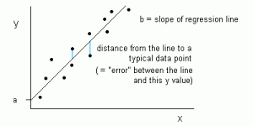
Linear regression algorithms
Linear Regression is used in problems where the label is of continuous nature e.g. Sales of a retail chain. It consists of ordinary least squares method fitting the best line that minimizes the sum of squared errors between the predicted and actual data points. Such algorithms are mostly used to for decision-making process to solve problems like – What should be my best marketing mix to optimize sales given the investment in various marketing channels or maximizing sales based on store layouts or pricing and promotional offers.

Slide 21
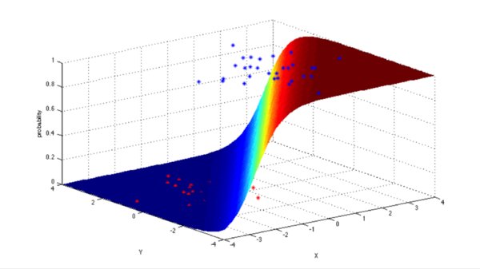
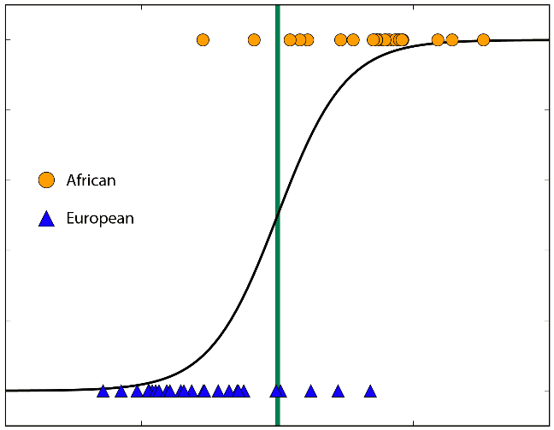
Logistic regression algorithms
Logistic Regression: When the label is that of categorical or discrete nature, we use log odds ratio to optimize business problems such as – scoring customers and then predict those that are most likely to default on the loan payment, or predict higher response rates to a certain marketing strategy.

Slide 22
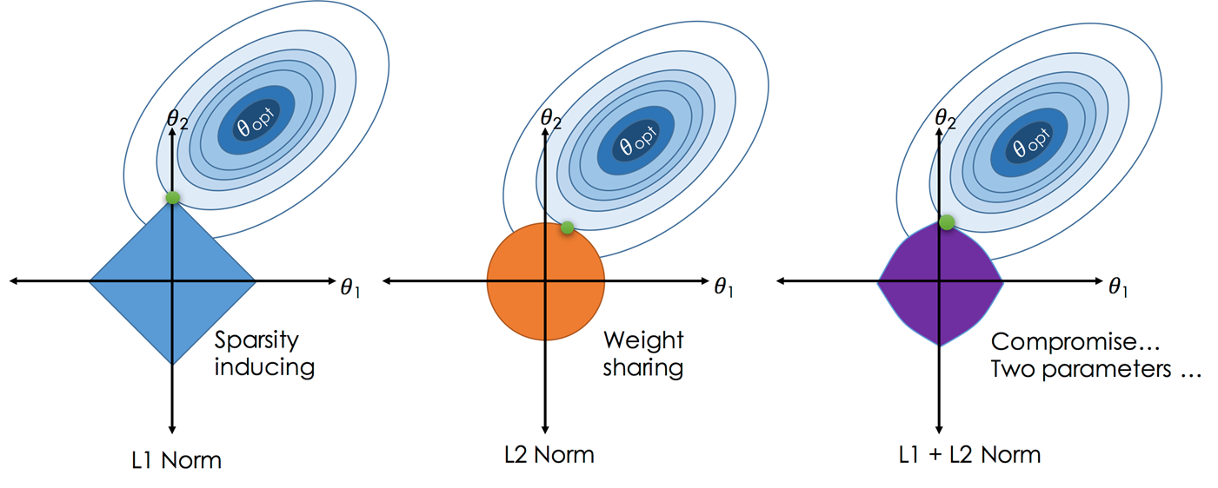
Ridge, Lasso, and Elasticnet algorithms
Ridge, Lasso, and Elasticnet are Best Linear Unbiased Estimator (BLUE)
To find a BLUE estimator just need mean and variance
BLUE restricts the estimator to be linear
BLUE use norms, norms play a vital role in reducing the Mean Squared Error (MSE)
Ridge vs Lasso vs Elasticnet
Ridge uses L2 Norm penalty term which limits the size of the coefficient vector.
Lasso uses L1 Norm penalty which imposes sparsity among the coefficients and thus, makes the fitted model more interpretable.
Elasticnet has a penalty which is a mix of L1 and L2 norms.

Slide 23
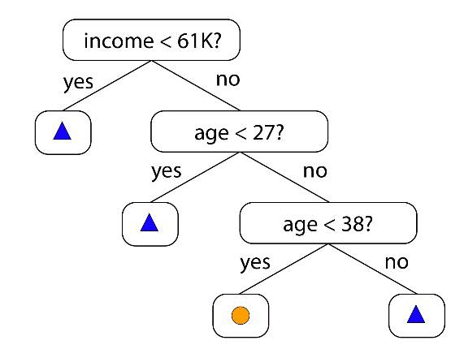
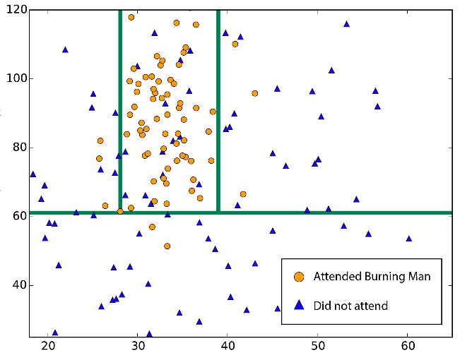
Decision Trees, forests, and jungles
Decision Trees methods construct a tree of predictive decisions made based on actual values of attributes in the data. It used for classification and regression problems.
Decision Trees, forests, and jungles: all do the same thing - subdivide the feature space into regions with mostly the same label. These can be regions of consistent category or of constant value, depending on whether you are doing classification or regression.

Slide 24
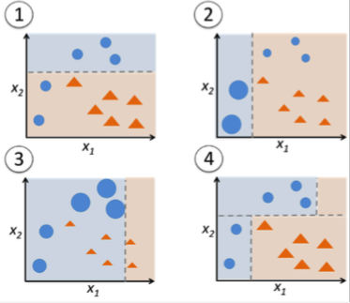
Ensemble Learning Algorithms (Gradient-Boosted/ Random Forests )
Decision trees do not have the same level of predictive accuracy.
This problem is addressed by using a collection of decision trees instead of just one decision tree.
this algorithm called ensemble learning algorithms and it is one of top performers for classification and regression tasks.
The commonly used ensemble algorithms are Random Forests and Gradient-Boosted Trees

Slide 25
Random Forests
Random Forest algorithm trains each decision tree in an ensemble independently using a random sample of data. In addition, each decision tree is trained using a subset of the features. The number of trees in an ensemble is of the order of hundreds.
Random Forest creates an ensemble model that has a better predictive performance than that of a single decision tree model.
For a regression task, a Random Forest model takes an input feature vector and gets a prediction from each decision tree in the ensemble. It averages the numeric labels return by all the trees and returns the average as its prediction.

Slide 26
Gradient-Boosted Trees
Gradient-Boosted Trees (GBTs) algorithm also trains an ensemble of decision trees. However, it sequentially trains each decision tree.
It optimizes each new tree using information from previously trained trees. Thus, the model becomes better with each new tree.
GBT can take longer to train a model since it trains one tree at a time. In addition, it is prone to overfitting if a large number of trees are used in an ensemble.
However, each tree in a GBT ensemble can be shallow, which are faster to train.

Slide 27
Random Forests vs Gradient-Boosted Trees (GBTs)
Random Forests can train multiple trees in parallel, but GBTs train one tree at a time
Random Forest reduces the likelihood of overfitting
Random Forests reduce variance by using more trees, whereas GBTs reduce bias by using more trees
To make a prediction on a new instance, a random forest must aggregate the predictions from its set of decision trees. This aggregation is done differently for classification and regression.
Classification: Majority vote. Each tree’s prediction is counted as a vote for one class. The label is predicted to be the class which receives the most votes.
Regression: Averaging. Each tree predicts a real value. The label is predicted to be the average of the tree predictions.

Slide 28
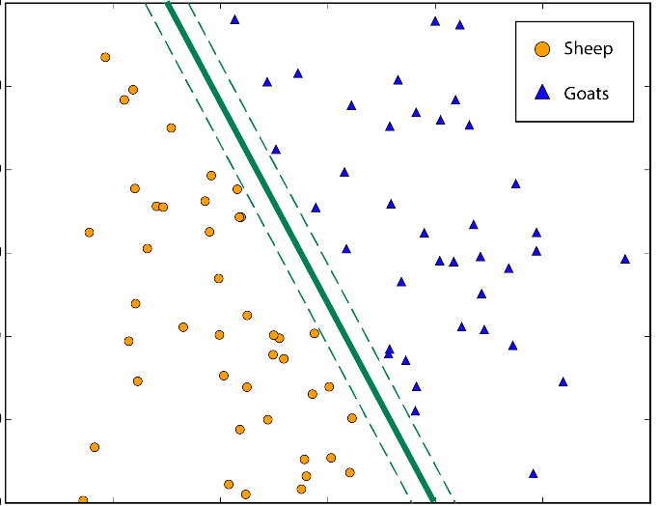
SVM
Support Vector Machines (SVM) are most popularly used in ML to deal with problems related to image segmentation, the stock market, text categorization and biological sciences, it try to find the line that give largest margin between two classes of observations.

Slide 29

DBScan / Optics
It is a Clustering algorithm that detect the continues patterns
The distance between points in DBScan are fixed. So, it is fast but not work well with Clusters with different densities.
Optics slower than DB Scan, identify clusters with different densities

Slide 30
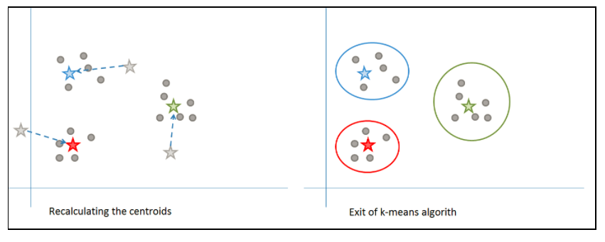
K-means
Clustering/ K-Means: This is a undirected or unsupervised data mining activity typically seen to be used in problems that involve market segmentation, fraud detection, recommendation engines, clustering web pages by similarity.

Slide 31
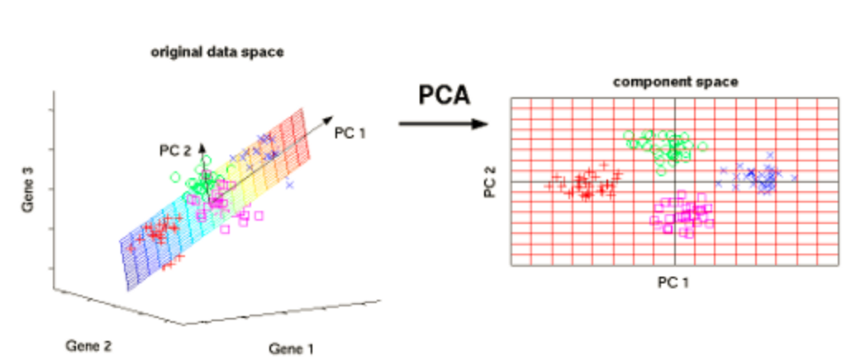
PCA
Used for dimension reduction

Slide 32
Naïve Bayes
Naïve Bayes mostly used in Real time Prediction , Multi class Prediction , Text classification, sentiment analysis, document categorization, spam filtering, disease prediction, Recommendation System.
Naïve Bayes Classifier is based on the Bayes Theorem of Probability and assumes independence of attributes.
Independence of attributes example: a fruit may be considered to be an apple if it is red, round, and about 3 inches in diameter. all of these properties independently contribute to the probability that this fruit is an apple and that is why it is known as ‘Naive’ =(child like/inexperienced).
Naive Bayes Pros:
It is easy and fast to predict class/multi class prediction
Performs better compare to other models, need less training data.
It perform well in case of categorical input variables compared to numerical variable(s). For numerical variable, normal distribution is assumed
Naive Bayes Cons:
If categorical variable has a category (in test data set), which was not observed in training data set, then model will assign a 0 (zero) probability and will be unable to make a prediction.
Naive Bayes is also known as a bad estimator, so the probability outputs from predict_proba are not to be taken too seriously.
In real life, it is almost impossible to get a set of predictors which are completely independent.
There are three types of Naive Bayes model
- Gaussian: It is used in classification and it assumes that features follow a normal distribution.
- Multinomial: It is used for discrete counts. For example, in text classification problem. “count how often negative word occurs in the document”
- Bernoulli: The binomial model is useful if your feature vectors are binary (i.e. zeros and ones).

Slide 33
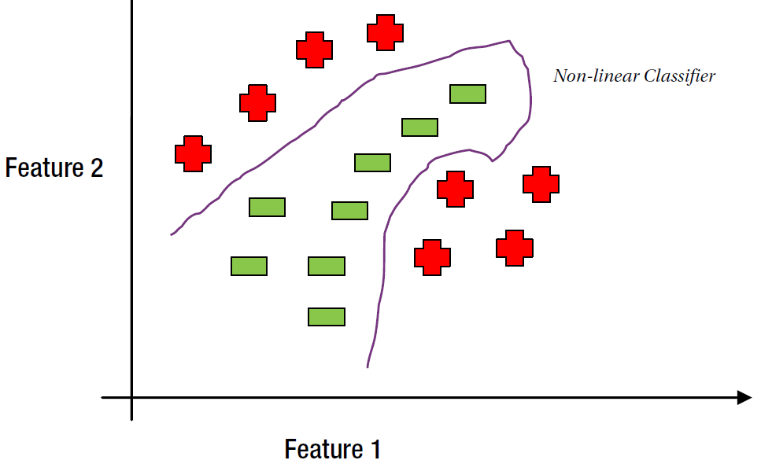
Neural Network
The feedforward neural network algorithm uses a technique known as backpropagation to train a model. During the training phase, prediction errors are fed back to the network. The algorithm uses this information for adjusting the weights of the edges connecting the nodes to minimize prediction errors. This process is repeated until the prediction errors converge to value less than a predefined threshold. Generally, a neural network with one layer is sufficient in most cases. If more than one hidden layers are used, it is recommended to have the same number of nodes in each hidden layer. Neural networks are better suited for classifying data that is not linearly separable.

Slide 34
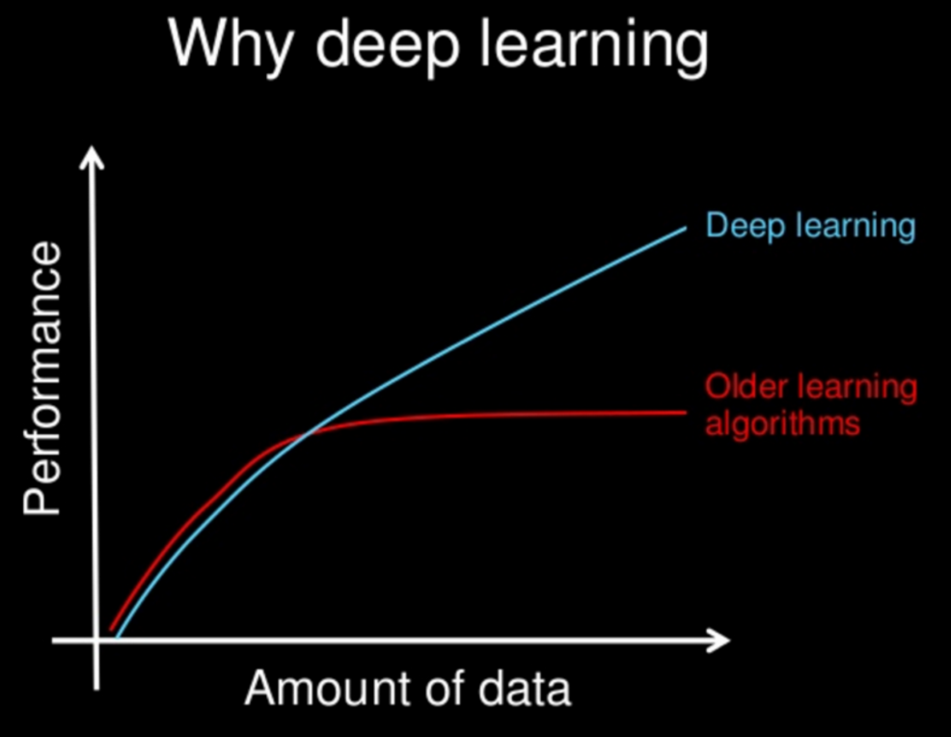
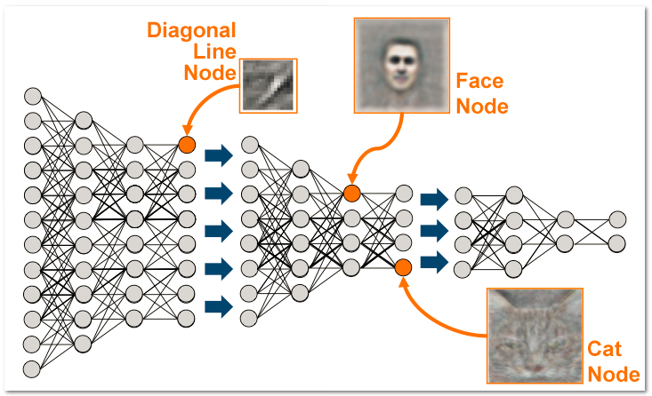
Deep learning
It is consists of many layers/nodes of neural networks.
Deep learning automatically finds out the features which are important for classification, but in Machine Learning we had to manually give the features
deep learning algorithms need a large amount of data to work perfect.

Slide 35
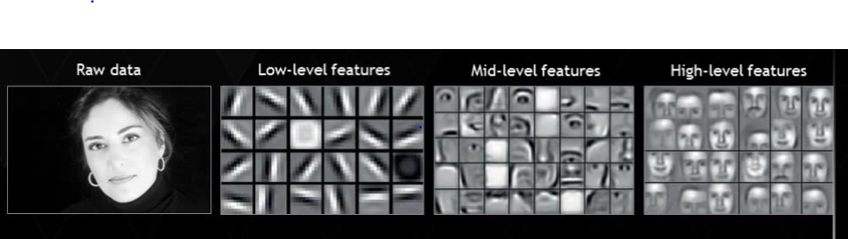
Traditional ML Algorithms
Deep learning algorithms
can work on low-end machines
break the problem down into different parts, solve them individually and combine them to get the result.
takes much less time to train, ranging from a few seconds to a few hours.
gives us the selection rules, so it is easy to interpret, safe to use in industry for interpretability.
need a large amount of data to work perfect
heavily depend on GPUs
solve the problem end-to-end.
takes a long time to train. (like two weeks)
It is excellent and is near human performance, but no guarantee to be always like this!, because most of operations are hidden and we can’t review selection logic!

Slide 36
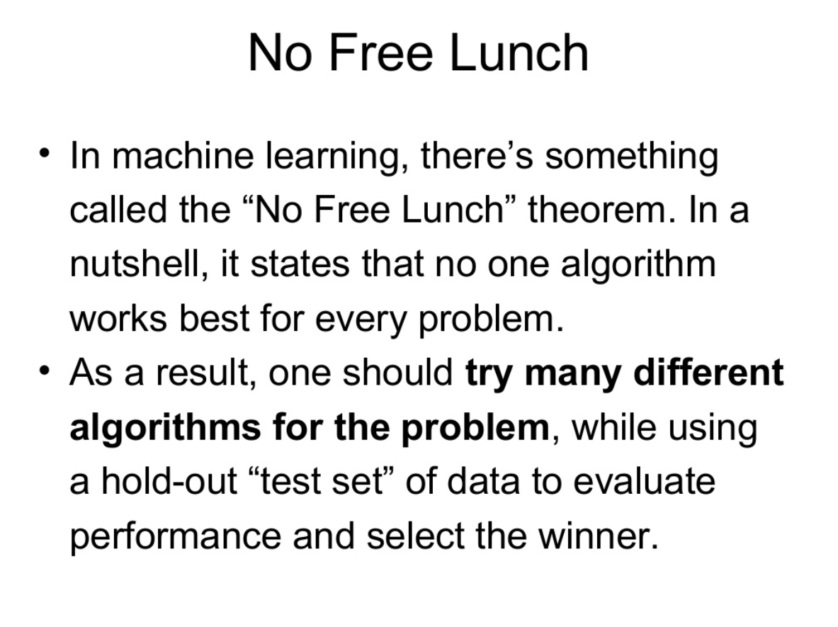

Slide 37
Python Machine learning

Slide 38
Why Python?
A large community
tons of machine learning specific libraries
easy to learn
TensorFlow make Python the leading language in the data science community.
About Python
It is case sensitive
Text indentation is important in logic flow!
Use # symbol to add a code comment
Use ‘’’ ‘’’ to comment a block of code

Slide 39
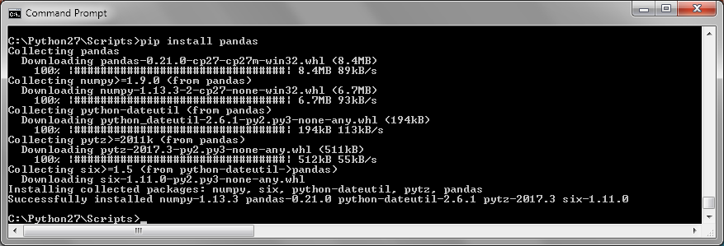
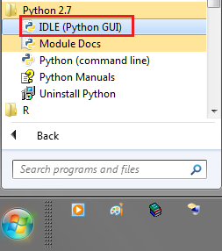
Prepare your machine
Install Python 2.7.xx
Pip install pandas
Pip install matplotlib Sklearn Statistics scipy seaborn Ipython pip install --no-cache-dir pystan #to force redownload exist package in case of error
Get Data set for training through http://archive.ics.uci.edu/ml/datasets.html

Slide 40
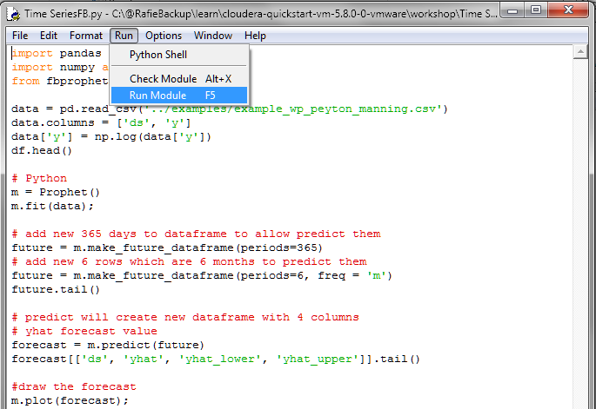
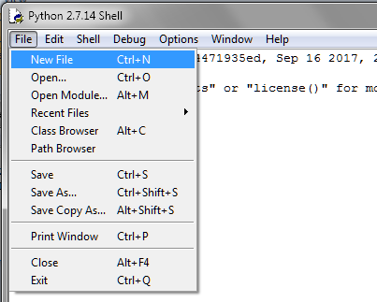
How to Run Python ML application
Open “IDLE (Python GUI)” → File → New File
Write your code on the new window then → Run → Run Module
Alt+3 ➔ Comment lines
Alt+4 ➔ Remove lines comments

Slide 41
Anaconda
Anaconda is Python distribution for data scientists .
It has around 270 packages including the most important ones for most scientific applications, data analysis, and machine learning such as NumPy, SciPy, Pandas, IPython, matplotlib, and scikit-learn.
Download it for free from https://www.continuum.io/downloads

Slide 42
Import Statistical libraries
import time
import random
import datetime
import pandas as pd
import matplotlib.pyplot as plt
import statistics
from scipy import stats
import sklearn
import seaborn
from IPython.display import Image
import numpy as np

Slide 43
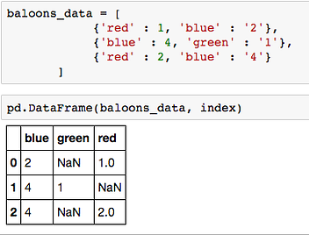
import pandas as pd
Pandas DataFrame similar to Python lists but it has extra column (index) and Any operation to perform on a DataFrame , get’s performed on every single element inside it.
Example of convert python list to DataFrame →
Common Operations
1) Set dataset columns names → data.columns = [‘blue’,’green’,’red’]
2) Get value of any cell use cell index and column index/name like this : data.ix[2,’red’]
3) replace NaN with zero using : data = data.replace(np.nan,0)
4) Select a subset of columns in new dataFrame : NewDF= data [ [ ‘blue’ , ’red’ ] ]
5) Count of rows that has data on a column: data[‘red'].value_counts().sum()
6) Select count of distinct value on a column: data[‘blue’].nunique()
7) Drop duplicates rows: data = data.drop_duplicates()
The missing values are dennoted by NaN __

Slide 44
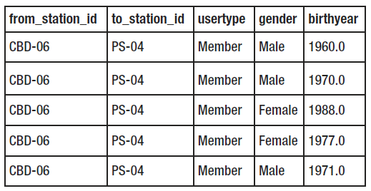
Basic commands
Reading the Data from disk into Memory
data = pd.read_csv('examples/trip.csv’)
Reading the Data from HDFS into Memory
with hd.open("/home/file.csv") as f:
data = pd.read_csv(f)
Printing Size of the Dataset and Printing First/last Few Rows
print len(data)
data.head()
data.tail()
data.describe() #get data summary count, mean, the min and max values
Order Dataset and get first and last element of a column
data = data.sort_values(by= 'birthyear')
data.reset_index()
print data.ix[1, 'birthyear’ ] #first element
print data.ix[len(data)-1, 'birthyear’ ] #last element

Slide 45
DataFrame cleaning
If need to convert column with negative values data['AwaitingTime'] = data['AwaitingTime'].apply(lambda x: abs(x))
Convert string values to integer values (DayOfTheWeek to Integers) Day_mapping = {'Monday' : 0, 'Tuesday' : 1, 'Wednesday' : 2, 'Thursday' : 3, 'Saturday' : 5, 'Sunday' : 6} data['DayOfTheWeek'] = data['DayOfTheWeek'].map(Day_mapping)
Remove rows that has age column less than zero data = data[data['Age'] >= 0]
Delete column from Dataset del data[‘from_station_id']

Slide 46
Filter data to remove rows that has NA/0
> df = pd.DataFrame({'a':[0,0,1,1], 'b':[0,1,0,1]})
df = df[(df.T != 0).any()] #keep row if any feature contain values
> print df
> df = df[(df.T != 0).all()] #keep row if all features contain values
> print df
Original DataFrame
Keep raw if ANY contains a value
Keep raw if ALL contains values
b | a
0 | 0 | 1
0 | 1 | 2
1 | 0 | 3
1 | 1 | 4
b | a
0 | 1 | 2
1 | 0 | 3
1 | 1 | 4
b | a
1 | 1 | 4
df[(df.T != 0).all()]
df[(df.T != 0).any()]

Slide 47
Drop the columns where Any/All elements are NaN
data.dropna(how='any’)
how : {‘any’, ‘all’}
any : if any NA values are present, drop that label
all : if all values are NA, drop that label

Slide 48
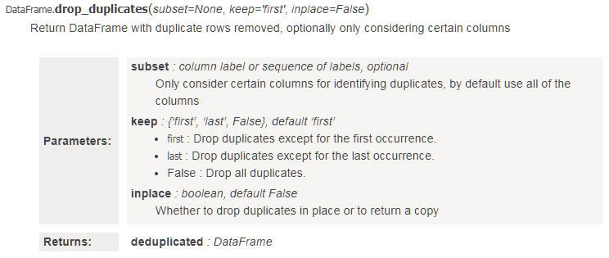
Drop duplicate rows
Consider duplicate if all the row are the same, return result in new dataframe
dataframe1 = df.drop_duplicates(subset=None, inplace=False)
Consider duplicate if Column1, Column3 are the same, drop duplicate except last row, return result in the same dataframe
df.drop_duplicates(subset=[‘Column1', ‘Column3'], keep=‘last’)
Save unique data
df.to_csv(file_name_output)

Slide 49
Split Dataset, Create training, and test dataset
How to split dataset by 70-30? [70% of the observations fall into training and 30% of observations fall into the test dataset.]
x_train,x_test, y_train, y_test = train_test_split(data[‘x’],data[‘y'], test_size=0.3, random_state=1)

Slide 50
import matplotlib.pyplot as plt
plt.bar – creates a bar chart
plt.scatter – makes a scatter plot
plt.boxplot – makes a box and whisker plot
plt.hist – makes a histogram
plt.plot – creates a line plot

Slide 51
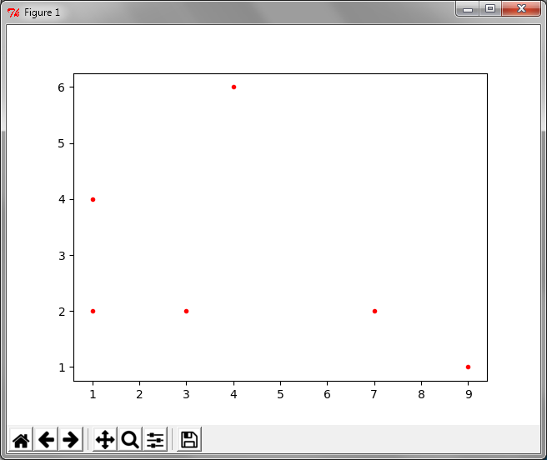
Plot for Data array
import numpy as np
import matplotlib.pyplot as plt
Data=np.array([ [1,2], [3,2], [4,6], [7,2], [1,4], [9,1] ])
Column1=0
Column2=1
for i in range( len(Data) ):
plt.plot( Data[ i ] [Column1] , Data[ i ] [Column2] ,'r.’) #r. :red
plt.show()

Slide 52
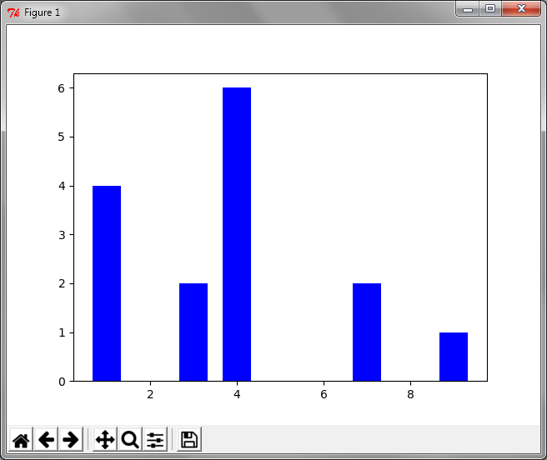
Bar plot for Data array
import numpy as np
import matplotlib.pyplot as plt
Data=np.array([ [1,2], [3,2], [4,6], [7,2], [1,4], [9,1] ])
Column1=0
Column2=1
BarWidth=1/1.5
for i in range( len(Data) ):
plt.bar( Data[ i ] [Column1] , Data[ i ] [Column2] , BarWidth , color="blue")
plt.show()

Slide 53
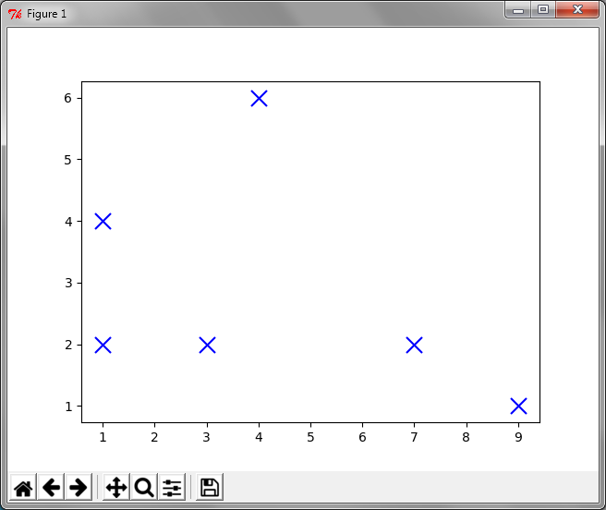
Scatter plot for Data
import numpy as np
import matplotlib.pyplot as plt
Data=np.array([ [1,2], [3,2], [4,6], [7,2], [1,4], [9,1] ])
Column1=0
Column2=1
plt.scatter( Data[:, Column1] , Data[:, Column2] , marker = "x“ , s=150 , linewidths = 5 , zorder = 1)
plt.show()
#Where s is the size of the marker

Slide 54
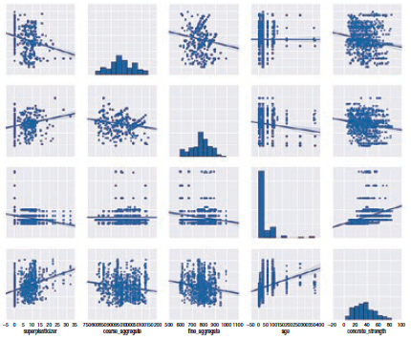
Calculating Pair Plot Between All Features
import numpy as np
import matplotlib.pyplot as plt
data=np.array([ [1,2], [3,2], [4,6], [7,2], [1,4], [9,1] ])
import pandas
df = pandas.DataFrame(Data)
#Calculating Pair Plot Between All Features
seaborn.pairplot(df)
plt.show()

Slide 55
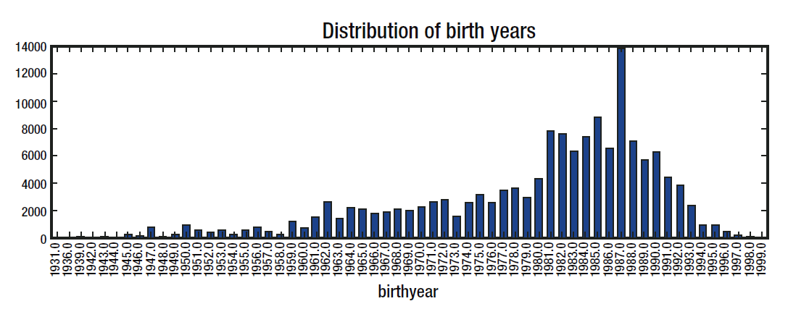
Basic commands
Sort, Filter, group, and Plotting the Data
data = data.sort_values(by='birthyear’)
data = data[(data['birthyear'] >= 1931) & (data['birthyear']<=1999)]
groupby_birthyear = data.groupby('birthyear').size()
groupby_birthyear.plot.bar(title = 'Distribution of birth years’, figsize = (15,4))
plt.show()

Slide 56
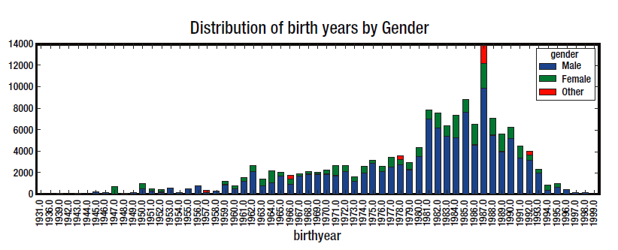
Stacked column chart
data1 = data.groupby(['birthyear', 'gender']).size().unstack('gender').fillna(0)
data1.plot.bar(title ='Distribution of birth years by Gender', stacked=True, figsize = (15,4))

Slide 57
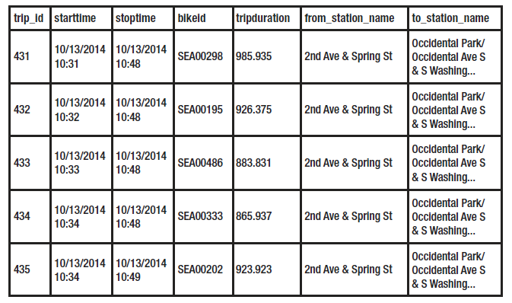
Convert string to DateTime
Create new column as date/time
data['StartTime1'] = data['starttime'].apply(lambda x: datetime.datetime.strptime(x, "%m/%d/%Y %H:%M") )
Extract Year, Month, Day, and Hour
data['year'] = data['StartTime1'].apply(lambda x: x.year )
data['month'] = data['StartTime1'].apply(lambda x: x.month )
data['day'] = data['StartTime1'].apply(lambda x: x.day )
data['hour'] = data['StartTime1'].apply(lambda x: x.hour )

Slide 58
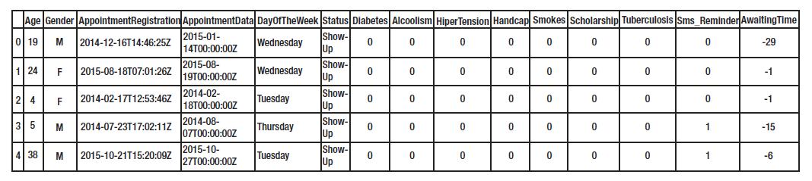
Split String column to create new columns for Year-Month-Day
for index, component in enumerate(['year', 'month', 'day']):
data[component] = data[‘AppointmentRegistration’].apply(lambda x: int(x.split('T')[0].split('-')[index]))
OR
data[‘year’] = data[‘AppointmentRegistration’].apply(lambda x: int(x.split('T')[0].split('-’)[0]))
data[‘month’] = data[‘AppointmentRegistration’].apply(lambda x: int(x.split('T')[0].split('-’)[1]))
data[‘day’] = data[‘AppointmentRegistration’].apply(lambda x: int(x.split('T')[0].split('-’)[2]))
Notes
‘abcde’[0:2] → ‘ab’
‘abcde’[:2] → ‘ab’
‘abcde’[:-1] → ‘abcd’

Slide 59
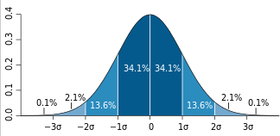
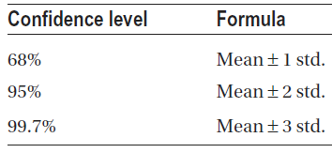
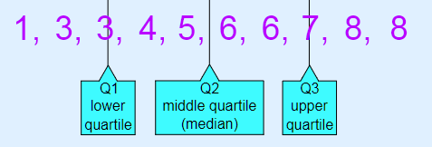
Concepts
Mean : Average
Median: When the frequency of observations in the data is odd, the middle data point is returned as the median.
Mode: returns the observation in the dataset with the highest frequency.
Variance: represents variability of data points about the mean.
Standard deviation: just like variance, also captures the spread of data along the mean. The only difference is that it is a square root of the variance.
Normal distribution (Gaussian distribution): the mean lies at the center of this distribution with a spread (i.e., standard deviation) around it. Some 68% of the observations lie within 1 standard deviation from the mean; 95% of the observations lie within 2 standard deviations from the mean, whereas 99.7% of the observations lie within 3 standard deviations from the mean.
Outliers: refer to the values distinct from majority of the observations. These occur either naturally, due to equipment failure, or because of entry mistakes.

Slide 60
Plot mean
Draw mean of ‘TripDuration’ group by ‘StartTime_date’
data.groupby('starttime_date')['tripduration'].mean() .plot.bar(title = 'Distribution of Trip duration by date', figsize = (15,4))
Calculate Mean, Standard deviation, Median
print data['tripduration_mean'].mean()
print data['tripduration_mean'].std()
print data['tripduration_mean'].median()

Slide 61
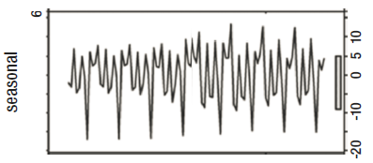
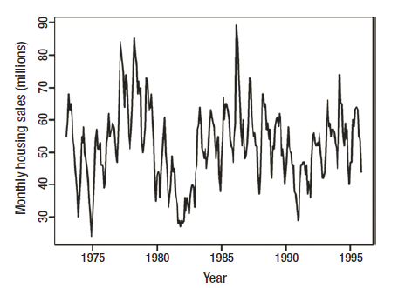
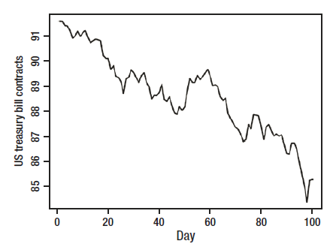
Seasonal pattern vs Cyclic Pattern vs Trend
Seasonal: pattern over fixed period, like monthly pattern
Cycle: pattern overall without worry about periods, to check if patterns repeat over non-periodic time cycles.
Trend: In long-term does the continuous variable increase/decrease
Seasonal pattern Cycle pattern Trend

Slide 62
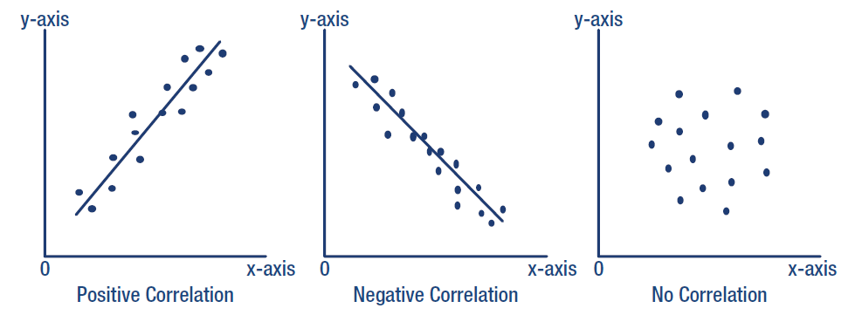
Correlation directions

Slide 63
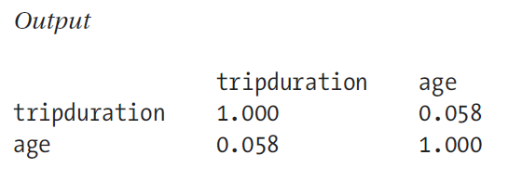
Calculate the correlation
pd.set_option('precision', 3)
correlations = data[['tripduration','age']].corr()
print(correlations)
.corr(method='pearson')
method : {‘pearson’, ‘kendall’, ‘spearman’}
pearson : standard correlation coefficient
kendall : Kendall Tau correlation coefficient
spearman : Spearman rank correlation
For more information http://www.statisticssolutions.com/correlation-pearson-kendall-spearman/

Slide 64
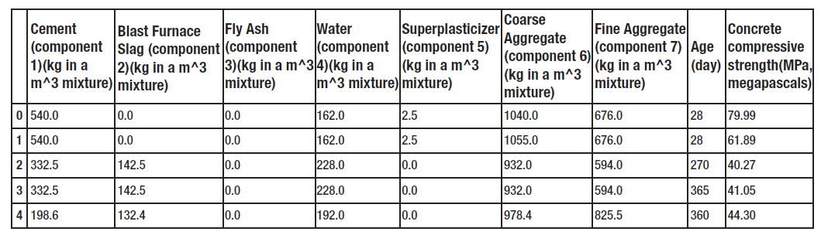
Rename Dataset columns' names
Get data from the next URL and save as “concrete_data.csv” http://archive.ics.uci.edu/ml/datasets/Concrete+Compressive+Strength
data = pd.read_csv('examples/concrete_data.csv’)
print len(data)
data.head()
Renaming the Columns
data.columns = ['cement_component', 'furnace_slag', 'flay_ash’,\
'water_component’, 'superplasticizer', 'coarse_aggregate’, \
'fine_aggregate', 'age', 'concrete_strength']

Slide 65
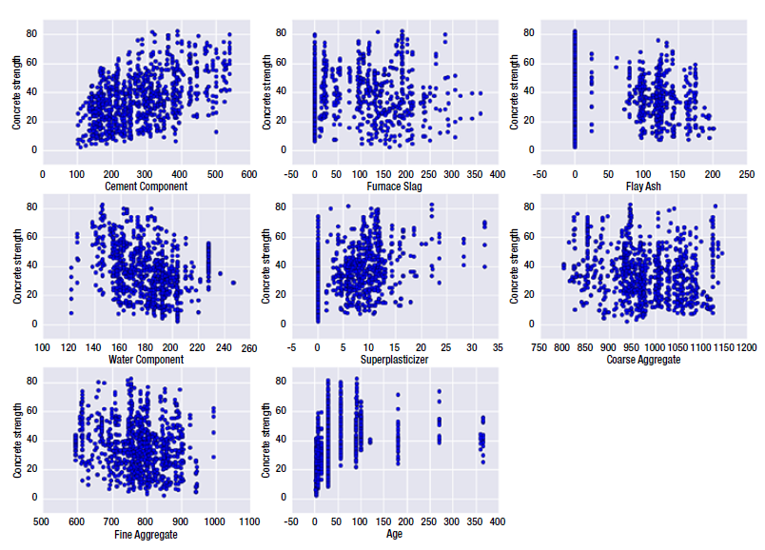
Loop through dataset Draw relation between each feature and concrete_strength
plt.figure(figsize=(15,10.5))
plot_count = 1
for feature in list(data.columns)[:-1]:
plt.subplot(3,3,plot_count)
plt.scatter(data[feature], data['concrete_strength'])
plt.xlabel(feature.replace('_',' ').title())
plt.ylabel('Concrete strength')
plot_count+=1
plt.show()
#//Get the correlation between data
pd.set_option('display.width', 100)
pd.set_option('precision', 3)
correlations = data.corr(method='pearson')
print(correlations)

Slide 66
Dimensionality Reduction

Slide 67
PCA Dimensionality Reduction
When we have a big dataset and we need to reduce the number of columns for fast training (remove redundancy features).
Example : Dataset (data) contains 20 features and we need to reduce them to 4 features
from sklearn.decomposition import PCA
NewDataFrame = PCA(n_components = 4).fit_transform(data)

Slide 68
Association Algorithm

Slide 69
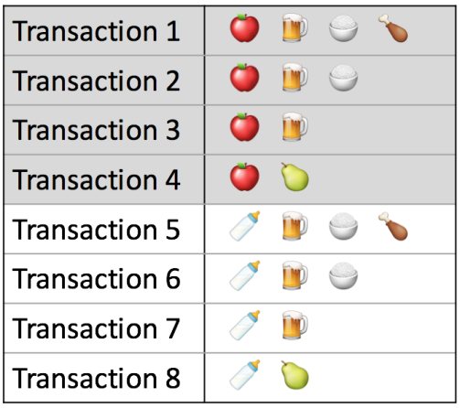



Association Rules
Association rules analysis is a technique to uncover how items are associated to each other.
There are three common ways to measure association:
Support: This says how popular an itemset is, as measured by the proportion of transactions in which an itemset appears.
Confidence: This says how likely item Y is purchased when item X is purchased (not good if one item is common)
Lift: This says how likely item Y is purchased when item X is purchased

Slide 70
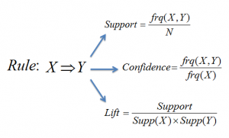
Association Rules (Apriori Algorithm)
from apyori import apriori
transactions = [
['beer', 'nuts'],
['beer', 'cheese'],
]
results = list(apriori(transactions))

Slide 71
Association Rules (Example)
pip install apyori
# Import the libraries import numpy as np import matplotlib.pyplot as plt import pandas as pd
# Import Dataset dataset = pd.read_csv(‘apriori_data2.csv’, header = None) records = [] for i in range(0, 11): records.append([str(dataset.values[i,j]) for j in range(0, 10)])
# Train Apriori Model from apyori import apriori rules = apriori(records, min_support = 0.003, min_confidence = 0.2, min_lift = 3, min_length = 2)
# Visualising the results results = list(rules)

Slide 72
Regression Algorithm
Supervised machine learning

Slide 73



Regression

Slide 74


Linear Regression
x_train,x_test, y_train, y_test = train_test_split(data[‘x’],data[‘y'], test_size=0.3, random_state=1)
regr = LinearRegression()
regr.fit(x_train, y_train)
y_pred = regr.predict(x_test)
print 'R2 score: %f'%r2_score(y_test, y_pred)
print 'Intercept: %f'%regr.intercept_
print 'Coefficients: %s'%str(regr.coef_)
What is Intercept and Coefficient?

Slide 75


Bias, Overfitting
Outliers can create a bias in the outcome of a regression model such that they will pull the best fit line toward themselves. Hence treatment of outliers is critical in regression.
Overfitting refers to the phenomenon where a model is highly fitted on a dataset. This generalization thus deprives the model from making highly accurate predictions about unseen data.
Overfitting = high variance
Bias = Under fitting

Slide 76


How to find the best regression line?
Here are some methods which check for error:
Sum of all errors (∑error)
Sum of absolute value of all errors (∑|error|)
Sum of square of all errors (∑error^2)

Slide 77

Ordinary Least Square (OLS)
The simplest form of regression formula is : Y= a * X + b
Now, find the value of a and b?
coefficients a and b are derived based on minimizing the sum of squared difference of distance between data points and regression line.
common algorithm to find the right coefficients for minimum sum of squared errors is Ordinary Least Square (OLS)

Slide 78
Regression regularization techniques
if you are using regression without regularization, you have to be very special!
‘regularization’ techniques means penalizing the magnitude of coefficients of features along with minimizing the error between predicted and actual observations.
Residual Sum of Squares (RSS): sum of square of errors between the predicted and actual values in the training data set.
Ridge Regression:
Performs L2 regularization, i.e. adds penalty equivalent to square of the magnitude of coefficients
Optimizes(Minimization) objective = RSS + α * (sum of square of coefficients)
Lasso Regression:
Performs L1 regularization, i.e. adds penalty equivalent to absolute value of the magnitude of coefficients
Optimizes(Minimization) objective = RSS + α * (sum of absolute value of coefficients)
Where a is alpha parameter, user should change to get the best fit

Slide 79


Regression Metrics of Evaluation
Explained Variance Score : The best score for this metric is 1.
Mean absolute error (MAE) : values closer to 0 are better.
Mean Squared Error : values closer to 0 are better.
R Square : values between 0% and 100% and closer to 100% is better
#Python sample code
print "Train MAE: ", metrics.mean_absolute_error(y_train, y_train_pred)
print "Train RMSE: ", np.sqrt(metrics.mean_squared_error(y_train, y_train_pred))

Slide 80


What Is R-squared, (Coefficient of determination)?
R-squared is a statistical measure of how close the data are to the fitted regression line. It is also known as the coefficient of determination, or the coefficient of multiple determination for multiple regression.
The definition of R-squared is fairly straight-forward; it is the percentage of the response variable variation that is explained by a linear model. Or: R-squared = Explained variation / Total variation
R-squared is always between 0 and 100%:
0% indicates that the model explains none of the variability of the response data around its mean.
100% indicates that the model explains all the variability of the response data around its mean.
In general, the higher the R-squared, the better the model fits your data

Slide 81


Slide 82

Multiple linear regression plot
Ridge Regression
Lasso Regression
ElasticNet
Gradient Boosting Regression
Support Vector Machines

Slide 83
Ridge Regression
x_train,x_test, y_train, y_test = train_test_split(data[‘x’],data[‘y'], test_size=0.3, random_state=1)
model = Ridge()
alphas = np.arange(0.1 , 5 , 0.1) #generate an array of values in the range of 0.1 to 5, with an offset of 0.1
cv = GridSearchCV(estimator=model, param_grid=dict(alpha=alphas))
y_pred = cv.fit(x_train, y_train).predict(x_test)
print 'R2 score: %f'%r2_score(y_test, y_pred)
print 'Intercept: %f'% model.intercept_
print 'Coefficients: %s'%str(model.coef_)

Slide 84
Lasso Regression
x_train,x_test, y_train, y_test = train_test_split(data[‘x’],data[‘y'], test_size=0.3, random_state=1)
model = Lasso()
alphas = np.arange(0.1 , 5 , 0.1) #generate an array of values in the range of 0.1 to 5, with an offset of 0.1
cv = GridSearchCV(estimator=model, param_grid=dict(alpha=alphas))
y_pred = cv.fit(x_train, y_train).predict(x_test)
print 'R2 score: %f'%r2_score(y_test, y_pred)
print 'Intercept: %f’%model.intercept_
print 'Coefficients: %s'%str(model.coef_)

Slide 85
ElasticNet
x_train,x_test, y_train, y_test = train_test_split(data[‘x’],data[‘y'], test_size=0.3, random_state=1)
model = ElasticNet()
alphas = np.arange(0.1 , 5 , 0.1)
cv = GridSearchCV(estimator=model, param_grid=dict(alpha=alphas))
y_pred = cv.fit(x_train, y_train).predict(x_test)
print 'R2 score: %f’ % r2_score(y_test, y_pred)
print 'Intercept: %f’ % model.intercept_
print 'Coefficients: %s' % str(model.coef_)

Slide 86
Gradient Boosting Regression
x_train,x_test, y_train, y_test = train_test_split(data[‘x’],data[‘y'], test_size=0.3, random_state=1)
regr = GradientBoostingRegressor()
regr.fit(x_train, y_train)
y_pred = regr.predict(x_test)
print 'R2 score: %f'%r2_score(y_test, y_pred)
print 'Intercept: %f'%regr.intercept_
print 'Coefficients: %s'%str(regr.coef_)
plt.scatter(x_test, y_test, color='black')
plt.plot(x_test, y_pred, color='blue’, linewidth=3)
plt.xlabel(‘X axis’)
plt.ylabel(‘Y axis')

Slide 87
Support Vector Machines
x_train,x_test, y_train, y_test = train_test_split(data[‘x’],data[‘y'], test_size=0.3, random_state=1)
regr = SVR(kernel='linear')
regr.fit(x_train, y_train)
y_pred = regr.predict(x_test)
print 'R2 score: %f'%r2_score(y_test, y_pred)
print 'Intercept: %f'%regr.intercept_
print 'Coefficients: %s'%str(regr.coef_)
plt.scatter(x_test, y_test, color='black')
plt.plot(x_test, y_pred, color='blue’, linewidth=3)
plt.xlabel(‘X axis’)
plt.ylabel(‘Y axis')

Slide 88
Time Series
Supervised machine learning

Slide 89

Time Series
A time series forecast is different from regression in that time acts as an exploratory variable and should be continuous along equal intervals.
Algorithms
1) Autoregressive Forecast Model: uses observations at previous time steps to predict observations at future time step.
2) ARIMA Forecast Model: linear model, predict after remove trends and seasonality.
3) Prophet: Facebook library, it is quick and gives very good results, forecasting time series data. Related Packages: pip install fbprophet
The input to Prophet is always a dataframe with two columns: ds and y. The ds (datestamp) column must contain a date or datetime (either is fine). The y column must be numeric, and represents the measurement we wish to forecast, It is good to use log(y) and not the actual y to remove trends and noise data

Slide 90




FB Prophet

Slide 91
Classification
Supervised machine learning

Slide 92
Classification
Algorithms
Naïve bayes
Decision Tree
Kernel Approximation
Random Forest Classification
Gradient Bosting

Slide 93

Binary classification example
Diabetes Data Set
Detect Diabetes Disease based on analysis
Dataset Attributes:
1. Number of times pregnant
2. Plasma
3. Diastolic blood pressure (mm Hg)
4. Triceps skin fold thickness (mm)
5. 2-Hour serum insulin (mu U/ml)
6. Body mass index
7. Diabetes pedigree function
8. Age (years)
9. Class variable (0 or 1)

Slide 94


Slide 95
Clustering
Unsupervised machine learning

Slide 96
Cluster
k-means clustering: needs the number of clusters before work!
we can get the expected numbers of clusters using one of the 3 next methods (Elbow method, Variance explained, BIC score)
Silhouette score: measure how close observations within a cluster are. The best value is 1 and the worst is -1. A coefficient value of 0 indicates overlapping clusters.

Slide 97


Slide 98
computer vision

Slide 99
Open CV for computer vision
To install OpenCV pip install opencv-python
Normal images are 4 dimensional array for each pixel (Blue ,Green, Red, and Alpha)
It is normal to process images in Gray scale for fast performance
Video is just a loop of images. So, any code processing images can process video too
For more information about open CV please visit
https://www.tutorialspoint.com/opencv/index.htm
https://www.youtube.com/playlist?list=PLQVvvaa0QuDdttJXlLtAJxJetJcqmqlQq

Slide 100






Common OpenCV functions
image = cv2.imread(ImgPATH) #Read image
cv2.cvtColor(ImgPATH, cv2.COLOR_BGR2GRAY) #Convert to gray scale
cv2.imshow( ‘Window Title’, image ) #Show Image in a window
cv2.imwrite(ImgPATH, image) # to write image to HD
_ , image = cv2.threshold(image, threshold, maxval, thresholdType) #change pixel to maxval if value greater than threshold
image = cv2.adaptiveThreshold(image, maxValue, adaptiveMethod, thresholdType, blockSize, C) #Threshold is automatic calculated
thresholdType
adaptiveMethod
ADAPTIVE_THRESH_MEAN_C : threshold value is the mean of neighborhood area.
ADAPTIVE_THRESH_GAUSSIAN_C : threshold value is the weighted sum of neighborhood values where weights are a Gaussian window.
blockSize : A variable of the integer type representing size of the pixelneighborhood used to calculate the threshold value.
C : A variable of double type representing the constant used in the both methods (subtracted from the mean or weighted mean).
THRESH_TOZERO_INV | THRESH_TOZERO | THRESH_TRUNC | THRESH_BINARY_INV | THRESH_BINARY | Original

Slide 101
OpenCV Video Stream Example
#VideoStream1 = cv2.VideoCapture('c:/boxed-correct.avi’) ➔ read stream from avi video file
VideoStream1 = cv2.VideoCapture(0) ➔ read stream from the first connected video cam
while True:
IsReturnFrame1,ImgFrame1=VideoStream1.read()
if IsReturnFrame1 == 0: break
GrayImgFrame1=cv2.cvtColor(ImgFrame1,cv2.COLOR_BGR2GRAY)
cv2.imshow('ImageTitle1',ImgFrame1)
cv2.imshow('ImageTitle2',GrayImgFrame1)
if cv2.waitKey(0): break
VideoStream1.release()
cv2.destroyAllWindows()

Slide 102






Image processing using OpenCV
Original
Threshold_Color
ThresholdGray
Threshold_GAUSSIAN
Threshold_MEAN

Slide 103



Object Recognition
MainImage
template
Search for image with exact lighting/scale/angle
Result

Slide 104
NLP
Natural Language Processing

Slide 105
NLP (Natural Language Processing)
Why we need NLP packages?
NLP Package handle a wide range of tasks such as Named-entity recognition , part-of-speech (POS) tagging, sentiment analysis, document classification, topic modeling, and much more.
Named-entity recognition: means extract names of persons, organizations, locations, time, quantities, percentages, etc. example: Jim bought 300 shares of Acme Corp. in 2006. ➔ [Jim]Person bought 300 shares of [Acme Corp.]Organization in [2006]Time.
Part-of-speech tagging: used to identification of words as nouns, verbs, adjectives, adverbs, etc.
Top 5 Python NLP libraries
NLTK good as education and research tool. Its modularized structure makes it excellent for learning and exploring NLP concepts, but it's not meant for production.
TextBlob is built on top of NLTK, and it's more easily-accessible. good library for fast-prototyping or building applications that don't require highly optimized performance. Beginners should start here.
Stanford's CoreNLP is a Java library with Python wrappers. It's in many existing production systems due to its speed.
SpaCy is a new NLP library that's designed to be fast, streamlined, and production-ready. It's not as widely adopted.
Gensim is most commonly used for topic modeling and similarity detection. It's not a general-purpose NLP library, but for the tasks it does handle, it does them well.

Slide 106


NLTK Package for Natural Language Processing
Pip install nltk
To download all packages using GUI, write ➔ nltk.download()

Slide 107
NLTK concepts
Tokenizing
Word tokenizers : split text by words
Sentence tokenizers : split text by paragraphs
Lexicon
Get words and their actual means in the context
Corpora
Text classification. Ex: medical journals, presidential speech
Lemmatizing (stemming)
return the word to its root, ie (gone, went, going) ➔ go
WordNet
List of different words that have the same meaning for the given word

Slide 108
NLTK Simple example
from nltk.tokenize import sent_tokenize, word_tokenize
from nltk.corpus import stopwords
EXAMPLE_TEXT = "Hello Mr. Smith, how are you doing today? The weather is great, and Python is awesome. The sky is pinkish-blue. You shouldn't eat cardboard."
WordsArray = sent_tokenize(EXAMPLE_TEXT)
print(WordsArray)
ListOfAvailableStopWords= set(stopwords.words("english"))
print(ListOfAvailableStopWords)

Slide 109

textblob
pip install textblob
python -m textblob.download_corpora

Slide 110
Sentimental Analysis Example
We have a sample of 3000 random users comments on imdb.com, amazon.com, and yelp.com website http://archive.ics.uci.edu/ml/machine-learning-databases/00331/
Each comment has a score, Score is either 1 (for positive) or 0 (for negative)

Slide 111



Slide 112
Python Deep Learning

Slide 113
Common Deep learning fields
Main Fields
Computer vision
Speech recognition
Natural language processing
Audio recognition
Social network filtering
Machine translation
Visual examples:
Colorization of Black and White Images. https://www.youtube.com/watch?v=_MJU8VK2PI4
Adding Sounds To Silent Movies. https://www.youtube.com/watch?v=0FW99AQmMc8
Automatic Machine Translation.
Object Classification in Photographs.
Automatic Handwriting Generation.
Character Text Generation.
Image Caption Generation.
Automatic Game Playing. https://www.youtube.com/watch?v=TmPfTpjtdgg

Slide 114
Common Deep learning development tool (Keras)
Keras is a free Artificial Neural Networks (ANN) library (deep learning library).
it is a high-level neural networks API, written in Python and capable of running on top of TensorFlow, CNTK, or Theano.
It was developed with a focus on enabling fast experimentation. Being able to go from idea to result with the least possible delay is key to doing good research.
Keras
TensorFlow
CNTK
Theano

Slide 115
Deep learning Computer vision (image processing)
3 common ways to detect objects
median based features
edge based features
threshold based features

Slide 116
How to use Neural Network Models in Keras
Five steps
Define Network.
Compile Network.
Fit Network.
Evaluate Network.
Make Predictions.

Slide 117
Step 1. Define Network
Neural networks are defined in Keras as a sequence of layers.
The first layer in the network must define the number of inputs to expect. for a Multilayer Perceptron model this is specified by the input_dim attribute.
Example of small Multilayer Perceptron model (2 inputs, 5 hidden layers, 1 output)
Re-write after add activation function
 | model = Sequential() model.add(Dense(5, input_dim=2)) model.add(Dense(1))
model = Sequential()
model.add(Dense(5, input_dim=2, activation='relu'))
model.add(Dense(1, activation='sigmoid'))

Slide 118




Available Activation Functions
Optional, it is like a filter, used to solve some common predictive modeling problem, to get significant boost in performance.
Sigmoid: used for Binary Classification (2 class) one neuron the output layer. What ever the input it will map to zero or one.
Softmax: used for Multiclass Classification (>2 class), one output neuron per class value.
Linear: used for Regression, the number of neurons matching the number of outputs.
Tanh: what ever the input it will convert to number between -1 and 1
Relu: either 0 for a<0 or a for a>0. so, it just remove the negative values and pass the positive as it is.
LeakyReLU: minimize the value of negative values and pass as it is if positive
elu
selu
softplus
softsign
hard_sigmoid
PReLU
ELU
ThresholdedReLU

Slide 119
Step 2. Compile Network
Specifically the optimization algorithm to use to train the network and the loss function used to evaluate the network that is minimized by the optimization algorithm.
Optimizers tool to minimize loss between prediction and real value. Commonly used optimization algorithms:
‘sgd‘ (Stochastic Gradient Descent) requires the tuning of a learning rate and momentum.
ADAM requires the tuning of learning rate.
RMSprop requires the tuning of learning rate.
Loss functions:
Regression: Mean Squared Error or ‘mse‘.
Binary Classification (2 class): ‘binary_crossentropy‘.
Multiclass Classification (>2 class): ‘categorical_crossentropy‘.
Finally, you can also specify metrics to collect while fitting the model in addition to the loss function. Generally, the most useful additional metric to collect is accuracy.
model.compile(optimizer='sgd', loss='mse’)
model.compile(optimizer='sgd', loss='mse', metrics=['accuracy'])

Slide 120
Optimizers

Slide 121
Step 3. Fit Network
history = model.fit(X, y, batch_size=10, epochs=100)
The network is trained using the backpropagation algorithm
Batch size is the number of samples that going to be propagated through the network.
epochs is the number of training times (for ALL the training examples)
Example: if you have 1000 training examples, and your batch size is 500, then it will take 2 iterations to complete 1 epoch.

Slide 122
Step 4. Evaluate Network
The model evaluates the loss across all of the test patterns, as well as any other metrics specified when the model was compiled.
For example, for a model compiled with the accuracy metric, we could evaluate it on a new dataset as follows:
loss, accuracy = model.evaluate(X, Y)
print("Loss: %.2f, Accuracy: %.2f% %" % (loss, accuracy*100))

Slide 123
Step 5. Make Predictions
probabilities = model.predict(X)
predictions = [float(round(x)) for x in probabilities]
accuracy = numpy.mean(predictions == Y) #count the number of True and divide by the total size
print("Prediction Accuracy: %.2f% %" % (accuracy*100))

Slide 124

Binary classification using Neural Network in Keras
Diabetes Data Set
Detect Diabetes Disease based on analysis
Dataset Attributes:
1. Number of times pregnant
2. Plasma
3. Diastolic blood pressure (mm Hg)
4. Triceps skin fold thickness (mm)
5. 2-Hour serum insulin (mu U/ml)
6. Body mass index
7. Diabetes pedigree function
8. Age (years)
9. Class variable (0 or 1)

Slide 125
Save prediction model
After train our model, ie, model.fit(X_train, Y_train), we can save this traning to use later.
This task can done by Pickle package(Python Object Serialization Library), using dump and load methods. Pickle can save any object not just the prediction model.
import pickle
…………….
model.fit(X_train, Y_train)
# save the model to disk
pickle.dump(model, open("c:/data.dump", 'wb’)) #wb= write bytes
# some time later... load the model from disk
model = pickle.load(open("c:/data.dump", 'rb’)) #rb= read bytes

