Slide 1


Slide 2

Week 4 Keys and Constraints
Information Systems
TU257

Slide 3
Agenda
Introduction to Logical Design
Identifiers/keys
Constrains
Referential actions
Data anomalies
Introduction to normalisation

Slide 4
Data Models
Specify concepts that are used to describe the database. These can be categorised as:
High Level (Conceptual)
Representational (Logical)
Low Level (Physical)

Slide 5
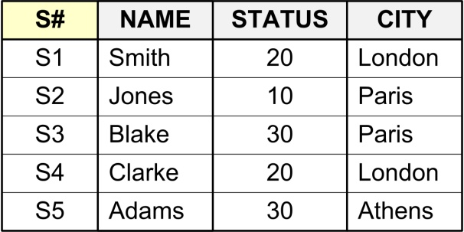
Database Terminology
What is a Table/Relation?
Single valued cells (groups and arrays are not allowed to be values).
All entries in any attribute are of the same kind.
Each column must have a unique name.
Note: The order of the columns is not significant.
No two rows are identical.
Note: The order of the rows is not significant.

Slide 6
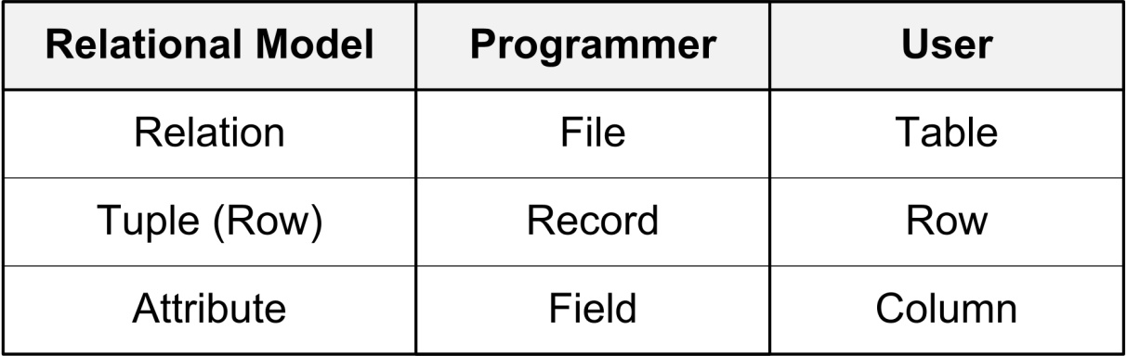
Database Terminology
Relation: Relation (in relational model) is not the same as relationship (in ER model)
Tuple: Row
Attribute: A property or characteristic of an entity or relationship type that is of interest to the enterprise.
Primary Key (PK):
A special attribute, or combination of attributes.
No two tuples can have the same PK value.

Slide 7
Database Terminology
Correspondence with ER Diagram:
Relations (tables) correspond with entity types.
Rows correspond with entity instances.
Columns correspond with attributes.

Slide 8
Database Terminology
Integrity:
The accuracy and correctness of data.
DBMS enforce integrity.
A constraint is any rule governing static values of attributes that is precise enough so that you can ascertain whether or not it is true.

Slide 9
Identifiers/keys

Slide 10
Identifiers/Keys
A key is one or more attributes (together) that uniquely identifies a tuple or row.
Primary Key: The column or set of columns that uniquely identifies any given row.
Would a name be a good primary key? Would a social insurance number be a good primary key? The value in the primary key can never point to more than one row in the table.

Slide 11
Identifiers/Keys Notation
A table and its primary key can be described by writing the columns within parentheses, and underlining the primary key:
STUDENTS (StudentID, Name, Address, PhoneNumber, DOB)

Slide 12
Identifiers/Keys Types
Types of key:
Single vs. Combination/Composite Key
Superkeys
Candidate Keys
Primary Keys vs. Alternative Keys
Foreign Keys

Slide 13
Identifiers/Keys
Single
STUDENTS (StudentID, Stu_Name, Address, PhoneNumber)
MODULES (ModuleID, Module_Name)
Combination Key
STUDENT_MODULE_REGISTRATION (StudentID, ModuleID, year, semester)

Slide 14
Identifiers/Keys Superkey
Superkey:
An attribute or set of attributes that uniquely identify rows in a table.
i.e. two distinct rows are always guaranteed to have distinct superkeys.

Slide 15
Example Superkeys
Stud_ID | LastName | specialization | credits | stage | PPS_number
1001 | Jones | Data Analytics | 20 | 1 | 123456
1022 | Murphy | Data Analytics | 55 | 4 | 431312
2012 | Ryan | Development | 35 | 3 | 321231
Stud_ID
Stud_ID, LastName
Stud_ID, LastName, specialization
PPS_number
PPS_number, LastName
PPS_number, stage
….
Stud_ID, LastName, specialization, credits, stage, PPS_number

Slide 16
Identifiers/Keys Candidate Key
Candidate Key:
A minimal superkey
i.e. a superkey for which you can say that no proper subset of it is also a superkey.

Slide 17
Example superkeys and candidate keys
Superkeys:
Stud_ID
Stud_ID, LastName
PPS_number
PPS_number, LastName
….
Candidate keys:
Stud_ID
PPS_number

Slide 18
Identifiers/Keys PK
Primary Key and alternative keys:
Exactly one candidate key must be chosen as the primary key, and the others are alternative keys.
Primary keys and alternative keys are both candidate keys.

Slide 19
Identifiers/Keys FKs
Foreign Key:
A foreign key is a reference to a key in another table.
A table’s primary key is used to establish relationships with other tables.
This is achieved by including the primary key of one table as the Foreign Key of another.

Slide 20
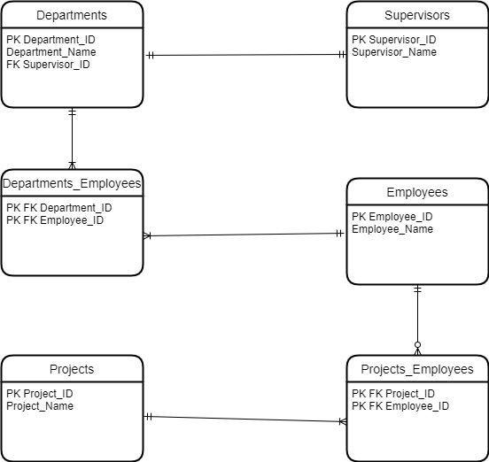
Identifiers/Keys
The general rule of thumb is to take the primary key of the one side of the relationship and include it in the table of the many side of the relationship.

Slide 21
Identifiers/Keys
Non-prime Attributes:
An attribute that does not occur in any candidate key.

Slide 22
Constraints

Slide 23
Constraint Classification
Type (Domain) Constraint: Define or constrain values that may be assigned to an attribute.
e.g. Define a type WEIGHT
real numbers.
legal values in [0, 1000]

Slide 24
Constraint Classification
Entity Integrity Constraint: Every row must have a non-null value for the primary key.
If it is a composite key, no part of the key may be null.
Null: Term used to describe a missing value for an attribute in a particular row.
It is not the same as zero

Slide 25
Constraint Classification
Referential Integrity constraint:
A rule that states that either each foreign key value must match a primary key value in another relation or the foreign key value must be null.

Slide 26

Practical Example University 2

Slide 27
Practice
Try to add the following data to the table Student_takes_modules:
What happened?
Student_ID | Module_ID
1 | 103
2 | 109
1 | 444

Slide 28
Referential Actions

Slide 29
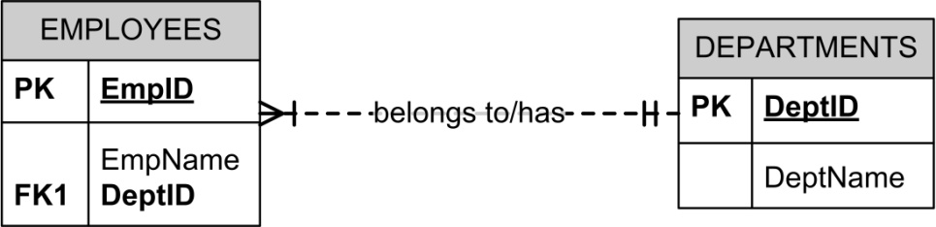
Referential Actions ON DELETE
When you delete a tuple from a table, say R1, that is referenced by another table, say R2, if the primary key (K#) value of R1 exists in R2, there are several choices of referential actions:
R2
R1

Slide 30
Referential Actions ON DELETE
ON DELETE CASCADE
The corresponding tuples in R2 will be deleted too.
ON DELETE RESTRICT
The deletion of the tuple from R1 is rejected.
ON DELETE NO ACTION
The tuple is deleted from R1, but no action to R2.
The referential integrity is violated.
R2
R1

Slide 31
Referential Actions ON UPDATE
When you update a tuple from a table, say R1, that is referenced by another table, say R2, there are similar choices of referential actions:
ON UPDATE CASCADE
ON UPDATE RESTRICT
ON UPDATE NO ACTION

Slide 32
Example: Referential Integrity
EmpID | EmpName | DeptID
123 | Sarah O’Connor | A
356 | Alice Smith | B
DepID | DepName
A | Web development
B | General Engineering

Slide 33
Example: Referential Integrity ON DELETE CASCADE
EmpID | EmpName | DeptID
123 | Sarah O’Connor | A
356 | Alice Smith | B
DepID | DepName
A | Web development
B | General Engineering
Delete

Slide 34
Example: Referential Integrity ON DELETE CASCADE
On Delete
CASCADE
EmpID | EmpName | DeptID
123 | Sarah O’Connor | A
356 | Alice Smith | B
DepID | DepName
A | Web development
B | General Engineering
User Delete

Slide 35
Example: Referential Integrity ON DELETE RESTRICT
EmpID | EmpName | DeptID
123 | Sarah O’Connor | A
356 | Alice Smith | B
X
DepID | DepName
A | Web development
B | General Engineering
User Delete

Slide 36
Example: Referential Integrity ON DELETE NO ACTION
EmpID | EmpName | DeptID
123 | Sarah O’Connor | A
356 | Alice Smith | B
The referential integrity is violated
DepID | DepName
A | Web development
B | General Engineering
User Delete

Slide 37
Referential Integrity ON DELETE NO ACTION Different DBMS
In MySQL:
NO ACTION is equivalent to RESTRICT.
Omitting the clause is the same as specifying RESTRICT or NO ACTION.
In SQLite:
If an action is not explicitly specified, it defaults to "NO ACTION".

Slide 38
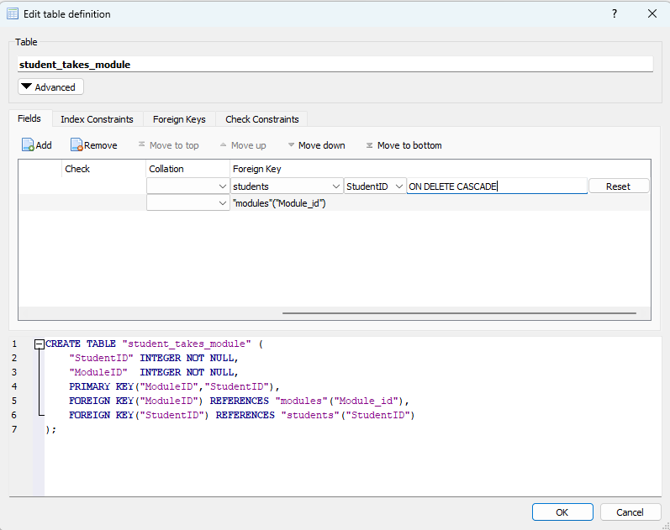
Practical Example University 2
Add the following constraint:
FOREIGN KEY("StudentID") REFERENCES "students"("StudentID") ON DELETE CASCADE
Delete student 1
Look at the Student_takes_module table to see the effect

Slide 39


Practical Example University 2

Slide 40
Normalisation

Slide 41
Normalisation
The process of designing a database in the most efficient way possible.
A technique for designing relational database tables to minimise duplication of information and, in doing so, to safeguard the database against certain types of logical inconsistency.

Slide 42
Normalisation
More highly normalised tables greatly simplify development and maintenance of the database and contribute to its extensibility.

Slide 43
Normalisation
Properly executed, the normalisation process eliminates uncontrolled data redundancies,
thus eliminating the data anomalies, and
the data integrity problems that are produced by such redundancies.

Slide 44
Normalisation
Normalisation does not fully eliminate data redundancy. Instead, it produces the carefully controlled redundancy that lets you properly link database tables.

Slide 45
Definitions relevant to normalisation
Data anomalies
Repeating groups
Dependencies
Functional and fully functional
Partial
Transitive

Slide 46
Data Anomalies
The most common anomalies considered when data redundancy exists are:
Update anomalies
Insert anomalies
Deletion anomalies
All these can easily be avoided through data normalisation.

Slide 47
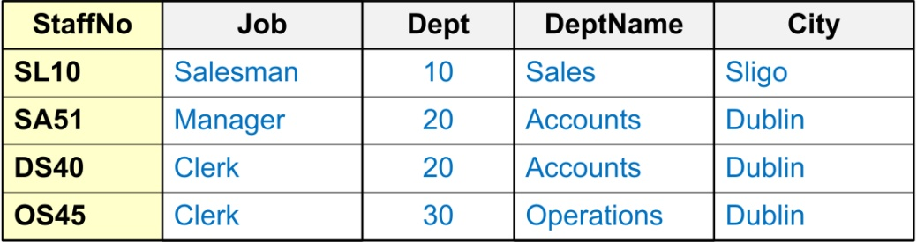
Example: Data Anomalies
The following relation contains staff and department details.
Such ‘redundancy’ could lead to the following ‘anomalies’
Insert Anomaly: You could insert a new staff member and add incorrect details for the Department.
Update Anomaly: You could change the name of the ‘Dept’ that SA51 (‘StaffNo’) works in without simultaneously changing the ‘Dept’ that DS40 (‘StaffNo’) works in.
Deletion Anomaly: By removing employee SL10 (‘StaffNo’) you have removed all information pertaining to the ‘Sales Dept’ (‘Dept’, ‘DeptName’ & ‘City’).

Slide 48
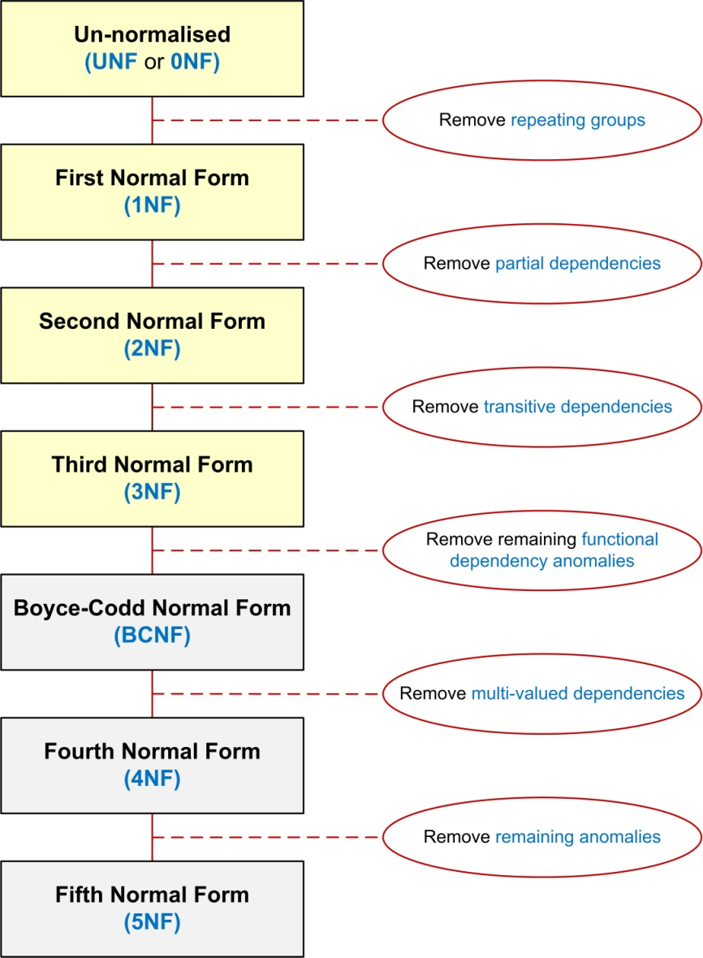
Stages of Normalisation

Slide 49
Recap: Purpose of Normalisation
To avoid redundancy by storing each ‘fact’ within the database only once.
To put data into a form that conforms to relational principles
single valued attributes,
each relation represents one entity, i.e. No Repeating Groups

Slide 50
Recap: Purpose of Normalisation
To put the data into a form that is more able to accurately accommodate change.
To avoid certain updating ‘anomalies’.
To facilitate the enforcement of data constraints.

Slide 51
Normalisation: Relational Model
In order to comply with the relational model it is necessary to
Remove repeating groups, and
Avoid redundancy and data anomalies by removing partial and transitive functional dependencies.
All attributes in a table must be ‘atomic’, and solely dependant fully upon the primary key of that table.

Slide 52
Thanks
Edmund Nevin for a earlier versions of these lecture notes

Slide 53
Lab 4
A university library needs a new DBMS. The system needs to handle users borrowing and returning books and keep track of the overall status of the library. The library is located across several sites and all students can borrow up to 10 books at a time from any of the sites. For some popular books, the library keeps multiple copies across different sites to facilitate students’ access. Details of site manager, authors and publishers are also kept.

Slide 54
Lab 4
Extra requirements:
Each site has one manager and managers can only manage one site.
Assume books only have one author (for now).
Pay attention
A copy of the book is different to the generic book
Decide what information is needed in the database and what can be calculated at a later stage

Slide 55


