Slide 1


Slide 2
ER Diagrams 2
Lesson 3 Information Systems
02/10/24
TU257

Slide 3
Lesson Outline
Foreign Keys
Many to many relationships and Bridge Entities
Identifying relationships
Degree of a relationship
Key Based ER Diagram

Slide 4
Foreign Key
A foreign key is a reference to a key in another table.
A foreign key is a set of attributes of one table, say R2, whose values are required to match values of some candidate key of another table, say R1.

Slide 5
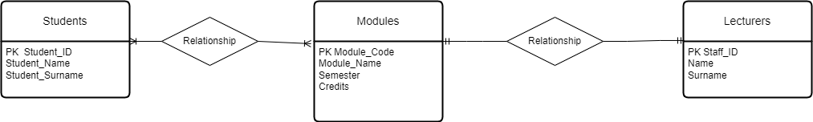
Example PKs

Slide 6

Foreign Key One to One v1

Slide 7

Foreign Key One to One v2

Slide 8

Modified Example Foreign Key One to Many
Case where students can only register for one module.
PK from the one side becomes FK on the many side.

Slide 9
Foreign Key Many to Many
Case where students can register for more than one module.
When modelling many to many relationships, no FKs can be used directly in the original entities.
A new entity has to be created.

Slide 10

Many to Many Relationships Associative (Bridge) Entities
When an instance of an entity may be related to multiple instances of another entity and vice versa, that is called a ‘many-to-many’ relationship.
While this relationship model is perfectly valid, it cannot be translated directly into a relational database design.

Slide 11

Many to Many Relationships Associative (Bridge or Weak) Entities
While this relationship model is perfectly valid, it cannot be translated directly into a relational database design.
In order to build a relational database that captures this relationship, it is necessary to build a bridge between the two entities that uniquely expresses each relationship instance.

Slide 12

Example Student-Module-Lecturer Week 2
Revise

Slide 13
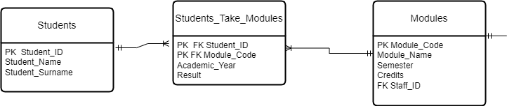
Associative (Bridge) Entities
Many-to-many relationships can cause lots of trouble.
Get rid of them by defining an intermediate third entity.

Slide 14

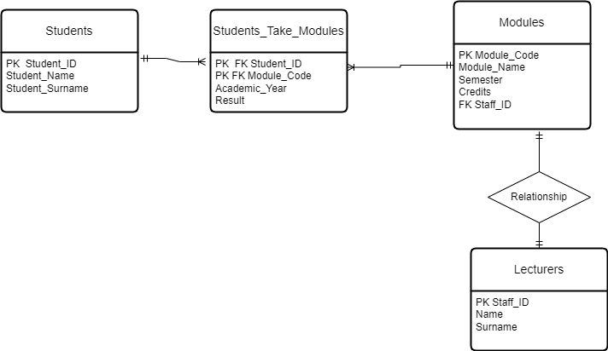
Example
Revise

Slide 15

Practice
Open the db provided University.db

Slide 16
Practice
Browse the data in the different tables.
Identify PKs and FKs.

Slide 17

Practice
Perform the following queries in the “Execute SQL” Tab
SELECT * FROM students
SELECT LastName FROM Lecturers
SELECT * FROM Modules

Slide 18
Identifying Relationships

Slide 19
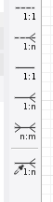
Identifying relationships
Non Ident
An identifying relationship means that the child table cannot be uniquely identified without the parent.
For example, you have this situation in the intersection table used to resolve a many-to-many relationship where the intersecting table's Primary Key is a composite of the left and right (parents) table's Primary Keys.
Ident

Slide 20
Identifying and non identifying relationships

Slide 21
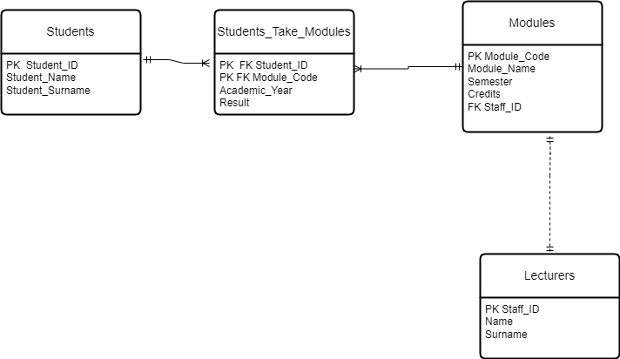
Identifying and non identifying relationships

Slide 22
Degree of a relationship

Slide 23

Degree of a Relationship
The number of participating entities in a relationship is known as the degree of the relationship.

Slide 24
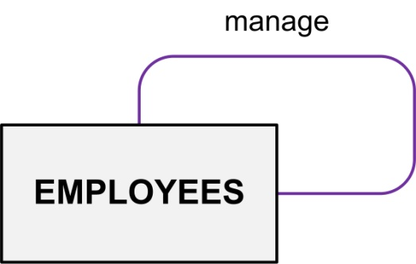
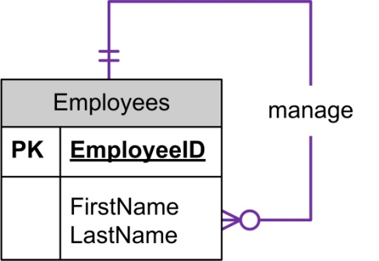
Unary Relationships
Unary relationships are also known as a recursive relationship.
Instances of entities may have relationships with other instances of the same entity.
These relationships may be drawn with relationship lines that begin and end connected to the same entity.

Slide 25
Unary Relationships
Unary relationships are also known as a recursive relationship.
It is a relationship where the same entity participates more than once in different roles.
In the example, employees are managed by employees.
If you wanted more information about who manages whom, you could introduce a second entity type called manager.

Slide 26
Example
For example, Suppose in a classroom, we have many students who belong to a particular club-like dance club, basketball club etc. and some of them are club leads. So, a particular group of student is managed by their respective club lead. Here, the group is formed from students and also, the club leads are chosen from students.
So, the ‘Student’ is the only entity participating here.

Slide 27
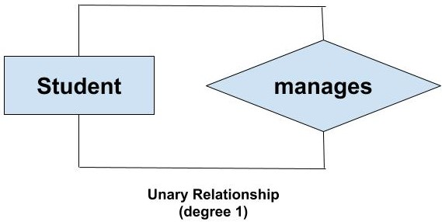
Example
We can represent this relationship using the E-R diagram as follows:

Slide 28
Binary Relationships
If there are two entity types involved it is a binary relationship type.

Slide 29
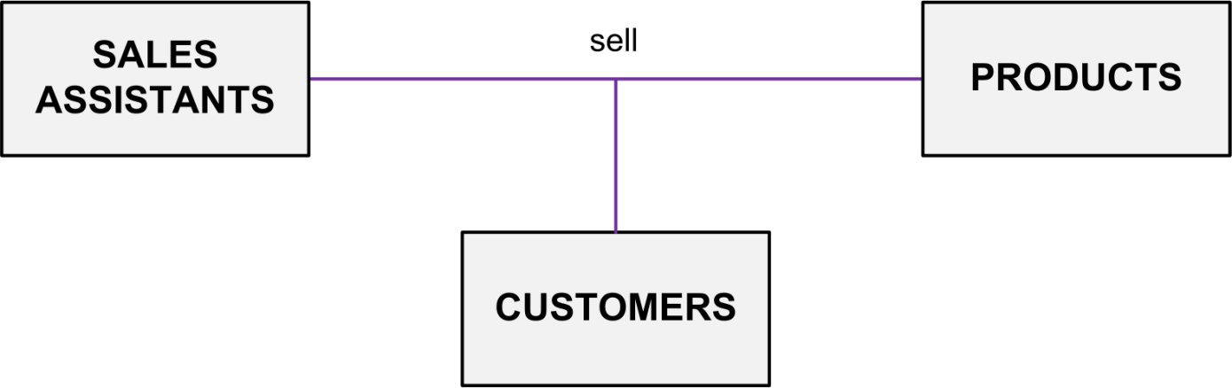
Ternary Relationship
If there are three entity types involved it is a ternary relationship type.

Slide 30
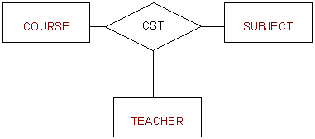
Example 1
The University might need to record which teachers taught which subjects in which courses.

Slide 31
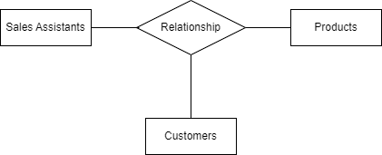
Example 2

Slide 32
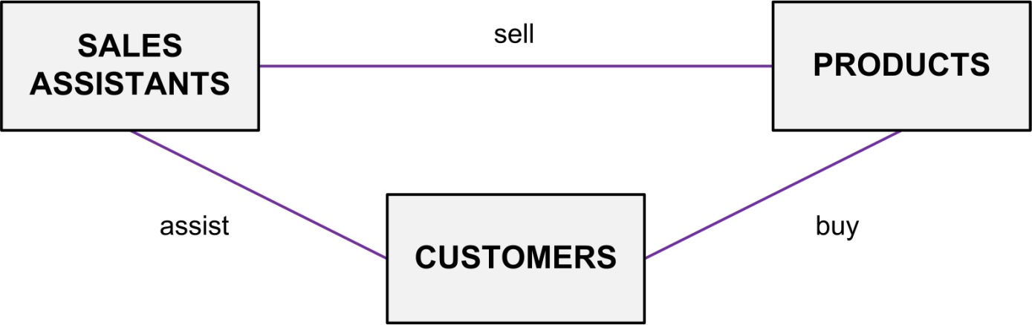
Replacing Ternary Relationships
When ternary relationships occurs in an ER model they should always be removed before finishing the model.
Sometimes the relationships can be replaced by a series of binary relationships that link pairs of the original ternary relationship.
This can result in the loss of some information i.e. It is no longer clear which sales assistant sold a customer a particular product.

Slide 33
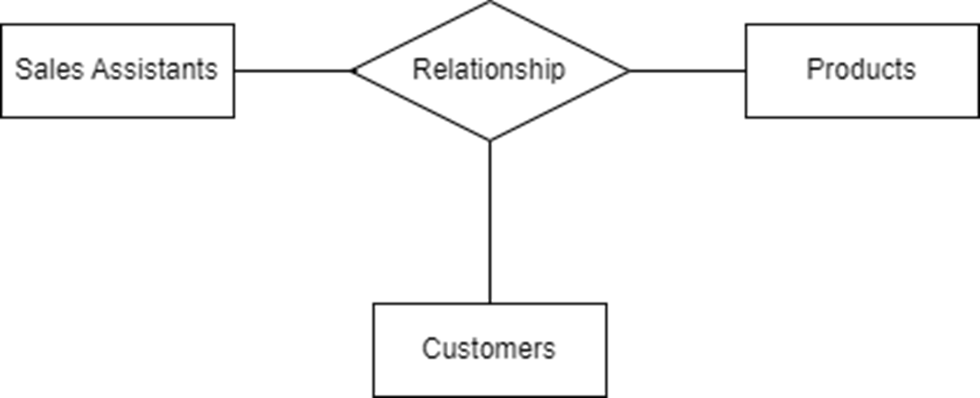
Replacing Ternary Relationships
Try replacing the ternary relationship with an entity type and a set of binary relationships.

Slide 34
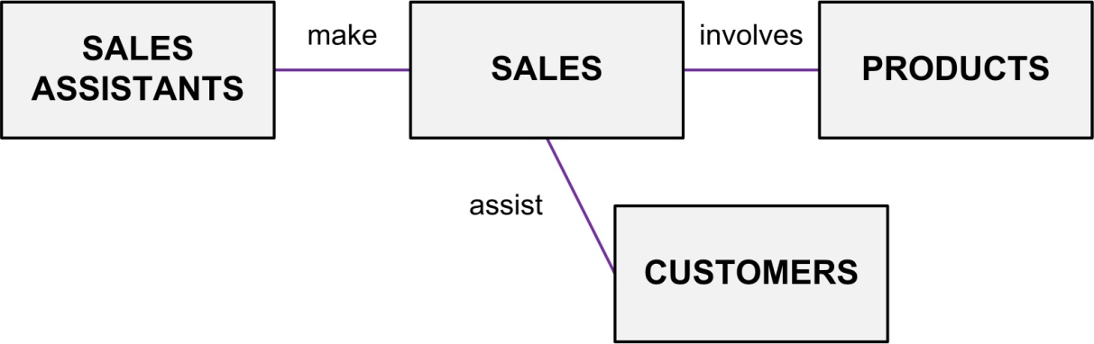
Replacing Ternary Relationships
Relationships are usually verbs, so name the new entity type by the relationship verb rewritten as a noun.
The relationship ‘sell’ can become the entity type ‘SALES’.

Slide 35
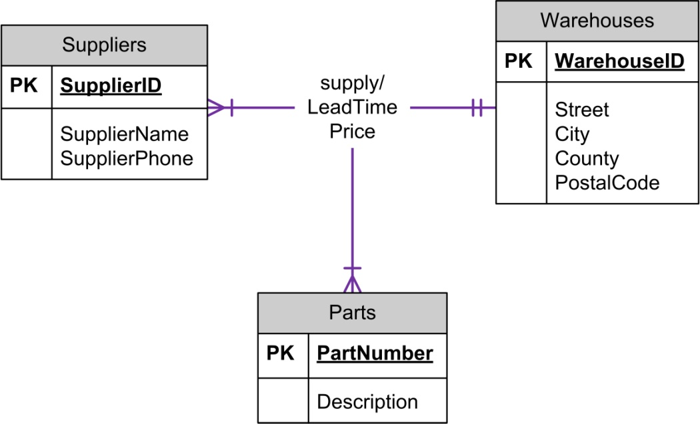
ERD Example: Ternary Relationships

Slide 36
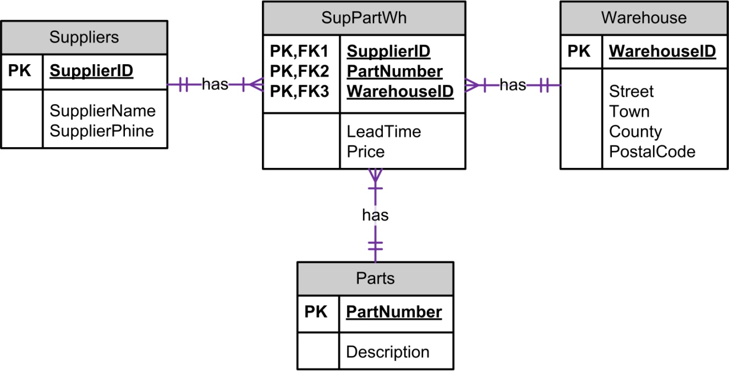
ERD Example: Ternary Relationship Converted
Associative entity
or linking table

Slide 37
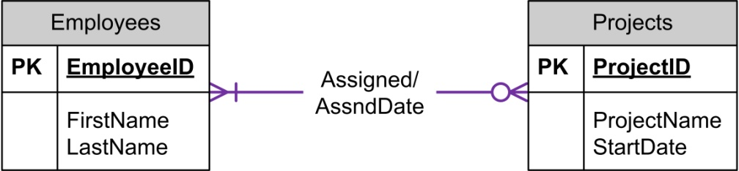
ERD Example: Relationship Attributes
Relationship Attributes:
Some relationships can have attributes just as an entity can have attributes.
Generally, this occurs with a many-to-many relationship.

Slide 38
ERD Example: Relationship Attributes
Relationship Attributes:
Rule-of-thumb:
If you have an attribute on a 1:N relationship, you probably have something wrong.
Attribute should go on one of the entities.

Slide 39
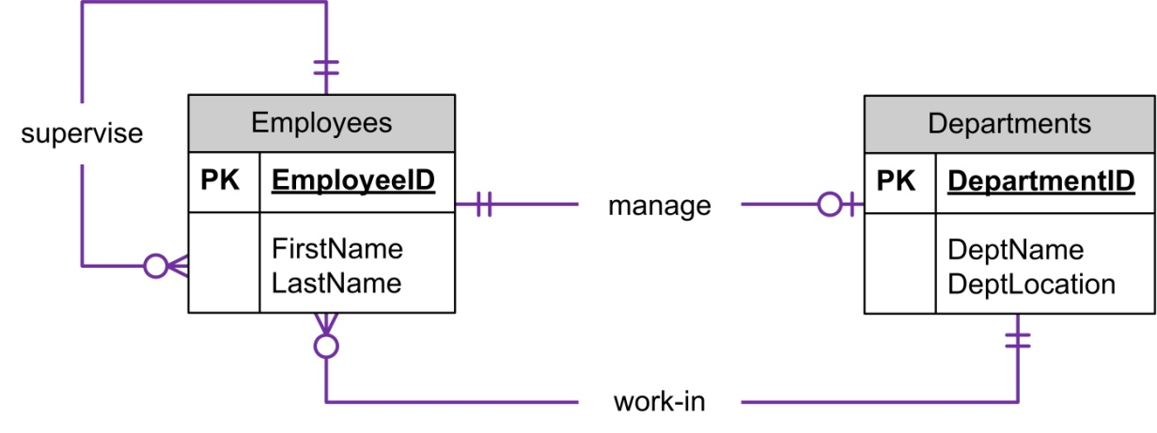
ERD Example: Multiple Relationships
Multiple Relationships - more than one relationship between the same entity types.
These are depicted in the ERD with multiple relationship lines connecting the two entities.

Slide 40
Solution lab 2 exercise 2
Prepare an ER diagram for a real estate company that lists property for sale. The following describes the organisation:
The company has a number of sales offices in several counties.
Attributes of sales office include Office_Number (identifier/key) and Location.
Each sales office is assigned one or more employees.
Attributes of employee include Employee_ID (identifier/key) and Employee_Name.
An employee must be assigned to only one sales office.
The firm lists property for sale.

Slide 41
Solution lab 2 exercise 2
Prepare an ER diagram for a real estate company that lists property for sale. The following describes the organisation:
The company has a number of sales offices in several counties.
Attributes of sales office include Office_Number (identifier/key) and Location.
Each sales office is assigned one or more employees.
Attributes of employee include Employee_ID (identifier/key) and Employee_Name.
An employee must be assigned to only one sales office.
The firm lists property for sale.

Slide 42
Solution lab 2 exercise 2
Attributes of property include Property_ID (identifier) and Location.
Components of Location include Address, City, County, and Postal_Code.
Each unit of property must be listed with one (and only one) of the sales offices.
A sales office may have any number of properties listed.
Each unit of property has one or more owners.
Attributes of owners are Owner_ID (identifier) and Owner_Name.
An owner may own one or more units of property.
An attribute of the association between property and owner is Percent_Owned.

Slide 43
Solution lab 2 exercise 2
Attributes of property include Property_ID (identifier) and Location.
Components of Location include Address, City, County, and Postal_Code.
Each unit of property must be listed with one (and only one) of the sales office.
A sales office may have any number of properties listed.
Each unit of property has one or more owners.
Attributes of owners are Owner_ID (identifier) and Owner_Name.
An owner may own one or more units of property.
An attribute of the association between property and owner is Percent_Owned.

Slide 44
Entities
Possible entities
Sales offices
Employees
Properties
Owners
Companies
Locations
Entities
Sales offices
Employees
Properties
Owners

Slide 45
Attributes
Entities | Attributes
Sales offices | Office id, location
Employees | Employee id, name, job description
Properties | Property id, address, city, county, postal code
Owners | Owner id, name

Slide 46
Relationships
 | Sales offices | Employees | Properties | Owners
Sales offices | X
Employees | Works in | X
Properties | Listed in |  | X
Owners |  |  | Owns | X

Slide 47
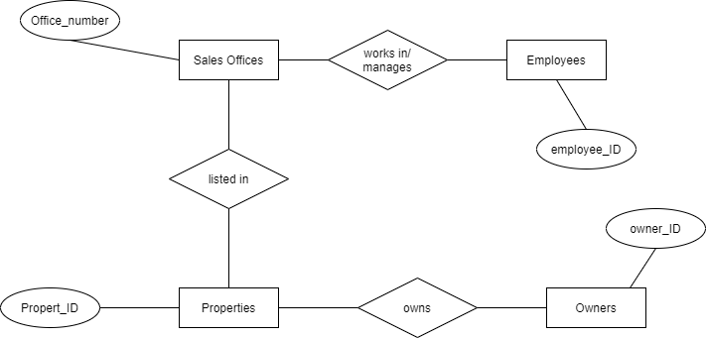
Rough ER Diagram with PKs

Slide 48
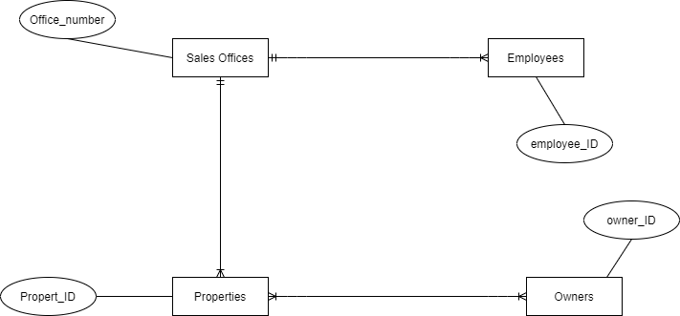
Rough ER Diagram with cardinality

Slide 49
Rough ER Diagram *

Slide 50
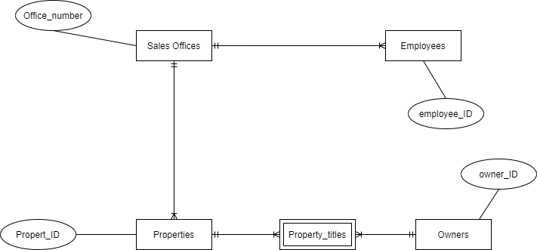
Rough ER Diagram with weak entities

Slide 51
Rough ER Diagram
Non Identifying
Non Identifying

Slide 52
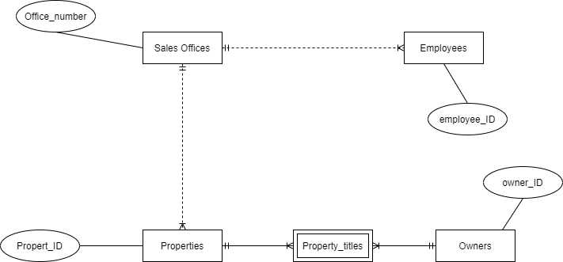
Rough ER Diagram

Slide 53
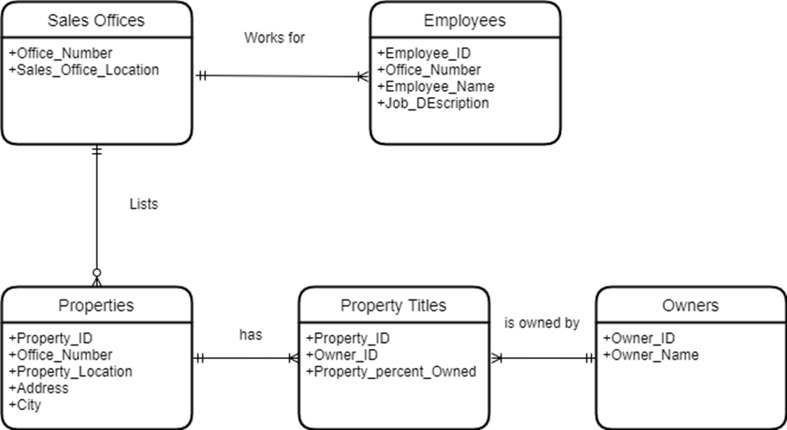
Solution lab 2 exercise 2 version 1

Slide 54
Solution lab 2 exercise 2 version 1 - PKs

Slide 55
Solution lab 2 exercise 2 version 1 - FKs

Slide 56
Solution lab 2 exercise 2 extra information
For each sales office, there is always one employee assigned to manage that office.

Slide 57
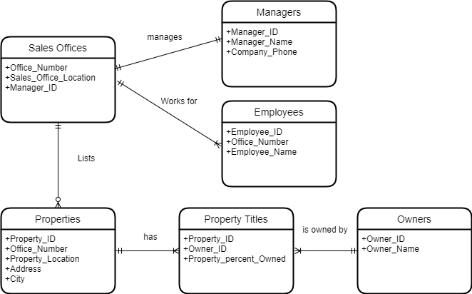
Solution lab 2 exercise 2 version 2

Slide 58
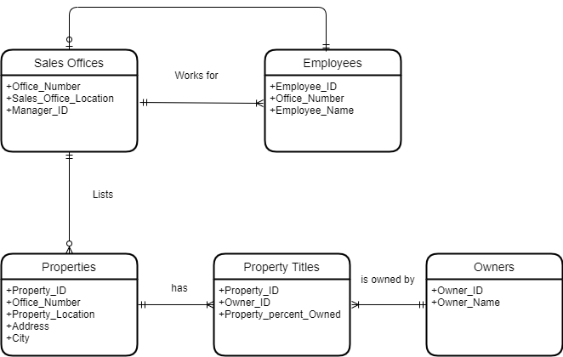
Solution lab 2 exercise 2 version 3
manages

Slide 59
Key Based ER Diagram
No many to many relationships
Bridge entities used if required
PKs defined
FKs defined

Slide 60
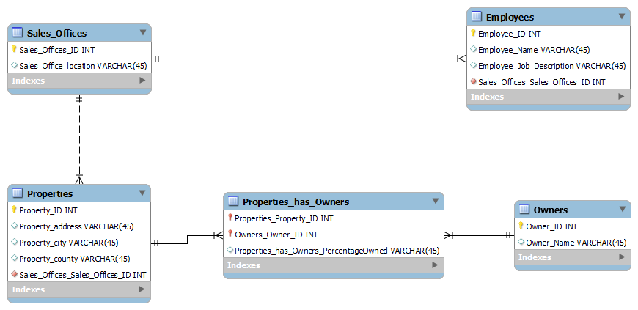
Solution lab 2 exercise 2 version 1 Key based ER diagram

Slide 61
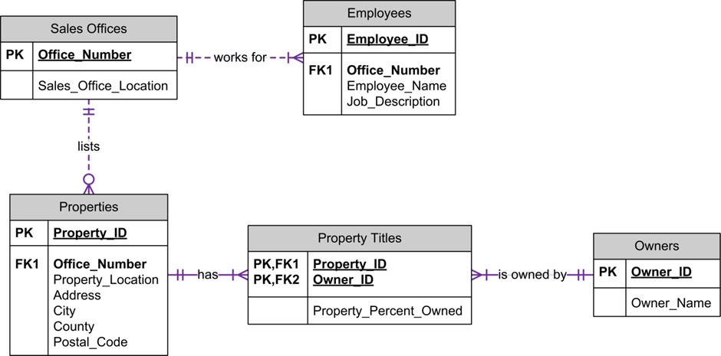
Foreign Key

Slide 62
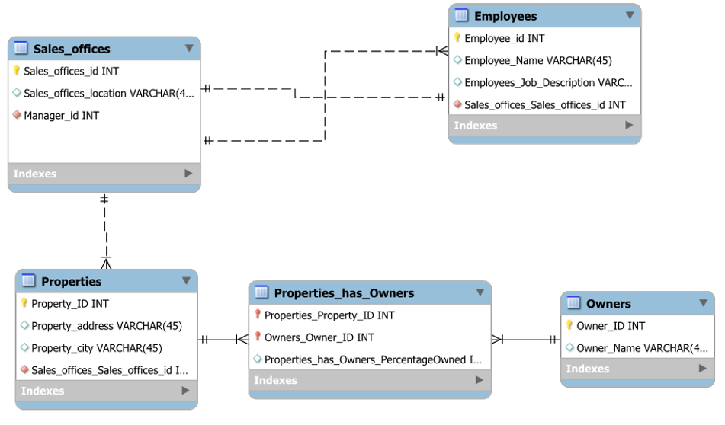
Solution lab 2 exercise 2 version 3 Key based ER diagram

Slide 63
Lab 3 description
Business Requirements
A company has several departments. Each department has a supervisor and at least one employee. Employees must be assigned to at least one, but possibly more departments. At least one employee is assigned to a project, but an employee may be on holidays and not assigned to any projects.

Slide 64
Work flow
Step 1: Identify Entities
Step 2: Find Relationships
Step 3: Draw Rough ER Diagram
Step 4: Fill in Cardinality
Step 5: Define Primary Keys
Step 6: Draw Key-Based ERD (eliminating many to many relationships, include FKs)
Step 7: Identify Attributes & Step 8: Map Attributes
Step 9: Draw Fully Attributed E-R Diagram
Step 10: Revise and update list of assumptions
Relationship matrix

Slide 65
Thanks
Edmund Nevin for earlier versions of these lecture notes

Slide 66
