Slide 1


Slide 2
Week 5 Information Systems
TU257

Slide 3
Agenda
Normalisation
UNF
1NF
2NF
3NF

Slide 4
Normalisation
The process of designing a database in the most efficient way possible.
A technique for designing relational database tables to minimise duplication of information and, in doing so, to safeguard the database against certain types of logical inconsistency.
More highly normalised tables greatly simplify development and maintenance of the database and contribute to its extensibility.

Slide 5
Normalisation
Properly executed, the normalisation process eliminates uncontrolled data redundancies,
thus eliminating the data anomalies, and
the data integrity problems that are produced by such redundancies.

Slide 6
Stages of Normalisation
Unnormalised
Remove repeating groups
1NF
Remove partial dependencies
2NF
Remove transitive dependencies
3NF

Slide 7
Repeating Groups
A repeating group is an attribute (or set of attributes) that can have more than one value for a primary key value.
Repeating Groups are not allowed in a relational design, since all attributes have to be ‘atomic’ - i.e. there can only be one value per cell in a table.

Slide 8
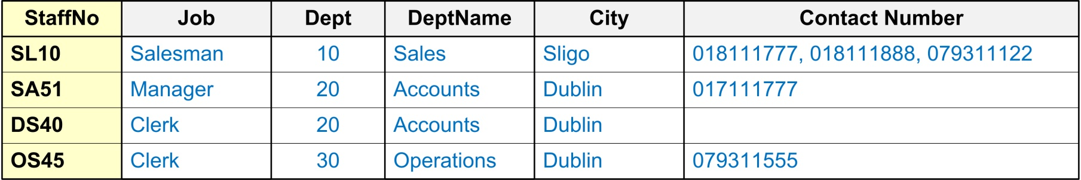
Repeating Groups
Example: The following relation contains staff and department details and a list of telephone contact numbers for each member of staff.

Slide 9

Repeating Groups

Slide 10
Repeating Groups
Invoice Number | ClientID | OrderDate | ProductID | Product Name | Quantity | Price | total
1234 | 432 | 2023-01-01 | 43,23,455,23 | Table, Chair, Pillow, Cushion | 1,6,4,4 | 900,190,42,25 | 900,1140,168,100

Slide 11
Dependencies
Functional Dependency:
Fully Functional Dependency
Partial Functional Dependency
Transitive Dependency

Slide 12
Functional Dependency
Formal Definition: Attribute B is functionally dependent upon attribute A (or a collection of attributes) if a value of A determines a single value of attribute B at any one time.
In other words, attribute B has a functional dependency on attribute A if, for each value of A, there is exactly one value of attribute B.

Slide 13
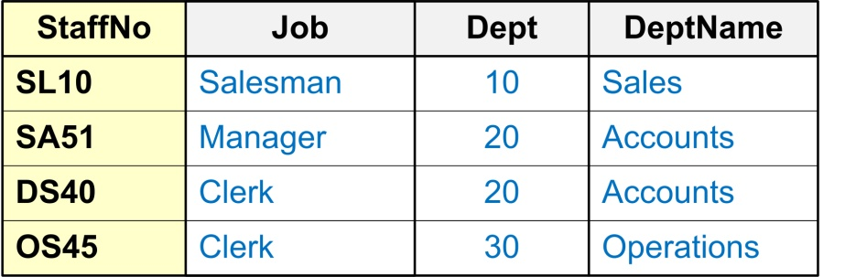
Functional Dependency Formal Notation A → B
This should be read as ‘A determines B’ or ‘B is functionally dependent on A’. A is called the determinant and B is called the object of the determinant.

Slide 14
Functional Dependency Example
Dept → DeptName
This should be read as ‘Department determines DepartmentName’ or
‘DepartmentName is functionally dependant on Department’.
Dept → DeptName

Slide 15
Full Functional Dependency
An attribute is fully functional dependent on a set of attributes X if it is…
functionally dependent on X, and
not functionally dependent on any proper subset of X
Only relevant for composite determinants

Slide 16
Full Functional Dependency
Only of relevance with composite determinants.
All the attributes of the composite determinant (Course# and Subject_Code) are needed to determine the Subject Type.
Course# | Subject_Code | Subject_Type
ICA40299 | ICAITB060A | Core
ICA40299 | ICAITU018B | Elective
ICA40199 | ICAITU018B | Core

Slide 17
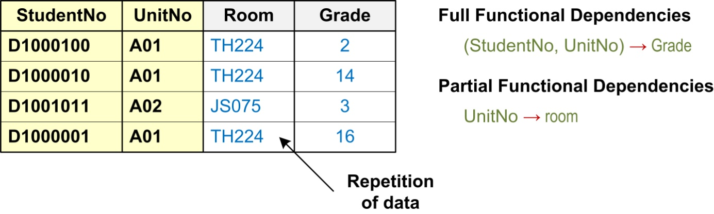
Partial Functional Dependency
This is the situation that exists if it is necessary to only use a subset of the attributes of the composite determinant to identify its object uniquely.

Slide 18
Transitive Dependency
A transitive dependency exists when there is an intermediate functional dependency.
A condition in which an attribute is dependent on another attribute that is not part of the primary key.
i.e. an indirect functional dependency,
one in which X → Z only by virtue of X → Y and Y → Z

Slide 19
Transitive Dependency Formal Notation
If A → B and B → C, then it can be stated that the following transitive dependency exists: A → B → C

Slide 20
Transitive Dependency
Example:
Company | CEO | age
Microsoft | Satya Nadella | 56
Alphabet/ Google | Sundar Pichai | 51
Alibaba | Jack Ma | 59
If company → CEO and CEO → age, then it can be stated that the following transitive dependency exists:
company → CEO → age

Slide 21
Normal Forms When is a table in 1NF?
A table is in 1NF when…
All the key attributes are defined (no repeating groups in the table) and when,
All remaining attributes are dependent on the primary key
Note: A table in 1NF still may contain partial dependencies, i.e., dependencies based on only part of the primary key.

Slide 22
Normal Forms When is a table in 2NF?
A table is in 2NF when
it is in 1NF and,
it includes no partial dependencies.
Note: A table in 2NF still may contain transitive dependencies, i.e., dependencies based on attributes that are not part of the primary key.

Slide 23
Normal Forms When is a table in 3NF?
A table is in 3NF when…
it is in 2NF, and
it contains no transitive dependencies.

Slide 24
Un-normalised Normal Form (UNF or 0NF)
Un-normalised Normal Form (UNF or 0NF)
Definition: A relation is un-normalised when it has not had any normalisation rules applied to it, and it suffers from various anomalies.
This only tends to occur where the relation has been designed using a ‘bottom-up approach’ i.e. the capturing of attributes to a ‘universal relation’ from a screen layout, manual report, manual document, etc...

Slide 25
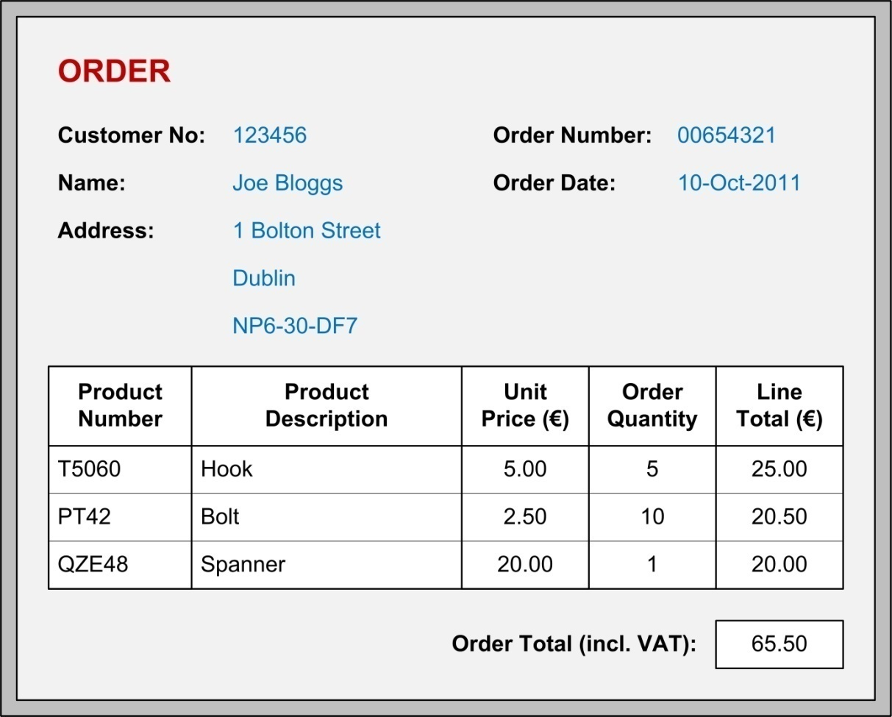
Example: Logical Design (‘Bottom-up’ Approach)

Slide 26
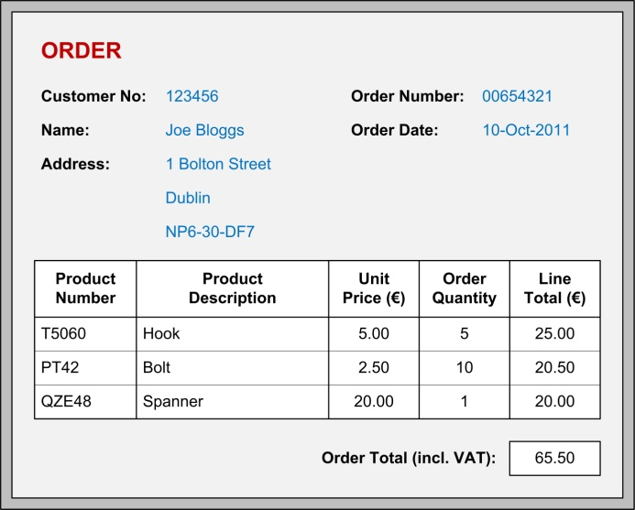
Example: Place in UNF
Calculated fields
Gather attributes in the following schema form:
Entity( non-repeating attributes (repeating attributes)* )
Repeating attributes

Slide 27
Example: Place in UNF
Entity( non-repeating attributes (repeating attributes)* )
Un-normalised Normal Form (UNF or 0NF)
Orders( cust_no,cust_name,cust_add, order_no, order_date,(product_no, prod_desc_unit_price, order_qty, line_total)*, order_total )

Slide 28
First Normal Form (1NF)
Definition: A relation is in 1NF if, and only if, all its underlying attributes contain ‘atomic’ values only.
Remove repeating groups into a new relation
ORDERS (order_no, order_date, cust_no, cust_name, cust_add,
(prod_no, prod_desc, unit_price, ord_qty, line_total)*, order-total)

Slide 29
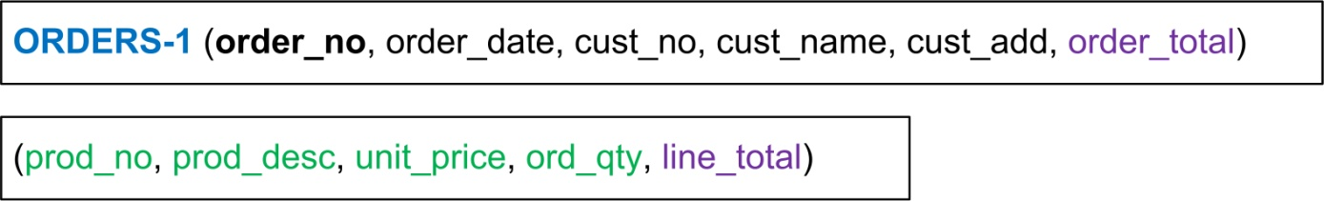
Example: UNF to 1NF
Remove the outermost repeating group (and any nested repeated groups it may contain) and create a new relation to contain it. Rename original to indicate 1NF.

Slide 30
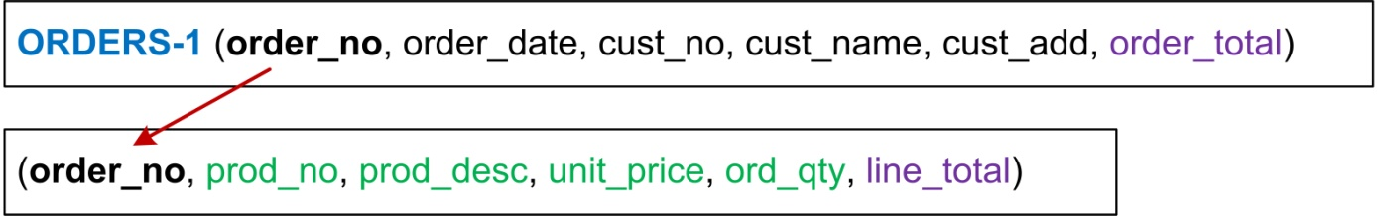
Example: UNF to 1NF
Add to this relation a copy of the PK of the relation immediately enclosing it.

Slide 31
Example: UNF to 1NF
Name the new entity (appending the number 1 to indicate 1NF).
Determine the PK of the new entity.

Slide 32
Note on choosing PK
Foreign Keys as part of a composite key can be used as PKs
A single Foreign key is usually not suitable as Primary Keys as they allow duplication
Alternatives:
Find a field that uniquely identifies each record in the table
Add a new field (auto-incrementing integer) to act as the primary key.

Slide 33
Second Normal Form (2NF)
Definition: A relation is in 2NF if, and only if, it is in 1NF and every non-key attribute is fully dependent on the primary key.
Remove partial functional dependencies into a new relation.
Check each relation individually.

Slide 34
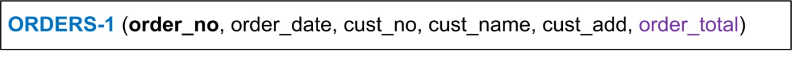
Second Normal Form (2NF) First relation check
Only one single primary key. No partial dependencies.

Slide 35
Second Normal Form (2NF) Second relation check
Composite primary key. Partial dependencies found.

Slide 36
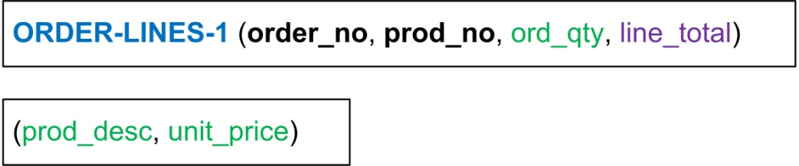
Example: 1NF to 2NF
Remove the offending attributes that are only partially functionally dependent on the composite key, and place them in a new relation.

Slide 37
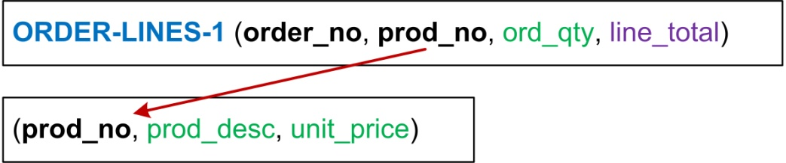
Example: 1NF to 2NF
Add to this relation a copy of the attribute(s) which determines these offending attributes. These will automatically become the primary key of this new relation…
FK?

Slide 38

Example: 1NF to 2NF
Name the new entity (appending the number 2 to indicate 2NF).
Rename the original entity (ending with a 2 to indicate 2NF).

Slide 39
Third Normal Form (3NF)
Definition: A relation is in 3NF if, and only if, it is in 2NF and every non-key attribute is non-transitively dependent on the primary key.
Remove transitive dependencies into a new relation

Slide 40
Third Normal Form (3NF)
Cust_no is not part of the primary key

Slide 41
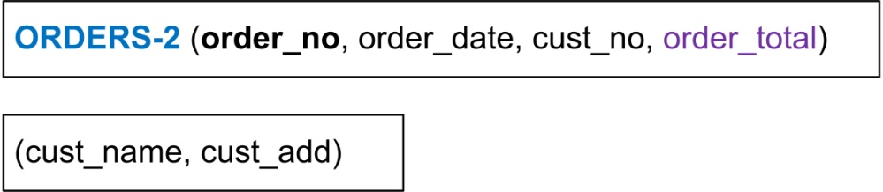
Example: 2NF to 3NF
Remove the offending attributes that are transitively dependent on non-key attributes, and place them in a new relation.

Slide 42
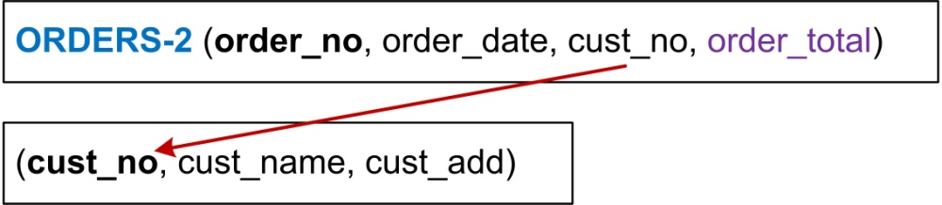
Example: 2NF to 3NF
Add to this relation a copy of the attribute(s) which determines these offending attributes. These will automatically become the primary key of this new relation…
FK?

Slide 43

Example: 2NF to 3NF
Name the new entity (appending the number 3 to indicate 3NF).
Rename the original entity (ending with a 3 to indicate 3NF).

Slide 44
Example: Relations in Highest Normal Form
Logical Schema:
ORDERS-3 (order_no, order_date, cust_no)
CUSTOMERS-3 (cust_no, cust_name, cust_add)
PRODUCTS-3 (prod_no, prod_desc, unit_price)
ORDER-LINES-3 (order_no, prod_no, ord_qty)
Note! Calculated fields are removed

Slide 45
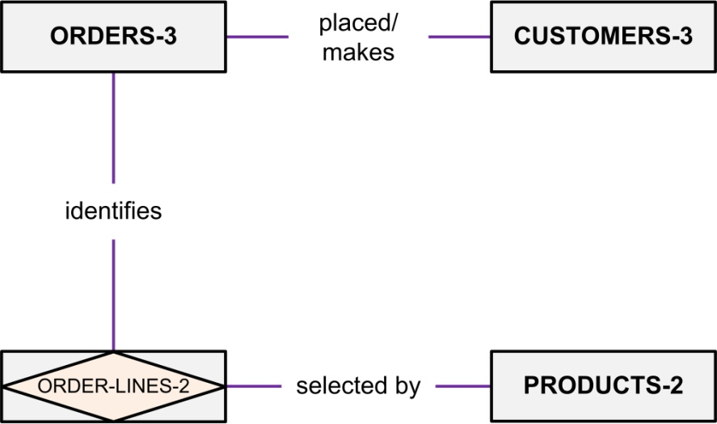
Example: E-R Diagrams
ORDERS-3 (order_no, order_date, cust_no)
CUSTOMERS-3 (cust_no, cust_name, cust_add)
PRODUCTS-3 (prod_no, prod_desc, unit_price)
ORDER-LINES-3 (order_no, prod_no, ord_qty)
Also in 3-NF
Basic E-R Diagram

Slide 46
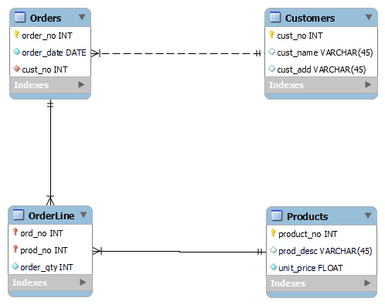
Example: E-R Diagrams
ORDERS-3 (order_no, order_date, cust_no)
CUSTOMERS-3 (cust_no, cust_name, cust_add)
PRODUCTS-3 (prod_no, prod_desc, unit_price)
ORDER-LINES-3 (order_no, prod_no, ord_qty)
Fully-Attributed Key-Based E-R Diagram

Slide 47
Normalisation Example
PPS number | Empl_Name | Empl_Role | Empl_salary | Empl_email
123 | Mary Smith | Manager | 4000 | mary@tup.ie, m.white@tup.ie, whitem@tup.ie
432 | John Murphy | Admin | 2000 | John.murphy@tup.ie
524 | Adele Ryan | Team leader | 2500 | a.ryan@tup.ie, ryana@tup.ie
8828 | Sonya Kennedy | Admin | 2000 | s.kennedy@tup.ie

Slide 48
Normalisation Example
PPS number | Empl_Name | Empl_Role | Empl_salary | Empl_email
123 | Mary Smith | Manager | 4000 | mary@tup.ie, m.white@tup.ie, whitem@tup.ie
432 | John Murphy | Admin | 2000 | John.murphy@tup.ie
524 | Adele Ryan | Team leader | 2500 | a.ryan@tup.ie, ryana@tup.ie
8828 | Sonya Kennedy | Admin | 2000 | s.kennedy@tup.ie
Salary depends on role
PK PPS number

Slide 49
Example Company
PPS number | Empl_Name | Empl_Role | Empl_salary | Empl_email
123 | Mary Smith | Manager | 4000 | mary@tup.ie, m.white@tup.ie, whitem@tup.ie
432 | John Murphy | Admin | 2000 | John.murphy@tup.ie
524 | Adele Ryan | Team leader | 2500 | a.ryan@tup.ie, ryana@tup.ie
8828 | Sonya Kennedy | Admin | 2000 | s.kennedy@tup.ie
What normal form is this table in?

Slide 50

Plan for next few weeks
Week 6
Revision class
Lab SQLite 1
Week 7
Quiz
No Lab
Week 8
Submission of Assignment
Lab SQLite 2

Slide 51
Thanks
Edmund Nevin for a earlier versions of these lecture notes

Slide 52


