Slide 1

Reinforcement Learning
Lab 1
Dr Bojan Božić
School of Computer Science
TU Dublin, Grangegorman
bojan.bozic@tudublin.ie
Slides adapted from https://huggingface.co/learn/deep-rl-course and Fundamentals of Machine Learning for Predictive Data Analytics. Kelleher, Mac Namee and D’Arcy

Slide 2
Lab 1 - Goal
Now that you’ve studied the basics of Reinforcement Learning, you’re ready to train your first agent: A Lunar Lander agent that will learn to land correctly on the Moon 🌕

Slide 3

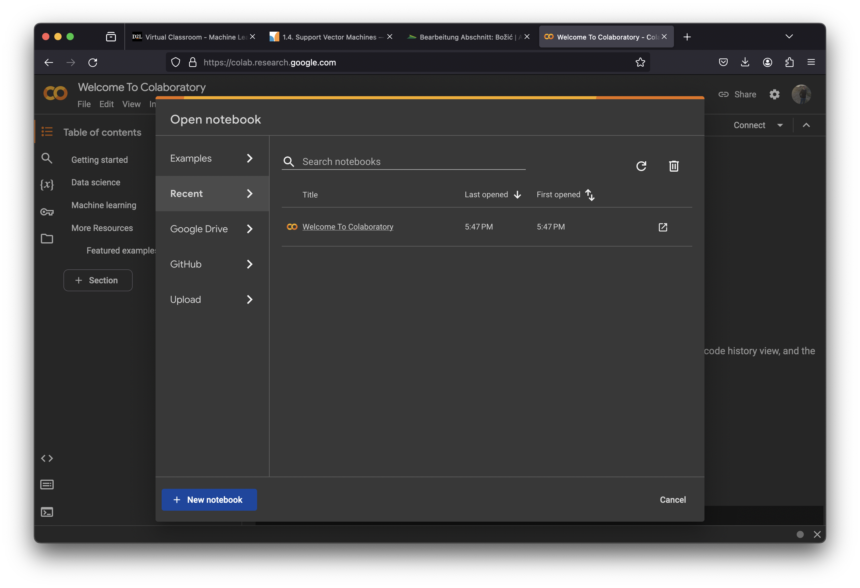
First Step
Go to https://colab.research.google.com and create a new notebook:

Slide 4
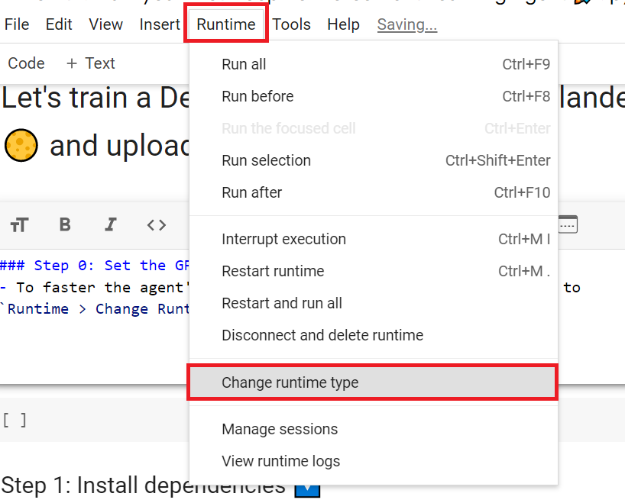
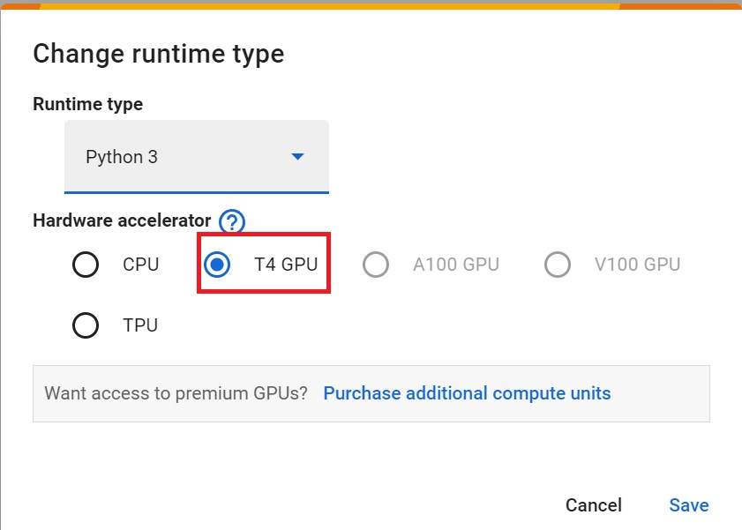
Set the GPU
To accelerate the agent’s training, we’ll use a GPU. To do that, go to Runtime > Change Runtime type
1
2

Slide 5

Install dependencies
The first step is to install the dependencies, we’ll install multiple ones.
gymnasium[box2d]: Contains the LunarLander-v2 environment 🌛
stable-baselines3[extra]: The deep reinforcement learning library.
huggingface_sb3: Additional code for Stable-baselines3 to load and upload models from the Hugging Face 🤗 Hub.
You can use a huggingface script to install all these dependencies.

Slide 6
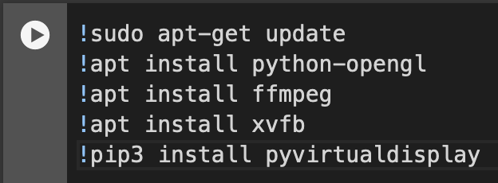
Create virtual screen
During the lab, we’ll need to generate a replay video. To do so, with colab, we need to have a virtual screen to be able to render the environment (and thus record the frames).

Slide 7
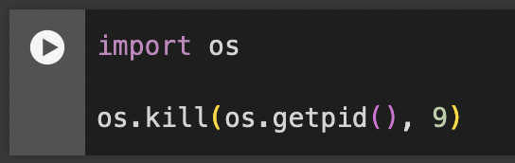
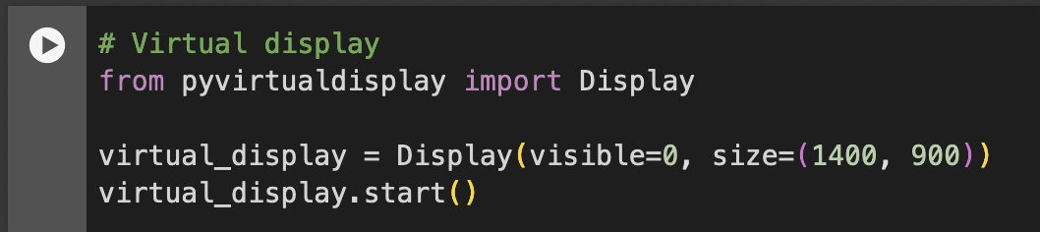
Start Virtual Screen
To make sure the new installed libraries are used, sometimes it’s required to restart the notebook runtime. The next cell will force the runtime to crash, so you’ll need to connect again and run the code starting from here. Thanks to this trick, we will be able to run our virtual screen.

Slide 8
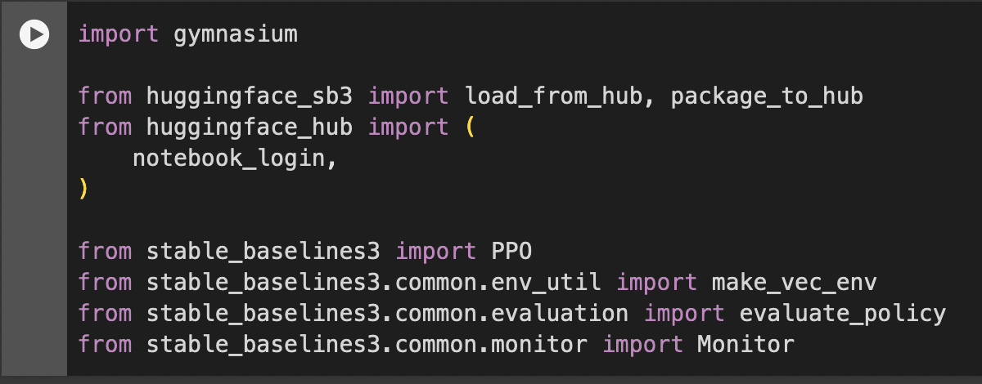
Import the packages

Slide 9
Understand Gymnasium and how it works
🏋 The library containing our environment is called Gymnasium. You’ll use Gymnasium a lot in Deep Reinforcement Learning.
Gymnasium is the new version of Gym library maintained by the Farama Foundation.
The Gymnasium library provides two things:
An interface that allows you to create RL environments.
A collection of environments (gym-control, atari, box2D…).

Slide 10
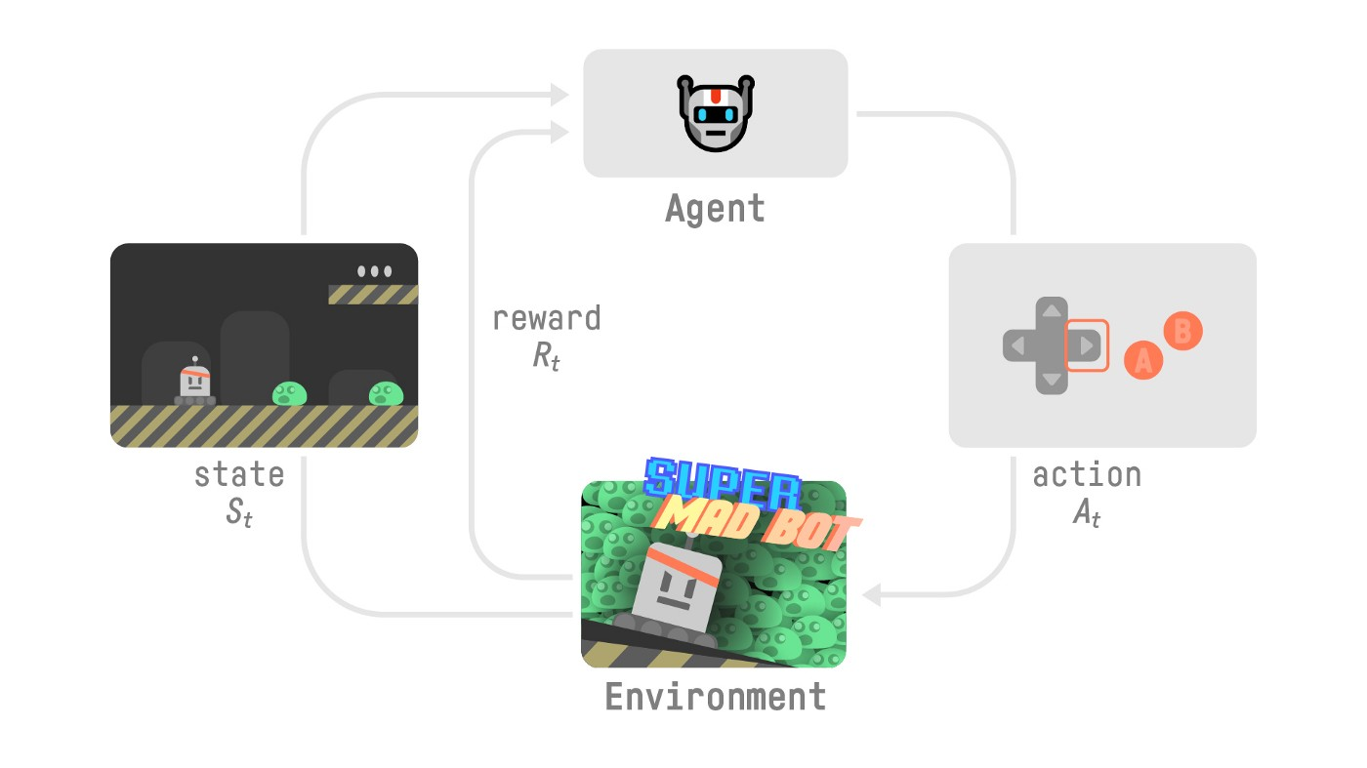
RL Loop Recall
At each step:
Our Agent receives a state (S₀) from the Environment — we receive the first frame of our game (Environment).
Based on that state (S₀), the Agent takes an action (A₀) — our Agent will move to the right.
The environment transitions to a new state (S₁) — new frame.
The environment gives some reward (R₁) to the Agent — we’re not dead (Positive Reward +1).

Slide 11
Rewards and Discounting
To discount the rewards, we proceed like this:
We define a discount rate called gamma. It must be between 0 and 1. Most of the time between 0.95 and 0.99.
The larger the gamma, the smaller the discount. This means our agent cares more about the long-term reward.
On the other hand, the smaller the gamma, the bigger the discount. This means our agent cares more about the short term reward (the nearest cheese).
Then, each reward will be discounted by gamma to the exponent of the time step. As the time step increases, the cat gets closer to us, so the future reward is less and less likely to happen.

Slide 12
With Gymnasium
We create our environment using gymnasium.make()
We reset the environment to its initial state with observation = env.reset()
At each step:
Get an action using our model (in our example we take a random action)
Using env.step(action), we perform this action in the environment and get
observation: The new state (s_{t+1})
reward: The reward we get after executing the action
terminated: Indicates if the episode terminated (agent reach the terminal state)
truncated: Introduced with this new version, it indicates a time limit or if an agent goes out of bounds of the environment for instance.
info: A dictionary that provides additional information (depends on the environment).

Slide 13
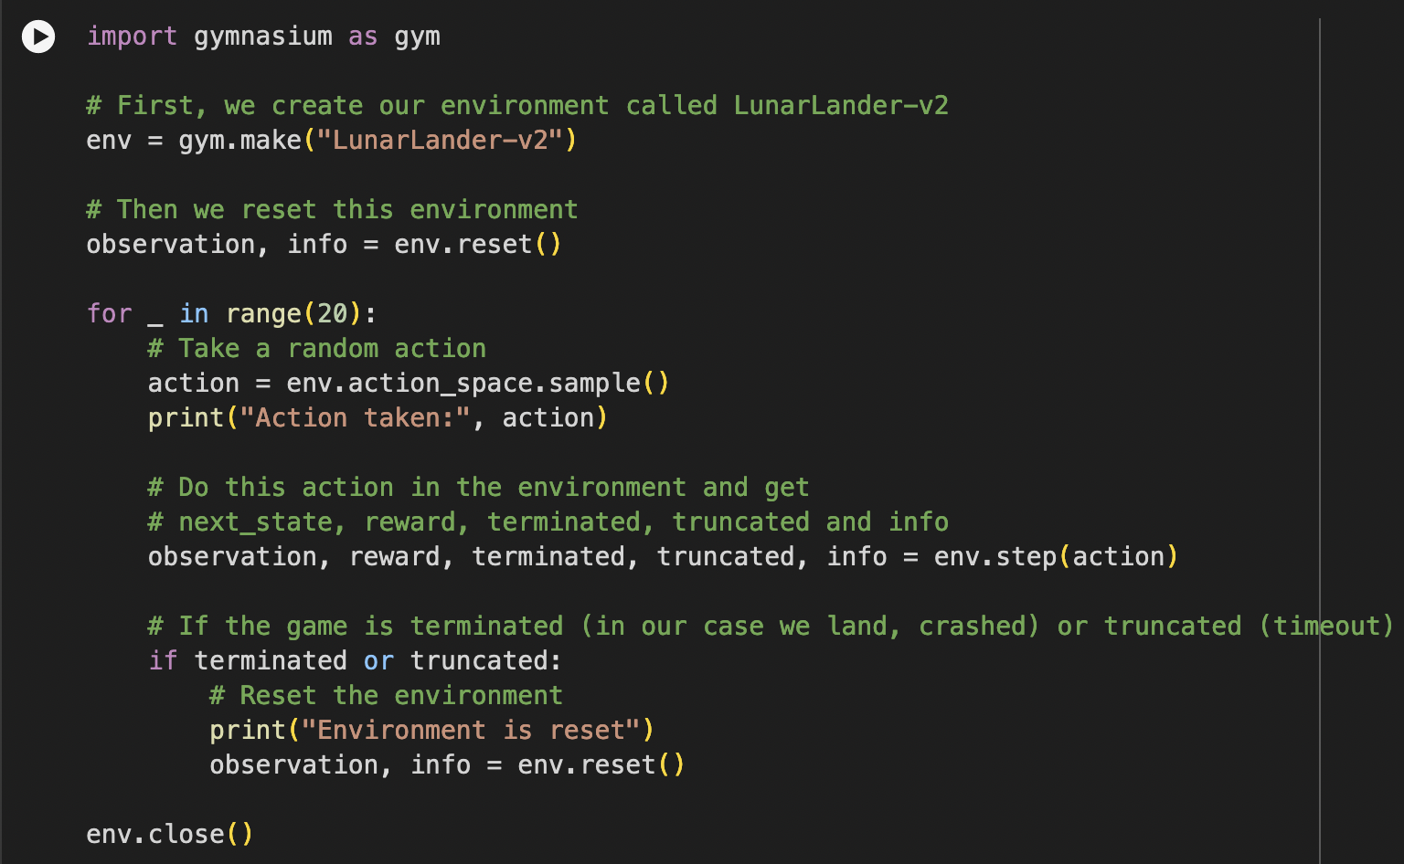
Example
If the episode is terminated:
We reset the environment to its initial state with observation = env.reset()

Slide 14
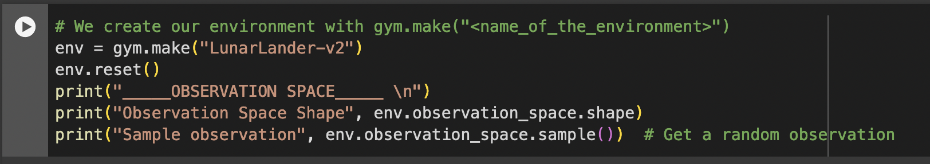
Create the LunarLander environment 🌛
We’re going to train our agent, a Lunar Lander, to land correctly on the moon. To do that, the agent needs to learn to adapt its speed and position (horizontal, vertical, and angular) to land correctly.
Let’s see what the Environment looks like:

Slide 15
Output
We see with Observation Space Shape (8,) that the observation is a vector of size 8, where each value contains different information about the lander:
Horizontal pad coordinate (x)
Vertical pad coordinate (y)
Horizontal speed (x)
Vertical speed (y)
Angle
Angular speed
If the left leg contact point has touched the land
If the right leg contact point has touched the land

Slide 16
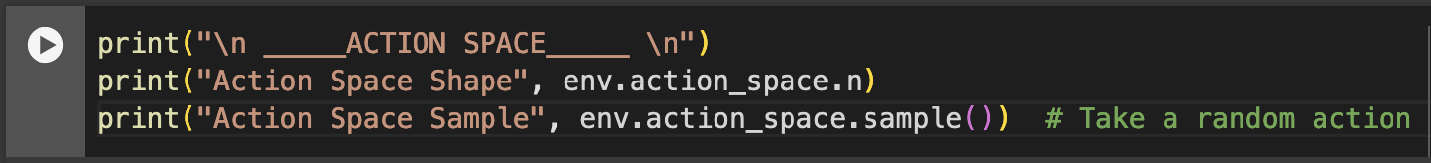
Action Space
The action space (the set of possible actions the agent can take) is discrete with 4 actions available 🎮:
Action 0: Do nothing,
Action 1: Fire left orientation engine,
Action 2: Fire the main engine,
Action 3: Fire right orientation engine.

Slide 17
Reward Function
After every step a reward is granted. The total reward of an episode is the sum of the rewards for all the steps within that episode.
For each step, the reward:
Is increased/decreased the closer/further the lander is to the landing pad.
Is increased/decreased the slower/faster the lander is moving.
Is decreased the more the lander is tilted (angle not horizontal).
Is increased by 10 points for each leg that is in contact with the ground.
Is decreased by 0.03 points each frame a side engine is firing.
Is decreased by 0.3 points each frame the main engine is firing.
The episode receives an additional reward of -100 or +100 points for crashing or landing safely respectively.
An episode is considered a solution if it scores at least 200 points.

Slide 18
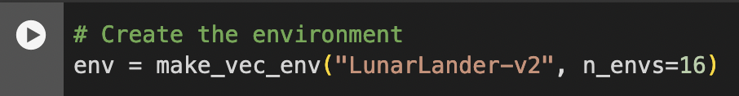
Vectorized Environment
We create a vectorized environment (a method for stacking multiple independent environments into a single environment) of 16 environments, this way, we’ll have more diverse experiences during the training.

Slide 19
Create the Model
We have studied our environment and we understood the problem: being able to land the Lunar Lander to the Landing Pad correctly by controlling left, right and main orientation engine. Now let’s build the algorithm we’re going to use to solve this Problem 🚀.
To do so, we’re going to use our first Deep RL library, Stable Baselines3 (SB3).
SB3 is a set of reliable implementations of reinforcement learning algorithms in PyTorch.
https://stable-baselines3.readthedocs.io/en/master/

Slide 20
Proximal Policy Optimization
PPO is a combination of:
Value-based reinforcement learning method: learning an action-value function that will tell us the most valuable action to take given a state and action.
Policy-based reinforcement learning method: learning a policy that will give us a probability distribution over actions.
Stable-Baselines3 is easy to set up:
1️⃣ You create your environment (in our case it was done above)
2️⃣ You define the model you want to use and instantiate this model -> model = PPO("MlpPolicy")
3️⃣ You train the agent with model.learn and define the number of training timesteps

Slide 21
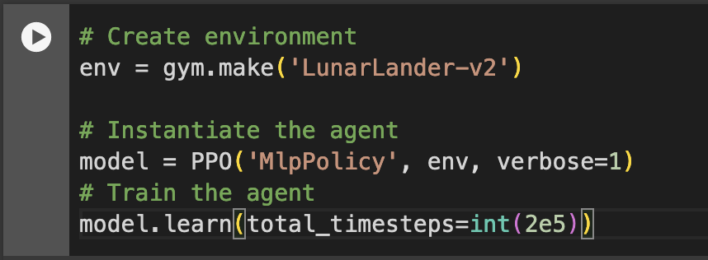
Model Code
This isn’t gonna be a very smart agent, so just prepare yourself for several crash landings!

Slide 22
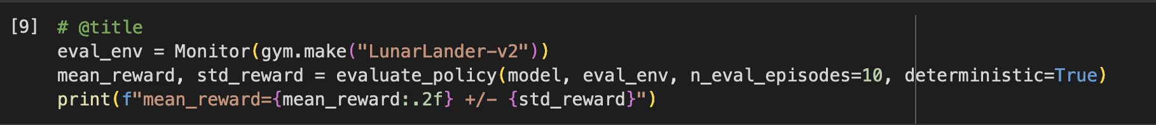
Evaluate the Agent
Remember to wrap the environment in a Monitor.
Now that our Lunar Lander agent is trained 🚀, we need to check its performance.
Stable-Baselines3 provides a method to do that: evaluate_policy.
To fill that part you need to check the documentation
In the next step, we’ll see how to automatically evaluate and share your agent to compete in a leaderboard, but for now let’s do it ourselves
💡 When you evaluate your agent, you should not use your training environment but create an evaluation environment.

Slide 23
Publish our trained model on the Hub 🔥
By using package_to_hub you evaluate, record a replay, generate a model card of your agent and push it to the hub.
This way:
You can showcase our work 🔥
You can visualize your agent playing 👀
You can share with the community an agent that others can use 💾
You can access a leaderboard 🏆 to see how well your agent is performing compared to your classmates 👉 https://huggingface.co/spaces/huggingface-projects/Deep-Reinforcement-Learning-Leaderboard

Slide 24
Share your model
To be able to share your model with the community there are three more steps to follow:
1️⃣ (If it’s not already done) create an account on Hugging Face ➡ https://huggingface.co/join
2️⃣ Sign in and then, you need to store your authentication token from the Hugging Face website.
Create a new token (https://huggingface.co/settings/tokens) with write role

Slide 25
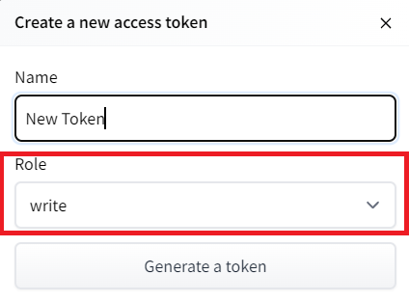
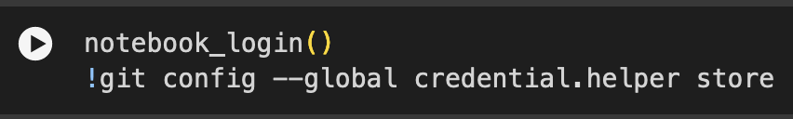
Login
Copy the token
Run the cell below and paste the token
3️⃣ We’re now ready to push our trained agent to the 🤗 Hub 🔥 using package_to_hub()function

Slide 26
package_to_hub
Let’s fill the package_to_hub function:
model: our trained model.
model_name: the name of the trained model that we defined in model_save
model_architecture: the model architecture we used, in our case PPO
env_id: the name of the environment, in our case LunarLander-v2
eval_env: the evaluation environment defined in eval_env
repo_id: the name of the Hugging Face Hub Repository that will be created/updated (repo_id = {username}/{repo_name})
💡 A good name is {username}/{model_architecture}-{env_id}
commit_message: message of the commit

Slide 27
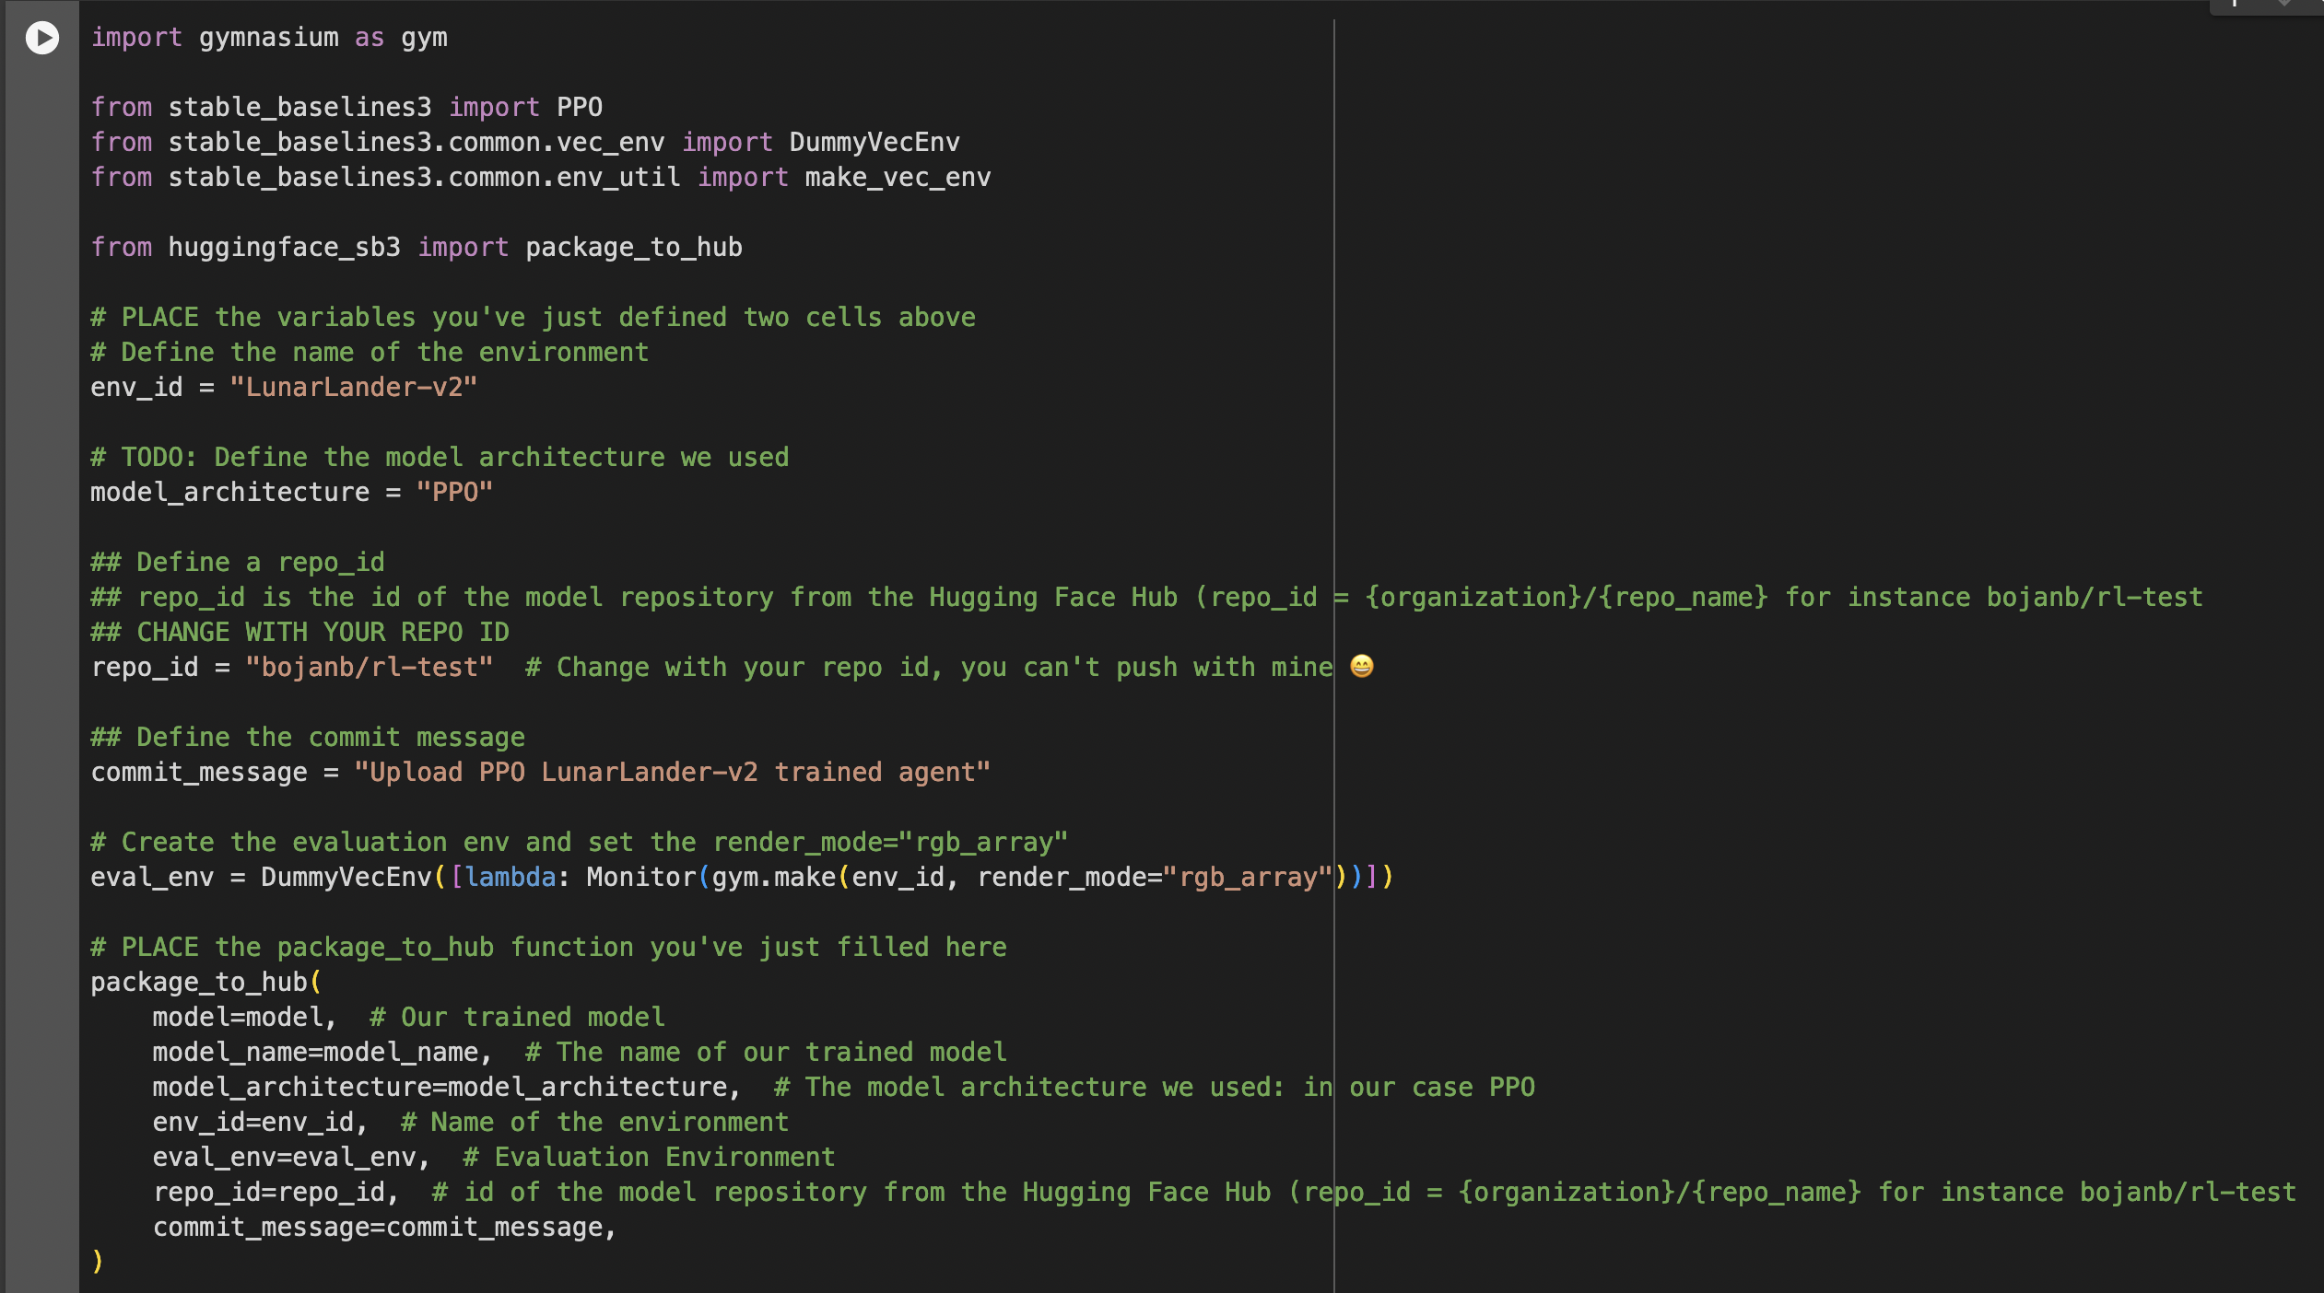
Code

Slide 28
Congrats
Congrats 🥳 you’ve just trained and uploaded your first Deep Reinforcement Learning agent. The script above should have displayed a link to a model repository such as https://huggingface.co/bojanb/rl-test. When you go to this link, you can:
See a video preview of your agent at the right.
Click “Files and versions” to see all the files in the repository.
Click “Use in stable-baselines3” to get a code snippet that shows how to load the model.
A model card (README.md file) which gives a description of the model
Under the hood, the Hub uses git-based repositories (don’t worry if you don’t know what git is), which means you can update the model with new versions as you experiment and improve your agent.

Slide 29
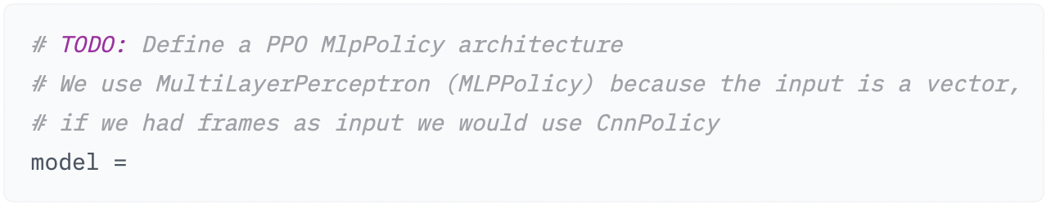
Task 1

Slide 30
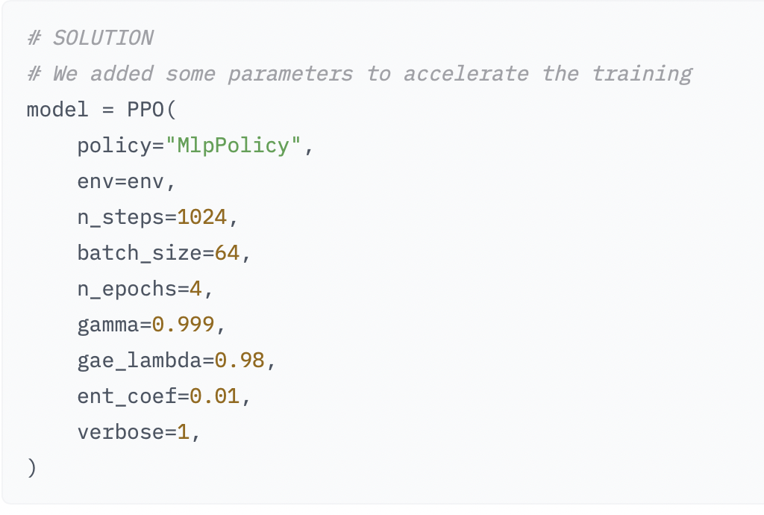
Solution

Slide 31
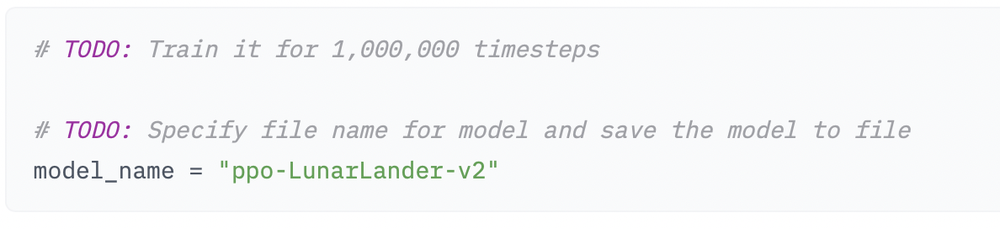
Task 2
Let’s train our agent for 1,000,000 timesteps, don’t forget to use GPU on Colab. It will take approximately ~20min, but you can use fewer timesteps if you just want to try it out.
During the training, take a ☕ break you deserved it 🤗

Slide 32
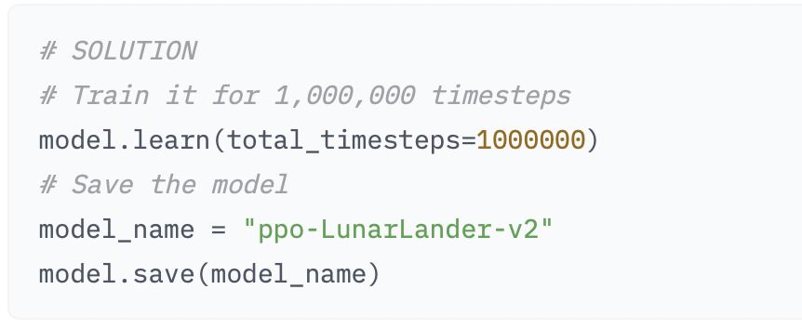
Solution

Slide 33
Task 3
Evaluate your new agent
Upload it to your repo
Check if your lunar lander can land now!

Slide 34

Questions?

