Slide 1

Reinforcement Learning
Lab 2
Dr Bojan Božić
School of Computer Science
TU Dublin, Grangegorman
bojan.bozic@tudublin.ie
Slides adapted from https://huggingface.co/learn/deep-rl-course and Fundamentals of Machine Learning for Predictive Data Analytics. Kelleher, Mac Namee and D’Arcy

Slide 2
Lab 2 - Goal
Implement a Q-Learning algorithm in autonomous taxi and frozen lake.

Slide 3

Games
Frozen-Lake-v1 (non-slippery and slippery version) ☃️ : where our agent will need to go from the starting state (S) to the goal state (G) by walking only on frozen tiles (F) and avoiding holes (H).
An autonomous taxi 🚖 will need to learn to navigate a city to transport its passengers from point A to point B.

Slide 4
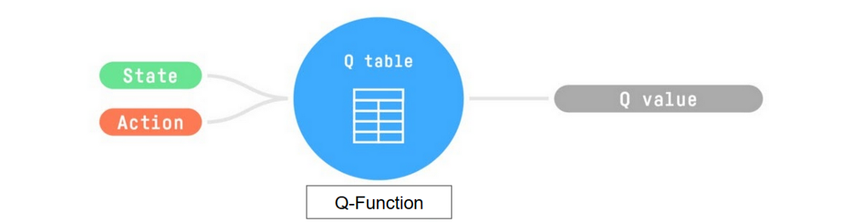
Q-Learning
Q-Learning is the RL algorithm that:
Trains Q-Function, an action-value function that is encoded, in internal memory, by a Q-table that contains all the state-action pair values.
Given a state and action, our Q-Function will search the Q-table for the corresponding value.
When the training is done, we have an optimal Q-Function, so an optimal Q-Table.
And if we have an optimal Q-function, we have an optimal policy, since we know for each state, the best action to take.

Slide 5
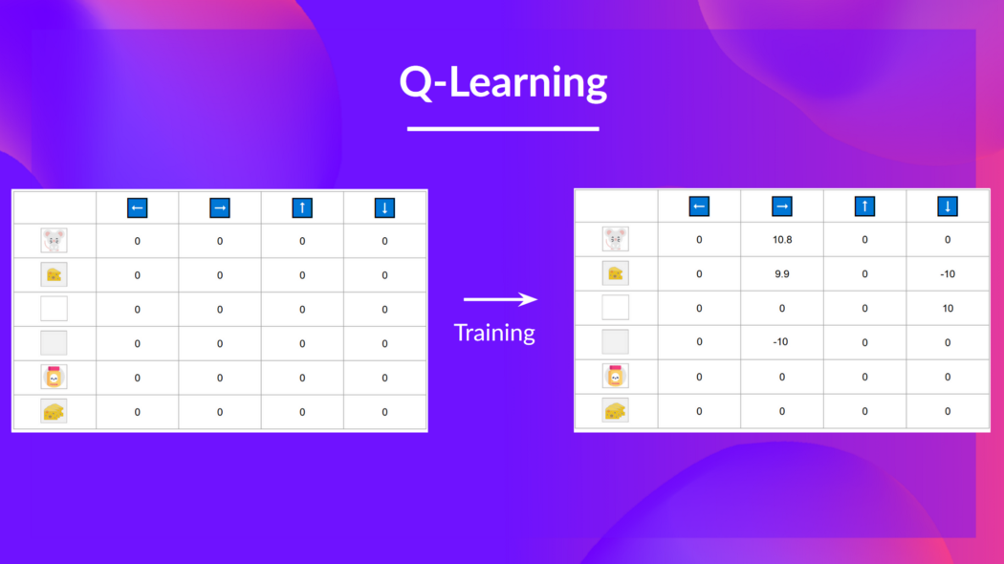
Q-Learning

Slide 6
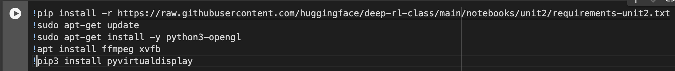
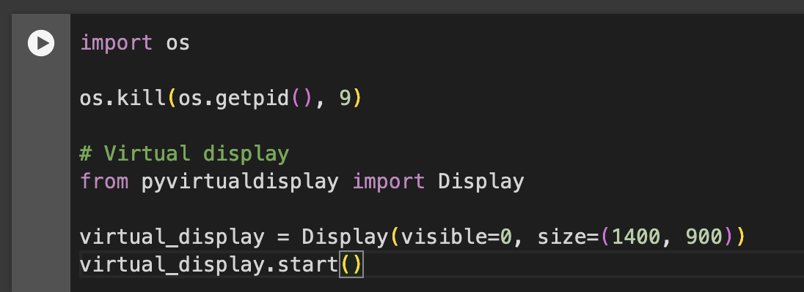
Setup

Slide 7
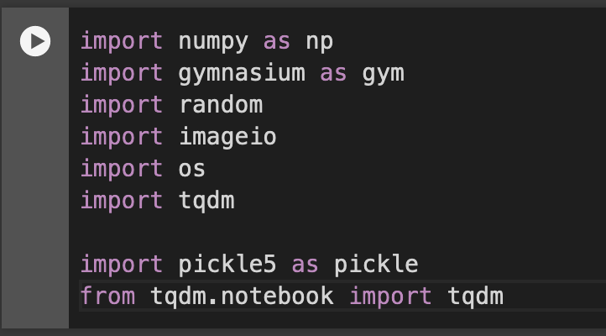
Import Packages

Slide 8
Part 1: Frozen Lake ⛄ (non slippery version)
We’re going to train our Q-Learning agent to navigate from the starting state (S) to the goal state (G) by walking only on frozen tiles (F) and avoid holes (H).
We can have two sizes of environment:
map_name="4x4": a 4x4 grid version
map_name="8x8": a 8x8 grid version
The environment has two modes:
is_slippery=False: The agent always moves in the intended direction due to the non-slippery nature of the frozen lake (deterministic).
is_slippery=True: The agent may not always move in the intended direction due to the slippery nature of the frozen lake (stochastic).

Slide 9
Frozen Lake
For now let’s keep it simple with the 4x4 map and non-slippery. We add a parameter called render_mode that specifies how the environment should be visualised. In our case because we want to record a video of the environment at the end, we need to set render_mode to rgb_array.
As explained in the documentation “rgb_array”: Return a single frame representing the current state of the environment. A frame is a np.ndarray with shape (x, y, 3) representing RGB values for an x-by-y pixel image.

Slide 10
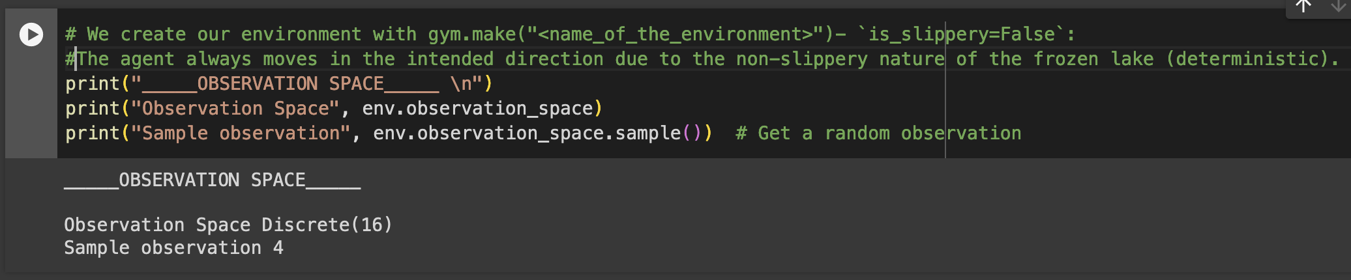
What does the environment look like?

Slide 11
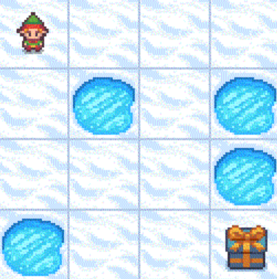
Environment
We see with Observation Space Shape Discrete(16) that the observation is an integer representing the agent’s current position as current_row * ncols + current_col (where both the row and col start at 0).
For example, the goal position in the 4x4 map can be calculated as follows: 3 * 4 + 3 = 15. The number of possible observations is dependent on the size of the map. For example, the 4x4 map has 16 possible observations.
For instance, this is what state = 0 looks like:

Slide 12
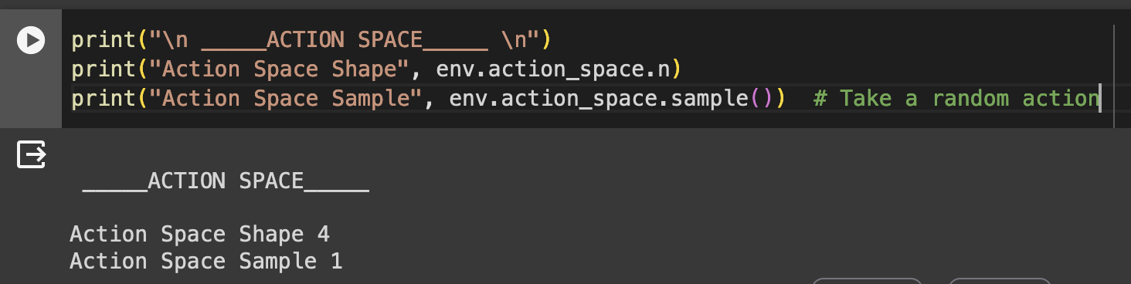
Action Space
The action space (the set of possible actions the agent can take) is discrete with 4 actions available 🎮:
0: GO LEFT
1: GO DOWN
2: GO RIGHT
3: GO UP
Reward function 💰:
Reach goal: +1
Reach hole: 0
Reach frozen: 0

Slide 13
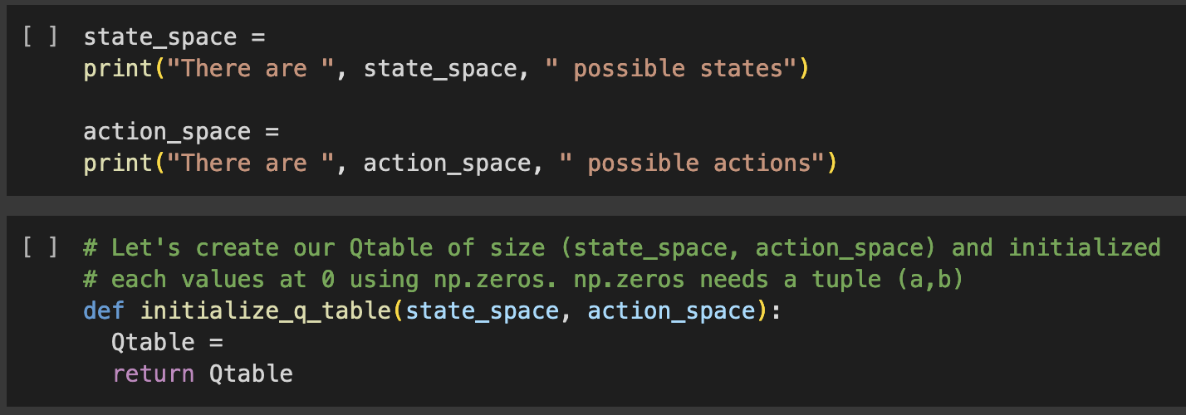
Create and Initialize the Q-table 🗄️
It’s time to initialize our Q-table! To know how many rows (states) and columns (actions) to use, we need to know the action and observation space. We already know their values from before, but we’ll want to obtain them programmatically so that our algorithm generalizes for different environments. Gym provides us a way to do that: env.action_space.n and env.observation_space.n

Slide 14
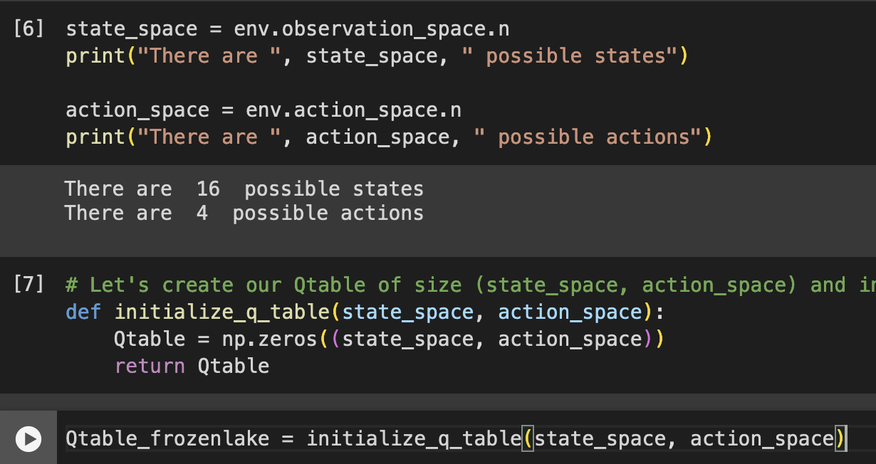
Solution

Slide 15
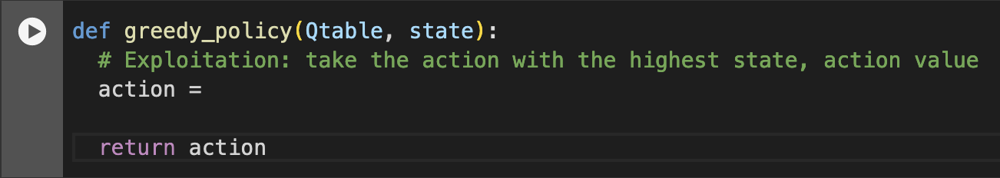
Define the greedy policy 🤖
We have two policies since Q-Learning is an off-policy algorithm. This means we’re using a different policy for acting and updating the value function.
Epsilon-greedy policy (acting policy)
Greedy-policy (updating policy)
The greedy policy will also be the final policy we’ll have when the Q-learning agent completes training. The greedy policy is used to select an action using the Q-table.

Slide 16
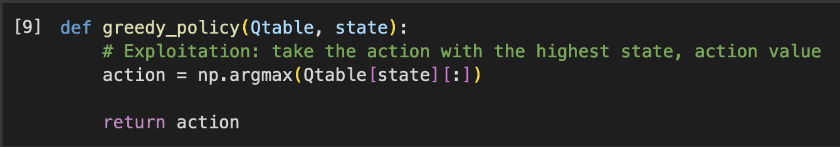
Solution

Slide 17
Define the epsilon-greedy policy 🤖
Epsilon-greedy is the training policy that handles the exploration/exploitation trade-off.
The idea with epsilon-greedy:
With probability 1 - ε : we do exploitation (i.e. our agent selects the action with the highest state-action pair value).
With probability ε: we do exploration (trying a random action).
As the training continues, we progressively reduce the epsilon value since we will need less and less exploration and more exploitation.

Slide 18
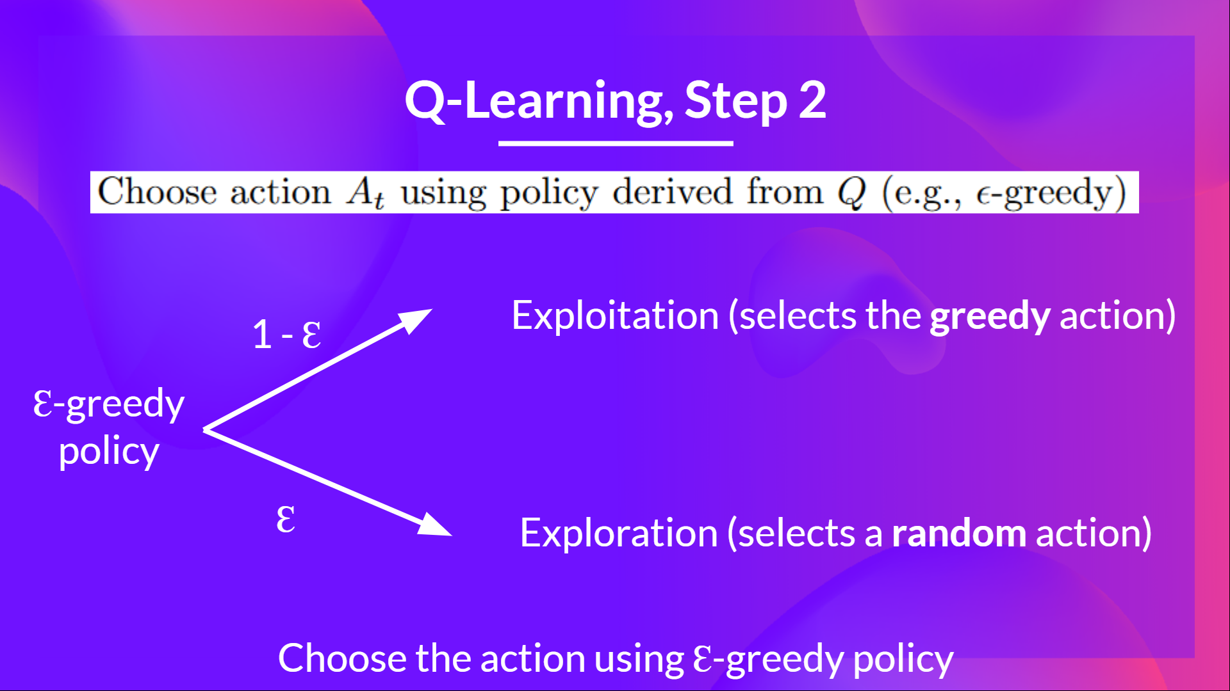
Vectorized Environment

Slide 19
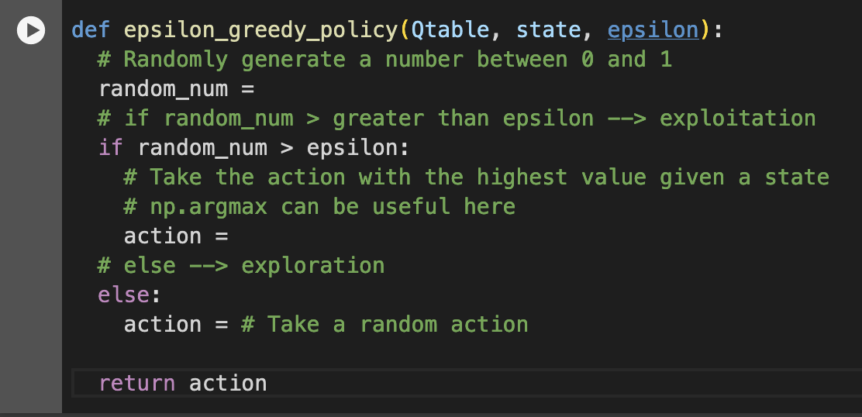
Task

Slide 20
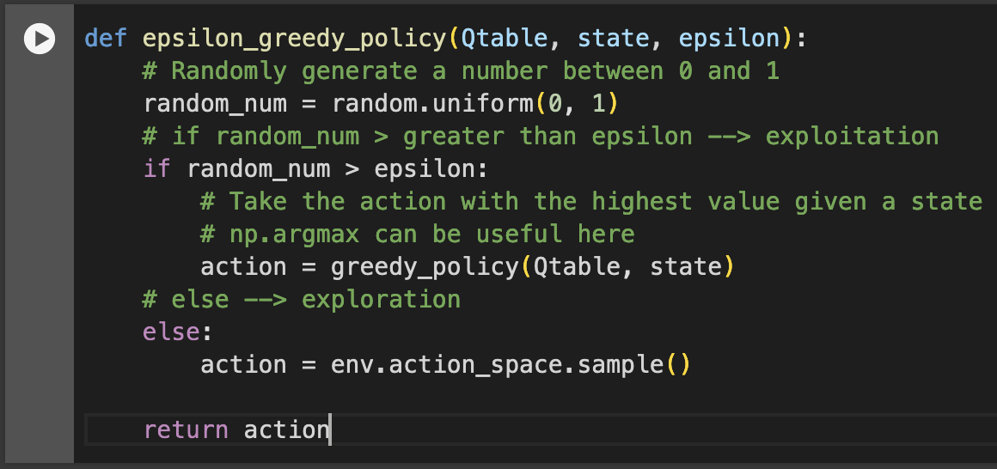
Solution

Slide 21
Define the hyperparameters ⚙️
The exploration related hyperparamters are some of the most important ones.
We need to make sure that our agent explores enough of the state space to learn a good value approximation. To do that, we need to have progressive decay of the epsilon.
If you decrease epsilon too fast (too high decay_rate), you take the risk that your agent will be stuck, since your agent didn’t explore enough of the state space and hence can’t solve the problem.

Slide 22
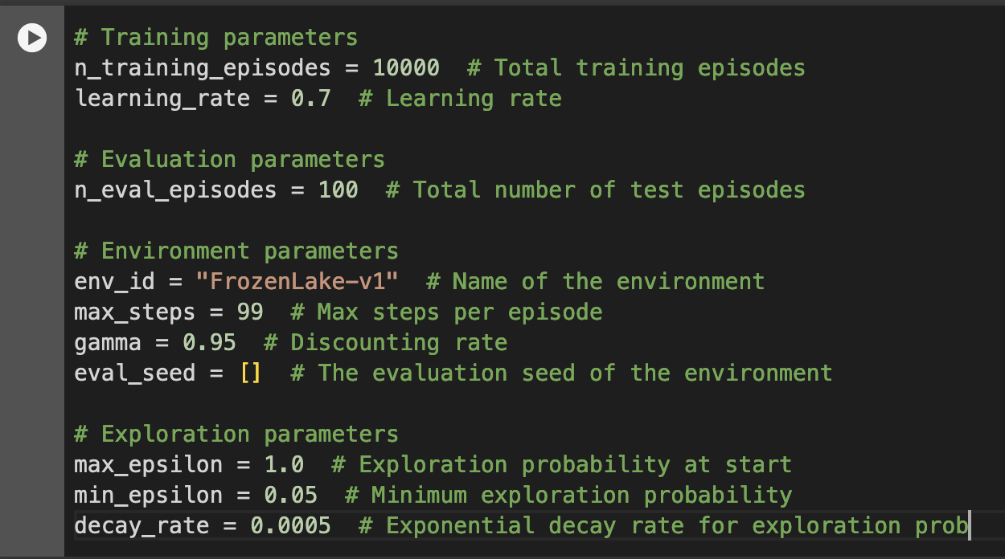
Code

Slide 23
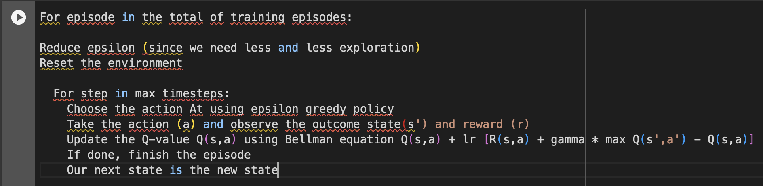
Create the training loop method
The training loop goes like this:

Slide 24
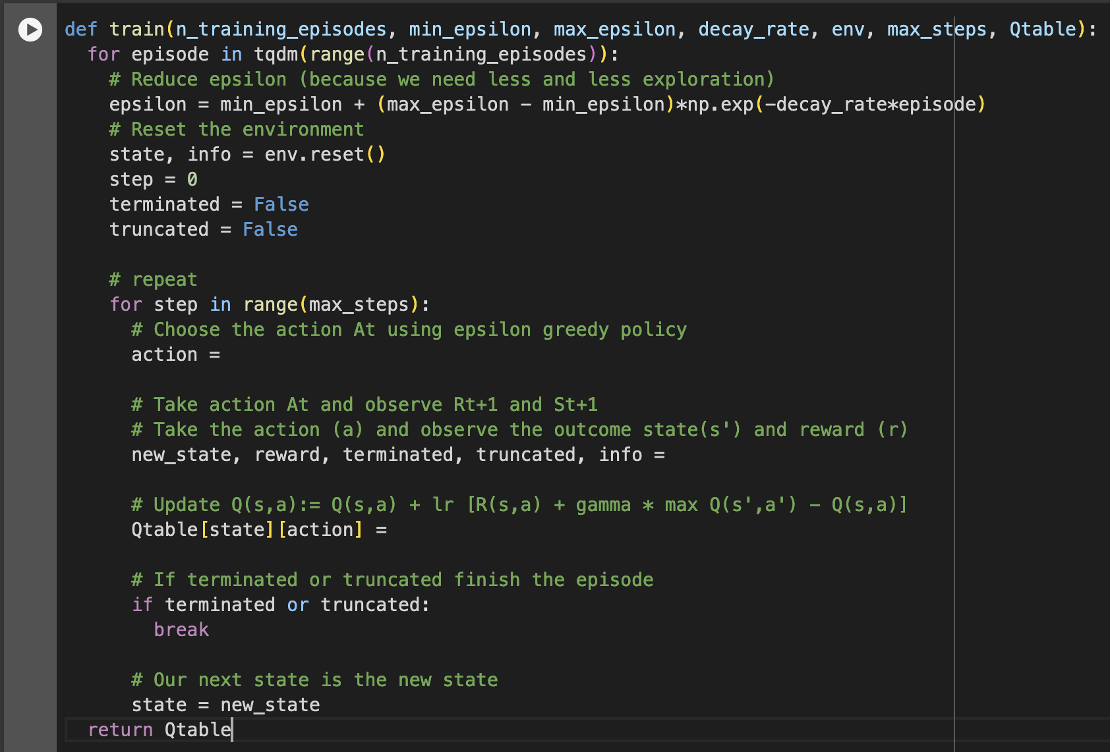
Task

Slide 25
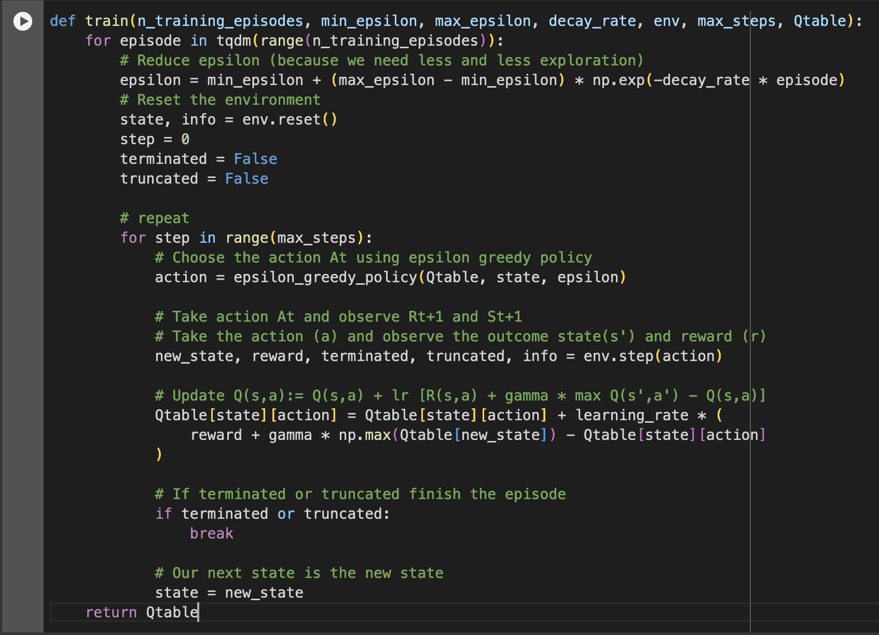
Solution

Slide 26
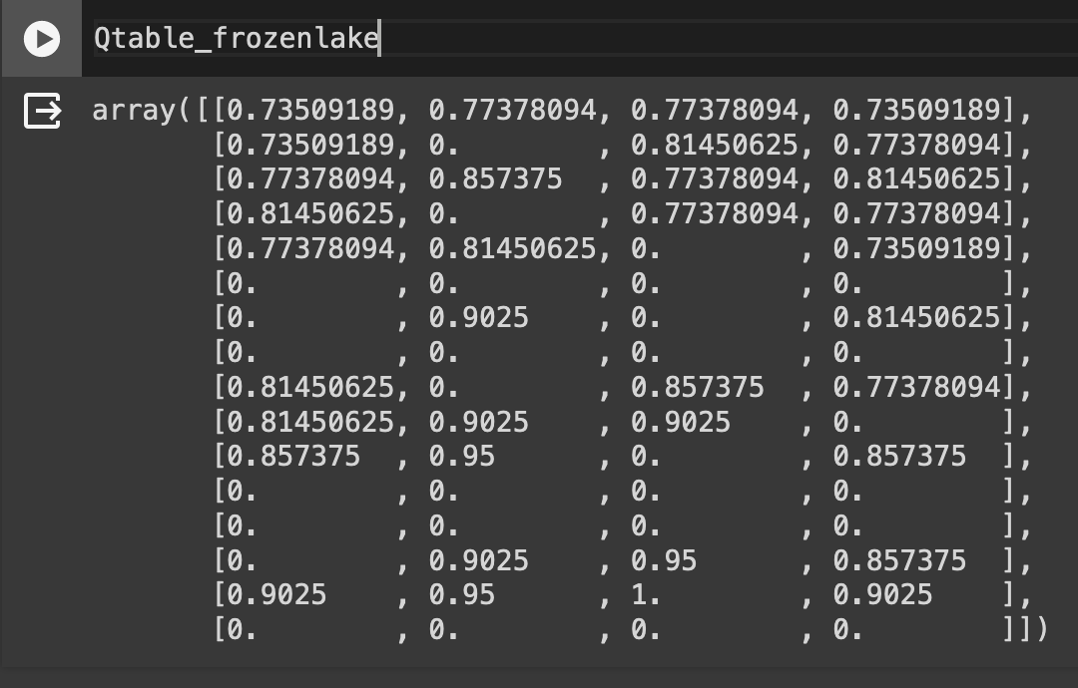
Train the Q-Learning agent 🏃
Let’s see what our Q-Learning table looks like now 👀

Slide 27
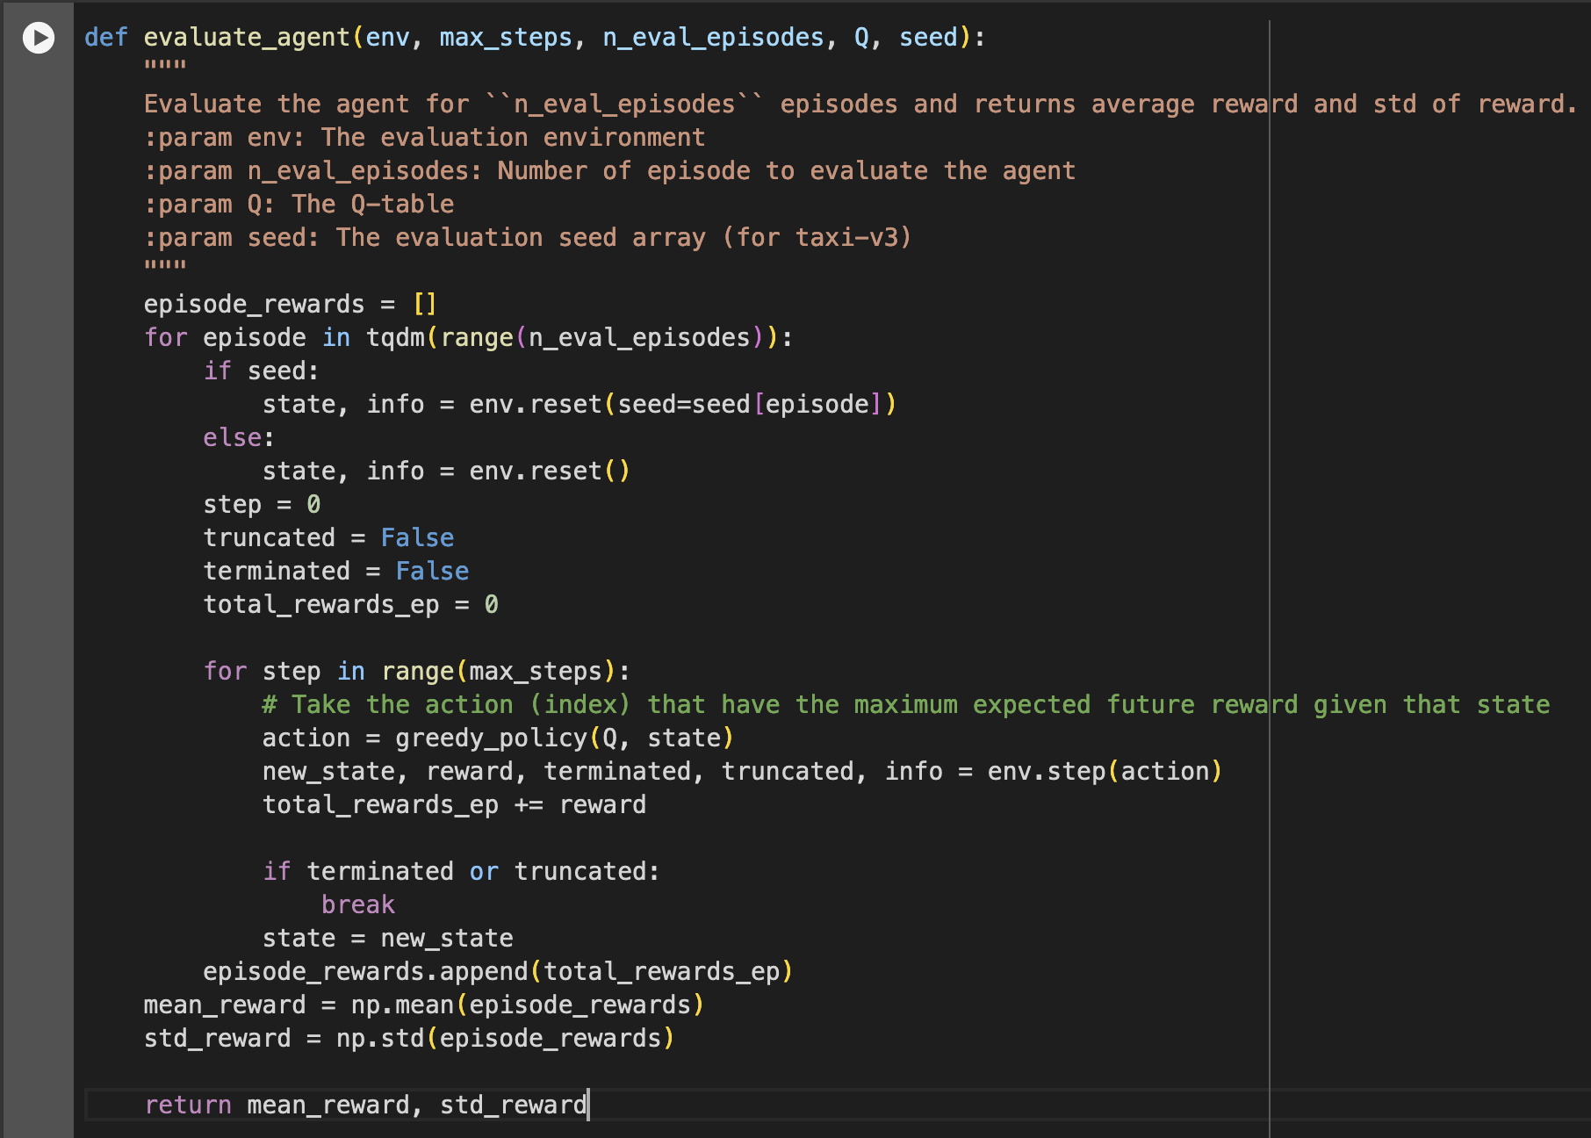
The evaluation method 📝
We defined the evaluation method that we’re going to use to test our Q-Learning agent.

Slide 28
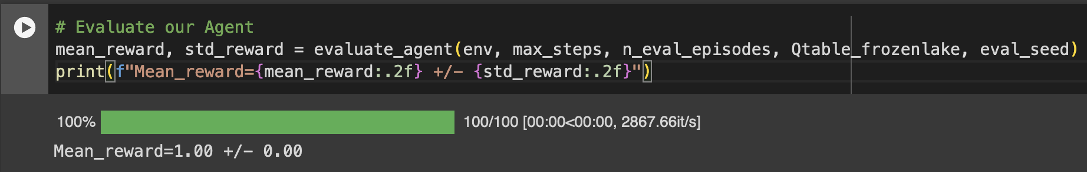
Evaluate our Q-Learning agent 📈
Usually, you should have a mean reward of 1.0
The environment is relatively easy since the state space is really small (16). What you can try to do is to replace it with the slippery version, which introduces stochasticity, making the environment more complex.

Slide 29
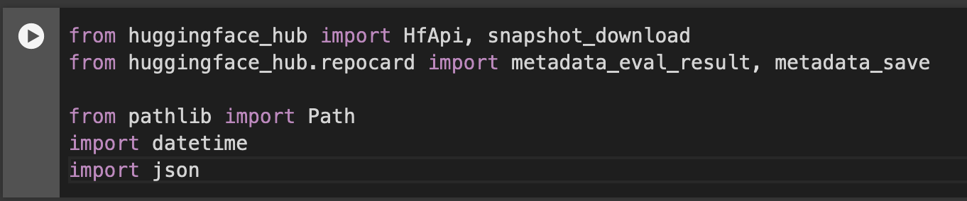
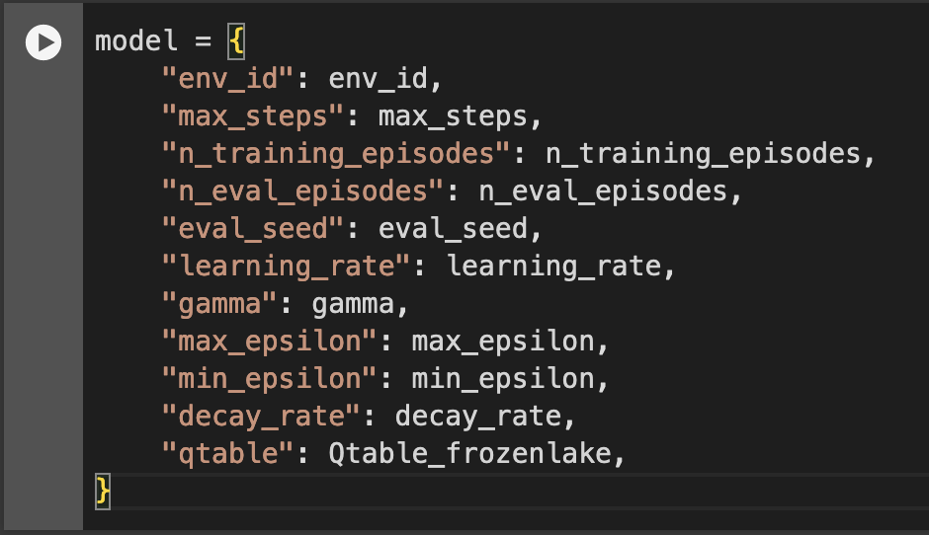
Publish your trained model
After loading the libraries (above) and defining the model (right), use the record_video and push_to_hub methods to publish your model.

Slide 30
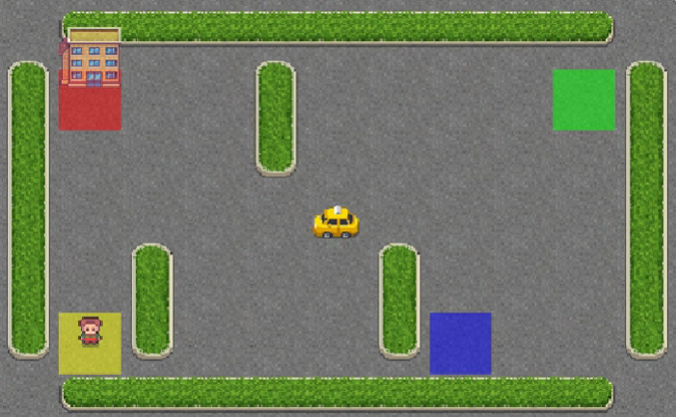
Part 2: Taxi-v3 🚖
In Taxi-v3 🚕, there are four designated locations in the grid world indicated by R(ed), G(reen), Y(ellow), and B(lue).
When the episode starts, the taxi starts off at a random square and the passenger is at a random location. The taxi drives to the passenger’s location, picks up the passenger, drives to the passenger’s destination (another one of the four specified locations), and then drops off the passenger. Once the passenger is dropped off, the episode ends.

Slide 31
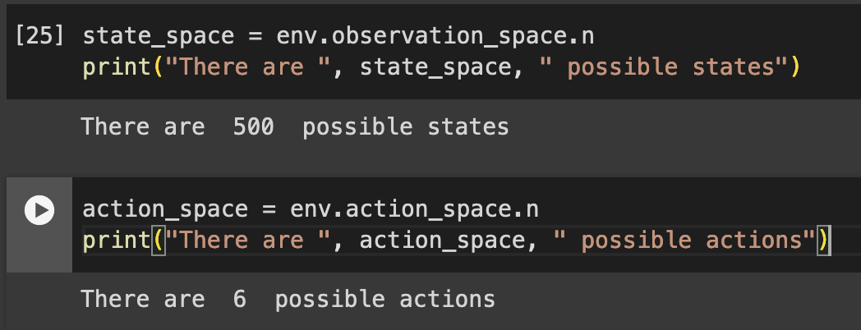
Taxi
There are 500 discrete states since there are 25 taxi positions, 5 possible locations of the passenger (including the case when the passenger is in the taxi), and 4 destination locations.

Slide 32
Action and Reward
The action space (the set of possible actions the agent can take) is discrete with 6 actions available 🎮:
0: move south
1: move north
2: move east
3: move west
4: pickup passenger
5: drop off passenger
Reward function 💰:
-1 per step unless other reward is triggered.
+20 delivering passenger.
-10 executing “pickup” and “drop-off” actions illegally.

Slide 33
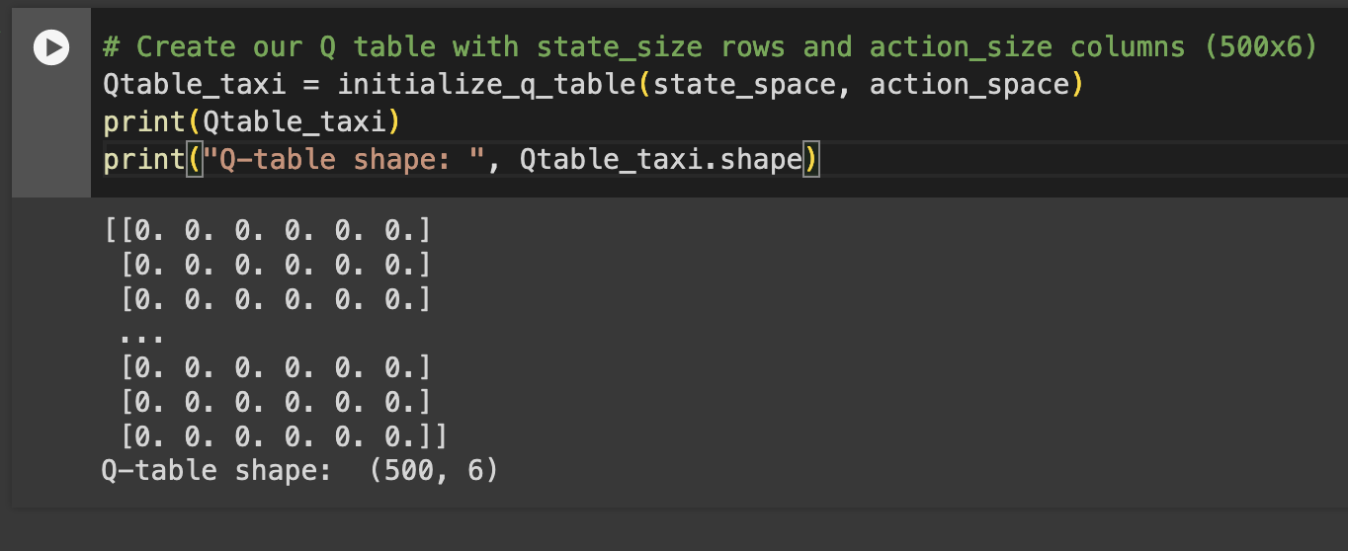
Code

Slide 34
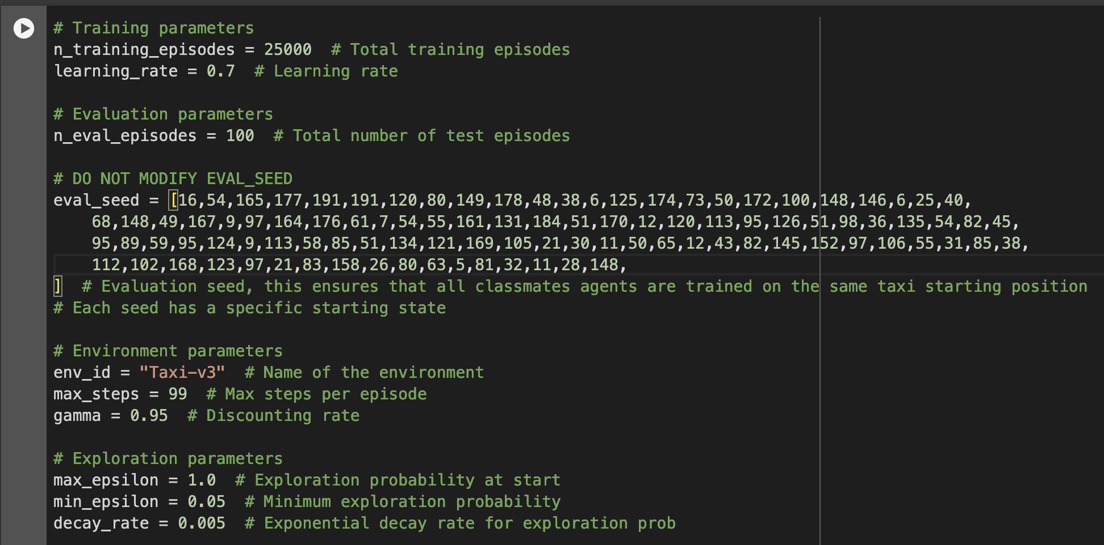
Define the hyperparameters ⚙️

Slide 35
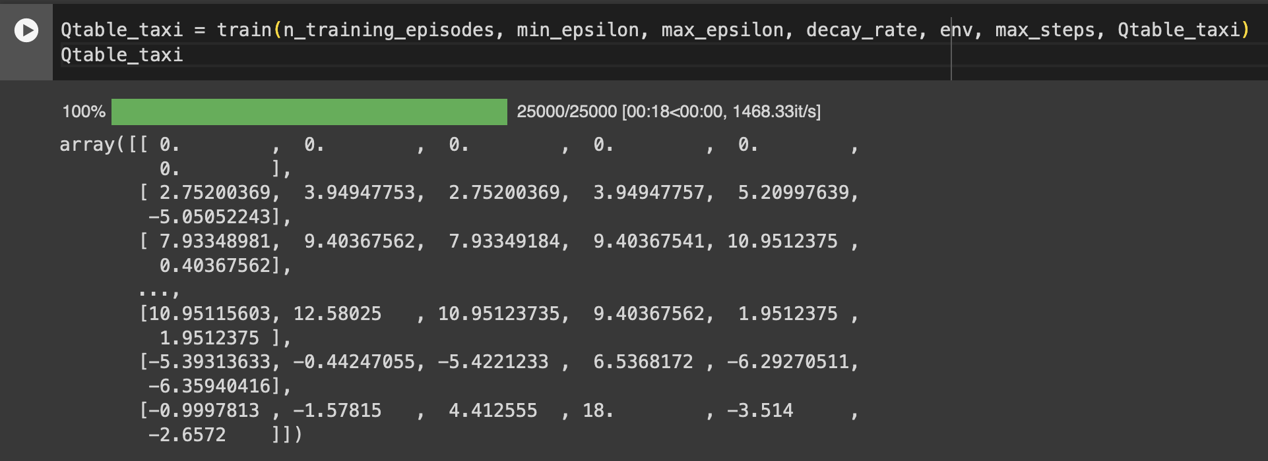
Train our Q-Learning agent 🏃

Slide 36
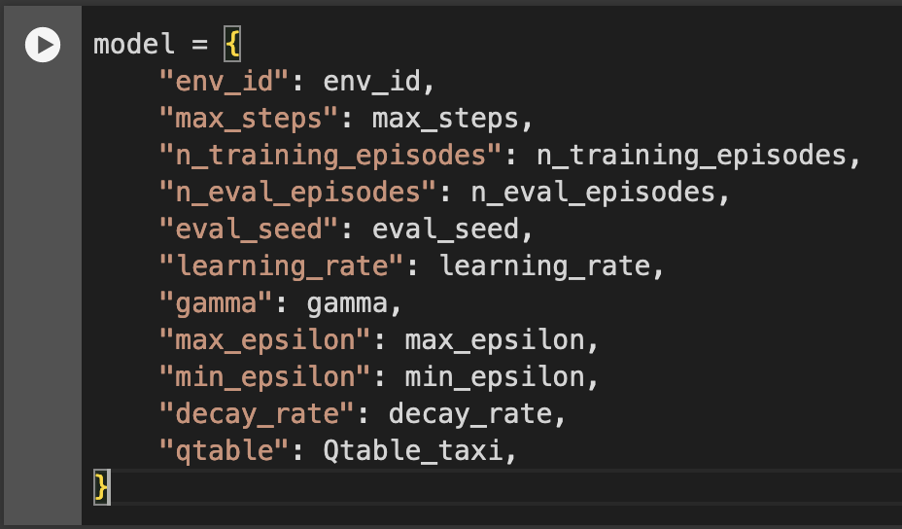
Create a model dictionary and publish
We create a model dictionary that will contain all the training hyperparameters for reproducibility and the Q-Table.

Slide 37

Questions?

