Slide 1
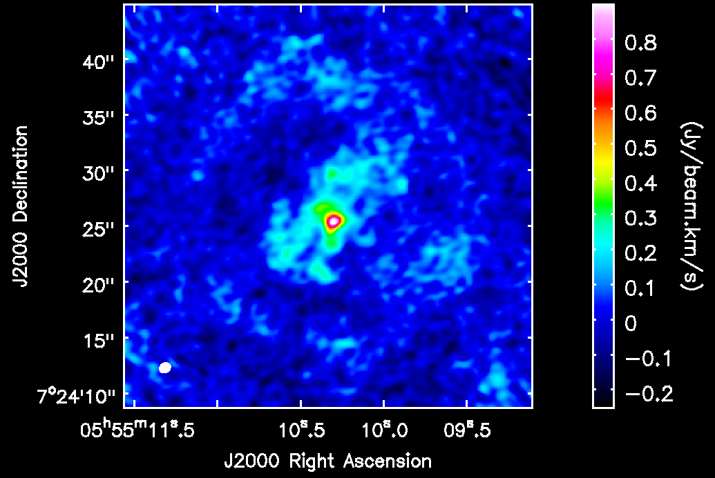
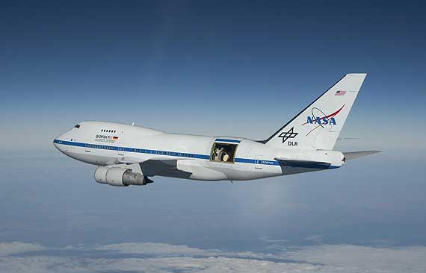
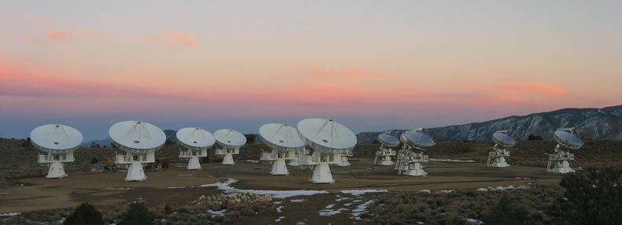
An international team of scientists, lead by Dr. Graham Harper and
Eamon O'Gorman of TCD, has, for the first time, measured the sizes of two nested outflows from the M supergiant Betelgeuse.
The new results, published in this month's The Astronomical Journal (O'Gorman et al., 2012, AJ, 144, 36), were obtained by combining three different arrangements of the 15
antenna CARMA millimeter radio array in Cedar Flat CA.
The size of the outer flow is greater than estimates obtained from large single dish telescopes, while the inner outflow is confirmed as the source of excited CO observed with NASA-DLR SOFIA.
Betelgeuse
+ S1 Flow
S2 Flow
SOFIA
CARMA
Credit: NASA/Jim Ross
Credit: Andrew A. West, U.C. Berkeley/ Radio Astronomy Lab

