Slide 1


Winds of cool supergiant stars driven by Alfvén waves
Vera Jatenco-Pereira
University of São Paulo
Institute of Astronomy, Geophysics and Atmospheric Science
São Paulo - Brazil
Cool Stars XV, St. Andrews, 2008.

Slide 2
Plan
Stellar winds
Alfvén waves as driving wind mechanism
Proposed model for wind acceleration
Results and Conclusion

Slide 3

1. Stellar Winds
Stellar mass loss has been systematically derived from observations and is present in almost all regions of the HR diagram.
In general, stars with the same spectral type and luminosity class show characteristic values of
mass loss rate
and
terminal velocity

Slide 4
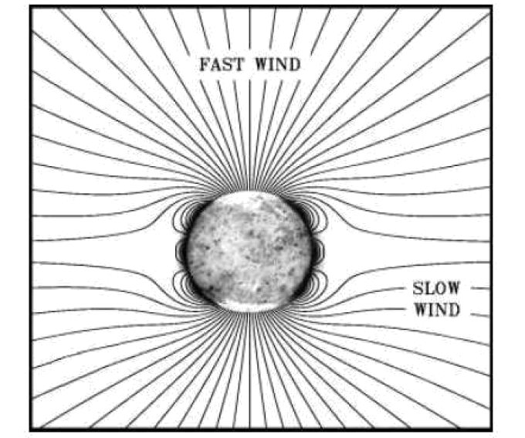
Solar Wind
→ a necessary reference for the study of stellar winds.
The outflowing solar wind → guided by open mangetic flux tubes
1971: Detection of Alfvén waves in the Sun
Models:
Alfvén waves responsible for the fast wind.
Cranmer & Ballegooijen (2005).

Slide 5

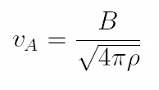
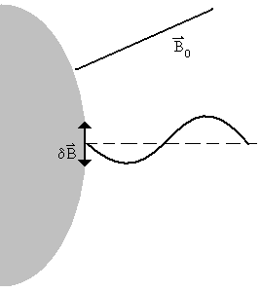
2. Alfvén waves as driving wind mechanism
(Hannes Alfvén 1942)
Transverse wave;
Incompressible ;
Pertubations perpendicular to the magnetic field;
Magnetic field lines curved due to plasma motion and restored due to magnetic tension.

Slide 6
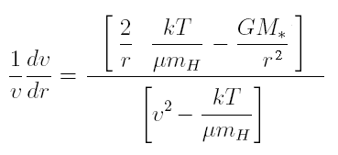
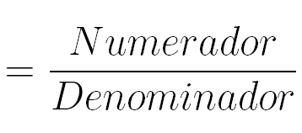
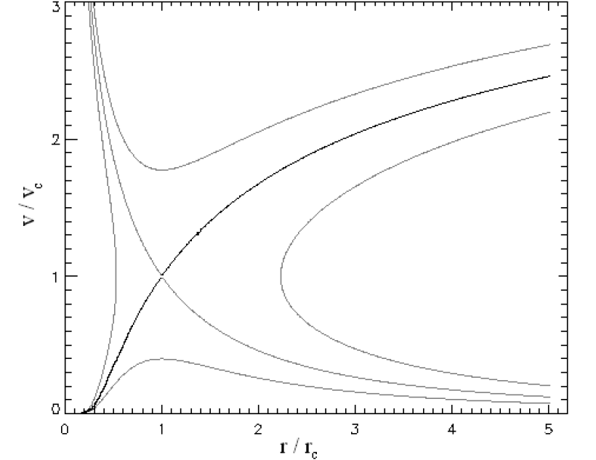
Critical Solution
N
Considering only
Gravity and Gas Pressure
D
For the critical curve
N < 0
D < 0
N = 0 = D
N > 0
Critical Point
D > 0
(Lamers & Cassinelli 1999)

Slide 7
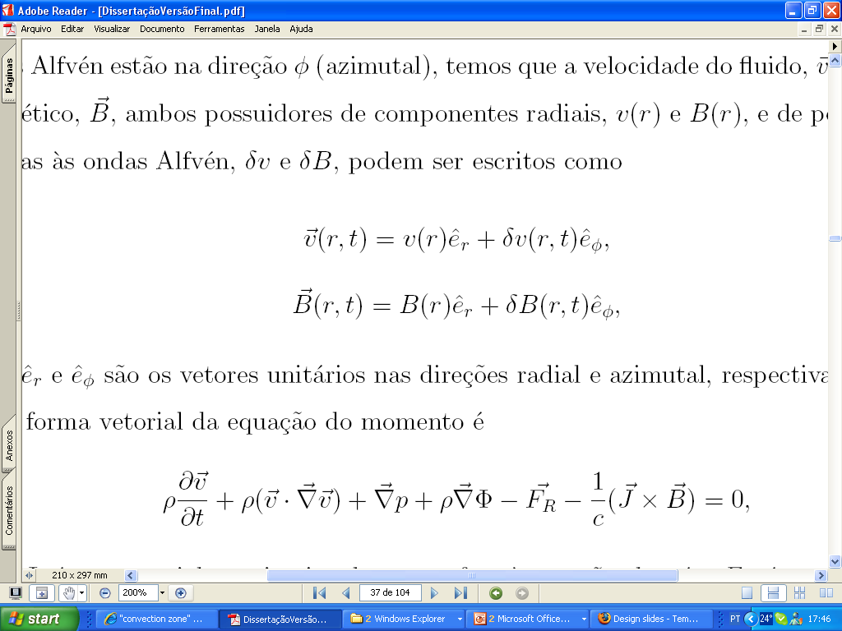
Alfvén wave and the momentum equation
The vetorial momentum equation is given by
Radiative force
Acceleration
Gravity
Magnetic force
Gas pressure gradient
The velocity fluid and magnetic field are given by
Perturbations

Slide 8
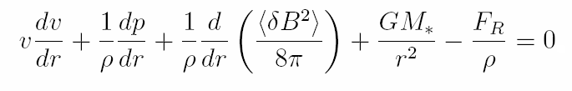
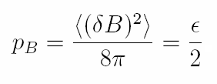

Assuming steady state and WKB approximation, the radial momentum equation can be written as:
The perturbations due to Alfvén waves generate a force in the form of a magnetic pressure gradient.
The wave energy density

Slide 9
Late-Type stars winds
Several models have been proposed using the transference of momentum and energy from Alfvén waves to the gas.
Models:
constant damping length (Hartmann, Edwards & Avrett 1982)
radial geometry of magnetic field (Hartmann, Edwards & Avrett 1982)
isothermal and simplified magnetic field geometry (Jatenco-Pereira & Opher 1989)
winds with ad hoc temperature profile (Falceta-Gonçalves & Jatenco-Pereira 2002)
self-consistently determination of magnetic flux tube (Falceta-Gonçalves, Vidotto & Jatenco-Pereira 2006)

Slide 10
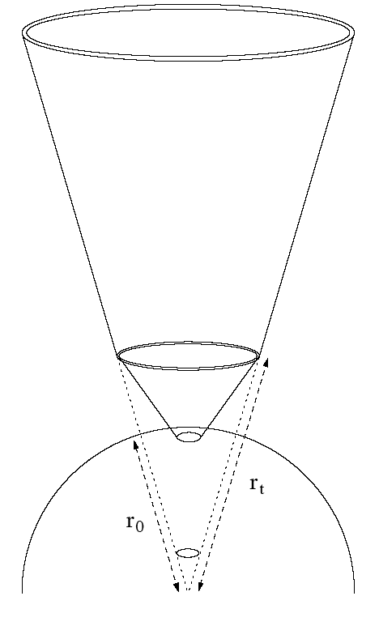
A simplified coronal holes geometry
Super-radial at the base and radial after a distance, called transition radius (r_{t}). The cross section of the flux tube, showed in the figure, is given by
Kuin and Hearn (1982) and Parker (1963)
S = 2
S > 2
M = 16 M
r₀ = 400 R
T₀ = 3500 K
B₀ = 10 G
φ_{A0} = 10⁷ erg cm⁻² s⁻¹
Model for a cool K5
supergiant star:
Flux of Alfvén waves --> non-linear damping mechanism.

Slide 11





A simplified coronal holes geometry
Mass:
Momentum:
Energy:
Heating due to Alfvén waves.
Radiative cooling.
Wave energy density.

Slide 12
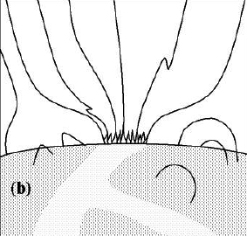

Self consistent coronal holes geometry
Following Pneuman, Solanki & Stenflo (1986), it is possible to determine self-consistently the flux tube geometry by considering equilibrium between internal and external pressures.
Plasma conditions:
- internal magnetic field at r₀: B₀
- external magnetic field at r₀: negligible
low-beta plasma → gas pressure
negligible.
Cranmer & Ballegooijen (2005).
We solve the set of equations: mass, momentum and energy together with the determination of magnetic curvature.

Slide 13
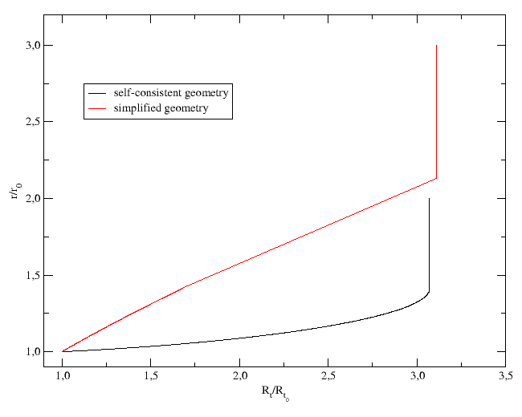
Results: Flux tube geometry
Evolution of tube radius with height.
Both geometries reach similar maximum radius considering a filling factor of 10%.
The difference is that the self-consistent geometry reach the maximum radius at lower height.

Slide 14
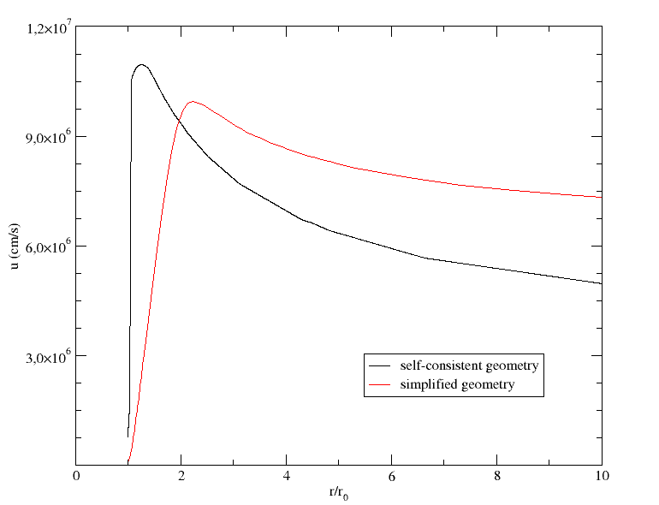
Results: Velocity profile
The v_{max} for self-consistent geometry is higher because the wave energy is fully deposited at the wind basis.
However, the u∞ is lower because at larger distances the wave energy flux is extinguished.

Slide 15
Conclusions
Solving self-consistently the mass, momentum and energy equations we evaluated the v(r) profile for a cool K5 supergiant star wind:
an outward-directed flux of damped Alfvén waves in order to drive the wind;
We modeled the magnetic field structure by:
- empirical geometry and
- self-consistent determination.
As main result we show that the magnetic geometry present a super-radial index due to the balance between internal and external magnetic pressure.
We compare the v(r) profiles for both magnetic geometries
⇒ showing the importance of a realistic field structure for wind models.
Thank You!

