Slide 1


Eamon O'Gorman
Trinity College Dublin
November 15, 2013
Supervisor: Prof. Graham Harper
Notes:
Once a star moves off the main sequence its mass loss rate increases substantially. Occurs via a slow moving low temperature wind wind. The mechanisms which drive these winds remain unknown due to our lack of understanding of the dynamics and thermodynamic of these outflow environment. Our lack of understanding is mainly due to limited disk averaged information. The latest suite of radio interferometers now have the capabilities to provide either direct spatially resolved information on these stars or through multi-frequnecy analyis which by the nature of free-free radio emission, probe different layers of the stellar atmosphere.

Slide 2

Overview
Mass-loss across the HR diagram
Mass-loss Diagnostics
Stellar Radio Emission Mechanisms
Red Supergiants vs. Red Giants
1) Winds of Red Supergiants
  1(a) mm study of Betelgeuse's CSE
  1(b) cm study of Betelgeuse's wind acceleration region
2) Winds of Red Giants
  2 (a) Multi-wavelength cm study
  2 (b) Thermal energy balance
Concluding Remarks

Slide 3
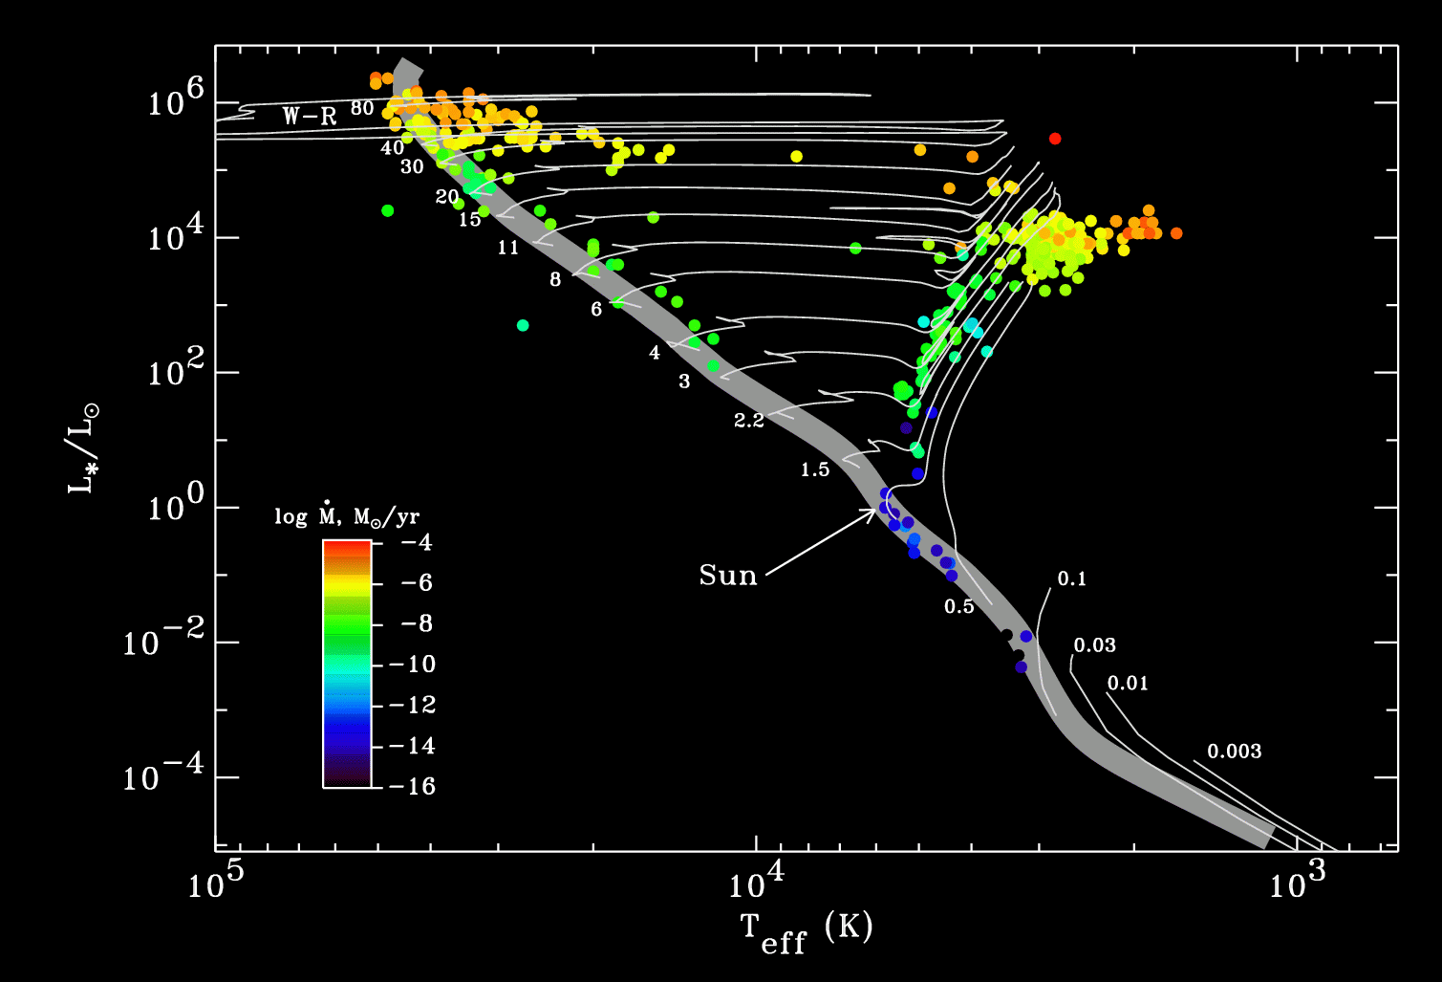
Mass-loss Across the H-R Diagram
Cool Evolved Stars: AGB + non-AGB
Image Credit: S. R. Cranmer
Page 1
Notes:
a) Enrich the interstellar medium b) Vital for stellar evolution
Massive stars (between 8 and 40 solar masses), massive fast winds, driven by radiation pressure. Most evolve almost horizontally to become red supergiants.
Low to intermediate mass stars
Solar-type stars: coronal winds (driven by MHD turbulence?)
Massive stars: radiation-driven winds
AGBs have been extensively studied and mass-loss occurs through a combination of pulsation/dust-driven winds

Slide 4
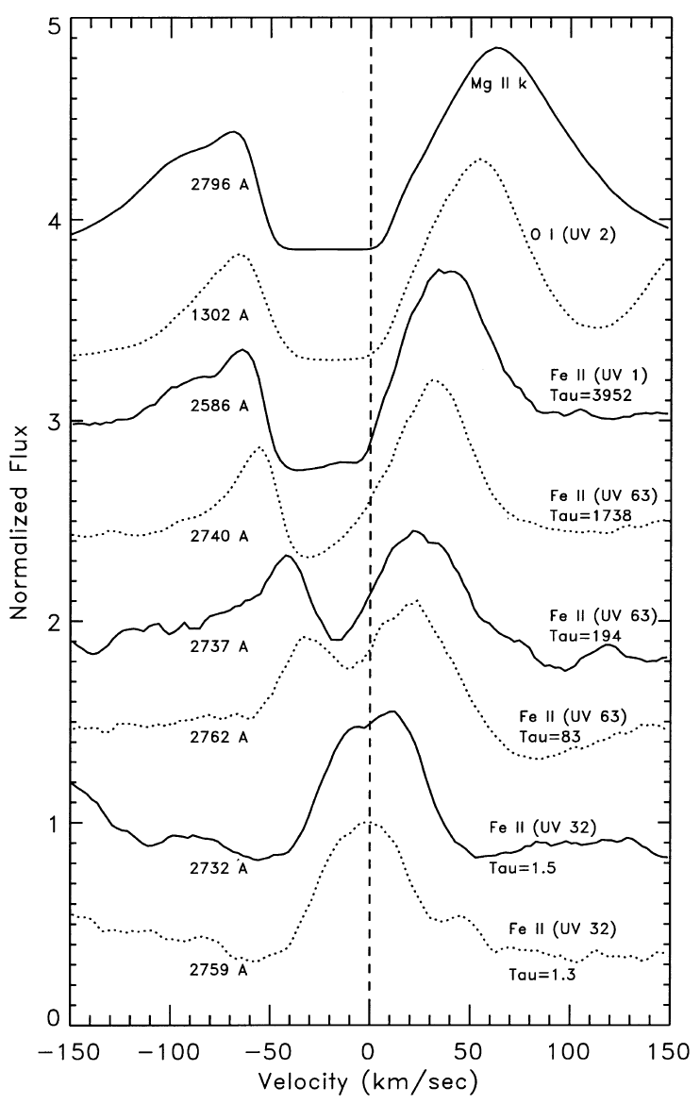
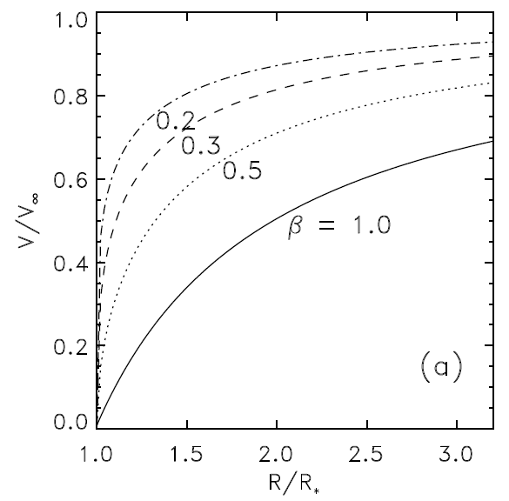
Traditional Diagnostics of Mass Loss
λ Vel (K5 Ib-II)
Robinson et al., (1998)
Optical and UV spectroscopy:
Full ''P Cygni'' profiles or blueshifted absorption
IR continuum: Dust excess
Molecular lines:
mm, sub-mm (disk averaged)
Centimetre continuum:
Ionized mass rate.
Single wavelength detections
Carpenter et al., (1999)
Page 2
Notes:
HST Goddard High-Resolution Spectrograph (GHRS) spectra showing the increase of wind scattering absorption velocity with optical depth for strong chromospheric lines. These data were taken for Vel (a K5 Ib-II star) and show that it’s wind accelerates in a quasi-steady manner.
HST allowed the important UV diagnostic transitions (e.g., lines from
Cii, Fe ii, Mg ii, and Oii) to be observed with superb detail. The photonscattering wind produces self-reversals in these chromospheric emission lines and revealed that, for the most part, the red giant winds accelerate in a quasi-steady manner and are not the result of ballistic ejecta. This is inferred by the increase of wind scattering absorption velocity with optical depth, and thus height in the wind, as shown in Figure 1.2 (Carpenter et al., 1999). The P Cygni-type line profiles, which are indicative of stellar outflows, are also shown in Figure 1.2 for the Mg ii and Ca ii resonance lines of α Boo (K2 III). For many evolved stars,
these disk averaged emission line profiles have also provided crude estimates of atmospheric properties such as the mass-loss rate and terminal velocity, by comparing them to synthetic profiles based on detailed radiative transfer code.
Increase in the wind scattering absorption velocity with optical depth. Acceleration in a quasi steady manner and not ballistic ejecta.

Slide 5
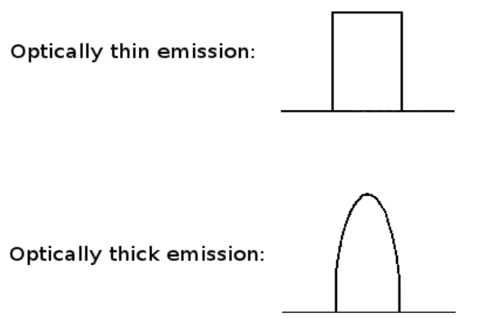
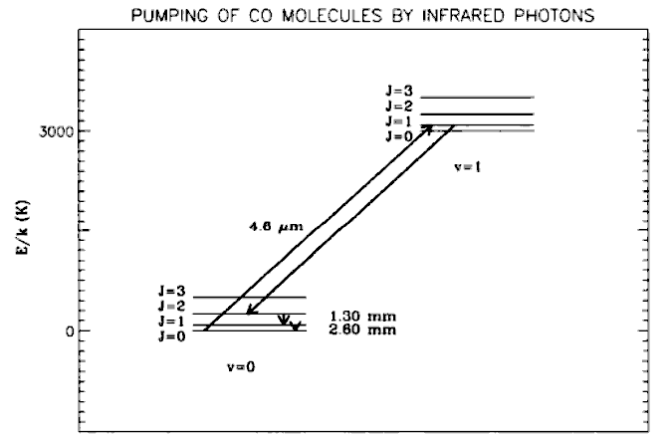
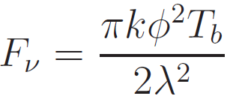
Radio Emission Mechanisms
1) Molecular Emission lines
Line profiles are either flat-topped or parabolic
Line full widths typically between 20 and 50 km s⁻¹
CO: Both O-rich and C-rich stars. Stable.
Excitation processes for CO: H2 collisions. Photo-excitation of vibrational levels by IR photons.
1) Thermal Bremsstrahlung Emission
Opacity is proportional to ~ λ²
Credit: NRAO/AUI
Page 3
Notes:
High mass loss rates + low outflow velocities = relatively high density
Can form over a region with a radius of the order of 104 stellar radii:
Usually smaller than vesc at stellar surface but molecular lines form at large distances from star where local escape velocity << vesc
H2 collisions excite rotational levels

Slide 6
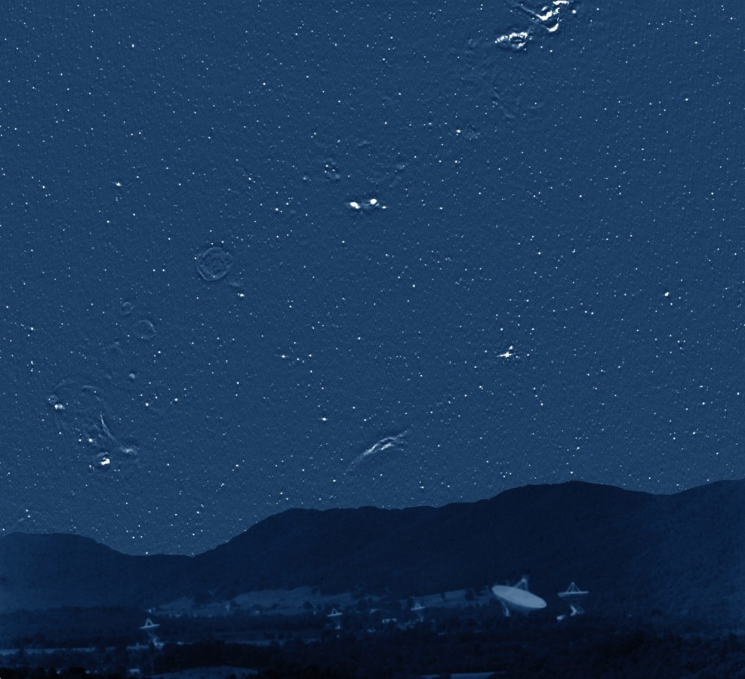
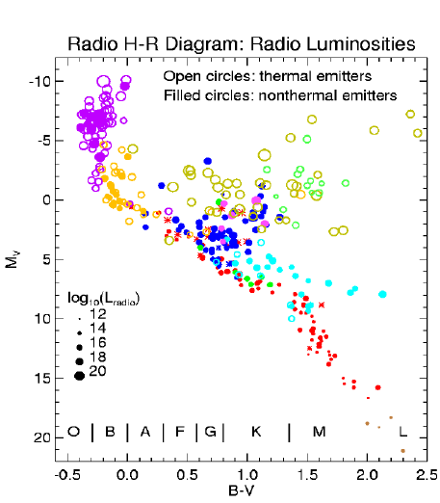
Stellar Radio Emission
Radio Sky at 4.85 GHz (300ft Green Bank)
(Pradio/Poptical)_{ʘ} ~ 10⁻¹⁵
Sυ=4.6 GHz ~ 40 μJy at α Cen
(not detectable with 'old' VLA!)
Credit: NRAO/AUI
Credit: NRAO/AUI
White (2000)
Page 4
Notes:
The brightest irregular sources are clouds of hydrogen ionized by luminous stars. Such stars quickly exhaust their nuclear fuel, collapse, and explode as supernovae, whose remnants appear as faint radio rings. Unlike the nearby (less than 1000 light years distant) stars visible to the human eye, almost none of the myriad radio "stars" scattered over the sky are really stars at all. Most are luminous radio galaxies or quasars.
The power (Energy per second) that the sun gives out at radio wavelengths divided by the power given out in the optical (which is almost all of the radiation of the sun) is about 10-16, so from an energy point of view its very very little
The fact that so many stars are detected tells us immediately that they are doing something different from the Sun. The stars are color-coded, with the key to different types of stars given at the bottom of the image. Main sequence dwarf stars are ordinary cool stars similar to the Sun: they tend to be detected as radio sources if they are young and/or rapidly spinning. T Tauri stars are very young stars shortly after birth. The letters at the bottom of the figure show the ranges of different spectral types of stars. The filled symbols represent stars which appear to have "nonthermal coronae", that is, unlike the Sun where the outer atmosphere is mostly just heated up, in these stars the atmosphere is full of very energetic accelerated electrons which are responsible for the radio emission.

Slide 7
Red Supergiants vs. Red Giants
 | Red Giants | Red Supergiants
Mass (Mסּ) | ~ 0.4 → ~ 8 | ~8 → ~ 40
Radius (Rסּ) | ~ 50 | ~ 500
Lifetime (yr) | ~ 10⁹ | ~ 5x10⁵
dM/dt (Mסּ yr⁻¹) | ~ 10⁻¹⁰ | ~ 10⁻⁵
Total dM/dt (Mסּ) | ~ 0.1 | ~ 5
Vteminal< v* escape
HP/R ~ 10⁻²
Twind < 10⁴ K
No coronae.
Insufficient dust opacity.
Small pulsation amplitudes.
Page 5

Slide 8
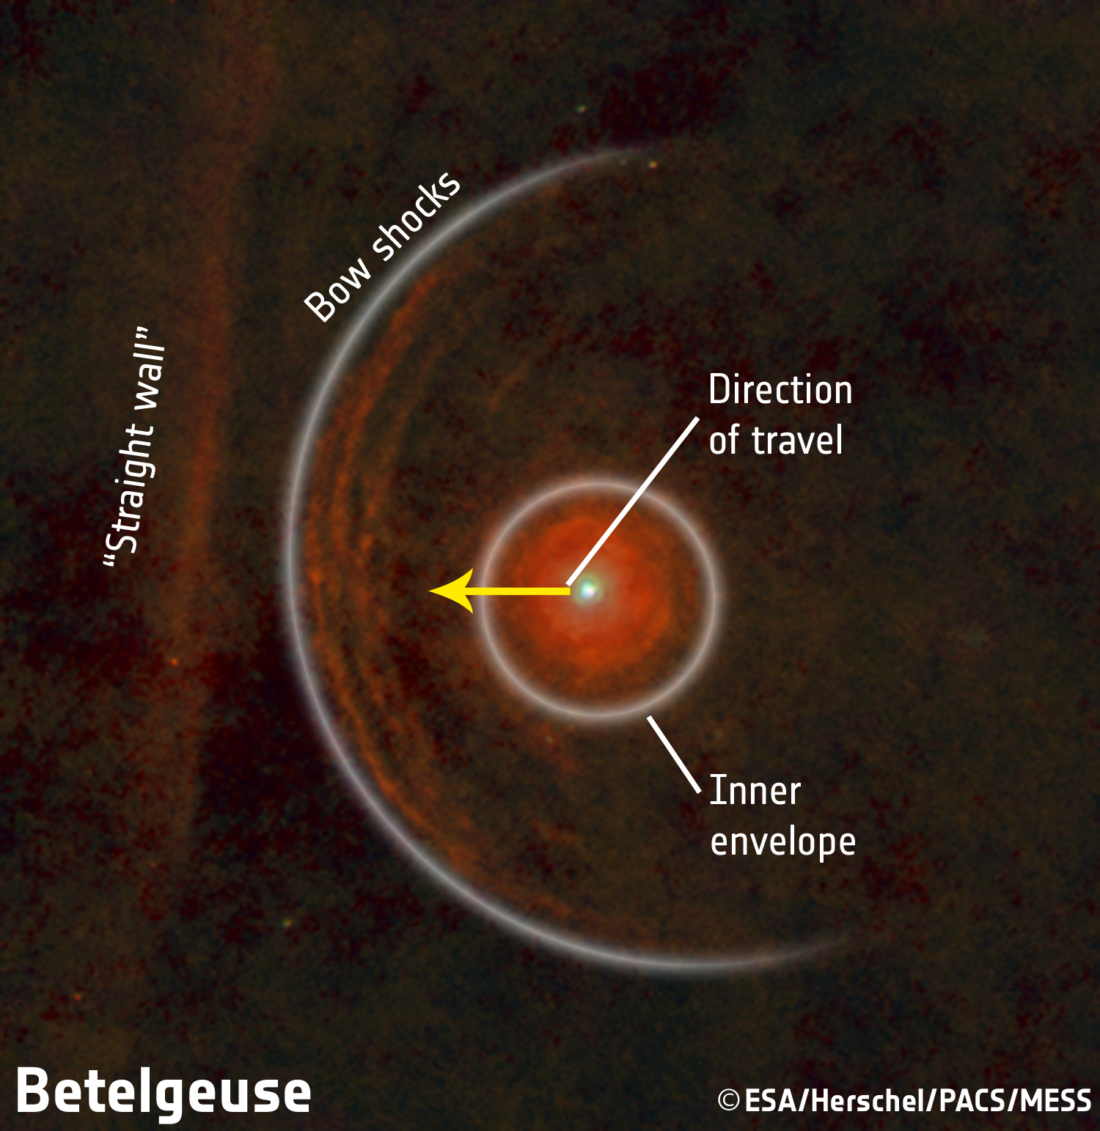
1) Winds of Red Supergiants
Betelgeuse (M2 Iab)
Log(L/L_{ʘ}) | 5.12
Distance | 197 ± 45 parsec
Photospheric Radius | 22.5 mas (950 R_{ʘ})
Mass (current) | ~15 - 18 M_{ʘ}
Mass loss rate | 3 x 10⁻⁶ M_{ʘ} yr⁻¹
Photospheric Temperature | 3,600 K (cool star)
Origin | O-type main sequence
Fate | Supernova Type II
¹²C/¹³C | 6 ± 1
(Decin et al., 2013)
Page 6

Slide 9
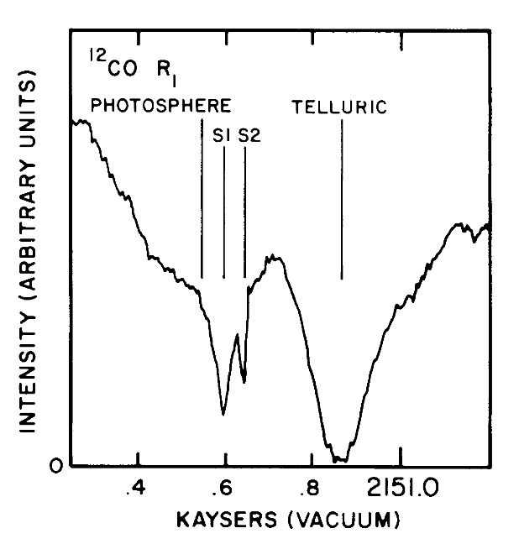
1 (a): Betelgeuse: Circumstellar Environment
(Bernat et al., 1979)
At least two recent mass loss phases
Two distinct shells spectrally resolved at 4.6 μm:
  S2, moving at 17 km s⁻¹
  S1, moving at 10 km s⁻¹
  Spatial extent not directly determined
Page 7

Slide 10
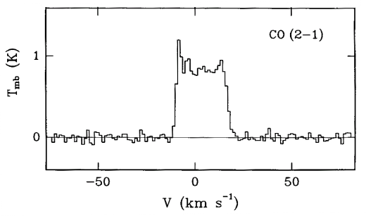
1 (a): Betelgeuse: Circumstellar Environment
(Bernat et al., 1979)
At least two recent mass loss phases
Two distinct shells spectrally resolved at 4.6 μm:
  S2, moving at 17 km s⁻¹
  S1, moving at 10 km s⁻¹
  Spatial extent not directly determined
Plez & Lambert (2002) appear to detect S2 shell at 50''
IRAM 30 m (θHPBW ~12") fails to resolve S2 shell at 1.3 mm
Single dish ¹²C¹⁶O mm-observations reveal only high velocity S2 shell.
(Huggins et al., 1994)
Page 7

Slide 11
1 (a): Betelgeuse: Circumstellar Environment
(Bernat et al., 1979)
At least two recent mass loss phases
Two distinct shells spectrally resolved at 4.6 μm:
  S2, moving at 17 km s⁻¹
  S1, moving at 10 km s⁻¹
  Spatial extent not directly determined
Plez & Lambert (2002) appear to detect S2 shell at 50''
IRAM 30 m (θHPBW ~12") fails to resolve S2 shell at 1.3 mm
Single dish ¹²C¹⁶O mm-observations reveal only high velocity S2 shell.
(Huggins et al., 1994)
Goal 1 (a): Measure both the spatial scales and the velocities of Betelgeuse’s outflow region using ¹²C¹⁶O J = 2-1 line as a tracer to sort out puzzling evidence.
Page 7

Slide 12
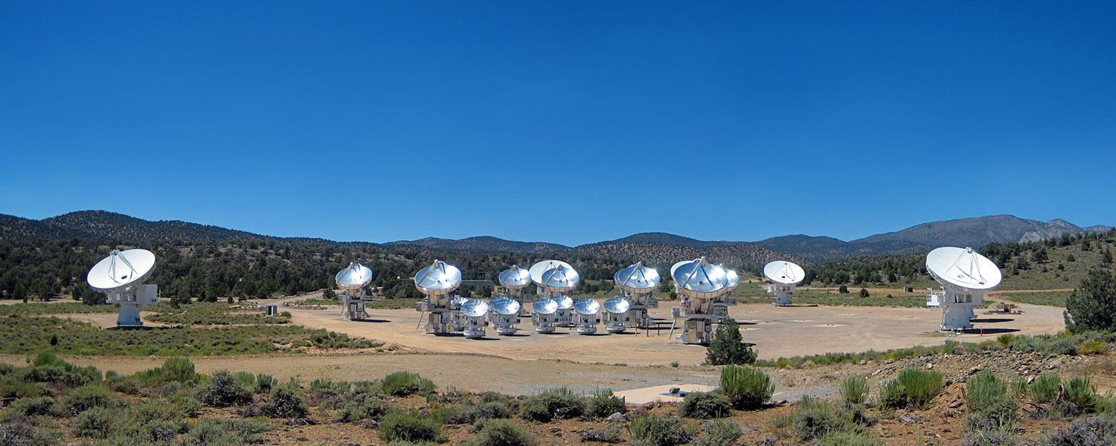
1 (a): CARMA
Combined Array for Research in Millimeter-wave Astronomy
Cedar Flat, eastern California (~ 2,200 m)
15 element interferometer (9 x 6.1 m + 6 x 10.4 m antennas)
Merger of two independent arrays: BIMA + OVRO (2007)
105 baselines (n(n-1)/2) with 5 configurations
Three bands: 7 mm, 3 mm and 1.3 mm
Credit: John Carlstrom
Page 8

Slide 13
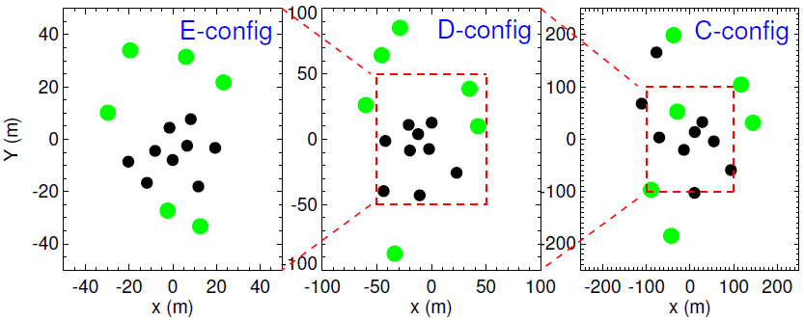
1 (a): mm Observations
Date | Config | Time (hr) | Resolution (") | Max Scale (")
Jun 07 | D | 8.4 | 2.1 | 15
Jul 09 | E | 3.2 | 4.4 | 19
Nov 09 | C | 8.4 | 0.9 | 6
Bmin= 8 m, Bmax= 66 m
Bmin= 11 m, Bmax= 150 m
Bmin= 30 m, Bmax= 350 m
Page 9

Slide 14
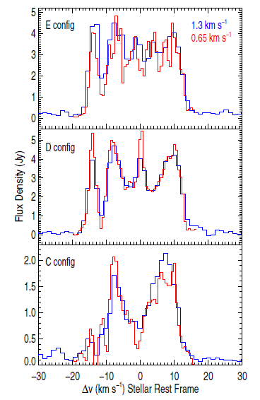
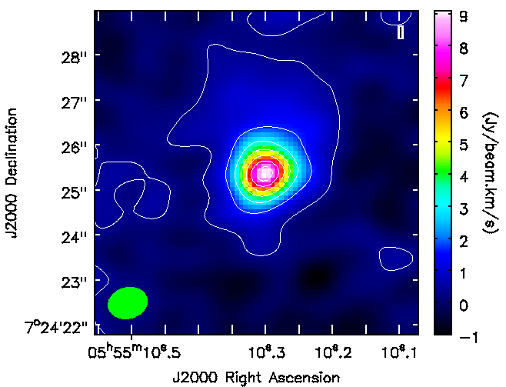
1 (a): Individual Configurations
Dec
velocity (km s⁻¹)
No shells in individual configuration image cubes.
RA
(O'Gorman et al., 2012)
Page 10

Slide 15
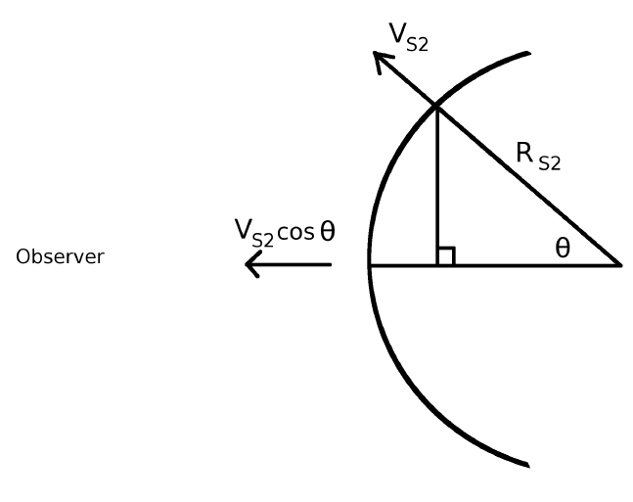
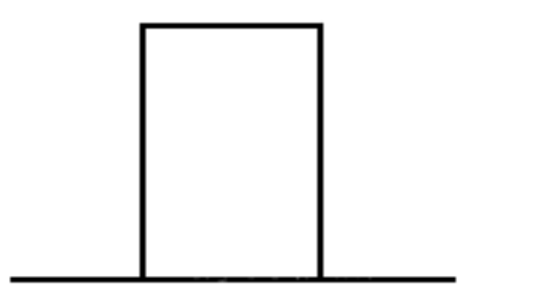
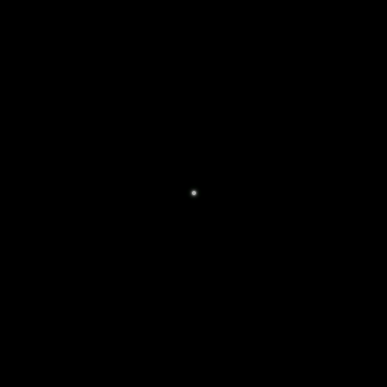
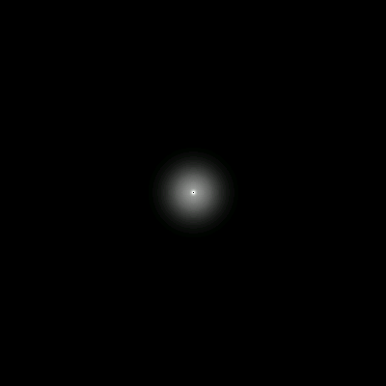
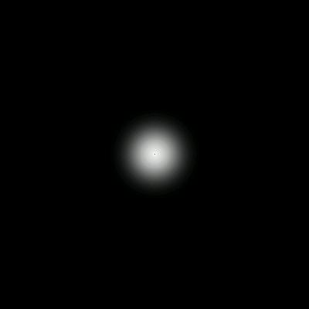



1 (a): Theoretical Shell
Flux
-15 0 15
Velocity (km s⁻¹)
-15 km s⁻¹
+15 km s⁻¹
Page 11

Slide 16
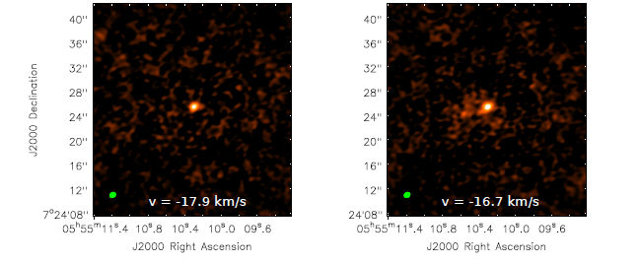
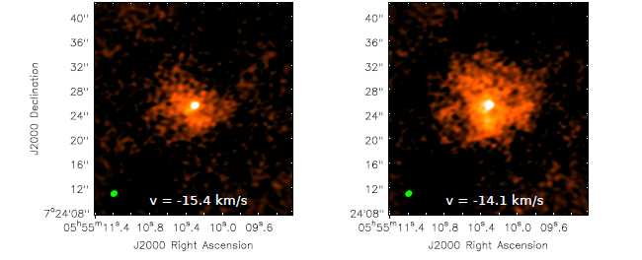
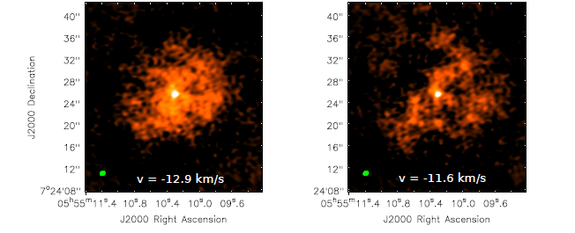
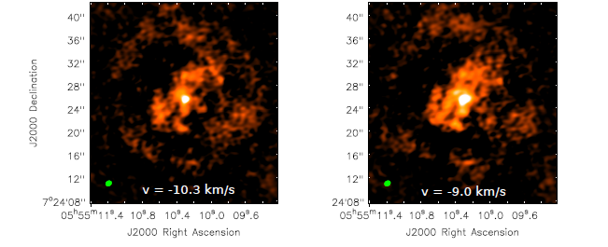
1 (a): Combined Configuration
Page 12

Slide 17
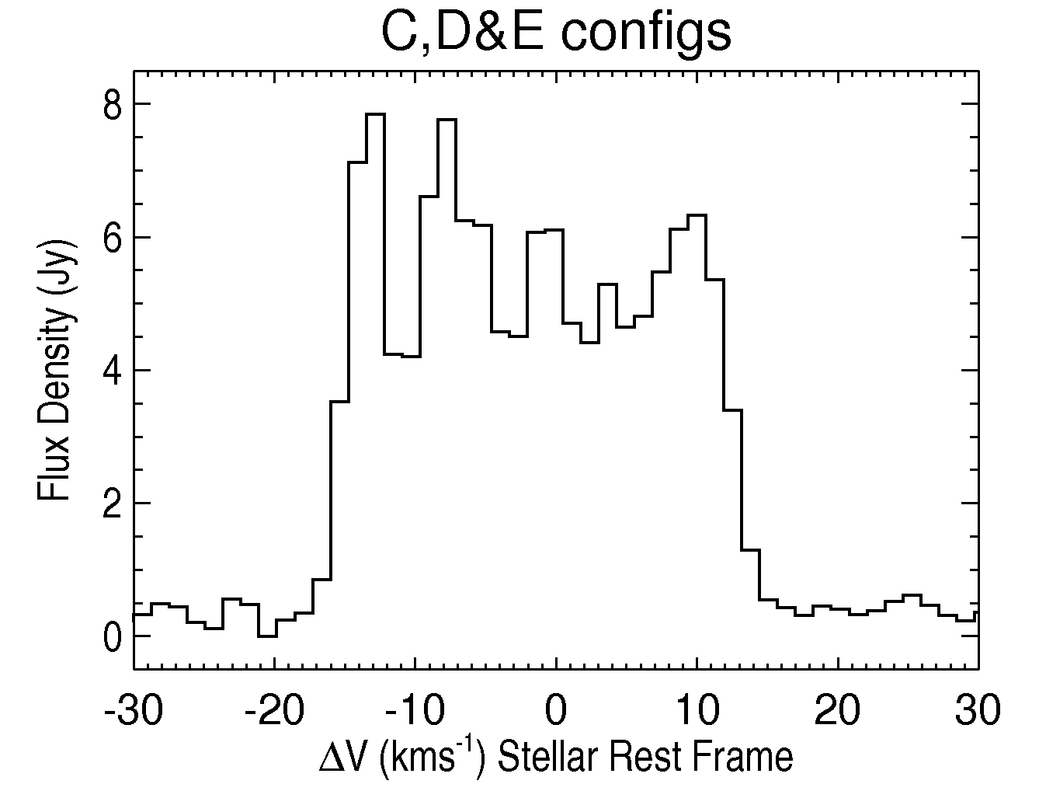
1 (a): Combined Configurations
Page 12

Slide 18
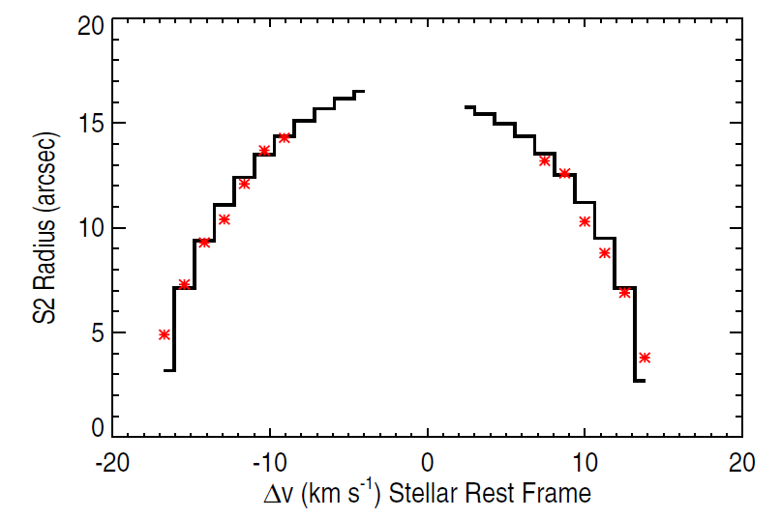

1 (a): S2 Flow
S2 flow not present at low absolute velocities.
(O'Gorman et al., 2012)
Page 13

Slide 19
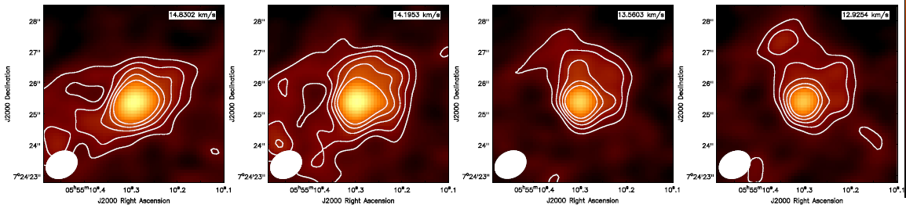
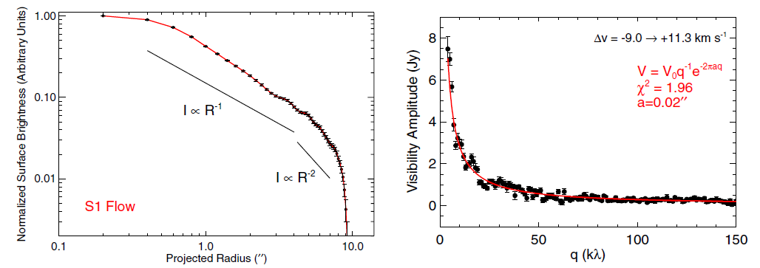
1 (a): S1 Flow
(O'Gorman et al., 2012)
(O'Gorman et al., 2012)
Page 14

Slide 20
1 (a): Conclusions
The high spatial resolution C configuration resolves out extended emission leaving us with S1 emission profile.
Multiple CARMA configurations provide the high spatial resolution needed to study the inner S1 shell while also ensuring that larger structures (i.e. S2 shell) are not resolved out.
Previous line profiles not horned shaped because:
    S1 emission is also present
    S2 emission weak at low absolute velocities
 | S1 | S2
Outflow Velocities (km s⁻¹) | 2.1 | 15
Maximum Spatial Extent ('') | 4 → 6 | 17
Age (yr) | 400 → 600 | 1100
Page 15

Slide 21
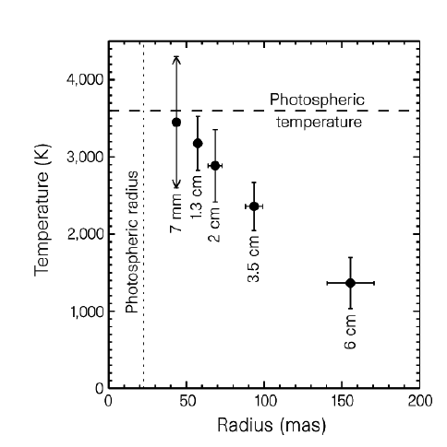
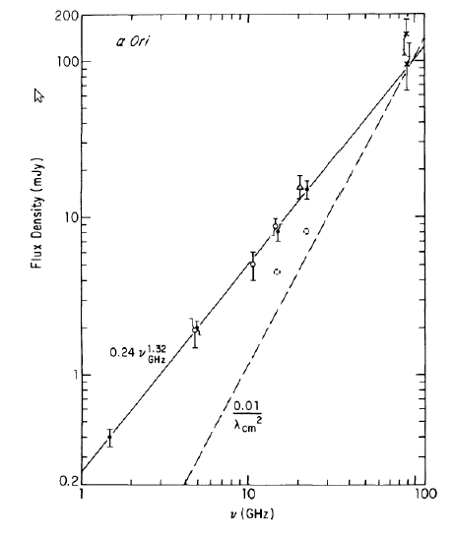
1 (b): Betelgeuse at cm w/ls: Wind Acceleration Region
(Newell & Hjellming, 1982)
(Lim et al., 1998)
Page 16

Slide 22
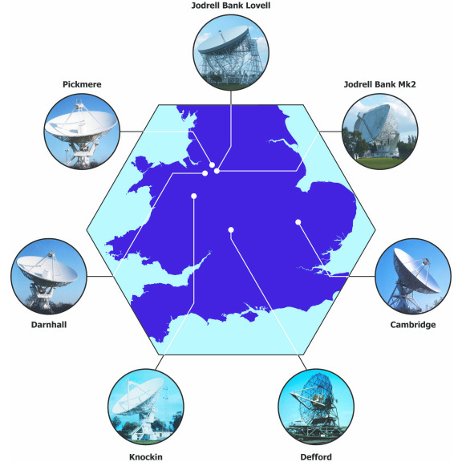
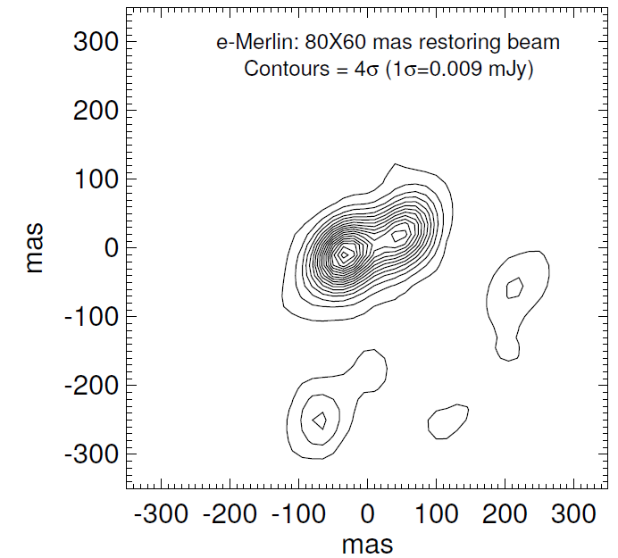
1 (b): Betelgeuse with e-MERLIN (5.2 cm)
Richards et al. (2013)
Two unresolved hot spots:
Te > 3800 K
Te > 5400 K
Where is the photosphere?
(Credit: MERLIN/VLBI national facility)
Goal 1 (b): Analyse high resolution archival cm data to search for signatures of hotspots.
Page 17
Notes:
6 times the spatial resolution of the VLA

Slide 23
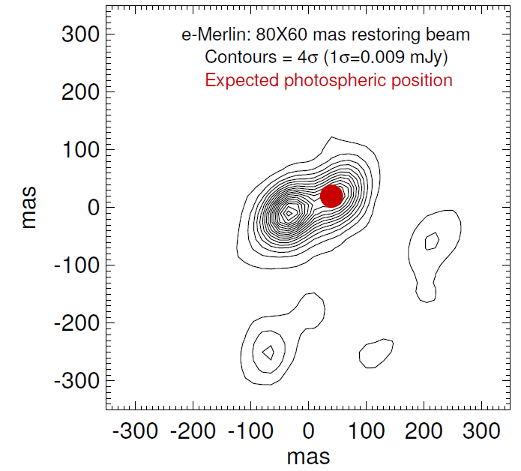
1 (b): Betelgeuse with e-MERLIN (5.2 cm)
Astrometric solution of Harper et al., (2008)
Hottest source at 4 R*.
At least ~3 times the predicted Te.
Page 18

Slide 24
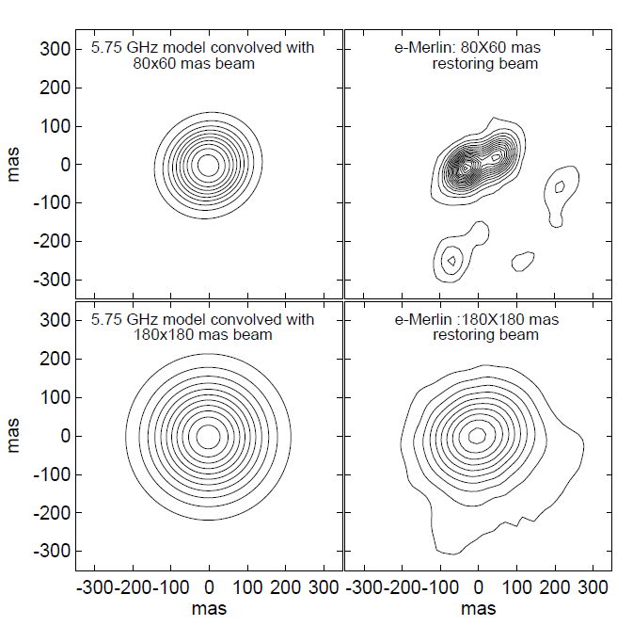
1 (b): Betelgeuse with e-MERLIN (5.2 cm)
Astrometric solution of Harper et al., (2008)
1-D model
Actual
Hottest source at 4 R*.
At least ~3 times the predicted Te.
1-D model
Actual
Spherically symmetric semi-empirical model of Harper et al., (2001)
Page 18

Slide 25
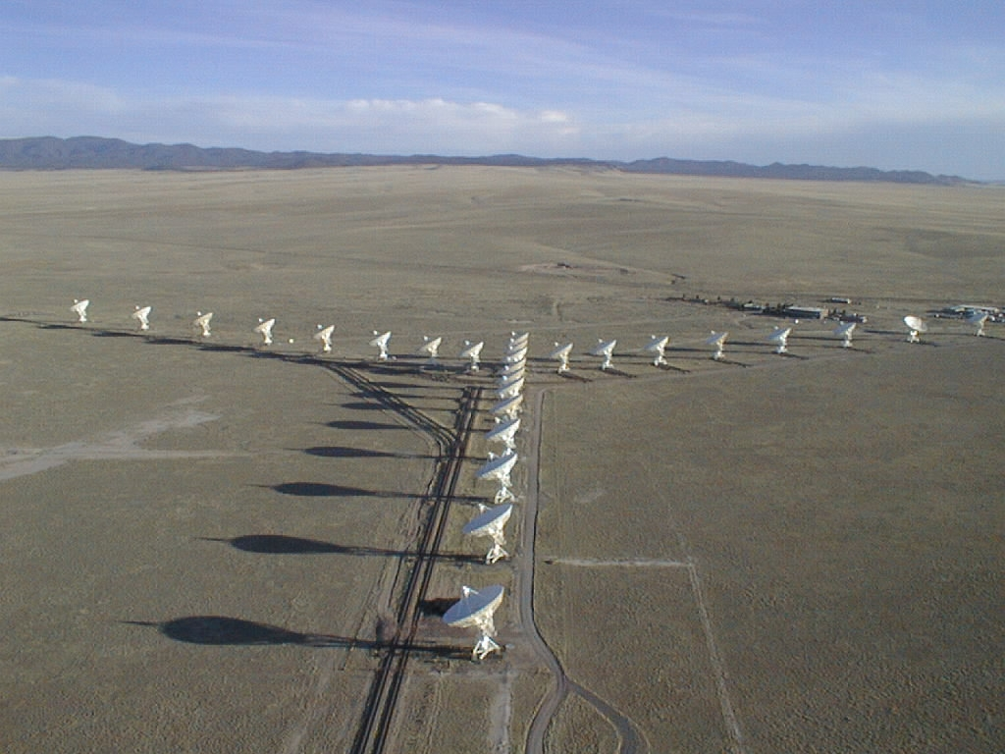
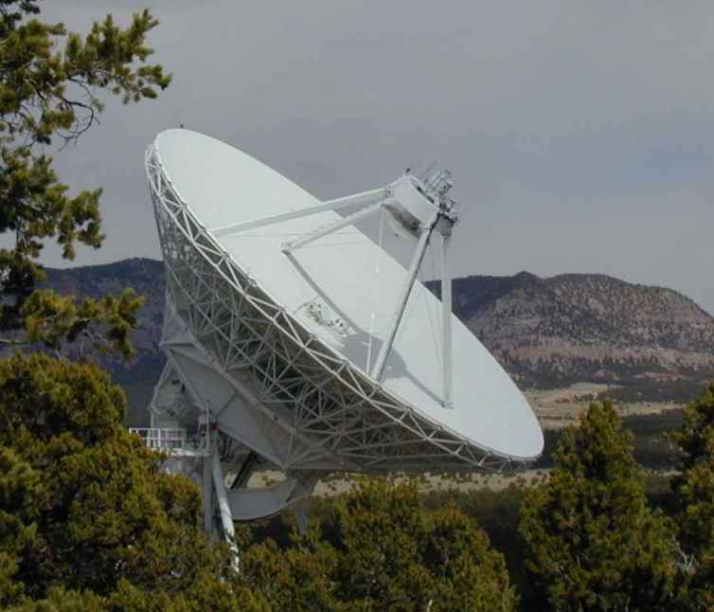
1 (b): Betelgeuse with VLA – Pie Town
VLA
e-MERLIN
w/l (cm) | Resolution ('')
5.2 | 80 x 60
VLA + Pie Town
w/l (cm) | Resolution ('')
0.7 | 40 x 25
1.3 | 80 x 40
2.0 | 120 x 90
3.5 | 200 x 130
6.2 | 380 x 270
+ =
Pie Town Antenna
Page 19

Slide 26
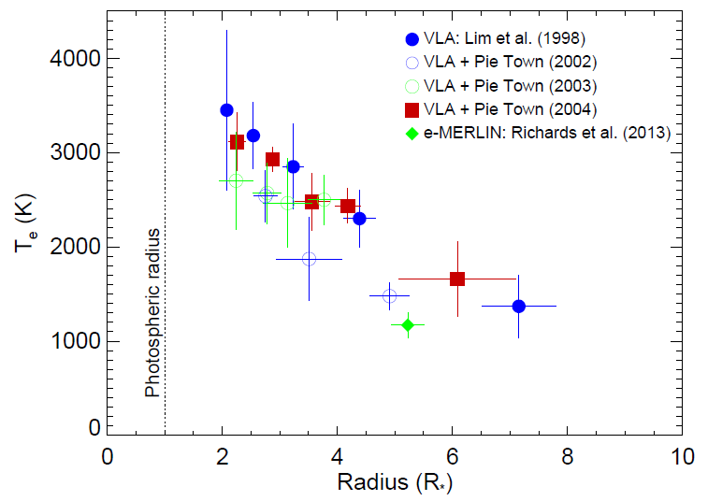
1 (b): Betelgeuse with VLA – Pie Town
Thermal Profile
Variability 1998-2004
w/l (cm) | Variability
0.7 | 23%
1.3 | 27%
2.0 | 32%
3.5 | 21%
6.2 | 35%
Page 20

Slide 27
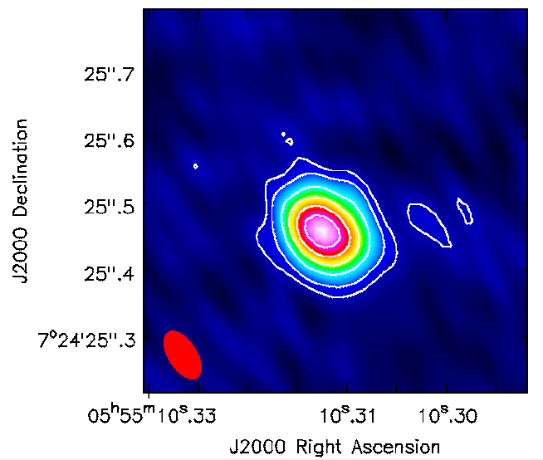
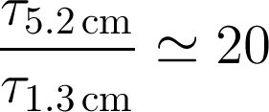
1 (b): Betelgeuse with VLA – Pie Town
Thermal Profile
1.3 cm Map
Variability 1998-2004
w/l (cm) | Variability
0.7 | 23%
1.3 | 27%
2.0 | 32%
3.5 | 21%
6.2 | 35%
No clear signature of hot spots any in any maps.
  Time dependence
  Opacity
Page 20

Slide 28
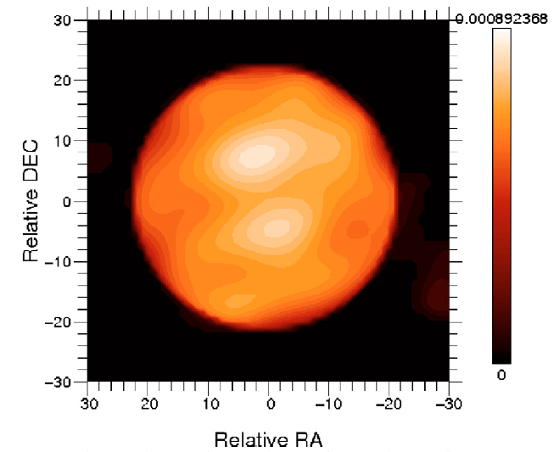
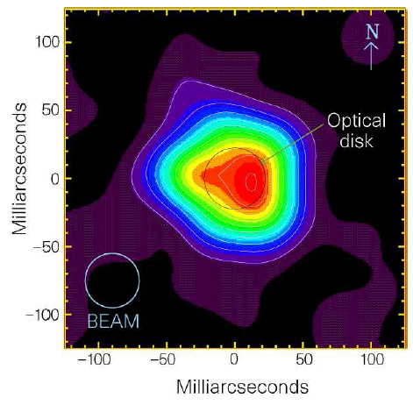
1 (b): Betelgeuse with VLA – Pie Town
(Haubois et al., 2009)
(Lim et al., 1998)
Page 21
Notes:
Image reconstruction of interferometric near IR data (IOTA)

Slide 29
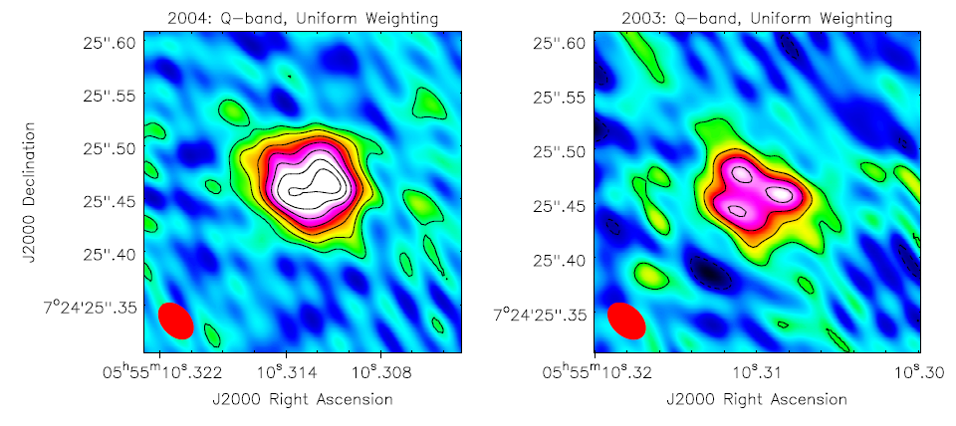
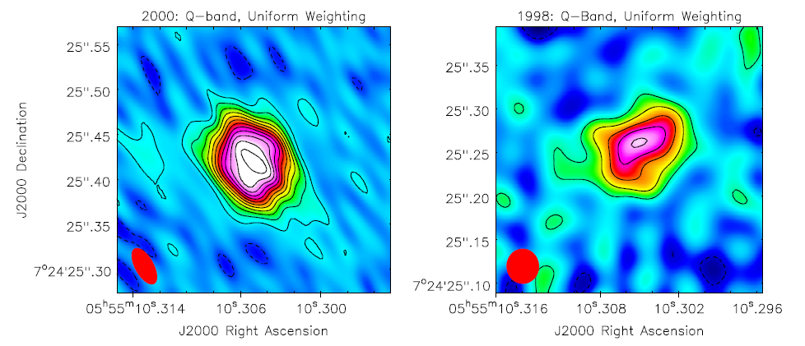
1 (b): Betelgeuse with VLA – Pie Town
Q-band (0.7 cm) maps using uniform weighting
2004
2003
(Haubois et al., 2009)
2000
1998
(Lim et al., 1998)
Page 21
Notes:
Image reconstruction of interferometric near IR data (IOTA)

Slide 30
1 (b): Conclusions
e-MERLIN has revealed two unresolved hotspots separated by 90 mas (i.e., 4 Rstar)
Cooler one may be at the position of photosphere
VLA + Pie Town data in good agreement with the findings of Lim et al. (1998) (i.e., mean thermal profile, asymmetries at 0.7 cm)
No clear signature of e-MERLIN hotspots in any of the VLA + Pie Town data
  Time dependant?
  Opacity?
Page 22

Slide 31
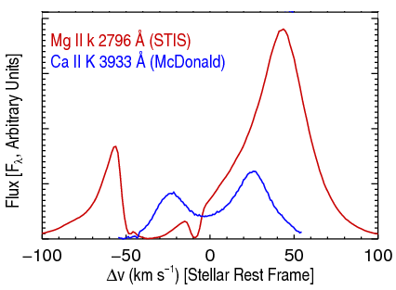
2) Winds of Red Giants
Currently cannot be spatially resolved at radio w/ls
Wind & chromospheric properties (dM/dt, vter )
generally determined by analysing strong
chromospheric resonance lines.
At cm/mm the thermal continuum Planck
function depends linearly on T, unlike the UV.
Continuum flux measurements at cm/mm: opacity is proportional to ~ λ^{2.1} nenion.
α-Boo: Blue-shifted absorption component->outflow
Goal 2 (a): Observe two 'standard' red giants at all possible cm wavelengths to test existing models and possibly develop ones.
Page 23
Notes:
Importance: T controls the level populations & ionization balance. Required for a detailed analysis of the wind thermal balance. Clues to mass-loss mechanism.
Spatial information from point sources!

Slide 32
2a) Red Giant Targets
 | Arcturus (α Boo: K2 III) | Aldebaran (α Tau: K5 III)
Distance (pc) | 11.3 | 20.4
Photospheric Radius (R_{ʘ}) | 25.4 | 44.2
Mass ( M_{ʘ}) | 0.8 | 1.3
Mass loss rate (M_{ʘ} yr⁻¹) | 2 x 10⁻¹⁰ | 1.6x 10⁻¹¹
Teff (K) | 4290 | 3970
Single, non-dusty and non-pulsating
Nearby, with well known stellar parameters
Semi-empirical 1-D chromospheric and wind models that can be directly tested
Page 24

Slide 33
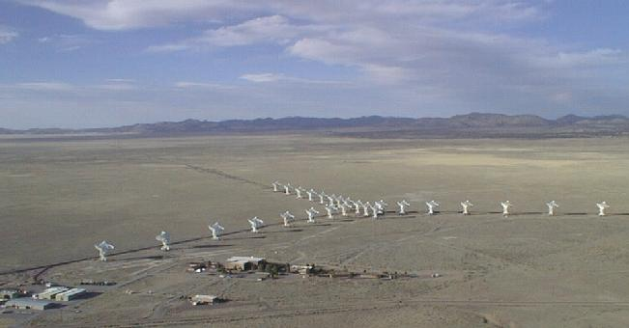
2 (a): The Karl G. Jansky Very Large Array
Credit: NRAO
  27 25 m antennas, New Mexico. Max baseline ~ 36 km
  Full frequency coverage between 1.0 and 50 GHz
  Continuum sensitivity improvement over the VLA by factors of 5 to 20
  Spectral Capability: A minimum of 16,384 and a maximum of 4,194,304 channels
Page 25

Slide 34
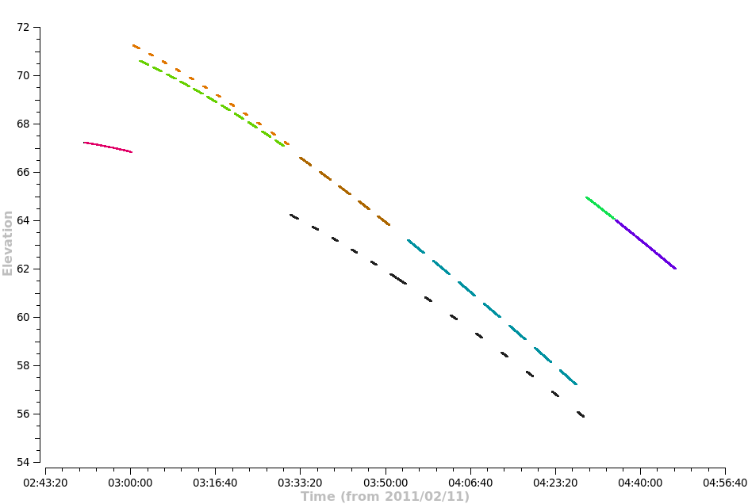
2 (a): Observations
Open Shared Risk Observing (OSRO)
B config (128 MHz)
α Boo: S → Q band (13th - 22nd Feb 2011)
α Tau: S → Q band (11th - 13th Feb 2011)
A unique dataset
Directors Discretionary Time (DDT)
B config (2 GHz)
α Boo: S & L band (July 2012)
Q
Q-band phase calibrator
Flux calibrator
Ka
X-band reference pointing
K
Ka & K-band phase calibrator
Page 26

Slide 35
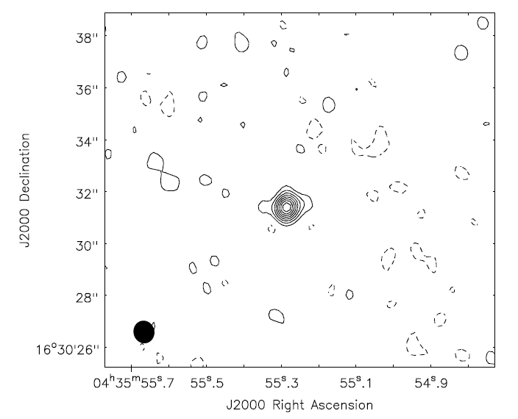
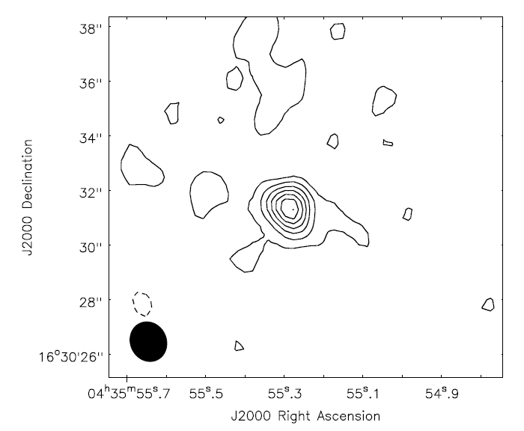
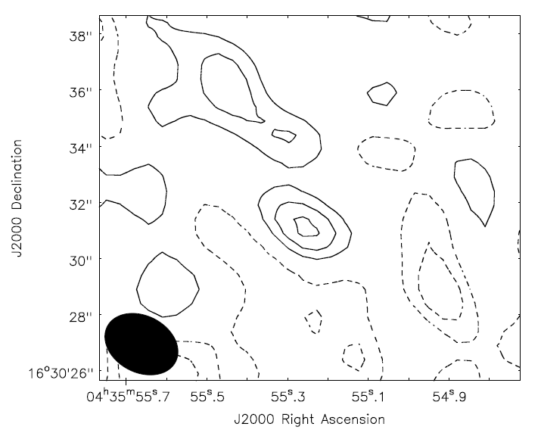
2 (a): Red Giant Radio Maps
Example: Aldebaran X (3 cm), C (6 cm), and S (10 cm) band
X-band (8 GHz)
Sν= 0.3 mJy
C-band (5 GHz)
Sν= 0.15 mJy
S-band (3 GHz)
Sν= 0.06 mJy
Contours = (-2,2,4......16)xσ
σ = 16 μJy
Contours = (-2,2,4,.....14)xσ
σ = 10 μJy
Contours = (-3,-2,-1,1,2,3)xσ
σ = 18 μJy
Page 27

Slide 36
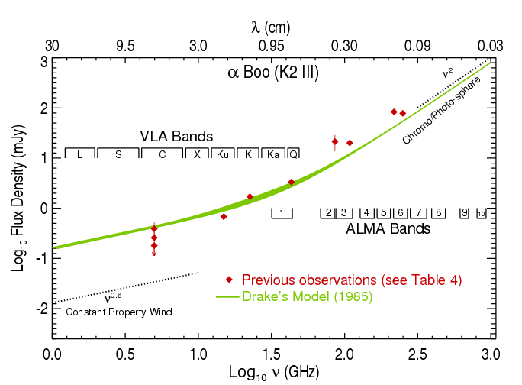
2 (a): Spectral Energy Distribution – α Boo
Page 28
Notes:
α = 2 (thermal free-free)
Assumes homogeneous ne
If ne ~ r ⁻² then α = 0.6
Assumes constant v, T

Slide 37

2 (a): Spectral Energy Distribution – α Boo
Page 28
Notes:
α = 2 (thermal free-free)
Assumes homogeneous ne
If ne ~ r ⁻² then α = 0.6
Assumes constant v, T

Slide 38






2 (a): Spectral Indices
If,
Then,
α Tau: wind ~ wind optically thin
α Boo:
Assume constant velocity wind,
Page 29

Slide 39
2 (a): Spectral Energy Distribution – α Boo
Page 30
Notes:
α = 2 (thermal free-free)
Assumes homogeneous ne
If ne ~ r ⁻² then α = 0.6
Assumes constant v, T

Slide 40

2 (a): Spectral Energy Distribution – α Boo
Page 30
Notes:
α = 2 (thermal free-free)
Assumes homogeneous ne
If ne ~ r ⁻² then α = 0.6
Assumes constant v, T

Slide 41
2 (b): Thermal Energy Balance
Close to photosphere: v²(r) << v²esc(r)
To escape star: v²(r) > v²esc(r)
Energy added in the form of either heat or momentum
Goal 2 (b): Carry out a thermal energy balance to investigate possible heating mechanisms in Arcturus' inner outflow region.
Page 31
Notes:
Gas kinetic power law slope

Slide 42


2 (b): Thermal Energy Balance
Close to photosphere: v²(r) << v²esc(r)
To escape star: v²(r) > v²esc(r)
Energy added in the form of either heat or momentum
Goal 2 (b): Carry out a thermal energy balance to investigate possible heating mechanisms in Arcturus' inner outflow region.
Notation:
Adiabatic Expansion
Heating
Cooling
Gas kinetic power law slope
Page 31
Notes:
Gas kinetic power law slope

Slide 43

2 (b): Cooling and Heating Processes
Cooling
Page 32

Slide 44

2 (b): Cooling and Heating Processes
Cooling
Heating
Page 32

Slide 45

2 (b): Cooling and Heating Processes
Page 33

Slide 46

2 (b): Cooling and Heating Processes
Page 33

Slide 47

2 (b): Cooling and Heating Processes
Page 33

Slide 48
2 (a) & (b) Conclusions
The most comprehensive set of multi-wavelength radio continuum observations of two standard red giants to date.
Allows us to test theoretical and semi-empirical atmospheric models.
Radio spectral indices allow flow properties to be investigated.
    Optically thin wind for α Tau.
    Rapidly cooling wind for α Boo.
Analytical advection model used to develop new wind model for α Boo.
Placed constraints on the heating produced by α Boo's mass-loss mechanism.
Page 34

Slide 49
Concluding Remarks
Betelgeuse has two unique outflows. Why?
    Unique epochs of mass-loss in the last ~1100 years.
    Change in outflow properties at certain distances.
Evidence for assymetries in both S1 and S2 flows
    Formed during outflow?
    Or from mass-loss process?
E-MERLIN hints at an episodic mass-loss mechanism in red supergiants. No signature in VLA data.
Multi-wavelength radio continuum observations provide spatial information from point sources. Provide wind diagnostics and updated outflow models.
Our understanding is improving and radio interferometry will continue to play a major role in future developments.
Page 35

