Slide 1

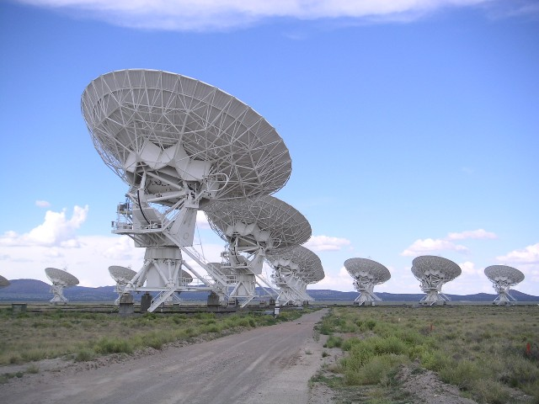
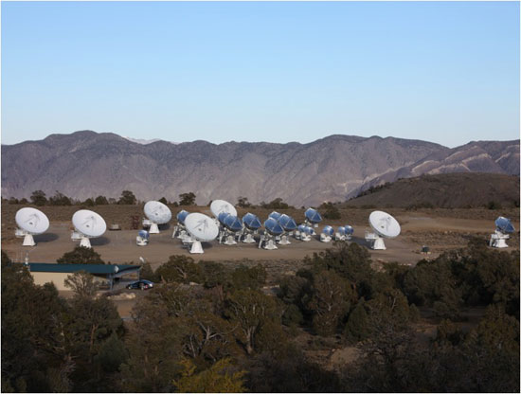
Radio Interferometric Studies of Cool Evolved Stellar Mass Outflows
Eamon O'Gorman Supervisor: Dr Graham Harper
Trinity College Dublin DIAS, February 1st 2013

Slide 2

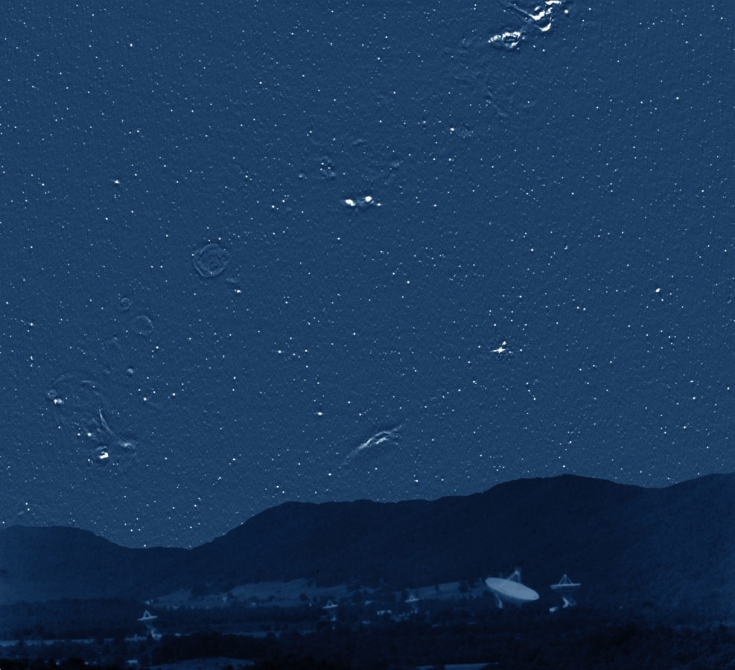
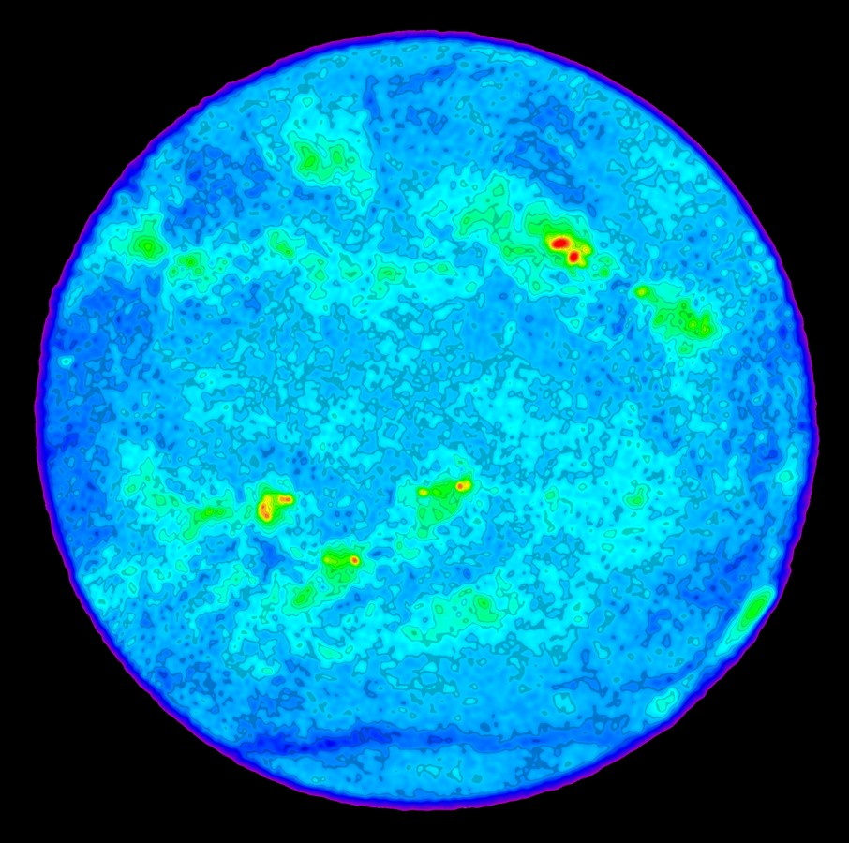
The Radio Sky
Radio Sky at 4.85 GHz (300ft Green Bank)
The sun at 4.6 GHz (VLA)
Credit: NRAO/AUI
(Pradio/Poptical)_{ʘ} ~ 10⁻¹⁵
Sυ ~ 40 μJy at α Cen
(not detectable with 'old' VLA!)
Credit: NRAO/AUI
DIAS 2013 2
Notes:
The brightest irregular sources are clouds of hydrogen ionized by luminous stars. Such stars quickly exhaust their nuclear fuel, collapse, and explode as supernovae, whose remnants appear as faint radio rings. Unlike the nearby (less than 1000 light years distant) stars visible to the human eye, almost none of the myriad radio "stars" scattered over the sky are really stars at all. Most are luminous radio galaxies or quasars
The picture shows an image of the full disk of the Sun at a frequency of 4.6 GHz made with the Very Large Array radiotelescope in New Mexico. The brightest features (red) in this image have a temperature of 1 million degrees and show where very strong magnetic fields exist in the Sun's atmosphere. An optical image on this day shows sunspots under these features. The green features are not as hot, but show where the Sun's atmosphere is very dense. The disk of the Sun is at a temperature of 30000 degrees, and the dark blue features are cooler yet. The giant slash across the bottom of the disk in this image is a feature called a filament channel, where the Sun's atmosphere is very thin: it marks the boundary of the South Pole of the Sun on this day.

Slide 3
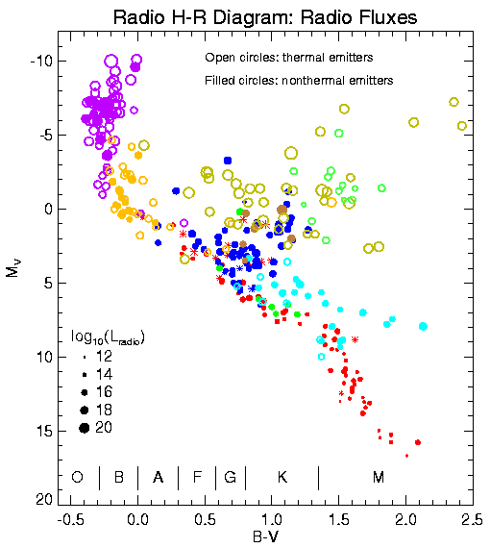
Radio Stars
Radio H-R Diagram
Majority: Non thermal emitters
A few thermal emitters
i.e. large θmas
DIAS 2013 3
Notes:
The fact that so many stars are detected tells us immediately that they are doing something different from the Sun. The stars are color-coded, with the key to different types of stars given at the bottom of the image. Main sequence dwarf stars are ordinary cool stars similar to the Sun: they tend to be detected as radio sources if they are young and/or rapidly spinning. T Tauri stars are very young stars shortly after birth. The letters at the bottom of the figure show the ranges of different spectral types of stars. The filled symbols represent stars which appear to have "nonthermal coronae", that is, unlike the Sun where the outer atmosphere is mostly just heated up, in these stars the atmosphere is full of very energetic accelerated electrons which are responsible for the radio emission.
The power (Energy per second) that the sun gives out at radio wavelengths divided by the power given out in the optical (which is almost all of the radiation of the sun) is about 10-16, so from an energy point of view its very very little

Slide 4
Radio Stars
Radio H-R Diagram
Majority: Non thermal emitters
A few thermal emitters
i.e. large θmas
Red Giants & Red Supergiants
DIAS 2013 3
Notes:
If we put the Sun at the distance of the nearest star, we would not be able to detect it as a radio source, so the fact that so many stars are detected tells us immediately that they are doing something different from the Sun. The stars are color-coded, with the key to different types of stars given at the bottom of the image. Main sequence dwarf stars are ordinary cool stars similar to the Sun: they tend to be detected as radio sources if they are young and/or rapidly spinning. T Tauri stars are very young stars shortly after birth. The letters at the bottom of the figure show the ranges of different spectral types of stars. The filled symbols represent stars which appear to have "nonthermal coronae", that is, unlike the Sun where the outer atmosphere is mostly just heated up, in these stars the atmosphere is full of very energetic accelerated electrons which are responsible for the radio emission.
The power (Energy per second) that the sun gives out at radio wavelengths divided by the power given out in the optical (which is almost all of the radiation of the sun) is about 10-16, so from an energy point of view its very very little

Slide 5
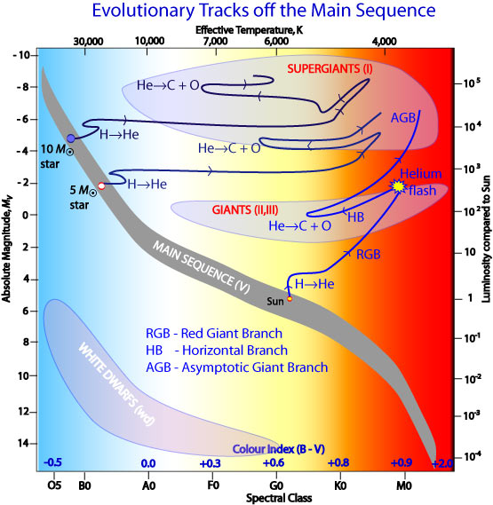
Red Giants and Red Supergiants
Red Giants:
0.35 → ~8 M_{ʘ}
a) RGB: Inert He Core
H burning shell
b) HB: Core He burning
H burning shell
c) AGB: Inert C-O core
H and He burning shells
DIAS 2013 4
Notes:
they mix the helium produced at their cores throughout the rest of their bodies
Red supergiants are the most mass stars in the universe in terms of volume

Slide 6
Red Giants and Red Supergiants
Red Giants:
0.35 → ~8 M_{ʘ}
a) RGB: Inert He Core
H burning shell
b) HB: Core He burning
H burning shell
c) AGB: Inert C-O core
H and He burning shells
Red Supergiants:
    ~8 M_{ʘ} ≤ M ≤ 40 M_{ʘ}.
    3,450 K ≤ T_{e} ≤ 4,100 K (i.e. M5 -> K1)
    Radii up to 1500 R_{ʘ}!
a) Short lifetimes
b) Onion-like internal structure
c) Die in a spectacular fashion
d) dM/dt ~ 10⁻⁴ – 10⁻⁶ M_{ʘ} yr⁻¹
e.g. α Sco, α Ori
DIAS 2013 4
Notes:
they mix the helium produced at their cores throughout the rest of their bodies
Red supergiants are the most mass stars in the universe in terms of volume

Slide 7
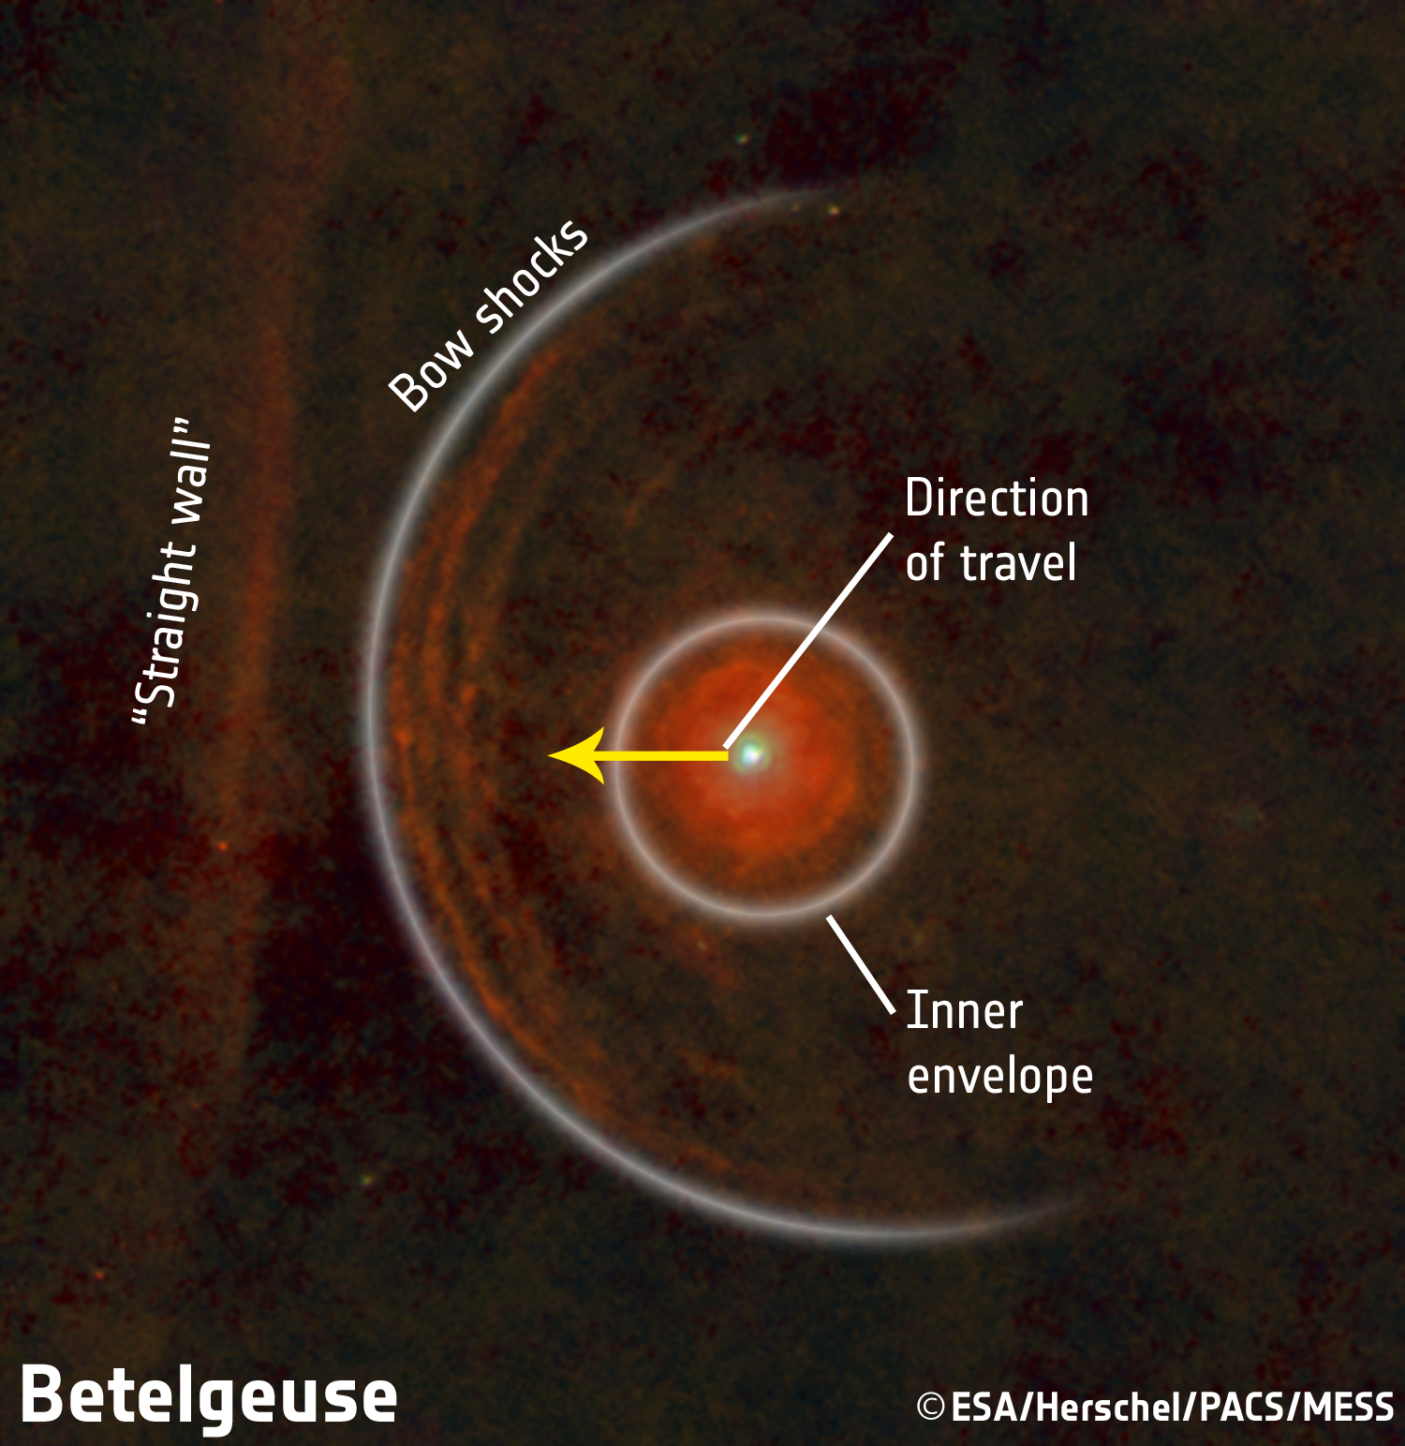
1. Betelgeuse
Spectral Type | M2 Iab
Radial Velocity | 20.7 km s⁻¹
Log(L/L_{ʘ}) | 5.12
Distance | 197 ± 45 parsec
Mass (birth) | ~20 M_{ʘ}
Mass (current) | ~18 M_{ʘ}
Mass loss rate | 3 x 10⁻⁶ M_{ʘ} yr⁻¹
Rotational Period | 17 years
Photospheric Radius | 22.5 mas (645 R_{ʘ})
Photospheric Temperature | 3,600 K (cool star)
Origin | O-type main sequence
Fate | Supernova Type II
(Decin et al., 2013)
DIAS 2013 5
Notes:
Luminosity ~ 130,000Lsol
2nd largest angular diameter in sky after R Doradus (RG Mira in southern hemisphere)
Cool star => convective outer envelope
Core collapse supernova
Because the rotational period of Betelgeuse is expected to
last several years (2335 days: AAVSO data, Stothers & Leung
1971; 17 years: Uitenbroek et al. 1998) a classical solar-type dy-
namo is not expected to operate there

Slide 8
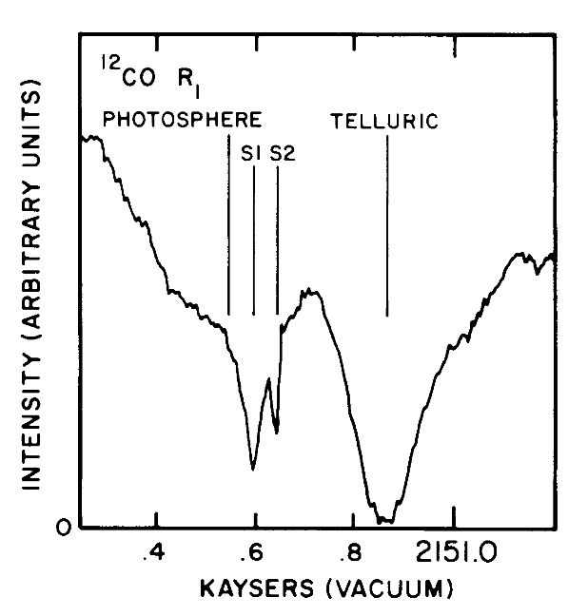
Betelgeuse: Circumstellar Environment
At least two different mass loss phase in the last ~100's yr.
Two distinct shells spectrally resolved in 4.6 μm ¹²C¹⁶O absorption spectra (Bernat et al., 1979):
  A fast, low column outer shell, S2, moving at 17 km s⁻¹
  A slower, high column inner shell, S1, moving at 10 km s⁻¹
  Spatial extent not directly determined
Plez & Lambert (2002) appear to detect S2 shell at 50 arcsec in K I spectra.
cm⁻¹
DIAS 2013 6
Notes:
Luminosity ~ 130,000Lsol
2nd largest angular diameter in sky after R Doradus (RG Mira in southern hemisphere)
Cool star => convective outer envelope
Core collapse supernova
Because the rotational period of Betelgeuse is expected to
last several years (2335 days: AAVSO data, Stothers & Leung
1971; 17 years: Uitenbroek et al. 1998) a classical solar-type dy-
namo is not expected to operate there

Slide 9
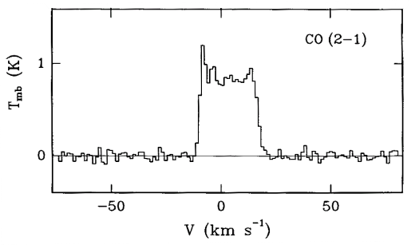
Betelgeuse: Circumstellar Environment
At least two different mass loss phase in the last ~100's yr.
Two distinct shells spectrally resolved in 4.6 μm ¹²C¹⁶O absorption spectra (Bernat et al., 1979):
  A fast, low column outer shell, S2, moving at 17 km s⁻¹
  A slower, high column inner shell, S1, moving at 10 km s⁻¹
  Spatial extent not directly determined
Plez & Lambert (2002) appear to detect S2 shell at 50 arcsec in K I spectra.
IRAM 30 m telescope (beam size ~12") fails to resolve S2 shell (Cernicharo & Bachiller, 1993) at 1.3 mm (i.e. ¹²C¹⁶O).
Single dish ¹²C¹⁶O mm-observations reveal only high velocity S2 shell.
Signature of S1 shell not obvious at millimeter wavelengths.
cm⁻¹
LSR
DIAS 2013 6
Notes:
Luminosity ~ 130,000Lsol
2nd largest angular diameter in sky after R Doradus (RG Mira in southern hemisphere)
Cool star => convective outer envelope
Core collapse supernova
Because the rotational period of Betelgeuse is expected to
last several years (2335 days: AAVSO data, Stothers & Leung
1971; 17 years: Uitenbroek et al. 1998) a classical solar-type dy-
namo is not expected to operate there

Slide 10
Betelgeuse: Circumstellar Environment
At least two different mass loss phase in the last ~100's yr.
Two distinct shells spectrally resolved in 4.6 μm ¹²C¹⁶O absorption spectra (Bernat et al., 1979):
  A fast, low column outer shell, S2, moving at 17 km s⁻¹
  A slower, high column inner shell, S1, moving at 10 km s⁻¹
  Spatial extent not directly determined
Plez & Lambert (2002) appear to detect S2 shell at 50 arcsec in K I spectra.
IRAM 30 m telescope (beam size ~12") fails to resolve S2 shell (Cernicharo & Bachiller, 1993) at 1.3 mm (i.e. ¹²C¹⁶O).
Single dish ¹²C¹⁶O mm-observations reveal only high velocity S2 shell.
Signature of S1 shell not obvious at millimeter wavelengths.
cm⁻¹
LSR
Goal: Measure both the spatial scales and the velocities of Betelgeuse’s outflow region using ¹²C¹⁶O J = 2-1 line as a tracer to sort out puzzling evidence.
DIAS 2013 6
Notes:
Luminosity ~ 130,000Lsol
2nd largest angular diameter in sky after R Doradus (RG Mira in southern hemisphere)
Cool star => convective outer envelope
Core collapse supernova
Because the rotational period of Betelgeuse is expected to
last several years (2335 days: AAVSO data, Stothers & Leung
1971; 17 years: Uitenbroek et al. 1998) a classical solar-type dy-
namo is not expected to operate there

Slide 11
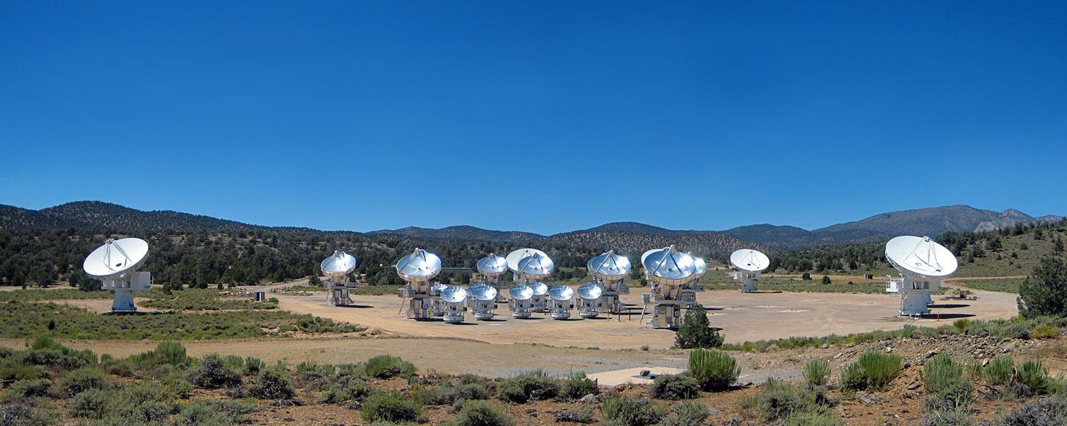
CARMA
Combined Array for Research in Millimeter-wave Astronomy
15 element interferometer (9 x 6.1 m + 6 x 10.4 m antennas)
Cedar Flat, eastern California (~ 2,200 m)
Merger of two independent arrays: BIMA + OVRO (2007)
105 baselines (n(n-1)/2) with 5 configurations (Bmin = 8 m and Bmax = 2 km)
Three bands: 7 mm, 3 mm and 1.3 mm
Credit: 2009 John Carlstrom
DIAS 2013 7
Notes:
Luminosity ~ 130,000Lsol
2nd largest angular diameter in sky after R Doradus (RG Mira in southern hemisphere)
Cool star => convective outer envelope
Core collapse supernova
Because the rotational period of Betelgeuse is expected to
last several years (2335 days: AAVSO data, Stothers & Leung
1971; 17 years: Uitenbroek et al. 1998) a classical solar-type dy-
namo is not expected to operate there

Slide 12
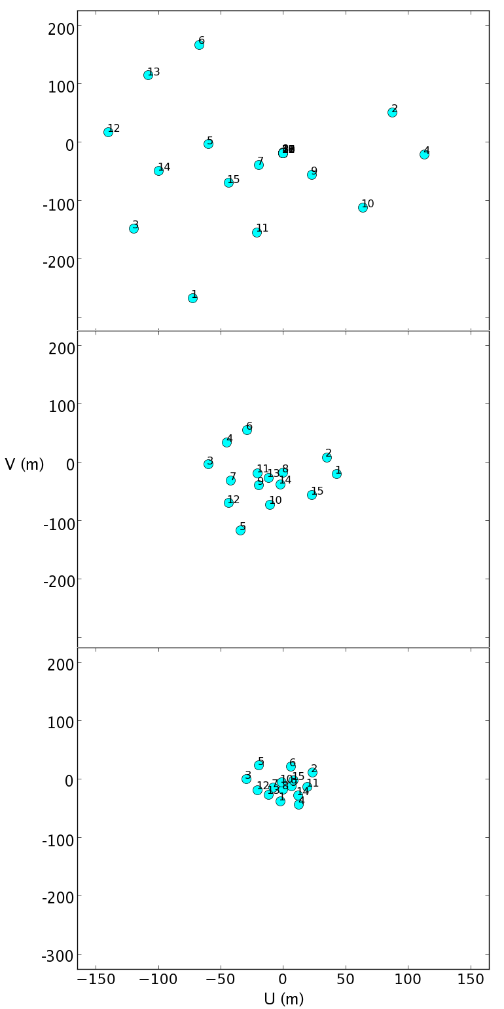
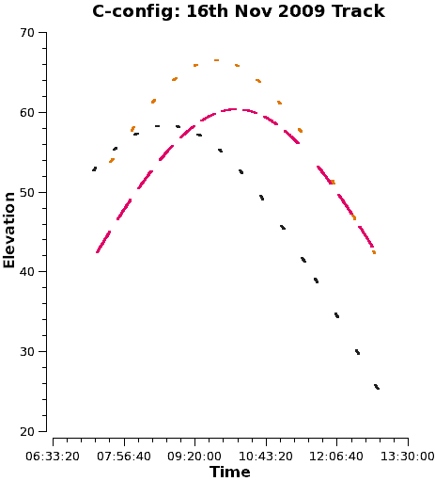
CARMA Observations
Date | Config | Tracks | Time (hr) | Resolution (") | Max Scale (")
Jun 07 | D | 5 | 9.5 | 1.8 | 24.4
Jul 09 | E | 1 | 3.25 | 4.0 | 33.5
Nov 09 | C | 5 | 8.75 | 0.8 | 8.9
Bmin= 30 m, Bmax= 350 m
3 separate bands: All centered on line
Maximum bandwidth of 468 MHz (15 channels)
62 MHz of bandwidth across 63 channels (1 MHz or 1.3 km s⁻¹ resolution)
31 MHz of bandwidth across 63 channels (0.5 MHz or 0.65 km s⁻¹ resolution)
Bmin= 11 m, Bmax= 150 m
Bmin= 8 m, Bmax= 66 m
DIAS 2013 8
Notes:
Luminosity ~ 130,000Lsol
2nd largest angular diameter in sky after R Doradus (RG Mira in southern hemisphere)
Cool star => convective outer envelope
Core collapse supernova
Because the rotational period of Betelgeuse is expected to
last several years (2335 days: AAVSO data, Stothers & Leung
1971; 17 years: Uitenbroek et al. 1998) a classical solar-type dy-
namo is not expected to operate there

Slide 13
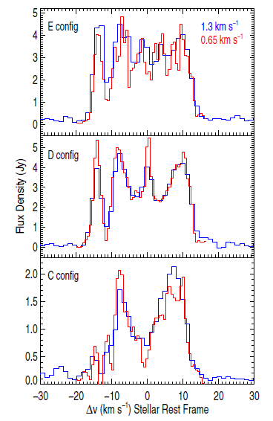
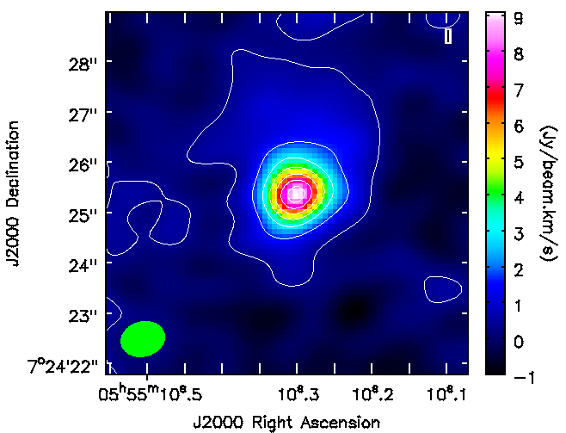
Individual Configurations
Dec
velocity (km s⁻¹)
RA
(O'Gorman et al., 2012)
DIAS 2013 9
Notes:
Luminosity ~ 130,000Lsol
2nd largest angular diameter in sky after R Doradus (RG Mira in southern hemisphere)
Cool star => convective outer envelope
Core collapse supernova
Because the rotational period of Betelgeuse is expected to
last several years (2335 days: AAVSO data, Stothers & Leung
1971; 17 years: Uitenbroek et al. 1998) a classical solar-type dy-
namo is not expected to operate there

Slide 14
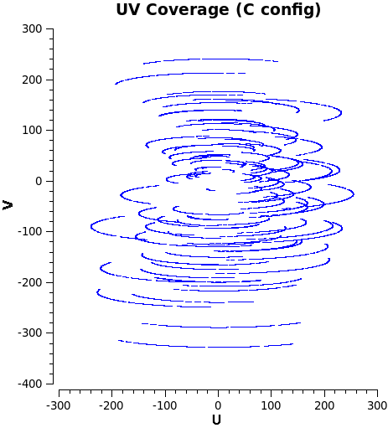
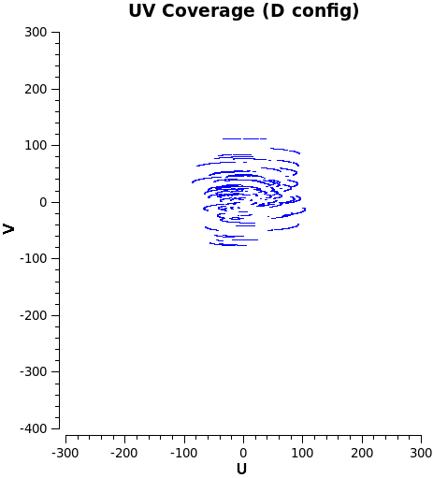
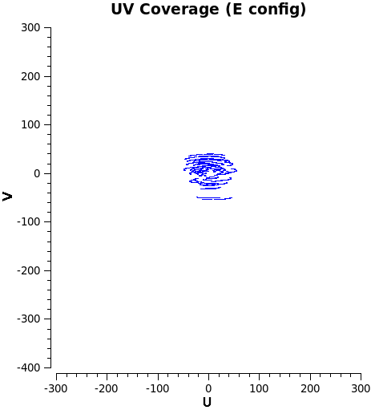
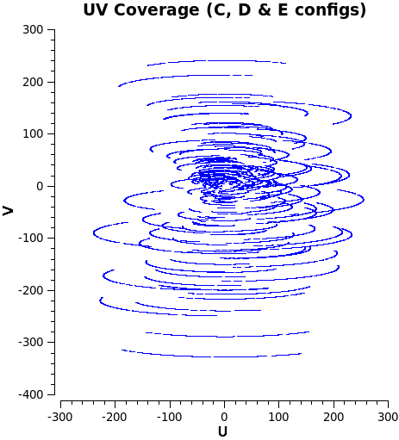
Combining Configurations
Increase uv-coverage
→ Increase sensitivity to different scales
→ Increase S/N
Config | S/N (1.3 km s⁻¹) | S/N (0.65 km s⁻¹)
C | 24 | 18
D | 23.5 | 21.5
E | 21.5 | 13.5
Combined | 33 | 24
DIAS 2013 10
Notes:
Luminosity ~ 130,000Lsol
2nd largest angular diameter in sky after R Doradus (RG Mira in southern hemisphere)
Cool star => convective outer envelope
Core collapse supernova
Because the rotational period of Betelgeuse is expected to
last several years (2335 days: AAVSO data, Stothers & Leung
1971; 17 years: Uitenbroek et al. 1998) a classical solar-type dy-
namo is not expected to operate there

Slide 15
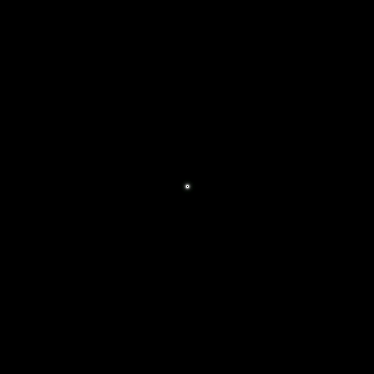


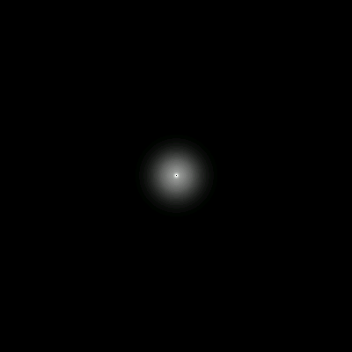
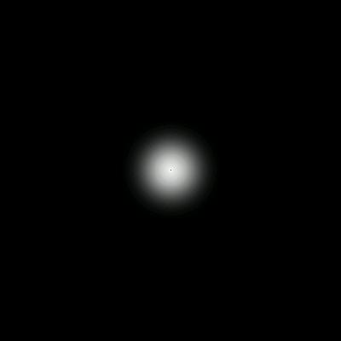
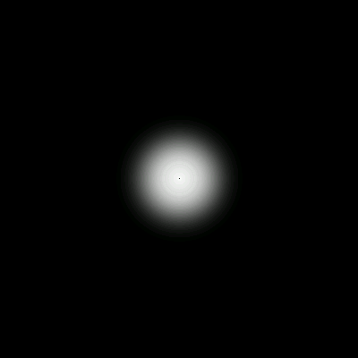


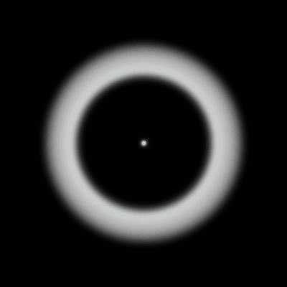
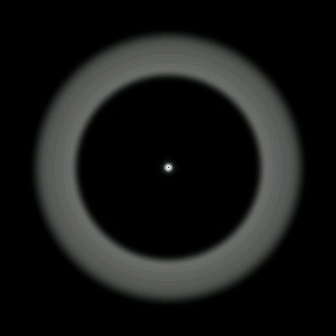
Image Cube Simulation
DIAS 2013 11
Notes:
Luminosity ~ 130,000Lsol
2nd largest angular diameter in sky after R Doradus (RG Mira in southern hemisphere)
Cool star => convective outer envelope
Core collapse supernova
Because the rotational period of Betelgeuse is expected to
last several years (2335 days: AAVSO data, Stothers & Leung
1971; 17 years: Uitenbroek et al. 1998) a classical solar-type dy-
namo is not expected to operate there

Slide 16
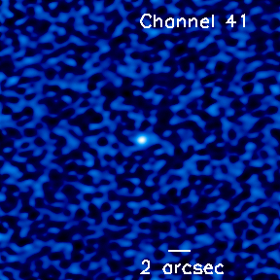
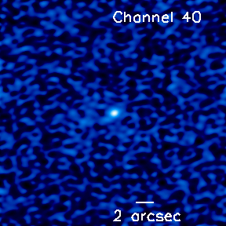
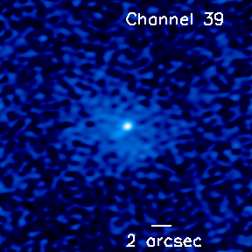
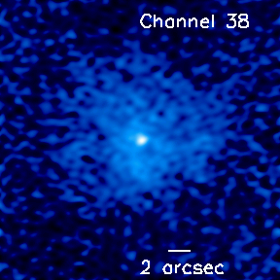
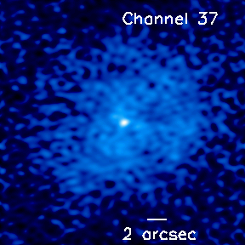
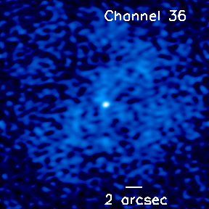
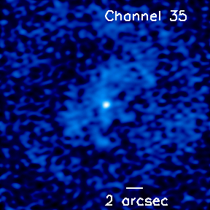
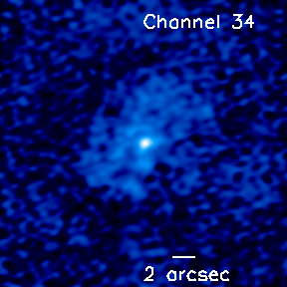
Simulation vs Actual
DIAS 2013 11
YERAC - 18th July 2011 14
Notes:
Luminosity ~ 130,000Lsol
2nd largest angular diameter in sky after R Doradus (RG Mira in southern hemisphere)
Cool star => convective outer envelope
Core collapse supernova
Because the rotational period of Betelgeuse is expected to
last several years (2335 days: AAVSO data, Stothers & Leung
1971; 17 years: Uitenbroek et al. 1998) a classical solar-type dy-
namo is not expected to operate there

Slide 17
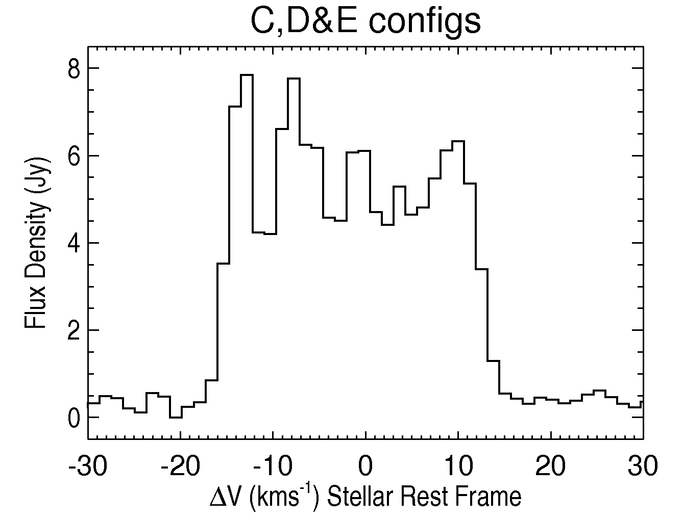
Simulation vs Actual
DIAS 2013 11
YERAC - 18th July 2011 14
Notes:
Luminosity ~ 130,000Lsol
2nd largest angular diameter in sky after R Doradus (RG Mira in southern hemisphere)
Cool star => convective outer envelope
Core collapse supernova
Because the rotational period of Betelgeuse is expected to
last several years (2335 days: AAVSO data, Stothers & Leung
1971; 17 years: Uitenbroek et al. 1998) a classical solar-type dy-
namo is not expected to operate there

Slide 18
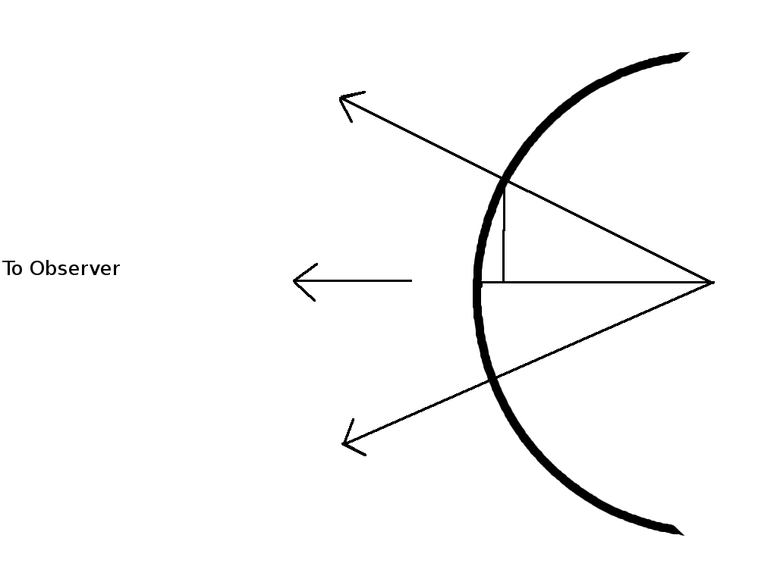
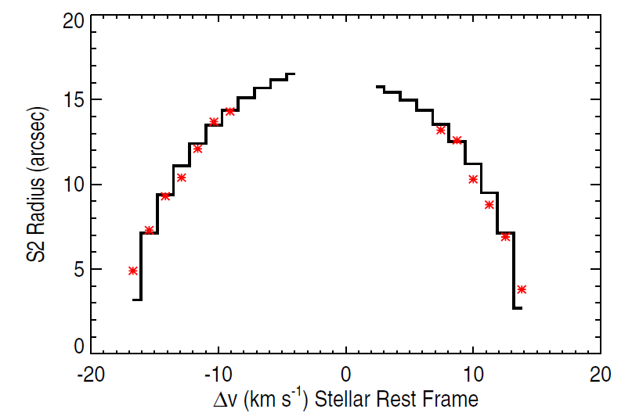

S2 Flow
RS2sinθ
VS2cosθ
θ
DIAS 2013 12
Notes:
Luminosity ~ 130,000Lsol
2nd largest angular diameter in sky after R Doradus (RG Mira in southern hemisphere)
Cool star => convective outer envelope
Core collapse supernova
Because the rotational period of Betelgeuse is expected to
last several years (2335 days: AAVSO data, Stothers & Leung
1971; 17 years: Uitenbroek et al. 1998) a classical solar-type dy-
namo is not expected to operate there

Slide 19
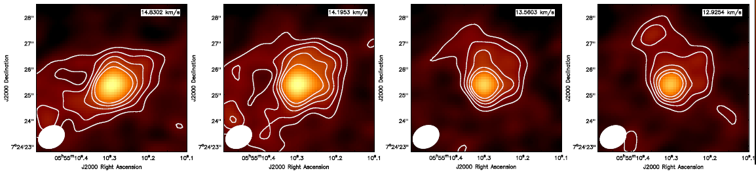
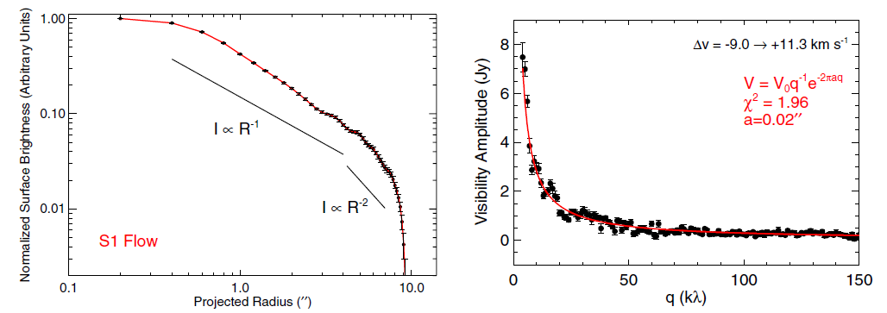
S1 Flow
DIAS 2013 13
Notes:
Luminosity ~ 130,000Lsol
2nd largest angular diameter in sky after R Doradus (RG Mira in southern hemisphere)
Cool star => convective outer envelope
Core collapse supernova
Because the rotational period of Betelgeuse is expected to
last several years (2335 days: AAVSO data, Stothers & Leung
1971; 17 years: Uitenbroek et al. 1998) a classical solar-type dy-
namo is not expected to operate there

Slide 20
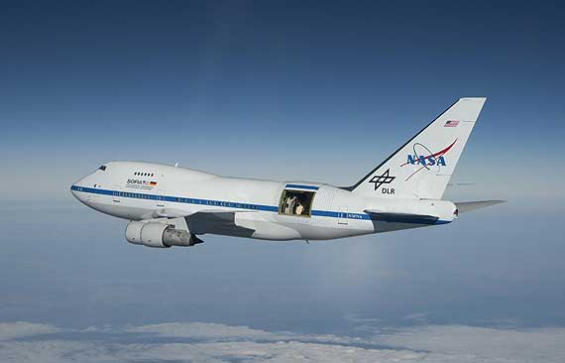
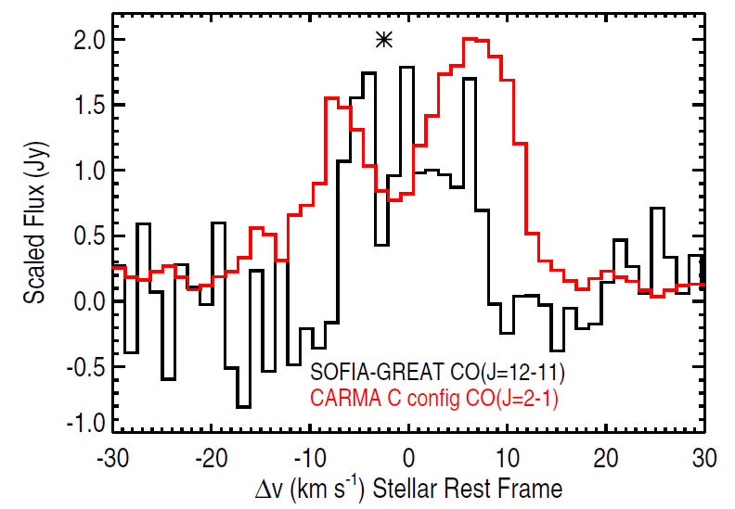
Inner Circumstellar Environment
Credit: NASA/Jim Ross.
J_{mp} = (T_{ex}/5.53)^{1/2} (Rodgers & Glassgold, 1991):
S1 @ 200 K J_{mp} = 6 (i.e. J=6->5 691 GHz ALMA band 9)
S2 @ 70 K J_{mp} = 3 (i.e. J=3->2 245 GHz ALMA band 6)
ALMA Early Science 1 → 0.1'' resolution of J=6-5 transition
DIAS 2013 14
Notes:
Luminosity ~ 130,000Lsol
2nd largest angular diameter in sky after R Doradus (RG Mira in southern hemisphere)
Cool star => convective outer envelope
Core collapse supernova
Because the rotational period of Betelgeuse is expected to
last several years (2335 days: AAVSO data, Stothers & Leung
1971; 17 years: Uitenbroek et al. 1998) a classical solar-type dy-
namo is not expected to operate there

Slide 21
1. Conclusions
1) Multiple CARMA configurations provide the high spatial resolution needed to study the inner S1 shell while also ensuring that larger structures (i.e. S2 shell) are not resolved out.
2) The high spatial resolution C configuration resolves out almost all material moving with a velocity < -9 km s-1 leaving us with S1 emission.
3) Image cube of total combined data reveal shell structure in channels corresponding to S2 shell in spectra.
4) Final Image Cube suggests:
Rs1 ~ 4 arcsec
Rs2 ~ 17 arcsec
DIAS 2013 15
Notes:
Luminosity ~ 130,000Lsol
2nd largest angular diameter in sky after R Doradus (RG Mira in southern hemisphere)
Cool star => convective outer envelope
Core collapse supernova
Because the rotational period of Betelgeuse is expected to
last several years (2335 days: AAVSO data, Stothers & Leung
1971; 17 years: Uitenbroek et al. 1998) a classical solar-type dy-
namo is not expected to operate there

Slide 22
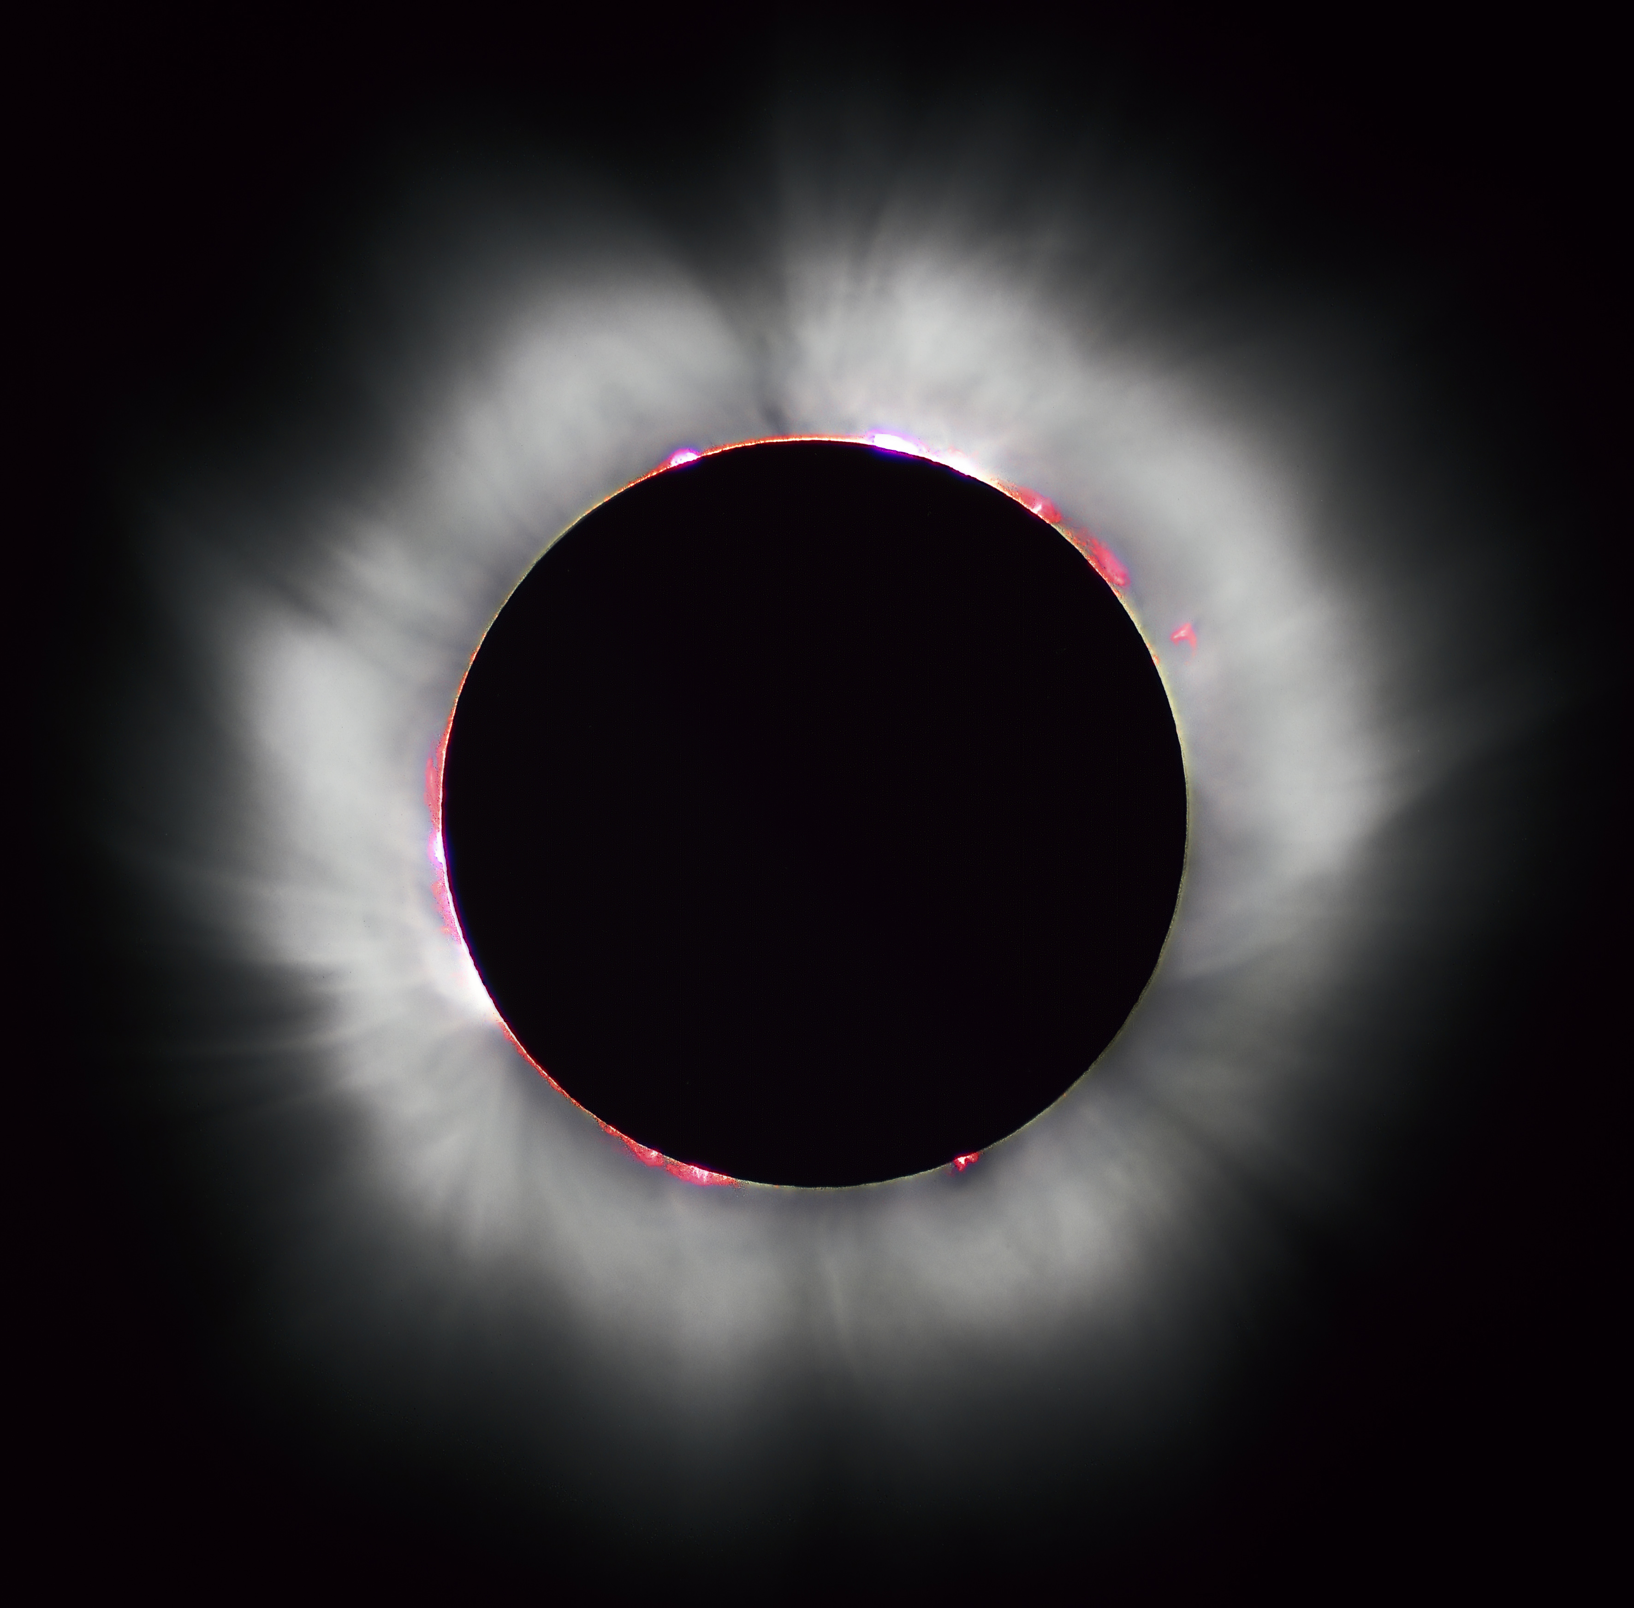
2. Red Giant Outflows
Late-type red giants:
  chromosphere is always present
  coronal emission diminishes
  cool massive wind kicks in
(e.g. Linsky & Haisch, 1981; Ayres et al., 1997)
  Relatively dense and slow moving winds
Vterminal < Vescape
Importance:
  Enrich the interstellar medium with material required
  for the next generation of stars and planets
  Mass loss can alter the evolutionary fate of a star
Wind Driving Mechanism:
  An enduring mystery! (Holzer & MacGregor, 1985)
  Insufficient molecular or dust opacity
  Mass-loss rates too large for acoustic/pulsation models (Sutmann & Cuntz, 1995)
  Absence of hot wind plasma in optical & UV data – too cool to be Parker type flows
Solar Eclipse
DIAS 2013 16
Notes:
Ubiquitous across the H-R diagram
The L-H dividing lines separates coronal from non-coronal giants although Ayres has found evidence for buried high-temperature emission in a few stars.
Majority of energy goes into lifting the material out of the gravitational potential and not into the kinetic energy of the wind.
Progress in the field continues to be driven by observations.
Magnetic fields are most likely involved due to a process of elimination!
All stars possess chromospheres with material heated above that predicted by radiative equilibrium.

Slide 23
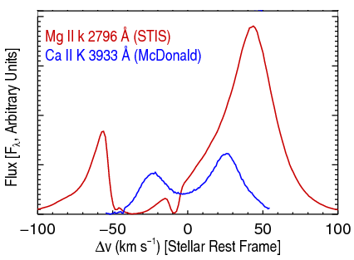
Red Giant Radio Emission
Wind & chromospheric properties (dM/dt, vter )
generally determined by analysing strong
chromospheric resonance lines.
Thermal structure poorly constrained. Very
sensitive to T (hν/kT >>1).
At cm/mm the thermal continuum (Planck)
function depends linearly on T.
Continuum flux measurements at cm/mm wavelengths can probe different different layers in the atmosphere as radio opacity is proportional to ~ λ^{2.1} nenion.
Multi-frequency observations at cm/mm wavelengths allow us to get spatial information from point sources!
Importance: T controls the level populations & ionization balance. Required for a detailed analysis of the wind thermal balance. Clues to mass-loss mechanism.
α-Boo: Blue-shifted absorption component->outflow
DIAS 2013 17
Notes:
So a hot plasma component may dominate the spectrum and may not be representative of the majority of the plasma.
The emission is thermal continuum so the source function is the Planck function in the RJ tail
So the longest w/ls sample the outermost layers.
Since the angular diameter of the radio emitting region is larger than the photospheric angular diameter, each cm w/l flux provides an upper limit to the electron temperature.

Slide 24
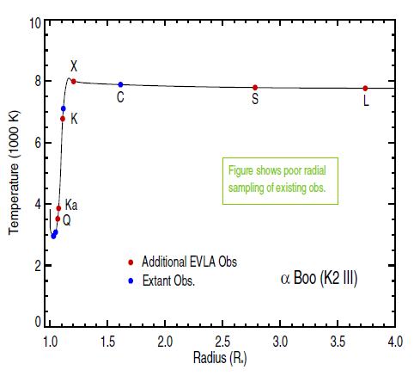
Sample Selection
Goal: Observe two 'standard' red giants at all possible JVLA frequencies allowing the temperature to be probed throughout the wind acceleration zone (~1 – 4 R* ) in each.
Arcturus (α Boo: K2 III) and Aldebaran (α Tau: K5 III)
Single, non-dusty and non-pulsating
Nearby (~ 11 pc and 20 pc)
Well known stellar parameters
Semi-empirical 1-D chromospheric
and wind models that can be directly tested
DIAS 2013 18
Notes:
Wind acceleration zone is where most of the energy is deposited into the wind and where the signatures of the mass loss process should be most manifest.
Really the first part of a 2 part project. 2nd part involves an investigation into the heating and cooling taking place to see what is heating the wind to maintain it at this derived temperature.
Easily the most thoroughly studied red giants at other wavelengths,
Ideal test-cases

Slide 25
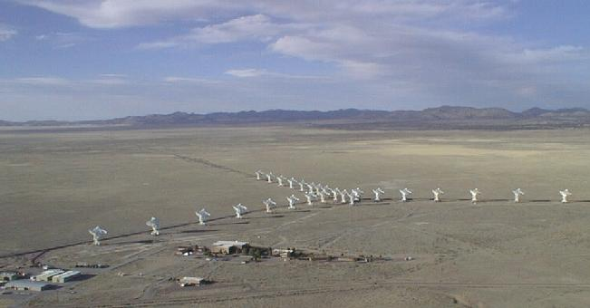
The Karl G. Jansky Very Large Array
  27 25 m antennas, New Mexico. Max baseline ~ 36 km
  Full frequency coverage between 1.0 and 50 GHz
  Continuum sensitivity improvement over the VLA by factors of 5 to 20
  Spectral Capability: A minimum of 16,384 and a maximum of 4,194,304 channels
DIAS 2013 19

Slide 26
JVLA Observations
Open Shared Risk Observing (OSRO)
B configuration – February 2011
Bandwidth = 256 MHz (2 spw's @ 64 x 2 MHz); Full Polarization
α Boo: S – Q-band in ~9 days (13th Feb 2011 - 22nd Feb 2011)
α Tau: S – Q-band in ~2 days (11th Feb 2011 - 13th Feb 2011)
A unique Data Set
α Boo: L-band not commissioned
α Tau: L-band not requested
DIAS 2013 20
Notes:
Decades now days

Slide 27
JVLA Observations
Open Shared Risk Observing (OSRO)
B configuration – February 2011
Bandwidth = 256 MHz (2 spw's @ 64 x 2 MHz); Full Polarization
α Boo: S – Q-band in ~9 days (13th Feb 2011 - 22nd Feb 2011)
α Tau: S – Q-band in ~2 days (11th Feb 2011 - 13th Feb 2011)
A unique Data Set
α Boo: L-band not commissioned
α Tau: L-band not requested
Directors Discretionary Time (DDT)
B configuration – July 2012
α Boo
L Band: Bandwidth = 1 GHz (16 spw's @ 64 x 1 MHz); Full Polarization
S Band: Bandwidth = 2 GHz (16 spw's @ 64 x 2 MHz); Full Polarization
DIAS 2013 20
Notes:
Decades now days

Slide 28
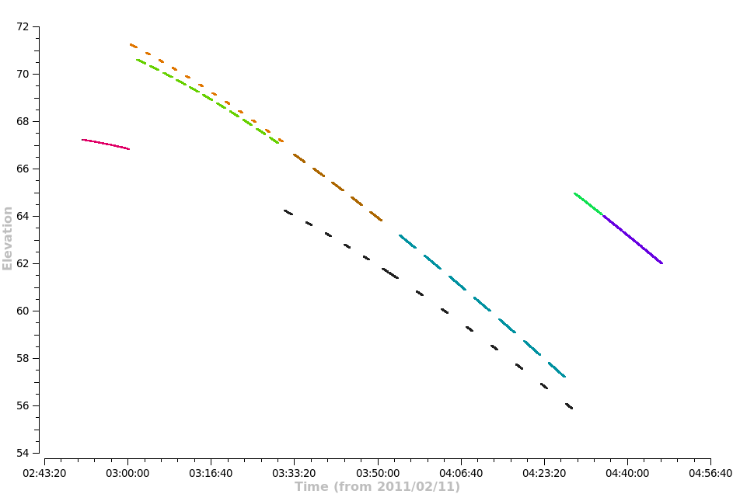
Observing Strategy – High Frequencies
11 Feb 2011: Alpha Tau: K,Ka & Q-bands: 2 Hr Track: Fast Switching
Q
Q-band phase calibrator
Q, Ka, K & X-band flux calibrator
Ka
Dummy scans + X-band reference pointing
K
Ka & K-band phase calibrator
DIAS 2013 21
Notes:
2 hour track
4 1 minute dummy scans. I min for each frequency used in track. ~10 minutes reference pointing on phase calibrator.
Hardware set up

Slide 29
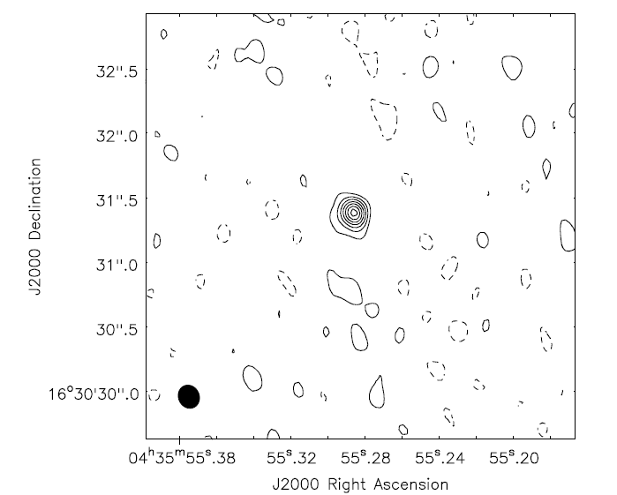
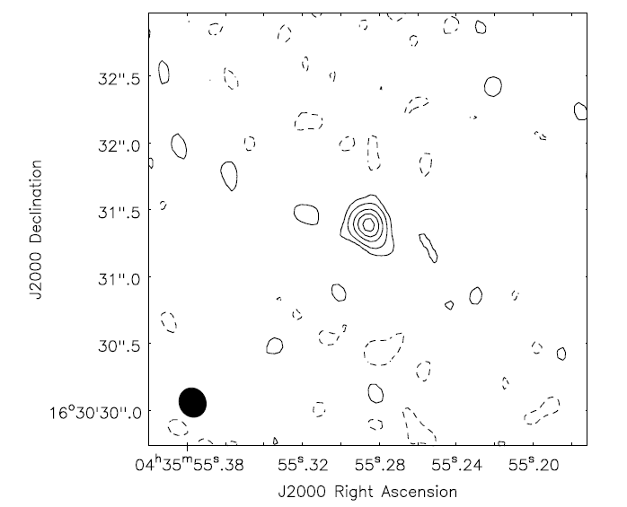
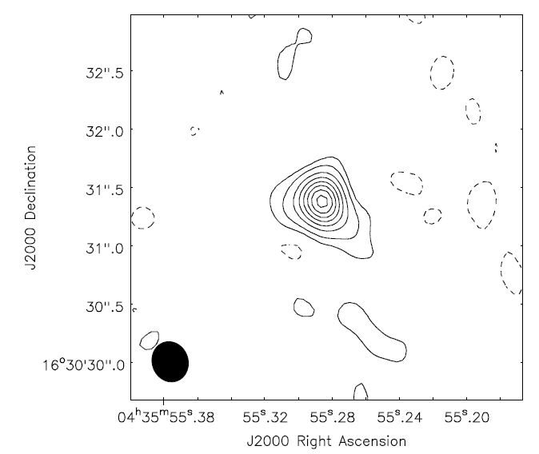
Results: α Tau – High Frequencies
Q-band (43 GHz)
Sν= 3.67 mJy
Ka-band (34 GHz)
Sν= 2.19 mJy
K-band (22 GHz)
Sν= 1.86 mJy
Contours = (-2,2,4......14)xσ
σ = 240 μJy
Contours = (-2,2,5,10,15,20)xσ
σ = 96 μJy
Contours = (-2,2,5,10,....35)xσ
σ = 50 μJy
DIAS 2013 22
Notes:
Natural weighting for best s/n as angular resolution is not important as point sources

Slide 30
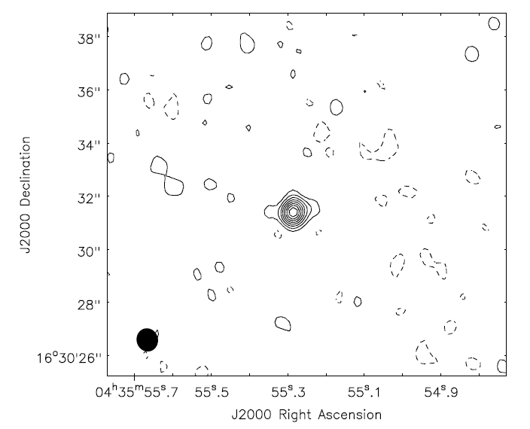
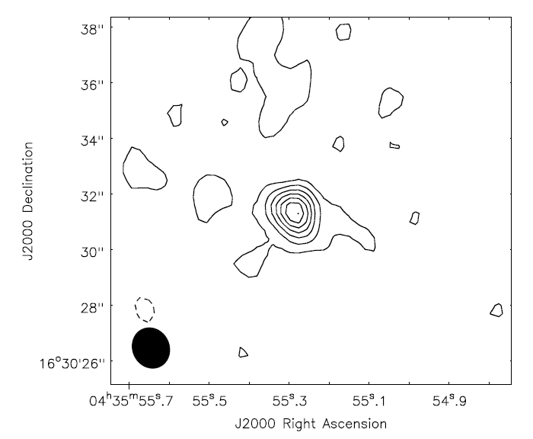
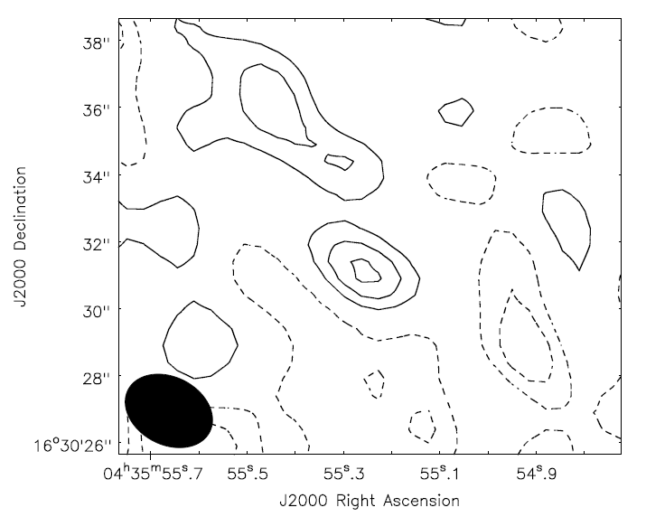
Results: α Tau – Low Frequencies
X-band (8 GHz)
Sν= 0.3 mJy
C-band (5 GHz)
Sν= 0.15 mJy
S-band (3 GHz)
Sν= 0.06 mJy
Contours = (-2,2,4......16)xσ
σ = 16 μJy
Contours = (-2,2,4,.....14)xσ
σ = 10 μJy
Contours = (-3,-2,-1,1,2,3)xσ
σ = 18 μJy
DIAS 2013 23

Slide 31

Spectral Energy Distribution - α Tau
DIAS 2013 24

Slide 32

Spectral Energy Distribution - α Tau
DIAS 2013 24

Slide 33



Results: α Boo – High Frequencies
Q-band (43 GHz)
Sν= 5.96 mJy
Ka-band (34 GHz)
Sν= 4.16 mJy
K-band (22 GHz)
Sν= 1.80 mJy
Contours = (-2,2,5,.....15)xσ
σ = 276 μJy
Contours = (-2,2,5,10,....35)xσ
σ = 100 μJy
Contours = (-2,2,5,10,....35)xσ
σ = 40 μJy
DIAS 2013 25

Slide 34



Results: α Boo – Low Frequencies
X-band (8 GHz)
Sν= 0.49 mJy
C-band (5 GHz)
Sν= 0.21 mJy
S-band (3 GHz)
Sν= 0.11 mJy
Contours = (-2,2,4......16)xσ
σ = 28 μJy
Contours = (-2,-1,1,2,3,4)xσ
σ = 46 μJy
Contours = (-2-1,1,2,3)xσ
σ = 35 μJy
DIAS 2013 26

Slide 35



Results: α Boo – Low Frequencies (DDT)
S-band (2 - 4 GHz)
Sν= 0.12 mJy
L-band (1-2 GHz)
Sν= 0.065 mJy
Strong 2nd Source @ C,S,L-band
SL-Band= 78 mJy
3'
SL-Band ~ 0.06 mJy
Contours = (-2,-1,1,2,3,4,5)xσ
σ = 22 μJy
Contours = (-2,2,1,2,3,4,5)xσ
σ = 15 μJy
DIAS 2013 27

Slide 36

Results: α Boo – Low Frequencies (DDT)
S-band (2 - 4 GHz)
Sν= 0.12 mJy
L-band (1-2 GHz)
Sν= 0.065 mJy
Strong 2nd Source @ C,S,L-band
SL-Band= 78 mJy
3'
SL-Band ~ 0.06 mJy
Contours = (-2,-1,1,2,3,4,5)xσ
σ = 22 μJy
Contours = (-2,2,1,2,3,4,5)xσ
σ = 15 μJy
DIAS 2013 27

Slide 37

Spectral Energy Distribution - α Boo
DIAS 2013 28

Slide 38

Spectral Energy Distribution - α Boo
DIAS 2013 28

Slide 39

Spectral Indices
α = d log Sν/d log ν
α = 2 (thermal free-free)
Assumes homogeneous ne
If ne ~ r ⁻² then α = 0.6
Assumes constant v, T
If ne ~ r ^{-p} & T ~ r ^{-n}
α = (4p-6.2-0.6n) (2p-1-1.35n)
If p=2: nα Boo=1.65, nα Tau=1.92
If n=0: pα Boo=2.7, pα Tau=5.5
DIAS 2013 29

Slide 40

Hydrogen Ionization Code
Aim: Calculate the radio flux between 1 to 50 GHz for a grid of wind models, with different wind accelerations, mass-loss rates, and temperature profiles and see which model best fits our JVLA data.
Computes the hydrogen ionization as a function of R(z) using a 6-level model for H I (n=1 - 5 and nK) using escape probabilities.
Assume steady flow
Statistical Equilibrium
Advection Term
Transition Probabilities
DIAS 2013 30
Notes:
Transition probability term is the sum of the radiative and collisional rate.
Escape probabilities faster than solving directly for specific intensity and handles the trouble J bar. Mean intensity.
Optically thick lines in H (e.g) Lymann Alpha using escape probabilities. Ionization solution is non-linear and finding models is a challanging computational project
Static if no advection term.

Slide 41

Hydrogen Ionization Code
Ionization state gets frozen into wind – freezing-in of ionization balance
Ionization state for in a stellar wind without/with advection
DIAS 2013 31
Notes:
Approaches a constant value
This happens when the recombination timscale becomes larger than the expansion timescale. The wind continues to cool due to adiabatic expansion.
So the ionizarion state does not tell us the gas temperature

Slide 42
Conclusions & Future Work
Multi-frequency (L,S,C,X,K,Ka & Q-band) detections of two 'standard' red giants obtained over 11 days.
Proves that existing atmospheric models are outdated.
Don't appear to be sampling the outer wind.
Use our hydrogen ionization code to match our JVLA fluxes and develop an accurate thermal and density outflow model for both stars.
Perform a comprehensive study into the thermal energy balance -> provide clues to the wind driving mechanism(s) (e.g. O'Gorman and Harper, 2011).
DIAS 2013 32
Notes:
Thermal energy balance =various heating and cooling processes.
Cooling is from wind expansion and radiative (line) cooling by atomic and singly ionized species. The heating is from the deposition of magnetic wave energy, ambipolar diffusion and radiative heating.

Slide 43
Conclusions & Future Work
Multi-frequency (L,S,C,X,K,Ka & Q-band) detections of two 'standard' red giants obtained over 11 days.
Proves that existing atmospheric models are outdated.
Don't appear to be sampling the outer wind.
Use our hydrogen ionization code to match our JVLA fluxes and develop an accurate thermal and density outflow model for both stars.
Perform a comprehensive study into the thermal energy balance -> provide clues to the wind driving mechanism(s) (e.g. O'Gorman and Harper, 2011).
Thank you
DIAS 2013 32
Notes:
Thermal energy balance =various heating and cooling processes.
Cooling is from wind expansion and radiative (line) cooling by atomic and singly ionized species. The heating is from the deposition of magnetic wave energy, ambipolar diffusion and radiative heating.

