Slide 1

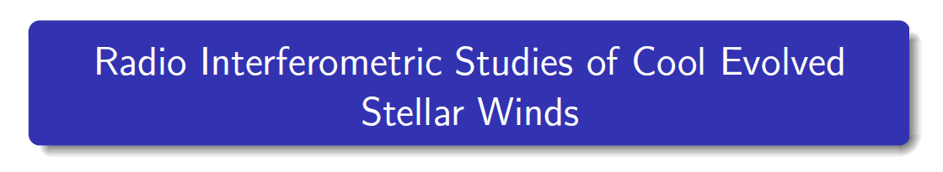
Eamon O'Gorman
Trinity College Dublin
November 15, 2013
Supervisor: Prof. Graham Harper
Notes:
Thank you Peter,
So this morning I'm going to present some of the main findings of my research which I have been carrying out here at Trinity over the last 4 years.
My research has focused on understanding the physical properties of the winds of cool evolved stars through radio interferometric techniques.
An understanding of stellar winds is crucial because they enrich the interstellar medium with the material required for the next generation of stars and planets, and they also play a key role in stellar evolution

Slide 2

Overview
Stellar Winds Across the HR Diagram
Stellar Radio Emission
1) Winds of Red Supergiants (CSE and inner wind)
2) Winds of Red Giants (inner wind)
Summary
Notes:
With an emphasise on red giants and supergiants
Why we can detect radio emission from stars other than the sun.

Slide 3
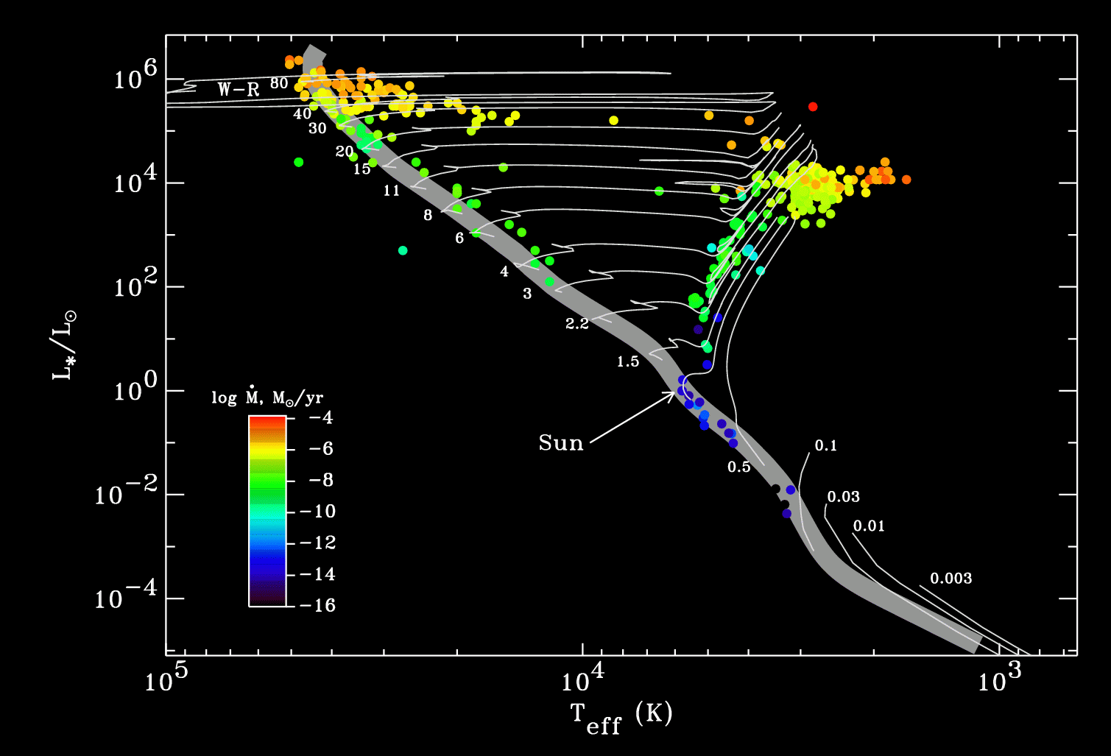
Stellar Winds Across the H-R Diagram
Hot Star Winds
Cool Evolved Stellar Winds:
AGB+non-AGB
Coronal Winds
Image Credit: S. R. Cranmer
Notes:
Stellar winds are a ubiquities phenomenon across almost all of the HR diagram. In the H-R diagram, the magnitude of stellar winds is color coded. You can see that these winds can be broadly grouped into three main categories of hot star winds, coronal winds, and cool evolved stellar winds.
The coronal winds are tenuous with mass-loss rates too small to be of evolutionary importance. These are driven mainly by the thermal pressure gradient of the hot corona, also known as the Parker mechanism.
Hot star winds have high velocities and large mass-loss rates. These winds are driven by the force of radiation pressure on optically thick atomic lines. These stars evolve almost horizontally across the HR diagram to become redsupergiants.
The evolved cool winds can be dived into agb and non-agb. These winds have low outflow velocites and usually large mass loss rates which vary by many orders of magnitude. The winds of agb stars are believed to be driven by a combination of pulsation and radiation pressure on dust grains. However, this mechanism is not operative for the winds of red supergiants and red giants.

Slide 4
Red Supergiants & Red Giants
 | Red Giants | Red Supergiants
Mass (Mסּ) | ~ 0.4 → ~ 8 | ~8 → ~ 40
Radius (Rסּ) | ~ 50 | ~ 500
Lifetime (yr) | ~ 10⁹ | ~ 5x10⁵
dM/dt (Mסּ yr⁻¹) | ~ 10⁻¹⁰ | ~ 10⁻⁵

Slide 5
Red Supergiants & Red Giants
 | Red Giants | Red Supergiants
Mass (Mסּ) | ~ 0.4 → ~ 8 | ~8 → ~ 40
Radius (Rסּ) | ~ 50 | ~ 500
Lifetime (yr) | ~ 10⁹ | ~ 5x10⁵
dM/dt (Mסּ yr⁻¹) | ~ 10⁻¹⁰ | ~ 10⁻⁵
HP/R* ~ 10⁻²
V < Vescape (R*)
Twind < 10⁴ K

Slide 6
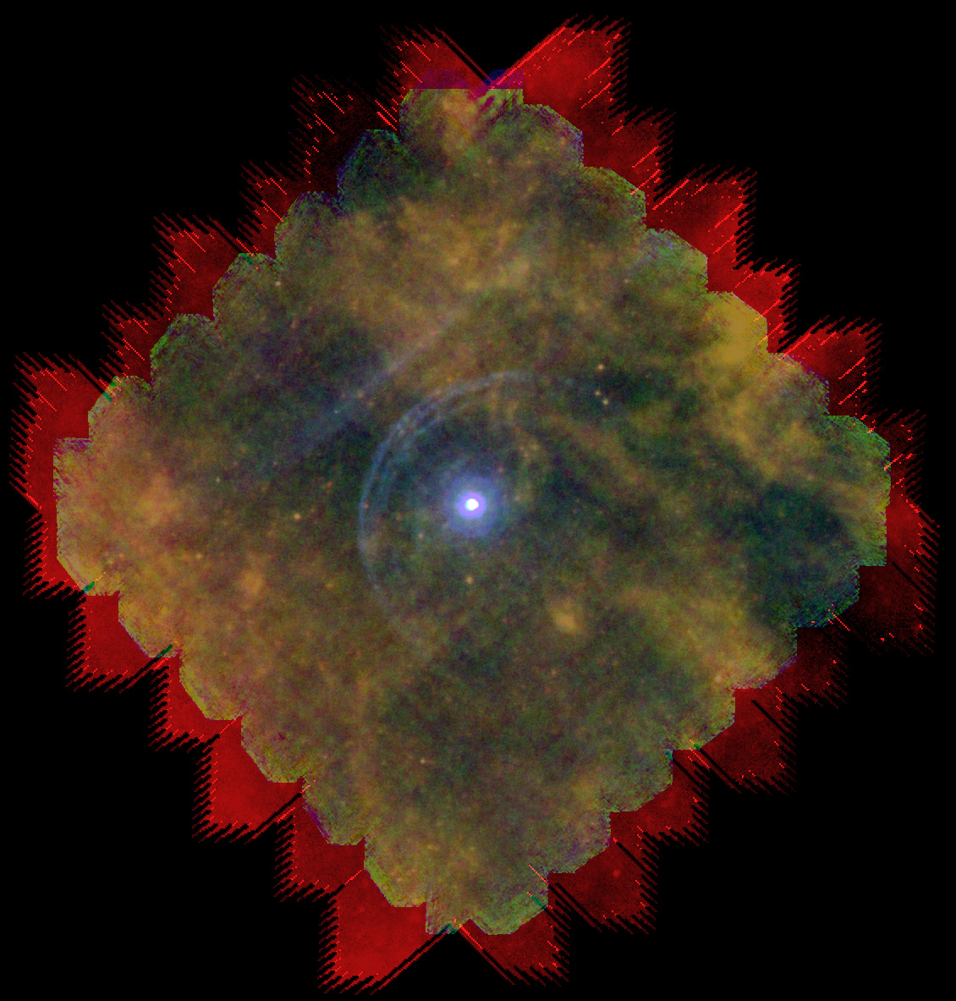
Red Supergiants & Red Giants
No coronae
Radiation field peaks in the IR
Small pulsation amplitudes and little dust
Unknown mass-loss mechanism
Image Credit: L. Decin
Notes:
Did so by doing 2 things:
moving to the radio regime where the wind emission can be directly detected
Used radio interferometry to gain high spatial resolution

Slide 7
Red Supergiants & Red Giants
No coronae
Radiation field peaks in the IR
Small pulsation amplitudes and little dust
Unknown mass-loss mechanism
Poor knowledge of outflow conditions
r, v(r), T(r)
  Disk averaged observations
  No wind emission features at UV or optical λ.
Image Credit: L. Decin
Notes:
Did so by doing 2 things:
moving to the radio regime where the wind emission can be directly detected
Used radio interferometry to gain high spatial resolution

Slide 8
Red Supergiants & Red Giants
No coronae
Radiation field peaks in the IR
Small pulsation amplitudes and little dust
Unknown mass-loss mechanism
Poor knowledge of outflow conditions
r, v(r), T(r)
  Disk averaged observations
  No wind emission features at UV or optical λ.
Image Credit: L. Decin
Thesis Goal: Improve understanding of outflow conditions to gain insight into mass-loss mechanism. → Radio
Notes:
Did so by doing 2 things:
moving to the radio regime where the wind emission can be directly detected
Used radio interferometry to gain high spatial resolution

Slide 9
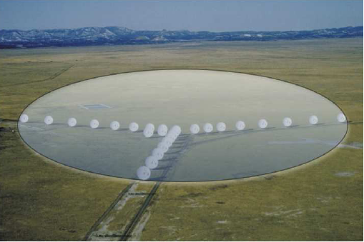
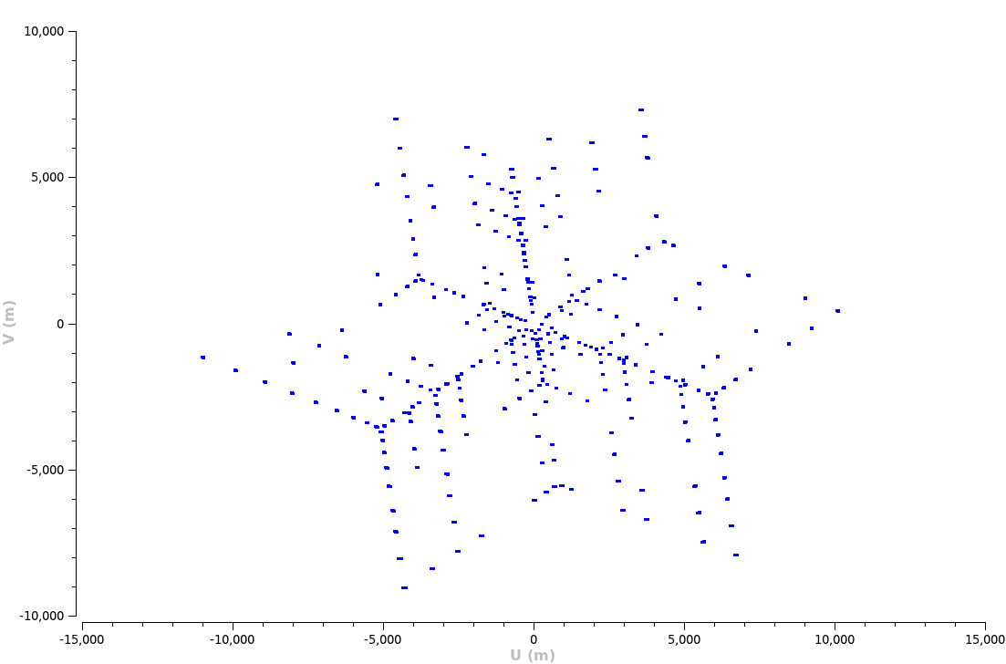
Aperture Synthesis
No need to measure all the incoming rays at one time.
Break aperture into N sub-apertures: N(N-1)/2 pairs
FT of each measurement is a sinusoid with spacing λ/B between successive peaks.
Build up image of sky by summing many such sinusoids.
Credit: NRAO/AUI
Notes:
Short baselines have large fringe spacings and measure large-scale structure on the sky – Long baselines have small
fringe spacings and measure small-scale structure on the sky

Slide 10
Aperture Synthesis
10 mins
Credit: NRAO/AUI
Notes:
Short baselines have large fringe spacings and measure large-scale structure on the sky – Long baselines have small
fringe spacings and measure small-scale structure on the sky

Slide 11
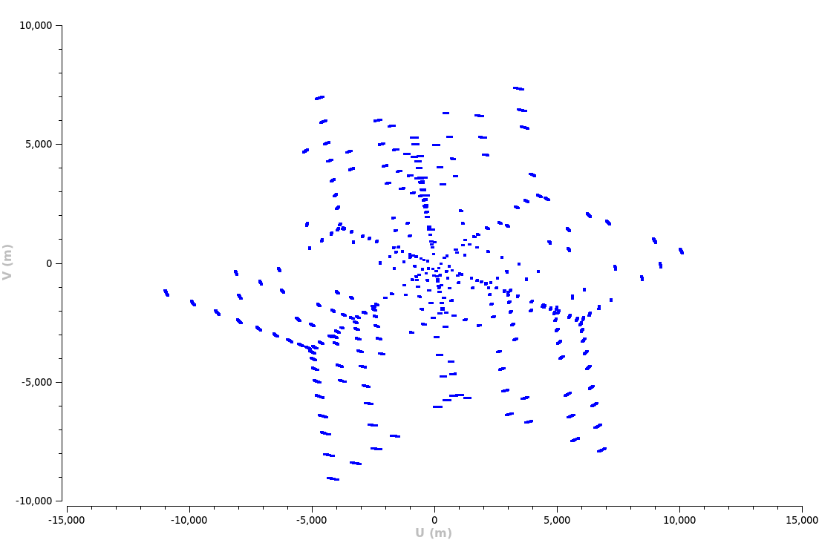
Aperture Synthesis
30 mins
Credit: NRAO/AUI
Notes:
Short baselines have large fringe spacings and measure large-scale structure on the sky – Long baselines have small
fringe spacings and measure small-scale structure on the sky

Slide 12
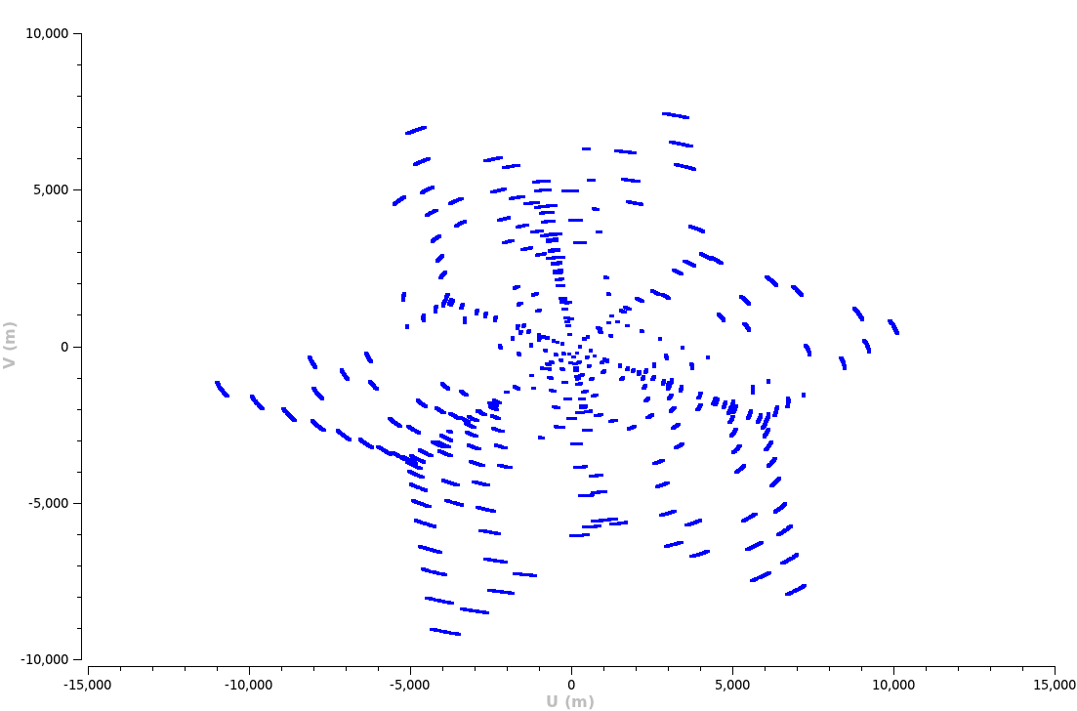
Aperture Synthesis
60 mins
Credit: NRAO/AUI
Notes:
Short baselines have large fringe spacings and measure large-scale structure on the sky – Long baselines have small
fringe spacings and measure small-scale structure on the sky

Slide 13
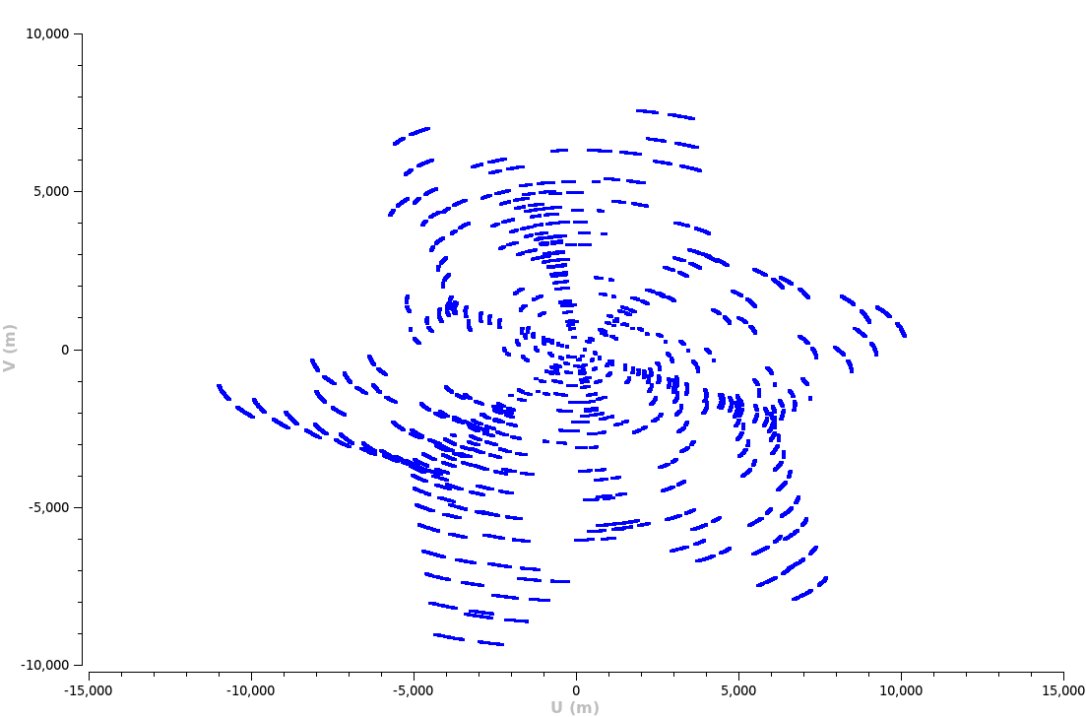
Aperture Synthesis
90 mins
Credit: NRAO/AUI
Notes:
Short baselines have large fringe spacings and measure large-scale structure on the sky – Long baselines have small
fringe spacings and measure small-scale structure on the sky

Slide 14

Aperture Synthesis
90 mins
120 mins
Credit: NRAO/AUI
Notes:
Short baselines have large fringe spacings and measure large-scale structure on the sky – Long baselines have small
fringe spacings and measure small-scale structure on the sky

Slide 15
Aperture Synthesis
120 mins
1) Field of View: λ/D (D = antenna diameter)
Credit: NRAO/AUI
Notes:
Short baselines have large fringe spacings and measure large-scale structure on the sky – Long baselines have small
fringe spacings and measure small-scale structure on the sky

Slide 16
Aperture Synthesis
120 mins
Bmax
1) Field of View: λ/D (D = antenna diameter)
2) Resolution: λ/Bmax (Bmax = longest projected baseline)
Credit: NRAO/AUI
Notes:
Short baselines have large fringe spacings and measure large-scale structure on the sky – Long baselines have small
fringe spacings and measure small-scale structure on the sky

Slide 17
Aperture Synthesis
120 mins
Bmin
Bmax
1) Field of View: λ/D (D = antenna diameter)
2) Resolution: λ/Bmax (Bmax = longest projected baseline)
3) Resolving out scale: λ/Bmin (Bmin = shortest projected baseline)
Credit: NRAO/AUI
Notes:
Short baselines have large fringe spacings and measure large-scale structure on the sky – Long baselines have small
fringe spacings and measure small-scale structure on the sky

Slide 18
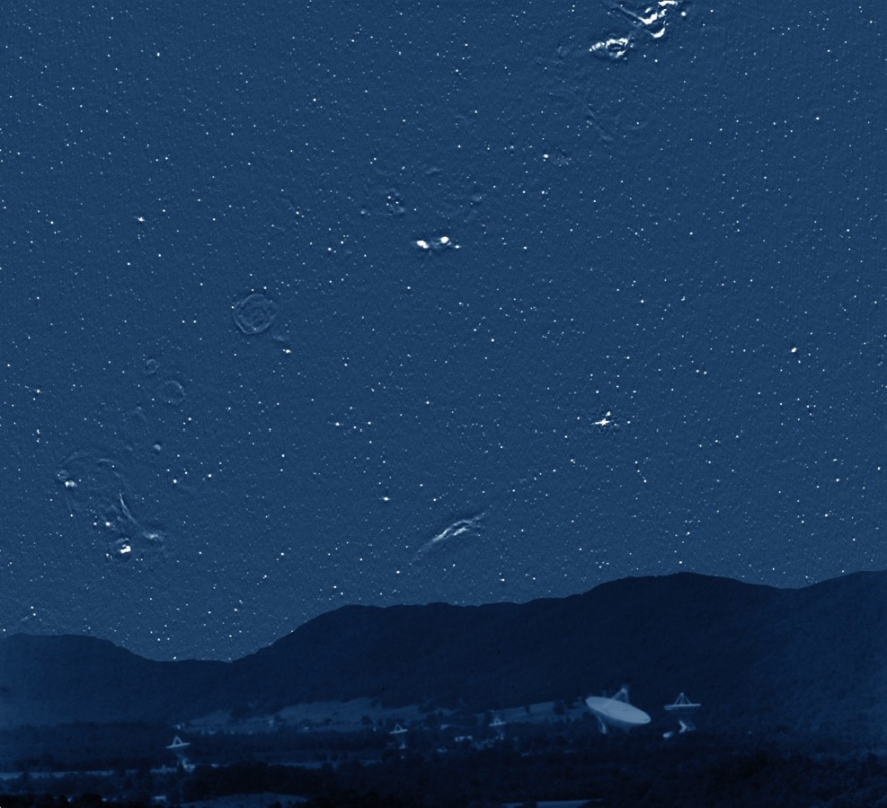
Stellar Radio Emission
Radio Sky at 4.85 GHz (300ft Green Bank)
(Pradio/Poptical)_{ʘ} ~ 10⁻¹⁵
Sυ=4.6 GHz ~ 40 μJy at α Cen
(not detectable with 'old' VLA!)
Credit: NRAO/AUI
Credit: NRAO/AUI
Notes:
The brightest irregular sources are clouds of hydrogen ionized by luminous stars. Such stars quickly exhaust their nuclear fuel, collapse, and explode as supernovae, whose remnants appear as faint radio rings. Unlike the nearby (less than 1000 light years distant) stars visible to the human eye, almost none of the myriad radio "stars" scattered over the sky are really stars at all. Most are luminous radio galaxies or quasars.
The power (Energy per second) that the sun gives out at radio wavelengths divided by the power given out in the optical (which is almost all of the radiation of the sun) is about 10-16, so from an energy point of view its very very little
The fact that so many stars are detected tells us immediately that they are doing something different from the Sun. The stars are color-coded, with the key to different types of stars given at the bottom of the image. Main sequence dwarf stars are ordinary cool stars similar to the Sun: they tend to be detected as radio sources if they are young and/or rapidly spinning. T Tauri stars are very young stars shortly after birth. The letters at the bottom of the figure show the ranges of different spectral types of stars. The filled symbols represent stars which appear to have "nonthermal coronae", that is, unlike the Sun where the outer atmosphere is mostly just heated up, in these stars the atmosphere is full of very energetic accelerated electrons which are responsible for the radio emission.

Slide 19
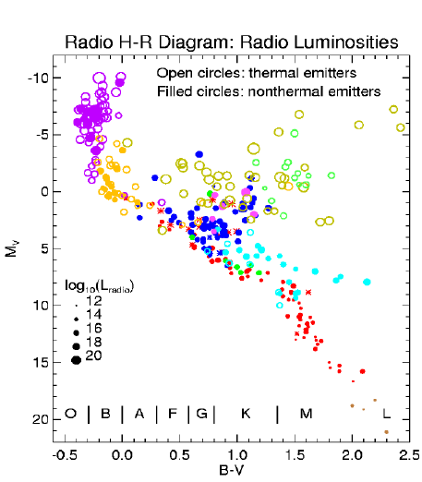
Stellar Radio Emission
Radio Sky at 4.85 GHz (300ft Green Bank)
(Pradio/Poptical)_{ʘ} ~ 10⁻¹⁵
Sυ=4.6 GHz ~ 40 μJy at α Cen
(not detectable with 'old' VLA!)
Credit: NRAO/AUI
Credit: NRAO/AUI
White (2000)
Notes:
The brightest irregular sources are clouds of hydrogen ionized by luminous stars. Such stars quickly exhaust their nuclear fuel, collapse, and explode as supernovae, whose remnants appear as faint radio rings. Unlike the nearby (less than 1000 light years distant) stars visible to the human eye, almost none of the myriad radio "stars" scattered over the sky are really stars at all. Most are luminous radio galaxies or quasars.
The power (Energy per second) that the sun gives out at radio wavelengths divided by the power given out in the optical (which is almost all of the radiation of the sun) is about 10-16, so from an energy point of view its very very little
The fact that so many stars are detected tells us immediately that they are doing something different from the Sun. The stars are color-coded, with the key to different types of stars given at the bottom of the image. Main sequence dwarf stars are ordinary cool stars similar to the Sun: they tend to be detected as radio sources if they are young and/or rapidly spinning. T Tauri stars are very young stars shortly after birth. The letters at the bottom of the figure show the ranges of different spectral types of stars. The filled symbols represent stars which appear to have "nonthermal coronae", that is, unlike the Sun where the outer atmosphere is mostly just heated up, in these stars the atmosphere is full of very energetic accelerated electrons which are responsible for the radio emission.

Slide 20
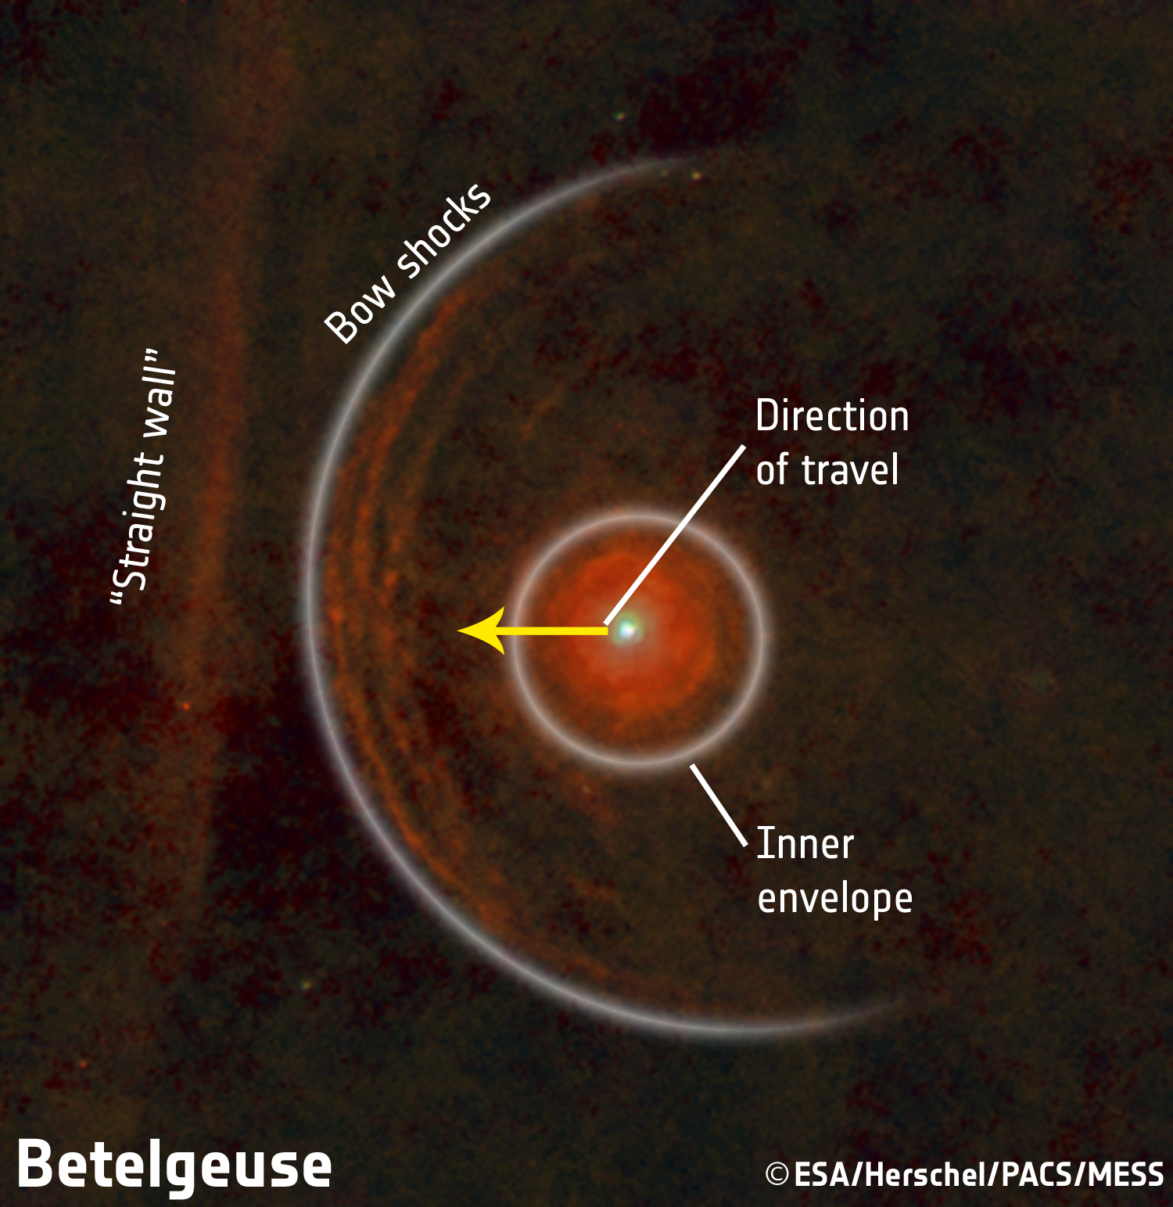
1) Winds of Red Supergiants
Betelgeuse (M2 Iab)
Log(L/L_{ʘ}) | 5
Distance | 197 ± 45 parsec
Photospheric Radius | 22.5 mas (950 R_{ʘ})
Mass | ~15 M_{ʘ}
Mass loss rate | 3 x 10⁻⁶ M_{ʘ} yr⁻¹
Photospheric Temperature | 3,600 K (cool star)
Origin | O-type main sequence
¹²C/¹³C | 6 ± 1
(Decin et al., 2013)

Slide 21
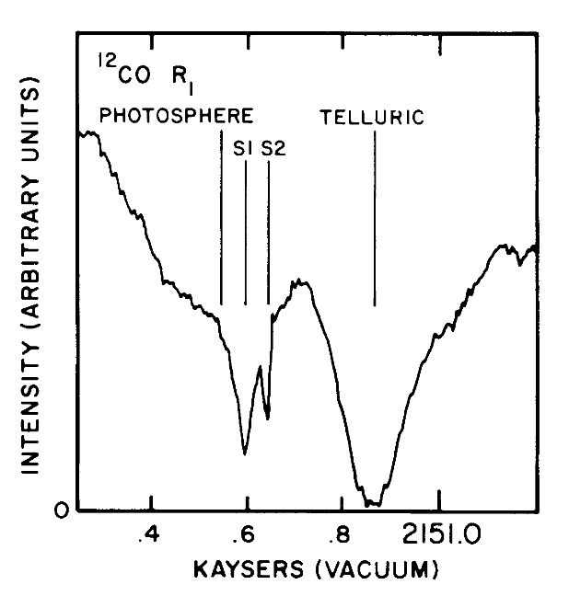
Betelgeuse: Circumstellar Environment
(Bernat et al., 1979)
At least two recent mass loss phases
Two distinct shells spectrally resolved at 4.6 μm:
  S2, moving at 17 km s⁻¹
  S1, moving at 10 km s⁻¹
  Spatial extent not directly determined

Slide 22
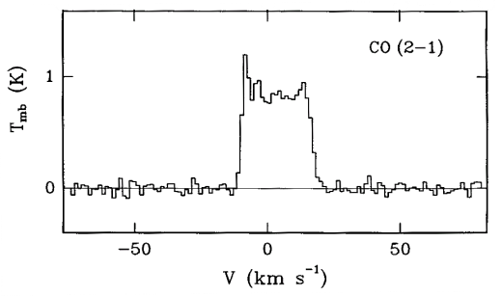
Betelgeuse: Circumstellar Environment
(Bernat et al., 1979)
At least two recent mass loss phases
Two distinct shells spectrally resolved at 4.6 μm:
  S2, moving at 17 km s⁻¹
  S1, moving at 10 km s⁻¹
  Spatial extent not directly determined
Plez & Lambert (2002) appear to detect S2 out to 50''
IRAM 30 m (θHPBW ~12") fails to resolve S2 shell at 1.3 mm
Single dish ¹²C¹⁶O mm-observations reveal only high velocity S2 shell.
(Huggins et al., 1994)
Notes:
50 arcsec =2000 R star
12 arcsec =500 rstar

Slide 23
Betelgeuse: Circumstellar Environment
(Bernat et al., 1979)
At least two recent mass loss phases
Two distinct shells spectrally resolved at 4.6 μm:
  S2, moving at 17 km s⁻¹
  S1, moving at 10 km s⁻¹
  Spatial extent not directly determined
Plez & Lambert (2002) appear to detect S2 out to 50''
IRAM 30 m (θHPBW ~12") fails to resolve S2 shell at 1.3 mm
Single dish ¹²C¹⁶O mm-observations reveal only high velocity S2 shell.
(Huggins et al., 1994)
Goal: Measure both the spatial scales and the velocities of Betelgeuse’s outflow region using ¹²C¹⁶O J = 2-1 line as a tracer to sort out puzzling evidence.

Slide 24
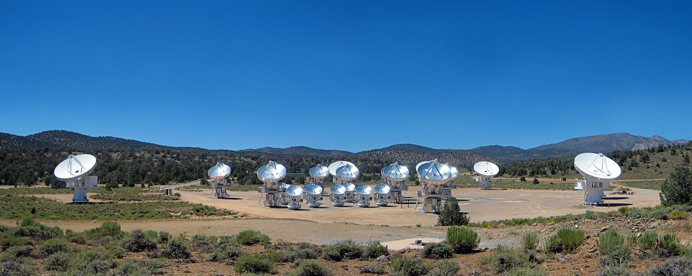
CARMA
Combined Array for Research in Millimeter-wave Astronomy
Cedar Flat, eastern California (~ 2,200 m)
15 element interferometer (9 x 6.1 m + 6 x 10.4 m antennas)
Merger of two independent arrays: BIMA + OVRO (2007)
105 baselines (n(n-1)/2) with 5 configurations
Three bands: 7 mm, 3 mm and 1.3 mm
Credit: John Carlstrom

Slide 25
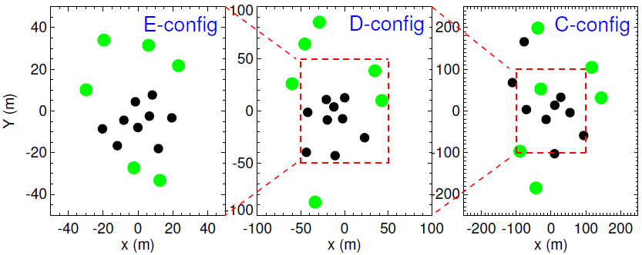
mm Observations
Date | Config | Time (hr) | Resolution (") | Max Scale (")
Jun 07 | D | 8.4 | 2.1 | 15
Jul 09 | E | 3.2 | 4.4 | 19
Nov 09 | C | 8.4 | 0.9 | 6
Bmin= 8 m, Bmax= 66 m
Bmin= 11 m, Bmax= 150 m
Bmin= 30 m, Bmax= 350 m

Slide 26
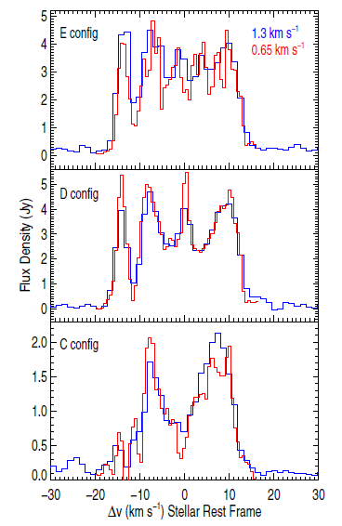
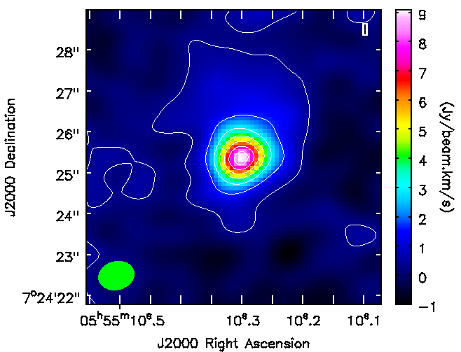
Individual Configurations
Dec
velocity (km s⁻¹)
No shells in individual configuration image cubes.
RA
(O'Gorman et al., 2012)

Slide 27
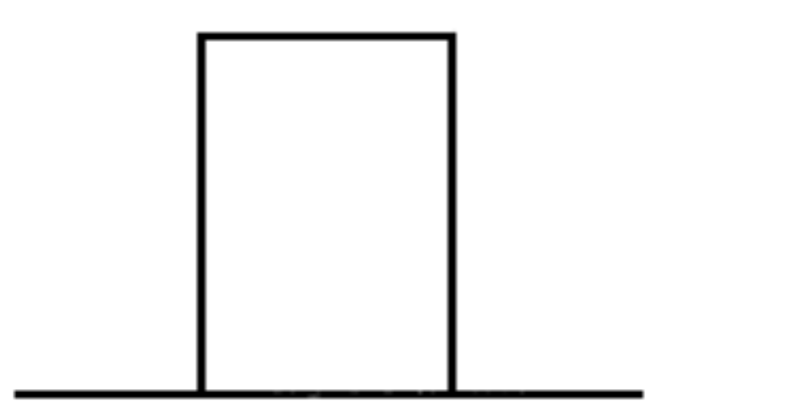
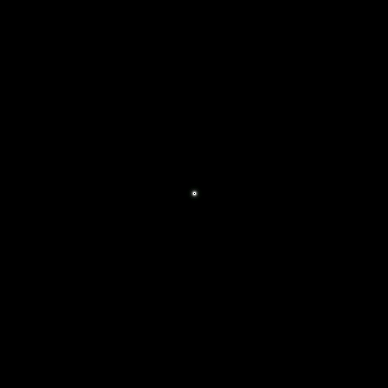
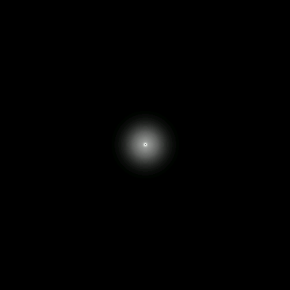
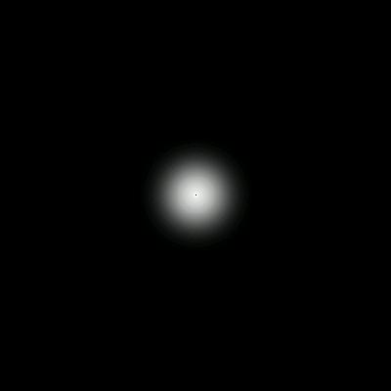


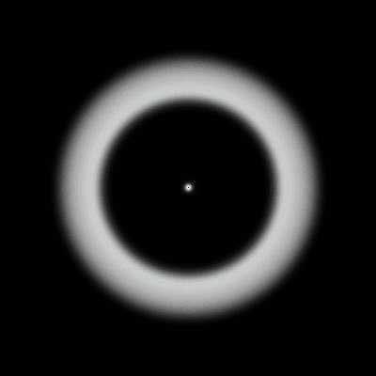
Spherically Symmetric Shell
Flux
-v 0 +v
Velocity (km s⁻¹)
Notes:
Ideal Spherical Shell

Slide 28
Spherically Symmetric Shell
Flux
-v 0 +v
Velocity (km s⁻¹)
Notes:
Ideal Spherical Shell

Slide 29
Spherically Symmetric Shell
Flux
-v 0 +v
Velocity (km s⁻¹)
Notes:
Ideal Spherical Shell

Slide 30
Spherically Symmetric Shell
Flux
-v 0 +v
Velocity (km s⁻¹)
Notes:
Ideal Spherical Shell

Slide 31
Spherically Symmetric Shell
Flux
-v 0 +v
Velocity (km s⁻¹)
Notes:
Ideal Spherical Shell

Slide 32
Spherically Symmetric Shell
Flux
-v 0 +v
Velocity (km s⁻¹)
Notes:
Ideal Spherical Shell

Slide 33
Spherically Symmetric Shell
Flux
-v 0 +v
Velocity (km s⁻¹)
Notes:
Ideal Spherical Shell

Slide 34
Spherically Symmetric Shell
Flux
-v 0 +v
Velocity (km s⁻¹)
Notes:
Ideal Spherical Shell

Slide 35
Spherically Symmetric Shell
Flux
-v 0 +v
Velocity (km s⁻¹)
Notes:
Ideal Spherical Shell

Slide 36
Spherically Symmetric Shell
Flux
-v 0 +v
Velocity (km s⁻¹)
Notes:
Ideal Spherical Shell

Slide 37
Spherically Symmetric Shell
Flux
-v 0 +v
Velocity (km s⁻¹)
Notes:
Ideal Spherical Shell

Slide 38
Spherically Symmetric Shell
Flux
-v 0 +v
Velocity (km s⁻¹)
Notes:
Ideal Spherical Shell

Slide 39
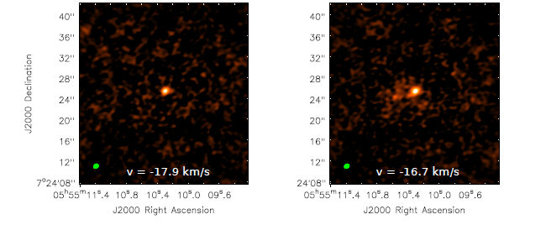
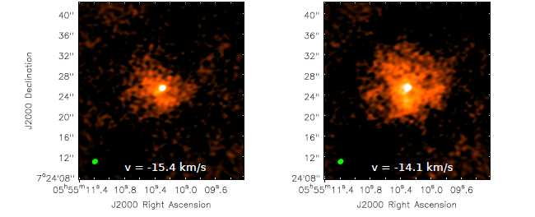
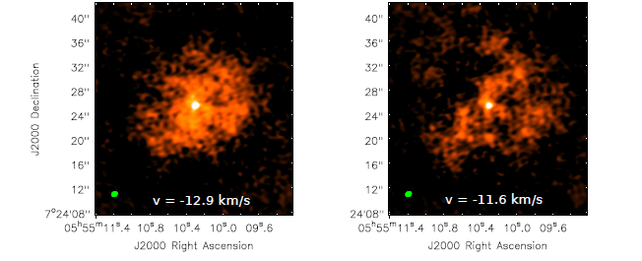
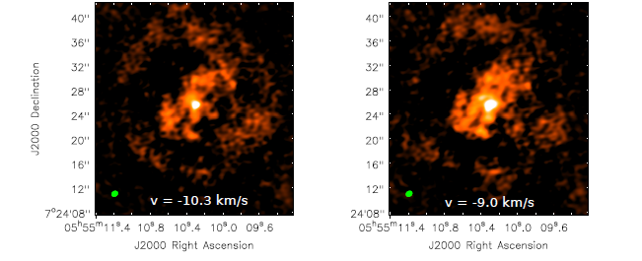
Combined Configuration

Slide 40
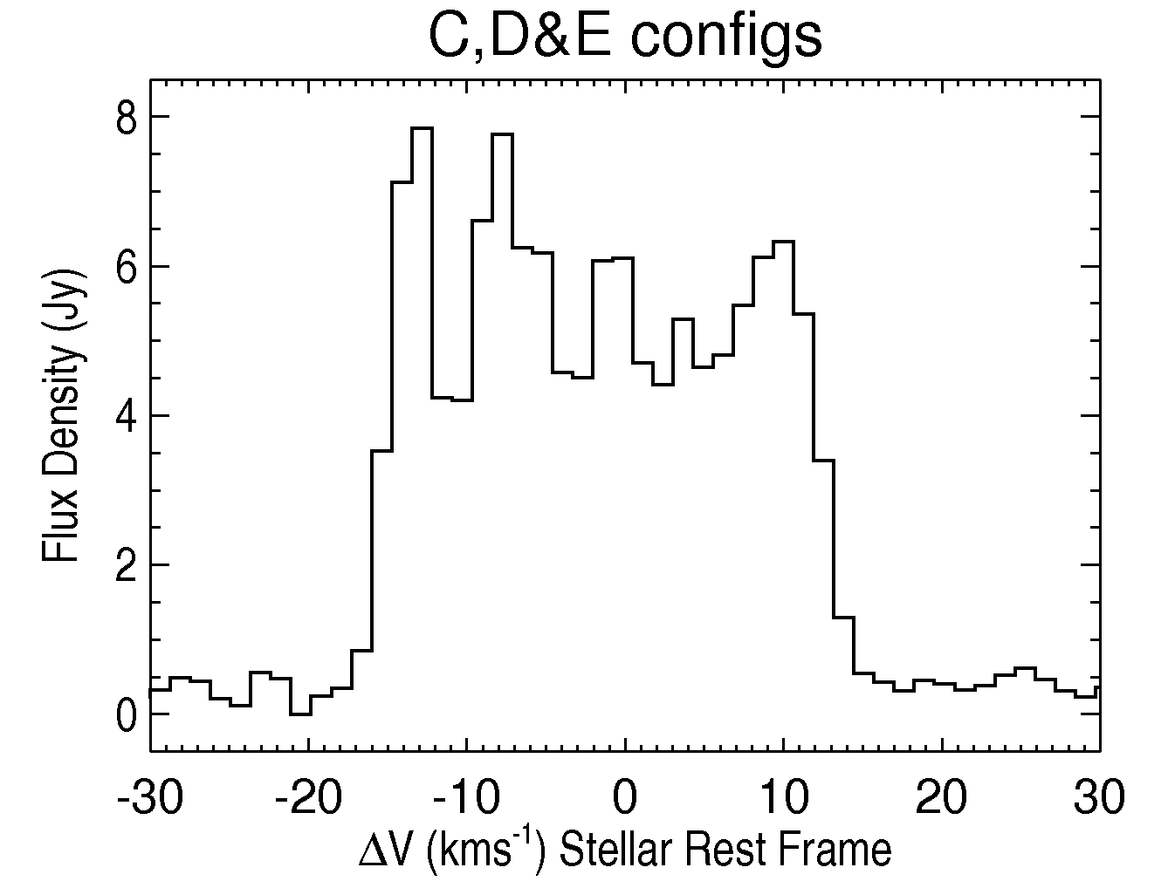
Combined Configurations

Slide 41
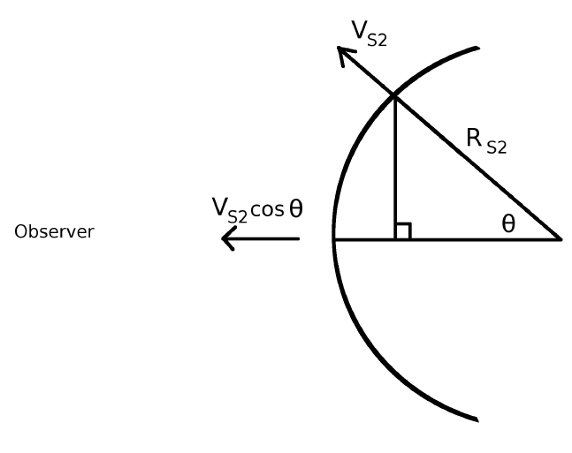
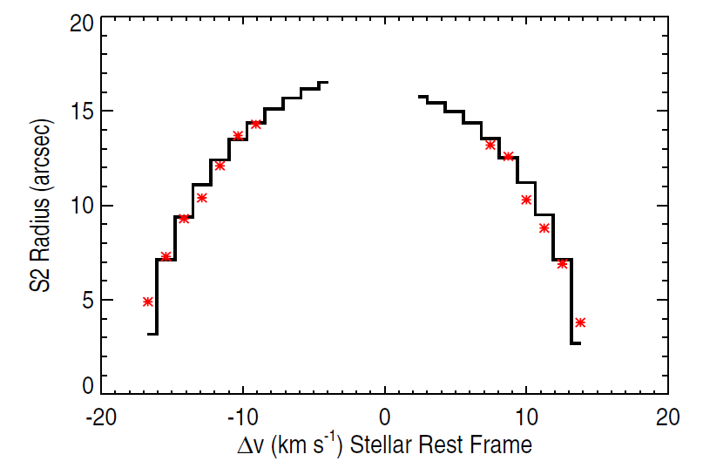

S2 Flow
S2 flow not present at low absolute velocities.
(O'Gorman et al., 2012)

Slide 42
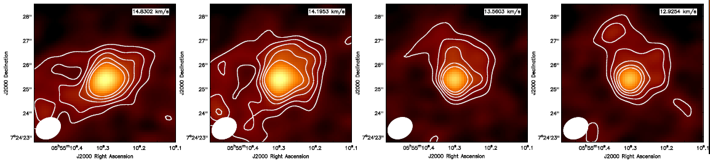
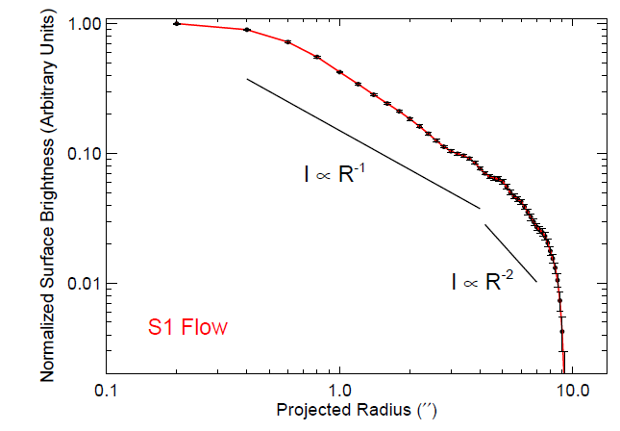
S1 Flow
(O'Gorman et al., 2012)

Slide 43
Conclusions
High spatial resolution configuration resolves out S2 emission providing S1 profile.
Multiple CARMA configurations provide the high spatial resolution needed to study the inner S1 flow, while ensuring the extended S2 flow is not resolved out.
Previous line profiles not horned shaped because:
    S1 emission is also present
    S2 emission weak at low absolute velocities
 | S1 | S2
Outflow Velocities (km s⁻¹) | 9.8 | 14.3
Maximum Spatial Extent ('') | 4 → 6 | 17
Age (yr) | 400 → 600 | 1100

Slide 44
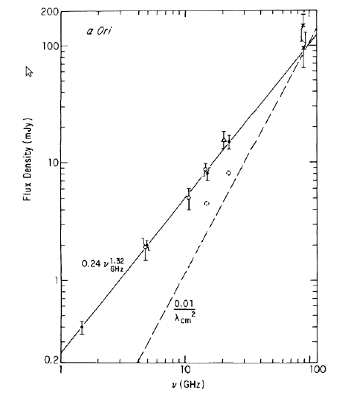
Betelgeuse's Wind Acceleration Region
(Newell & Hjellming, 1982)
Wind
BB
Notes:
Unreolved vs spatially resolved

Slide 45
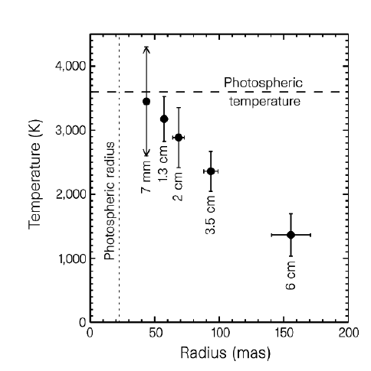
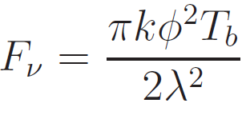
Betelgeuse's Wind Acceleration Region
(Newell & Hjellming, 1982)
(Lim et al., 1998)
Wind
BB
Brightness Temperature
Size
Notes:
Unreolved vs spatially resolved

Slide 46
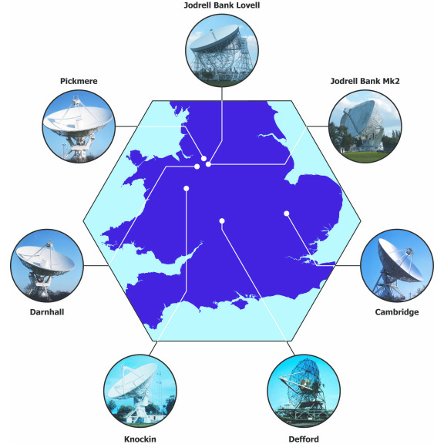
Betelgeuse with e-MERLIN (5.2 cm)
(Credit: MERLIN/VLBI national facility)
Notes:
6 times the spatial resolution of the VLA

Slide 47
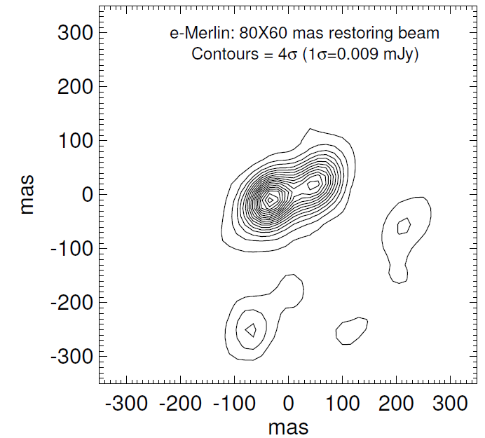
Betelgeuse with e-MERLIN (5.2 cm)
Richards et al. (2013)
Two unresolved hot spots:
Te > 3800 K
Te > 5400 K
Where is the photosphere?
(Credit: MERLIN/VLBI national facility)
Notes:
6 times the spatial resolution of the VLA

Slide 48
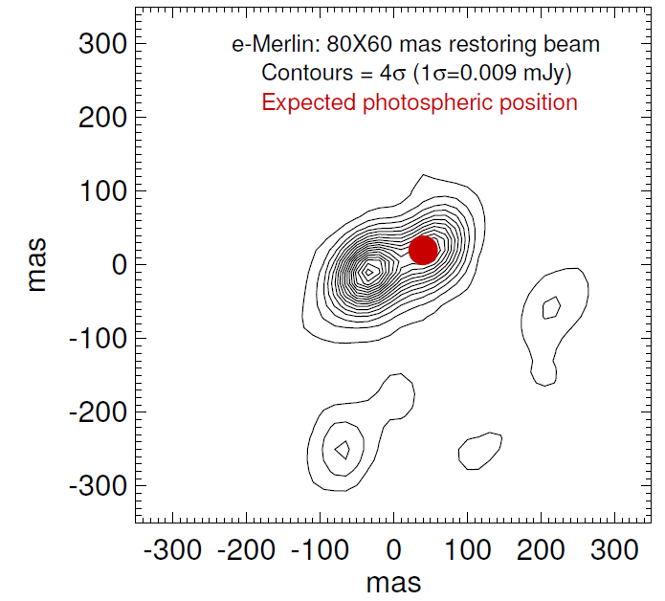
Betelgeuse with e-MERLIN (5.2 cm)
Astrometric solution of Harper et al., (2008)
Hottest source at 4 R*.
At least ~3 times the predicted Te.

Slide 49
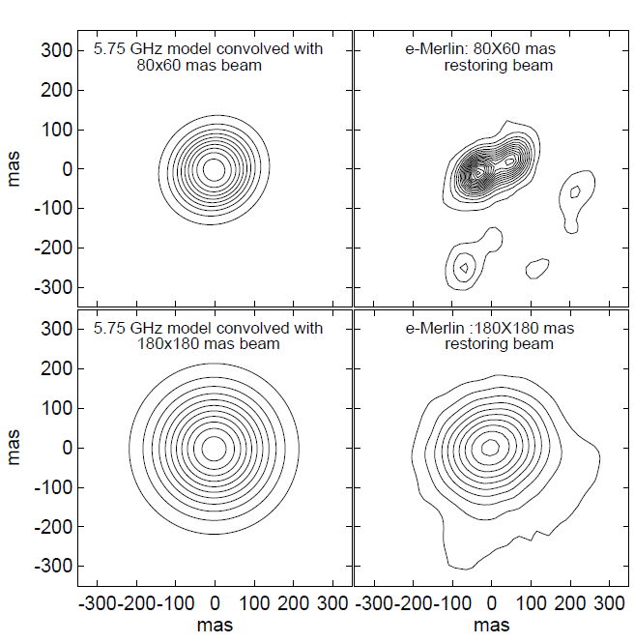
Betelgeuse with e-MERLIN (5.2 cm)
Astrometric solution of Harper et al., (2008)
1-D model
Actual
Hottest source at 4 R*.
At least ~3 times the predicted Te.
1-D model
Actual
Spherically symmetric semi-empirical model of Harper et al., (2001)

Slide 50
Betelgeuse with e-MERLIN (5.2 cm)
Astrometric solution of Harper et al., (2008)
1-D model
Actual
Hottest source at 4 R*.
At least ~3 times the predicted Te.
1-D model
Actual
Goal: Analyse high resolution archival cm data to search for signatures of hotspots.
Spherically symmetric semi-empirical model of Harper et al., (2001)

Slide 51
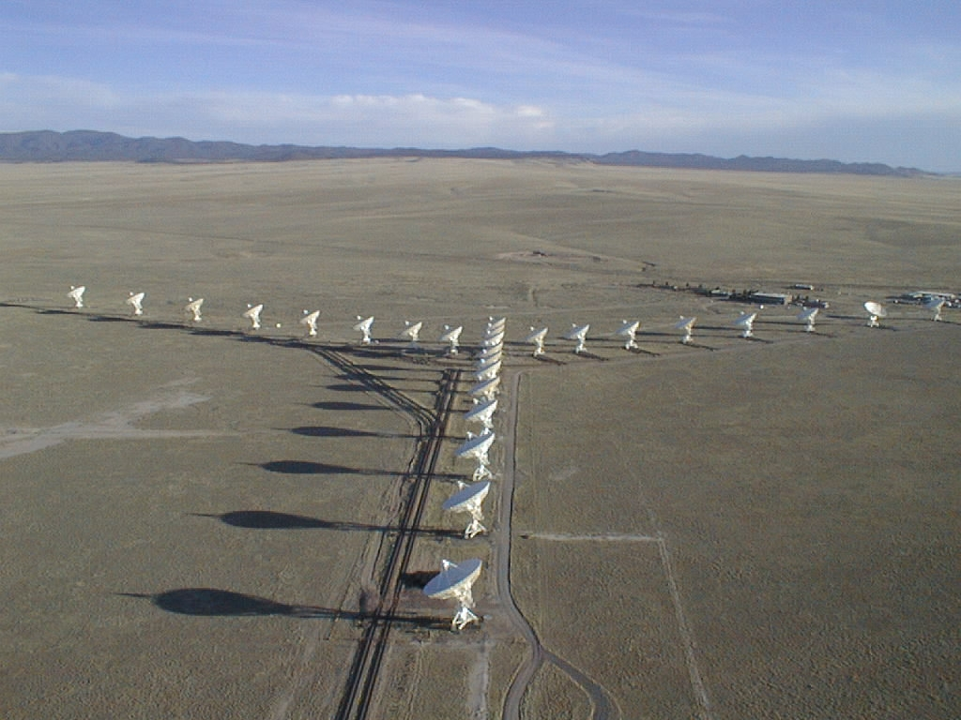
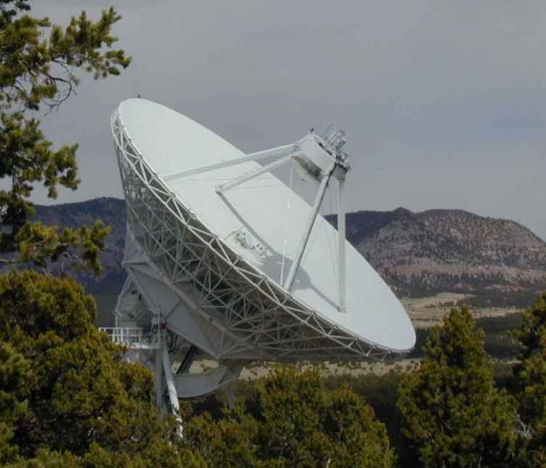
Betelgeuse with VLA – Pie Town
VLA
e-MERLIN
w/l (cm) | Resolution ('')
5.2 | 80 x 60
VLA + Pie Town
w/l (cm) | Resolution ('')
0.7 | 40 x 25
1.3 | 80 x 40
2.0 | 120 x 90
3.5 | 200 x 130
6.2 | 380 x 270
+ =
Pie Town Antenna

Slide 52
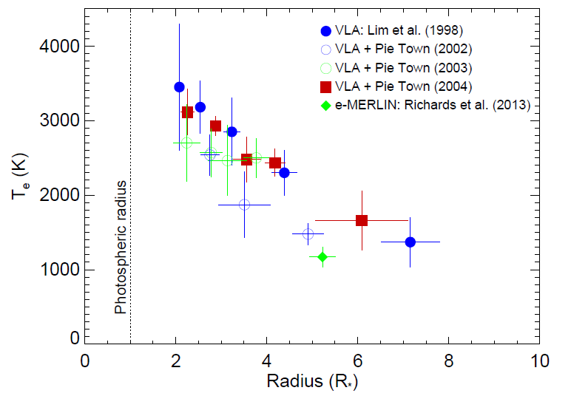
Betelgeuse with VLA – Pie Town
Variability 1998-2004
w/l (cm) | Variability
0.7 | 23%
1.3 | 27%
2.0 | 32%
3.5 | 21%
6.2 | 35%
Thermal Profile

Slide 53
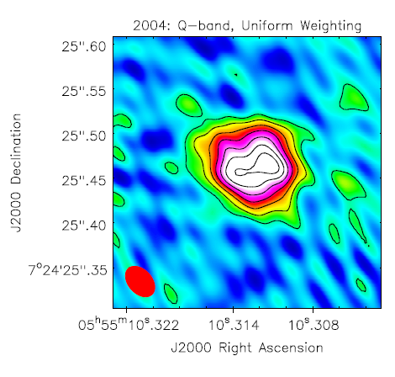
Betelgeuse with VLA – Pie Town
Variability 1998-2004
w/l (cm) | Variability
0.7 | 23%
1.3 | 27%
2.0 | 32%
3.5 | 21%
6.2 | 35%
Q band (0.7 cm)
Thermal Profile

Slide 54
Betelgeuse with VLA – Pie Town
Variability 1998-2004
w/l (cm) | Variability
0.7 | 23%
1.3 | 27%
2.0 | 32%
3.5 | 21%
6.2 | 35%
Q band (0.7 cm)
Thermal Profile

Slide 55
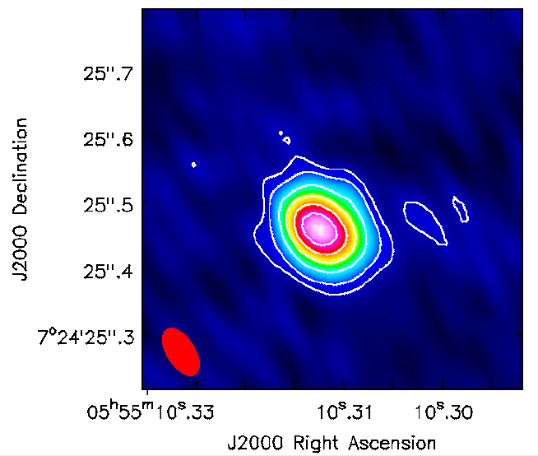
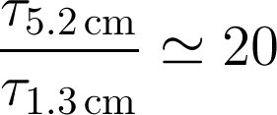
Betelgeuse with VLA – Pie Town
1.3 cm Map
No clear signature of hot spots any in any maps.
  Time dependence?
  Opacity?

Slide 56
Conclusions
e-MERLIN has revealed two unresolved hotspots separated by 4 R*
One may be at the position of photosphere
VLA + Pie Town data in good agreement with Lim et al. (1998)
Flux and structure variability present in data
No clear signature of e-MERLIN hotspots in any of the VLA + Pie Town data

Slide 57
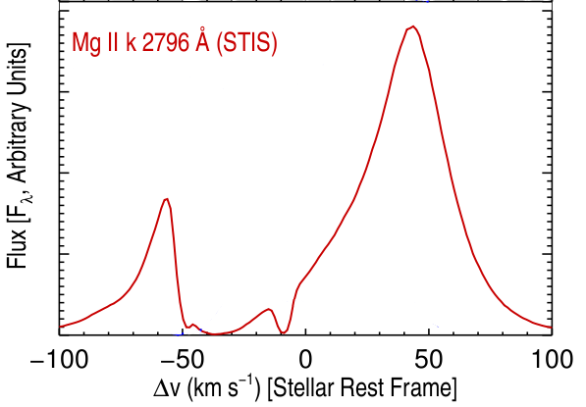
2) Winds of Red Giants
Atmospheres cannot be spatially resolved at radio wavelengths.
Wind properties generally traditionally determined
by analysing strong UV and optical resonance lines.
At cm/mm the thermal continuum Planck
function depends linearly on T, unlike the UV.
Continuum flux measurements at cm/mm: opacity is proportional to ~ λ^{2.1} nenion.
α-Boo: Blue-shifted absorption component->outflow
Goal: Observe two 'standard' red giants at all possible cm wavelengths to test and improve existing models.
Notes:
Importance: T controls the level populations & ionization balance. Required for a detailed analysis of the wind thermal balance. Clues to mass-loss mechanism.
Spatial information from point sources!

Slide 58
Red Giant Targets
 | Arcturus (α Boo: K2 III) | Aldebaran (α Tau: K5 III)
Distance (pc) | 11.3 | 20.4
Photospheric Radius (R_{ʘ}) | 25.4 | 44.2
Mass ( M_{ʘ}) | 0.8 | 1.3
Mass loss rate (M_{ʘ} yr⁻¹) | 2 x 10⁻¹⁰ | 1.6 x 10⁻¹¹
Teff (K) | 4290 | 3970
Single, non-dusty and non-pulsating
Nearby, with well known stellar parameters
Semi-empirical 1-D chromospheric and wind models that can be directly tested

Slide 59
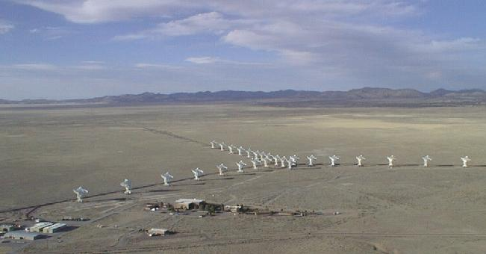
Karl G. Jansky Very Large Array
Credit: NRAO
  27 25 m antennas, New Mexico. Max baseline ~ 36 km
  Full frequency coverage between 1.0 and 50 GHz
  Continuum sensitivity improvement over the VLA by factors of 5 to 20
  Spectral Capability: A minimum of 16,384 and a maximum of 4,194,304 channels

Slide 60
New Observations
Open Shared Risk Observing (OSRO)
B config (128 MHz)
α Boo: S → Q band (13th - 22nd Feb 2011)
α Tau: S → Q band (11th - 13th Feb 2011)
A unique dataset
Directors Discretionary Time (DDT)
B config (2 GHz)
α Boo: S & L band (July 2012)

Slide 61
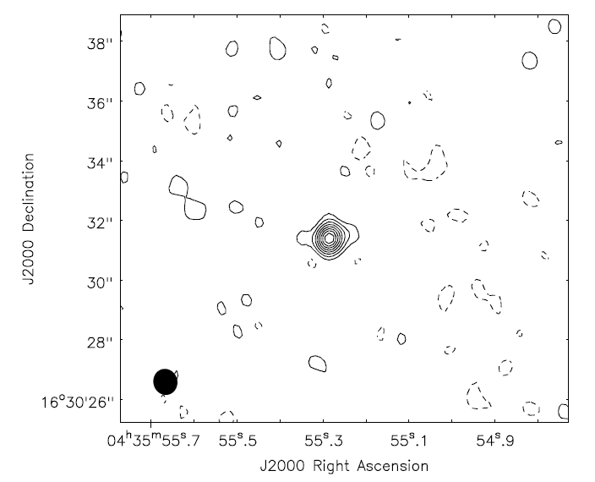
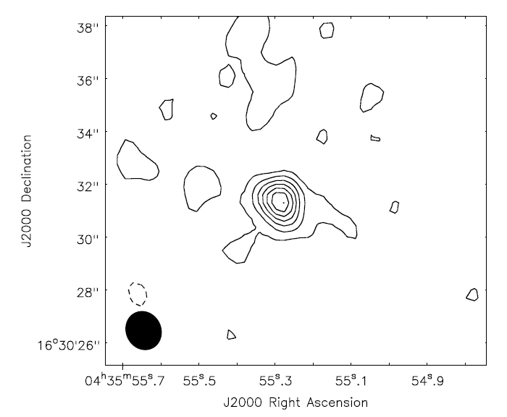
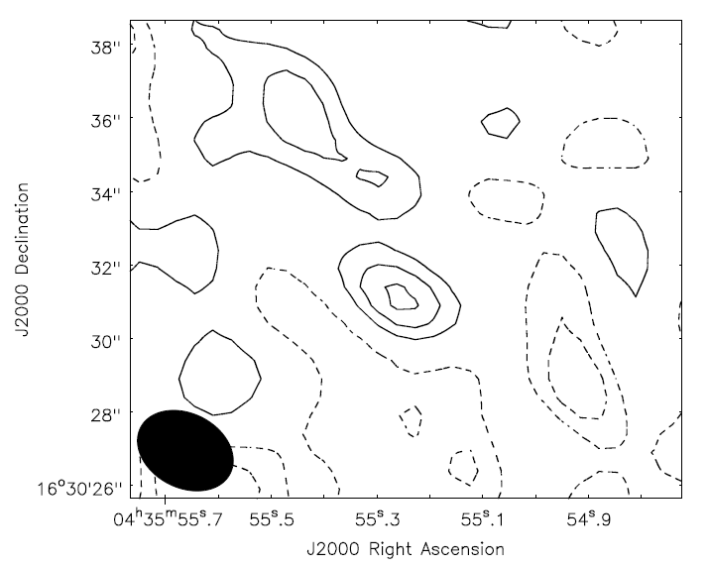
Red Giant Radio Maps
Example: Aldebaran X (3 cm), C (6 cm), and S (10 cm) band
X-band (8 GHz)
Sν= 0.3 mJy
C-band (5 GHz)
Sν= 0.15 mJy
S-band (3 GHz)
Sν= 0.06 mJy
Contours = (-2,2,4......16)xσ
σ = 16 μJy
Contours = (-2,2,4,.....14)xσ
σ = 10 μJy
Contours = (-3,-2,-1,1,2,3)xσ
σ = 18 μJy

Slide 62
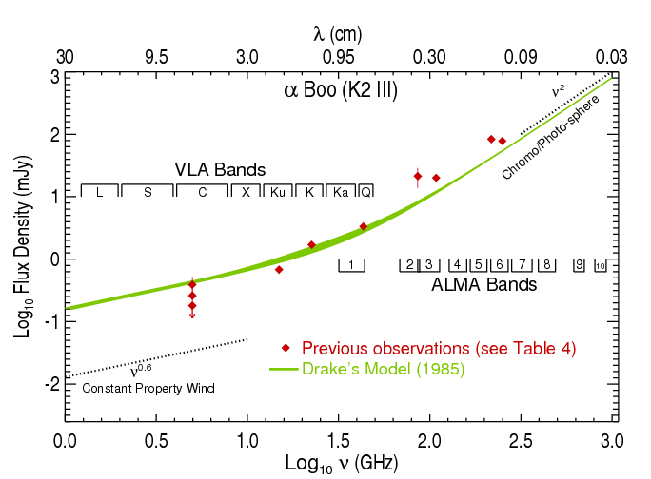
Spectral Energy Distribution – α Boo
Notes:
α = 2 (thermal free-free)
Assumes homogeneous ne
If ne ~ r ⁻² then α = 0.6
Assumes constant v, T

Slide 63

Spectral Energy Distribution – α Boo
Notes:
α = 2 (thermal free-free)
Assumes homogeneous ne
If ne ~ r ⁻² then α = 0.6
Assumes constant v, T

Slide 64







Spectral Indices
If,
then,
α Tau: wind ~ wind optically thin
α Boo:
Assume constant velocity wind,

Slide 65
Spectral Energy Distribution – α Boo
Notes:
α = 2 (thermal free-free)
Assumes homogeneous ne
If ne ~ r ⁻² then α = 0.6
Assumes constant v, T

Slide 66

Spectral Energy Distribution – α Boo
Notes:
α = 2 (thermal free-free)
Assumes homogeneous ne
If ne ~ r ⁻² then α = 0.6
Assumes constant v, T

Slide 67
2) Conclusions
Most comprehensive set of multi-λ radio observations of two standard red giants.
Tested theoretical and semi-empirical atmospheric models.
Radio spectral indices allow flow properties to be investigated.
    Optically thin wind for α Tau.
    Rapidly cooling wind for α Boo.
New analytical advection wind model for α Boo.

Slide 68
Summary
Established spatial scales for the two flows in CSE of Betelgeuse
Evidence for asymmetries in both S1 and S2 flows
e-MERLIN results are surprising. Episodic mass-loss mechanism in RSGs?
1st multi-wavelength radio study of red giants
Provide wind diagnostics and updated outflow models.
Understanding of mass-loss is improving and radio interferometry will continue to play a major role in future developments.
Notes:
Unique epochs of mass-loss in the last ~1100 years.
Change in outflow properties at certain distances.
Formed during outflow?
Or from mass-loss process?

Slide 69
Thermal Energy Balance
Close to photosphere: v²(r) << v²esc(r)
To escape star: v²(r) > v²esc(r)
Energy added in the form of either heat or momentum
Goal: Create a wind thermal energy balance to investigate possible heating mechanisms in Arcturus' inner outflow region.
Notes:
Gas kinetic power law slope
If t = constant, isothermal flow, lambda=0

Slide 70


Thermal Energy Balance
Close to photosphere: v²(r) << v²esc(r)
To escape star: v²(r) > v²esc(r)
Energy added in the form of either heat or momentum
Goal: Carry out a thermal energy balance to investigate possible heating mechanisms in Arcturus' inner outflow region.
Notation:
Adiabatic Expansion
Heating
Cooling
Gas kinetic power law slope
Notes:
Gas kinetic power law slope

Slide 71


Cooling and Heating Processes
Cooling
Heating

Slide 72

Cooling and Heating Processes
Notes:
Step function: artifact of isothermal approximation

Slide 73

Cooling and Heating Processes

Slide 74

Cooling and Heating Processes

Slide 75



Radio Emission Mechanisms
1) Molecular Emission lines
Line profiles: flat-topped or horned shaped (optically thin)
Line full widths typically between 20 and 50 km s⁻¹
CO: Both O-rich and C-rich stars. Stable.
Excitation processes for CO: H and H2 collisions. Photo-excitation of vibrational levels by IR photons.
Unresolved Resolved
1) Thermal Bremsstrahlung Emission
Opacity is proportional to ~ λ^{2.1}
Source or beam size
Notes:
High mass loss rates + low outflow velocities = relatively high density
Can form over a region with a radius of the order of 104 stellar radii:
Usually smaller than vesc at stellar surface but molecular lines form at large distances from star where local escape velocity << vesc
H2 collisions excite rotational levels

