Slide 1
MondeϕIA
Détection d’événements Euro 2016

Slide 2
Team
Ghislain (Mondeca)
Hacene (Mondeca)
Anh (Mondeca)
Arnaud (Mondeca)
Julien (Eurecom)
Edouard (INRIA)

Slide 3
Our Approach
Temporal Analysis
Topic Detection relevant to the Euro 2016
Semantic Event Representation
Semantic Annotation and Rule-based analysis
Indexation and visualization

Slide 4
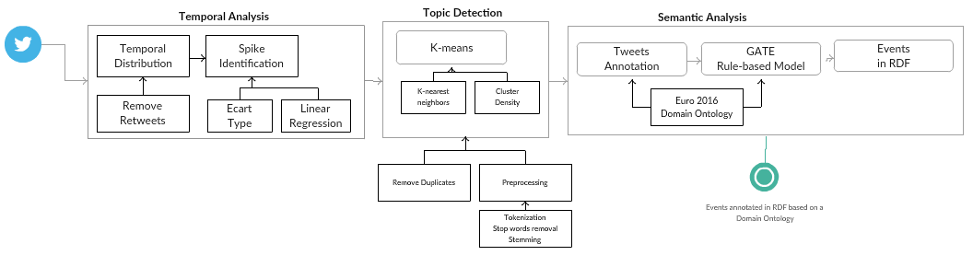
Our Approach - Diagram

Slide 5
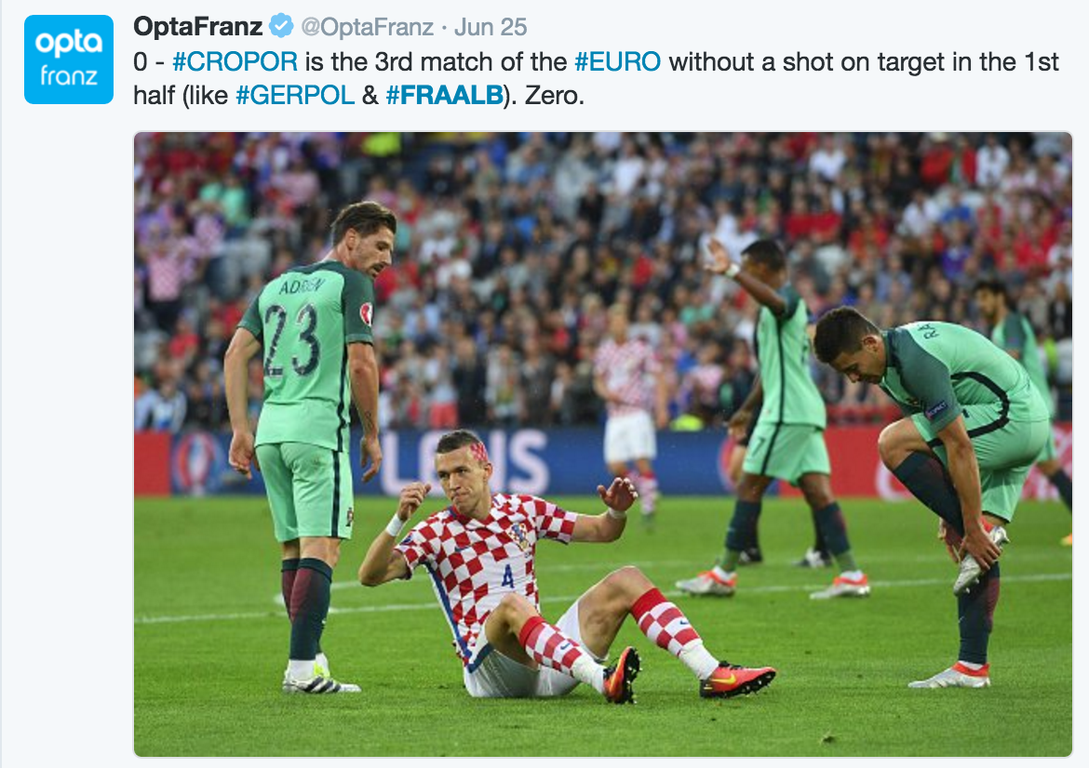



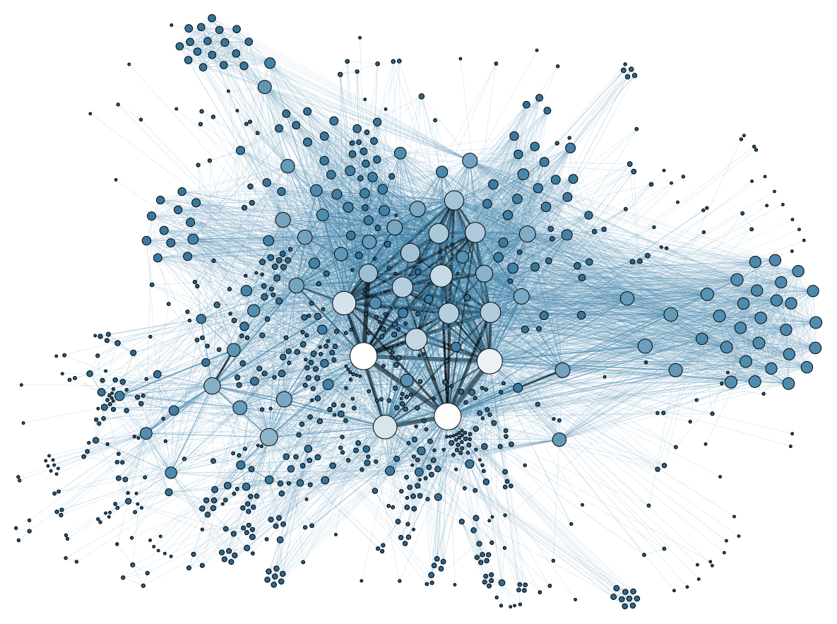

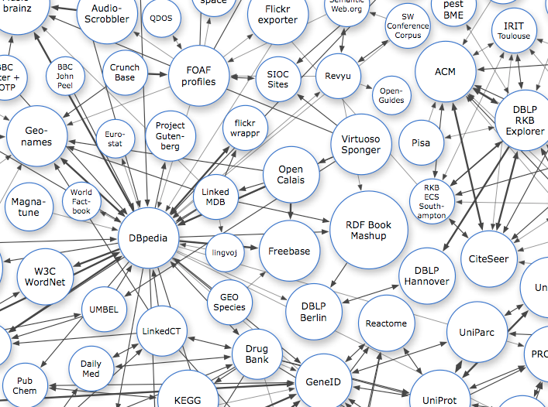


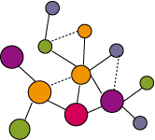
Extraction
Détection
Filtrage des Tweets
Formatage du flux
Content Annotation
Détection des joueurs, actions du match
Pose de metadatas
Indexation
Sortie Annotation et des tags détectés
Visualisation
Ontologie des évènements et référentiels
Alimente les composants

Slide 6
Temporal Analysis and Spike Detection
Retrospective analyse of a collection of tweets
Temporal distribution of tweets based on a fixed time-window
Ignore time-window with low frequency
Ecart Type
Linear Regression

Slide 7
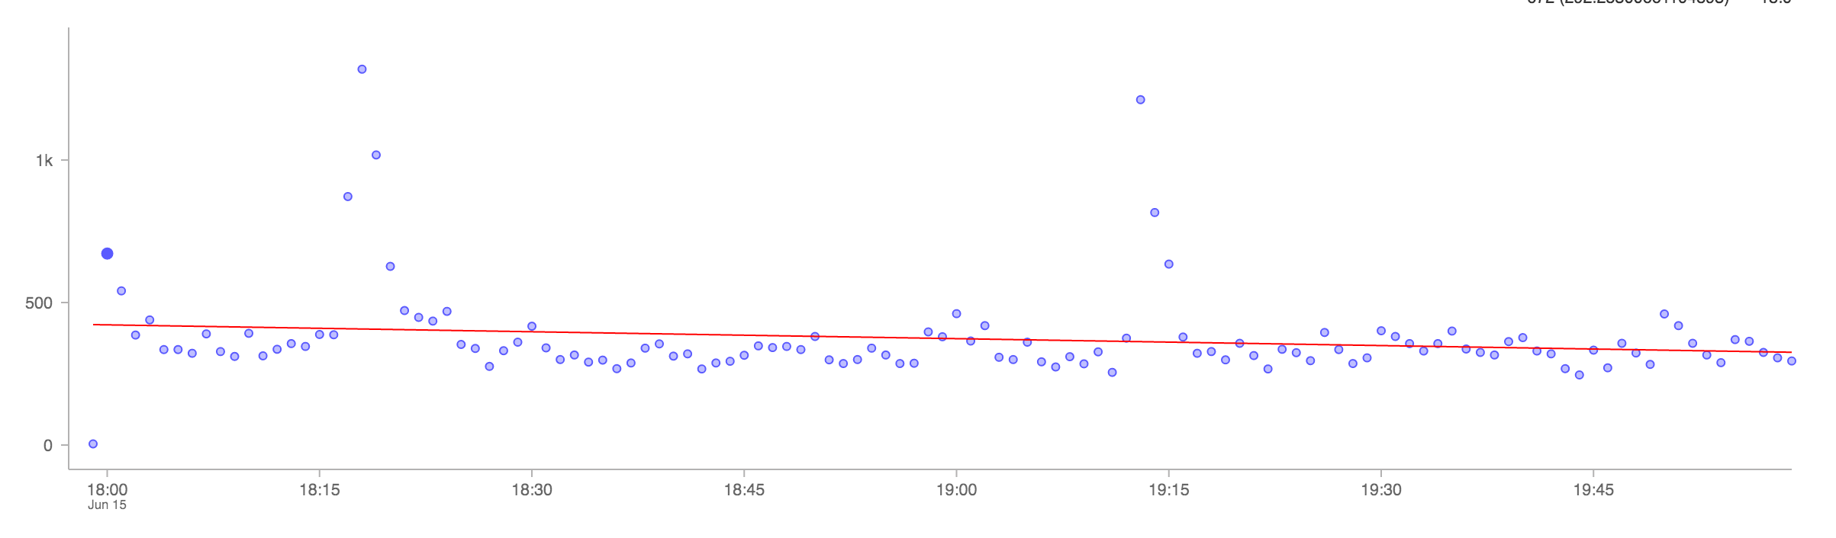
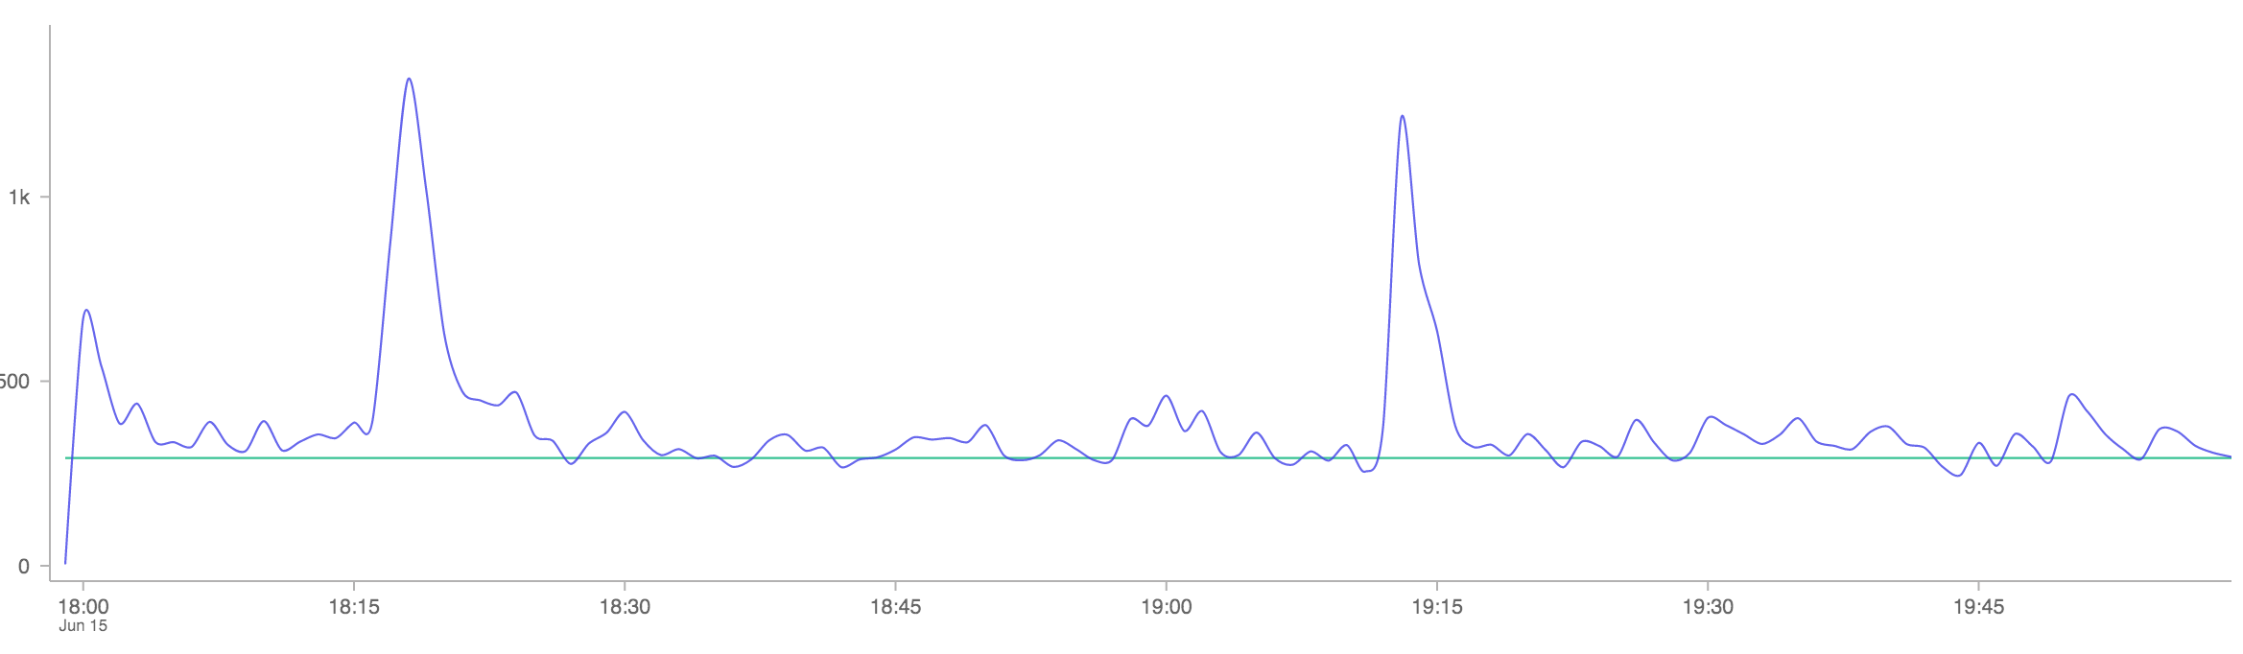
Spikes Detection (Roumanie VS Switzerland)
Linear Regression
Less unrelevant tweets
Miss events (e.g. shoot)
Linear Regression
More unrelevant tweets
Capture almost all actions

Slide 8
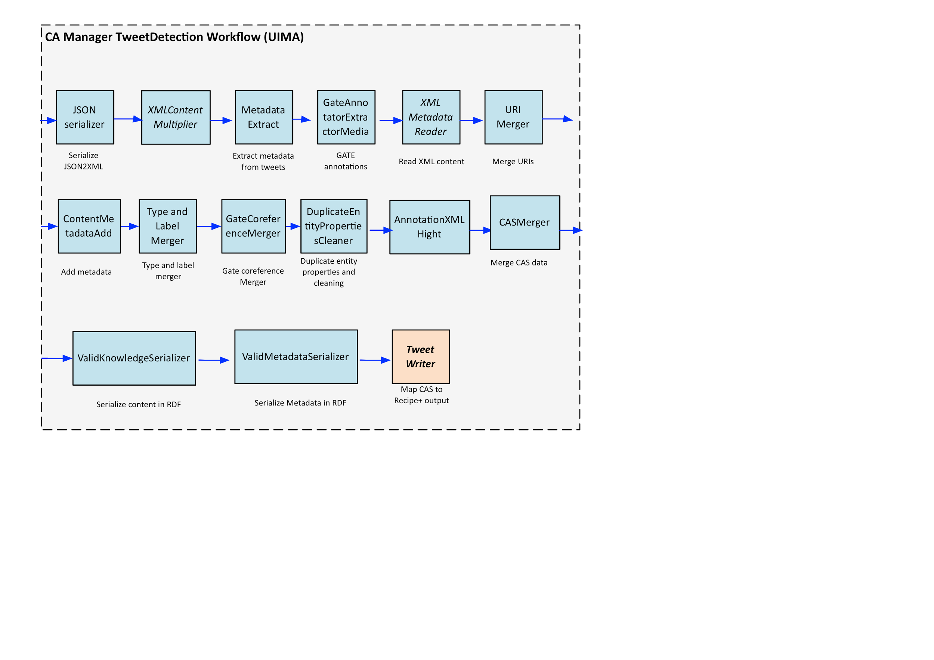
Semantic Annotation

Slide 9
Demo

Slide 10
Link Visualization Demo
http://testl.si.mondeca.com/kibana/

Slide 11
Useful Resources
Shared Domain ontology: http://goo.gl/XBfQHc (in fr/en; some in ar)
Shared External datasets in RDF: https://github.com/eamosse/mondephia/tree/master/rdf ( mainly fr/en; some resources in ar)
Shared Filtered datasets in JSON: https://www.dropbox.com/sh/c1kmfht4v39nwc5/AAD5LDO8u47u0mQMFrshvINga?dl=0
More on our Github: https://github.com/eamosse/mondephia/

Slide 12
Conclusion
More can be done to write rules on matching
We didn’t have time to finish our initial plan
Deep identification of actions in Tweets

