Slide 1
MondeϕIA
Détection d’événements Euro 2016

Slide 2
Team
Ghislain (Mondeca)
Hacene (Mondeca)
Anh (Mondeca)
Arnaud (Mondeca)
Julien (Eurecom)
Edouard (INRIA)

Slide 3
Our Approach
Temporal Analysis
Topic Detection relevant to the Euro 2016
Semantic Event Representation
Semantic Annotation and Rule-based analysis
Indexation and visualization

Slide 4
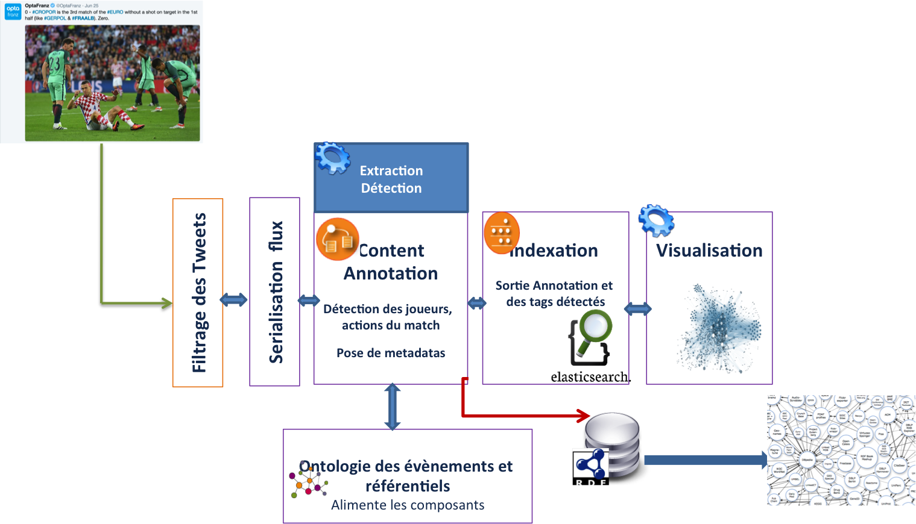
Workflow Process

Slide 5
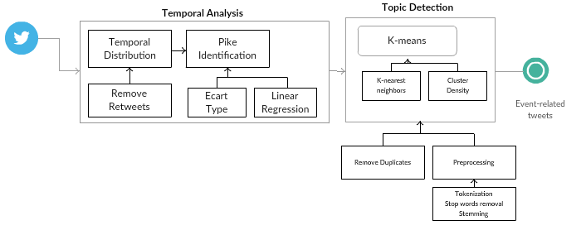
Event Filtering

Slide 6
Temporal Analysis and Pike Detection
Retrospective analysis of a collection of tweets
Temporal distribution of tweets based on a fixed time-window
Ignore time-window with low frequency
Ecart Type
Linear Regression

Slide 7
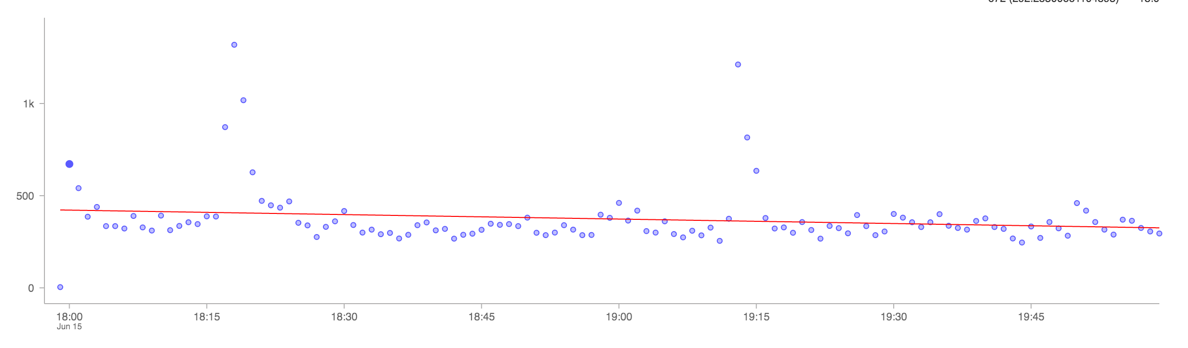
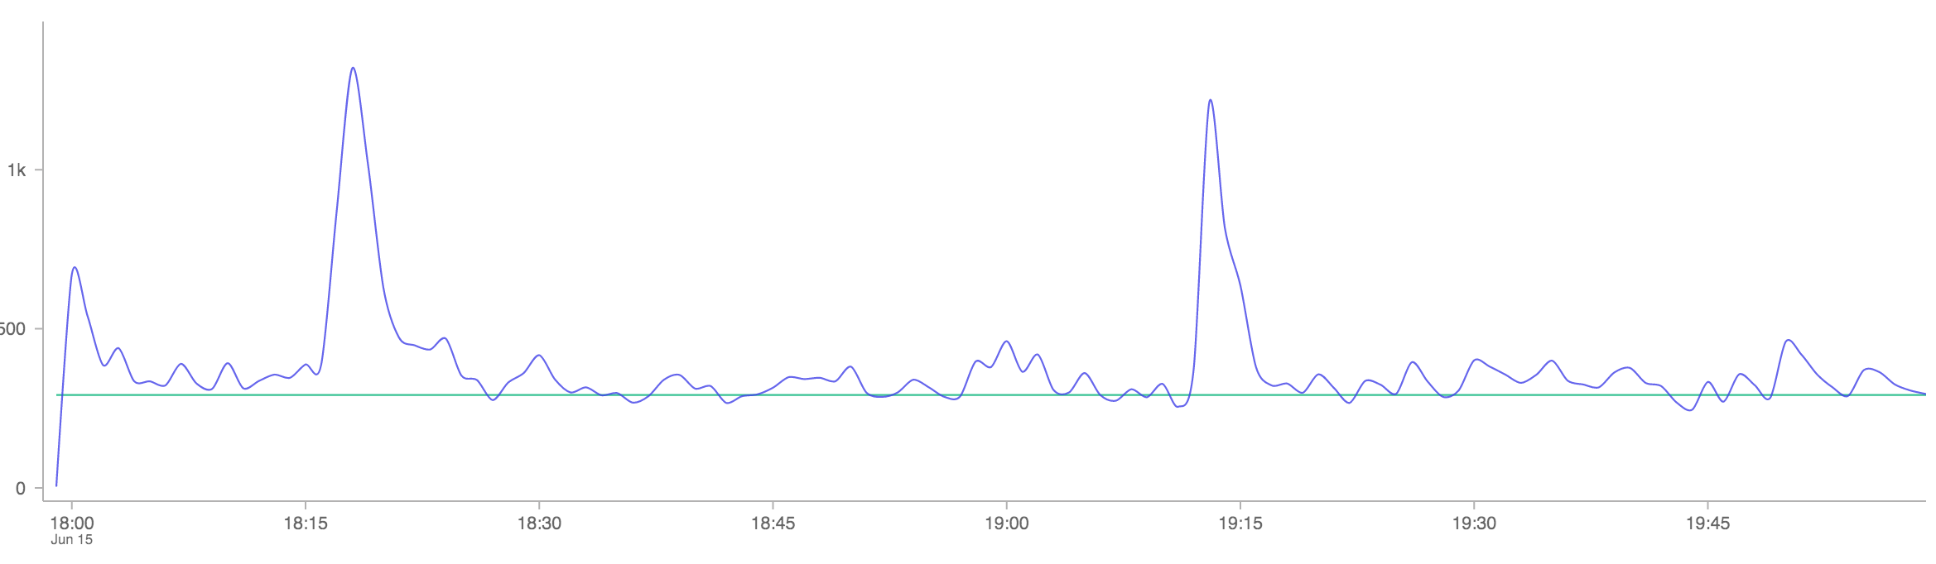
Pikes Detection (Romania VS Switzerland)
Linear Regression
Less unrelevant tweets
Miss events (e.g. shoot)
Increase Precision
Ecart Type
More unrelevant tweets
Capture almost all actions
Increase Recall

Slide 8
Topic Detection
Our goal is to detect topic in relevant time-windows
We use K-means to create tweets clusters in each spike
Common Preprocessing tasks (Stop words removal - Near duplicate removal - Stemming)
Identify cluster with highest density

Slide 9
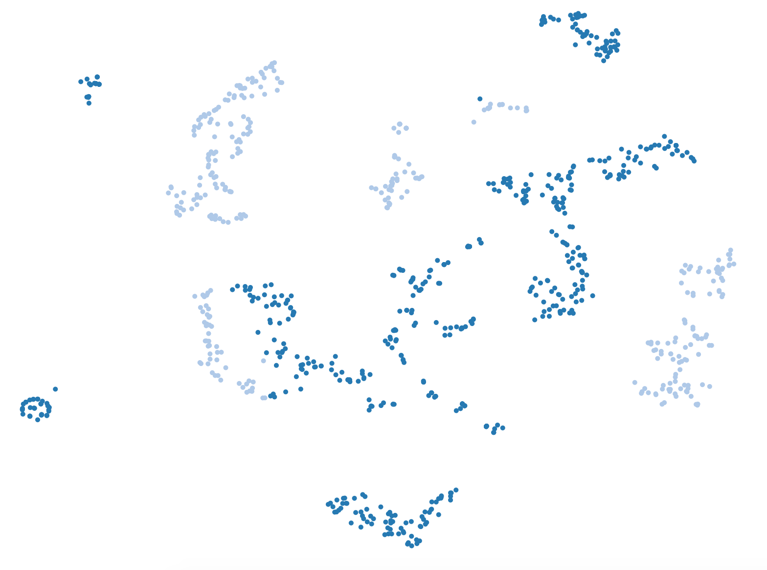
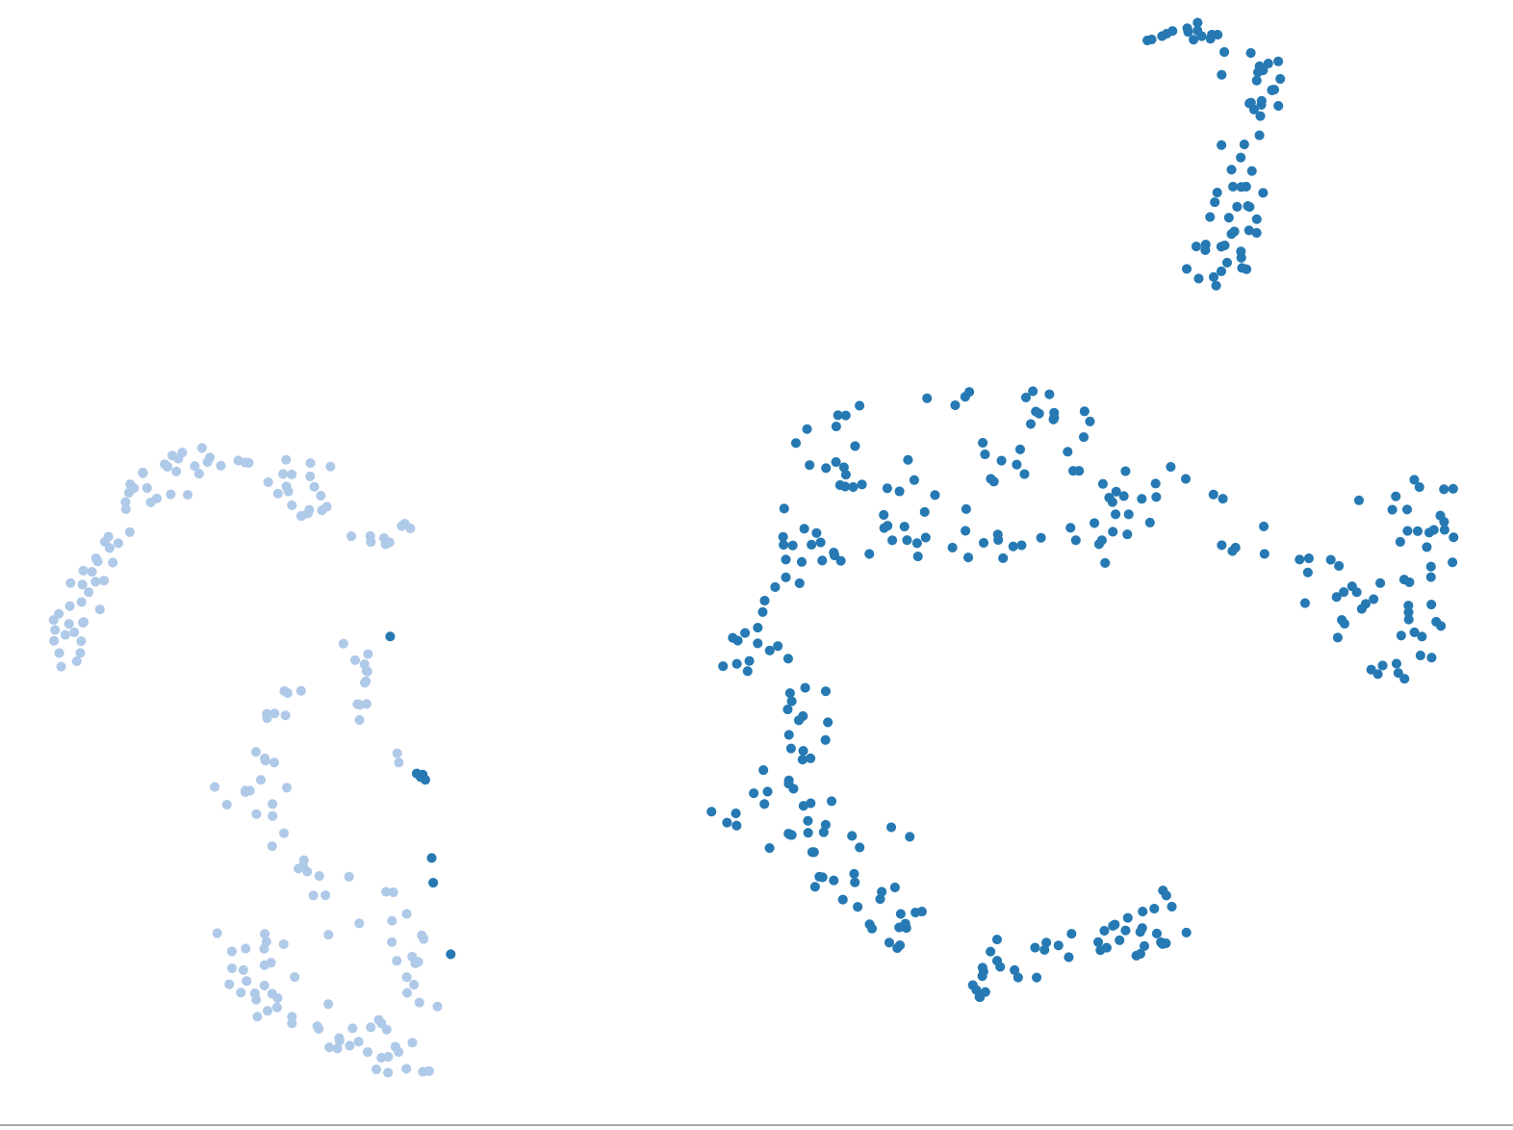
Romania Vs. Switzerland Goal at 21:15
21:13
21:15

Slide 10
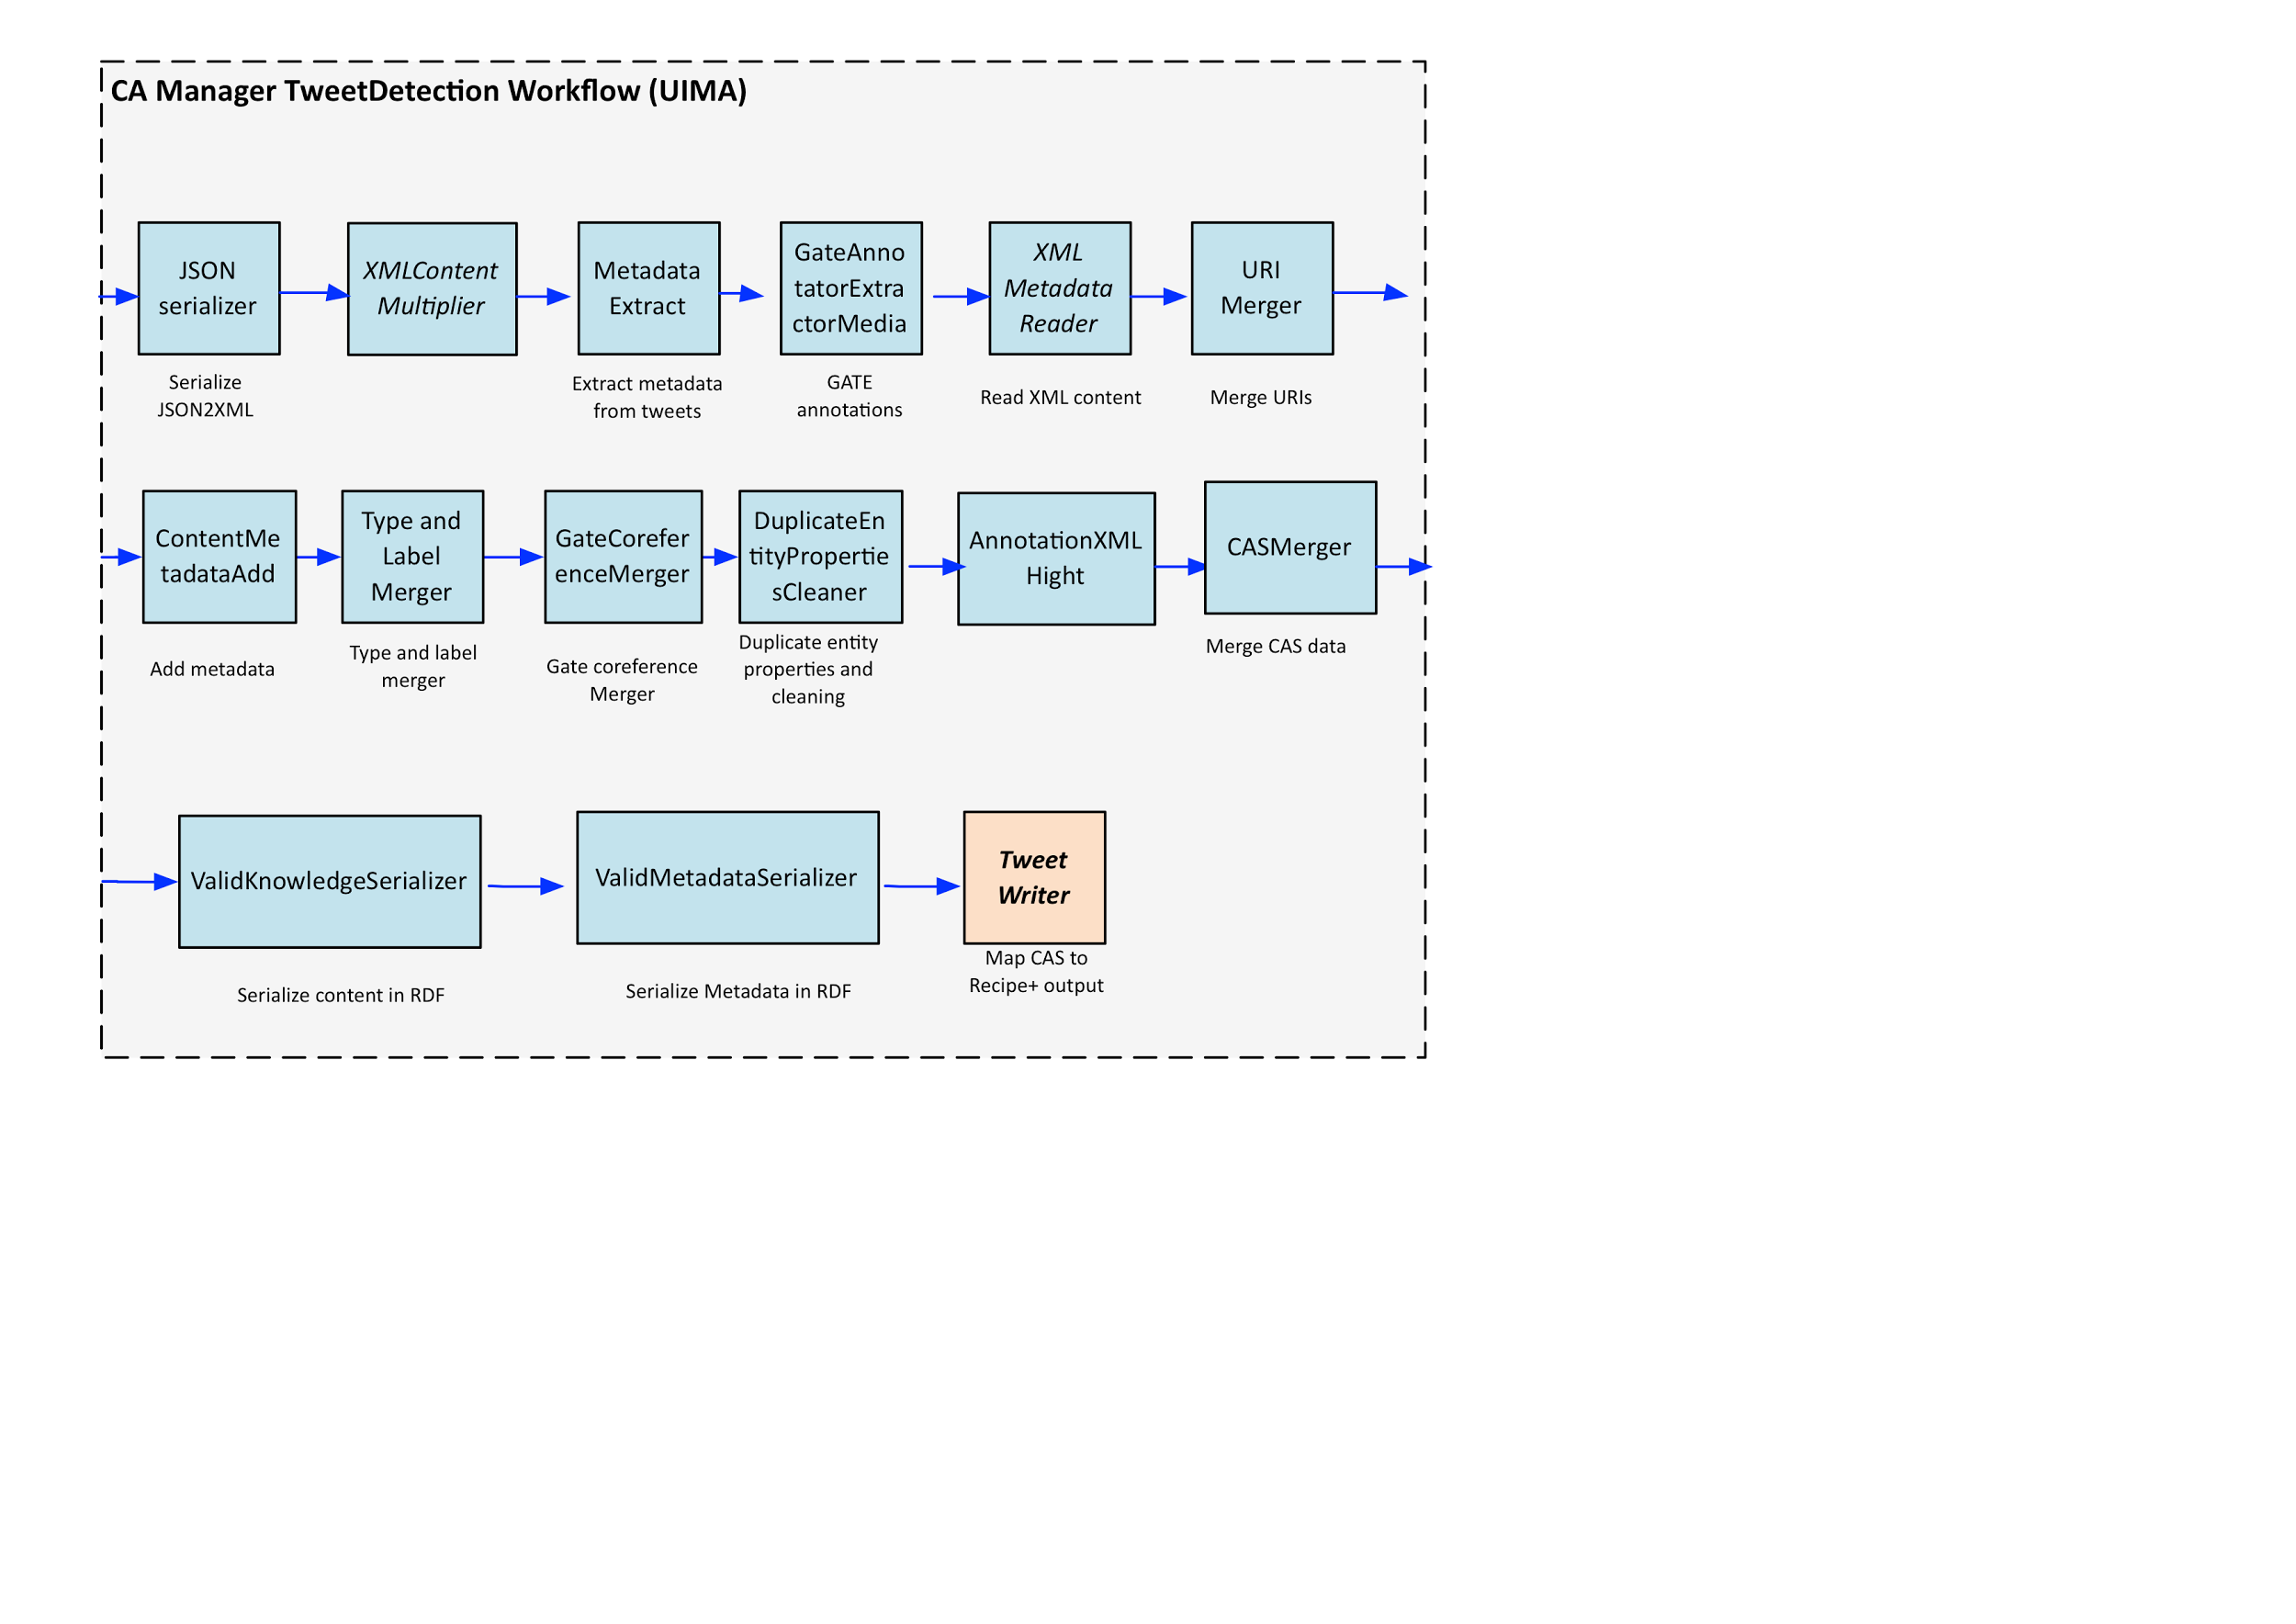
Semantic Annotation

Slide 11
DEMO

Slide 12
Useful Resources & Tools
Shared Domain ontology: http://goo.gl/XBfQHc (in fr/en; some in ar)
Shared External datasets in RDF: https://github.com/eamosse/mondephia/tree/master/rdf ( mainly fr/en; some resources in ar)
Shared Filtered datasets in JSON: https://www.dropbox.com/sh/c1kmfht4v39nwc5/AAD5LDO8u47u0mQMFrshvINga?dl=0
More on our Github: https://github.com/eamosse/mondephia/
Python: NLTK, Numpy, SK-Learn
Mondeca : CAM, ITM

Slide 13
Conclusion & Perspectives
An approach for detecting events on Twitter
Natural Language Processing Analysis with Machine Learning
Semantic Enrichment with Rule-Based Systems
We plan to evaluate this approach using the Hackatal 2016 dataset as ground truth
Submit a research paper

Slide 14
Thank You
Questions?

