Slide 1
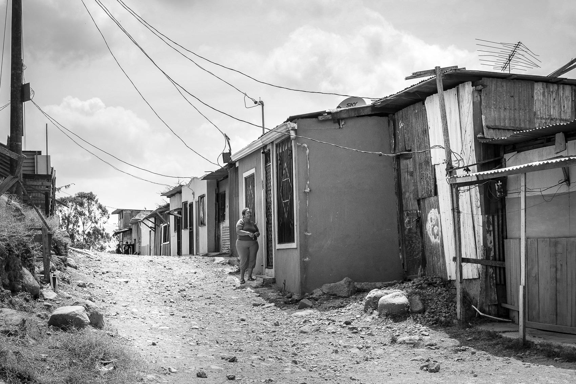
DATA MINING TO HELP THE WORLD’S POOREST
Elijah Ampo
Matthew Dunne
Ruohan Zhou
Xiaolei Zhang

Slide 2
Background
Data/Data Cleaning
Analytical Approach:
Exploratory Data Analysis
Resampling
Models:
Ordinal Logistic Regression
Classification Tree/Random Forest
LDA/QDA
Ensemble Model
Conclusion
Q&A

Slide 3
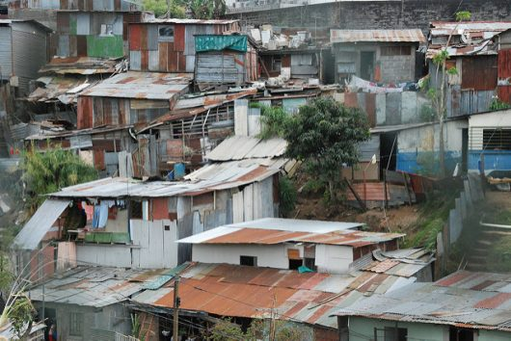
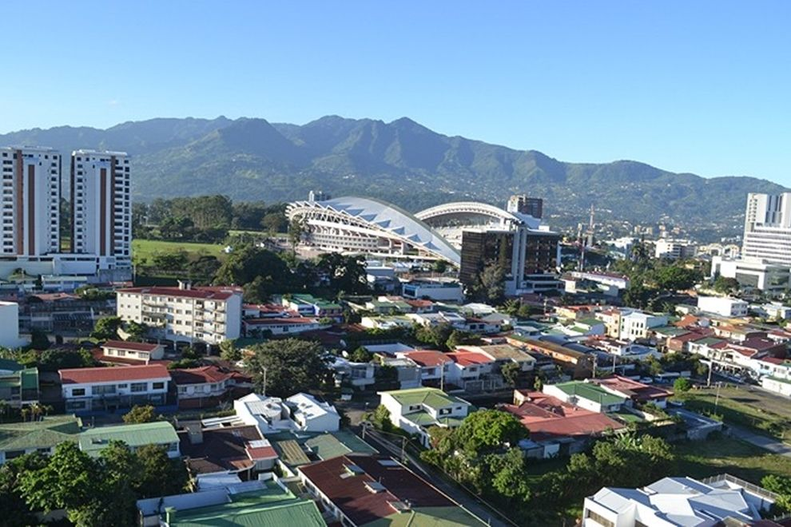
BACKGROUND
Social programs in the developing world have a unique problem. The poorest families are so poor as that they are unable to provide documentation of income (or lack thereof).
Development organizations have developed alternative methods, such as the Proxy Means Test (PMT):
uses a family’s observable household attributes to verify income qualification (brick houses vs clay houses)
an improvement on traditional methods, yet it still suffers from accuracy problems (verification, usefulness, context)

Slide 4
GOALS OF ANALYSIS
The Inter-American Development Bank has asked Kaggle to improve on the PMT’s accuracy
Will use data from Costa Rica. If it works – take it worldwide!
Will use several data mining techniques to explore the data for insights and develop predictive models

Slide 5
THE DATA
DEPENDENT VARIABLE
INDEPENDENT VARIABLES
EXTREME POVERTY
HOUSE CHARACTERISTICS
# rooms, overcrowding, construction, toilets
INHABITANT CHARACTERISTICS
# people, age, composition of households
MODERATE POVERTY
VULNERABLE
INCOME INDICATORS
education, appliances
OTHER
Location, rent/own
NON-VULNERABLE

Slide 6
METHODOLOGY - OVERVIEW
Observations are individuals, but dependent variable (poverty) is largely the same for the entire household
Obs. of Individuals
Obs. Of
Households

Slide 7
Exploratory Data Analysis
THE DATA - Not a lot of separation
OVERCROWDING
Poverty Level | # of Overcrowded Households
1 | 5
2 | 7
3 | 4
4 | 7

Slide 8
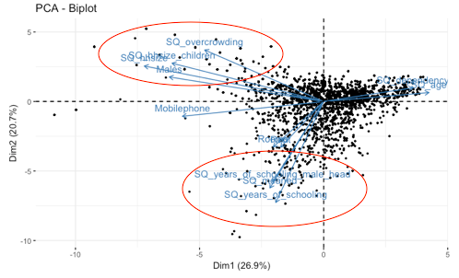
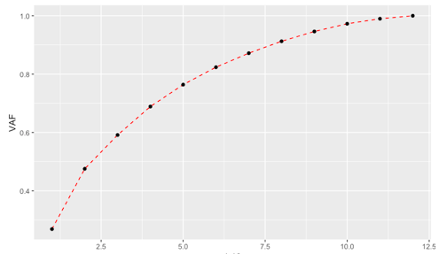
Exploratory Data Analysis
Principal Component Analysis
PC1-PC5 VARIANCE CAPTURED
76.4%
NEW FEATURES: Principal Component Scores

Slide 9
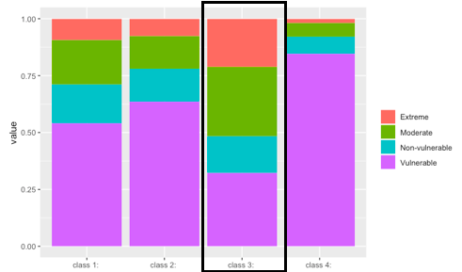
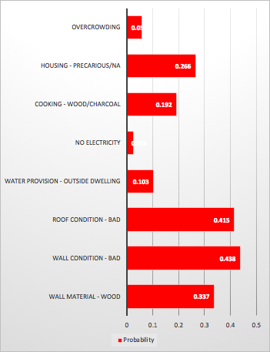
Exploratory Data Analysis
Latent Class Analysis
CLASS 3 PROFILE
PROBABILITY
NEW FEATURES: Class Membership Probabilities

Slide 10
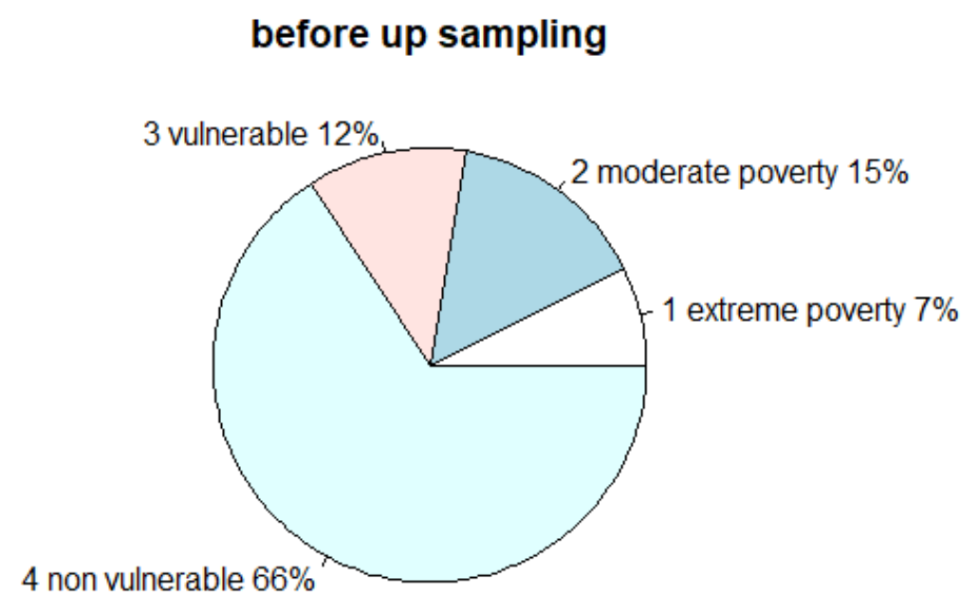
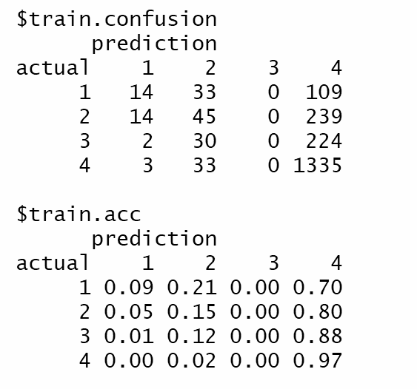
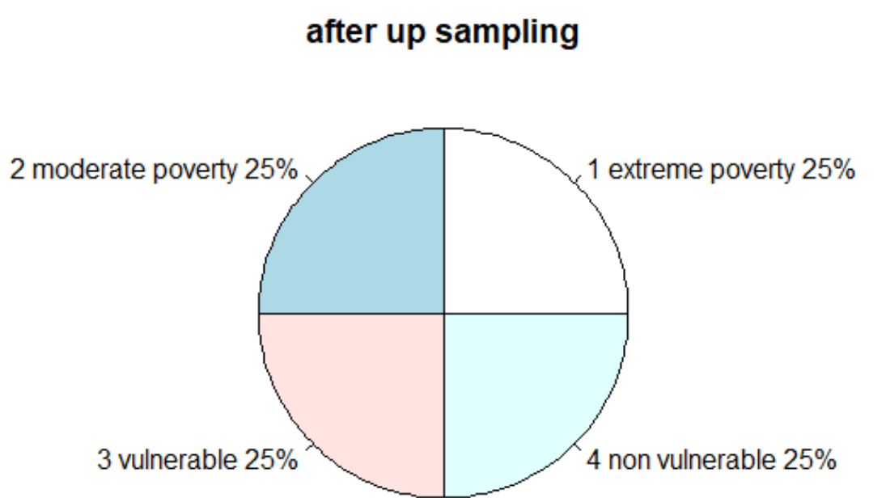
Up Sampling-for imbalanced data
An unbalanced dataset will bias the prediction towards the more common class
up_sample<-(costarican_train %>% group_by(Poverty) %>% sample_n(size=max(factor_count$n),replace=T))

Slide 11
Ordinal Logistic Regression with up-sampling
Polr() from library(MASS)& step()
Train Test
 | Predicted 1 | Predicted 2 | Predicted 3 | Predicted 4
Actual 1 | 0.57 | 0.21 | 0.14 | 0.09
Actual 2 | 0.36 | 0.23 | 0.23 | 0.18
Actual 3 | 0.25 | 0.20 | 0.28 | 0.27
Actual 4 | 0.08 | 0.09 | 0.24 | 0.58
 | Predicted 1 | Predicted 2 | Predicted 3 | Predicted 4
Actual 1 | 0.52 | 0.12 | 0.20 | 0.17
Actual 2 | 0.39 | 0.24 | 0.22 | 0.15
Actual 3 | 0.28 | 0.14 | 0.28 | 0.29
Actual 4 | 0.10 | 0.10 | 0.20 | 0.58

Slide 12
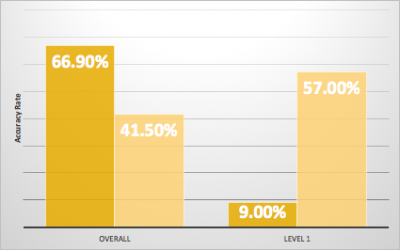
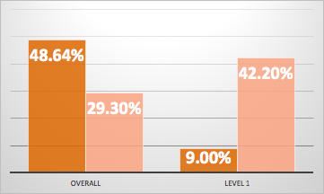
OLR Upsampling Results
OLR
OLR - PCA/LCA

Slide 13
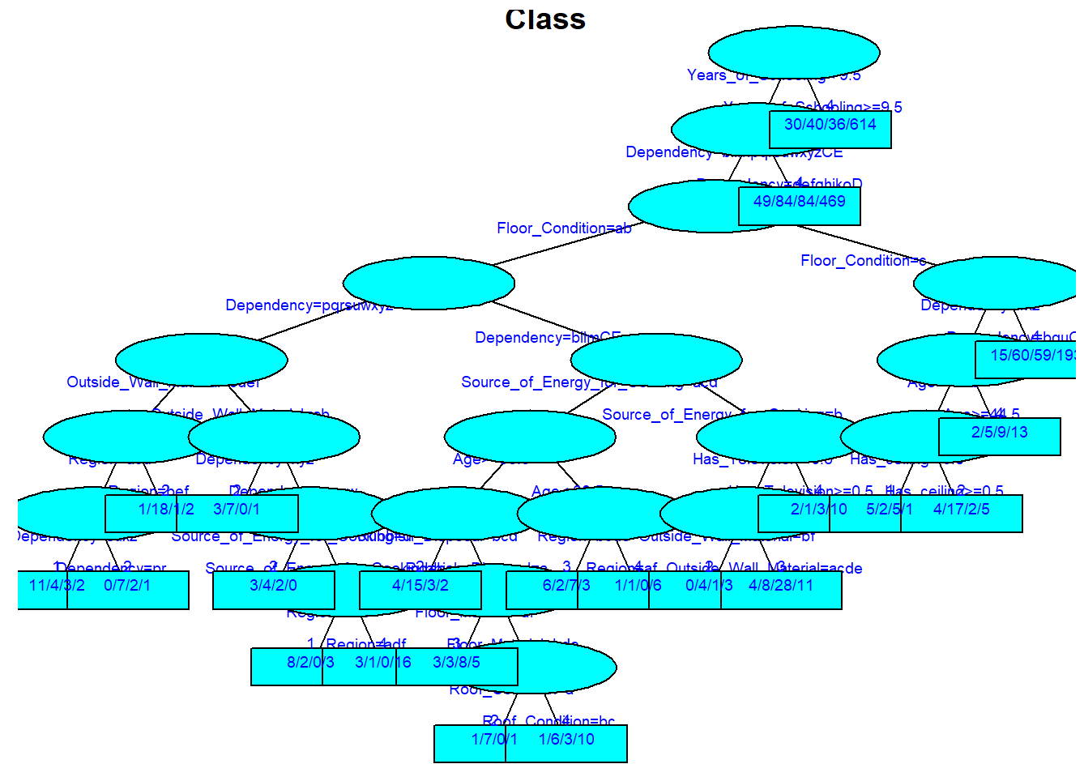
Classification Tree - Unbalanced data
43 nodes included in pruned tree model
Years of schooling and Dependency being the most important variables in classification
First split are years of schooling greater than/equal to and less than 9.5 years

Slide 14
Classification Tree
Unbalanced Data
Up-sampled Data
 | Predicted 1 | Predicted 2 | Predicted 3 | Predicted 4
Actual 1 | 15% | 10% | 8% | 66%
Actual 2 | 3% | 27% | 4% | 66%
Actual 3 | 3% | 4% | 17% | 76%
Actual 4 | 1% | 1% | 1% | 97%
 | Predicted 1 | Predicted 2 | Predicted 3 | Predicted 4
Actual 1 | 98% | 0 | 1% | 1%
Actual 2 | 5% | 86% | 6% | 4%
Actual 3 | 2% | 5% | 88% | 5%
Actual 4 | 7% | 8% | 12% | 72%
Upsampling improves train predicting significantly

Slide 15
Random Forest
ntree=50 mtry=10
maxnodes = NULL
Train
Test are not as robust
 | Predicted 1 | Predicted 2 | Predicted 3 | Predicted 4
Actual 1 | 100% | 0 | 0 | 0
Actual 2 | 0 | 99% | 0 | 1%
Actual 3 | 0 | 0 | 100% | 0
Actual 4 | 1% | 3% | 4% | 92%
 | Predicted 1 | Predicted 2 | Predicted 3 | Predicted 4
Actual 1 | 15% | 36% | 5% | 44%
Actual 2 | 14% | 28% | 17% | 41%
Actual 3 | 12% | 14% | 17% | 57%
Actual 4 | 3% | 7% | 6% | 84%

Slide 16
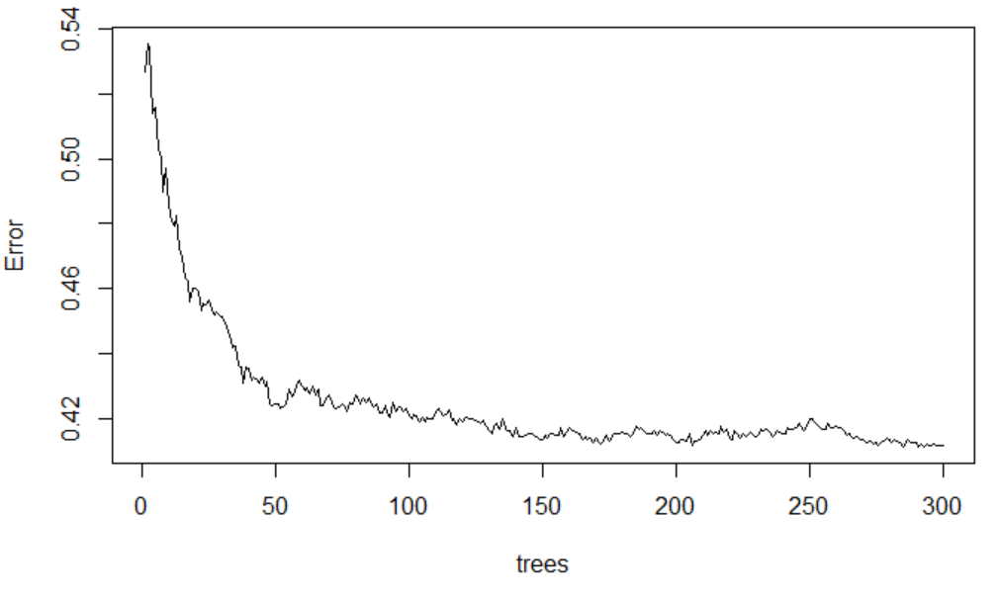
Optimizing Random Forest
which.min() and train() for parameter tuning
Holdout Validation is Improved
ntree=285 mtry=12 maxnodes=39
 | Predicted 1 | Predicted 2 | Predicted 3 | Predicted 4
Actual 1 | 47% | 20% | 23% | 12%
Actual 2 | 27% | 26% | 34% | 15%
Actual 3 | 23% | 9% | 39% | 27%
Actual 4 | 14% | 5% | 21% | 61%
Out-of-bag (OOB) estimate is a method of measuring the prediction error of random forests

Slide 17
LDA and QDA - Not Bad if You Group the Groups
LDA
QDA (not all variables)
 | Predicted 1 | Predicted 2 | Predicted 3 | Predicted 4
Actual 1 | 42% | 29% | 18% | 11%
Actual 2 | 33% | 28% | 23% | 17%
Actual 3 | 29% | 19% | 26% | 25%
Actual 4 | 11% | 13% | 19% | 57%
 | Predicted 1 | Predicted 2 | Predicted 3 | Predicted 4
Actual 1 | 20% | 11% | 26% | 44%
Actual 2 | 17% | 6% | 36% | 41%
Actual 3 | 11% | 2% | 31% | 56%
Actual 4 | 4% | 3% | 12% | 81%

Slide 18
LDA and QDA - Worse If You Actually Group the Groups
LDA
QDA (not all variables)
 | Predicted 1, 2 | Predicted 3 | Predicted 4
Actual 1, 2 | 80% | 10% | 10%
Actual 3 | 60% | 17% | 23%
Actual 4 | 39% | 9% | 53%
 | Predicted 1, 2 | Predicted 3 | Predicted 4
Actual 1, 2 | 34% | 27% | 39%
Actual 3 | 19% | 29% | 52%
Actual 4 | 8% | 11% | 81%

Slide 19
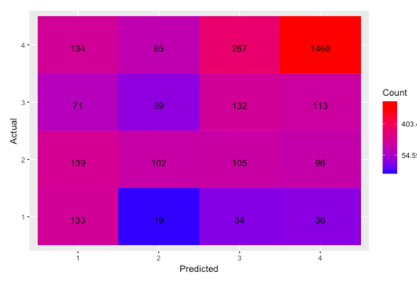
ENSEMBLE MODEL
MODELS INCLUDED
RESAMPLING METHOD
OLR
Tree
LDA
QDA
MLR
Tree
OLR
OVERALL ACCURACY
61.73%

Slide 20
CONCLUSIONS/INSIGHTS
LCA as a means to reduce high dimensionality of categorical variables.
Understanding of the business problem. Trade off where necessary. (Sacrificed overall accuracy to gain level 1 accuracy)
Build future models based on the up-sampled/down-sampled data.
Prediction accuracy in practice depends on where you draw the line for providing assistance.
Conduct a similar analysis on another country.

Slide 21
Q&A

